Slide 1


Zechariah
Introductory Matters

Slide 2

Introductory Matters
  Title
  Authorship
  Biography
  Scope
  Date
  Audience
  Place of writing

Slide 3
1. Title
Named after the book’s spokesman
Hebrew: Zekar-yah
LXX: Zecharias
Latin: Zecharias
English: Zechariah
“Yahweh Remembers”

Slide 4
Introductory Matters
  Title
  Authorship
  Biography
  Scope
  Date
  Audience
  Place of writing

Slide 5
2. Authorship
Zechariah (1:1)
Hebrew & Christian tradition
Zechariah 9‒14?
  Matt. 27:9-10?
  Hellenistic or Maccabean eras?
  Unity arguments

Slide 6
Introductory Matters
  Title
  Authorship
  Biography
  Scope
  Date
  Audience
  Place of writing

Slide 7
3. Biography
Common name
Son of Berechiah (1:1)
Called into ministry as a youth (2:4)
Born during Babylonian Captivity
Taken to Israel in first return
A priest
Member of the Great Synagogue

Slide 8
Introductory Matters
  Title
  Authorship
  Biography
  Scope
  Date
  Audience
  Place of writing

Slide 9
4. Scope
SCRIPTURE | SCRIPTURAL DATE | DATE
1:1 | 8th month, 2nd year of Darius | 10 or 11/520 B.C.
1:7 | 24th day, 11th month, 2nd year of Darius | 2/15/519 B.C.
7:1 | 4th day, 9th month, 4th year of Darius | 12/17/518 B.C.

Slide 10
Introductory Matters
  Title
  Authorship
  Biography
  Scope
  Date
  Audience
  Place of writing

Slide 11
5. Date
Written immediately after the visions were given
Zechariah 9‒14?
  519‒518 B.C.
  470‒469 B.C.

Slide 12
Introductory Matters
  Title
  Authorship
  Biography
  Scope
  Date
  Audience
  Place of writing

Slide 13
Three Returns
 | DATE | DURATION | PERSIAN KING | JEWISH LEADER | SCRIPTURE | PURPOSE | NUMBER OF RETURNEES
1st return | 538–515 B.C. | 23 years | Cyrus (Isa. 44:28‒45:1) | Zerubbabel | Ezra 1–6; Isaiah 44:28 | Rebuilding the temple | 50,000
2nd return | 458–457 B.C. | 2 years | Artaxerxes | Ezra | Ezra 7–10 | Adorning of the temple and reforming the people | 2,000
3rd return | 444–432 B.C. | 8 years | Artaxerxes | Nehemiah | Nehemiah | Rebuilding the wall

Slide 14
Introductory Matters
  Title
  Authorship
  Biography
  Scope
  Date
  Audience
  Place of writing

Slide 15
7. Place of Writing
Temple standing
Zech. 1:16; 3:1‒4:9; 6:9-15; 8:9, 20-23; 14:16-19
Jerusalem

Slide 16
Introductory Matters
  Occasion
  Structure
  Message
  Purposes
  Themes
  Unique characteristics
  Genre
  Christ in Zechariah

Slide 17
ISRAEL’S FOUR TEMPLES
Solomon’s pre-exilic temple (Kings and Chronicles)
Zerubbabel’s post exilic temple (Ezra 1-6; John 2:20)
Antichrist's temple (Dan. 9:27; Matt. 24:15; 2 Thess. 2:4; Rev. 11:1-2)
Millennial temple (Ezek. 40-48)

Slide 18
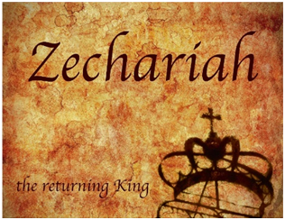
8. Occasion
538 B.C. | Cyrus’ decree | 520‒518 B.C. | Ministries of Zechariah & Haggai
536 B.C. | Temple foundation laid | 519 B.C. | Darius confirms Cyrus’ decree
534 B.C. | Temple building interrupted | ----- | Resumption of Temple building
----- | Temple project stalled for 15 years | 516 B.C. | Temple completed

Slide 19

8. Occasion
538 B.C. ‒ Cyrus’ decree
536 B.C. ‒ Temple foundation laid
534 B.C. ‒ Temple building interrupted
Temple project stalled for 15 years
520‒518 B.C. ‒ Ministries of Zechariah & Haggai
519 B.C. ‒ Darius confirmation of Cyrus’ decree
Resumption of Temple building
516 B.C. ‒ Temple completed

Slide 20
Introductory Matters
  Occasion
  Structure
  Message
  Purposes
  Themes
  Unique characteristics
  Genre
  Christ in Zechariah

Slide 21
9. Structure
Introductory call to repentance (1:1-6)
Eight-night visions (1:7–6:15)
Question and answers about fasting (7–8)
Two burdens (9–14)

Slide 22
9. Structure
Introductory call to repentance (1:1-6)
Eight-night visions (1:7–6:15)
Question and answers about fasting (7–8)
Two burdens (9–14)

Slide 23
9. Structure
Introductory call to repentance (1:1-6)
Eight-night visions (1:7–6:15)
Question and answers about fasting (7–8)
Two burdens (9–14)

Slide 24
II. Eight Night Visions
(1:7‒6:15)
  Riders & horses among the myrtle trees (1:7-17)
  Four horns & four craftsmen (1:18-21)
  Man with the measuring line (2)
  Cleansing of the High Priest Joshua (3)
  Lampstand & olive tree (4)
  Flying scroll (5:1-4)
  Woman in the basket (5:5-11)
  Four chariots (6:1-8)
  Conclusion: crowning of Joshua (6:9-15)

Slide 25
9. Structure
Introductory call to repentance (1:1-6)
Eight-night visions (1:7–6:15)
Question and answers about fasting (7–8)
Two burdens (9–14)

Slide 26

III. Questions & Answers Concerning Fasting
(7‒8)
  Question (7:1-3)
  Four divine answers (7:4‒8:23)
    Condemnation of empty ritualism (7:4-7)
    Condemnation of past covenant failure (7:8-14)
    Prediction of Jerusalem’s restoration (8:1-17)
    Prediction of future blessing (8:18-23)

Slide 27
9. Structure
Introductory call to repentance (1:1-6)
Eight-night visions (1:7–6:15)
Question and answers about fasting (7–8)
Two burdens (9–14)

Slide 28
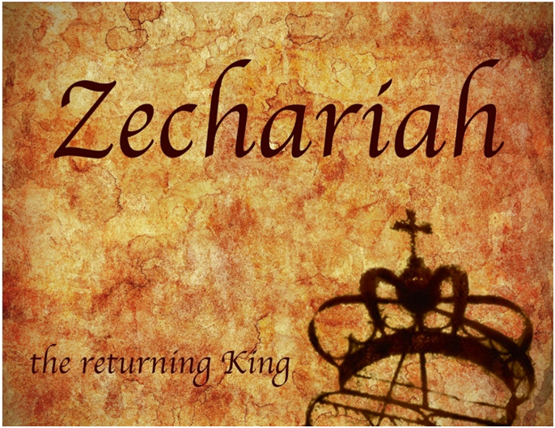
IV. Two Burdens
(9‒14)
  Israel’s postponed deliverance due to her rejection of her Messiah (9‒11)
  Israel’s future deliverance due to her acceptance of her Messiah (12‒14)

Slide 29
Introductory Matters
  Occasion
  Structure
  Message
  Purposes
  Themes
  Unique characteristics
  Genre
  Christ in Zechariah

Slide 30
10. Message
The Messiah’s future restoration of Israel and millennial reign is depicted through various divine visions, responses, and burdens, and these are given to induce hope and obedience among the beleaguered remnant.

Slide 31
Introductory Matters
  Occasion
  Structure
  Message
  Purposes
  Themes
  Unique characteristics
  Genre
  Christ in Zechariah

Slide 32
11. Purposes
  To encourage the returnees to rebuild the Temple
  To provide eschatological hope in the challenging post-exilic world
  To prepare the returnees for Temple worship
  To exhort the returnees toward covenant obedience

Slide 33
Haggai vs. Zechariah
HAGGAI | ZECHARIAH
Exhortation | Encouragement
More concrete | More abstract
Concise | Expanded
Present concern | Future concern
Take part! | Take heart!
Older activist | Younger missionary
Wilkinson and Boa, Talk Thru the Bible, p. 291

Slide 34
Introductory Matters
  Occasion
  Structure
  Message
  Purposes
  Themes
  Unique characteristics
  Genre
  Christ in Zechariah

Slide 35
12.Themes
  1st and 2nd advents
  Temple
  Israel’s Eschatology
  Israel’s elect status
  Covenant renewal

Slide 36


Slide 37
Introductory Matters
  Occasion
  Structure
  Message
  Purposes
  Themes
  Unique characteristics
  Genre
  Christ in Zechariah

Slide 38
13. Unique Characteristics
  Interpreting angel
  Longest minor prophet
  Messianic prophecies
  Multiplicity of literary styles
  Times of the Gentiles
  Israel’s Eschatology
  Two burdens focused upon in the passion narratives
  Third most alluded to book in the Apocalypse
  Imputation (3:1-5)
  Summation of prophetic themes

Slide 39
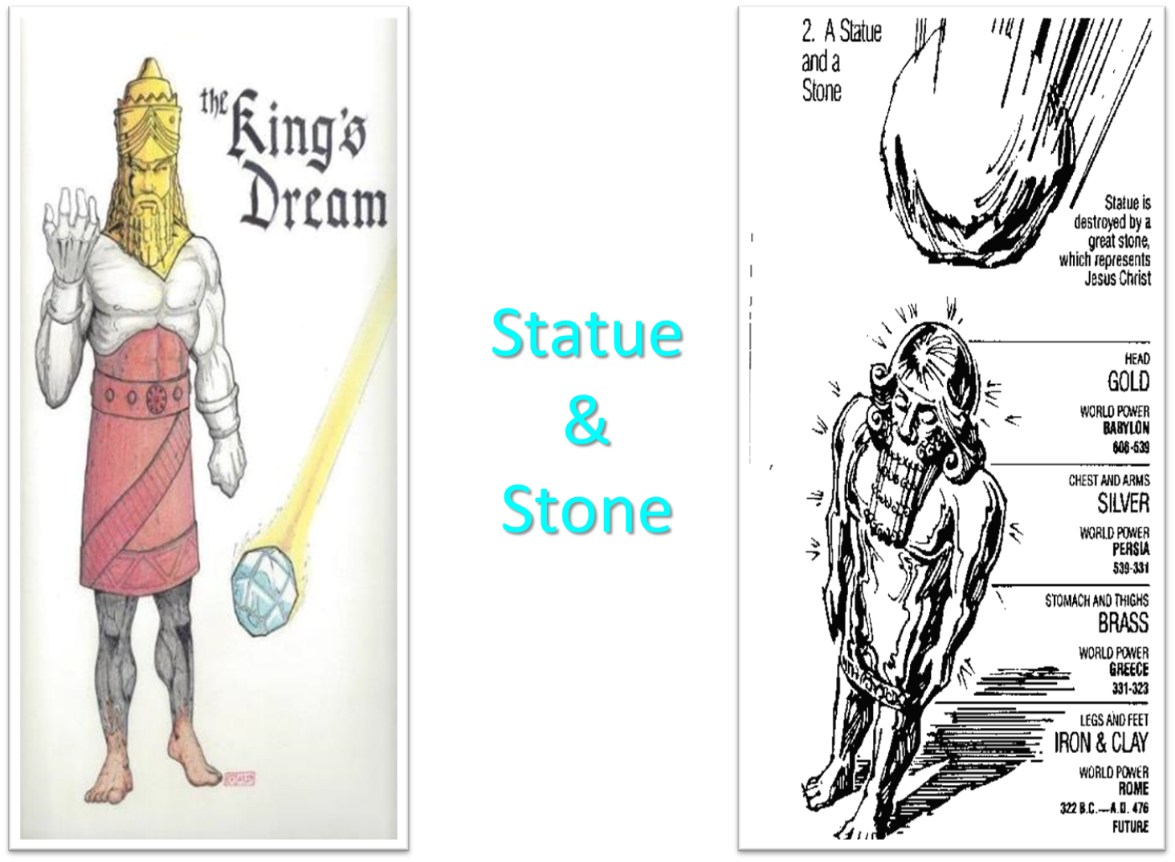

Slide 40


Slide 41
Introductory Matters
  Occasion
  Structure
  Message
  Purposes
  Themes
  Unique characteristics
  Genre
  Christ in Zechariah

Slide 42
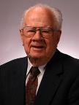
J. Dwight Pentecost
“Daniel,” in Bible Knowledge Commentary, ed. John F. Walvoord and Roy B. Zuck (Colorado Springs, CO: Victor, 1985), 1323.
“Apocalyptic literature in the Bible has several characteristics: (1) In apocalyptic literature a person who received God’s truths in visions recorded what he saw. (2) Apocalyptic literature makes extensive use of symbols or signs. (3) Such literature normally gives revelation concerning God’s program for the future of His people Israel. (4) Prose was usually employed in apocalyptic literature, rather than poetic style which was normal in most prophetic literature.”

Slide 43
J. Dwight Pentecost
“Daniel,” in Bible Knowledge Commentary, ed. John F. Walvoord and Roy B. Zuck (Colorado Springs, CO: Victor, 1985), 1323.
“In addition to Daniel and Revelation, apocalyptic literature is found in Ezekiel 37–48 and Zechariah 1:7–7:8. In interpreting visions, symbols, and signs in apo­ca­­lyp­tic literature, one is seldom left to his own ingenuity to discover the truth. In most instances an examination of the context or comparison with the parallel biblical passages provides the Scriptures’ own interpretation of the visions or the symbols employed. Apocalyptic literature then demands a careful comparison of Scripture with Scripture to arrive at a correct understanding of the revelation being given.”

Slide 44
Introductory Matters
  Occasion
  Structure
  Message
  Purposes
  Themes
  Unique characteristics
  Genre
  Christ in Zechariah

Slide 45
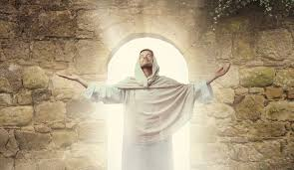
The Uniqueness of Jesus Christ
A man of verifiable history
A man of fulfilled prophecy
A man of predictive prophecy
A man of unimpeachable morality
A man of profound teaching
A man of authentic miracles
A man of bodily resurrection

Slide 46
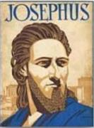
Josephus
Antiquities 18.3.3
“About this time there lived Jesus, a wise man, if indeed one ought to call him a man. For he was one who performed surprising deeds and was a teacher of such people as accept the truth gladly. He won over many Jews and many of the Greeks. He was the Christ. And when, upon the accusation of the principal men among us, Pilate had condemned him to a cross, those who had first come to love him did not cease. He appeared to them spending a third day restored to life, for the prophets of God had foretold these things and a thousand other marvels about him. And the tribe of the Christians, so called after him, has still to this day not disappeared.”

Slide 47
OT Prophecies About Christ
Prophecy | Scripture | Years in Advance
Manner of Birth | Isaiah 7:14 | 700 years
Place of Birth | Micah 5:2 | 700 years
Nationality | Numbers 24:17 | 1400 years
Tribe | Genesis 49:10 | 1800 years
Time of & Response to His Messiahship | Dan. 9:25-26 | 600 years

Slide 48
OT Prophecies About Christ
Prophecy | Scripture | Years in Advance
Crucified Between Thieves | Isaiah 53:9 | 700 years
Pierced | Isaiah 53:5 | 700 years
No Broken Bones | Psalm 22:17 | 1000 years
Gamble for His Clothing | Psalm 22:18 | 1000 years
Buried in Rich Man’s Tomb | Isaiah 53:9 | 700 years
Notes:
109 prophecies…
Peter Stoner – SCIENCE SPEAKS, An Evaluation of Certain Christian Evidences
To fulfill just 8 prophecies =1 X 10 to the twenty-eighth power!
Can we visualize this with an illustration? Suppose we took an atheistic professor, blindfolded him and covered the state of Texas two feet deep with silver dollars. Then we put a check on one of those silver dollars and mixed them up. The odds of one person fulfilling just these eight prophecies would be the same as this atheistic professor selecting the silver dollar upon which we have placed a check, in his first try.
https://www.bereanpublishers.com/the-odds-of-eight-messianic-prophecies-coming-true/

Slide 49

Luke 24:27, 44
“²⁷ Then beginning with Moses and with all the prophets, He explained to them the things concerning Himself in all the Scriptures…⁴⁴ Now He said to them, ‘These are My words which I spoke to you while I was still with you, that all things which are written about Me in the Law of Moses and the Prophets and the Psalms must be fulfilled.’”

Slide 50

John 5:39, 46
“³⁹ You search the Scriptures because you think that in them you have eternal life; it is these that testify about Me…⁴⁶ For if you believed Moses, you would believe Me, for he wrote about Me.”

Slide 51

Acts 17:1–3
¹ Now when they had traveled through Amphipolis and Apollonia, they came to Thessalonica, where there was a synagogue of the Jews. ² And according to Paul’s custom, he went to them, and for three Sabbaths reasoned with them from the Scriptures, ³ explaining and giving evidence that the Christ had to suffer and rise again from the dead, and saying, “This Jesus whom I am proclaiming to you is the Christ.”

Slide 52
1 Corinthians 15:3-4
“³ For I handed down to you as of first importance what I also received, that Christ died for our sins according to the Scriptures, ⁴ and that He was buried, and that He was raised on the third day according to the Scriptures.”

Slide 53

Christ in Zechariah general
the angel of the Lord (3:1-2)
the righteous branch (3:8; 6:12-13)
the servant (3:8)
the stone with seven eyes (3:9)
the King-Priest (6:13)
the cornerstone, tent peg, and the bow of battle (10:4)

Slide 54
Christ in Zechariah first advent
the humble king riding on a donkey (9:9-10; Matt 21:1-8; John 12:14-16)
the rejected good shepherd sold for thirty pieces of silver (11:4-13; Matt 26:14-16; 27:9-10)
the one the Jews pierced (12:10; John 19:37; 20:24-27)
the smitten good shepherd (13:7)

Slide 55
Christ in Zechariah second advent
the one who will be accepted by Israel (12:10–13:1; Rom 11:26)
the one who cleanses Israel (13:1)
the coming judge (14)
the destroyer of Israel’s enemies (14:3, 12-15; Rev 19:11-16)
the one who will split the Mount of Olives (14:4)
the one who will reign from Jerusalem (14:9, 16; Rev 20:4-6)

Slide 56

Romans 11:25-26
“²⁵ For I do not want you, brethren, to be uninformed of this mystery—so that you will not be wise in your own estimation—that a partial hardening has happened to Israel until the fullness of the Gentiles has come in; ²⁶ and so all Israel will be saved; just as it is written, ‘The Deliverer will come from Zion, He will remove ungodliness from Jacob.’”

Slide 57

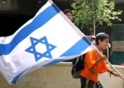
Zechariah 14:2-3
“² For I will gather all the nations against Jerusalem to battle, and the city will be captured, the houses plundered, the women ravished and half of the city exiled, but the rest of the people will not be cut off from the city. ³ Then the Lord will go forth and fight against those nations, as when He fights on a day of battle.”

Slide 58

Zechariah 14:16-18
“Then it will come about that any who are left of all the nations that went against Jerusalem will go up from year to year to worship the King, the Lord of hosts, and to celebrate the Feast of Booths. ¹⁷ And it will be that whichever of the families of the earth does not go up to Jerusalem to worship the King, the Lord of hosts, there will be no rain on them. ¹⁸ If the family of Egypt does not go up or enter, then no rain will fall on them; it will be the plague with which the Lord smites the nations who do not go up to celebrate the Feast of Booths.”

Slide 59

Isaiah 2:2-3
“Now it will come about that In the last days The mountain of the house of the Lord Will be established as the chief of the mountains, And will be raised above the hills; And all the nations will stream to it.³ And many peoples will come and say, ‘Come, let us go up to the mountain of the Lord, To the house of the God of Jacob; That He may teach us concerning His ways And that we may walk in His paths.’ For the law will go forth from Zion And the word of the Lord from Jerusalem.”

Slide 60

Revelation 20:7-9
“⁷ When the thousand years are completed, Satan will be released from his prison, ⁸ and will come out to deceive the nations which are in the four corners of the earth, Gog and Magog, to gather them together for the war; the number of them is like the sand of the seashore. ⁹ And they came up on the broad plain of the earth and surrounded the camp of the saints and the beloved city, and fire came down from heaven and devoured them.

Slide 61

Robert Thomas
Four Views on the Book of Revelation, page 207.
“At the end of the Millennium that city will be Satan’s prime objective with his rebel army, because Israel will be a leader among the nations.”

Slide 62
Conclusion

Slide 63
Introductory Matters
  Title
  Authorship
  Biography
  Scope
  Date
  Audience
  Place of writing

Slide 64
Introductory Matters
  Occasion
  Structure
  Message
  Purposes
  Themes
  Unique characteristics
  Genre
  Christ in Zechariah

