Slide 1


Genesis 10‒11
National Dispersion

Slide 2


GENESIS STRUCTURE
  Beginning of the Human race (Gen. 1‒11)
  Beginning of the Hebrew race (Gen. 12‒50)

Slide 3

GENESIS STRUCTURE
  Genesis 1-11 (four events)
    Creation (1-2)
    Fall (3-5)
    Flood (6-9)
    National dispersion (10-11)

Slide 4
GENESIS STRUCTURE
  Genesis 1-11 (four events)
    Creation (1-2)
    Fall (3-5)
    Flood (6-9)
    National dispersion (10-11)

Slide 5


Genesis 3:15
“And I will put enmity Between you and the woman, And between your seed and her seed; He shall bruise you on the head, And you shall bruise him on the heel.”

Slide 6
GENESIS STRUCTURE
  Genesis 1-11 (four events)
    Creation (1-2)
    Fall (3-5)
    Flood (6-9)
    National dispersion (10-11)

Slide 7
GENESIS STRUCTURE
  Genesis 1-11 (four events)
    Creation (1-2)
    Fall (3-5)
    Flood (6-9)
    National dispersion (10-11)

Slide 8
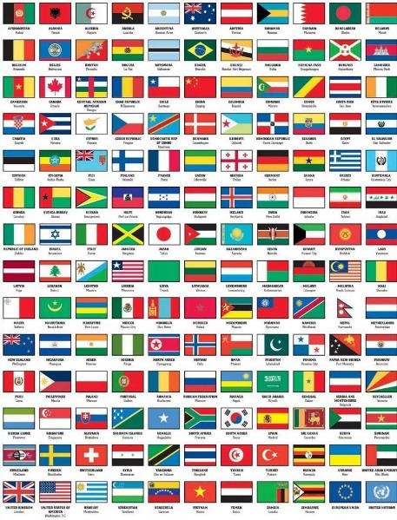
Outline
  Table of nations (Gen 10)
  Tower of Babel (Gen 11:1-9)
  Genealogy from Shem to Terah (Gen 11:10-32)

Slide 9
Outline
  Table of nations (Gen 10)
  Tower of Babel (Gen 11:1-9)
  Genealogy from Shem to Terah (Gen 11:10-32)

Slide 10
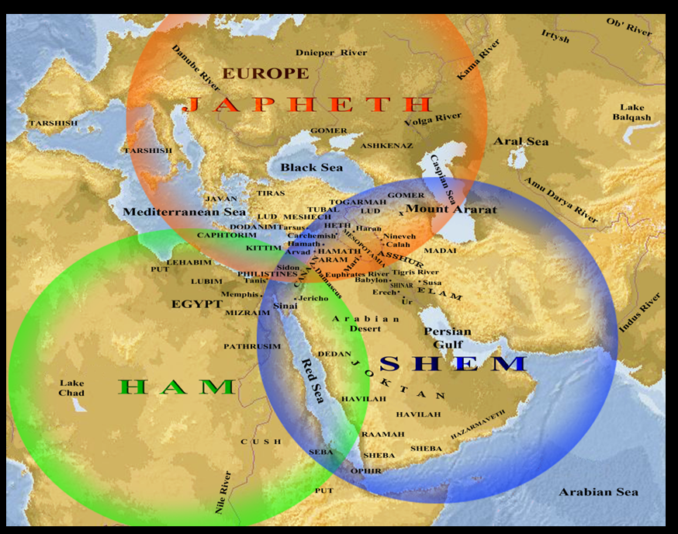

Slide 11
Genesis 10–11 Questions & Answers
  Origin of the nations?
  Dispersal of the nations?
  Corruption of the nations?
  What happened in the days of Peleg? (Gen. 10:25)
  Nimrod’s empire in Shinar? (Gen. 10:10)
  How did Nimrod get to Assyria? (Gen. 10:11-12)

Slide 12
Outline
  Table of nations (Gen 10)
  Tower of Babel (Gen 11:1-9)
  Genealogy from Shem to Terah (Gen 11:10-32)

Slide 13
GENESIS 11:1-9
Outline
  The Former World (1-2)
  The Rebellion (3-4)
  God’s Condescension (5)
  God’s Observations (6)
  God’s Intervention (7-8a)
  The Results (8b-9)

Slide 14
Outline
  Table of nations (Gen 10)
  Tower of Babel (Gen 11:1-9)
  Genealogy from Shem to Terah (Gen 11:10-32)

Slide 15
Genesis 9:26
“He also said, ‘Blessed be the Lord, The God of Shem; And let Canaan be his servant.’”

Slide 16

God’s Messianic Purposes Beginning in Genesis
Proto-evangelium from Adam & Eve (3:15)
Seth (4:25)
Noah (Gen 5:29)
Shem (9:26)
Abraham (12:3)
Isaac (21:12)
Jacob (25:23)
Judah (49:10)

Slide 17
God’s Messianic Purposes Beginning in Genesis
Proto-evangelium from Adam & Eve (3:15)
Seth (4:25)
Noah (Gen 5:29)
Shem (9:26)
Abraham (12:3)
Isaac (21:12)
Jacob (25:23)
Judah (49:10)

Slide 18

Genesis 11:10-26 Outline
  Shem (11:10-11)
  Arphachshad (11:12-13)
  Shelah (11:14-15)
  Eber (11:16-17)
  Peleg (11:18-19)
  Reu (11:20-21)
  Serug (11:22-23)
  Nahor (11:24-25)
  Terah (11:26)

Slide 19
Eight-Fold Pattern
Genesis 11:10-26
  Generation of Shem:
  Name:
  Meaning:
  Name of seed son:
  Age at birth of seed-son:
  Additional years lived:
  Total years lived:
  Begat other sons & daughters:

Slide 20
Genesis 11:10-26 Outline
  Shem (11:10-11)
  Arphachshad (11:12-13)
  Shelah (11:14-15)
  Eber (11:16-17)
  Peleg (11:18-19)
  Reu (11:20-21)
  Serug (11:22-23)
  Nahor (11:24-25)
  Terah (11:26)

Slide 21
Genesis 11:10-26 Outline
  Shem (11:10-11)
  Arphachshad (11:12-13)
  Shelah (11:14-15)
  Eber (11:16-17)
  Peleg (11:18-19)
  Reu (11:20-21)
  Serug (11:22-23)
  Nahor (11:24-25)
  Terah (11:26)

Slide 22

Norman Geisler
Systematic Theology, vol. 2 (Minneapolis, MN: Bethany, 2003), 648.
“Bishop James Usher (1581–1656), whose chronology was used in the old Scofield Reference Bible, argued that Adam was created in 4,004 b.c. However, his calculations are based on the assumption that there are no gaps in the genealogical tables of Genesis 5 and 11, while we know this is false. For instance, the Bible says: ‘Arphaxad…became the father of Shelah’ (Gen. 11:12), but in Jesus’ genealogy in Luke 3:35–36, ‘Cainan’ is listed between Arphaxad and Shelah. If there is one gap, there may be more...”

Slide 23

Dr. Henry M. Morris
The Genesis Record, 281-82
“It is worth noting that Luke (3:36) inserts the name of Cainan between Arphaxad and Selah in this genealogy…it would not be too difficult for a careless scribe to copy ‘Cainan’ inadvertently from Luke 3:37 as he was copying Luke 3:36, thus getting two Cainans into the list. It is known that the New Testament copyists were often much less careful in this work than had been the Old Testament scribes…Cainan’s name should not be included, and its insertion in Luke 3:36 is most likely a copyist’s error.”

Slide 24
Genesis 11:10-26 Outline
  Shem (11:10-11)
  Arphachshad (11:12-13)
  Shelah (11:14-15)
  Eber (11:16-17)
  Peleg (11:18-19)
  Reu (11:20-21)
  Serug (11:22-23)
  Nahor (11:24-25)
  Terah (11:26)

Slide 25
Eight-Fold Pattern
Genesis 11:14-15
  Generation of Shem: Third
  Name: Shelah
  Meaning: Sent one
  Name of seed son: Eber
  Age at birth of seed-son: 30 years
  Additional years lived: 403 years
  Total years lived: 433 years
  Begat other sons & daughters: Yes

Slide 26
Genesis 11:10-26 Outline
  Shem (11:10-11)
  Arphachshad (11:12-13)
  Shelah (11:14-15)
  Eber (11:16-17)
  Peleg (11:18-19)
  Reu (11:20-21)
  Serug (11:22-23)
  Nahor (11:24-25)
  Terah (11:26)

Slide 27
Eight-Fold Pattern
Genesis 11:16-17
  Generation of Shem: Fourth
  Name: Eber
  Meaning: Cross over
  Name of seed son: Peleg
  Age at birth of seed-son: 34 years
  Additional years lived: 430 years
  Total years lived: 464 years
  Begat other sons & daughters: Yes

Slide 28


Dr. Arnold G. Fruchtenbaum
The Book of Genesis, 217
“The line of Shem begins in verse 21: And unto Shem, the father of all the children of Eber. Eber in Hebrew is Ever and is the source of the Hebrew word for ‘Hebrew,’ Ivrit. To be the father of the Hebrews is the main significance of the line of Shem.”

Slide 29
Genesis 11:10-26 Outline
  Shem (11:10-11)
  Arphachshad (11:12-13)
  Shelah (11:14-15)
  Eber (11:16-17)
  Peleg (11:18-19)
  Reu (11:20-21)
  Serug (11:22-23)
  Nahor (11:24-25)
  Terah (11:26)

Slide 30
Eight-Fold Pattern
Genesis 11:18-19
  Generation of Shem: Fifth
  Name: Peleg
  Meaning: Division
  Name of seed son: Reu
  Age at birth of seed-son: 30 years
  Additional years lived: 209 years
  Total years lived: 239 years
  Begat other sons & daughters: Yes

Slide 31
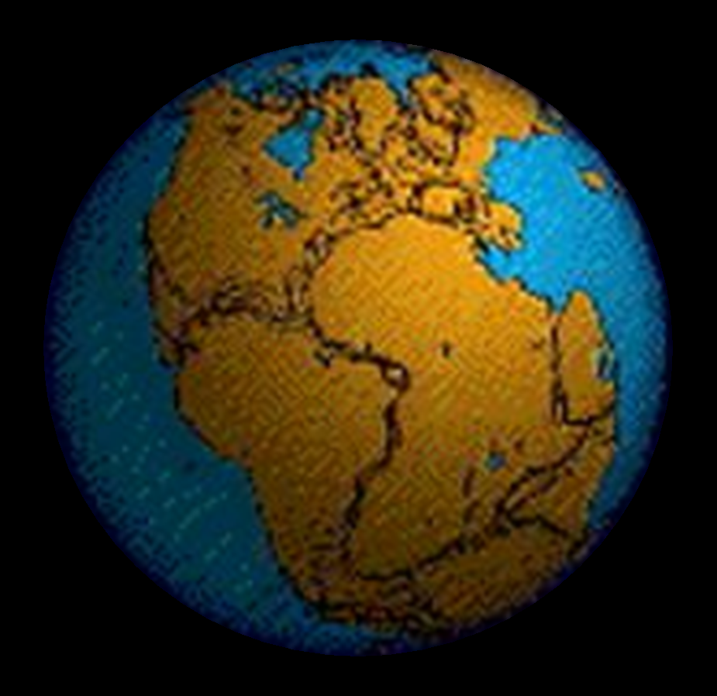

Slide 32
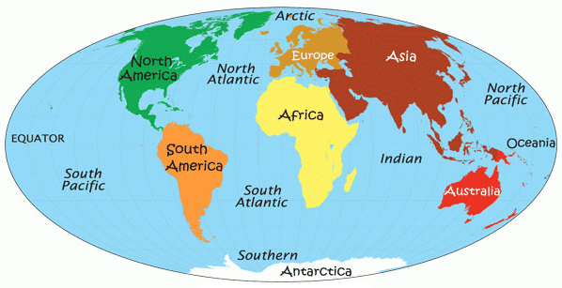

Slide 33

Genesis 11:1-9
¹ Now the whole earth used the same language and the same words. ² It came about as they journeyed east, that they found a plain in the land of Shinar and settled there. ³ They said to one another, “Come, let us make bricks and burn them thoroughly.” And they used brick for stone, and they used tar for mortar. ⁴ They said, “Come, let us build for ourselves a city, and a tower whose top will . . .

Slide 34
Dr. Arnold G. Fruchtenbaum
The Book of Genesis, 219
“…the name of the one was Peleg. For in his days was the earth divided. The name Peleg means ‘to divide.’ Some identify this event with the continental divide or the continental drift. However, contextually, it more likely refers to the language division of the Tower of Babel judgment. This means that the confusion of tongues occurred during Peleg’s lifetime.”

Slide 35
Dr. Henry M. Morris
The Genesis Record, 260-61
“Evidently this was a most memorable event, and Eber named his son in commemoration of it. The name Peleg means ‘division.’… The big question concerns the meaning of the indicated division of the earth. The most obvious interpretation of this verse is that the division was the division of the peoples at the Tower of Babel, as discussed in Genesis 11. It is significant that some such division is mentioned here in Genesis 10:5 (‘By these were the isles of the Gentiles divided in their lands; every one after his tongue, after their families, in their nations’) and Genesis 10:32 (‘. . . by these were the nations divided in the earth after the flood’).”

Slide 36
Dr. Henry M. Morris
The Genesis Record, 260-61
“These verses seem clearly to refer to a linguistic and geographic division, rather than to an actual splitting of the continents. This is especially clear in verse 5, where the division is specifically ‘after his tongue.’… If it is ever actually proved that the earth once was a single land mass that somehow split apart, with the segments gradually drifting away to form the present continents, then indeed this verse might be understood to refer to such an event. At present, the question of continental drift is still open among scientists; and creationist scientists have pointed to a number of unresolved physical difficulties with the whole idea.”

Slide 37
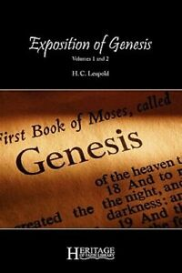
H. C. Leupold
H. C. Leupold, Exposition of Genesis, 1:378.
“Peleg means ‘division’, for he lived at the time when the earth was divided (niphlegah) and the name given to the man is in memory of this event. The event referred to must be the one under consideration—the Confusion of Tongues.”

Slide 38
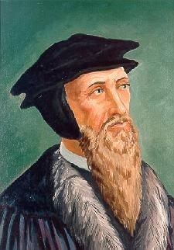
John Calvin
Genesis, 1554 (Edinburgh, UK: Banner of Truth, 1984), p. 324.
“For after he [Moses] has mentioned Arphaxad as the third of the sons of Shem, he then names Peleg, his great grandson, in whose days the languages were divided.”

Slide 39
Genesis 11:10-26 Outline
  Shem (11:10-11)
  Arphachshad (11:12-13)
  Shelah (11:14-15)
  Eber (11:16-17)
  Peleg (11:18-19)
  Reu (11:20-21)
  Serug (11:22-23)
  Nahor (11:24-25)
  Terah (11:26)

Slide 40
Eight-Fold Pattern
Genesis 11:20-21
  Generation of Shem: Sixth
  Name: Reu
  Meaning: Friend or neighbor
  Name of seed son: Serug
  Age at birth of seed-son: 32 years
  Additional years lived: 207 years
  Total years lived: 239 years
  Begat other sons & daughters: Yes

Slide 41
Genesis 11:10-26 Outline
  Shem (11:10-11)
  Arphachshad (11:12-13)
  Shelah (11:14-15)
  Eber (11:16-17)
  Peleg (11:18-19)
  Reu (11:20-21)
  Serug (11:22-23)
  Nahor (11:24-25)
  Terah (11:26)

Slide 42
Eight-Fold Pattern
Genesis 11:22-23
  Generation of Shem: Seventh
  Name: Serug
  Meaning: Unclear
  Name of seed son: Nahor
  Age at birth of seed-son: 30 years
  Additional years lived: 200 years
  Total years lived: 230 years
  Begat other sons & daughters: Yes

Slide 43
Genesis 11:10-26 Outline
  Shem (11:10-11)
  Arphachshad (11:12-13)
  Shelah (11:14-15)
  Eber (11:16-17)
  Peleg (11:18-19)
  Reu (11:20-21)
  Serug (11:22-23)
  Nahor (11:24-25)
  Terah (11:26)

Slide 44
Eight-Fold Pattern
Genesis 11:24-25
  Generation of Shem: Eighth
  Name: Nahor
  Meaning: River
  Name of seed son: Terah
  Age at birth of seed-son: 29 years
  Additional years lived: 119 years
  Total years lived: 148 years
  Begat other sons & daughters: Yes

Slide 45


Slide 46
Genesis 11:10-26 Outline
  Shem (11:10-11)
  Arphachshad (11:12-13)
  Shelah (11:14-15)
  Eber (11:16-17)
  Peleg (11:18-19)
  Reu (11:20-21)
  Serug (11:22-23)
  Nahor (11:24-25)
  Terah (11:26)

Slide 47
Eight-Fold Pattern
Genesis 11:26
  Generation of Shem: Ninth
  Name: Terah
  Meaning: Moon
  Name of seed son: Abram, Nahor, Haran
  Age at birth of seed-son: 70 years
  Additional years lived: 135 years
  Total years lived: 205 years
  Begat other sons & daughters: Yes

Slide 48

Genesis 1:1-3
“¹ In the beginning God created the heavens and the earth. ² The earth was formless and void, and darkness was over the surface of the deep, and the Spirit of God was moving over the surface of the waters. ³ Then God said, ‘Let there be light’; and there was light.”

Slide 49

Day 4 Light Before the Sun?
(Gen. 1:3; Gen 1:14-19)
God can create light independently without the use of a secondary source
Revelation 21:23; 22:5
Deuteronomy 4:19

Slide 50
Deuteronomy 4:19
“And beware not to lift up your eyes to heaven and see the sun and the moon and the stars, all the host of heaven, and be drawn away and worship them and serve them, those which the Lord your God has allotted to all the peoples under the whole heaven.”

Slide 51
Three Concluding Observations
(Gen 11:10-26)
    Age of patriarch at birth of seed-son demonstrate no genealogical gaps
    Antediluvian and Patriarchal overlap
    Shorter patriarchal ages indicate changed world conditions

Slide 52
Three Concluding Observations
(Gen 11:10-26)
    Age of patriarch at birth of seed-son demonstrate no genealogical gaps
    Antediluvian and Patriarchal overlap
    Shorter patriarchal ages indicate changed world conditions

Slide 53
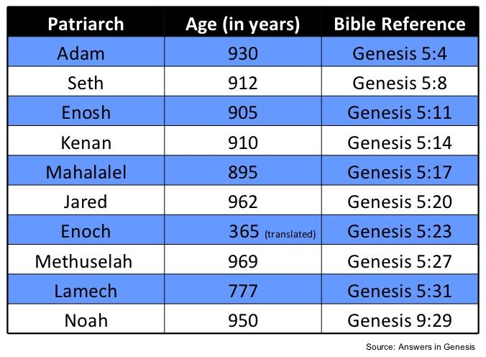

Slide 54
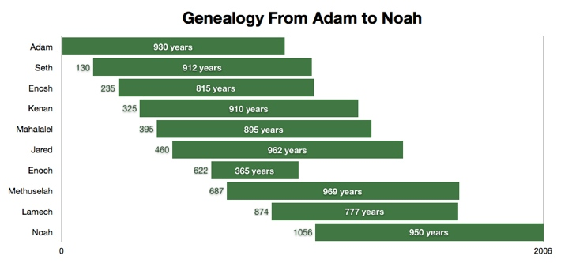

Slide 55
Genealogical Gaps?
Internal
  Seth is a descendant of Adam and Eve replacing Abel (4:25)
  Seth named Enosh (4:26)
  Lamech named Noah (5:29)
Jude 14

Slide 56
Dr. Arnold G. Fruchtenbaum
The Book of Genesis, 141
“A third observation is that there are no gaps in the genealogy. Some try to put gaps into the genealogy in order to accommodate the scientific long age of man, but the wording does not allow for that. If the text only said begat, then that would be permissible since the word ‘begat’ does not always require direct father/son relationship. It could mean grandfather, great grandfather, or ancestors and so on. Nevertheless, the wording in this section does not allow for that interpretation. The text does not say simply begat. It gives the years before and after the birth of the seed-son. So this type of language simply does not allow gaps to occur.”

Slide 57
Dr. Arnold G. Fruchtenbaum
The Book of Genesis, 231
“…In Shem’s genealogy, as in the previous genealogy of Adam (Genesis 5), the language does not allow for gaps in the genealogy, since the text does not merely say begat, but it is more specific, giving the age of the father when the seed-son is born and how many years the father lived thereafter.”

Slide 58

James Barr
“Letter from Professor James Barr to David C.C. Watson of the UK, dated 23 April 1984.” Cited in Jonathan Sarfati, Refuting Compromise: A Biblical and Scientific Refutation of "Progressive Creationism" (Billions of Years), as Popularized by Astronomer Hugh Ross. Updated and expanded ed. (Powder Springs, GA: Creation Book Publishers, 2014), 134-35.
“Probably, so far as I know, there is no professor of Hebrew or Old Testament at any world-class university who does not believe that the writer(s) of Genesis 1–11 intended to convey to their readers the ideas that: (a) creation took place in a series of six days which were the same as the days of 24 hours we now experience. (b) the figures contained in the Genesis genealogies provided by simple addition a chronology from the beginning of the world up to later stages in the biblical story (c) Noah’s flood was understood to be world-wide and extinguish human and animal life except for those in the ark. Or, to put it negatively, the apologetic arguments which suppose the ‘days’ of creation to be long eras of time, the figures of years not to be chronological, and the flood to be a merely local Mesopotamian flood, are not taken seriously by any such professors, as far as I know.”

Slide 59

AUTHORSHIP
Charles Darwin
Karl Marx
Julius Wellhausen
John Dewey
Sigmund Freud
John Maynard Keynes
Soren Kierkegaard

Slide 60


Slide 61
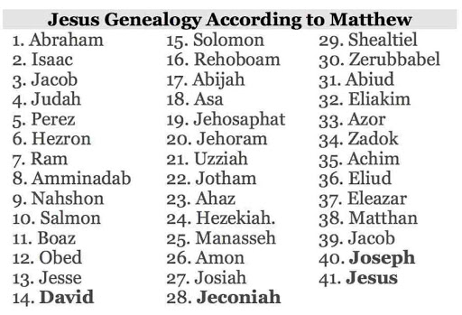

Slide 62
Norman Geisler
Systematic Theology, vol. 2 (Minneapolis, MN: Bethany, 2003), 648.
“If there is one gap, there may be more—indeed, we know there are more. For example, Matthew 1:8 says: ‘Jehoram the father of Uzziah,’ but the parallel listing in 1 Chronicles 3:11–14 illustrates missing generations between Jehoram and Uzziah (Azariah), namely, Ahaziah, Joash, and Amaziah. Just how many gaps there are in biblical genealogies and how much time they represent is not known. Even so, gaps there are and, hence, complete chronologies cannot be made; only accurate genealogies (lines of descent) are given.”

Slide 63
Genealogical Gaps?
Matthew 1:1-17?
  Matt 1:8-9; 1 Chr 3:10-12
  Larger portion of history
  Age of father at the time the son is born
  Matt 1:17 (3 groups of 14)
  Gematria (sum of Hebrew letters in David’s name adds up to 14)

Slide 64
Matthew’s Purposes
Earliest Gospel written to Hebrew-Christians
To explain that Jesus in whom they had believed was indeed the long-awaited Jewish Messiah
To explain why the kingdom had been postponed despite the fact that the king had arrived
To explain the interim program of God during the kingdom’s absence

Slide 65
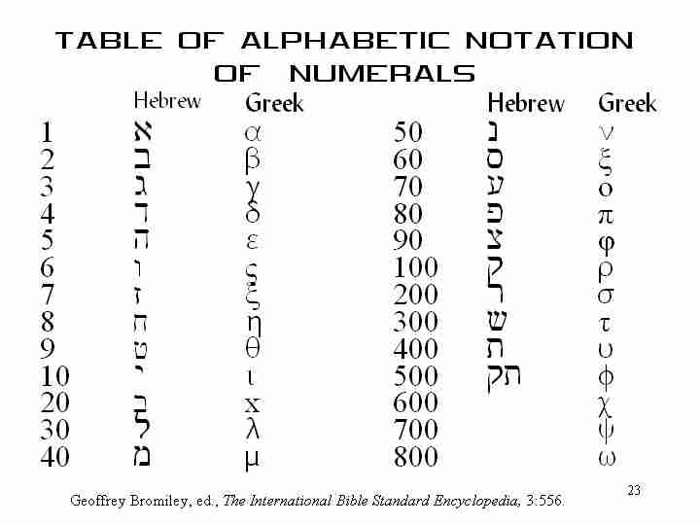

Slide 66
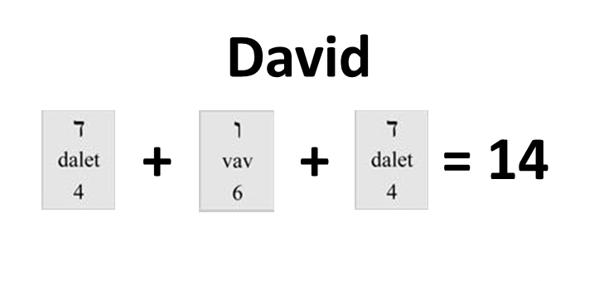

Slide 67
Genealogical Gaps?
  10/10 symmetrical scheme (Gen 5; 11) with gaps like Matt 1:17?
  Gen 5 = Ten patriarchs from Adam to Noah (3 sons)
  Gen 11 = Nine patriarchs from Shem to Terah (3 sons)

Slide 68
Genealogy of Genesis 5 vs. Genesis 11
 | GENESIS 5 | GENESIS 11
Number of generations | Ten | Nine
Conclusion | Noah’s three sons: Shem, Ham, Japheth | Terah’s three sons: Abram, Nahor, Haran
Scope | From Adam to Noah | From Shem to Terah
“And he died” | Yes | No
Man’s lifespan | Long | Curtailed
Historical perspective | Universal history | National history
Historical perspective | Pre-Israel history | Israel’s history
Families | Many | One

Slide 69

Age of the Earth?
  971-931 BC = Solomonic reign
  966 = Solomon rebuilds temple (1 Kgs 6:1b)
  - 480 years for the Exodus’ date (1 Kgs 6:1a)
  = 1446 BC for Exodus’ date
  - 430 years for Jacob’s migration to Egypt (Exod 12:40)
  = 1876 BC for Jacob’s migration to Egypt (Gen 46)
  Genealogies of Gen 5; 11
  = 4000 BC for the earth’s age

Slide 70
Age of the Earth?
  971-931 BC = Solomonic reign
  966 = Solomon rebuilds temple (1 Kgs 6:1b)
  - 480 years for the Exodus’ date (1 Kgs 6:1a)
  = 1446 BC for Exodus’ date
  - 430 years for Jacob’s migration to Egypt (Exod 12:40)
  = 1876 BC for Jacob’s migration to Egypt (Gen 46)
  Genealogies of Gen 5; 11
  = 4000 BC for the earth’s age

Slide 71
Age of the Earth?
  971-931 BC = Solomonic reign
  966 = Solomon rebuilds temple (1 Kgs 6:1b)
  - 480 years for the Exodus’ date (1 Kgs 6:1a)
  = 1446 BC for Exodus’ date
  - 430 years for Jacob’s migration to Egypt (Exod 12:40)
  = 1876 BC for Jacob’s migration to Egypt (Gen 46)
  Genealogies of Gen 5; 11
  = 4000 BC for the earth’s age

Slide 72
1 Kings 6:1
“Now it came about in the four hundred and eightieth year after the sons of Israel came out of the land of Egypt, in the fourth year of Solomon’s reign over Israel, in the month of Ziv which is the second month, that he began to build the house of the Lord.”

Slide 73
Age of the Earth?
  971-931 BC = Solomonic reign
  966 = Solomon rebuilds temple (1 Kgs 6:1b)
  - 480 years for the Exodus’ date (1 Kgs 6:1a)
  = 1446 BC for Exodus’ date
  - 430 years for Jacob’s migration to Egypt (Exod 12:40)
  = 1876 BC for Jacob’s migration to Egypt (Gen 46)
  Genealogies of Gen 5; 11
  = 4000 BC for the earth’s age

Slide 74
1 Kings 6:1
“Now it came about in the four hundred and eightieth year after the sons of Israel came out of the land of Egypt, in the fourth year of Solomon’s reign over Israel, in the month of Ziv which is the second month, that he began to build the house of the Lord.”

Slide 75
Age of the Earth?
  971-931 BC = Solomonic reign
  966 = Solomon rebuilds temple (1 Kgs 6:1b)
  - 480 years for the Exodus’ date (1 Kgs 6:1a)
  = 1446 BC for Exodus’ date
  - 430 years for Jacob’s migration to Egypt (Exod 12:40)
  = 1876 BC for Jacob’s migration to Egypt (Gen 46)
  Genealogies of Gen 5; 11
  = 4000 BC for the earth’s age

Slide 76


Slide 77
Age of the Earth?
  971-931 BC = Solomonic reign
  966 = Solomon rebuilds temple (1 Kgs 6:1b)
  - 480 years for the Exodus’ date (1 Kgs 6:1a)
  = 1446 BC for Exodus’ date
  - 430 years for Jacob’s migration to Egypt (Exod 12:40)
  = 1876 BC for Jacob’s migration to Egypt (Gen 46)
  Genealogies of Gen 5; 11
  = 4000 BC for the earth’s age

Slide 78
Exodus 12:40-41
“⁴⁰ Now the time that the sons of Israel lived in Egypt was four hundred and thirty years. ⁴¹ And at the end of four hundred and thirty years, to the very day, all the hosts of the Lord went out from the land of Egypt.”

Slide 79
Age of the Earth?
  971-931 BC = Solomonic reign
  966 = Solomon rebuilds temple (1 Kgs 6:1b)
  - 480 years for the Exodus’ date (1 Kgs 6:1a)
  = 1446 BC for Exodus’ date
  - 430 years for Jacob’s migration to Egypt (Exod 12:40)
  = 1876 BC for Jacob’s migration to Egypt (Gen 46)
  Genealogies of Gen 5; 11
  = 4000 BC for the earth’s age

Slide 80
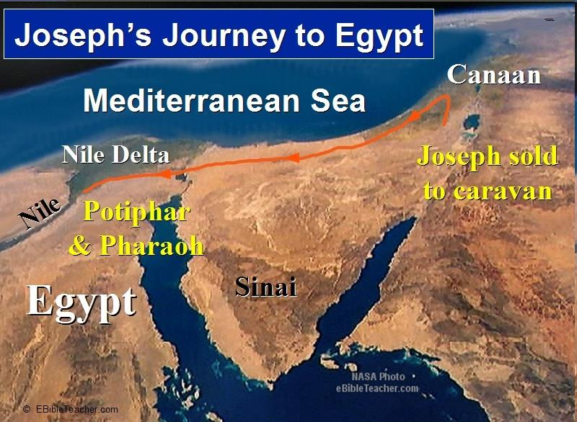

Slide 81
Age of the Earth?
  971-931 BC = Solomonic reign
  966 = Solomon rebuilds temple (1 Kgs 6:1b)
  - 480 years for the Exodus’ date (1 Kgs 6:1a)
  = 1446 BC for Exodus’ date
  - 430 years for Jacob’s migration to Egypt (Exod 12:40)
  = 1876 BC for Jacob’s migration to Egypt (Gen 46)
  Genealogies of Gen 5; 11
  = 4000 BC for the earth’s age

Slide 82
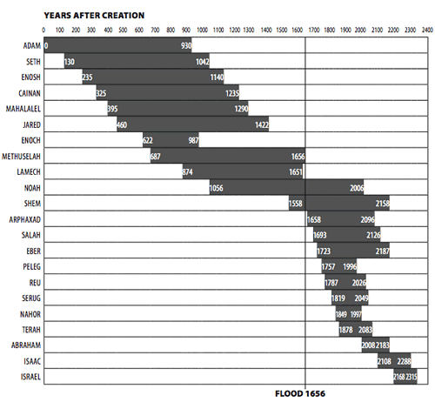

Slide 83
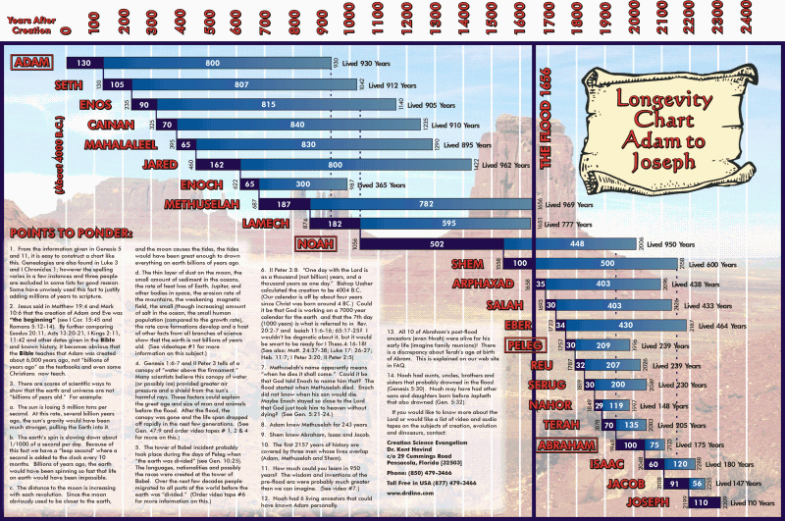

Slide 84
Age of the Earth?
  971-931 BC = Solomonic reign
  966 = Solomon rebuilds temple (1 Kgs 6:1b)
  - 480 years for the Exodus’ date (1 Kgs 6:1a)
  = 1446 BC for Exodus’ date
  - 430 years for Jacob’s migration to Egypt (Exod 12:40)
  = 1876 BC for Jacob’s migration to Egypt (Gen 46)
  Genealogies of Gen 5; 11
  = 4000 BC for the earth’s age

Slide 85
Matthew 19:4-6
“³ Some Pharisees came to Jesus, testing Him and asking, “Is it lawful for a man to divorce his wife for any reason at all?” ⁴ And He answered and said, “Have you not read that He who created them from the beginning made them male and female, ⁵ and said, ‘For this reason a man shall leave his father and mother and be joined to his wife, and the two shall become one flesh’? ⁶ So they are no longer two, but one flesh. What therefore God has joined together, let no man separate.”

Slide 86
Creation with the Appearance of Age?
  Adam and Eve (Gen 1–2)
  Water to wine (John 2:1-12)
  Feeding of the multitudes (Matt 14:13-21; 15:29-39)
  Mount St. Helens
  Fall, flood

Slide 87
UNIFORMITARIANISM IS NOT BIBLICISM
 | ERA | SCRIPTURE | DISTINCTIVES
1. | CREATION | Genesis 1-2 | No death
2. | FALL | Genesis 3-6 | Death, painful pregnancy & toil, long life spans, no human government
3. | FLOOD | Genesis 7-10 | Shorter life spans, human government, one language, no nations
4. | BABEL | Genesis 11-present | No global government, multiple languages, nations, ethnicities
5. | ANTICHRIST | Rapture to 2nd Advent | Global government, restrainer removed
6. | KINGDOM | Rev. 20:1-10 | Long life spans, kingdom conditions, reality of death, renovated earth
7. | ETERNAL STATE | Rev. 21-22 | No death, new earth

Slide 88

Earliest Known Human Writing
“No date appears before the start of human civilizations about 5,500 years ago and the beginning of written pictorial history.”
Richard Overy, “The 50 Key Dates of World History” (Oct. 19, 2007)

Slide 89
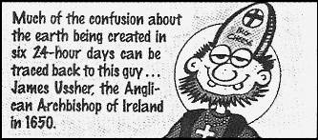

Slide 90
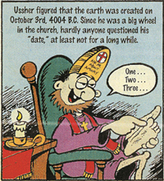

Slide 91
Rehabilitating Ussher
Archbishop James Ussher (A.D. 1581‒1656) was also a distinguished theologian, “recognized as one of the greatest scholars of his time.” He was one of only six theologians allowed to address the Parliament and the King. The Evangelical Dictionary of Theology states, “He was much sought after by contemporaries for his knowledge and beauty of character, and his personal impact was probably even greater than his scholarly legacy.”
Van Bebber and Taylor, Creation and Time, p. 102 quoting, The Evangelical Dictionary of Theology

Slide 92
Three Concluding Observations
(Gen 11:10-26)
    Age of patriarch at birth of seed-son demonstrate no genealogical gaps
    Antediluvian and Patriarchal overlap
    Shorter patriarchal ages indicate changed world conditions

Slide 94
Dr. Arnold G. Fruchtenbaum
The Book of Genesis, 232
“…only four life spans link together the continuity of tradition from Adam to Jacob, and these make three links. The four life spans are Adam, Lamech, Shem and Jacob. The three links are from Adam to Lamech, since Adam was living when Lamech was born; from Lamech to Shem, since Lamech was living when Shem was born; and from Shem to Isaac and Jacob, since Shem was still living when both Isaac and Jacob were born. Therefore, there are not many gaps in the tradition to retain the history.”

Slide 95
Dr. Arnold G. Fruchtenbaum
The Book of Genesis, 232
“Along this line, the following points should be made: Noah lived until Terah, the father of Abraham, was 128 years old; Shem and Eber outlived Terah; Eber outlived Abraham; and, based upon when Terah died, Shem died when Isaac or Jacob was 48 years old…So as to the question of how history was maintained and how the tradition was kept, there is really no problem here because quite a bit of overlapping occurs within these genealogies.”

Slide 96
Three Concluding Observations
(Gen 11:10-26)
    Age of patriarch at birth of seed-son demonstrate no genealogical gaps
    Antediluvian and Patriarchal overlap
    Shorter patriarchal ages indicate changed world conditions

Slide 99
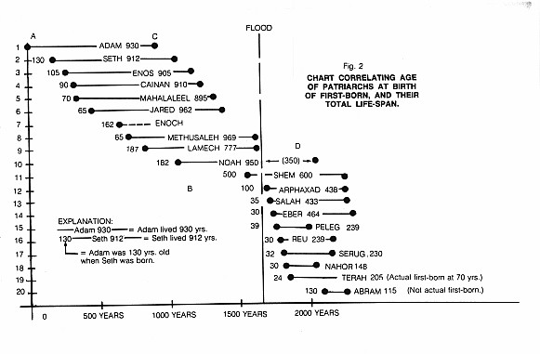

Slide 100
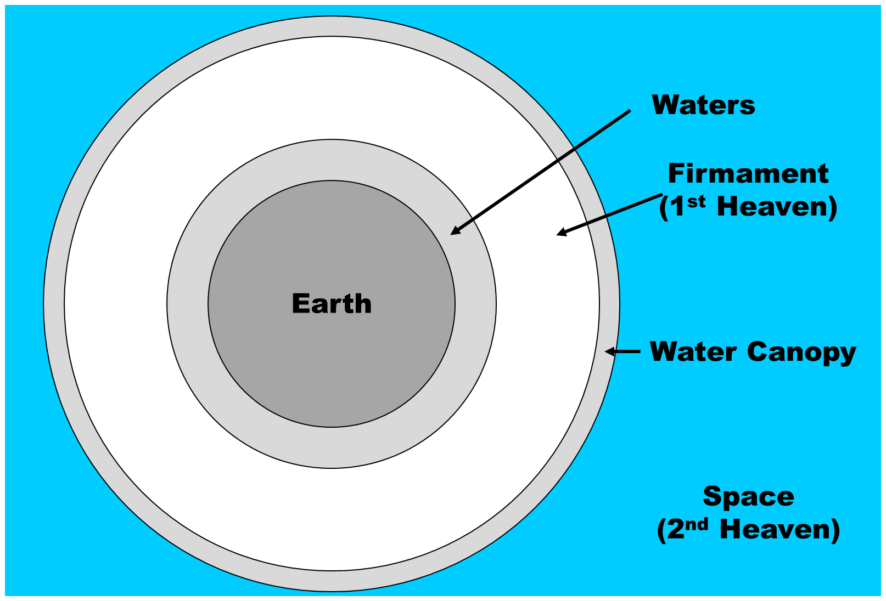

Slide 101
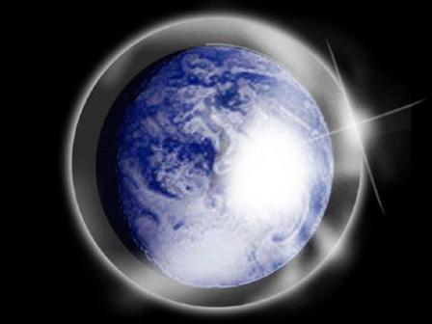

Slide 102
Day 2 Canopy Theory
(Gen 1:6-8)
Implied – Gen. 1:6-7; Ps. 148:4
Explains
  Long life spans of early man – Gen. 5:5, 27
  Strange beasts – (Gen. 1:24-25; Job 40‒41)
  Where the flood waters came from – (Gen. 2:5-6)
  Why man’s post-flood life span cut short – (Gen. 11:24-25)

Slide 103
Eight-Fold Pattern
Genesis 11:10-11
  Generation of Shem: First
  Name: Shem
  Meaning: Name
  Name of seed son: Arphachshad
  Age at birth of seed-son: 100 years
  Additional years lived: 500 years
  Total years lived: 600 years
  Begat other sons & daughters: Yes

Slide 104
Eight-Fold Pattern
Genesis 11:12-13
  Generation of Shem: Second
  Name: Arphachshad
  Meaning: Unclear
  Name of seed son: Shelah
  Age at birth of seed-son: 35 years
  Additional years lived: 403 years
  Total years lived: 438 years
  Begat other sons & daughters: Yes

Slide 105
Dr. Arnold G. Fruchtenbaum
The Book of Genesis, 231
“…there is a gradual decrease in the age of man. A sharp drop occurs between Shem and Arpachshad, between the first and second generation, during which time the Flood occurred. What probably caused the sudden decrease was the Flood. This was part of God’s divine judgment on humanity.”

Slide 106
Eight-Fold Pattern
Genesis 11:16-17
  Generation of Shem: Fourth
  Name: Eber
  Meaning: Cross over
  Name of seed son: Peleg
  Age at birth of seed-son: 34 years
  Additional years lived: 430 years
  Total years lived: 464 years
  Begat other sons & daughters: Yes

Slide 107
Eight-Fold Pattern
Genesis 11:18-19
  Generation of Shem: Fifth
  Name: Peleg
  Meaning: Division
  Name of seed son: Reu
  Age at birth of seed-son: 30 years
  Additional years lived: 209 years
  Total years lived: 239 years
  Begat other sons & daughters: Yes

Slide 108
Dr. Arnold G. Fruchtenbaum
The Book of Genesis Record, 231-32
“A second sharp drop occurs between Eber and Peleg, which are the fourth and fifth generations. It was between the fourth and fifth generation that the Tower of Babel event occurred. Therefore, with these two divine judgments, a sharp drop in the longevity of man occurs. If the canopy theory is correct, that might account for it. However, even without the canopy theory, divine judgment will easily account for this decrease, because it is following the divine judgments that the sharp drops occurred.”

Slide 109
UNIFORMITARIANISM IS NOT BIBLICISM
 | ERA | SCRIPTURE | DISTINCTIVES
1. | CREATION | Genesis 1-2 | No death
2. | FALL | Genesis 3-6 | Death, painful pregnancy & toil, long life spans, no human government
3. | FLOOD | Genesis 7-10 | Shorter life spans, human government, one language, no nations
4. | BABEL | Genesis 11-present | No global government, multiple languages, nations, ethnicities
5. | ANTICHRIST | Rapture to 2nd Advent | Global government, restrainer removed
6. | KINGDOM | Rev. 20:1-10 | Long life spans, kingdom conditions, reality of death, renovated earth
7. | ETERNAL STATE | Rev. 21-22 | No death, new earth

Slide 110
Conclusion

Slide 111
Genesis 11:10-26 Outline
  Shem (11:10-11)
  Arphachshad (11:12-13)
  Shelah (11:14-15)
  Eber (11:16-17)
  Peleg (11:18-19)
  Reu (11:20-21)
  Serug (11:22-23)
  Nahor (11:24-25)
  Terah (11:26)

Slide 112
Toledoth
“And These Are the Generations of…”
Introduction to the generations (1:1–2:3)
Generations of the heaven and earth (2:4–4:26)
Generations of Adam (5:1–6:8)
Generations of Noah (6:9–9:29)
Generations of the sons of Noah (10:1–11:9)
Generations of Shem (11:10–26)
Generations of Terah (11:27–25:11)
Generations of Ishmael (25:12-18)
Generations of Isaac (25:19–35:29)
Generations of Esau (36:1–37:1)
Generations of Jacob (37:2–50:26)

Slide 113
GENESIS STRUCTURE
  Beginning of the Human race (Gen. 1‒11)
  Beginning of the Hebrew race (Gen. 12‒50)

Slide 114

GENESIS STRUCTURE
  Genesis 12-50 (four people)
  Abraham (12:1–25:11)
  Isaac (25:12–26:35)
  Jacob (27–36)
  Joseph (37–50)

Slide 115
GENESIS STRUCTURE
  Genesis 12-50 (four people)
  Abraham (12:1–25:11)
  Isaac (25:12–26:35)
  Jacob (27–36)
  Joseph (37–50)

Slide 116


Isaiah 43:1
“But now, thus says the Lord, your Creator, O Jacob, And He who formed you, O Israel, 'Do not fear, for I have redeemed you; I have called you by name; you are Mine!'”

Slide 117


Slide 118

“The Lord bless you and keep you; the Lord make his face shine on you and be gracious to you; the Lord turn his face toward you and give you peace.” (NIV)

