Slide 1
Law and Grace: An Overview Jim McGowan, Th.D. Sugar Land Bible Church 09-05-2021
…but grace and truth were realized through Jesus Christ - John 1:17
For the Law was given through Moses…
Special thanks to Dr. Vern Peterman for access to his insights and resources.

Slide 2
Session 29 Outline
Review
Purpose, Aim, and Objective
General Overview
The Law True and Deep - Part I
Background Information
Matthew 5:21-48
Concluding Observations

Slide 3
OUR PURPOSE, AIM AND OBJECTIVE
Law and Grace
…is to Compare and Contrast Law and Grace so as to properly understand these two important themes and how they are related to the life of the New Testament Believer.

Slide 4
C. I. Scofield, D. D.
The Grace of God, The Fundamentals Vol. 3, Chapter VII, p. 98
We have, most of us, been reared and now live under the influence of Galatianism. Protestant theology, alas, is for the most part, thoroughly Galatianized, in that neither law nor grace are given their distinct and separated places, as in the counsels of God, but are mingled together in one incoherent system.
The law is no longer, as in the Divine intent, a ministration of death (2 Cor. 3:7), of cursing (Gal. 3:10), of conviction (Rom. 3:19), because we are taught that we must try to keep it, and that by Divine help we may.
Nor, on the other hand, does grace bring us blessed deliverance from the dominion of sin, for we are kept under the law as a rule of life despite the plain declaration, “Sin shall not have dominion over you: for ye are not under the law, but under grace” (Rom. 6:14). (emphasis mine)

Slide 5
William R. Newell
Romans Verse-by-Verse (p. 274).
Grand Rapids, MI: Christian Classics Ethereal Library.
It is because Reformed theology has kept us Gentiles under the Law,—if not as a means of righteousness, then as “a rule of life,” that all the trouble has arisen. The Law is no more a rule of life than it is a means of righteousness. Walking in the Spirit has now taken the place of walking by ordinances. God has another principle under which He has put his saints: “Ye are not under law, but, under grace! (Rom. 6:14)” (italics mine)
PDF Download Here: https://archive.org/details/Romans_Verse_By_Verse-NewellWR

Slide 6
Henry Ironside
The Continual Burnt Offering: Daily Meditations on the Word of God (p. 265). Neptune, NJ: Loizeaux Brothers.
In Romans 7 we have a man renewed by the Spirit of God, but struggling under law, hoping thereby to subdue or find deliverance from the power of the old Adamic nature. In chapter 8 we have God’s way of deliverance through the death and resurrection of Christ with which the believer is identified before God. The chapter begins with “no condemnation” and ends with “no separation.” All who are in Christ Jesus are accepted in the Beloved and as free from every charge of guilt as He is Himself. He paid our penalty on the cross. Now we are linked up with Him in resurrection, not under law but under grace.

Slide 7
Matthew’s 3-Fold Purpose
Law and Grace: Review The SOM – Matthew 5:1–8:1 (Luke 6:17–49)
To explain:
that Jesus in whom they had believed was the long-awaited Jewish Messiah
why the kingdom had been postponed despite the fact that the king had arrived
the interim program of God during the kingdom’s absence

Slide 8
Matthew & the Kingdom
Law and Grace: Review The SOM – Matthew 5:1–8:1 (Luke 6:17–49)
 | offered
 | rejected
 | postponed Interim program
 | ultimately accepted

Slide 9
Matthew’s Message
Law and Grace: Review The SOM – Matthew 5:1–8:1 (Luke 6:17–49)
Jesus is the predicted Jewish king who ushered in an interim program by building the sons of the kingdom into the Church in between Israel’s past rejection and future acceptance of her king.

Slide 10
Session 29 Outline
Review
Purpose, Aim, and Objective
General Overview
The Law True and Deep - Part I
Background Information
Matthew 5:21-48
Concluding Observations

Slide 11
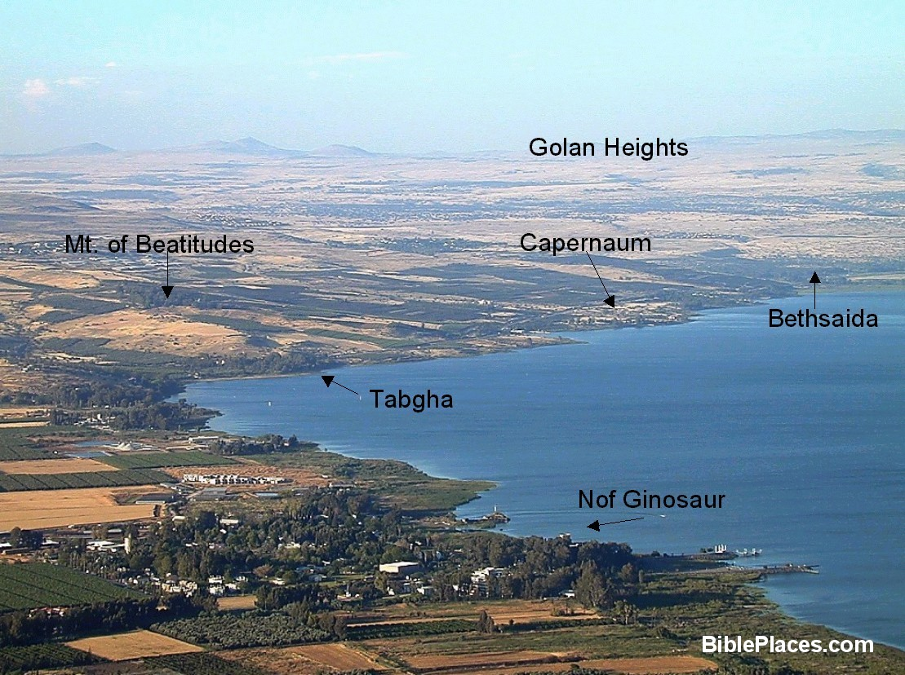
Law and Grace: Review The SOM – Matthew 5:1–8:1 (Luke 6:17–49)

Slide 12
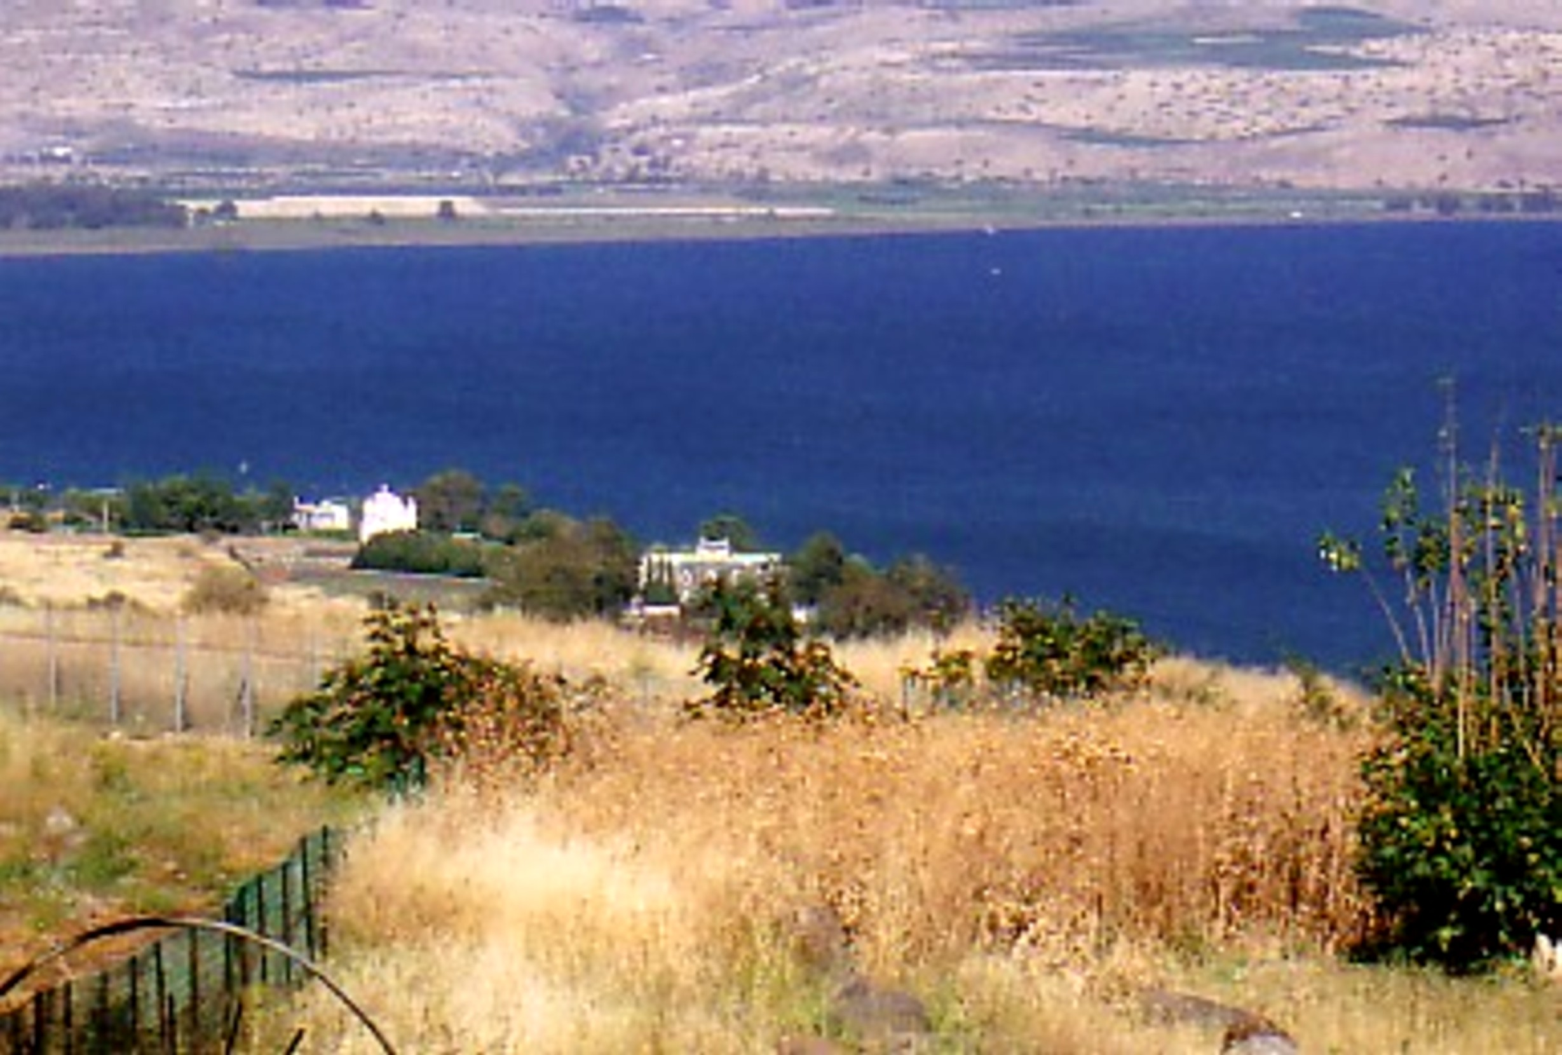
Law and Grace: Review The SOM – Matthew 5:1–8:1 (Luke 6:17–49)

Slide 13
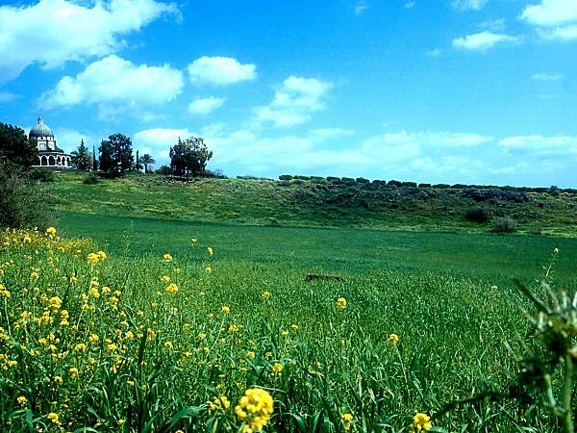
Law and Grace: Review The SOM – Matthew 5:1–8:1 (Luke 6:17–49)

Slide 14
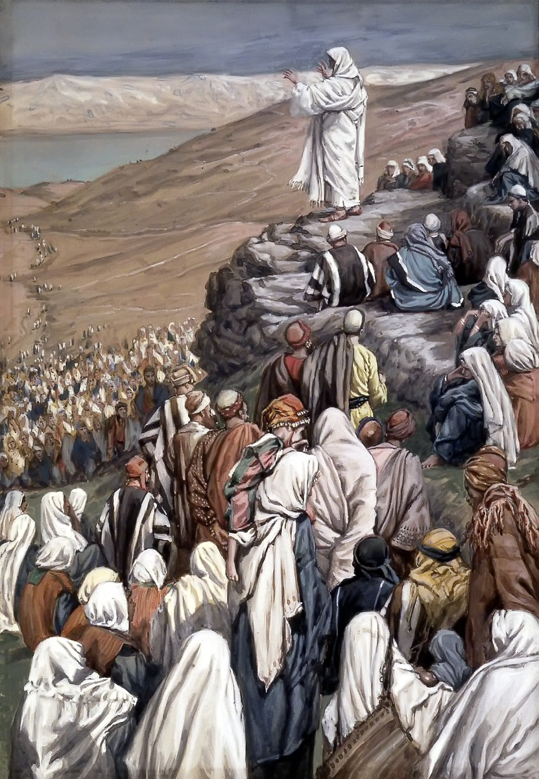
Law and Grace: Review The SOM – Matthew 5:1–8:1 (Luke 6:17–49)
To Whom is Jesus speaking in the SOM?
Rose are red
And violets are bluish
All of those listening to Jesus are Jewish!

Slide 15
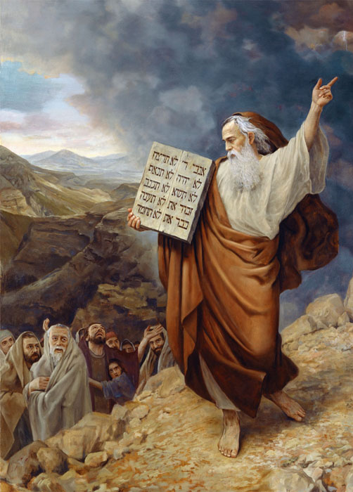
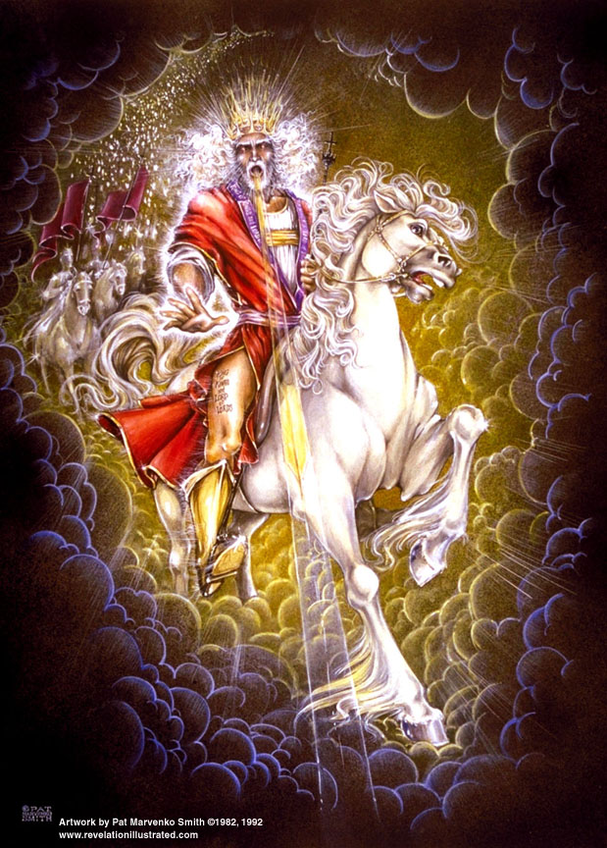
Law and Grace: Review The SOM – Matthew 5:1–8:1 (Luke 6:17–49)
BY WAY OF REMINDER
The Law of Moses was given to the people of Israel, who will all be empowered by the Spirit to know and live out the new Law of the Kingdom in the coming earthly reign of Christ.

Slide 16
Law and Grace: Review The SOM – Matthew 5:1–8:1 (Luke 6:17–49)
BY WAY OF REMINDER
By way of contrast however, we in the church, in our co-death with Christ, have died to the Law of Moses and are now empowered, as we walk in the Spirit, so that Christ’s life may be lived through us (Galatians 2:19-20).

Slide 17
Session 29 Outline
Review
Purpose, Aim, and Objective
General Overview
The Law True and Deep - Part I
Background Information
Matthew 5:21-48
Concluding Observations

Slide 18
Law and Grace: Session 29 The SOM – Matthew 5:1–8:1 (Luke 6:17–49)
The Law True and Deep Matthew 5:21-48
In this portion of the Sermon on the Mount, Jesus says things about the Law of Moses that fall into these patterns:
“It was said…” then “but I say to you…” or
“You have heard that the ancients were told…” or
“You have heard that it was said…” or
“It was said…” then “but I say to you…”

Slide 19
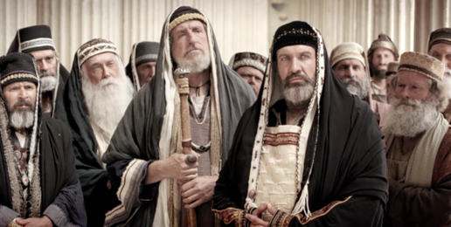
Law and Grace: Session 29 The SOM – Matthew 5:1–8:1 (Luke 6:17–49)
Jesus contrasted with the Scribes & Pharisees
Matthew 5:20-48
The Scribes and Pharisees who Jesus mentioned in verse 20, along with other Jewish religious leaders, nullified the Law of Moses by reducing its application in some places, or adding to it in others.

Slide 20
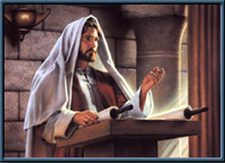
Law and Grace: Session 29 The SOM – Matthew 5:1–8:1 (Luke 6:17–49)
Jesus contrasted with the Scribes & Pharisees
Matthew 5:20-48
Jesus made the Law of Moses apply to the whole person, all the way from the heart and thoughts, to all of the outward expressions and even in the relationships between Jews, and with God.

Slide 21
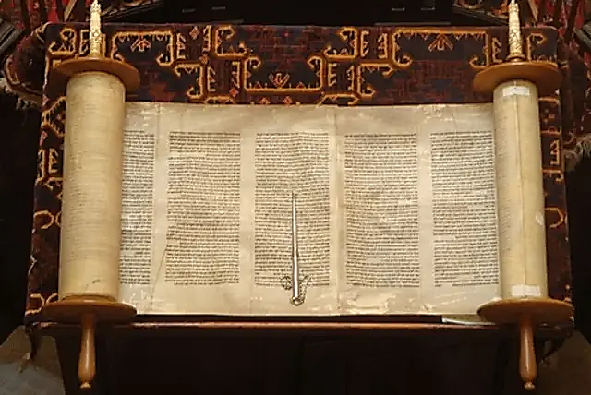
Law and Grace: Session 29 The SOM – Matthew 5:1–8:1 (Luke 6:17–49)
Two Primary Patterns in Jesus’ Statements
Matthew 5:21-48
Jesus will quote an Old Testament passage or two and include those laws that require full heart-level and even relationship compliance.

Slide 22
Law and Grace: Session 29 The SOM – Matthew 5:1–8:1 (Luke 6:17–49)
Two Primary Patterns in Jesus’ Statements
Matthew 5:21-48
Jesus will quote an Old Testament passage along with one of the traditions that have been added to the Law of Moses, and then correct the tradition by taking the application deeper and/or back to the original intent of the Law of Moses.

Slide 23
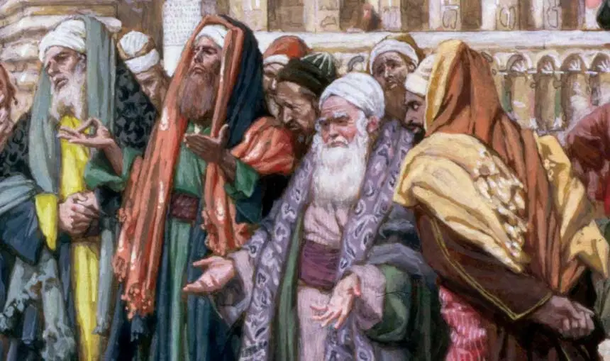
Law and Grace: Session 29 The SOM – Matthew 5:1–8:1 (Luke 6:17–49)
Two Primary Patterns in Jesus’ Statements
Matthew 5:21-48
In both instances, Jesus will say something that His listeners will find shocking!

Slide 24
Law and Grace: Session 29 The SOM – Matthew 5:1–8:1 (Luke 6:17–49)
Jesus Used Hyperbole
Matthew 5:21-26
Jesus sometimes used *hyperbole in His expressions in this passage, and elsewhere in the Sermon on the Mount, for the sake of emphasis and as an aid to memory.
* hyperbole an obvious and intentional exaggeration used for stress or emphasis; not intended to be taken literally…i.e. I’m so hungry, I could eat a horse.

Slide 25
Law and Grace: Session 29 The SOM – Matthew 5:1–8:1 (Luke 6:17–49)
Jesus Used Hyperbole
Matthew 5:21-26
Recognizing the use of hyperbole is important in literal, grammatical, historical, interpretation because a failure to do so could lead to serious problems like:
Plucking out your eye
Cutting off your foot
Developing crazy doctrine

Slide 26
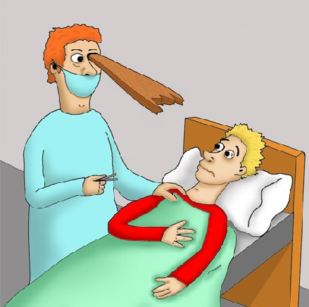
Law and Grace: Session 29 The SOM – Matthew 5:1–8:1 (Luke 6:17–49)
Jesus Used Hyperbole
Matthew 5:21-26
It is important to recognize hyperbole in order to draw the right conclusion and to keep us out of the emergency ward!

Slide 27
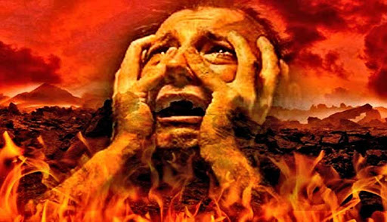
Law and Grace: Session 29 The SOM – Matthew 5:1–8:1 (Luke 6:17–49)
Jesus’ Word for ‘Hell’
Matthew 5:21-32
In Matthew 5:22, 29-30, Jesus uses the Greek word, “Gehenna” (cf. Mark) which is translated ‘hell’ in most English Bibles. “Gehenna” means ‘valley of Hinnom’, referring to a valley situated just south of Jerusalem.
It is used only once in the Gospel of Luke and once in the Epistle of James, written by the Lord’s brother.

Slide 28
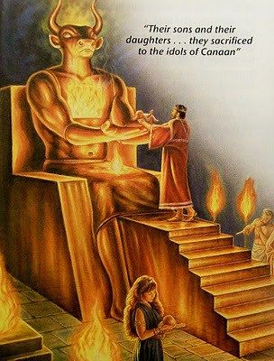
Law and Grace: Session 29 The SOM – Matthew 5:1–8:1 (Luke 6:17–49)
Gehenna, or Valley of (Ben-) Hinnom
Matthew 5:21-32
In Old Testament times, infants were presented as holocaust offerings to the pagan god Molech in this valley (2 Kings 23:10; Jeremiah 7:31).

Slide 29
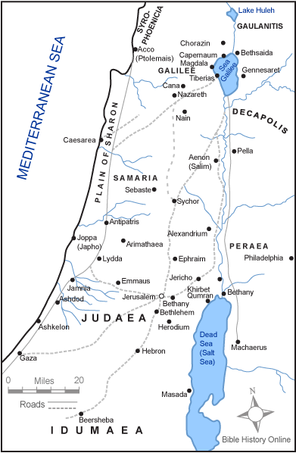
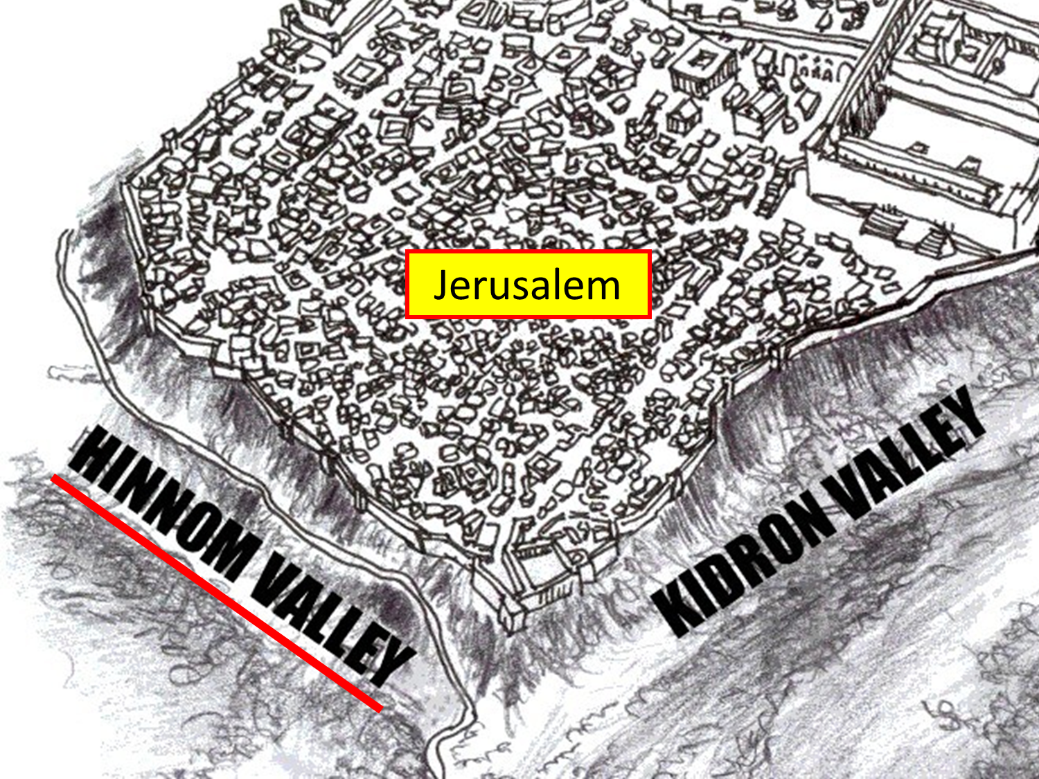
Law and Grace: Session 29 The SOM – Matthew 5:1–8:1 (Luke 6:17–49)
Gehenna, or Valley of (Ben-) Hinnom
Matthew 5:21-32
The valley was deemed to be cursed and became a figurative equivalent for “hell” among the Jews.

Slide 30
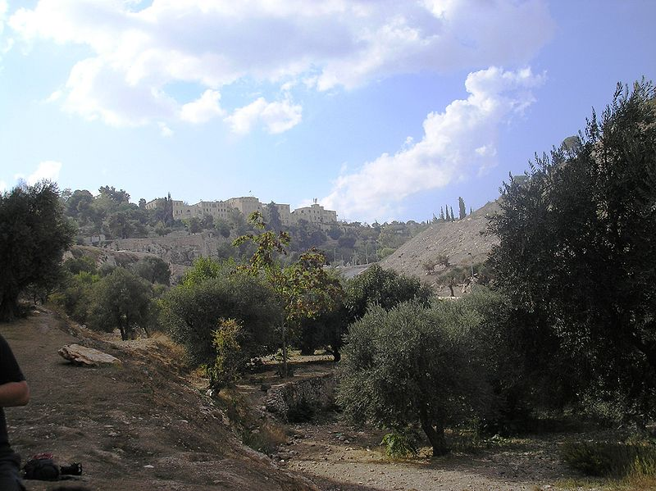
Law and Grace: Session 29 The SOM – Matthew 5:1–8:1 (Luke 6:17–49)
Gehenna, or Valley of (Ben-) Hinnom
Matthew 5:21-32
What the Valley of Hinnom, or Gehenna, looks like today.

Slide 31
Session 29 Outline
Review
Purpose, Aim, and Objective
General Overview
The Law True and Deep - Part I
Background Information
Matthew 5:21-48
Concluding Observations

Slide 32
Matthew 5:21-22
²¹ “You have heard that the ancients were told, ‘You shall not commit murder’ and ‘Whoever commits murder shall be liable to the court.’ ²² “But I say to you that everyone who is angry with his brother shall be guilty before the court; and whoever says to his brother, ‘You good-for-nothing,’ shall be guilty before the supreme court [Sanhedrin]; and whoever says, ‘You fool,’ shall be guilty enough to go into the fiery hell.

Slide 33
Law and Grace: Session 29 The SOM – Matthew 5:1–8:1 (Luke 6:17–49)
Murder… From The Inside Out
Matthew 5:21-22
Jesus says that the heart is where the offense first takes place, (cf. Exo. 20:13 – 6th Commandment; Lev. 19:17-18) and if the heart condition were known, judgment would occur starting with the lowest civil court and reach even to the highest of Jewish courts, the Sanhedrin!

Slide 34
Exodus 20:13
'You shall not murder.'
Leviticus 19:17-18
¹⁷ ‘You shall not hate your fellow countryman in your heart; you may surely reprove your neighbor, but shall not incur sin because of him. ¹⁸ You shall not take vengeance, nor bear any grudge against the sons of your people, but you shall love your neighbor as yourself; I am the Lord.'

Slide 35
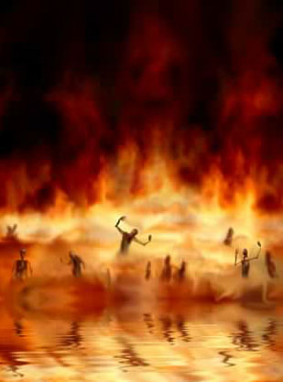
Law and Grace: Session 29 The SOM – Matthew 5:1–8:1 (Luke 6:17–49)
Murder… From The Inside Out
Matthew 5:21-22
In v. 22, Jesus even went so far as to make hateful expressions, designed to diminish the personal and public value of another Israelite, a capital offense! “whoever says, ‘You fool,’ shall be guilty enough to go into the fiery hell.”

Slide 36
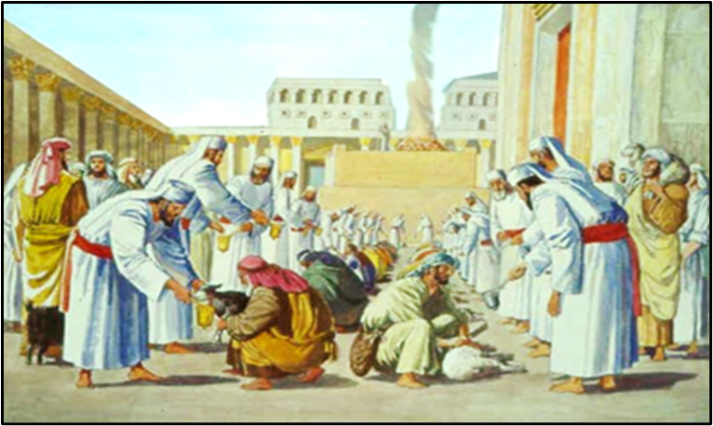
Matthew 5:23-24
²³ "Therefore if you are presenting your offering at the altar, and there remember that your brother has something against you, ²⁴ leave your offering there before the altar and go; first be reconciled to your brother, and then come and present your offering.

Slide 37
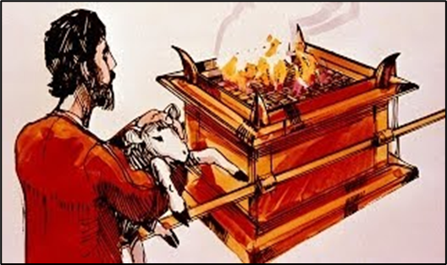
Law and Grace: Session 29 The SOM – Matthew 5:1–8:1 (Luke 6:17–49)
Murder… From The Inside Out
Matthew 5:23-24
Between offering a sacrifice and resolving a wrong against another Israelite, resolving the wrong is the higher priority!
Jesus isn’t addressing the Jews’ anger against the other person, but rather that he has caused his Jewish brother to have anger against him!

Slide 38
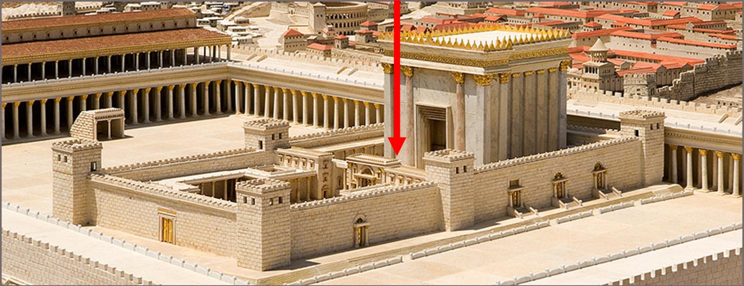
Matthew 5:23-24
²³ "Therefore if you are presenting your offering at the altar, and there remember that your brother has something against you, ²⁴ leave your offering there before the altar and go; first be reconciled to your brother, and then come and present your offering.

Slide 39
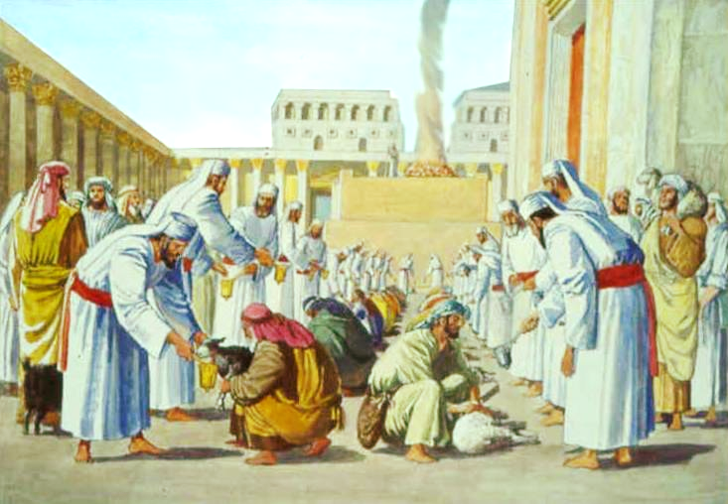
Law and Grace: Session 29 The SOM – Matthew 5:1–8:1 (Luke 6:17–49)
Where You Took Your Offering
Matthew 5:21-26

Slide 40
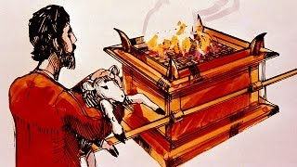
Law and Grace: Session 29 The SOM – Matthew 5:1–8:1 (Luke 6:17–49)
Murder… From The Inside Out
Matthew 5:21-26
GALILEE
JERUSALEM

Slide 41
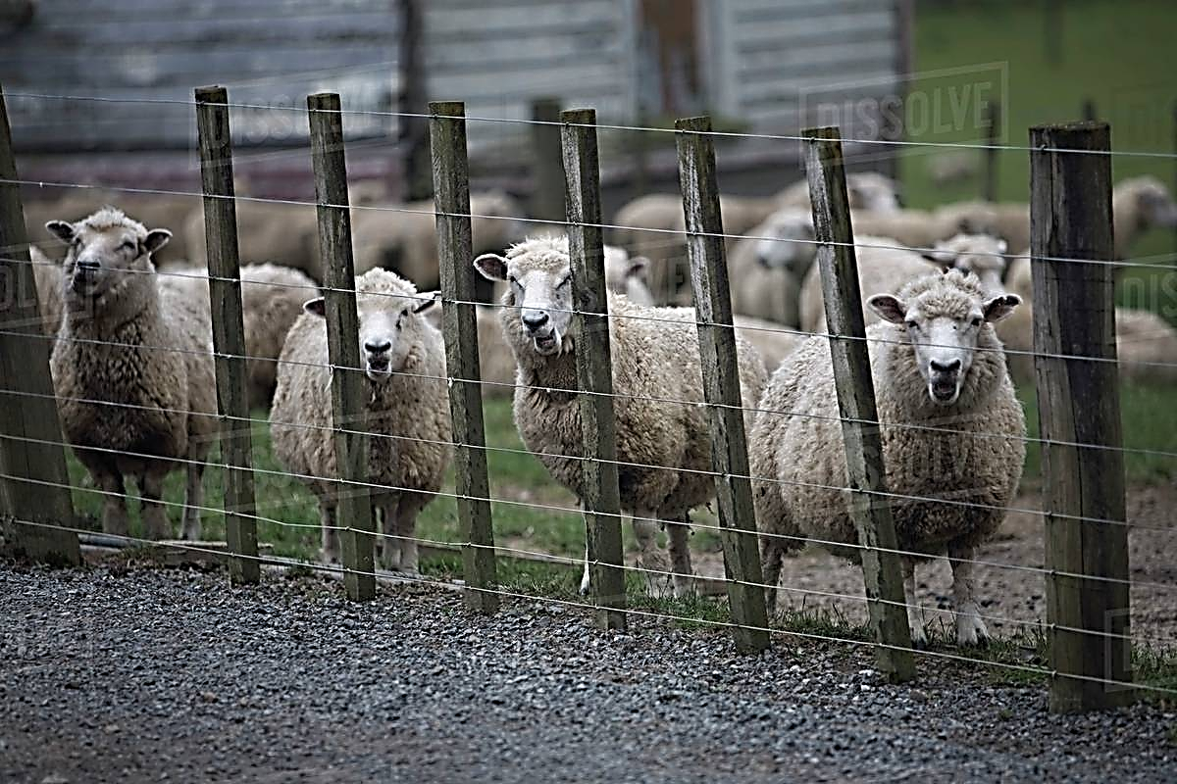
Law and Grace: Session 29 The SOM – Matthew 5:1–8:1 (Luke 6:17–49)
Murder… From The Inside Out
Matthew 5:21-26
GALILEE
JERUSALEM

Slide 42
Law and Grace: Session 29 The SOM – Matthew 5:1–8:1 (Luke 6:17–49)
Murder… From The Inside Out
Matthew 5:21-26
GALILEE
JERUSALEM

Slide 43
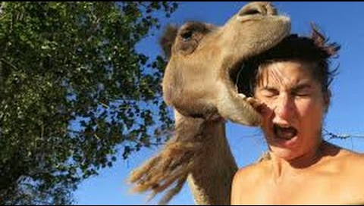
Law and Grace: Session 29 The SOM – Matthew 5:1–8:1 (Luke 6:17–49)
Murder… From The Inside Out
Matthew 5:21-26
GALILEE
JERUSALEM

Slide 44
Matthew 5:25-26
²⁵ Make friends quickly with your opponent at law while you are with him on the way, so that your opponent may not hand you over to the judge, and the judge to the officer, and you be thrown into prison. ²⁶ Truly I say to you, you will not come out of there until you have paid up the last cent."

Slide 45
Law and Grace: Session 29 The SOM – Matthew 5:1–8:1 (Luke 6:17–49)
The Faster The Resolution, The Better
Matthew 5:21-26
In the court system of the day, a person might have to travel right alongside the opponent at law to appear before a judge at the same time.

Slide 46
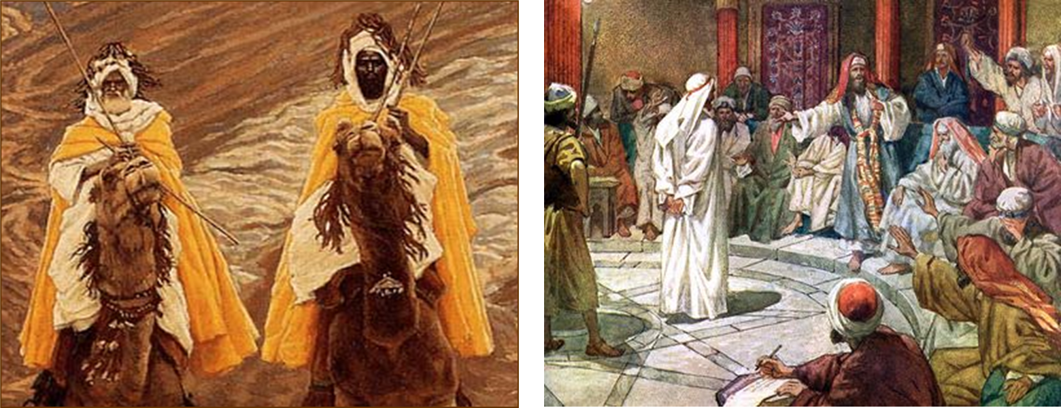
Law and Grace: Session 29 The SOM – Matthew 5:1–8:1 (Luke 6:17–49)
The Faster The Resolution, The Better
Matthew 5:21-26
This harmonizes with 1 Corinthians 6:1-8 regarding lawsuits between believers.

Slide 47
1 Corinthians 6:7-8
⁷ Actually, then, it is already a defeat for you, that you have lawsuits with one another. Why not rather be wronged? Why not rather be defrauded? ⁸ On the contrary, you yourselves wrong and defraud. You do this even to your brethren.

Slide 48
Law and Grace: Session 29 The SOM – Matthew 5:1–8:1 (Luke 6:17–49)
GENERAL PRINCIPLES
Matthew 5:21-26 / 1 Corinthians 6:1-8
Prefer resolution of conflicts sooner rather than later.
Lean toward avoiding financial and legal hazards rather than ‘getting your pound of flesh’.
Place resolution of matters, for which you are at fault in some way, as high priority.
Place the honor of the Lord’s name as highest priority.
Avoid being the cause of someone else wanting ‘a pound of your flesh’.

Slide 49
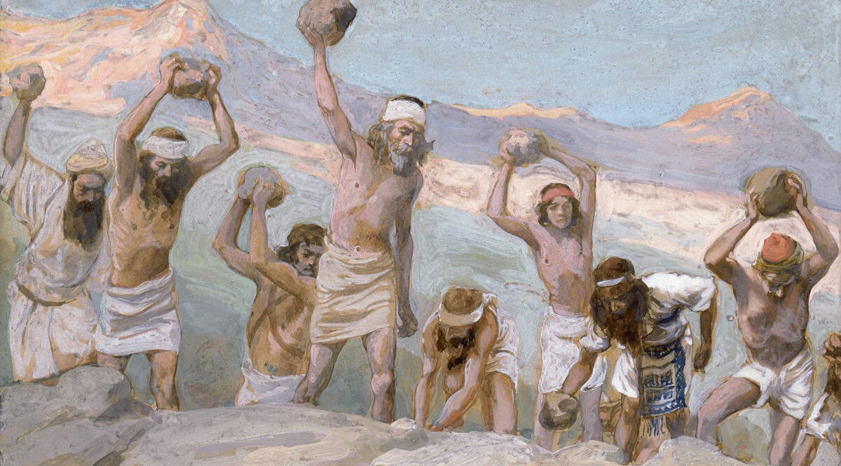
Matthew 5:27-28
²⁷ “You have heard that it was said, ‘You shall not commit adultery’; ²⁸ but I say to you that everyone who looks at a woman with lust for her has already committed adultery with her in his heart.

Slide 50
Law and Grace: Session 29 The SOM – Matthew 5:1–8:1 (Luke 6:17–49)
Committing Adultery Without Making A Move
Matthew 5:27-30
The Law of Moses not only prohibited committing adultery, but it also forbade a man to covet another man’s wife (Deu. 5:21).
Both were capital crimes, but Jesus said here that the externalized adultery offense is the same as the coveting offense!

Slide 51
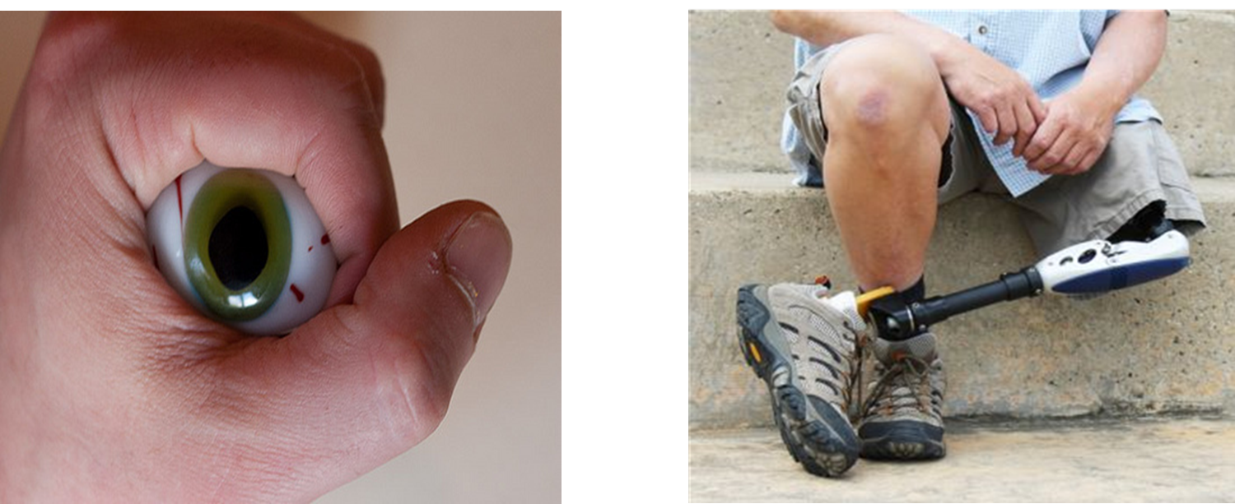
Matthew 5:29-30
²⁹ “If your right eye makes you stumble, tear it out and throw it from you; for it is better for you to lose one of the parts of your body, than for your whole body to be thrown into hell. ³⁰ “If your right hand makes you stumble, cut it off and throw it from you; for it is better for you to lose one of the parts of your body, than for your whole body to go into hell.

Slide 52
Law and Grace: Session 29 The SOM – Matthew 5:1–8:1 (Luke 6:17–49)
Sin? Let’s get serious!
Matthew 5:29-30
In Matthew 5:29-30 Jesus uses some obvious hyperbole to emphasize how seriously sin must be treated.

Slide 53
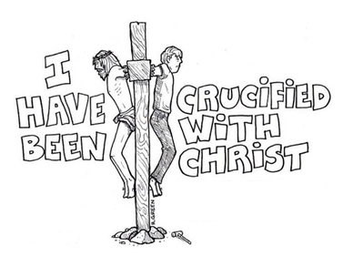
Law and Grace: Session 29 The SOM – Matthew 5:1–8:1 (Luke 6:17–49)
Sin? Let’s get serious!
Matthew 5:29-30
Fortunately for us in the body of Christ, God performed the most intensive heart operation on each of us who believed.
Rather than plucking out our eyes or cutting off our hands, we reckon ourselves as having been crucified with Christ, and as having died in relationship to the source of sin (cf. Rom. 6:1–14; Gal. 2:19-20; Rom. 8:1-4).

Slide 54
Romans 6:1–14
¹ What shall we say then? Are we to continue in sin so that grace may increase? ² May it never be! How shall we who died to sin still live in it? ³ Or do you not know that all of us who have been baptized into Christ Jesus have been baptized into His death? ⁴ Therefore we have been buried with Him through baptism into death, so that as Christ was raised from the dead through the glory of the Father, so we too might walk in newness of life. ⁵ For if we have become united with Him in the likeness of His death, certainly we shall also be in the likeness of His resurrection, ⁶ knowing this, that our old self was crucified with Him, in order that our body of sin might be done away with, so that we would no longer be slaves to sin; ⁷ for he who has died is freed from sin. ⁸ Now if we have …

Slide 55
Romans 6:1–14
… died with Christ, we believe that we shall also live with Him, ⁹ knowing that Christ, having been raised from the dead, is never to die again; death no longer is master over Him. ¹⁰ For the death that He died, He died to sin once for all; but the life that He lives, He lives to God. ¹¹ Even so consider yourselves to be dead to sin, but alive to God in Christ Jesus. ¹² Therefore do not let sin reign in your mortal body so that you obey its lusts, ¹³ and do not go on presenting the members of your body to sin as instruments of unrighteousness; but present yourselves to God as those alive from the dead, and your members as instruments of righteousness to God. ¹⁴ For sin shall not be master over you, for you are not under law but under grace.

Slide 56
Galatians 2:19-20
¹⁹ “For through the Law I died to the Law, so that I might live to God. ²⁰ “I have been crucified with Christ; and it is no longer I who live, but Christ lives in me; and the life which I now live in the flesh I live by faith in the Son of God, who loved me and gave Himself up for me.

Slide 57
Romans 8:1-4
¹ Therefore there is now no condemnation for those who are in Christ Jesus. ² For the law of the Spirit of life in Christ Jesus has set you free from the law of sin and of death. ³ For what the Law [of Moses] could not do, weak as it was through the flesh, God did: sending His own Son in the likeness of sinful flesh and as an offering for sin, He condemned sin in the flesh, ⁴ so that the requirement of the Law might be fulfilled in us, who do not walk according to the flesh but according to the Spirit.
law = principle: the way things work
Law = Law of Moses

Slide 58
Matthew 5:31-32
³¹ “It was said, ‘Whoever sends his wife away, let him give her a certificate of divorce’; ³² but I say to you that everyone who divorces his wife, except for the reason of unchastity, makes her commit adultery; and whoever marries a divorced woman commits adultery. (cf. chap. 19)

Slide 59
Law and Grace: Session 29 The SOM – Matthew 5:1–8:1 (Luke 6:17–49)
Divorce is Adultery?
Matthew 5:31-32
Some have taken this verse to mean that a believer cannot get a divorce under any circumstances and that remarriage is absolutely out of the question, but that ignores the rest of God’s word.

Slide 60
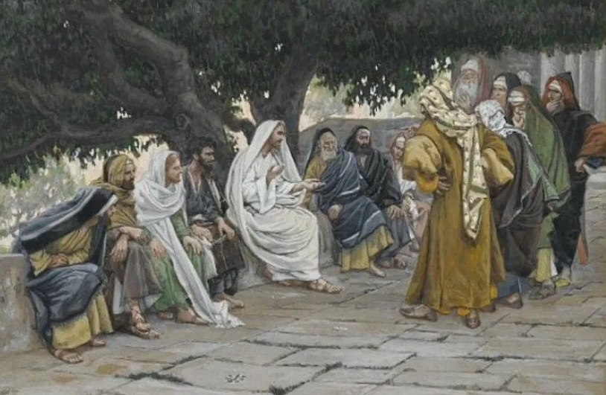
Law and Grace: Session 29 The SOM – Matthew 5:1–8:1 (Luke 6:17–49)
Divorce is Adultery?
Matthew 5:31-32
Divorce is not the focus in this session, so suffice it to say for now, that the Law of Moses did allow divorce for ‘legitimate’ cause (cf. Matthew 19:1-19).

Slide 61
Session 29 Outline
Review
Purpose, Aim, and Objective
General Overview
The Law True and Deep - Part I
Background Information
Matthew 5:21-48
Concluding Observations

Slide 62
Law and Grace: Session 29 The SOM – Matthew 5:1–8:1 (Luke 6:17–49)
What about Grace?
Ephesians 5:25-32
But under grace what is revealed isn’t about the exit, but, rather presents a love that doesn’t have the exit in mind.

Slide 63
Law and Grace: Session 29 The SOM – Matthew 5:1–8:1 (Luke 6:17–49)
THE FOUR KINDS OF LOVE IN EPHESIANS 5:25-32
²⁵ Husbands, love your wives, just as Christ also loved the church and gave Himself up for her,
❐ SACRIFICIAL LOVE
²⁶ so that He might sanctify her, having cleansed her by the washing of water with the word, ²⁷ that He might present to Himself the church in all her glory, having no spot or wrinkle or any such thing; but that she would be holy and blameless.
❐ SANCTIFYING LOVE
²⁸ So husbands ought also to love their own wives as their own bodies. He who loves his own wife loves himself; ²⁹ for no one ever hated his own flesh, but nourishes and cherishes it, just as Christ also does the church, ³⁰ because we are members of His body.
❐ CARING LOVE
³¹ For this reason a man shall leave his father and mother and shall be joined to his wife, and the two shall become one flesh. ³² This mystery is great; but I am speaking with reference to Christ and the church.
❐ BONDED LOVE

Slide 64
Law and Grace: Session 29 The SOM – Matthew 5:1–8:1 (Luke 6:17–49)
Law = What You Do And Don’t Do!

Slide 65
Law and Grace: Session 29 The SOM – Matthew 5:1–8:1 (Luke 6:17–49)

Slide 66
Law and Grace: An Overview Jim McGowan, Th.D. Sugar Land Bible Church 09-05-2021
…but grace and truth were realized through Jesus Christ - John 1:17
For the Law was given through Moses…
Special thanks to Dr. Vern Peterman for access to his insights and resources.

