Slide 1
THE RAPTURE
What and When? – Part 61
Andrew Marshall Woods, Th.M., JD., PhD.
Sr. Pastor, Sugar Land Bible Church

Slide 2
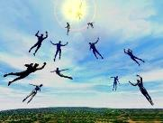
The Rapture Course Overview
What is the Rapture?
When is the Rapture?
Strengthening the Pre-Tribulational case
The opposing views
One second after the Rapture

Slide 3
The Rapture Course Overview
What is the Rapture?
When is the Rapture?
Strengthening the Pre-Tribulational case
The opposing views
One second after the Rapture

Slide 4
What is the Rapture?
An important doctrine
Distinct from the Second Advent
Catching away of all living believers (1 Thess 4:17)
Reunion (1 Thess 4:14-16)
Resurrection (1 Cor 15:50-54)
Exemption from death (1 Cor 15:51, 54-56)
Instantaneous (1 Cor 15:52)
Mystery (1 Cor 15:51)
Imminent (1 Cor 15:51; 1 Thess 4:15)
Traditional doctrine now being recovered

Slide 5
The Rapture Course Overview
What is the Rapture?
When is the Rapture?
Strengthening the Pre-Tribulational case
The opposing views
One second after the Rapture

Slide 6
When is the Rapture?
7 Arguments Favoring the Pre-Tribulation View
Tribulation's purpose concerns Israel (Jer 30:7; Dan 9:24)
No biblical reference to the church on earth during the Tribulation period (Rev 4-22)
Church is promised an exemption from divine wrath (1 Thess 1:10; 5:9; Rom 5:9; Rev 3:10; 6:17)
Rapture is imminent (1 Cor 15:51; 1 Thess 4:15)
Rapture is a comfort (1 Thess 4:18)
Antichrist cannot come to power until the restrainer is removed (2 Thess 2:6-7)
Symbolic parallels (2 Peter 2:5-9)

Slide 7
The Rapture Course Overview
What is the Rapture?
When is the Rapture?
Strengthening the Pre-Tribulational case
The opposing views
One second after the Rapture

Slide 8
Strengthening the Pre-Tribulation Case
John 14:1-4
Revelation 3:10
First Thessalonians 4‒5
Second Thessalonians 2:3a
Matthew 24‒25

Slide 9
The Rapture Course Overview
What is the Rapture?
When is the Rapture?
Strengthening the Pre-Tribulational case
The opposing views
One second after the Rapture

Slide 10
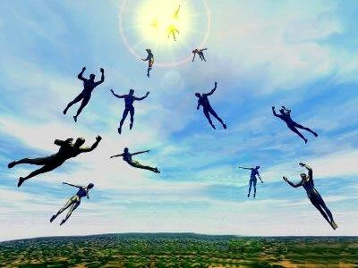
When Will the Rapture Take Place Relative to the Tribulation Period?
Pre-tribulation rapture theory
Mid-tribulation rapture theory
Post-tribulation rapture theory
Pre-wrath rapture theory
Partial rapture theory

Slide 11
The Rapture Course Overview
What is the Rapture?
When is the Rapture?
Strengthening the Pre-Tribulational case
The opposing views
One second after the Rapture

Slide 12
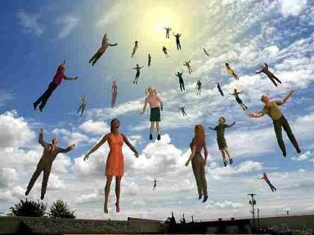
One Second After the Rapture Sugar Land Bible Church 2021
Dr. Andy Woods
Senior Pastor – Sugar Land Bible Church
President – Chafer Theological Seminary

Slide 13
One Second After the Rapture
For the believer
For the unbeliever
So what?

Slide 14
One Second After the Rapture
For the believer
For the unbeliever
So what?

Slide 15
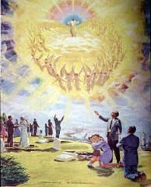
1. For the Believer
Reunion (1 Thess. 4:13-18)
Resurrection (1 Cor. 15:51, 53-55)
Reward (2 Cor. 5:10)

Slide 16
One Second After the Rapture
For the believer
For the unbeliever
So what?

Slide 17
2. For the Unbeliever
A perverted explanation to be offered
Change in God’s program
Identification of the Antichrist
Global governance
One-world religion
Signs & wonders movement
The demise of America
God’s wrath

Slide 18
2. For the Unbeliever
A perverted explanation to be offered
Change in God’s program
Identification of the Antichrist
Global governance
One-world religion
Signs & wonders movement
The demise of America
God’s wrath

Slide 19
Explanation of the missing
“The people who leave the planet during the time of Earth changes do not fit in here any longer, and they are stopping the harmony of Earth. When the time comes that perhaps 20 million people leave the planet at one time there will be a tremendous shift in consciousness for those who are remaining.”
Barbara Marciniak, Bringers of the Dawn: Teachings from the Pleiadians (Rochester, VT: Bear and Co., 1992), cited in “Rapture: The New Age Version,” <www.redmoonrising.com/newage.htm>, 29 January, 2010. See Gary Bates, Alien Intrusion: UfOs and the Evolution Connection (Powder Springs, GA: Creation Book Publishers, 2004), 367-68.

Slide 20
2. For the Unbeliever
A perverted explanation to be offered
Change in God’s program
Identification of the Antichrist
Global governance
One-world religion
Signs & wonders movement
The demise of America
God’s wrath

Slide 21
Change in God’s Program
From the Church to Israel
In the Holy Spirit’s operation

Slide 22
Change in God’s Program
From the Church to Israel
In the Holy Spirit’s operation

Slide 23
Change in God’s Program
From the Church to Israel
In the Holy Spirit’s operation

Slide 24
WORK OF THE SPIRIT IN THE OT
 | OT/GOSPELS/ACTS 1 | ACTS 2/TODAY
External vs. Internal | Upon (1 Sam. 16:13) | Within (John 14:17)
Reception of all of the Spirit at the moment of salvation? | Subsequent to salvation (Exod 31:3) | At moment of salvation (Rom 8:9)
How long is the indwelling? | Temporary indwelling (1 Sam 16:14; Ps 51:11) | Permanent indwelling (John 14:16)
Who is indwelt? | Selective indwelling (Joel 2:28) | Universal indwelling (1 Cor 12:13)

Slide 25
2. For the Unbeliever
A perverted explanation to be offered
Change in God’s program
Identification of the Antichrist
Global governance
One-world religion
Signs & wonders movement
The demise of America
God’s wrath

Slide 26
2 Thessalonians 2:6-7
⁶And you know what restrains [katechon; neuter] him now, so that in his time he will be revealed. ⁷For the mystery of lawlessness is already at work; only he who now restrains [katechōn; masculine] will do so until he is taken out of the way.

Slide 27
Revelation 13:17-18
“¹⁷ and he provides that no one will be able to buy or to sell, except the one who has the mark, either the name of the beast or the number of his name. ¹⁸ Here is wisdom. Let him who has understanding calculate the number of the beast, for the number is that of a man [anthrōpos]; and his number is six hundred and sixty-six.”

Slide 28
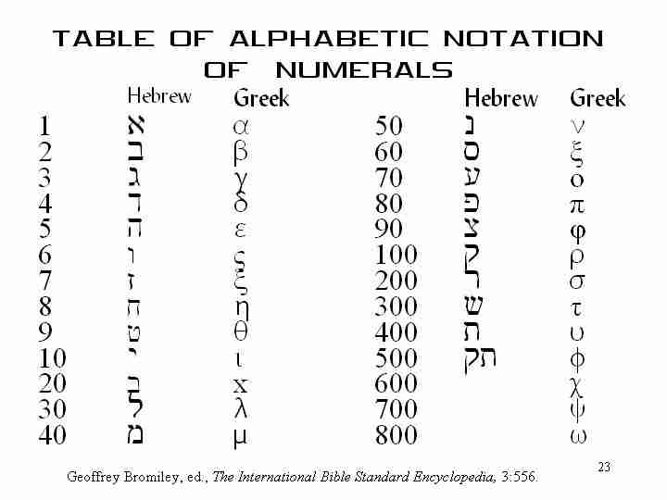

Slide 29
2. For the Unbeliever
A perverted explanation to be offered
Change in God’s program
Identification of the Antichrist
Global governance
One-world religion
Signs & wonders movement
The demise of America
God’s wrath

Slide 30
Daniel 7:23
“The fourth beast will be a fourth kingdom on the earth, which will be different from all the other kingdoms and will devour the whole earth and tread it down and crush it.”

Slide 31
2 Thessalonians 2:6-7
⁶And you know what restrains [katechon; neuter] him now, so that in his time he will be revealed. ⁷For the mystery of lawlessness is already at work; only he who now restrains [katechōn; masculine] will do so until he is taken out of the way.

Slide 32
Zechariah 5:5-11 | Revelation 17–18
Woman sitting in a basket | Woman sitting on beast, seven mountains, many waters (17: 3, 9, 15)
Emphasis on commerce (a basket for measuring grain) | Emphasis on commerce (merchant of grain, 18:13)
Woman’s name is wickedness | Woman’s name is Babylon the Great, Mother of Harlots and Abominations of the Earth
Focus on False worship (a temple is built for the woman) | Focus on False worship (17:5)
Woman is taken to Babylon | Woman is called Babylon
Hitchcock, The Second Coming of Babylon, 109.

Slide 33
2. For the Unbeliever
A perverted explanation to be offered
Change in God’s program
Identification of the Antichrist
Global governance
One-world religion
Signs & wonders movement
The demise of America
God’s wrath

Slide 34
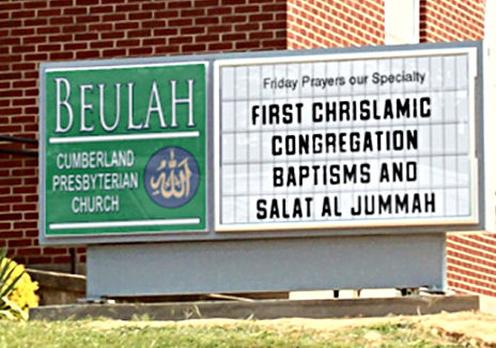
Chrislam?

Slide 35
2. For the Unbeliever
A perverted explanation to be offered
Change in God’s program
Identification of the Antichrist
Global governance
One-world religion
Signs & wonders movement
The demise of America
God’s wrath

Slide 36
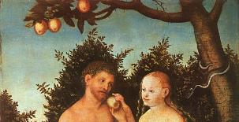
2 Thessalonians 2:9
“that is, the one whose coming is in accord with the activity of Satan, with all power and signs and false wonders.”

Slide 37
Antichrist’s Satanic Miracles (2 Thessalonians 2:9)
MIRACLE | GREEK | CHRIST’S MINISTRY
Powers | Dynamis | Matt. 11:20
Signs | Semēion | John 20:30
Wonders | Teras | Acts 2:22

Slide 38
Satanic/Demonic Miracles
Exod. 7–8
Deut. 13:1-3
Job 1:12-19; 2:7-8
1 Sam. 28?
Matt. 7:21-23; 24:24
Acts 8:9; 16:16
Gal. 1:6-9
2 Thess. 2:9
Rev. 13:3, 13, 15; 16:13-14

Slide 39
Deuteronomy 13:1-5
“¹ If a prophet or a dreamer of dreams arises among you and gives you a sign or a wonder, ² and the sign or the wonder comes true, concerning which he spoke to you, saying, ‘Let us go after other gods (whom you have not known) and let us serve them,’ ³ you shall not listen to the words of that prophet or that dreamer of dreams; for the Lord your God is testing you to find out if you love the Lord your God with all your heart and with all your soul.”

Slide 40
Deuteronomy 13:1-5
⁴ “You shall follow the Lord your God and fear Him; and you shall keep His commandments, listen to His voice, serve Him, and cling to Him. ⁵ “But that prophet or that dreamer of dreams shall be put to death, because he has counseled rebellion against the Lord your God who brought you from the land of Egypt and redeemed you from the house of slavery, to seduce you from the way in which the Lord your God commanded you to walk. So you shall purge the evil from among you.

Slide 41
Galatians 1:6-9
“⁶ I am amazed that you are so quickly deserting Him who called you by the grace of Christ, for a different gospel; ⁷ which is really not another; only there are some who are disturbing you and want to distort the gospel of Christ. ⁸ But even if we, or an angel from heaven, should preach to you a gospel contrary to what we have preached to you, he is to be accursed! ⁹ As we have said before, so I say again now, if any man is preaching to you a gospel contrary to what you received, he is to be accursed!”

Slide 42
2. For the Unbeliever
A perverted explanation to be offered
Change in God’s program
Identification of the Antichrist
Global governance
One-world religion
Signs & wonders movement
The demise of America
God’s wrath

Slide 43
God Blesses His Truth
Proverbs 14:34
“Righteousness exalts a nation, but sin is a reproach to any people.”
Ps 33:12
“Blessed is the nation whose God is the Lord.”

Slide 44
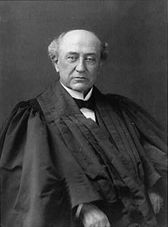
America is a “Christian Nation”
“This is historically true. From the discovery of this continent to the present hour, there is a single voice making this affirmation… These are not the sayings, declarations of private persons: they are organic utterances; they speak the voice of the entire people…These and many other matters which might be noticed, add a volume of unofficial declarations to the mass of organic utterances that this is a Christian nation.”
Church of the Holy Trinity v. U.S., 143 U.S. 457, 465, 470-71 (1892)

Slide 45
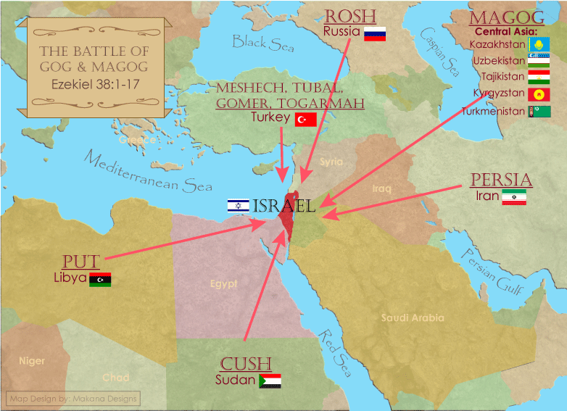

Slide 46
2. For the Unbeliever
A perverted explanation to be offered
Change in God’s program
Identification of the Antichrist
Global governance
One-world religion
Signs & wonders movement
The demise of America
God’s wrath

Slide 47
Pretribulationism is not Escapism
Trials (John 16:33)
Man’s wrath (2 Tim 3:12)
Satan’s wrath (Eph 6:11-12)
World’s wrath (John 15:18-19)

Slide 48
Promised Exemption from Divine Wrath
The promise (1 Thess 1:10; 5:9; Rom 5:9; 8:1; Rev 3:10)
Tribulation = divine wrath (Rev 6:16-17; 11:18; 15:1, 7; 16:1, 19)

Slide 49
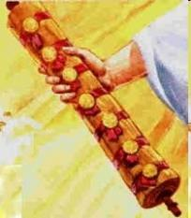
God’s Role in Redemption (Rev 5)
Seven sealed scroll (5:1)
John weeps (5:2-4)
Christ is qualified to open the scroll (5:5-6)
Christ takes the scroll (5:7)
Christ praised by various entities (5:8-14)

Slide 50
Telescoping
7th judgment releases 1st in next series
Seals: 1 2 3 4 5 6 7
Trumpets: 1 2 3 4 5 6 7
Bowls: 1 2 3 4 5 6 7

Slide 52
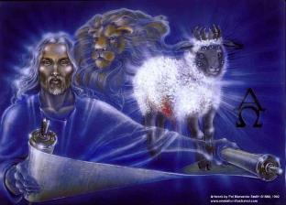
1st Six Seals (Rev 6)
6:1-2 – Advent of antichrist
6:3-4 – War
6:5-6 – Famine
6:7-8 – Death
6:9-11 – Martyrdoms
6:12-17 – Cosmic disturbances

Slide 53
Revelation 6:16-17
^{“16} and they said to the mountains and the rocks, ‘Fall on us and hide us from the sight of Him who sits on the throne, and from the wrath [orgḗ] of the Lamb; ¹⁷ for the great day of Their wrath [orgḗ] has come, and who is able to stand?’”

Slide 54
Robert L. Thomas Rev. 6:16-17
"The verb ēlethen ("has come") is aorist indicative, referring to a previous arrival of wrath, not something that is about to take place. Men see the arrival of this day at least as early as the cosmic upheavals that characterize the sixth seal (6:12-14), but upon reflection they probably recognize that it was already in effect with the death of one-fourth of the population (6:7-8), the worldwide famine (6:5-6), and the global warfare (6:3-4). The rapid sequence of all of these events could not escape notice, but the light of their true explanation does not dawn upon human consciousness until the severe phenomena of the sixth seal arrive."
Robert L. Thomas, Revelation 1–7: An Exegetical Commentary, ed. Kenneth Barker (Chicago: Moody, 1992), 457-58.

Slide 55
2 Peter 2:7-9
“⁷and if He rescued righteous Lot, oppressed by the sensual conduct of unprincipled men ⁸ (for by what he saw and heard that righteous man, while living among them, felt his righteous soul tormented day after day by their lawless deeds), ⁹ then the Lord knows how to rescue the godly from temptation, and to keep the unrighteous under punishment for the day of judgment.”

Slide 56
Genesis 19:22
“Hurry, escape there, for I cannot do anything until you arrive there.” Therefore the name of the town was called Zoar.”

Slide 57
2. For the Unbeliever
A perverted explanation to be offered
Change in God’s program
Identification of the Antichrist
Global governance
One-world religion
Signs & wonders movement
The demise of America
God’s wrath

Slide 58
One Second After the Rapture
For the believer
For the unbeliever
So what?

Slide 59
3. So What?
Uniformitarianism?
Live for Christ
Reach the lost
Believe the Gospel

Slide 60
3. So What?
Uniformitarianism?
Live for Christ
Reach the lost
Believe the Gospel

Slide 61
2 Peter 3:3-6
“³ Know this first of all, that in the last days mockers will come with their mocking, following after their own lusts, ⁴ and saying, ‘Where is the promise of His coming? For ever since the fathers fell asleep, all continues just as it was from the beginning of creation.’ ⁵ For when they maintain this, it escapes their notice that by the word of God the heavens existed long ago and the earth was formed out of water and by water. ⁶ through which the world at that time was destroyed by being flooded with water.”

Slide 62
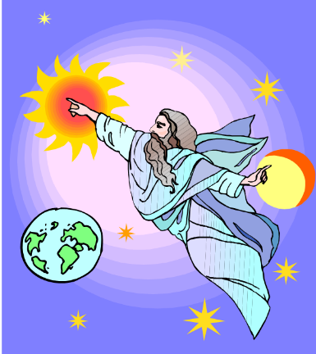
HISTORY 2 Pet. 3:5-7
Creation (5)
Flood (6-7)
God will judge again via fire

Slide 63
UNIFORMITARIANISM IS NOT BIBLICISM
 | ERA | SCRIPTURE | DISTINCTIVES
1. | CREATION | Genesis 1-2 | No death
2. | FALL | Genesis 3-6 | Death, painful pregnancy & toil, long life spans, no human government
3. | FLOOD | Genesis 7-10 | Shorter life spans, human government, one language, no nations
4. | BABEL | Genesis 11-present | No global government, multiple languages, nations, ethnicities
5. | ANTICHRIST | Rapture to 2nd Advent | Global government, restrainer removed
6. | KINGDOM | Rev. 20:1-10 | Long life spans, kingdom conditions, reality of death, renovated earth
7. | ETERNAL STATE | Rev. 21-22 | No death, new earth

Slide 64
3. So What?
Uniformitarianism?
Live for Christ
Reach the lost
Believe the Gospel

Slide 65
Romans 13:11-12
“Do this, knowing the time, that it is already the hour for you to awaken from sleep; for now salvation is nearer to us than when we believed. ¹² The night is almost gone, and the day is near. Therefore let us lay aside the deeds of darkness and put on the armor of light.”

Slide 66
Three Tenses of Salvation
PHASE | JUSTIFICATION | SANCTIFICATION | GLORIFICATION
TENSE | Past | Present | Future
SAVED FROM SIN’S: | Penalty | Power | Presence
SCRIPTURE | Eph 2:8-9; Titus 3:5 | Philip 2:12 | Rom 5:10
NATURE | Single | Dual | Single

Slide 67
Three Tenses of Salvation
PHASE | JUSTIFICATION | SANCTIFICATION | GLORIFICATION
TENSE | Past | Present | Future
SAVED FROM SIN’S: | Penalty | Power | Presence
SCRIPTURE | Eph 2:8-9; Titus 3:5 | Philip 2:12 | Rom 5:10
NATURE | Single | Dual | Single

Slide 68
3. So What?
Uniformitarianism?
Live for Christ
Reach the lost
Believe the Gospel

Slide 69
Mark 16:15
“And He said to them, ‘Go into all the world and preach the gospel to all creation.’”

Slide 70
3. So What?
Uniformitarianism?
Live for Christ
Reach the lost
Believe the Gospel

Slide 71
John 5:24
“Truly, truly, I say to you, he who hears My word, and believes Him who sent Me, has eternal life, and does not come into judgment, but has passed out of death into life.”

Slide 72
Review: One Second After the Rapture
For the believer
For the unbeliever
So what?

Slide 73
CONCLUSION

Slide 74
The Rapture Course Overview
What is the Rapture?
When is the Rapture?
Strengthening the Pre-Tribulational case
The opposing views
One second after the Rapture

