Slide 1


Genesis 10‒11
National Dispersion

Slide 2


GENESIS STRUCTURE
  Beginning of the Human race (Gen. 1‒11)
  Beginning of the Hebrew race (Gen. 12‒50)

Slide 3

GENESIS STRUCTURE
  Genesis 1-11 (four events)
    Creation (1-2)
    Fall (3-5)
    Flood (6-9)
    National dispersion (10-11)

Slide 4
GENESIS STRUCTURE
  Genesis 1-11 (four events)
    Creation (1-2)
    Fall (3-5)
    Flood (6-9)
    National dispersion (10-11)

Slide 5


Genesis 3:15
“And I will put enmity Between you and the woman, And between your seed and her seed; He shall bruise you on the head, And you shall bruise him on the heel.”

Slide 6
GENESIS STRUCTURE
  Genesis 1-11 (four events)
    Creation (1-2)
    Fall (3-5)
    Flood (6-9)
    National dispersion (10-11)

Slide 7
GENESIS STRUCTURE
  Genesis 1-11 (four events)
    Creation (1-2)
    Fall (3-5)
    Flood (6-9)
    National dispersion (10-11)

Slide 8
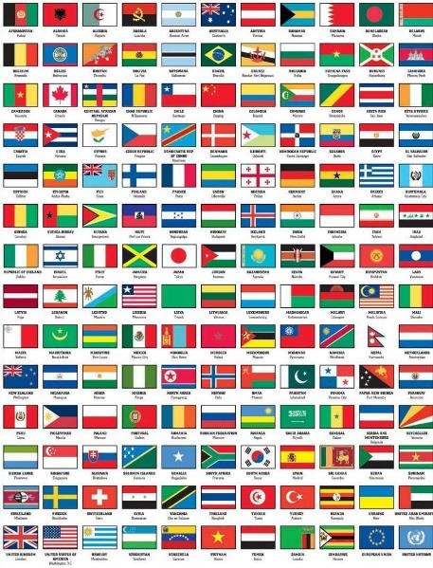
Outline
  Table of nations (Gen 10)
  Tower of Babel (Gen 11:1-9)
  Genealogy from Shem to Terah (Gen 11:10-32)

Slide 9
Outline
  Table of nations (Gen 10)
  Tower of Babel (Gen 11:1-9)
  Genealogy from Shem to Terah (Gen 11:10-32)

Slide 10
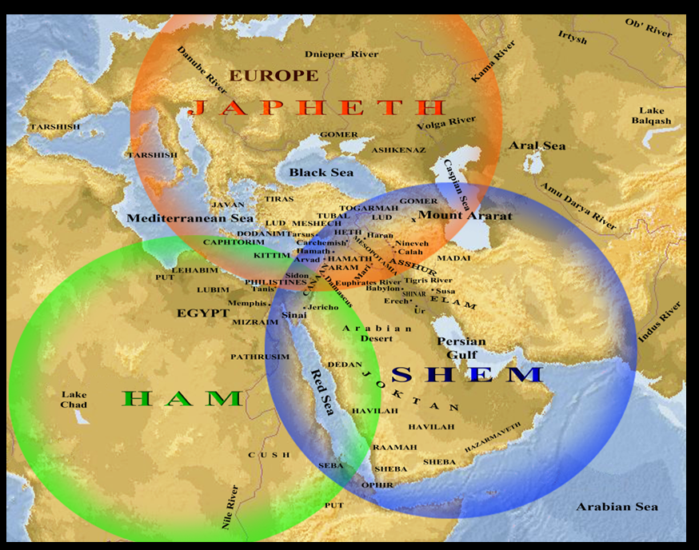

Slide 11
Genesis 10–11 Questions & Answers
  Origin of the nations?
  Dispersal of the nations?
  Corruption of the nations?
  What happened in the days of Peleg? (Gen. 10:25)
  Nimrod’s empire in Shinar? (Gen. 10:10)
  How did Nimrod get to Assyria (Gen. 10:11-12)

Slide 12
GENESIS 11:1-9
Outline
  The Former World (1-2)
  The Rebellion (3-4)
  God’s Condescension (5)
  God’s Observations (6)
  God’s Intervention (7-8a)
  The Results (8b-9)

Slide 13
GENESIS 11:1-9
Outline
  The Former World (1-2)
  The Rebellion (3-4)
  God’s Condescension (5)
  God’s Observations (6)
  God’s Intervention (7-8a)
  The Results (8b-9)

Slide 14
IV. The Rebellion v. 6
  Their universality (6a)
  Their beginning (6b)
  Their potential (6c)

Slide 15
IV. The Rebellion v. 6
  Their universality (6a)
  Their beginning (6b)
  Their potential (6c)

Slide 16
IV. The Rebellion v. 6
  Their universality (6a)
  Their beginning (6b)
  Their potential (6c)

Slide 17

Dr. Arnold G. Fruchtenbaum
The Book of Genesis, 224
“The first problem was: This is what they begin to do, meaning this is only the first act of rebellion in this one place; if left to themselves, more such acts will follow in this one place.”

Slide 18
IV. The Rebellion v. 6
  Their universality (6a)
  Their beginning (6b)
  Their potential (6c)

Slide 19

Genesis 11:6
The Lord said, “Behold, they are one people, and they all have the same language. And this is what they began to do, and now nothing which they purpose to do will be impossible for them.”

Slide 20

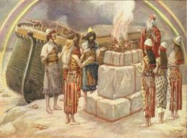
Genesis 8:21
The Lord smelled the soothing aroma; and the Lord said to Himself, “I will never again curse the ground on account of man, for the intent of man’s heart is evil from his youth; and I will never again destroy every living thing, as I have done.

Slide 21


Jeremiah 17:9
“The heart is more deceitful than all else And is desperately sick; Who can understand it?.”

Slide 22
Mark 7:20–23
²⁰ And He was saying, “That which proceeds out of the man, that is what defiles the man. ²¹ “For from within, out of the heart of men, proceed the evil thoughts, fornications, thefts, murders, adulteries, ²² deeds of coveting and wickedness, as well as deceit, sensuality, envy, slander, pride and foolishness. ²³ “All these evil things proceed from within and defile the man.”

Slide 23
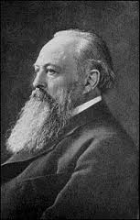
Lord Acton
“All power tends to corrupt and absolute power corrupts absolutely.”

Slide 24
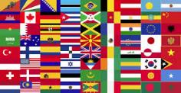
God’s Doctrine of Nations
Since Babel | Deut. 32:8; Acts 17:26
Millennium | Isaiah 2:4; 66:18; Zech. 14:16-18; Rev. 12:5; 20:3
Eternal State | Rev. 21:24, 26

Slide 25


Deuteronomy 32:8
“When the Most High gave the nations their inheritance, When He separated the sons of man, He set the boundaries of the peoples According to the number of the sons of Israel.”

Slide 26

Acts 17:26
“and He made from one man [Adam] every nation of mankind to live on all the face of the earth, having determined their appointed times and the boundaries of their habitation.”

Slide 27
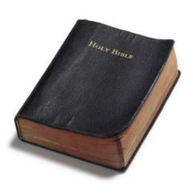
Founders’ Sources
34% Bible
8.3% Baron Montesquieu
7.9% William Blackstone
2.9% John Locke
Donald S. Lutz, The Origins of American Constitutionalism (Baton Rouge, LA: Louisiana State University Press, 1988), 141.

Slide 28

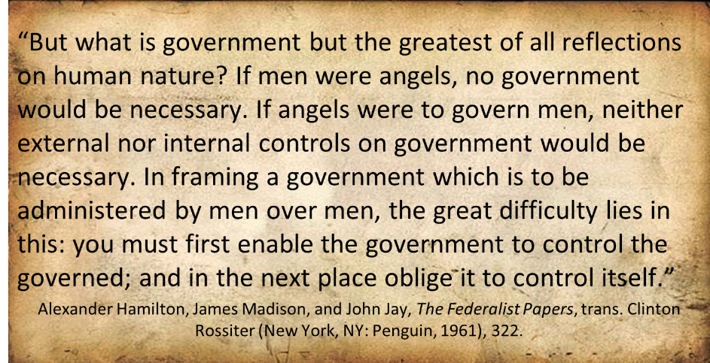
Federalist # 51

Slide 29

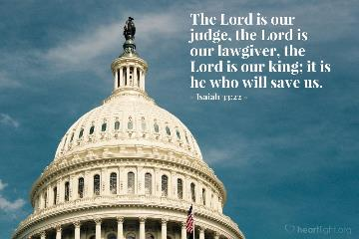
Isaiah 33:22
“For the LORD is our judge, The LORD is our lawgiver, The LORD is our king.”

Slide 30
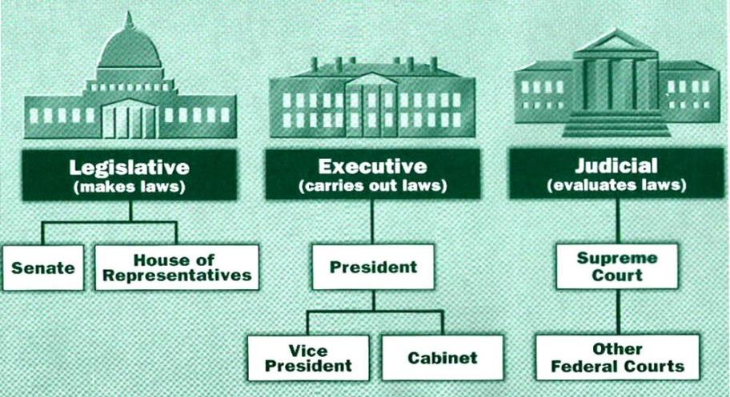

Slide 31
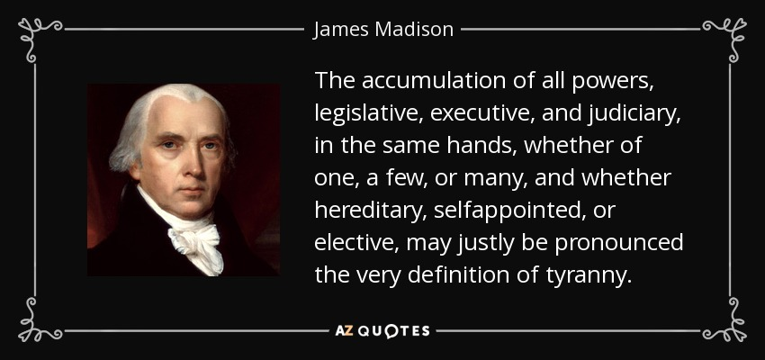
James Madison
Federalist No. 47 (January 30, 1788)

Slide 32
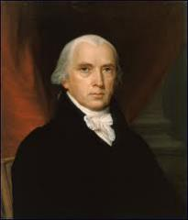
Federalist # 45
“The powers delegated by the proposed Constitution to the federal government, are few and defined. Those which are to remain in the State governments are numerous and indefinite.”
Alexander Hamilton, James Madison, and John Jay, The Federalist Papers, trans. Clinton Rossiter (New York, NY: Penguin, 1961), 292.

Slide 33
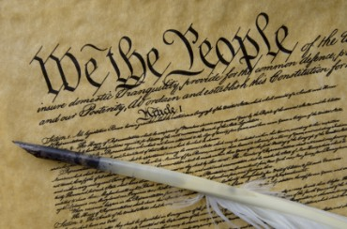
Tenth Amendment
“The powers not delegated to the United States by the Constitution nor prohibited by it to the States are reserved to the States respectively or to the people.”

Slide 34
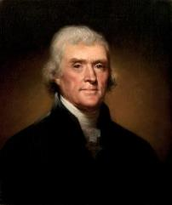
Thomas Jefferson
Kentucky Resolutions of 1798: "...in questions of power then, let no more be heard of confidence in man, but bind him down from mischief by the chains of the constitution..." (from draft)
Papers of Thomas Jefferson 30:529-556

Slide 35
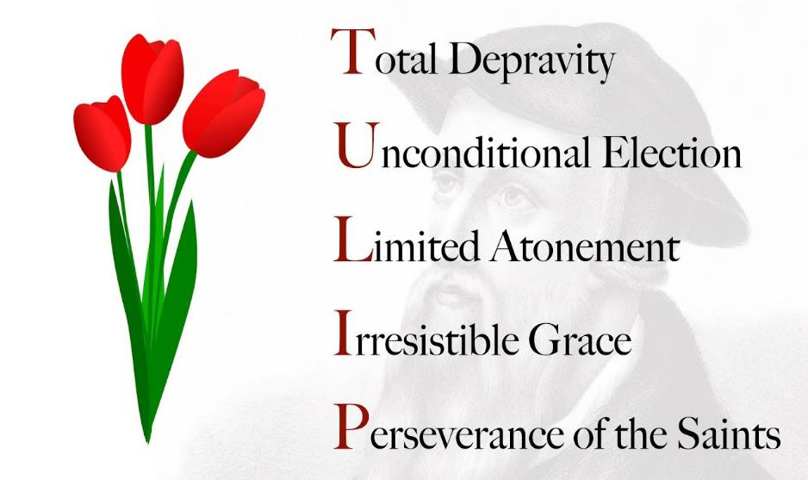

Slide 36
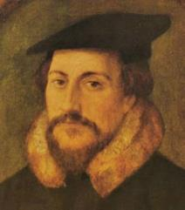
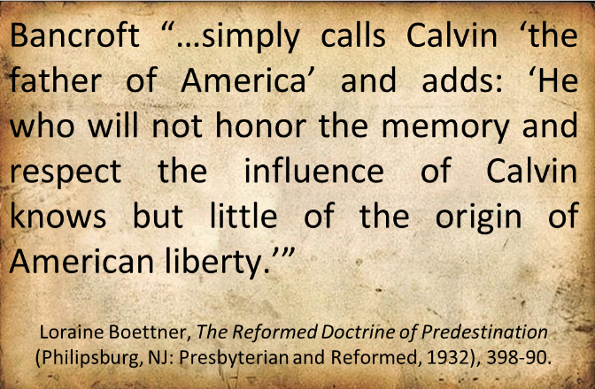
John Calvin

Slide 37

“Every tin horn dictator in the world today, every president for life, has a Bill of Rights...That’s not what makes us free; if it did, you would rather live in Zimbabwe. But you wouldn’t want to live in most countries in the world that have a Bill of Rights. What has made us free is our Constitution. Think of the word ‘constitution;’ it means structure. That’s why America’s framers debated not the Bill of Rights during the Constitutional Convention of 1787 in Philadelphia…but rather the structure of the federal government. The genius of the American constitutional system is the dispersal of power…Once power is centralized in one person, or one part [of government], a Bill of Rights is just words on paper…A constitution is about setting structure; it is not about writing the preferences of special interest groups.”
Kevin Mooney, “Supreme Court Justice Scalia: Constitution, Not Bill of Rights, Makes Us Free,” online: http://dailysignal.com /2015/05/11/supreme-court-justice-scalia-constitution-not-bill-of-rights-makes-us-free/, May 11 2015, accessed 20 January 2016.

Slide 38
The Divine Institutions
Conscience (Gen. 3:22)
Marriage and family (Gen. 1:26-28; 2:18-25)
Labor (Gen. 2:15; 3:19)
Government (Gen. 9:6)
Nationalism (Gen. 11:1-9)

Slide 39
The Divine Institutions
Conscience (Gen. 3:22)
Marriage and family (Gen. 1:26-28; 2:18-25)
Labor (Gen. 2:15; 3:19)
Government (Gen. 9:6)
Nationalism (Gen. 11:1-9)

Slide 40

Sine Qua Non of Nationhood
Common currency
Common language
Common culture
Enforceable national borders

Slide 41
Sine Qua Non of Nationhood
Common currency
Common language
Common culture
Enforceable national borders

Slide 42
Humanist Manifesto II (1973)
“We deplore the division of humankind on nationalistic grounds. We have reached a turning point in human history where the best option is to transcend the limits of national sovereignty and to move toward the building of a world community… a system of world law and world order based upon transnational federal government.”

Slide 43

Open Borders
“In a private, paid speech to a Brazilian bank on May 16, 2013, Hillary Clinton said: ‘My dream is a hemispheric common market, with open trade and open borders, some time in the future with energy that is as green and sustainable as we can get it, powering growth and opportunity for every person in the hemisphere.’ This secret speech was released as part of the Podesta emails obtained by Wikileaks.”
http://www.breitbart.com/live/third-presidential-debate-fact-check-livewire/fact-check-yes-hillary-clinton-wants-open-borders/

Slide 44
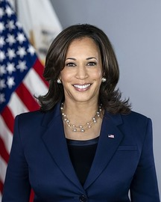
Open Borders
“‘We’re going to be increasing the requests that we’re making of our allies in the United Nations, Harris said. Harris continued, insisting that the United States must ‘institutionalize and internationalize’ the migration issues. ‘This has to be a function of an American priority…but we are a neighbor in the Western Hemisphere,’ she said, noting that she has been working with…the U.N…to obtain help from the international community.”
KAMALA HARRIS PLANS TO GET ON HER KNEES AND BEG THE U.N. TO HANDLE THE BORDER CRISIS – JEFF CHARLES, APR 26, 2021. https://redstate.com/jeffc/2021/04/26/kamala-harris-plans-to-get-on-her-knees-and-beg-the-u-n-to-handle-the-border-crisis-n369302

Slide 45
GENESIS 11:1-9
Outline
  The Former World (1-2)
  The Rebellion (3-4)
  God’s Condescension (5)
  God’s Observations (6)
  God’s Intervention (7-8a)
  The Results (8b-9)

Slide 46
V. God’s Intervention vv. 7-8a
  God’s intention (7)
    To go down (7a)
    To confound (7b)
  God’s disruption (8a)

Slide 47
V. God’s Intervention vv. 7-8a
  God’s intention (7)
    To go down (7a)
    To confound (7b)
  God’s disruption (8a)

Slide 48
V. God’s Intervention vv. 7-8a
  God’s intention (7)
    To go down (7a)
    To confound (7b)
  God’s disruption (8a)

Slide 49

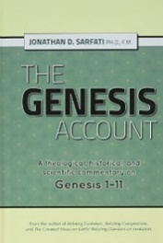
Dr. Jonanathan D. Sarfati
Jonathan D. Sarfati, The Genesis Account: A Theological, Historical, and Scientific Commentary on Genesis 1‒11 (Powder Springs, GA: Creation Book Publishers, 2015), 660.
“In this case, the account emphasizes the greatness of God and the puniness of man by comparison. Although man vainly tried to build this immensely high tower, God was still described as ‘coming down’ to see this comparatively tiny venture.”

Slide 50

Genesis 1:26-28
²⁶ Then God said, “Let Us make man in Our image, according to Our likeness; and let them rule over the fish of the sea and over the birds of the sky and over the cattle and over all the earth, and over every creeping thing that creeps on the earth.” ²⁷ God created man in His own image, in the image of God He created him; male and female He created them. ²⁸ God blessed them; and God said to them, “Be fruitful and multiply, and fill the earth, and subdue it; and rule over the fish of the sea and over the birds of the sky and over every living thing that moves on the earth.”

Slide 51
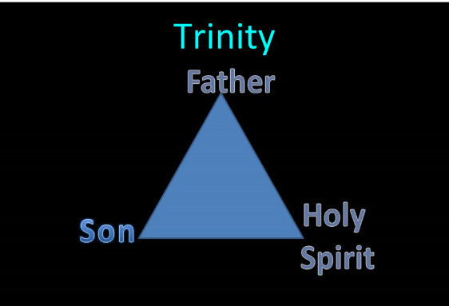
TRINITARIANISM IN GENESIS
  Gen 1:26
  Gen 3:22
  Gen 11:7
  Isa 6:8

Slide 52
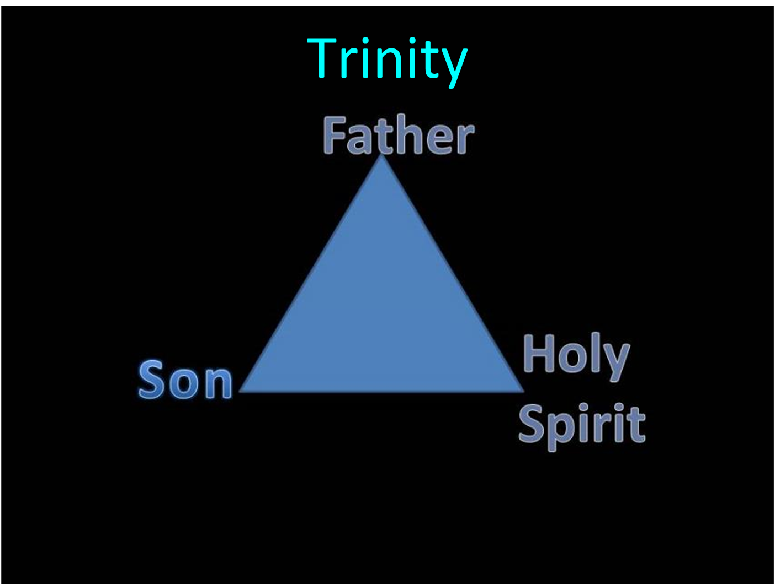

Slide 53


Slide 54
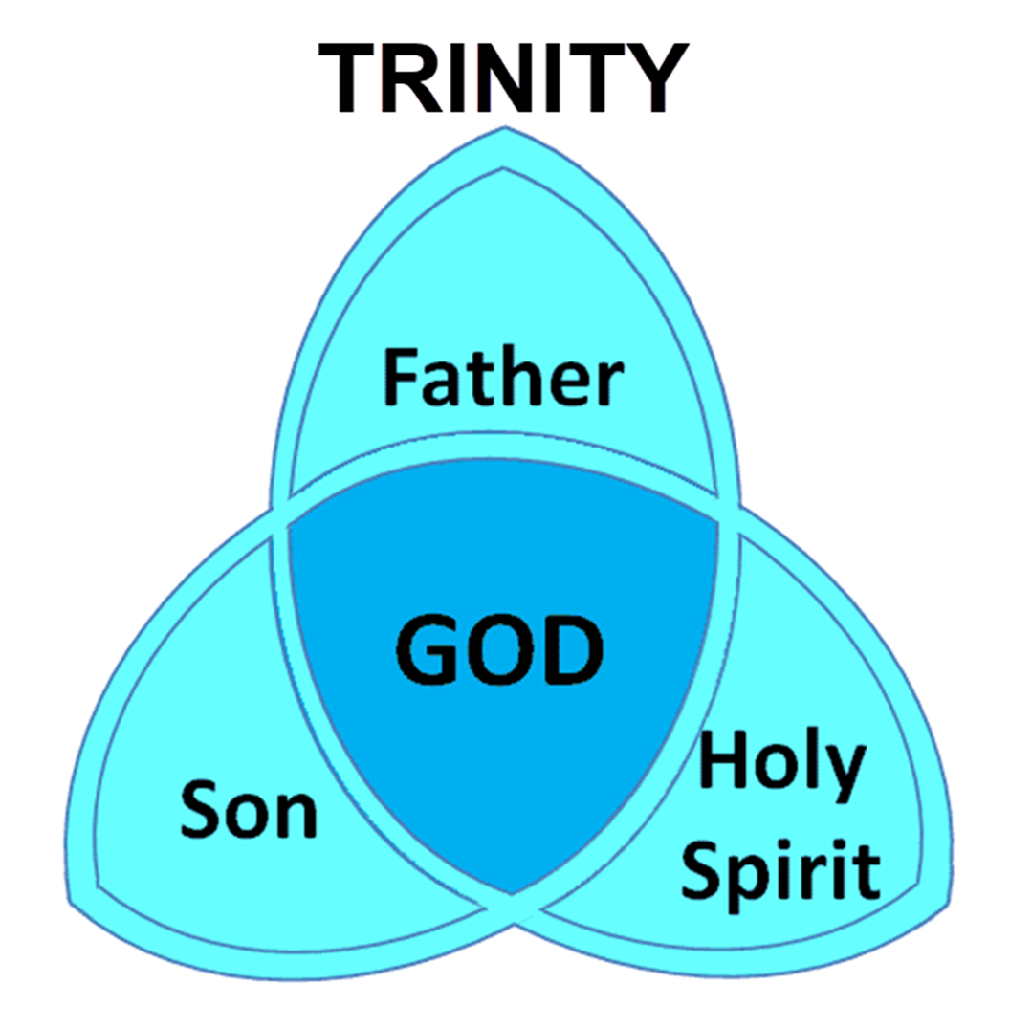
Dr. Arnold G. Fruchtenbaum
The Book of Genesis, 224
“This is a ‘going down’ for the second time. However, this time it was not to observe, but to thwart man’s purpose. Once again the word us, the plural pronoun, is used, implying a plurality in the Godhead.”

Slide 55
Dr. Jonanathan D. Sarfati
Jonathan D. Sarfati, The Genesis Account: A Theological, Historical, and Scientific Commentary on Genesis 1‒11 (Powder Springs, GA: Creation Book Publishers, 2015), 661.
“Once more, God is presented as going down to Babel, to the people who vainly thought they could build a tower up to heaven. Here we see another example of plurality in the Godhead, because YHWH says, ‘let us...’”

Slide 56
V. God’s Intervention vv. 7-8a
  God’s intention (7)
    To go down (7a)
    To confound (7b)
  God’s disruption (8a)

Slide 57


Slide 58
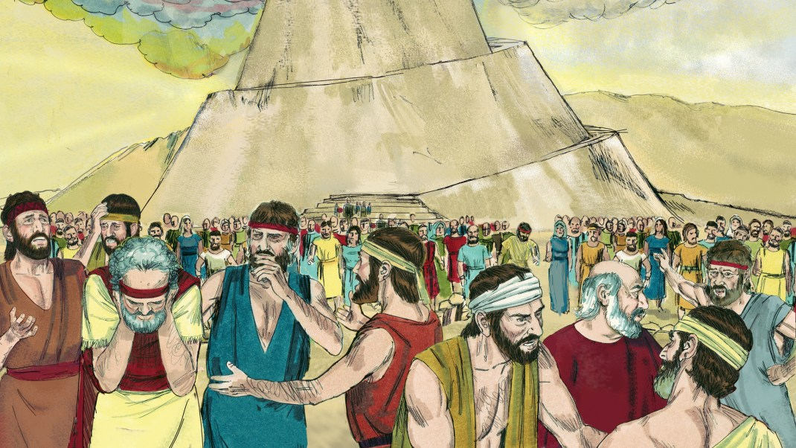
Dr. Arnold G. Fruchtenbaum
The Book of Genesis, 225
“…because Jehovah did there confound the language of all the earth. This is the origin of the multi-language world. The one-world language will be restored in the Messianic Kingdom (Zeph. 3:9).”

Slide 59
V. God’s Intervention vv. 7-8a
  God’s intention (7)
    To go down (7a)
    To confound (7b)
  God’s disruption (8a)

Slide 60

Genesis 11:1-9
¹ Now the whole earth used the same language and the same words. ² It came about as they journeyed east, that they found a plain in the land of Shinar and settled there. ³ They said to one another, “Come, let us make bricks and burn them thoroughly.” And they used brick for stone, and they used tar for mortar. ⁴ They said, “Come, let us build for ourselves a city, and a tower whose top will . . .

Slide 61

Shinar

Slide 62
Spread of the Mother-Child Cult
 | MOTHER | CHILD
Assyria | Ishtar | Tammuz
Phoenicia | Astarte | Baal
Egypt | Isis | Osirus/Horus
Greece | Aphrodite | Eros
Rome | Venus | Cupid
Asia | Cybele | Desius
India | Isi | Aswara
Roman Catholicism | Mary | Jesus
Israel | Queen of Heaven (Jer. 7:18; 44:17) | Tammuz (Ezek. 8:14-15)
Alexander Hislop, Two Babylons

Slide 63
Larkin, The Book of Revelation, 151.
“The river Euphrates, on which the city of Babylon was built, was one of the four branches into which the river that flowed through the Garden of Eden was divided, and Satan doubtless chose the site of Babylon as his headquarters from which to sally forth to tempt Adam and Eve. It was doubtless here that the Antediluvian apostasy had its source that ended in the flood. To this centre the ‘forces of Evil’ gravitated after the Flood, and ‘Babel’ was the result. This was the origin of the nations, but the nations were not scattered abroad over the earth until Satan had implanted in them the ‘Virus’ of a doctrine that has been the source of every false religion the world has ever known.”

Slide 64
“MYSTERY” IN HARLOT’S TITLE? REV. 17:5
And on her forehead a name was written: MYSTERY, BABYLON THE GREAT, THE MOTHER OF HARLOTS AND OF THE ABOMINATIONS OF THE EARTH. (KJV, NIV)
… and upon her forehead a name was written, a mystery, “BABYLON THE GREAT, THE MOTHER OF HARLOTS AND OF THE ABOMINATIONS OF THE EARTH.” (NASB)

Slide 65
GENESIS 11:1-9
Outline
  The Former World (1-2)
  The Rebellion (3-4)
  God’s Condescension (5)
  God’s Observations (6)
  God’s Intervention (7-8a)
  The Results (8b-9)

Slide 66
VI. The Results vv. 8b-9
  The abandonment (8b)
  The name (9a)
  The scattering (9b)

Slide 67
VI. The Results vv. 8b-9
  The abandonment (8b)
  The name (9a)
  The scattering (9b)

Slide 68
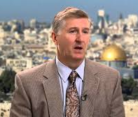
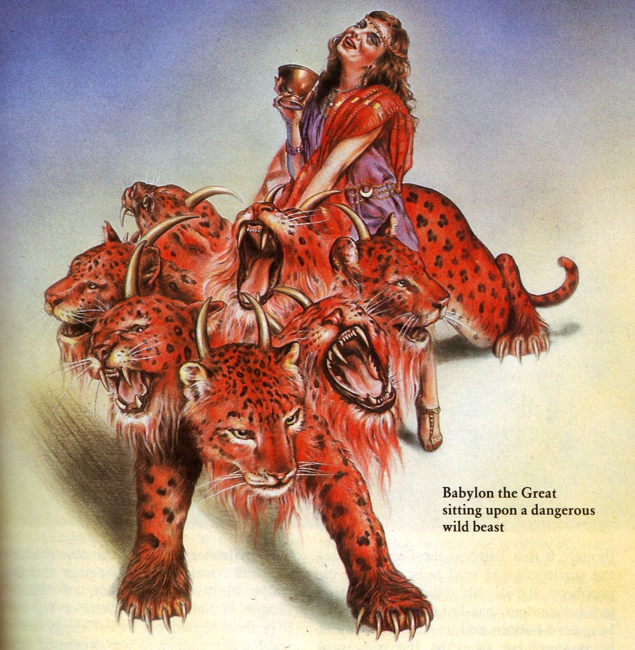
Satan’s Goal
Mark Hitchcock, The Second Coming of Babylon (Sisters, OR: Multnomah, 2003), 43.
Thus, Satan’s ambition has always been “to bring man back to Babylon un­der His rule. This will finally happen according to Revelation 17–18. Both the city of Babylon and the false religious system of Babylon will be resurrected in the end times.”

Slide 69


Revelation 17:18
“The woman whom you saw is the great city, which reigns over the kings of the earth.

Slide 70
Revelation 18:10
“standing at a distance because of the fear of her torment, saying, ‘Woe, woe, the great city, Babylon, the strong city! For in one hour your judgment has come.’”

Slide 71
Bullinger
The Apocalypse or “The Day of the Lord”, 509
“It is indeed surprising how any mistake could have been made in the identification of this woman. For the Holy Spirit first shows us her very name upon her forehead. Then, in verse 18, He tells us as plainly as words can tell anything, that ‘the woman which thou sawest is that great city, which reignest over the kings of the earth’, and chap. xvi. 19, as well as xvii. 5, identifies this city with Babylon. God says it is a ‘city.’ He does not say a system or a religion, but a ‘CITY.’”

Slide 72


Slide 73

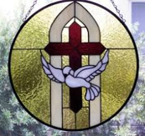
2 Thessalonians 2:6-7
⁶And you know what restrains [katechon; neuter] him now, so that in his time he will be revealed. ⁷For the mystery of lawlessness is already at work; only he who now restrains [katechōn; masculine] will do so until he is taken out of the way.

Slide 74


Slide 75

2 Thessalonians 2:3, 7
“…the man of lawlessness is revealed, the son of destruction…For the mystery of lawlessness is already at work; only he who now restrains will do so until he is taken out of the way.”

Slide 76
1 John 4:3
“and every spirit that does not confess Jesus is not from God; this is the spirit of the antichrist, of which you have heard that it is coming, and now it is already in the world.”

Slide 77

David Rockefeller cited in Memoirs, page 405.
“For more than a century ideological extremists…have seized upon well-publicized incidents…to attack the Rockefeller family for the inordinate influence they claim we wield over American political and economic institutions. Some even believe we are part of a secret cabal working against the best interests of the United States, characterizing my family and me as 'internationalists' and of conspiring with others around the world to build a more integrated global political and economic structure--one world, if you will. If that's the charge, I stand guilty, and I am proud of it.”

Slide 78
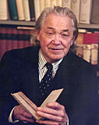
Henry Steele Commager cited in The New World Order, page 147
“The inescapable fact, traumatized by the energy crisis, the population crisis, armaments race, and so forth, is that nationalism as we have noted in the 19th and much of the 20th century is as much of an anachronism today as with States Rights when Calhoun preached it and Jefferson Davis fought for it.”

Slide 79
Henry Steele Commager cited in The New World Order, page 147
“Just as we know, or should know, that none of our domestic problems can be solved within the artificial boundaries of the states, so none of our global problems can be solved within the largely artificial boundaries of the nations.”

Slide 80
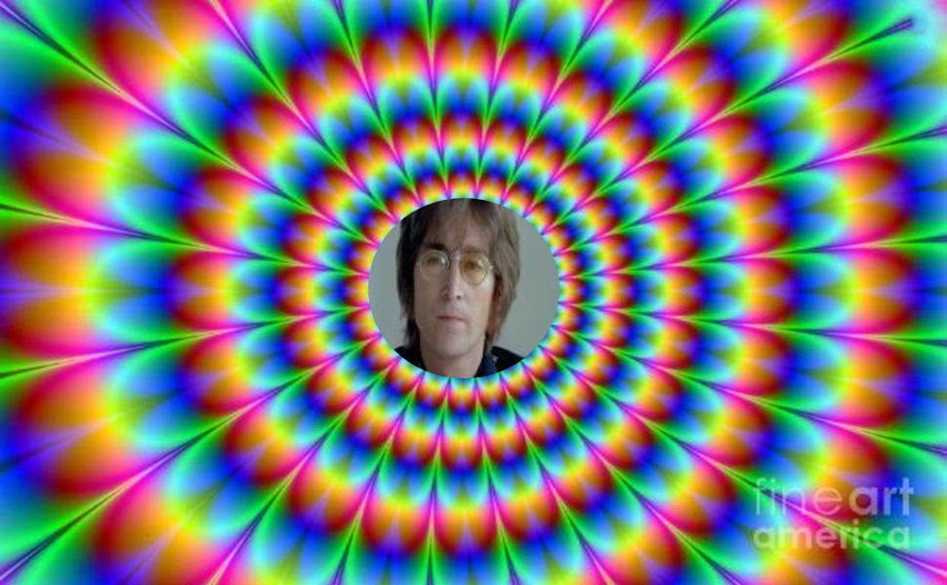
John Lennon
Song “Imagine”
… imagine a time when there will be “no countries,” “no religion,” “no heaven,” “no hell,” “no possessions,” everyone “living for today,” and the world “as one.”

Slide 81
VI. The Results vv. 8b-9
  The abandonment (8b)
  The name (9a)
  The scattering (9b)

Slide 82
Dr. Arnold G. Fruchtenbaum
The Book of Genesis, 225
“The contrast is from ‘the gate of God’ to ‘the gate of confusion.’ While the people called it Babel, the gate of God, God made a babble of it.”

Slide 83
Dr. Jonanathan D. Sarfati
Jonathan D. Sarfati, The Genesis Account: A Theological, Historical, and Scientific Commentary on Genesis 1‒11 (Powder Springs, GA: Creation Book Publishers, 2015), 662.
“That is, the rebellious people proposed to build a tower that would be a gateway to the gods in heaven, but instead, it became the site of the confusion of languages and man’s ignominious dispersion.”

Slide 84
VI. The Results vv. 8b-9
  The abandonment (8b)
  The name (9a)
  The scattering (9b)

Slide 85
Spread of the Mother-Child Cult
 | MOTHER | CHILD
Assyria | Ishtar | Tammuz
Phoenicia | Astarte | Baal
Egypt | Isis | Osirus/Horus
Greece | Aphrodite | Eros
Rome | Venus | Cupid
Asia | Cybele | Desius
India | Isi | Aswara
Roman Catholicism | Mary | Jesus
Israel | Queen of Heaven (Jer. 7:18; 44:17) | Tammuz (Ezek. 8:14-15)
Alexander Hislop, Two Babylons

Slide 86


Slide 87


Isaiah 43:1
“But now, thus says the Lord, your Creator, O Jacob, And He who formed you, O Israel, 'Do not fear, for I have redeemed you; I have called you by name; you are Mine!'”

Slide 88
UNIFORMITARIANISM IS NOT BIBLICISM
 | ERA | SCRIPTURE | DISTINCTIVES
1. | CREATION | Genesis 1-2 | No death
2. | FALL | Genesis 3-6 | Death, painful pregnancy & toil, long life spans, no human government
3. | FLOOD | Genesis 7-10 | Shorter life spans, human government, one language, no nations
4. | BABEL | Genesis 11-present | No global government, multiple languages, nations, ethnicities
5. | ANTICHRIST | Rapture to 2nd Advent | Global government, restrainer removed
6. | KINGDOM | Rev. 20:1-10 | Long life spans, kingdom conditions, reality of death, renovated earth
7. | ETERNAL STATE | Rev. 21-22 | No death, new earth

Slide 89
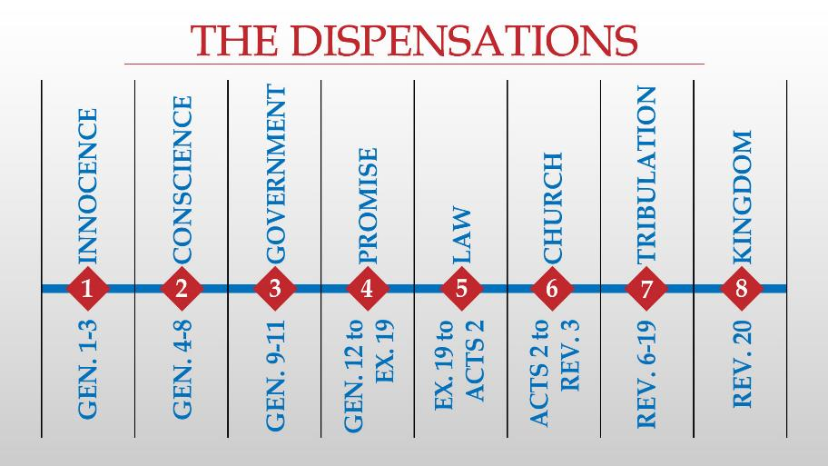

Slide 90
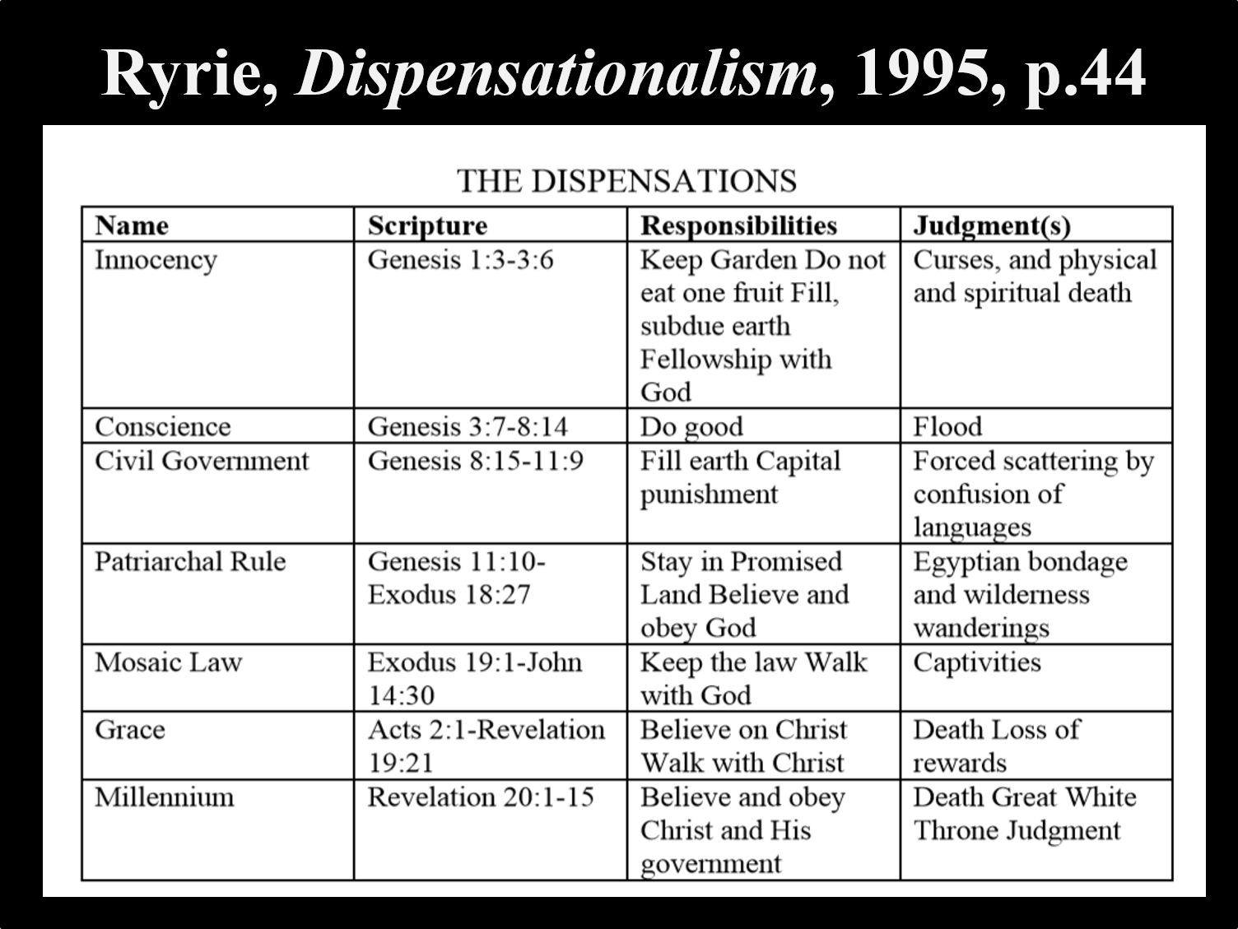

Slide 91
Conclusion

Slide 92
GENESIS 11:1-9
Outline
  The Former World (1-2)
  The Rebellion (3-4)
  God’s Condescension (5)
  God’s Observations (6)
  God’s Intervention (7-8a)
  The Results (8b-9)

Slide 93
Outline
  Table of nations (Gen 10)
  Tower of Babel (Gen 11:1-9)
  Genealogy from Shem to Terah (Gen 11:10-32)

Slide 94

“The Lord bless you and keep you; the Lord make his face shine on you and be gracious to you; the Lord turn his face toward you and give you peace.” (NIV)

