Slide 1


Genesis 10‒11
National Dispersion

Slide 2


GENESIS STRUCTURE
  Beginning of the Human race (Gen. 1‒11)
  Beginning of the Hebrew race (Gen. 12‒50)

Slide 3

GENESIS STRUCTURE
  Genesis 1-11 (four events)
    Creation (1-2)
    Fall (3-5)
    Flood (6-9)
    National dispersion (10-11)

Slide 4
GENESIS STRUCTURE
  Genesis 1-11 (four events)
    Creation (1-2)
    Fall (3-5)
    Flood (6-9)
    National dispersion (10-11)

Slide 5


Genesis 3:15
“And I will put enmity Between you and the woman, And between your seed and her seed; He shall bruise you on the head, And you shall bruise him on the heel.”

Slide 6
GENESIS STRUCTURE
  Genesis 1-11 (four events)
    Creation (1-2)
    Fall (3-5)
    Flood (6-9)
    National dispersion (10-11)

Slide 7
GENESIS STRUCTURE
  Genesis 1-11 (four events)
    Creation (1-2)
    Fall (3-5)
    Flood (6-9)
    National dispersion (10-11)

Slide 8
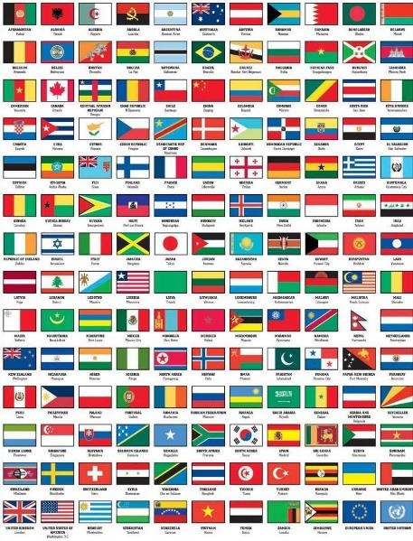
Outline
  Table of nations (Gen 10)
  Tower of Babel (Gen 11:1-9)
  Genealogy from Shem to Terah (Gen 11:10-32)

Slide 9
Outline
  Table of nations (Gen 10)
  Tower of Babel (Gen 11:1-9)
  Genealogy from Shem to Terah (Gen 11:10-32)

Slide 10
GENESIS 10
Outline
  Introduction (1)
  Japheth's line (2-5)
  Ham’s Line (6-20)
  Shem’s line (21-31)
  Conclusion (32)

Slide 11
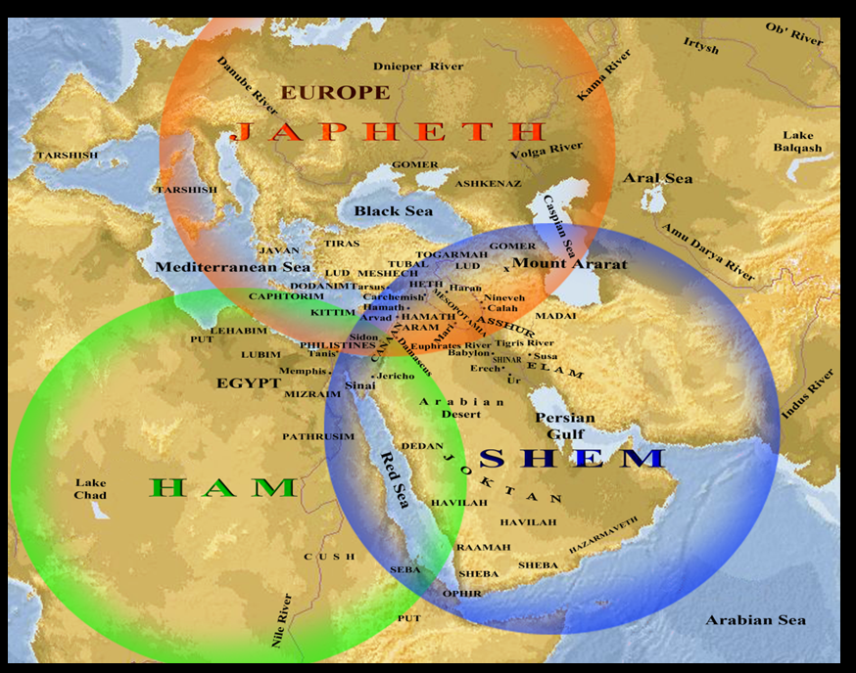

Slide 12
Genesis 10–11 Questions & Answers
  Origin of the nations?
  Dispersal of the nations?
  Corruption of the nations?
  What happened in the days of Peleg? (Gen. 10:25)
  Nimrod’s empire in Shinar? (Gen. 10:10)
  How did Nimrod get to Assyria? (Gen. 10:11-12)

Slide 13
GENESIS 11:1-9
Outline
  The Former World (1-2)
  The Rebellion (3-4)
  God’s Condescension (5)
  God’s Observations (6)
  God’s Intervention (7-8a)
  The Results (8b-9)

Slide 14
GENESIS 11:1-9
Outline
  The Former World (1-2)
  The Rebellion (3-4)
  God’s Condescension (5)
  God’s Observations (6)
  God’s Intervention (7-8a)
  The Results (8b-9)

Slide 15
I. The Former World vv.1-2
  The Philology (1)
    One language (1a)
    One speech (1b)
  The Location (2)
    In the East (2a)
    At Shinar (2b)

Slide 16
I. The Former World vv.1-2
  The Philology (1)
    One language (1a)
    One speech (1b)
  The Location (2)
    In the East (2a)
    At Shinar (2b)

Slide 17
I. The Former World vv.1-2
  The Philology (1)
    One language (1a)
    One speech (1b)
  The Location (2)
    In the East (2a)
    At Shinar (2b)

Slide 18

Dr. Arnold G. Fruchtenbaum
The Book of Genesis, 141
“A second observation is that all these ten names are Hebrew names and only make sense in Hebrew, although Jewish history has not yet begun. Moreover, all these people and their names existed prior to the Tower of Babel in Genesis 11, again indicating that the first language was the Hebrew language.”

Slide 19
I. The Former World vv.1-2
  The Philology (1)
    One language (1a)
    One speech (1b)
  The Location (2)
    In the East (2a)
    At Shinar (2b)

Slide 20
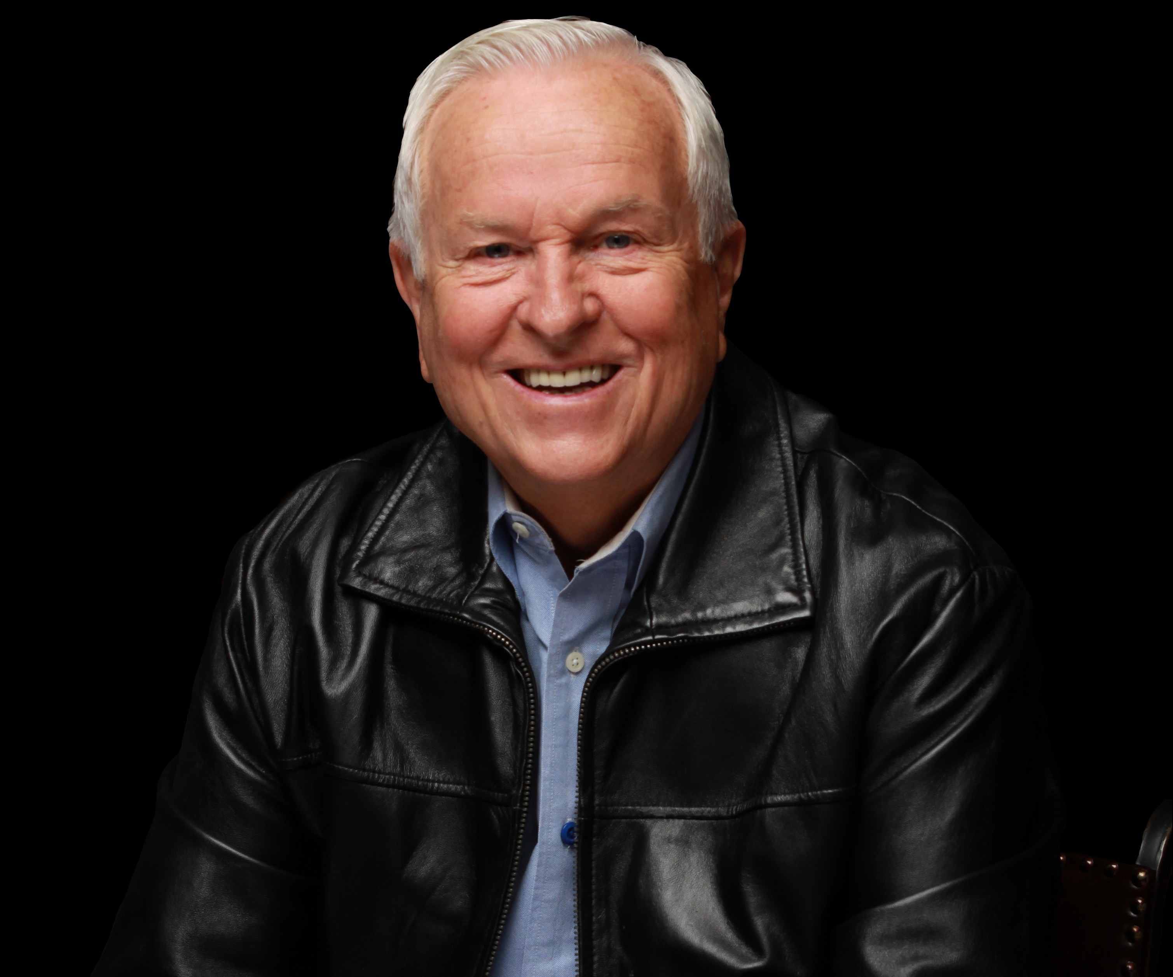
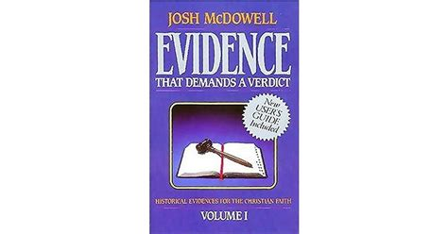
Josh McDowell
Evidence that Demands a Verdict, Vol, 1, p. 69
“According to Scripture, ‘The whole earth was of one language and one speech’ (Genesis 11:1) before the Tower of Babel. After the building of the tower and its destruction, God confounded the language of all the earth (Genesis 11:9). Many modern-day philologists attest to the likelihood of such an origin for the world's languages. Alfredo Trombetti says he can trace and prove the common origin of all languages. Max Mueller also attests to the common origin. And Otto Jespersen goes so far as to say that language was directly given to the first men by God.”

Slide 21
I. The Former World vv.1-2
  The Philology (1)
    One language (1a)
    One speech (1b)
  The Location (2)
    In the East (2a)
    At Shinar (2b)

Slide 22
I. The Former World vv.1-2
  The Philology (1)
    One language (1a)
    One speech (1b)
  The Location (2)
    In the East (2a)
    At Shinar (2b)

Slide 23
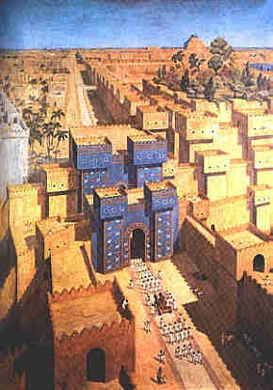
East = Babylon
Genesis 2:8
Genesis 11:2
Matthew 2:2

Slide 24
I. The Former World vv.1-2
  The Philology (1)
    One language (1a)
    One speech (1b)
  The Location (2)
    In the East (2a)
    At Shinar (2b)

Slide 25


Slide 26

Daniel 1:1-2
“¹ In the third year of the reign of Jehoiakim king of Judah, Nebuchadnezzar king of Babylon came to Jerusalem and besieged it.² The Lord gave Jehoiakim king of Judah into his hand, along with some of the vessels of the house of God; and he brought them to the land of Shinar, to the house of his god, and he brought the vessels into the treasury of his god.”

Slide 27


Slide 28
Zechariah 5:5-11
⁹ Then I lifted up my eyes and looked, and there two women were coming out with the wind in their wings; and they had wings like the wings of a stork, and they lifted up the ephah between the earth and the heavens. ¹⁰ I said to the angel who was speaking with me, “Where are they taking the ephah?” ¹¹ Then he said to me, “To build a temple for her in the land of Shinar; and when it is prepared, she will be set there on her own pedestal.”

Slide 29


Ecclesiastes 1:9
“That which has been is that which will be, And that which has been done is that which will be done. So there is nothing new under the sun.”

Slide 30
GENESIS 11:1-9
Outline
  The Former World (1-2)
  The Rebellion (3-4)
  God’s Condescension (5)
  God’s Observations (6)
  God’s Intervention (7-8a)
  The Results (8b-9)

Slide 31
II. The Rebellion vv. 3-4
  Their building (3-4b)
  Their reputation (4c)
  Their rejection of the divine command (4d)

Slide 32
II. The Rebellion vv. 3-4
  Their building (3-4b)
  Their reputation (4c)
  Their rejection of the divine command (4d)

Slide 33
Their Building vv. 3-4b
    The bricks (3)
    The city (4a)
    The tower (4b)

Slide 34
Their Building vv. 3-4b
    The bricks (3)
    The city (4a)
    The tower (4b)

Slide 35
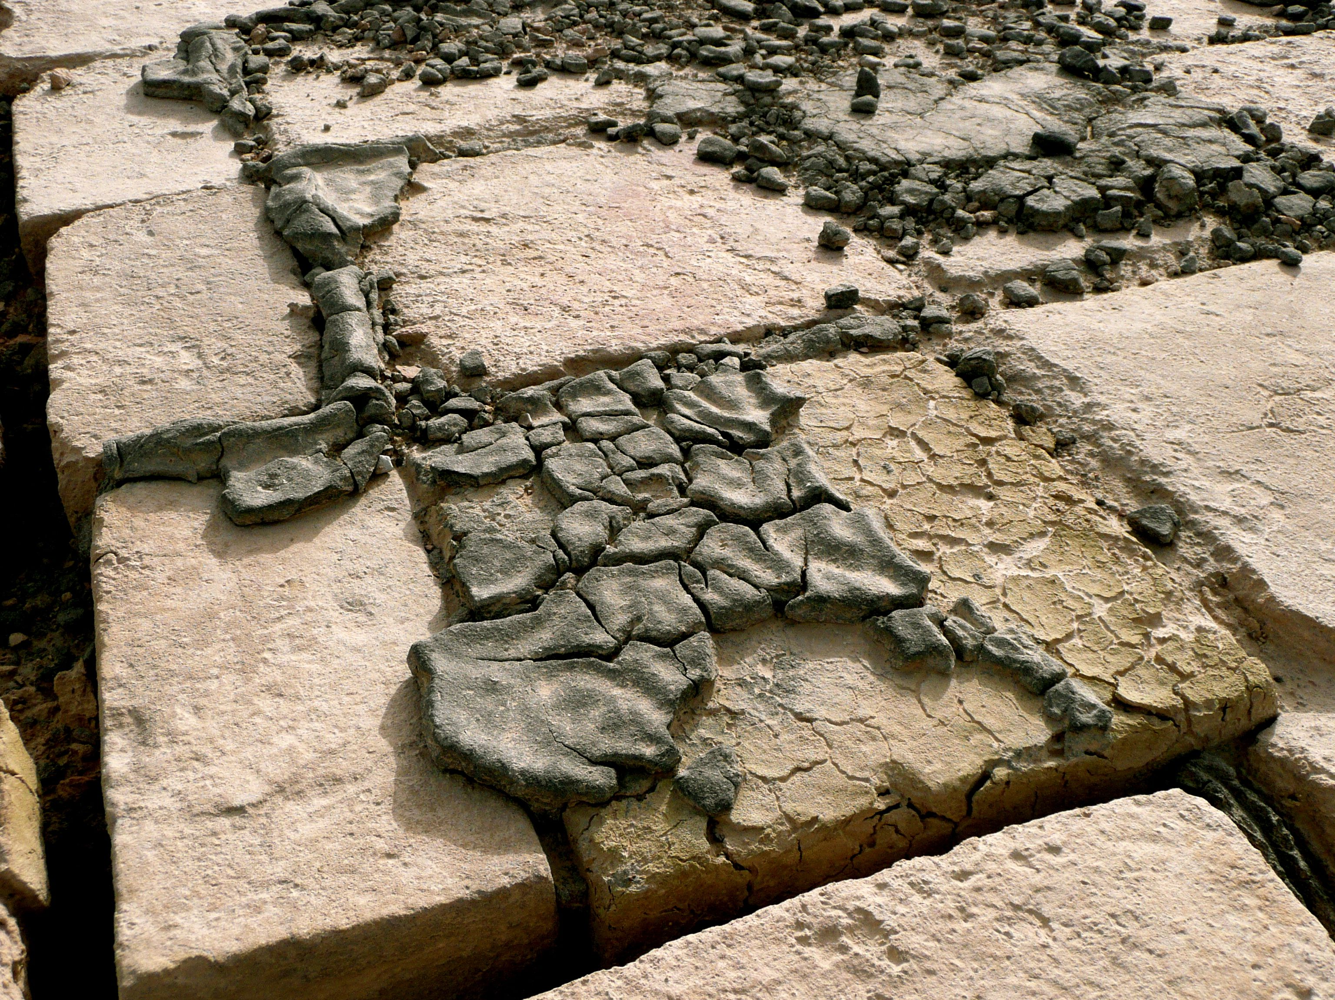
Dr. Arnold G. Fruchtenbaum
The Book of Genesis, 222
“This is to make the bricks hard and to make them last a very long time. The result was that they had brick for stone; the hardened brick was used for building in place of stone. Indeed, South Mesopotamia is rich in alluvial deposits, but is extremely short in stone.”

Slide 36
Their Building vv. 3-4b
    The bricks (3)
    The city (4a)
    The tower (4b)

Slide 37
Their Building vv. 3-4b
    The bricks (3)
    The city (4a)
    The tower (4b)

Slide 38
Dr. Arnold G. Fruchtenbaum
The Book of Genesis, 222
“They wanted to build a tower, with the goal being: whose top may reach unto heaven, or literally, ‘with its peak in the heavens.’ The very name ‘Babylon’ in Hebrew, Babel, means ‘the gate of God.’ The point is that they want to reach out to the heavens. The purpose of this tower was for the purpose of astrology, or the signs of the zodiac. This act marks the beginnings of false religion and idolatry.”

Slide 39
Spread of the Mother-Child Cult
 | Mother | Child
Assyria | Ishtar | Tammuz
Phoenicia | Astarte | Baal
Egypt | Isis | Osirus/Horus
Greece | Aphrodite | Eros
Rome | Venus | Cupid
Asia | Cybele | Desius
India | Isi | Aswara
Roman Catholicism | Mary | Jesus
Israel | Queen of Heaven (Jer. 7:18; 44:17) | Tammuz (Ezek. 8:14-15)
Alexander Hislop, Two Babylons

Slide 40
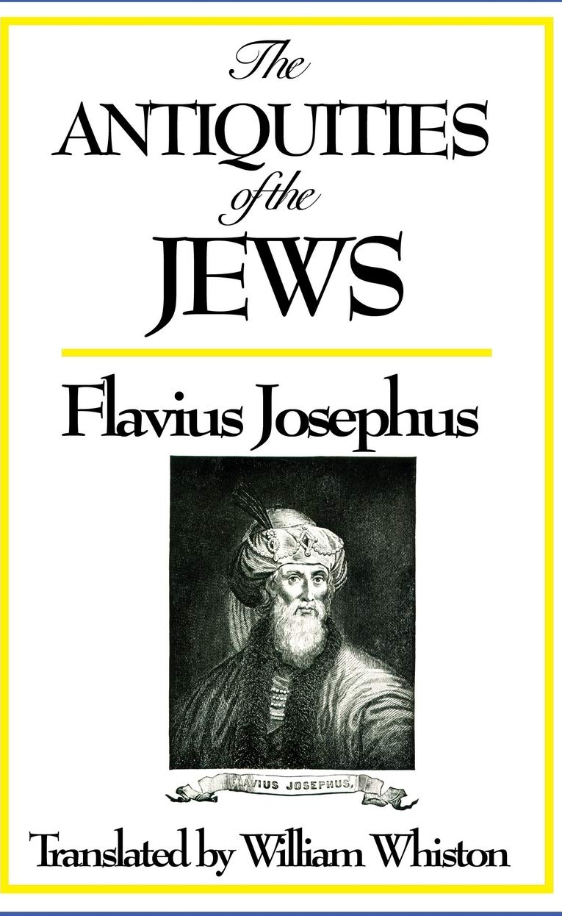
Josephus
Antiquities, 1.4.2
“He [Nimrod] persuaded them to attribute their prosperity not to God but to their own valour, and little by little transformed the state of affairs into tyranny, holding that the only way to detach men from the fear of God was by making them continuously dependent upon his power. He threatened to have his revenge on God if He wished to inundate the earth again; for he would build a tower higher than the water could reach and avenge the destruction of their forefathers.”

Slide 41
II. The Rebellion vv. 3-4
  Their building (3-4b)
  Their reputation (4c)
  Their rejection of the divine command (4d)

Slide 42

Humanist Beliefs
  The non-existence or irrelevancy of god
  Man as the center of all things
  The reality of evolution
  Man as an evolved animal rather than a special creature made in the image of his creator
  The absence of any absolute morals or values
  Confidence in the scientific method to solve the world’s problems.
John Eidsmoe, The Christian Legal Advisor, 180-87.

Slide 43
II. The Rebellion vv. 3-4
  Their building (3-4b)
  Their reputation (4c)
  Their rejection of the divine command (4d)

Slide 44

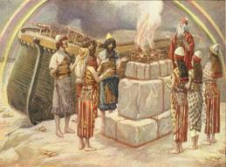
Genesis 8:21
The Lord smelled the soothing aroma; and the Lord said to Himself, “I will never again curse the ground on account of man, for the intent of man’s heart is evil from his youth; and I will never again destroy every living thing, as I have done.

Slide 45
GENESIS 11:1-9
Outline
  The Former World (1-2)
  The Rebellion (3-4)
  God’s Condescension (5)
  God’s Observations (6)
  God’s Intervention (7-8a)
  The Results (8b-9)

Slide 46

Benjamin Franklin
June 28, 1787; quoted by Albert Henry Smyth, ed., The Writings of Benjamin Franklin (New York: The Macmillan Company, 1905-7), IX:600-1.
“I firmly believe this; and I also believe that, without his concurring aid, we shall succeed in this political building no better than the builders of Babel.... I therefore beg leave to move that, henceforth, prayers imploring the assistance of heaven and its blessings on our deliberations be held in this assembly every morning before we proceed to business, and that one or more of the clergy of this city be requested to officiate in that service.”

Slide 47
Dr. Arnold G. Fruchtenbaum
The Book of Genesis, 223-224
“Here the author uses anthropomorphic satire, to satirize what puny man is trying to do. No matter how high man towered, God still has to come down to see it and to get a better look. This shows that God is interested in the affairs of men, but God is so high and man is so puny that God had to come down to get a better look.”

Slide 48

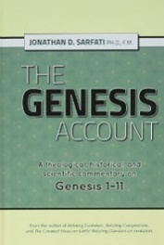
Dr. Jonanathan D. Sarfati
Jonathan D. Sarfati, The Genesis Account: A Theological, Historical, and Scientific Commentary on Genesis 1‒11 (Powder Springs, GA: Creation Book Publishers, 2015), 660.
“In this case, the account emphasizes the greatness of God and the puniness of man by comparison. Although man vainly tried to build this immensely high tower, God was still described as ‘coming down’ to see this comparatively tiny venture.”

Slide 49
GENESIS 11:1-9
Outline
  The Former World (1-2)
  The Rebellion (3-4)
  God’s Condescension (5)
  God’s Observations (6)
  God’s Intervention (7-8a)
  The Results (8b-9)

Slide 50
IV. The Rebellion v. 6
  Their universality (6a)
  Their beginning (6b)
  Their potential (6c)

Slide 51
IV. The Rebellion v. 6
  Their universality (6a)
  Their beginning (6b)
  Their potential (6c)

Slide 52
IV. The Rebellion v. 6
  Their universality (6a)
  Their beginning (6b)
  Their potential (6c)

Slide 53
Dr. Arnold G. Fruchtenbaum
The Book of Genesis, 224
“The first problem was: This is what they begin to do, meaning this is only the first act of rebellion in this one place; if left to themselves, more such acts will follow in this one place.”

Slide 54
IV. The Rebellion v. 6
  Their universality (6a)
  Their beginning (6b)
  Their potential (6c)

Slide 55

Genesis 11:6
The Lord said, “Behold, they are one people, and they all have the same language. And this is what they began to do, and now nothing which they purpose to do will be impossible for them.”

Slide 56
Genesis 8:21
The Lord smelled the soothing aroma; and the Lord said to Himself, “I will never again curse the ground on account of man, for the intent of man’s heart is evil from his youth; and I will never again destroy every living thing, as I have done.

Slide 57


Jeremiah 17:9
“The heart is more deceitful than all else And is desperately sick; Who can understand it?.”

Slide 58
Mark 7:20–23
²⁰ And He was saying, “That which proceeds out of the man, that is what defiles the man. ²¹ “For from within, out of the heart of men, proceed the evil thoughts, fornications, thefts, murders, adulteries, ²² deeds of coveting and wickedness, as well as deceit, sensuality, envy, slander, pride and foolishness. ²³ “All these evil things proceed from within and defile the man.”

Slide 59
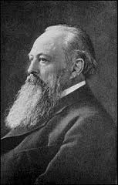
Lord Acton
“All power tends to corrupt and absolute power corrupts absolutely.”

Slide 60

God’s Doctrine of Nations
Since Babel | Deut. 32:8; Acts 17:26
Millennium | Isaiah 2:4; 66:18; Zech. 14:16-18; Rev. 12:5; 20:3
Eternal State | Rev. 21:24, 26

Slide 61


Deuteronomy 32:8
“When the Most High gave the nations their inheritance, When He separated the sons of man, He set the boundaries of the peoples According to the number of the sons of Israel.”

Slide 62

Acts 17:26
“and He made from one man [Adam] every nation of mankind to live on all the face of the earth, having determined their appointed times and the boundaries of their habitation,”

Slide 63
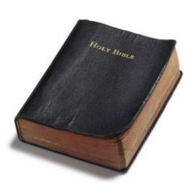
Founders’ Sources
34% Bible
8.3% Baron Montesquieu
7.9% William Blackstone
2.9% John Locke
Donald S. Lutz, The Origins of American Constitutionalism (Baton Rouge, LA: Louisiana State University Press, 1988), 141.

Slide 64

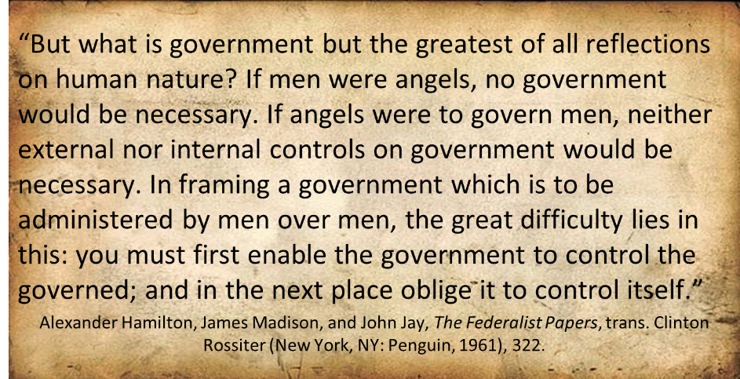
Federalist # 51

Slide 65

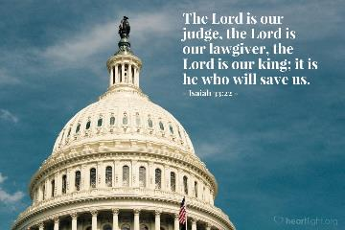
Isaiah 33:22
“For the LORD is our judge, The LORD is our lawgiver, The LORD is our king.”

Slide 66
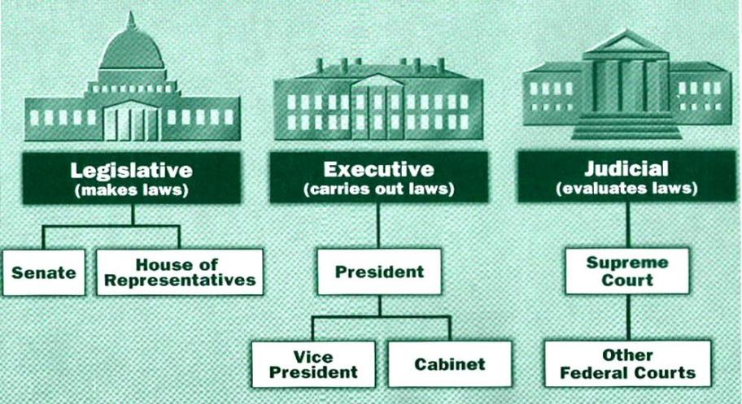

Slide 67
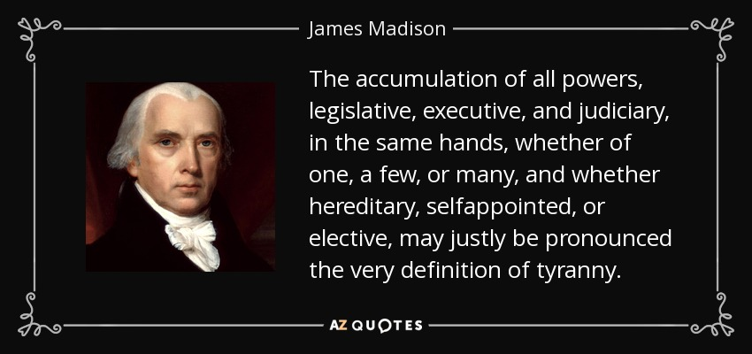
James Madison
Federalist No. 47 (January 30, 1788)

Slide 68
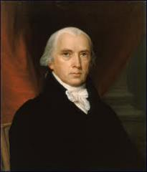
Federalist # 45
“The powers delegated by the proposed Constitution to the federal government, are few and defined. Those which are to remain in the State governments are numerous and indefinite.”
Alexander Hamilton, James Madison, and John Jay, The Federalist Papers, trans. Clinton Rossiter (New York, NY: Penguin, 1961), 292.

Slide 69
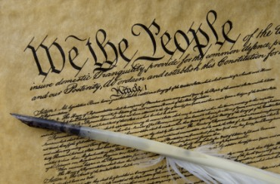
Tenth Amendment
“The powers not delegated to the United States by the Constitution nor prohibited by it to the States are reserved to the States respectively or to the people.”

Slide 70
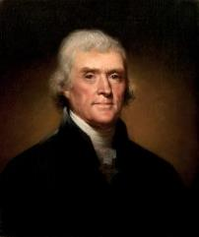
Thomas Jefferson
Kentucky Resolutions of 1798: "...in questions of power then, let no more be heard of confidence in man, but bind him down from mischief by the chains of the constitution..." (from draft)
Papers of Thomas Jefferson 30:529-556

Slide 71
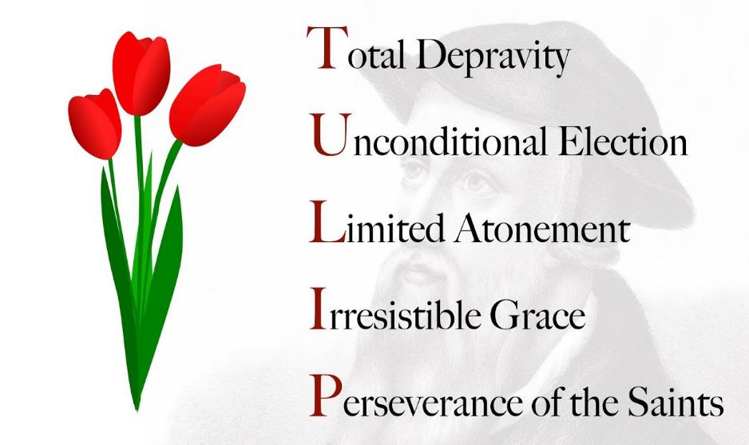

Slide 72
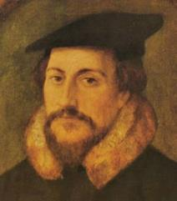
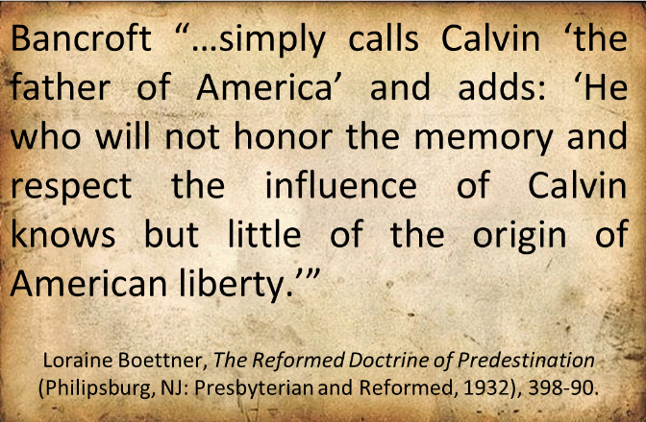
John Calvin

Slide 73

“Every tin horn dictator in the world today, every president for life, has a Bill of Rights,”...“That’s not what makes us free; if it did, you would rather live in Zimbabwe. But you wouldn’t want to live in most countries in the world that have a Bill of Rights. What has made us free is our Constitution. Think of the word ‘constitution;’ it means structure.” “That’s why America’s framers debated not the Bill of Rights during the Constitutional Convention of 1787 in Philadelphia,” he said, “but rather the structure of the federal government.” “The genius of the American constitutional system is the dispersal of power,” he said. “Once power is centralized in one person, or one part [of government], a Bill of Rights is just words on paper.”...“A constitution is about setting structure; it is not about writing the preferences of special interest groups,” he said.
Kevin Mooney, “Supreme Court Justice Scalia: Constitution, Not Bill of Rights, Makes Us Free,” online: http://dailysignal.com /2015/05/11/supreme-court-justice-scalia-constitution-not-bill-of-rights-makes-us-free/, May 11 2015, accessed 20 January 2016.

Slide 74
The Divine Institutions
Conscience (Gen. 3:22)
Marriage and family (Gen. 1:26-28; 2:18-25)
Labor (Gen. 2:15; 3:19)
Government (Gen. 9:6)
Nationalism (Gen. 11:1-9)

Slide 75
The Divine Institutions
Conscience (Gen. 3:22)
Marriage and family (Gen. 1:26-28; 2:18-25)
Labor (Gen. 2:15; 3:19)
Government (Gen. 9:6)
Nationalism (Gen. 11:1-9)

Slide 76

Sine Qua Non of Nationhood
Common currency
Common language
Common culture
Enforceable national borders

Slide 77
Sine Qua Non of Nationhood
Common currency
Common language
Common culture
Enforceable national borders

Slide 78
Humanist Manifesto II (1973)
“We deplore the division of humankind on nationalistic grounds. We have reached a turning point in human history where the best option is to transcend the limits of national sovereignty and to move toward the building of a world community… a system of world law and world order based upon transnational federal government.”

Slide 79

Open Borders
“In a private, paid speech to a Brazilian bank on May 16, 2013, Hillary Clinton said: ‘My dream is a hemispheric common market, with open trade and open borders, some time in the future with energy that is as green and sustainable as we can get it, powering growth and opportunity for every person in the hemisphere.’ This secret speech was released as part of the Podesta emails obtained by Wikileaks.”
http://www.breitbart.com/live/third-presidential-debate-fact-check-livewire/fact-check-yes-hillary-clinton-wants-open-borders/

Slide 80
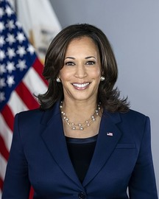
Open Borders
“‘We’re going to be increasing the requests that we’re making of our allies in the United Nations, Harris said. Harris continued, insisting that the United States must ‘institutionalize and internationalize’ the migration issues. ‘This has to be a function of an American priority…but we are a neighbor in the Western Hemisphere,’ she said, noting that she has been working with…the U.N…to obtain help from the international community.”
KAMALA HARRIS PLANS TO GET ON HER KNEES AND BEG THE U.N. TO HANDLE THE BORDER CRISIS – JEFF CHARLES, APR 26, 2021. https://redstate.com/jeffc/2021/04/26/kamala-harris-plans-to-get-on-her-knees-and-beg-the-u-n-to-handle-the-border-crisis-n369302

Slide 81
GENESIS 11:1-9
Outline
  The Former World (1-2)
  The Rebellion (3-4)
  God’s Condescension (5)
  God’s Observations (6)
  God’s Intervention (7-8a)
  The Results (8b-9)

Slide 82
V. God’s Intervention vv. 7-8a
  God’s intention (7)
    To go down (7a)
    To confound (7b)
  God’s disruption (8a)

Slide 83
V. God’s Intervention vv. 7-8a
  God’s intention (7)
    To go down (7a)
    To confound (7b)
  God’s disruption (8a)

Slide 84
V. God’s Intervention vv. 7-8a
  God’s intention (7)
    To go down (7a)
    To confound (7b)
  God’s disruption (8a)

Slide 85

Genesis 1:26-28
²⁶ Then God said, “Let Us make man in Our image, according to Our likeness; and let them rule over the fish of the sea and over the birds of the sky and over the cattle and over all the earth, and over every creeping thing that creeps on the earth.” ²⁷ God created man in His own image, in the image of God He created him; male and female He created them. ²⁸ God blessed them; and God said to them, “Be fruitful and multiply, and fill the earth, and subdue it; and rule over the fish of the sea and over the birds of the sky and over every living thing that moves on the earth.”

Slide 86
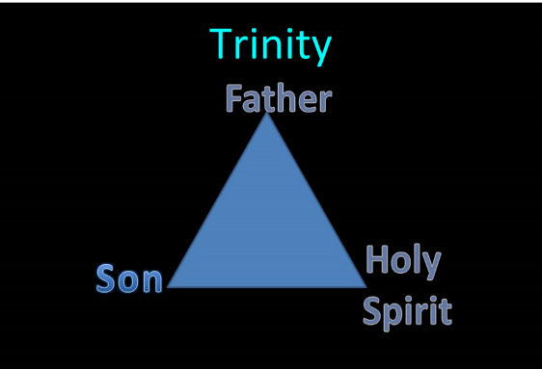
TRINITARIANISM IN GENESIS
  Gen 1:26
  Gen 3:22
  Gen 11:7
  Isa 6:8

Slide 87
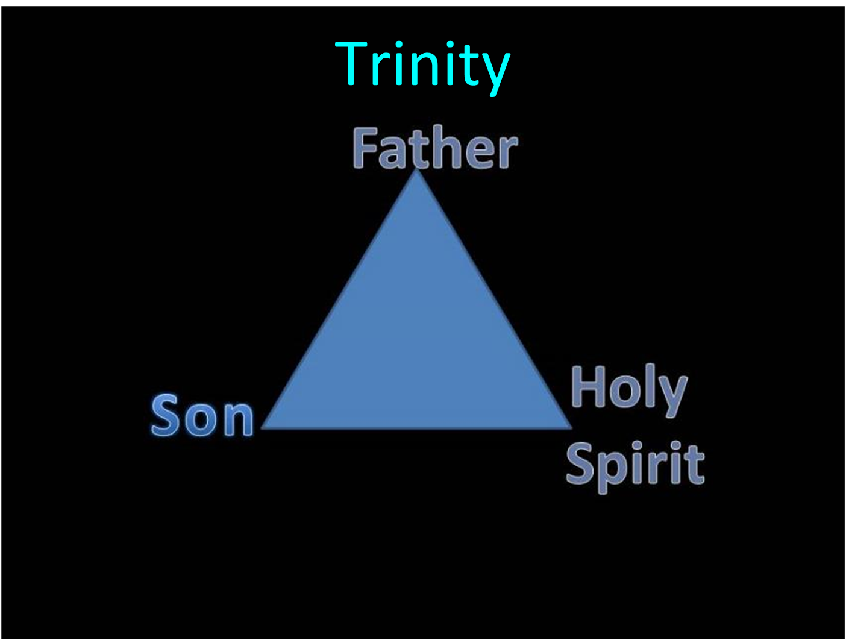

Slide 88


Slide 89
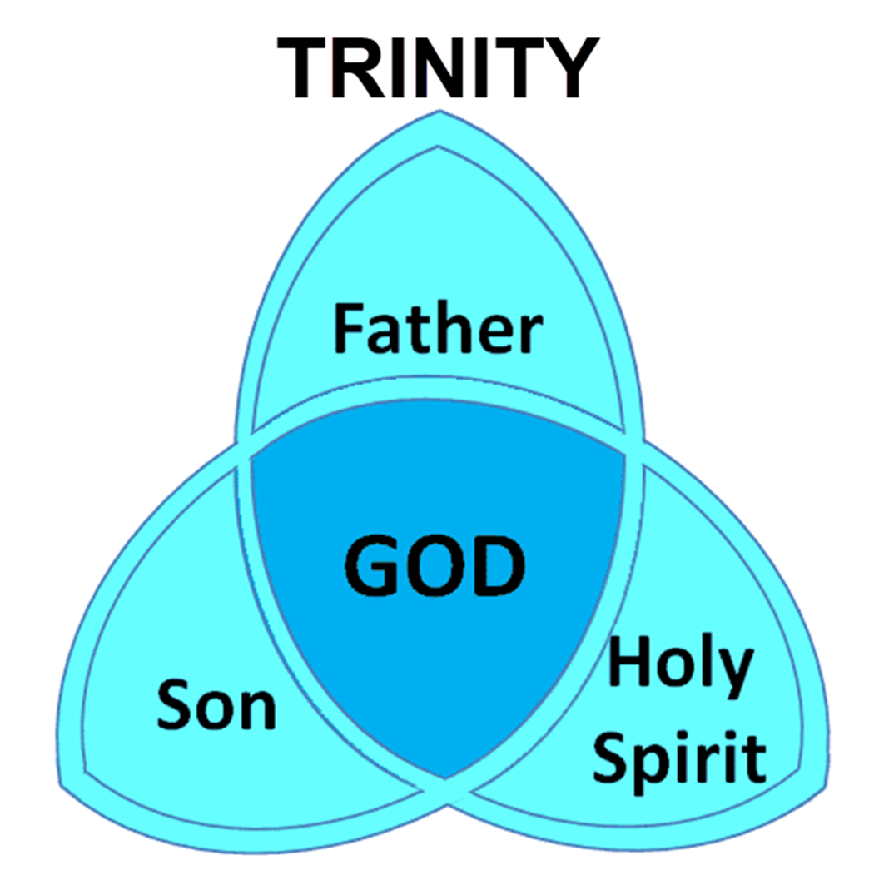
Dr. Arnold G. Fruchtenbaum
The Book of Genesis, 224
“This is a ‘going down’ for the second time. However, this time it was not to observe, but to thwart man’s purpose. Once again the word us, the plural pronoun, is used, implying a plurality in the Godhead.”

Slide 90
Dr. Jonanathan D. Sarfati
Jonathan D. Sarfati, The Genesis Account: A Theological, Historical, and Scientific Commentary on Genesis 1‒11 (Powder Springs, GA: Creation Book Publishers, 2015), 661.
“Once more, God is presented as going down to Babel, to the people who vainly thought they could build a tower up to heaven. Here we see another example of plurality in the Godhead, because YHWH says, ‘let us...’”

Slide 91
V. God’s Intervention vv. 7-8a
  God’s intention (7)
    To go down (7a)
    To confound (7b)
  God’s disruption (8a)

Slide 92


Slide 93
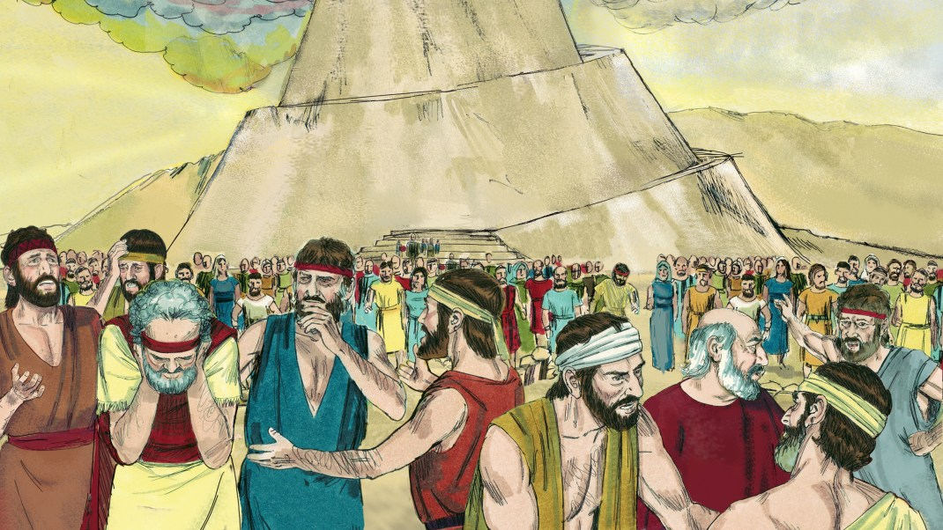
Dr. Arnold G. Fruchtenbaum
The Book of Genesis, 225
“…because Jehovah did there confound the language of all the earth. This is the origin of the multi-language world. The one-world language will be restored in the Messianic Kingdom (Zeph. 3:9).”

Slide 94
V. God’s Intervention vv. 7-8a
  God’s intention (7)
    To go down (7a)
    To confound (7b)
  God’s disruption (8a)

Slide 95

Genesis 11:1-9
¹ Now the whole earth used the same language and the same words. ² It came about as they journeyed east, that they found a plain in the land of Shinar and settled there. ³ They said to one another, “Come, let us make bricks and burn them thoroughly.” And they used brick for stone, and they used tar for mortar. ⁴ They said, “Come, let us build for ourselves a city, and a tower whose top will . . .

Slide 96
Shinar

Slide 97
Spread of the Mother-Child Cult
 | MOTHER | CHILD
Assyria | Ishtar | Tammuz
Phoenicia | Astarte | Baal
Egypt | Isis | Osirus/Horus
Greece | Aphrodite | Eros
Rome | Venus | Cupid
Asia | Cybele | Desius
India | Isi | Aswara
Roman Catholicism | Mary | Jesus
Israel | Queen of Heaven (Jer. 7:18; 44:17) | Tammuz (Ezek. 8:14-15)
Alexander Hislop, Two Babylons

Slide 98
Larkin, The Book of Revelation, 151.
“The river Euphrates, on which the city of Babylon was built, was one of the four branches into which the river that flowed through the Garden of Eden was divided, and Satan doubtless chose the site of Babylon as his headquarters from which to sally forth to tempt Adam and Eve. It was doubtless here that the Antediluvian apostasy had its source that ended in the flood. To this centre the ‘forces of Evil’ gravitated after the Flood, and ‘Babel’ was the result. This was the origin of the nations, but the nations were not scattered abroad over the earth until Satan had implanted in them the ‘Virus’ of a doctrine that has been the source of every false religion the world has ever known.”

Slide 99
“MYSTERY” IN HARLOT’S TITLE? REV. 17:5
And on her forehead a name was written: MYSTERY, BABYLON THE GREAT, THE MOTHER OF HARLOTS AND OF THE ABOMINATIONS OF THE EARTH. (KJV, NIV)
… and upon her forehead a name was written, a mystery, “BABYLON THE GREAT, THE MOTHER OF HARLOTS AND OF THE ABOMINATIONS OF THE EARTH.” (NASB)

Slide 100
GENESIS 11:1-9
Outline
  The Former World (1-2)
  The Rebellion (3-4)
  God’s Condescension (5)
  God’s Observations (6)
  God’s Intervention (7-8a)
  The Results (8b-9)

Slide 101
VI. The Results vv. 8b-9
  The abandonment (8b)
  The name (9a)
  The scattering (9b)

Slide 102
VI. The Results vv. 8b-9
  The abandonment (8b)
  The name (9a)
  The scattering (9b)

Slide 103
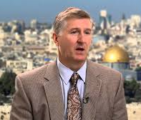
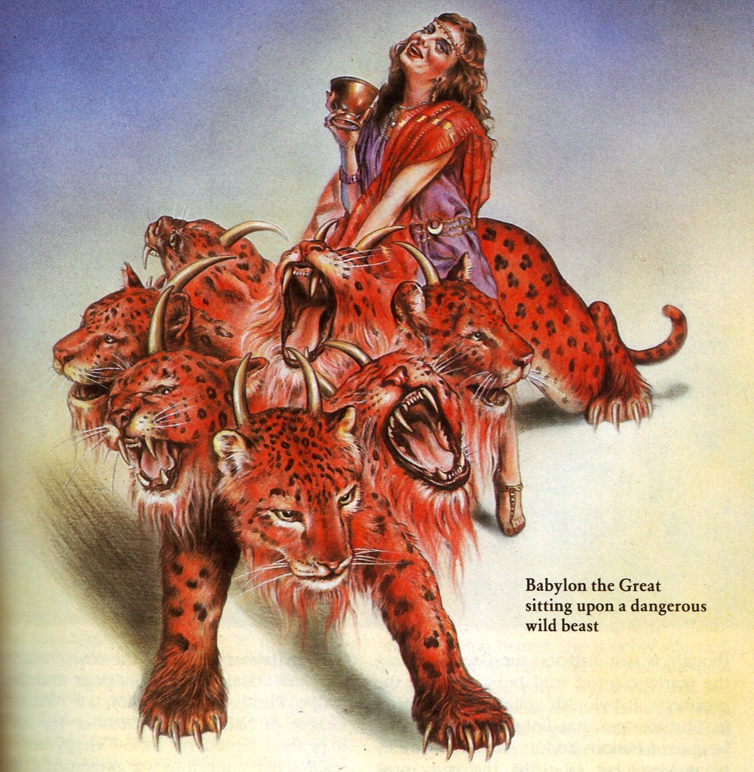
Satan’s Goal
Mark Hitchcock, The Second Coming of Babylon (Sisters, OR: Multnomah, 2003), 43.
Thus, Satan’s ambition has always been “to bring man back to Babylon un­der His rule. This will finally happen according to Revelation 17–18. Both the city of Babylon and the false religious system of Babylon will be resurrected in the end times.”

Slide 104

Revelation 17:18
“The woman whom you saw is the great city, which reigns over the kings of the earth.

Slide 105
Revelation 18:10
“standing at a distance because of the fear of her torment, saying, ‘Woe, woe, the great city, Babylon, the strong city! For in one hour your judgment has come.’”

Slide 106
Bullinger
The Apocalypse or “The Day of the Lord”, 509
“It is indeed surprising how any mistake could have been made in the identification of this woman. For the Holy Spirit first shows us her very name upon her forehead. Then, in verse 18, He tells us as plainly as words can tell anything, that ‘the woman which thou sawest is that great city, which reignest over the kings of the earth’, and chap. xvi. 19, as well as xvii. 5, identifies this city with Babylon. God says it is a ‘city.’ He does not say a system or a religion, but a ‘CITY.’”

Slide 107


Slide 108

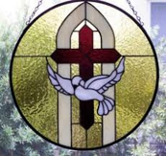
2 Thessalonians 2:6-7
⁶And you know what restrains [katechon; neuter] him now, so that in his time he will be revealed. ⁷For the mystery of lawlessness is already at work; only he who now restrains [katechōn; masculine] will do so until he is taken out of the way.

Slide 109


Slide 110

2 Thessalonians 2:3, 7
“…the man of lawlessness is revealed, the son of destruction…For the mystery of lawlessness is already at work; only he who now restrains will do so until he is taken out of the way.”

Slide 111
1 John 4:3
“and every spirit that does not confess Jesus is not from God; this is the spirit of the antichrist, of which you have heard that it is coming, and now it is already in the world.”

Slide 112

David Rockefeller cited in Memoirs, page 405.
“For more than a century ideological extremists…have seized upon well-publicized incidents…to attack the Rockefeller family for the inordinate influence they claim we wield over American political and economic institutions. Some even believe we are part of a secret cabal working against the best interests of the United States, characterizing my family and me as 'internationalists' and of conspiring with others around the world to build a more integrated global political and economic structure--one world, if you will. If that's the charge, I stand guilty, and I am proud of it.”

Slide 113
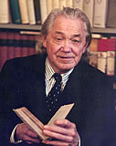
Henry Steele Commager cited in The New World Order, page 147
“The inescapable fact, traumatized by the energy crisis, the population crisis, armaments race, and so forth, is that nationalism as we have noted in the 19th and much of the 20th century is as much of an anachronism today as with States Rights when Calhoun preached it and Jefferson Davis fought for it.”

Slide 114
Henry Steele Commager cited in The New World Order, page 147
“Just as we know, or should know, that none of our domestic problems can be solved within the artificial boundaries of the states, so none of our global problems can be solved within the largely artificial boundaries of the nations.”

Slide 115
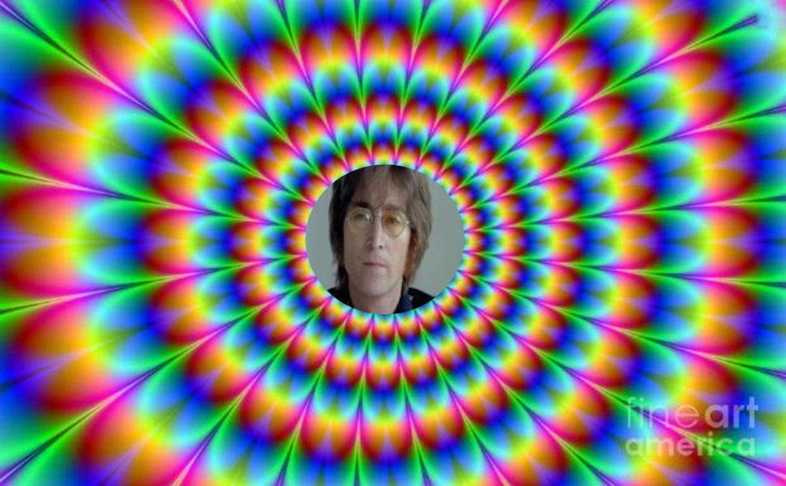
John Lennon
Song “Imagine”
… imagine a time when there will be “no countries,” “no religion,” “no heaven,” “no hell,” “no possessions,” everyone “living for today,” and the world “as one.”

Slide 116
VI. The Results vv. 8b-9
  The abandonment (8b)
  The name (9a)
  The scattering (9b)

Slide 117
Dr. Arnold G. Fruchtenbaum
The Book of Genesis, 225
“The contrast is from ‘the gate of God’ to ‘the gate of confusion.’ While the people called it Babel, the gate of God, God made a babble of it.”

Slide 118
Dr. Jonanathan D. Sarfati
Jonathan D. Sarfati, The Genesis Account: A Theological, Historical, and Scientific Commentary on Genesis 1‒11 (Powder Springs, GA: Creation Book Publishers, 2015), 662.
“That is, the rebellious people proposed to build a tower that would be a gateway to the gods in heaven, but instead, it became the site of the confusion of languages and man’s ignominious dispersion.”

Slide 119
VI. The Results vv. 8b-9
  The abandonment (8b)
  The name (9a)
  The scattering (9b)

Slide 120
Spread of the Mother-Child Cult
 | MOTHER | CHILD
Assyria | Ishtar | Tammuz
Phoenicia | Astarte | Baal
Egypt | Isis | Osirus/Horus
Greece | Aphrodite | Eros
Rome | Venus | Cupid
Asia | Cybele | Desius
India | Isi | Aswara
Roman Catholicism | Mary | Jesus
Israel | Queen of Heaven (Jer. 7:18; 44:17) | Tammuz (Ezek. 8:14-15)
Alexander Hislop, Two Babylons

Slide 121


Slide 122


Isaiah 43:1
“But now, thus says the Lord, your Creator, O Jacob, And He who formed you, O Israel, 'Do not fear, for I have redeemed you; I have called you by name; you are Mine!'”

Slide 123
UNIFORMITARIANISM IS NOT BIBLICISM
 | ERA | SCRIPTURE | DISTINCTIVES
1. | CREATION | Genesis 1-2 | No death
2. | FALL | Genesis 3-6 | Death, painful pregnancy & toil, long life spans, no human government
3. | FLOOD | Genesis 7-10 | Shorter life spans, human government, one language, no nations
4. | BABEL | Genesis 11-present | No global government, multiple languages, nations, ethnicities
5. | ANTICHRIST | Rapture to 2nd Advent | Global government, restrainer removed
6. | KINGDOM | Rev. 20:1-10 | Long life spans, kingdom conditions, reality of death, renovated earth
7. | ETERNAL STATE | Rev. 21-22 | No death, new earth

Slide 124
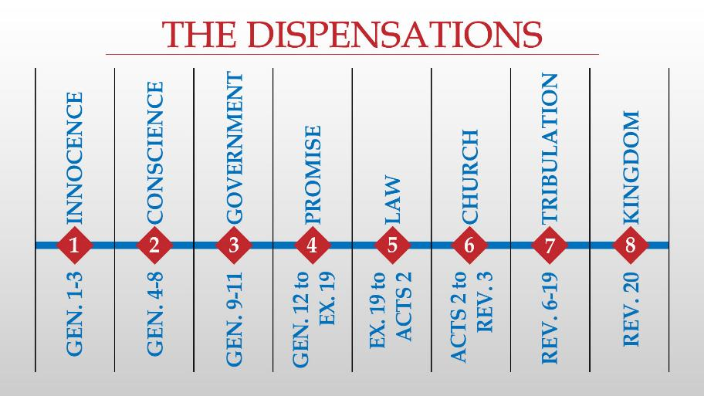

Slide 125
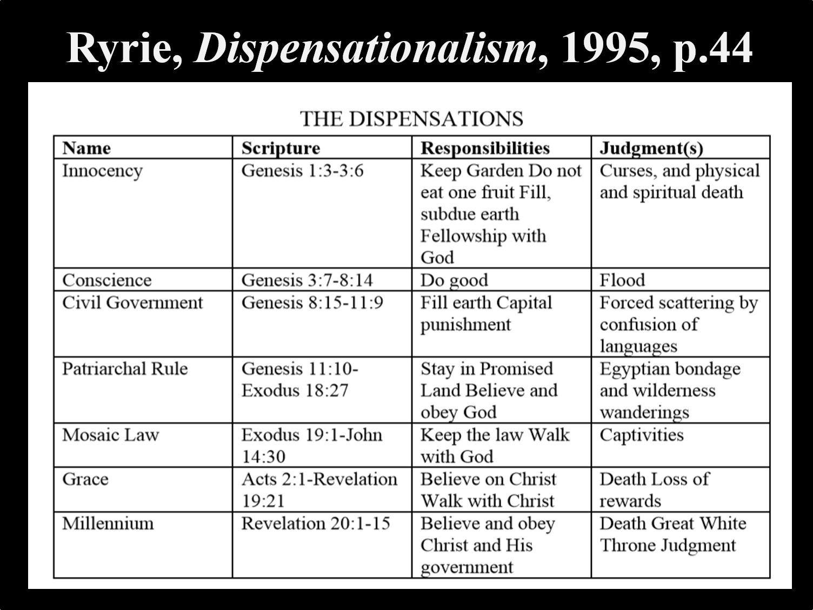

Slide 126
Conclusion

Slide 127
GENESIS 11:1-9
Outline
  The Former World (1-2)
  The Rebellion (3-4)
  God’s Condescension (5)
  God’s Observations (6)
  God’s Intervention (7-8a)
  The Results (8b-9)

Slide 128
Outline
  Table of nations (Gen 10)
  Tower of Babel (Gen 11:1-9)
  Genealogy from Shem to Terah (Gen 11:10-32)

Slide 129

“The Lord bless you and keep you; the Lord make his face shine on you and be gracious to you; the Lord turn his face toward you and give you peace.” (NIV)

