Slide 1


THE RAPTURE
What and When? – Part 58
Andrew Marshall Woods, Th.M., JD., PhD.
Sr. Pastor, Sugar Land Bible Church

Slide 2
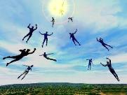
The Rapture
Course Overview
What is the Rapture?
When is the Rapture?
Strengthening the Pre-Tribulational case
The opposing views
One second after the Rapture

Slide 3
The Rapture
Course Overview
What is the Rapture?
When is the Rapture?
Strengthening the Pre-Tribulational case
The opposing views
One second after the Rapture

Slide 4

What is the Rapture?
An important doctrine
Distinct from the Second Advent
Catching away of all living believers (1 Thess 4:17)
Reunion (1 Thess 4:14-16)
Resurrection (1 Cor 15:50-54)
Exemption from death (1 Cor 15:51, 54-56)
Instantaneous (1 Cor 15:52)
Mystery (1 Cor 15:51)
Imminent (1 Cor 15:51; 1 Thess 4:15)
Traditional doctrine now being recovered

Slide 5
The Rapture
Course Overview
What is the Rapture?
When is the Rapture?
Strengthening the Pre-Tribulational case
The opposing views
One second after the Rapture

Slide 6
When is the Rapture?
7 Arguments Favoring the Pre-Tribulation View
Tribulation's purpose concerns Israel (Jer 30:7; Dan 9:24)
No biblical reference to the church on earth during the Tribulation period (Rev 4-22)
Church is promised an exemption from divine wrath (1 Thess 1:10; 5:9; Rom 5:9; Rev 3:10; 6:17)
Rapture is imminent (1 Cor 15:51; 1 Thess 4:15)
Rapture is a comfort (1 Thess 4:18)
Antichrist cannot come to power until the restrainer is removed (2 Thess 2:6-7)
Symbolic parallels (2 Peter 2:5-9)

Slide 7
The Rapture
Course Overview
What is the Rapture?
When is the Rapture?
Strengthening the Pre-Tribulational case
The opposing views
One second after the Rapture

Slide 8
Strengthening the Pre-Tribulation Case
John 14:1-4
Revelation 3:10
First Thessalonians 4‒5
Second Thessalonians 2:3a
Matthew 24‒25

Slide 9
The Rapture
Course Overview
What is the Rapture?
When is the Rapture?
Strengthening the Pre-Tribulational case
The opposing views
One second after the Rapture

Slide 10
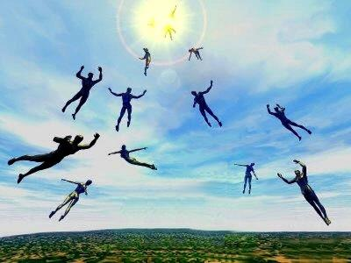
When Will the Rapture Take Place Relative to the Tribulation Period?
Pre-tribulation rapture theory
Mid-tribulation rapture theory
Post-tribulation rapture theory
Pre-wrath rapture theory
Partial rapture theory

Slide 11
The Rapture
Course Overview
What is the Rapture?
When is the Rapture?
Strengthening the Pre-Tribulational case
The opposing views
One second after the Rapture

Slide 12
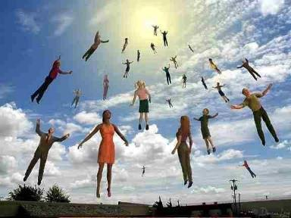

One Second After the Rapture
Sugar Land Bible Church 2021
Dr. Andy Woods
Senior Pastor – Sugar Land Bible Church
President – Chafer Theological Seminary

Slide 13

One Second After the Rapture
For the believer
For the unbeliever
So what?

Slide 14
One Second After the Rapture
For the believer
For the unbeliever
So what?

Slide 15

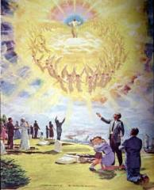
1. For the Believer
Reunion (1 Thess. 4:13-18)
Resurrection (1 Cor. 15:51, 53-55)
Reward (2 Cor. 5:10)

Slide 16
One Second After the Rapture
For the believer
For the unbeliever
So what?

Slide 17
2. For the Unbeliever
A perverted explanation to be offered
Change in God’s program
Identification of the Antichrist
Global governance
One-world religion
Signs & wonders movement
The demise of America
God’s wrath

Slide 18
2. For the Unbeliever
A perverted explanation to be offered
Change in God’s program
Identification of the Antichrist
Global governance
One-world religion
Signs & wonders movement
The demise of America
God’s wrath

Slide 19

Explanation of the missing
“The people who leave the planet during the time of Earth changes do not fit in here any longer, and they are stopping the harmony of Earth. When the time comes that perhaps 20 million people leave the planet at one time there will be a tremendous shift in consciousness for those who are remaining.”
Barbara Marciniak, Bringers of the Dawn: Teachings from the Pleiadians (Rochester, VT: Bear and Co., 1992), cited in “Rapture: The New Age Version,” <www.redmoonrising.com/newage.htm>, 29 January, 2010. See Gary Bates, Alien Intrusion: UfOs and the Evolution Connection (Powder Springs, GA: Creation Book Publishers, 2004), 367-68.

Slide 20
2. For the Unbeliever
A perverted explanation to be offered
Change in God’s program
Identification of the Antichrist
Global governance
One-world religion
Signs & wonders movement
The demise of America
God’s wrath

Slide 21
Change in God’s Program
From the Church to Israel
In the Holy Spirit’s operation

Slide 22
Change in God’s Program
From the Church to Israel
In the Holy Spirit’s operation

Slide 23

Romans 11:25-26
“²⁵ For I do not want you, brethren, to be uninformed of this mystery—so that you will not be wise in your own estimation—that a partial hardening has happened to Israel until the fullness of the Gentiles has come in; ²⁶ and so all Israel will be saved; just as it is written, ‘The Deliverer will come from Zion, He will remove ungodliness from Jacob.’”

Slide 24
Jeremiah 31:35-37
Thus says the Lord, Who gives the sun for light by day And the fixed order of the moon and the stars for light by night, Who stirs up the sea so that its waves roar; The Lord of hosts is His name:³⁶ “If this fixed order departs From before Me,” declares the Lord, “Then the offspring of Israel also will cease From being a nation before Me forever.”³⁷ Thus says the Lord, “If the heavens above can be measured And the foundations of the earth searched out below, Then I will also cast off all the offspring of Israel For all that they have done,” declares the Lord.

Slide 25


Slide 26


Slide 27
Distinctions Between 144,000 & Multitude
144,000 | MULTITUDE
Revelation 7:1-8 | Revelation 7:9-17
Numbered | Innumerable
Jews | All nations
Sealed | Slain
Sealed before the Tribulation | Converted out of the Tribulation
Hitchcock and Ice, The Truth Behind Left Behind, 77

Slide 28
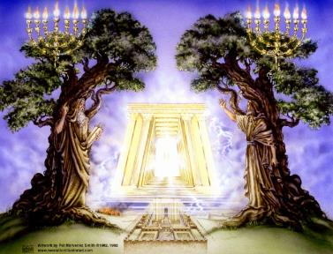
God’s Work Through Israel
Rev 7-144,000 Jews
Rev 11-Two Jewish witnesses
Rev 12-Israel flees

Slide 29


Jeremiah 30:7
“Alas! for that day is great, There is none like it; And it is the time of Jacob’s distress (Gen. 32:8; 35:10), But he will be saved from it.”

Slide 30
Change in God’s Program
From the Church to Israel
In the Holy Spirit’s operation

Slide 31


Slide 32


1 Samuel 16:13-14
¹³ Then Samuel took the horn of oil and anointed him in the midst of his brothers; and the Spirit of the Lord came mightily upon David from that day forward. And Samuel arose and went to Ramah. ¹⁴ Now the Spirit of the Lord departed from Saul, and an evil spirit from the Lord terrorized him.

Slide 33
John 14:16-17
¹⁶ I will ask the Father, and He will give you another Helper, that He may be with you forever; ¹⁷ that is the Spirit of truth, whom the world cannot receive, because it does not see Him or know Him, but you know Him because He abides with you and will be in you.

Slide 34
WORK OF THE SPIRIT IN THE OT
 | OT/GOSPELS | TODAY
External vs. Internal | Upon (1 Sam. 16:13) | Within (John 14:17)
Reception of all of the Spirit at the moment of salvation? | Subsequent to salvation (Exod 31:3) | At moment of salvation (Rom 8:9)
How long is the indwelling? | Temporary indwelling (1 Sam 16:14; Ps 51:11) | Permanent indwelling (John 14:16)
Who is indwelt? | Selective indwelling (Joel 2:28) | Universal indwelling (1 Cor 12:13)

Slide 35

Daniel 9:24
Seventy weeks have been decreed for your people and your holy city, to finish the transgression, to make an end of sin, to make atonement for iniquity, to bring in everlasting righteousness, to seal up vision and prophecy and to anoint the most holy place.

Slide 36


Slide 37
Daniel 9:24
Seventy weeks have been decreed for your people and your holy city, to finish the transgression, to make an end of sin, to make atonement for iniquity, to bring in everlasting righteousness, to seal up vision and prophecy and to anoint the most holy place.

Slide 38
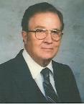

Robert Culver
Daniel and the Latter Days
(Chicago, IL: Moody Press, 1977), p. 149
“Let the postmillennial and amillennial commentators look long and steadily at this fact. This prophecy is a prophecy for Daniel’s people and Daniel’s city. No alchemy of Origenistic spiritualizing interpretation can change that.”

Slide 39
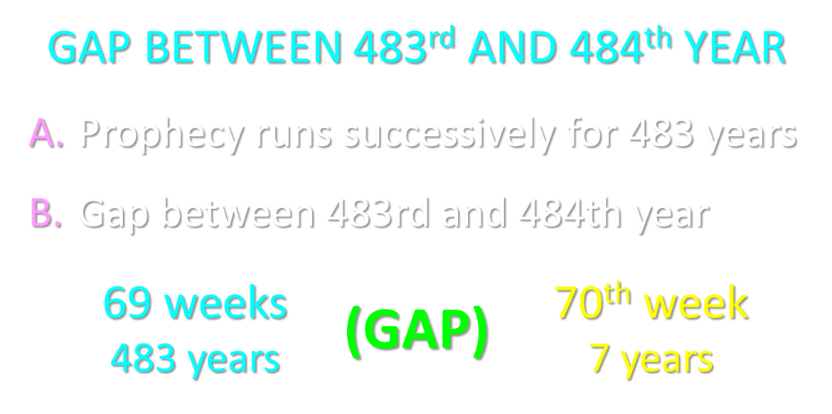

Slide 40
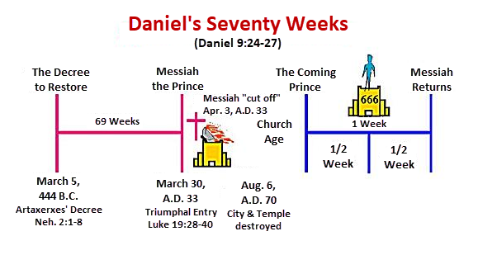

Slide 41
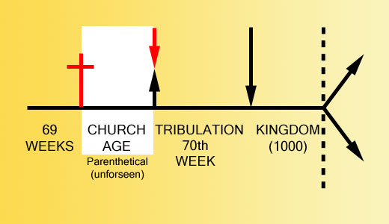

Slide 42


Slide 43
2. For the Unbeliever
A perverted explanation to be offered
Change in God’s program
Identification of the Antichrist
Global governance
One-world religion
Signs & wonders movement
The demise of America
God’s wrath

Slide 44
2 Thessalonians 2:6-7
⁶And you know what restrains [katechon; neuter] him now, so that in his time he will be revealed. ⁷For the mystery of lawlessness is already at work; only he who now restrains [katechōn; masculine] will do so until he is taken out of the way.

Slide 45
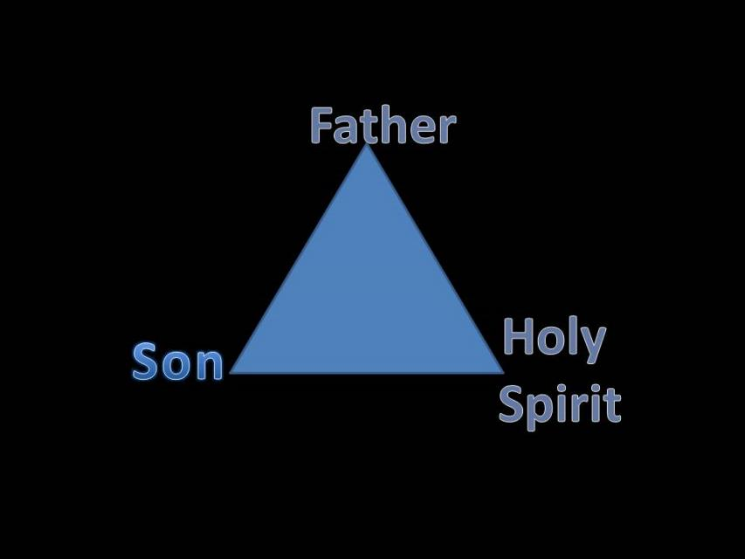
Trinity

Slide 46


Slide 47

3 Reasons Why the Restrainer is the Holy Spirit
(2 Thessalonians 2:6-7)
The Holy Spirit is omnipotent
The Holy Spirit view handles well the switch in gender from the neuter (vs. 6) to the masculine (vs. 7)
The Holy Spirit is active in the world (Gen. 6:3; John 16:7-11)

Slide 48
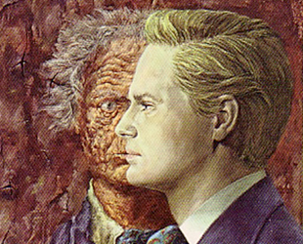
Who is the Antichrist?
“We will not, however, incur the risk of pronouncing positively as to the name of Antichrist; but if it had been necessary to announce his name plainly at the present time, it would have been spoken by him who saw the apocalypse. For it was not seen long ago, but almost in our own time, at the end of the reign of Domitian.”
Irenaeus Against Heresies 5.30.3

Slide 49

Ezekiel 28:13, 15
¹³ “You were in Eden, the garden of God; Every precious stone was your covering: The ruby, the topaz and the diamond; The beryl, the onyx and the jasper; The lapis lazuli, the turquoise and the emerald; And the gold, the workmanship of your settings and sockets, Was in you. On the day that you were created They were prepared… ¹⁵ “You were blameless in your ways From the day you were created Until unrighteousness was found in you.

Slide 50

2 Thessalonians 2:3, 7
“…the man of lawlessness is revealed, the son of destruction…For the mystery of lawlessness is already at work; only he who now restrains will do so until he is taken out of the way.”

Slide 51
1 John 4:3
“and every spirit that does not confess Jesus is not from God; this is the spirit of the antichrist, of which you have heard that it is coming, and now it is already in the world.”

Slide 52

Revelation 13:16-18
¹⁶ And he causes all, the small and the great, and the rich and the poor, and the free men and the slaves, to be given a mark on their right hand or on their forehead, ¹⁷ and he provides that no one will be able to buy or to sell, except the one who has the mark, either the name of the beast or the number of his name. ¹⁸ Here is wisdom. Let him who has understanding calculate the number of the beast, for the number is that of a man; and his number is six hundred and sixty-six.

Slide 53
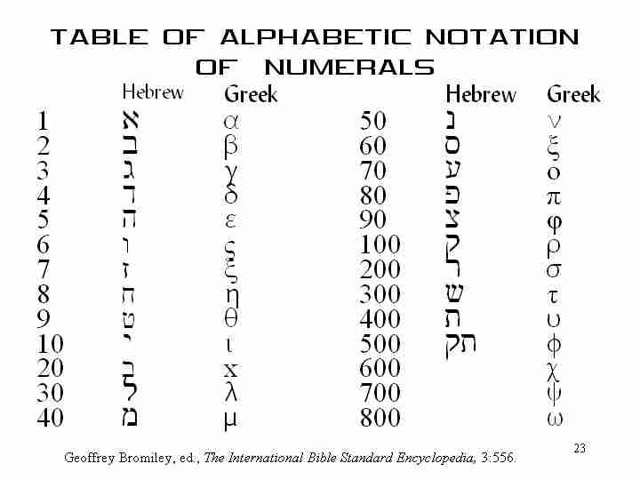

Slide 54



Slide 55
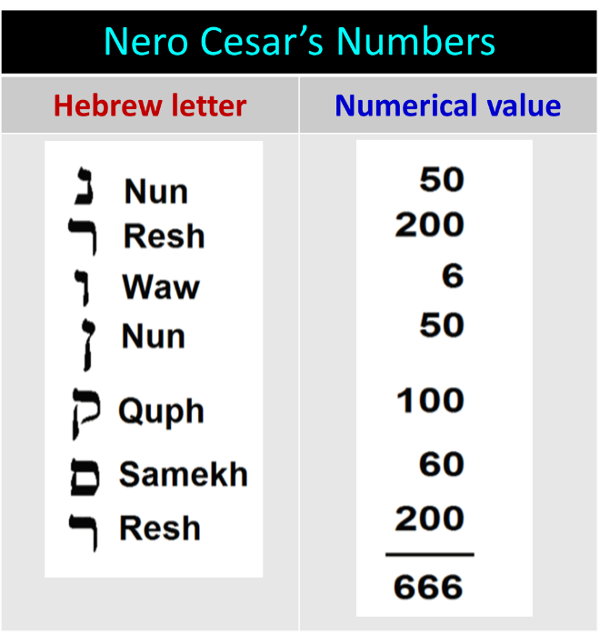
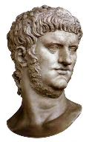

Slide 56

Revelation 13:17-18
“¹⁷ and he provides that no one will be able to buy or to sell, except the one who has the mark, either the name of the beast or the number of his name. ¹⁸ Here is wisdom. Let him who has understanding calculate the number of the beast, for the number is that of a man [anthrōpos]; and his number is six hundred and sixty-six.”

Slide 57
Problems With
Neronian Calculation
Transliteration from Greek to Hebrew
“Cherry picking” to fit an ordained outcome
Not suggested by the ancient commentators
Inconsistent use of numbers
Date of Revelation

Slide 58
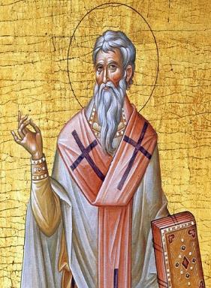
Late Date (A.D. 95)
Irenaeus Against Heresies 5.30.3
“But if it had been necessary to announce his name plainly at the present time, it would have been spoken by him who saw the apocalypse. For it was not seen long ago, but almost in our own time, at the end of the reign of Domitian.”

Slide 59
DATE: EXTERNAL EVIDENCE
WITNESSES FOR DOMITIANIC DATE | WITNESSES FOR NERONIC DATE
Irenaeus (A.D. 180)
Victorinus (c.300)
Eusebius (c. 300)
Jerome (c. 400)
Sulpicius Severus (c.400)
The Acts of John (c. 650)
Primasius (c. 540) | Syriac Version of N.T. (550)
Orosius (c. 600)
Andreas (c. 600)
Venerable Bede (A.D. 700)
 | Arethas (c. 900)
 | Theophylact (d. 1107)
Mark Hitchcock, The End Times Controversy, 138.

Slide 60
Nero Does Not Fit
the Facts of Revelation 13
Nero did not:
  Usher in persecution for exactly 42 months (13:5)
  Control the entire planet (13:7; 5:9)
  Force people to receive a mark on their right hand or forehead in order to participate in the global economy (13:16-18)

Slide 61
Revelation 13:14
“And he deceives those who dwell on the earth because of the signs which it was given him to perform in the presence of the beast, telling those who dwell on the earth to make an image (eikōn) to the beast who had the wound of the sword and has come to life [záō].”

Slide 62
Nero Does Not Fit
the Facts of Revelation 13
Nero did not:
  Coerce the entire world to worship a singular image of him (13:15)
  Resurrect from the dead (13:14)
  Associate with a miracle working false prophet (13:13, 15)
  Receive global veneration (13:8)

Slide 63
2. For the Unbeliever
A perverted explanation to be offered
Change in God’s program
Identification of the Antichrist
Global governance
One-world religion
Signs & wonders movement
The demise of America
God’s wrath

Slide 64


Daniel 7:23
“The fourth beast will be a fourth kingdom on the earth, which will be different from all the other kingdoms and will devour the whole earth and tread it down and crush it.”

Slide 65
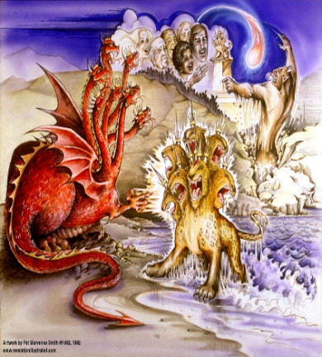
Satan’s Goal of Globalism
  Dan. 7:23
  Rev. 13:7-8; Rev. 5:9
  Rev. 13:16-18
  Rev. 17:15

Slide 66

Zechariah 5:5-11
Woman (wickedness)
Ephah (commerce)
House (Temple-2 Sam 7; religion)
Shinar (Gen 10:10; 11:2; Dan 1:2)

Slide 67
2 Thessalonians 2:6-7
⁶And you know what restrains [katechon; neuter] him now, so that in his time he will be revealed. ⁷For the mystery of lawlessness is already at work; only he who now restrains [katechōn; masculine] will do so until he is taken out of the way.

Slide 68
Zechariah 5:5-11 | Revelation 17–18
Woman sitting in a basket | Woman sitting on beast, seven mountains, many waters (17: 3, 9, 15)
Emphasis on commerce (a basket for measuring grain) | Emphasis on commerce (merchant of grain, 18:13)
Woman’s name is wickedness | Woman’s name is Babylon the Great, Mother of Harlots and Abominations of the Earth
Focus on False worship (a temple is built for the woman) | Focus on False worship (17:5)
Woman is taken to Babylon | Woman is called Babylon
Hitchcock, The Second Coming of Babylon, 109.

Slide 69


Slide 70
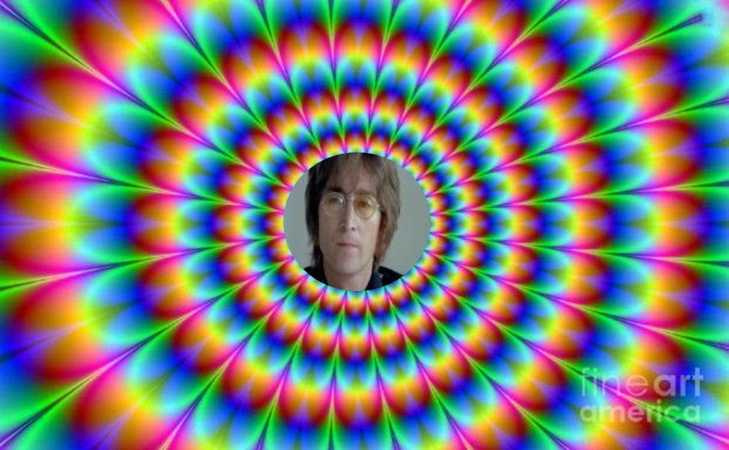
John Lennon
Song “Imagine”
… imagine a time when there will be “no countries,” “no religion,” “no heaven,” “no hell,” “no possessions,” everyone “living for today,” and the world “as one.”

Slide 71

David Rockefeller cited in Memoirs, page 405.
“For more than a century ideological extremists…have seized upon well-publicized incidents…to attack the Rockefeller family for the inordinate influence they claim we wield over American political and economic institutions. Some even believe we are part of a secret cabal working against the best interests of the United States, characterizing my family and me as 'internationalists' and of conspiring with others around the world to build a more integrated global political and economic structure--one world, if you will. If that's the charge, I stand guilty, and I am proud of it.”

Slide 72
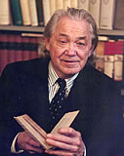
Henry Steele Commager cited in The New World Order, page 147
“The inescapable fact, traumatized by the energy crisis, the population crisis, armaments race, and so forth, is that nationalism as we have noted in the 19th and much of the 20th century is as much of an anachronism today as with States Rights when Calhoun preached it and Jefferson Davis fought for it.”

Slide 73
Henry Steele Commager cited in The New World Order, page 147
“Just as we know, or should know, that none of our domestic problems can be solved within the artificial boundaries of the states, so none of our global problems can be solved within the largely artificial boundaries of the nations.”

Slide 74
2. For the Unbeliever
A perverted explanation to be offered
Change in God’s program
Identification of the Antichrist
Global governance
One-world religion
Signs & wonders movement
The demise of America
God’s wrath

Slide 75
2 Thessalonians 2:3, 7
“…the man of lawlessness is revealed, the son of destruction…For the mystery of lawlessness is already at work; only he who now restrains will do so until he is taken out of the way.”

Slide 76
1 John 4:3
“and every spirit that does not confess Jesus is not from God; this is the spirit of the antichrist, of which you have heard that it is coming, and now it is already in the world.”

Slide 77
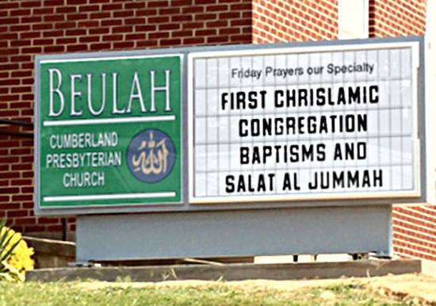
Chrislam?

Slide 78
2. For the Unbeliever
A perverted explanation to be offered
Change in God’s program
Identification of the Antichrist
Global governance
One-world religion
Signs & wonders movement
The demise of America
God’s wrath

Slide 79

2 Thessalonians 2:9
“that is, the one whose coming is in accord with the activity of Satan, with all power and signs and false wonders.”

Slide 80
Antichrist’s Satanic Miracles (2 Thessalonians 2:9)
MIRACLE | GREEK | CHRIST’S MINISTRY
Powers | Dynamis | Matt. 11:20
Signs | Semēion | John 20:30
Wonders | Teras | Acts 2:22

Slide 81

Satanic/Demonic Miracles
Exod. 7–8
Deut. 13:1-3
Job 1:12-19; 2:7-8
1 Sam. 28?
Matt. 7:21-23; 24:24
Acts 8:9; 16:16
Gal. 1:6-9
2 Thess. 2:9
Rev. 13:3, 13, 15; 16:13-14

Slide 82
2. For the Unbeliever
A perverted explanation to be offered
Change in God’s program
Identification of the Antichrist
Global governance
One-world religion
Signs & wonders movement
The demise of America
God’s wrath

Slide 83

God Blesses His Truth
Proverbs 14:34
“Righteousness exalts a nation, but sin is a reproach to any people.”
Ps 33:12
“Blessed is the nation whose God is the Lord.”

Slide 84

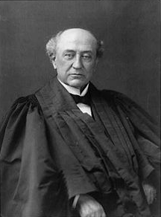
America is a “Christian Nation”
“This is historically true. From the discovery of this continent to the present hour, there is a single voice making this affirmation… These are not the sayings, declarations of private persons: they are organic utterances; they speak the voice of the entire people…These and many other matters which might be noticed, add a volume of unofficial declarations to the mass of organic utterances that this is a Christian nation.”
Church of the Holy Trinity v. U.S., 143 U.S. 457, 465, 470-71 (1892)

Slide 85


Slide 86
2. For the Unbeliever
A perverted explanation to be offered
Change in God’s program
Identification of the Antichrist
Global governance
One-world religion
Signs & wonders movement
The demise of America
God’s wrath

Slide 87

Pretribulationism is not Escapism
Trials (John 16:33)
Man’s wrath (2 Tim 3:12)
Satan’s wrath (Eph 6:11-12)
World’s wrath (John 15:18-19)

Slide 88

Promised Exemption from Divine Wrath
The promise (1 Thess 1:10; 5:9; Rom 5:9; 8:1; Rev 3:10)
Tribulation = divine wrath (Rev 6:16-17; 11:18; 15:1, 7; 16:1, 19)

Slide 89

God’s Role in Redemption (Rev 5)
Seven sealed scroll (5:1)
John weeps (5:2-4)
Christ is qualified to open the scroll (5:5-6)
Christ takes the scroll (5:7)
Christ praised by various entities (5:8-14)

Slide 90

Telescoping
7th judgment releases 1st in next series
Seals: 1 2 3 4 5 6 7
Trumpets: 1 2 3 4 5 6 7
Bowls: 1 2 3 4 5 6 7

Slide 91


Slide 92
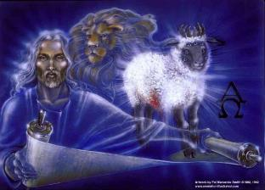
1st Six Seals (Rev 6)
6:1-2 – Advent of antichrist
6:3-4 – War
6:5-6 – Famine
6:7-8 – Death
6:9-11 – Martyrdoms
6:12-17 – Cosmic disturbances

Slide 93

Revelation 6:16-17
^{“16} and they said to the mountains and the rocks, ‘Fall on us and hide us from the sight of Him who sits on the throne, and from the wrath [orgḗ] of the Lamb; ¹⁷ for the great day of Their wrath [orgḗ] has come, and who is able to stand?’”

Slide 94

Robert L. Thomas
Rev. 6:16-17
"The verb ēlethen ("has come") is aorist indicative, referring to a previous arrival of wrath, not something that is about to take place. Men see the arrival of this day at least as early as the cosmic upheavals that characterize the sixth seal (6:12-14), but upon reflection they probably recognize that it was already in effect with the death of one-fourth of the population (6:7-8), the worldwide famine (6:5-6), and the global warfare (6:3-4). The rapid sequence of all of these events could not escape notice, but the light of their true explanation does not dawn upon human consciousness until the severe phenomena of the sixth seal arrive."
Robert L. Thomas, Revelation 1–7: An Exegetical Commentary, ed. Kenneth Barker (Chicago: Moody, 1992), 457-58.

Slide 95

2 Peter 2:7-9
“⁷and if He rescued righteous Lot, oppressed by the sensual conduct of unprincipled men ⁸ (for by what he saw and heard that righteous man, while living among them, felt his righteous soul tormented day after day by their lawless deeds), ⁹ then the Lord knows how to rescue the godly from temptation, and to keep the unrighteous under punishment for the day of judgment.”

Slide 96
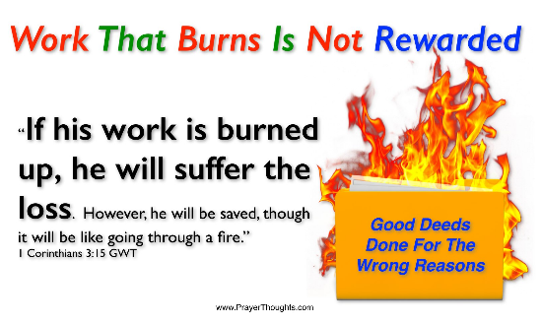
Genesis 19:22
“Hurry, escape there, for I cannot do anything until you arrive there.” Therefore the name of the town was called Zoar.”

Slide 97
2. For the Unbeliever
A perverted explanation to be offered
Change in God’s program
Identification of the Antichrist
Global governance
One-world religion
Signs & wonders movement
The demise of America
God’s wrath

Slide 98
One Second After the Rapture
For the believer
For the unbeliever
So what?

Slide 99
3. So What?
Uniformitarianism?
Live for Christ
Reach the lost
Believe the Gospel

Slide 100
3. So What?
Uniformitarianism?
Live for Christ
Reach the lost
Believe the Gospel

Slide 101

2 Peter 3:3-6
“³ Know this first of all, that in the last days mockers will come with their mocking, following after their own lusts, ⁴ and saying, ‘Where is the promise of His coming? For ever since the fathers fell asleep, all continues just as it was from the beginning of creation.’ ⁵ For when they maintain this, it escapes their notice that by the word of God the heavens existed long ago and the earth was formed out of water and by water. ⁶ through which the world at that time was destroyed by being flooded with water.”

Slide 102
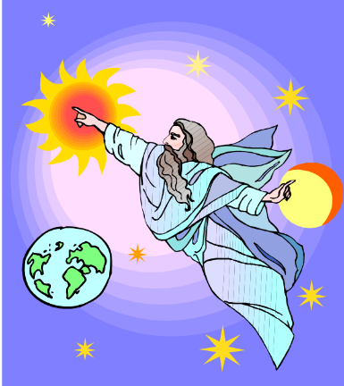
HISTORY
2 Pet. 3:5-7
Creation (5)
Flood (6-7)
  God will judge again via fire

Slide 103
3. So What?
Uniformitarianism?
Live for Christ
Reach the lost
Believe the Gospel

Slide 104
Romans 13:11-12
“Do this, knowing the time, that it is already the hour for you to awaken from sleep; for now salvation is nearer to us than when we believed. ¹² The night is almost gone, and the day is near. Therefore let us lay aside the deeds of darkness and put on the armor of light.”

Slide 105
3. So What?
Uniformitarianism?
Live for Christ
Reach the lost
Believe the Gospel

Slide 106
3. So What?
Uniformitarianism?
Live for Christ
Reach the lost
Believe the Gospel

Slide 107

John 5:24
“Truly, truly, I say to you, he who hears My word, and believes Him who sent Me, has eternal life, and does not come into judgment, but has passed out of death into life.”

Slide 108
Review: One Second After the Rapture
For the believer
For the unbeliever
So what?

Slide 109
CONCLUSION

Slide 110
The Rapture
Course Overview
What is the Rapture?
When is the Rapture?
Strengthening the Pre-Tribulational case
The opposing views
One second after the Rapture

