Slide 1


Genesis 10‒11
National Dispersion

Slide 2


GENESIS STRUCTURE
  Beginning of the Human race (Gen. 1‒11)
  Beginning of the Hebrew race (Gen. 12‒50)

Slide 3

GENESIS STRUCTURE
  Genesis 1-11 (four events)
    Creation (1-2)
    Fall (3-5)
    Flood (6-9)
    National dispersion (10-11)

Slide 4
GENESIS STRUCTURE
  Genesis 1-11 (four events)
    Creation (1-2)
    Fall (3-5)
    Flood (6-9)
    National dispersion (10-11)

Slide 5


Genesis 3:15
“And I will put enmity Between you and the woman, And between your seed and her seed; He shall bruise you on the head, And you shall bruise him on the heel.”

Slide 6
GENESIS STRUCTURE
  Genesis 1-11 (four events)
    Creation (1-2)
    Fall (3-5)
    Flood (6-9)
    National dispersion (10-11)

Slide 7
GENESIS STRUCTURE
  Genesis 1-11 (four events)
    Creation (1-2)
    Fall (3-5)
    Flood (6-9)
    National dispersion (10-11)

Slide 8
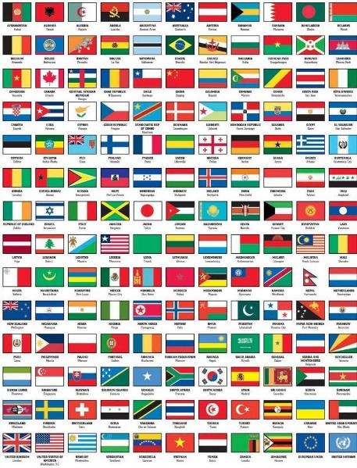
Outline
  Table of nations (Gen 10)
  Tower of Babel (Gen 11:1-9)
  Genealogy from Shem to Terah (Gen 11:10-32)

Slide 9
Outline
  Table of nations (Gen 10)
  Tower of Babel (Gen 11:1-9)
  Genealogy from Shem to Terah (Gen 11:10-32)

Slide 10
Genesis 10–11
  Sinful origin of the nations necessitating Israel’s unique birth and redemptive purpose to these nations
  Gen 11:1-9 occurs first and Genesis 10 occurs second (Gen 10:5, 20, 31; 11:1)

Slide 11
Table of Nations (Gen 10)
  Nations emanating from Noah’s three sons
  Birth order: Shem, Ham, Japeth (Gen 10:1)
  Lesser to greater importance relative to Israel (Japheth, Ham, Shem)

Slide 12
GENESIS 10
Outline
  Introduction (1)
  Japheth's line (2-5)
  Ham’s Line (6-20)
  Shem’s line (21-31)
  Conclusion (32)

Slide 13
GENESIS 10
Outline
  Introduction (1)
  Japheth's line (2-5)
  Ham’s Line (6-20)
  Shem’s line (21-31)
  Conclusion (32)

Slide 14
GENESIS 10
Outline
  Introduction (1)
  Japheth's line (2-5)
  Ham’s Line (6-20)
  Shem’s line (21-31)
  Conclusion (32)

Slide 15
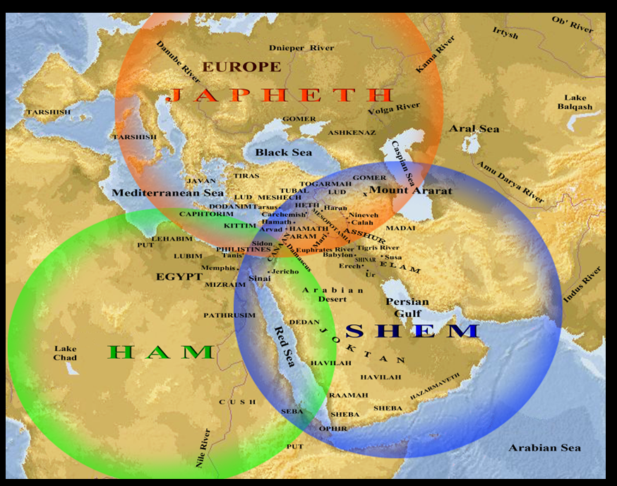

Slide 16
Japheth’s Sons (vs. 2)
  Gomer
  Magog
  Madai
  Javan
  Tubal
  Meshech
  Tiras

Slide 17
GENESIS 10
Outline
  Introduction (1)
  Japheth's line (2-5)
  Ham’s Line (6-20)
  Shem’s line (21-31)
  Conclusion (32)

Slide 18
Ham’s Sons (vs. 6)
  Cush
  Mizraim
  Put
  Canaan

Slide 19
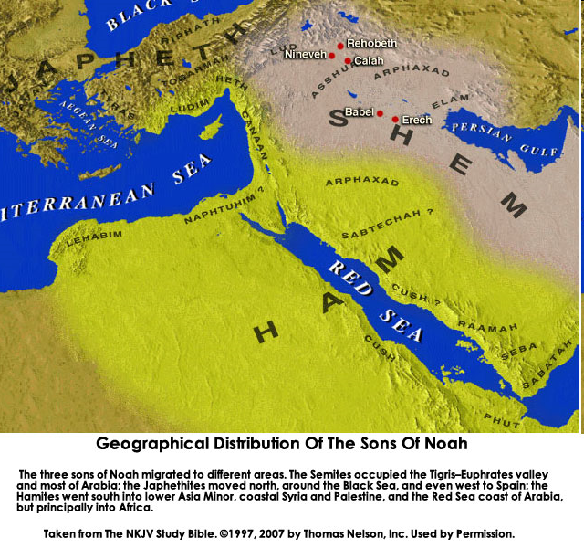

Slide 20
GENESIS 10
Outline
  Introduction (1)
  Japheth's line (2-5)
  Ham’s Line (6-20)
  Shem’s line (21-31)
  Conclusion (32)

Slide 23
Table of Nations (Gen 10)
  Shem’s descendants (Gen 10:21-32)
  Shem = Semites
  Assyrians, Babylonians, Persians, Arabs, Hebrews
  Line leading to Israel
  Eber (Gen 10:21, 25) is origin of the word Hebrews (Gen 14:13)

Slide 24


Dr. Arnold G. Fruchtenbaum
The Book of Genesis, 217
“The line of Shem begins in verse 21: And unto Shem, the father of all the children of Eber. Eber in Hebrew is Ever and is the source of the Hebrew word for ‘Hebrew,’ Ivrit. To be the father of the Hebrews is the main significance of the line of Shem.”

Slide 25
Genesis 3:15
“And I will put enmity Between you and the woman, And between your seed and her seed; He shall bruise you on the head, And you shall bruise him on the heel.”

Slide 26

God’s Messianic Purposes
Beginning in Genesis
Proto-evangelium from Adam & Eve (3:15)
Seth (4:25)
Noah (Gen 5:29)
Shem (9:26)
Abraham (12:3)
Isaac (21:12)
Jacob (25:23)
Judah (49:10)

Slide 27
God’s Messianic Purposes
Beginning in Genesis
Proto-evangelium from Adam & Eve (3:15)
Seth (4:25)
Noah (Gen 5:29)
Shem (9:26)
Abraham (12:3)
Isaac (21:12)
Jacob (25:23)
Judah (49:10)

Slide 28
Shem’s Sons (vs. 22)
  Elam
  Asshur
  Arphachshad
  Lud
  Aram

Slide 29
Shem’s Sons (vs. 22)
  Elam
  Asshur
  Arphachshad
  Lud
  Aram

Slide 30
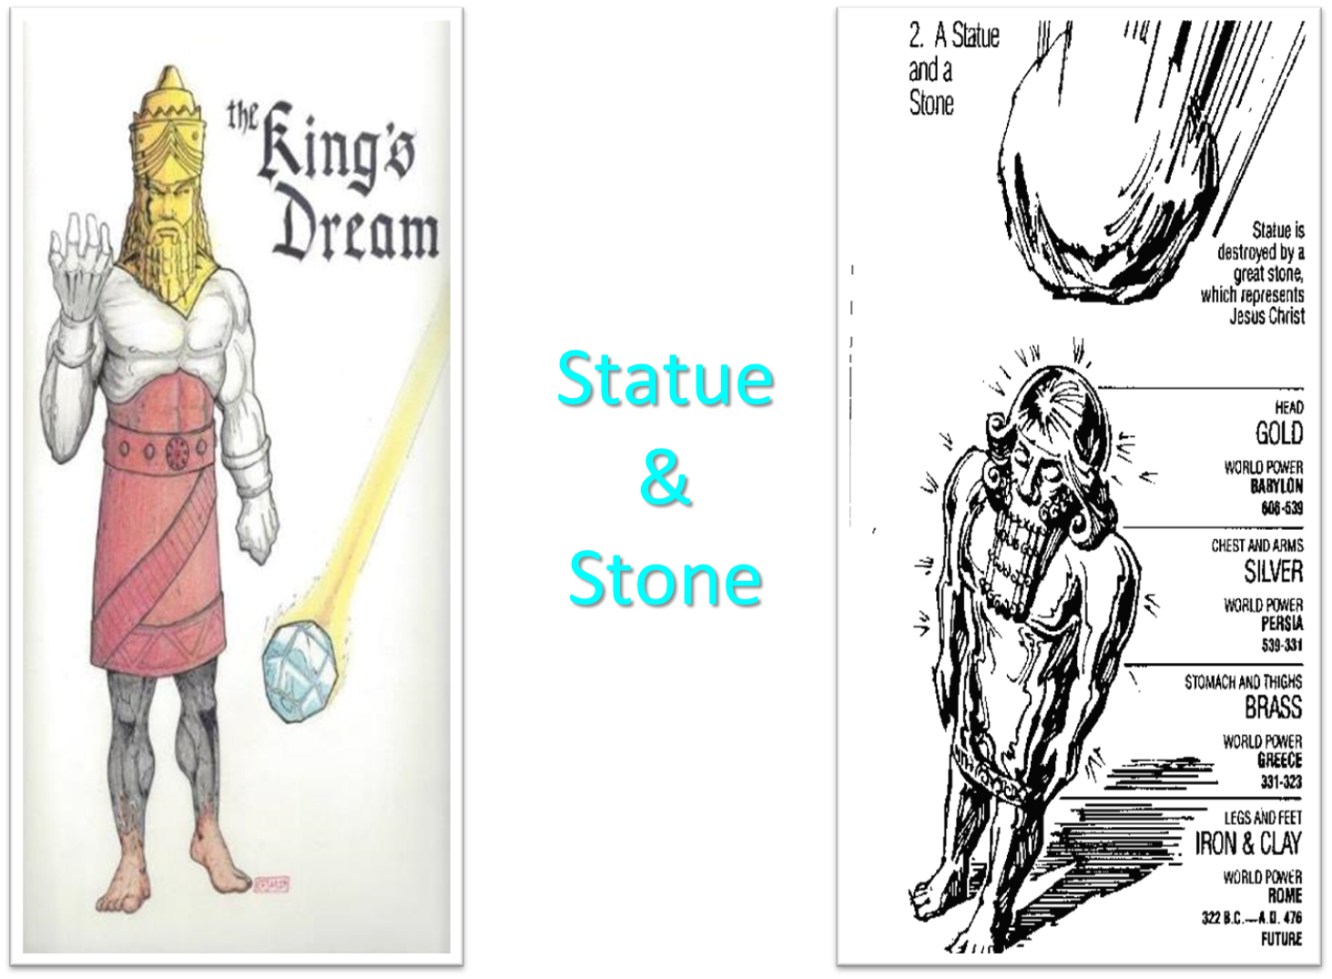

Slide 31


Slide 32
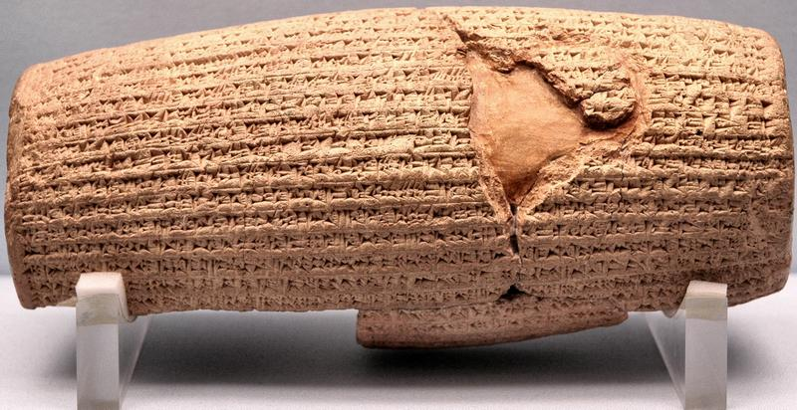
Cyrus Cylinder

Slide 33
Three Returns
 | DATE | DURATION | PERSIAN KING | JEWISH LEADER | SCRIPTURE | PURPOSE | NUMBER OF RETURNEES
1st return | 538–515 B.C. | 23 years | Cyrus (Isa 44:28‒45:1) | Zerubbabel | Ezra 1–6; Isaiah 44:28 | Rebuilding the temple | 50,000
2nd return | 458–457 B.C. | 2 years | Artaxerxes | Ezra | Ezra 7–10 | Adorning of the temple and reforming the people | 2,000
3rd return | 444–432 B.C. | 8 years | Artaxerxes | Nehemiah | Nehemiah | Rebuilding the wall

Slide 34


Slide 35

Ancient Names From Ezekiel 38:1-9
Magog (Central Asia) Rosh (Russia) Meshec (Turkey) Tubal (Turkey) Persia (Iran) Put (Libya) Cush (Sudan) Gomer (Turkey) | Togarmah (Turkey) Sheba (Saudi Arabia) Dedan (Saudi Arabia or Yemen) Tarshish (Spain) Merchants of Tarshish (Conglomeration of Western powers including Europe) Israel

Slide 36
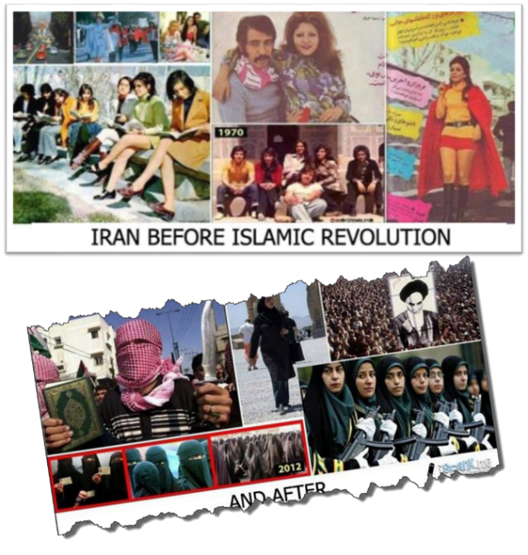

Slide 37
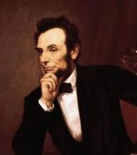
Cited in Mark A. Beliles and Stephen K. McDowell, America's Providential History (Charlottesville, VA: Providence, 1989), 95.
“The philosophy of the school room in one generation will be the philosophy of government in the next.”

Slide 38
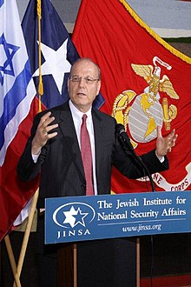
Yoram Ettinger
“Iran's School Textbooks‒Can Congress Afford to Ignore It?,” online: http://theettingerreport.com/Iran-and-MidEast/Iran-s-School-Textbooks-%E2%80%93-can-Congress-afford-to-i.aspx, May 29, 2015, accessed 30 May 2015.
“Iranian school textbooks, such as The Qur'an and Life (Grade 12, p. 125) prepare Iranian children for the Ayatollahs' sublime goal: the apocalyptic, horrifying, millenarian, military battle against the USA and other ‘arrogant oppressors of the world,’ which are ostensibly led by ‘idolatrous devils.’ While the ‘savior’ – the infallible, immortal, divinely ordained and eventual global leader, the Mahdi – has not surfaced yet, Iranian children are taught that the battle is already raging throughout the world, awaiting their sacrifice. School . . .

Slide 39
Yoram Ettinger
“Iran's School Textbooks‒Can Congress Afford to Ignore It?,” online: http://theettingerreport.com/Iran-and-MidEast/Iran-s-School-Textbooks-%E2%80%93-can-Congress-afford-to-i.aspx, May 29, 2015, accessed 30 May 2015.
. . .textbooks of Western democracies are the most authentic reflection of peoples' values and worldview. School textbooks of tyrannies are the most authentic reflection of the nature and mission of the regimes. Iranian school textbooks reflect the strategy and tactics of the Ayatollahs, much more authentically than speeches, interviews, diplomatic statements and conversations conducted by President Rouhani and Foreign Minister Zarif.”

Slide 40
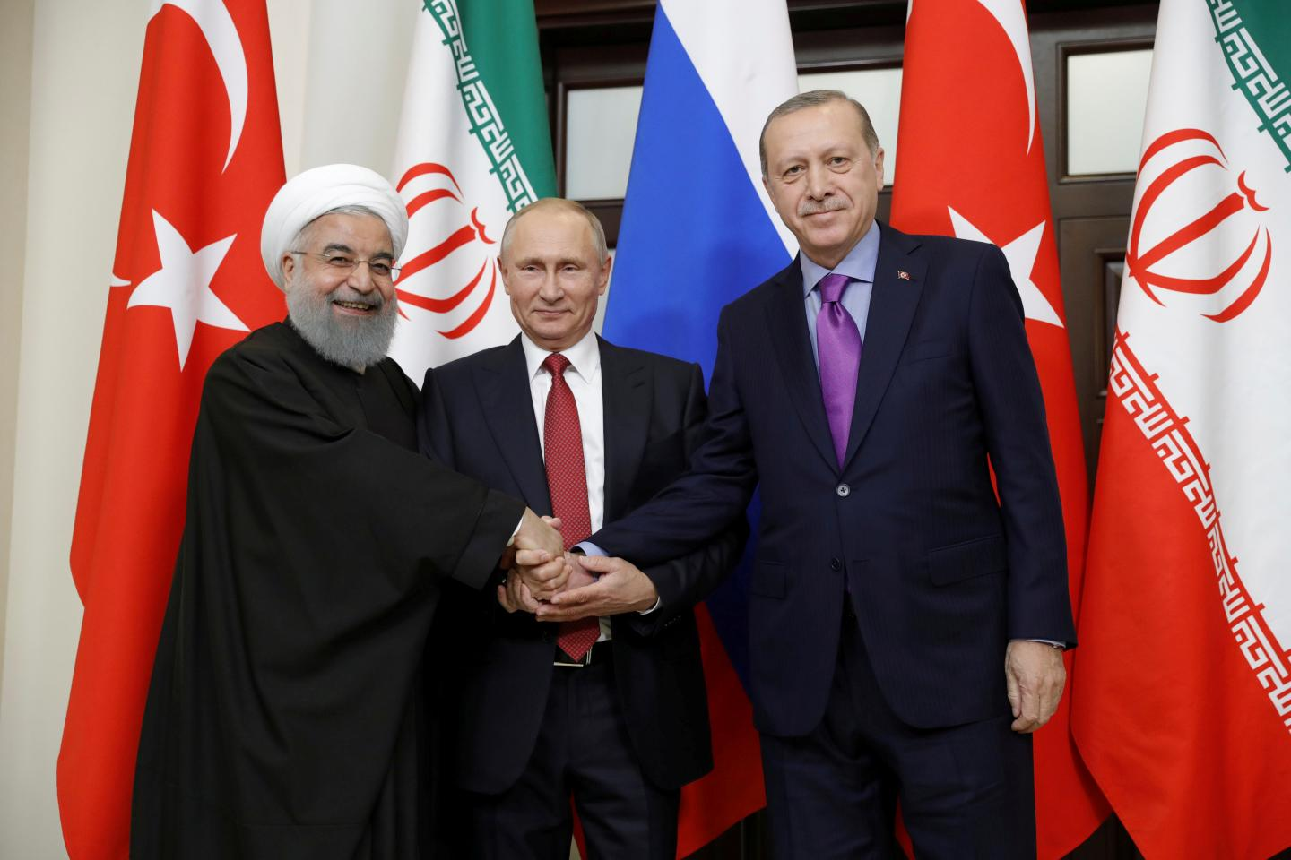

Slide 41
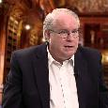
Ron Rhodes
Ron Rhodes, Northern Storm Rising: Russia, Iran, and the Emerging End-Times Military Coalition against Israel (Eugene, OR: Harvest, 2008), pp. 90.
“The unique alignment of nations described in Ezekiel 38 and 39 has never occurred in the past, but it is occurring now.”

Slide 42
Shem’s Sons (vs. 22)
  Elam
  Asshur
  Arphachshad
  Lud
  Aram

Slide 43

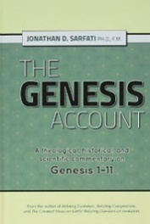
Asshur = Assyria
Jonathan D. Sarfati, The Genesis Account: A Theological, Historical, and Scientific Commentary on Genesis 1‒11 (Powder Springs, GA: Creation Book Publishers, 2015), 651.
“Asshur was the ancestor of the Assyrians. Indeed, whenever the English word ‘Assyria’ is used, it is the Hebrew Asshur (‘ashshûr). These Shemitic Assyrians replaced the Hamitic Assyrians of 10:11. Assyria later became a powerful empire noted for its cruelty.”

Slide 44

Shinar

Slide 45
Israel's Judgments
Division of the kingdom in 931 B.C. (1 Kgs. 12)
Assyrian judgment in 722 B.C. (2 Kgs. 17)
Babylonian captivity in 586 B.C. (2 Kgs. 25)
Rome Diaspora in A.D. 70 (Luke 19:41-44)

Slide 46
Shem’s Sons (vs. 22)
  Elam
  Asshur
  Arphachshad
  Lud
  Aram

Slide 47
5. Aram’s Sons (vs. 23)
  Uz
  Hul
  Gether
  Mash

Slide 48
5. Aram’s Sons (vs. 23)
  Uz
  Hul
  Gether
  Mash

Slide 49
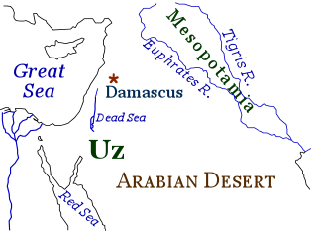

Slide 50
Shem’s Sons (vs. 22)
  Elam
  Asshur
  Arphachshad
  Lud
  Aram

Slide 51
Eber’s Sons (vs. 25)
  Peleg
  Joktan

Slide 52
Eber’s Sons (vs. 25)
  Peleg
  Joktan

Slide 53
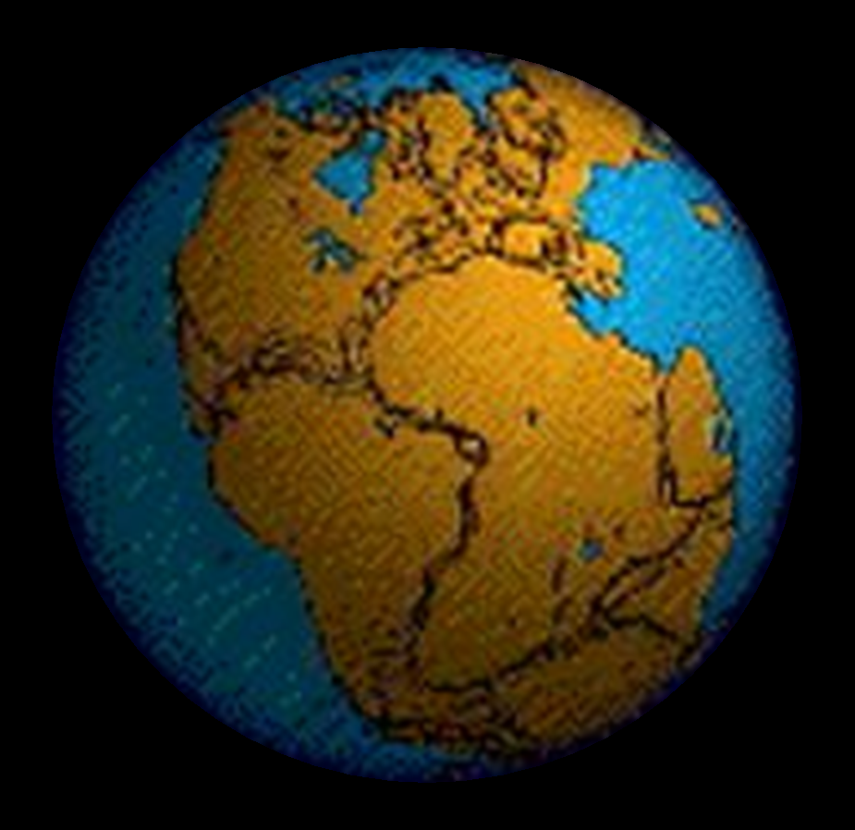

Slide 54
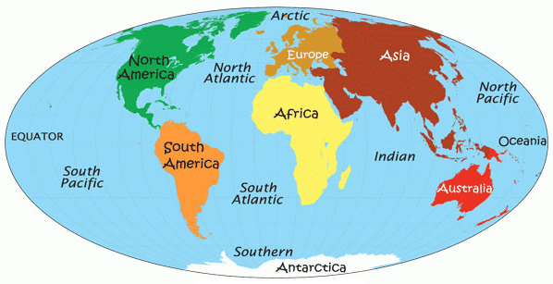

Slide 55

Genesis 11:1-9
¹ Now the whole earth used the same language and the same words. ² It came about as they journeyed east, that they found a plain in the land of Shinar and settled there. ³ They said to one another, “Come, let us make bricks and burn them thoroughly.” And they used brick for stone, and they used tar for mortar. ⁴ They said, “Come, let us build for ourselves a city, and a tower whose top will . . .

Slide 56
Dr. Arnold G. Fruchtenbaum
The Book of Genesis, 219
“…the name of the one was Peleg. For in his days was the earth divided. The name Peleg means ‘to divide.’ Some identify this event with the continental divide or the continental drift. However, contextually, it more likely refers to the language division of the Tower of Babel judgment. This means that the confusion of tongues occurred during Peleg’s lifetime.”

Slide 57

Dr. Henry M. Morris
The Genesis Record, 260-61
“Evidently this was a most memorable event, and Eber named his son in commemoration of it. The name Peleg means ‘division.’… The big question concerns the meaning of the indicated division of the earth. The most obvious interpretation of this verse is that the division was the division of the peoples at the Tower of Babel, as discussed in Genesis 11. It is significant that some such division is mentioned here in Genesis 10:5 (‘By these were the isles of the Gentiles divided in their lands; every one after his tongue, after their families, in their nations’) and Genesis 10:32 (‘. . . by these were the nations divided in the earth after the flood’).”

Slide 58
Dr. Henry M. Morris
The Genesis Record, 260-61
“These verses seem clearly to refer to a linguistic and geographic division, rather than to an actual splitting of the continents. This is especially clear in verse 5, where the division is specifically ‘after his tongue.’… If it is ever actually proved that the earth once was a single land mass that somehow split apart, with the segments gradually drifting away to form the present continents, then indeed this verse might be understood to refer to such an event. At present, the question of continental drift is still open among scientists; and creationist scientists have pointed to a number of unresolved physical difficulties with the whole idea.”

Slide 59
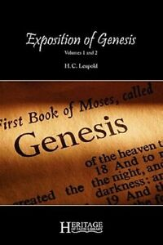
H. C. Leupold
H.C. Leupold, Exposition of Genesis, 1:378.
“Peleg means ‘division’, for he lived at the time when the earth was divided (niphlegah) and the name given to the man is in memory of this event. The event referred to must be the one under consideration—the Confusion of Tongues.”

Slide 60
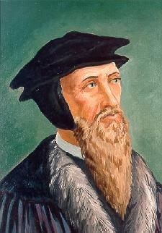
John Calvin
Genesis, 1554 (Edinburgh, UK: Banner of Truth, 1984), p. 324.
“For after he [Moses] has mentioned Arphaxad as the third of the sons of Shem, he then names Peleg, his great grandson, in whose days the languages were divided.”

Slide 61
Eber’s Sons (vs. 25)
  Peleg
  Joktan

Slide 62
Joktan’s Sons (vs. 26-29)
  Alamodad
  Sheleph
  Hazarmaveth
  Jerah
  Hadoram
  Uzal
  Diklah
  Obal
  Abimael
  Sheba
  Ophir
  Havilah
  Jobab

Slide 63
GENESIS 10
Outline
  Introduction (1)
  Japheth's line (2-5)
  Ham’s Line (6-20)
  Shem’s line (21-31)
  Conclusion (32)

Slide 64
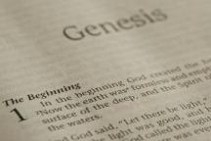
Beginning Themes
Universe Life Man Marriage Evil Clothing | Religion Salvation Language Government Nations Israel
Morris, Genesis Record, 18-20

Slide 65

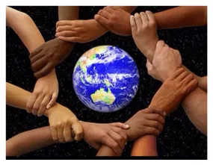
Acts 17:26
“and He made from one man [Adam] every nation of mankind to live on all the face of the earth, having determined their appointed times and the boundaries of their habitation,”

Slide 66
Conclusion

Slide 67
GENESIS 10
Outline
  Introduction (1)
  Japheth's line (2-5)
  Ham’s Line (6-20)
  Shem’s line (21-31)
  Conclusion (32)

Slide 68
Outline
  Table of nations (Gen 10)
  Tower of Babel (Gen 11:1-9)
  Genealogy from Shem to Terah (Gen 11:10-32)

Slide 69

“The Lord bless you and keep you; the Lord make his face shine on you and be gracious to you; the Lord turn his face toward you and give you peace.” (NIV)

