Slide 1


THE RAPTURE
What and When? – Part 57
Andrew Marshall Woods, Th.M., JD., PhD.
Sr. Pastor, Sugar Land Bible Church

Slide 2
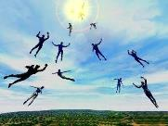
The Rapture
Course Overview
What is the Rapture?
When is the Rapture?
Strengthening the Pre-Tribulational case
The opposing views
One second after the Rapture

Slide 3
The Rapture
Course Overview
What is the Rapture?
When is the Rapture?
Strengthening the Pre-Tribulational case
The opposing views
One second after the Rapture

Slide 4

What is the Rapture?
An important doctrine
Distinct from the Second Advent
Catching away of all living believers (1 Thess 4:17)
Reunion (1 Thess 4:14-16)
Resurrection (1 Cor 15:50-54)
Exemption from death (1 Cor 15:51, 54-56)
Instantaneous (1 Cor 15:52)
Mystery (1 Cor 15:51)
Imminent (1 Cor 15:51; 1 Thess 4:15)
Traditional doctrine now being recovered

Slide 5
The Rapture
Course Overview
What is the Rapture?
When is the Rapture?
Strengthening the Pre-Tribulational case
The opposing views
One second after the Rapture

Slide 6
When is the Rapture?
7 Arguments Favoring the Pre-Tribulation View
Tribulation's purpose concerns Israel (Jer 30:7; Dan 9:24)
No biblical reference to the church on earth during the Tribulation period (Rev 4-22)
Church is promised an exemption from divine wrath (1 Thess 1:10; 5:9; Rom 5:9; Rev 3:10; 6:17)
Rapture is imminent (1 Cor 15:51; 1 Thess 4:15)
Rapture is a comfort (1 Thess 4:18)
Antichrist cannot come to power until the restrainer is removed (2 Thess 2:6-7)
Symbolic parallels (2 Peter 2:5-9)

Slide 7
The Rapture
Course Overview
What is the Rapture?
When is the Rapture?
Strengthening the Pre-Tribulational case
The opposing views
One second after the Rapture

Slide 8
Strengthening the Pre-Tribulation Case
John 14:1-4
Revelation 3:10
First Thessalonians 4‒5
Second Thessalonians 2:3a
Matthew 24‒25

Slide 9
The Rapture
Course Overview
What is the Rapture?
When is the Rapture?
Strengthening the Pre-Tribulational case
The opposing views
One second after the Rapture

Slide 10
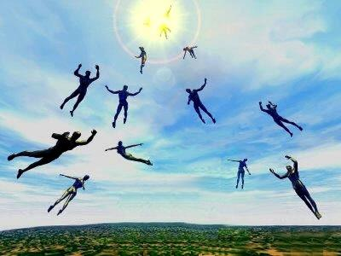
When Will the Rapture Take Place Relative to the Tribulation Period?
Pre-tribulation rapture theory
Mid-tribulation rapture theory
Post-tribulation rapture theory
Pre-wrath rapture theory
Partial rapture theory

Slide 11
The Rapture
Course Overview
What is the Rapture?
When is the Rapture?
Strengthening the Pre-Tribulational case
The opposing views
One second after the Rapture

Slide 12
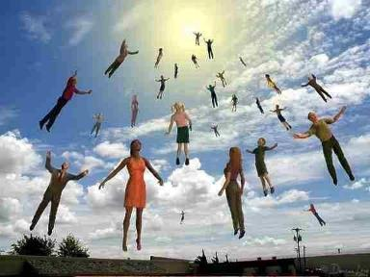

One Second After the Rapture
Sugar Land Bible Church 2021
Dr. Andy Woods
Senior Pastor – Sugar Land Bible Church
President – Chafer Theological Seminary

Slide 13

One Second After the Rapture
For the believer
For the unbeliever
So what?

Slide 14
One Second After the Rapture
For the believer
For the unbeliever
So what?

Slide 15

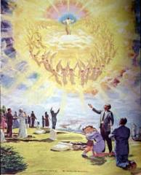
1. For the Believer
Reunion (1 Thess. 4:13-18)
Resurrection (1 Cor. 15:51, 53-55)
Reward (2 Cor. 5:10)

Slide 16
1. For the Believer
Reunion (1 Thess. 4:13-18)
Resurrection (1 Cor. 15:51, 53-55)
Reward (2 Cor. 5:10)

Slide 17

1 Thessalonians 4:13-18
^{13 “}But we do not want you to be uninformed, brethren, about those who are asleep, so that you will not grieve as do the rest who have no hope. ¹⁴ For if we believe that Jesus died and rose again, even so God will bring with Him those who have fallen asleep in Jesus. ¹⁵ For this we say to you by the word of the Lord, that we who are alive and remain until the coming of the Lord, will not precede. . .

Slide 18
1 Thessalonians 4:13-18
...those who have fallen asleep. ¹⁶ For the Lord Himself will descend from heaven with a shout, with the voice of the archangel and with the trumpet of God, and the dead in Christ will rise first. ¹⁷ Then we who are alive and remain will be caught up together with them in the clouds to meet the Lord in the air, and so we shall always be with the Lord. ¹⁸ Therefore comfort one another with these words.”

Slide 19
1. For the Believer
Reunion (1 Thess. 4:13-18)
Resurrection (1 Cor. 15:51, 53-55)
Reward (2 Cor. 5:10)

Slide 20

1 Corinthians 15:50-51
“⁵⁰ Now I say this, brethren, that flesh and blood cannot inherit the kingdom of God; nor does the perishable inherit the imperishable. ⁵¹ Behold, I tell you a mystery; we will not all sleep, but we will all be changed.”

Slide 21

Romans 8:19-23
¹⁹ “For the anxious longing of the creation waits eagerly for the revealing of the sons of God. ²⁰ For the creation was subjected to futility, not willingly, but because of Him who subjected it, in hope ²¹ that the creation itself also will be set free from its slavery to corruption into the freedom of the glory of the children of God. ²² For we know that the whole creation groans and suffers the . . .

Slide 22
Romans 8:19-23
. . . pains of childbirth together until now. ²³ And not only this, but also we ourselves, having the first fruits of the Spirit, even we ourselves groan within ourselves, waiting eagerly for our adoption as sons, the redemption of our body.”

Slide 23
1. For the Believer
Reunion (1 Thess. 4:13-18)
Resurrection (1 Cor. 15:51, 53-55)
Reward (2 Cor. 5:10)

Slide 24

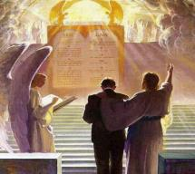
2 Corinthians 5:10
“For we must all appear before the judgment seat of Christ, so that each one may be recompensed for his deeds in the body, according to what he has done, whether good or bad.”

Slide 25
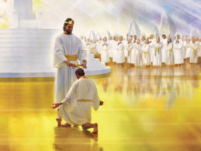
Our Performance Appraisals

Slide 26

Why?
Not to judge sin (John 19:30)
Not to determine salvation (John 5:24)
But rather to give or not give rewards

Slide 27

John 5:24
“Truly, truly, I say to you, he who hears My word, and believes Him who sent Me, has eternal life, and does not come into judgment, but has passed out of death into life.”

Slide 28
Scripture’s Five Crowns (Rev 4:10: 3:11; 2 John 8)
SCRIPTURE | CROWN | PURPOSE
1 Cor. 9:24-27 | Incorruptible | Gaining mastery over the flesh
1 Thess. 2:19-20 | Rejoicing | Soul winning
Jas. 1:12; Rev. 2:10 | Life | Enduring trials
1 Pet. 5:2-4 | Glory | Shepherding God’s people
2 Tim. 4:8 | Righteousness | Longing for His appearing

Slide 29

1 Corinthians 3:14-15
“¹⁴ If any man’s work which he has built on it remains, he will receive a reward. ¹⁵ If any man’s work is burned up, he will suffer loss; but he himself will be saved, yet so as through fire.”

Slide 30
One Second After the Rapture
For the believer
For the unbeliever
So what?

Slide 31
2. For the Unbeliever
A perverted explanation to be offered
Change in God’s program
Identification of the Antichrist
Global governance
One-world religion
Signs & wonders movement
The demise of America
God’s wrath

Slide 32
2. For the Unbeliever
A perverted explanation to be offered
Change in God’s program
Identification of the Antichrist
Global governance
One-world religion
Signs & wonders movement
The demise of America
God’s wrath

Slide 33

Explanation of the missing
“Your unfinished species is ready to evolve. The time has come on Earth for this quantum change to occur in many of you." Her "Christ" further informed her "I cannot 'return' until enough of you are attracted and linked." Hubbard's "Christ" explained, "I did not intend for you to deify me, but to deify yourselves as being at the same stage of evolution as I am." "Suffice it to say, that if you do not choose to evolve into a wholesome, co-creative human, then you shall not." "...the fundamental regression is self-centeredness, or the illusion that you are separate from God. I 'make war' on self-centeredness.“…
Barbara Marx Hubbard, The Revelation: A Message of Hope for the New Millennium, 2nd ed. (Novato, CA: Nataraj, 1995), 65, 66, 195, 233, 240, 255.

Slide 34
Explanation of the missing (cont’d)
…Furthermore, "At the co-creative stage of evolution, one self-centered soul is like a lethal cancer cell in a body; deadly to itself and to the whole." Thus, "The surgeon dare leave no cancer in the body when he closes up the wound after a delicate operation. We dare leave no self-centered person on Earth after the selection process.”
Barbara Marx Hubbard, The Revelation: A Message of Hope for the New Millennium, 2nd ed. (Novato, CA: Nataraj, 1995), 65, 66, 195, 233, 240, 255.

Slide 35

The Coming Synthesis
“The coming of the Aquarian age also stimulates in man a spirit of universality and a tendency towards fusion. This can be seen working out in the present trend towards synthesis in business, in religion and in politics. It produces an urge towards union, and among other unions, towards religious understanding and tolerance...False and true standards will emerge in man’s consciousness, and those choices will be made which will lay the foundation of the new order, which will inaugurate the new race, with its new laws and novel approaches, and so usher in the new religion of love and brotherhood, and that period wherein the group and the group-good will be the dominant note. Then separateness and hatreds will fade out and men will be merged in a true unity."
Alice A. Bailiey and Dijwhal Khul, The Seventh Ray: Revealer of the New Age (NY: Lucius Press, 1995), 198-99.

Slide 36
Explanation of the missing
New Age writer Randolph Price says that his spirit guide, an "awakened one" called "Asher," has informed him that "Nature will soon enter her cleansing cycle" during which those of "lower vibratory rates" will purified off the planet. Perhaps one of the factors which will bring the antichrist to power will be his ability to restore order from chaos by offering an acceptable explanation for all of the missing Christians.
Randall Baer, Inside the New Age Nightmare (Lafayette, LA: Huntington House, 1989), 169.

Slide 37

Explanation of the missing
“The people who leave the planet during the time of Earth changes do not fit in here any longer, and they are stopping the harmony of Earth. When the time comes that perhaps 20 million people leave the planet at one time there will be a tremendous shift in consciousness for those who are remaining.”
Barbara Marciniak, Bringers of the Dawn: Teachings from the Pleiadians (Rochester, VT: Bear and Co., 1992), cited in “Rapture: The New Age Version,” <www.redmoonrising.com/newage.htm>, 29 January, 2010. See Gary Bates, Alien Intrusion: UfOs and the Evolution Connection (Powder Springs, GA: Creation Book Publishers, 2004), 367-68.

Slide 38
2. For the Unbeliever
A perverted explanation to be offered
Change in God’s program
Identification of the Antichrist
Global governance
One-world religion
Signs & wonders movement
The demise of America
God’s wrath

Slide 39
Change in God’s Program
From the Church to Israel
In the Holy Spirit’s operation

Slide 40
Change in God’s Program
From the Church to Israel
In the Holy Spirit’s operation

Slide 41

Romans 11:25-26
“²⁵ For I do not want you, brethren, to be uninformed of this mystery—so that you will not be wise in your own estimation—that a partial hardening has happened to Israel until the fullness of the Gentiles has come in; ²⁶ and so all Israel will be saved; just as it is written, ‘The Deliverer will come from Zion, He will remove ungodliness from Jacob.’”

Slide 42
Jeremiah 31:35-37
Thus says the Lord, Who gives the sun for light by day And the fixed order of the moon and the stars for light by night, Who stirs up the sea so that its waves roar; The Lord of hosts is His name:³⁶ “If this fixed order departs From before Me,” declares the Lord, “Then the offspring of Israel also will cease From being a nation before Me forever.”³⁷ Thus says the Lord, “If the heavens above can be measured And the foundations of the earth searched out below, Then I will also cast off all the offspring of Israel For all that they have done,” declares the Lord.

Slide 43


Slide 44


Slide 45
Distinctions Between 144,000 & Multitude
144,000 | MULTITUDE
Revelation 7:1-8 | Revelation 7:9-17
Numbered | Innumerable
Jews | All nations
Sealed | Slain
Sealed before the Tribulation | Converted out of the Tribulation
Hitchcock and Ice, The Truth Behind Left Behind, 77

Slide 46
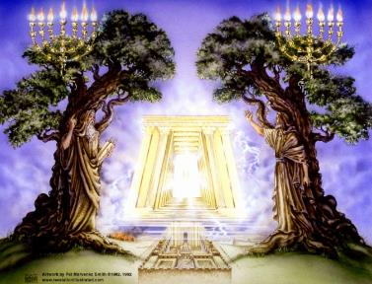
God’s Work Through Israel
Rev 7-144,000 Jews
Rev 11-Two Jewish witnesses
Rev 12-Israel flees

Slide 47


Jeremiah 30:7
“Alas! for that day is great, There is none like it; And it is the time of Jacob’s distress (Gen. 32:8; 35:10), But he will be saved from it.”

Slide 48
Change in God’s Program
From the Church to Israel
In the Holy Spirit’s operation

Slide 49


Slide 50

1 Samuel 16:13-14
¹³ Then Samuel took the horn of oil and anointed him in the midst of his brothers; and the Spirit of the Lord came mightily upon David from that day forward. And Samuel arose and went to Ramah. ¹⁴ Now the Spirit of the Lord departed from Saul, and an evil spirit from the Lord terrorized him.

Slide 51
John 14:16-17
¹⁶ I will ask the Father, and He will give you another Helper, that He may be with you forever; ¹⁷ that is the Spirit of truth, whom the world cannot receive, because it does not see Him or know Him, but you know Him because He abides with you and will be in you.

Slide 52
WORK OF THE SPIRIT IN THE OT
 | OT/GOSPELS | TODAY
External vs. Internal | Upon (1 Sam. 16:13) | Within (John 14:17)
Reception of all of the Spirit at the moment of salvation? | Subsequent to salvation (Exod 31:3) | At moment of salvation (Rom 8:9)
How long is the indwelling? | Temporary indwelling (1 Sam 16:14; Ps 51:11) | Permanent indwelling (John 14:16)
Who is indwelt? | Selective indwelling (Joel 2:28) | Universal indwelling (1 Cor 12:13)

Slide 53

Daniel 9:24
Seventy weeks have been decreed for your people and your holy city, to finish the transgression, to make an end of sin, to make atonement for iniquity, to bring in everlasting righteousness, to seal up vision and prophecy and to anoint the most holy place.

Slide 54


Slide 55
Daniel 9:24
Seventy weeks have been decreed for your people and your holy city, to finish the transgression, to make an end of sin, to make atonement for iniquity, to bring in everlasting righteousness, to seal up vision and prophecy and to anoint the most holy place.

Slide 56
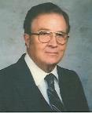

Robert Culver
Daniel and the Latter Days
(Chicago, IL: Moody Press, 1977), p. 149
“Let the postmillennial and amillennial commentators look long and steadily at this fact. This prophecy is a prophecy for Daniel’s people and Daniel’s city. No alchemy of Origenistic spiritualizing interpretation can change that.”

Slide 57
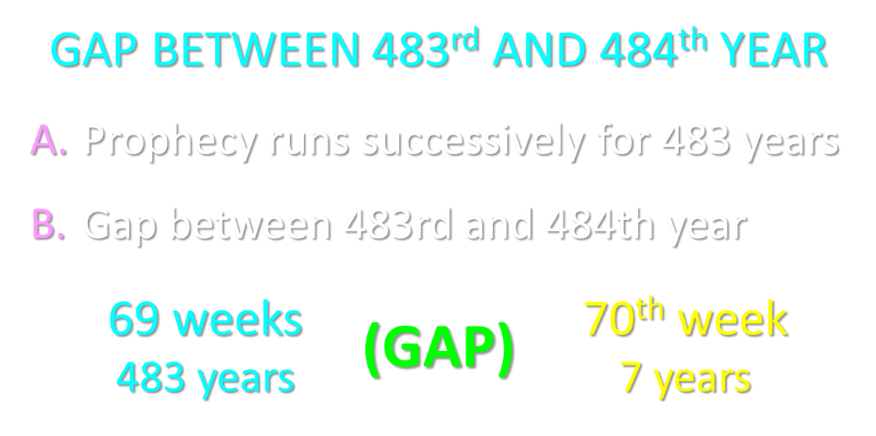

Slide 58
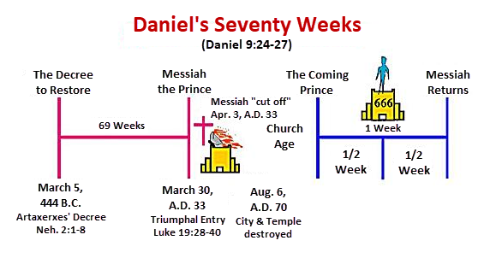

Slide 59
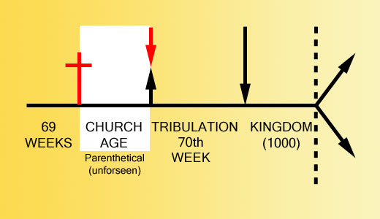

Slide 60


Slide 61
2. For the Unbeliever
A perverted explanation to be offered
Change in God’s program
Identification of the Antichrist
Global governance
One-world religion
Signs & wonders movement
The demise of America
God’s wrath

Slide 62
2 Thessalonians 2:6-7
⁶And you know what restrains [katechon; neuter] him now, so that in his time he will be revealed. ⁷For the mystery of lawlessness is already at work; only he who now restrains [katechōn; masculine] will do so until he is taken out of the way.

Slide 63
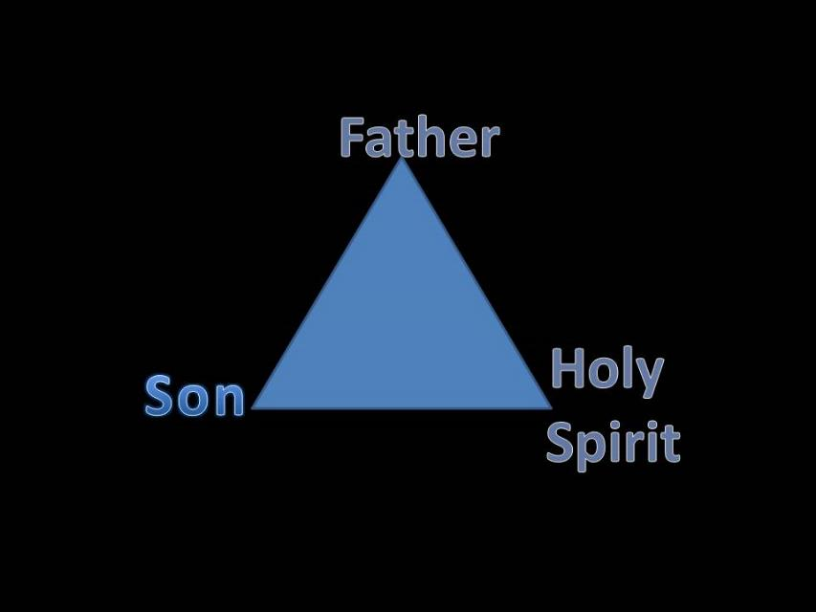
Trinity

Slide 64


Slide 65

3 Reasons Why the Restrainer is the Holy Spirit
(2 Thessalonians 2:6-7)
The Holy Spirit is omnipotent
The Holy Spirit view handles well the switch in gender from the neuter (vs. 6) to the masculine (vs. 7)
The Holy Spirit is active in the world (Gen. 6:3; John 16:7-11)

Slide 66
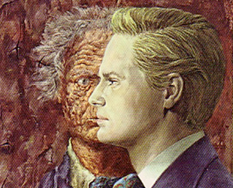
Who is the Antichrist?
“We will not, however, incur the risk of pronouncing positively as to the name of Antichrist; but if it had been necessary to announce his name plainly at the present time, it would have been spoken by him who saw the apocalypse. For it was not seen long ago, but almost in our own time, at the end of the reign of Domitian.”
Irenaeus Against Heresies 5.30.3

Slide 67

Ezekiel 28:13, 15
¹³ “You were in Eden, the garden of God; Every precious stone was your covering: The ruby, the topaz and the diamond; The beryl, the onyx and the jasper; The lapis lazuli, the turquoise and the emerald; And the gold, the workmanship of your settings and sockets, Was in you. On the day that you were created They were prepared… ¹⁵ “You were blameless in your ways From the day you were created Until unrighteousness was found in you.

Slide 68

Revelation 13:16-18
¹⁶ And he causes all, the small and the great, and the rich and the poor, and the free men and the slaves, to be given a mark on their right hand or on their forehead, ¹⁷ and he provides that no one will be able to buy or to sell, except the one who has the mark, either the name of the beast or the number of his name. ¹⁸ Here is wisdom. Let him who has understanding calculate the number of the beast, for the number is that of a man; and his number is six hundred and sixty-six.

Slide 69
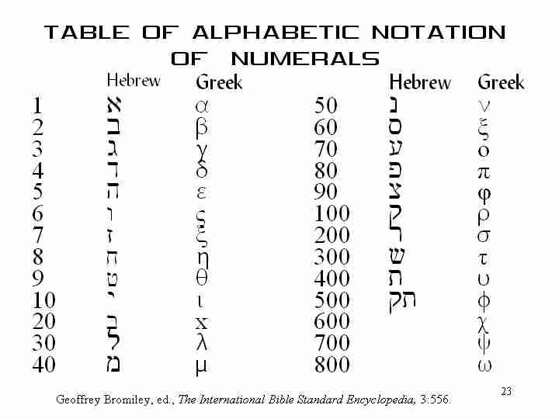

Slide 70



Slide 71
2. For the Unbeliever
A perverted explanation to be offered
Change in God’s program
Identification of the Antichrist
Global governance
One-world religion
Signs & wonders movement
The demise of America
God’s wrath

Slide 72


Daniel 7:23
“The fourth beast will be a fourth kingdom on the earth, which will be different from all the other kingdoms and will devour the whole earth and tread it down and crush it.”

Slide 73
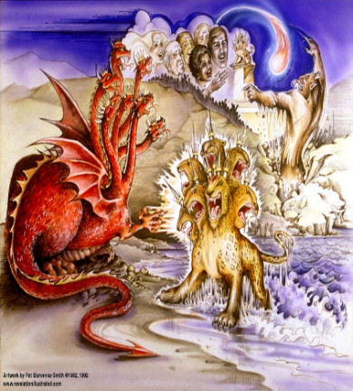
Satan’s Goal of Globalism
  Dan. 7:23
  Rev. 13:7-8; Rev. 5:9
  Rev. 13:16-18
  Rev. 17:15

Slide 74

Zechariah 5:5-11
Woman (wickedness)
Ephah (commerce)
House (Temple-2 Sam 7; religion)
Shinar (Gen 10:10; 11:2; Dan 1:2)

Slide 75
2 Thessalonians 2:6-7
⁶And you know what restrains [katechon; neuter] him now, so that in his time he will be revealed. ⁷For the mystery of lawlessness is already at work; only he who now restrains [katechōn; masculine] will do so until he is taken out of the way.

Slide 76
Zechariah 5:5-11 | Revelation 17–18
Woman sitting in a basket | Woman sitting on beast, seven mountains, many waters (17: 3, 9, 15)
Emphasis on commerce (a basket for measuring grain) | Emphasis on commerce (merchant of grain, 18:13)
Woman’s name is wickedness | Woman’s name is Babylon the Great, Mother of Harlots and Abominations of the Earth
Focus on False worship (a temple is built for the woman) | Focus on False worship (17:5)
Woman is taken to Babylon | Woman is called Babylon
Hitchcock, The Second Coming of Babylon, 109.

Slide 77


Slide 78
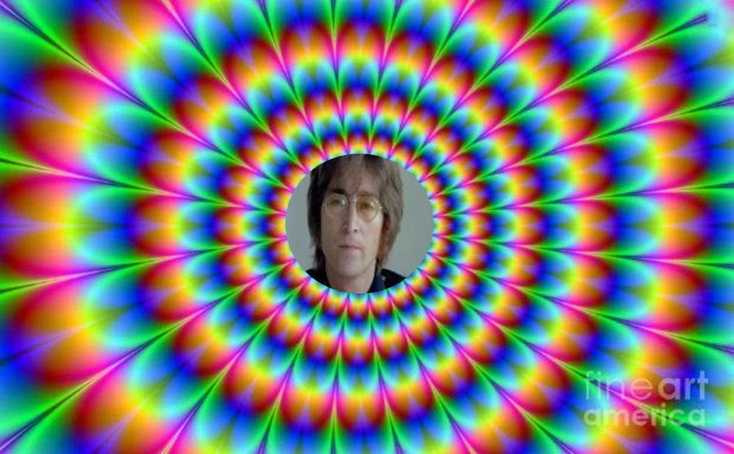
John Lennon
Song “Imagine”
… imagine a time when there will be “no countries,” “no religion,” “no heaven,” “no hell,” “no possessions,” everyone “living for today,” and the world “as one.”

Slide 79
2. For the Unbeliever
A perverted explanation to be offered
Change in God’s program
Identification of the Antichrist
Global governance
One-world religion
Signs & wonders movement
The demise of America
God’s wrath

Slide 80

2 Thessalonians 2:3, 7
“…the man of lawlessness is revealed, the son of destruction…For the mystery of lawlessness is already at work; only he who now restrains will do so until he is taken out of the way.”

Slide 81
1 John 4:3
“and every spirit that does not confess Jesus is not from God; this is the spirit of the antichrist, of which you have heard that it is coming, and now it is already in the world.”

Slide 82
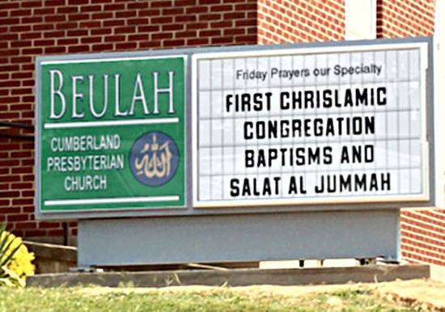
Chrislam?

Slide 83
2. For the Unbeliever
A perverted explanation to be offered
Change in God’s program
Identification of the Antichrist
Global governance
One-world religion
Signs & wonders movement
The demise of America
God’s wrath

Slide 84

2 Thessalonians 2:9
“that is, the one whose coming is in accord with the activity of Satan, with all power and signs and false wonders.”

Slide 85
Antichrist’s Satanic Miracles (2 Thessalonians 2:9)
MIRACLE | GREEK | CHRIST’S MINISTRY
Powers | Dynamis | Matt. 11:20
Signs | Semēion | John 20:30
Wonders | Teras | Acts 2:22

Slide 86

Satanic/Demonic Miracles
Exod. 7–8
Deut. 13:1-3
Job 1:12-19; 2:7-8
1 Sam. 28?
Matt. 7:21-23; 24:24
Acts 8:9; 16:16
Gal. 1:6-9
2 Thess. 2:9
Rev. 13:3, 13, 15; 16:13-14

Slide 87
2. For the Unbeliever
A perverted explanation to be offered
Change in God’s program
Identification of the Antichrist
Global governance
One-world religion
Signs & wonders movement
The demise of America
God’s wrath

Slide 88

God Blesses His Truth
Proverbs 14:34
“Righteousness exalts a nation, but sin is a reproach to any people.”
Ps 33:12
“Blessed is the nation whose God is the Lord.”

Slide 89

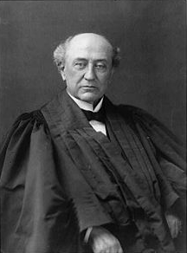
America is a “Christian Nation”
“This is historically true. From the discovery of this continent to the present hour, there is a single voice making this affirmation… These are not the sayings, declarations of private persons: they are organic utterances; they speak the voice of the entire people…These and many other matters which might be noticed, add a volume of unofficial declarations to the mass of organic utterances that this is a Christian nation.”
Church of the Holy Trinity v. U.S., 143 U.S. 457, 465, 470-71 (1892)

Slide 90


Slide 91
2. For the Unbeliever
A perverted explanation to be offered
Change in God’s program
Identification of the Antichrist
Global governance
One-world religion
Signs & wonders movement
The demise of America
God’s wrath

Slide 92

Pretribulationism is not Escapism
Trials (John 16:33)
Man’s wrath (2 Tim 3:12)
Satan’s wrath (Eph 6:11-12)
World’s wrath (John 15:18-19)

Slide 93

Promised Exemption from Divine Wrath
The promise (1 Thess 1:10; 5:9; Rom 5:9; 8:1; Rev 3:10)
Tribulation = divine wrath (Rev 6:16-17; 11:18; 15:1, 7; 16:1, 19)

Slide 94

God’s Role in Redemption (Rev 5)
Seven sealed scroll (5:1)
John weeps (5:2-4)
Christ is qualified to open the scroll (5:5-6)
Christ takes the scroll (5:7)
Christ praised by various entities (5:8-14)

Slide 95

Telescoping
7th judgment releases 1st in next series
Seals: 1 2 3 4 5 6 7
Trumpets: 1 2 3 4 5 6 7
Bowls: 1 2 3 4 5 6 7

Slide 96


Slide 97
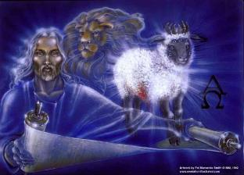
1st Six Seals (Rev 6)
6:1-2 – Advent of antichrist
6:3-4 – War
6:5-6 – Famine
6:7-8 – Death
6:9-11 – Martyrdoms
6:12-17 – Cosmic disturbances

Slide 98
Revelation 6:16-17
^{“16} and they said to the mountains and the rocks, ‘Fall on us and hide us from the sight of Him who sits on the throne, and from the wrath [orgḗ] of the Lamb; ¹⁷ for the great day of Their wrath [orgḗ] has come, and who is able to stand?’”

Slide 99

Robert L. Thomas
Rev. 6:16-17
"The verb ēlethen ("has come") is aorist indicative, referring to a previous arrival of wrath, not something that is about to take place. Men see the arrival of this day at least as early as the cosmic upheavals that characterize the sixth seal (6:12-14), but upon reflection they probably recognize that it was already in effect with the death of one-fourth of the population (6:7-8), the worldwide famine (6:5-6), and the global warfare (6:3-4). The rapid sequence of all of these events could not escape notice, but the light of their true explanation does not dawn upon human consciousness until the severe phenomena of the sixth seal arrive."
Robert L. Thomas, Revelation 1–7: An Exegetical Commentary, ed. Kenneth Barker (Chicago: Moody, 1992), 457-58.

Slide 100
2 Peter 2:7-9
“⁷and if He rescued righteous Lot, oppressed by the sensual conduct of unprincipled men ⁸ (for by what he saw and heard that righteous man, while living among them, felt his righteous soul tormented day after day by their lawless deeds), ⁹ then the Lord knows how to rescue the godly from temptation, and to keep the unrighteous under punishment for the day of judgment.”

Slide 101
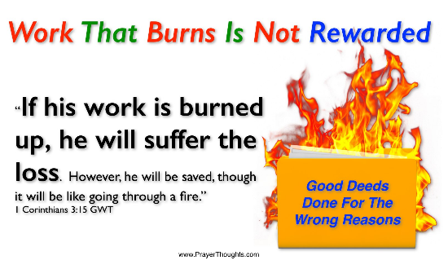
Genesis 19:22
“Hurry, escape there, for I cannot do anything until you arrive there.” Therefore the name of the town was called Zoar.”

Slide 102
2. For the Unbeliever
A perverted explanation to be offered
Change in God’s program
Identification of the Antichrist
Global governance
One-world religion
Signs & wonders movement
The demise of America
God’s wrath

Slide 103
One Second After the Rapture
For the believer
For the unbeliever
So what?

Slide 104
3. So What?
Uniformitarianism?
Live for Christ
Reach the lost
Believe the Gospel

Slide 105
3. So What?
Uniformitarianism?
Live for Christ
Reach the lost
Believe the Gospel

Slide 106

2 Peter 3:3-6
“³ Know this first of all, that in the last days mockers will come with their mocking, following after their own lusts, ⁴ and saying, ‘Where is the promise of His coming? For ever since the fathers fell asleep, all continues just as it was from the beginning of creation.’ ⁵ For when they maintain this, it escapes their notice that by the word of God the heavens existed long ago and the earth was formed out of water and by water. ⁶ through which the world at that time was destroyed by being flooded with water.”

Slide 107
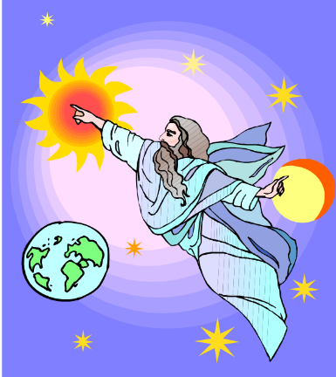
HISTORY
2 Pet. 3:5-7
Creation (5)
Flood (6-7)
  God will judge again via fire

Slide 108
3. So What?
Uniformitarianism?
Live for Christ
Reach the lost
Believe the Gospel

Slide 109
Romans 13:11-12
“Do this, knowing the time, that it is already the hour for you to awaken from sleep; for now salvation is nearer to us than when we believed. ¹² The night is almost gone, and the day is near. Therefore let us lay aside the deeds of darkness and put on the armor of light.”

Slide 110
3. So What?
Uniformitarianism?
Live for Christ
Reach the lost
Believe the Gospel

Slide 111
3. So What?
Uniformitarianism?
Live for Christ
Reach the lost
Believe the Gospel

Slide 112
John 5:24
“Truly, truly, I say to you, he who hears My word, and believes Him who sent Me, has eternal life, and does not come into judgment, but has passed out of death into life.”

Slide 113
Review: One Second After the Rapture
For the believer
For the unbeliever
So what?

Slide 114
CONCLUSION

Slide 115
The Rapture
Course Overview
What is the Rapture?
When is the Rapture?
Strengthening the Pre-Tribulational case
The opposing views
One second after the Rapture

