Slide 1


Genesis 10‒11
National Dispersion

Slide 2


GENESIS STRUCTURE
  Beginning of the Human race (Gen. 1‒11)
  Beginning of the Hebrew race (Gen. 12‒50)

Slide 3

GENESIS STRUCTURE
  Genesis 1-11 (four events)
    Creation (1-2)
    Fall (3-5)
    Flood (6-9)
    National dispersion (10-11)

Slide 4
GENESIS STRUCTURE
  Genesis 1-11 (four events)
    Creation (1-2)
    Fall (3-5)
    Flood (6-9)
    National dispersion (10-11)

Slide 5


Genesis 3:15
“And I will put enmity Between you and the woman, And between your seed and her seed; He shall bruise you on the head, And you shall bruise him on the heel.”

Slide 6
GENESIS STRUCTURE
  Genesis 1-11 (four events)
    Creation (1-2)
    Fall (3-5)
    Flood (6-9)
    National dispersion (10-11)

Slide 7
GENESIS STRUCTURE
  Genesis 1-11 (four events)
    Creation (1-2)
    Fall (3-5)
    Flood (6-9)
    National dispersion (10-11)

Slide 8
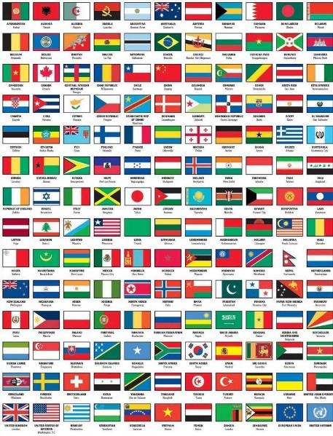
Outline
  Table of nations (Gen 10)
  Tower of Babel (Gen 11:1-9)
  Genealogy from Shem to Terah (Gen 11:10-32)

Slide 9
Outline
  Table of nations (Gen 10)
  Tower of Babel (Gen 11:1-9)
  Genealogy from Shem to Terah (Gen 11:10-32)

Slide 10
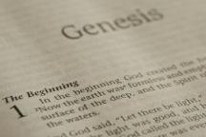
Beginning Themes
Universe Life Man Marriage Evil Clothing | Religion Salvation Language Government Nations Israel
Morris, Genesis Record, 18-20

Slide 11
Genesis 10–11
  Sinful origin of the nations necessitating Israel’s unique birth and redemptive purpose to these nations
  Gen 11:1-9 occurs first and Genesis 10 occurs second (Gen 10:5, 20, 31; 11:1)

Slide 12
Table of Nations (Gen 10)
  Nations emanating from Noah’s three sons
  Birth order: Shem, Ham, Japeth (Gen 10:1)
  Lesser to greater importance relative to Israel (Japheth, Ham, Shem)

Slide 13
GENESIS 10
Outline
  Introduction (1)
  Japheth's line (2-5)
  Ham’s Line (6-20)
  Shem’s line (21-31)
  Conclusion (32)

Slide 14
GENESIS 10
Outline
  Introduction (1)
  Japheth's line (2-5)
  Ham’s Line (6-20)
  Shem’s line (21-31)
  Conclusion (32)

Slide 15
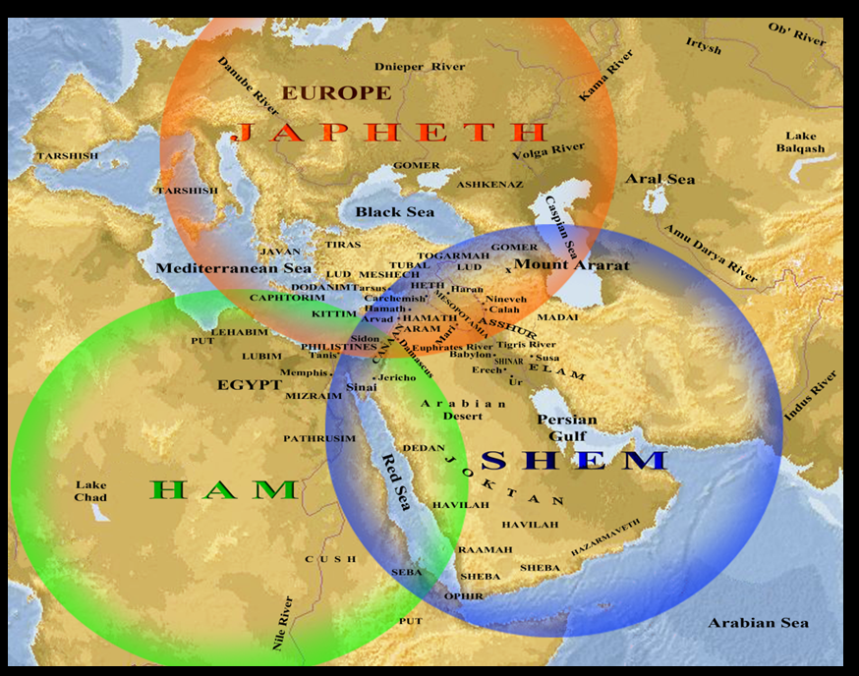

Slide 16
Japheth’s Sons (vs. 2)
  Gomer
  Magog
  Madai
  Javan
  Tubal
  Meshech
  Tiras

Slide 17
GENESIS 10
Outline
  Introduction (1)
  Japheth's line (2-5)
  Ham’s Line (6-20)
  Shem’s line (21-31)
  Conclusion (32)

Slide 18
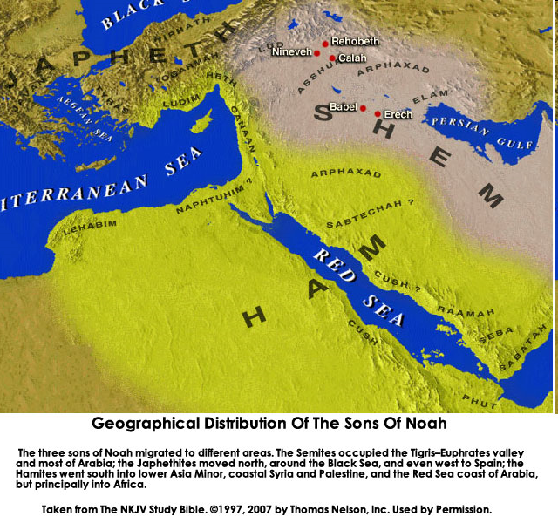

Slide 20
Table of Nations (Gen 10)
  Ham’s descendants (Gen 10:6-20)
  Southwest Asia and Northeast Africa
  Perennial enemies of Israel (Egyptians, Canaanites-Gen 10:15-20)

Slide 21
Ham’s Sons (vs. 6)
  Cush
  Mizraim
  Put
  Canaan

Slide 22
Ham’s Sons (vs. 6)
  Cush
  Mizraim
  Put
  Canaan

Slide 23
1. Cush’s Sons (vs. 7-12)
  Seba
  Havilah
  Sabtah
  Raamah
    Sheba
    Dedan
  Sabteca
  Nimrod

Slide 24
1. Cush’s Sons (vs. 7-12)
  Seba
  Havilah
  Sabtah
  Raamah
    Sheba
    Dedan
  Sabteca
  Nimrod

Slide 25
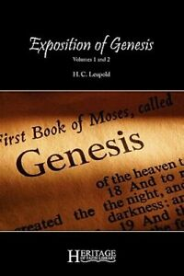
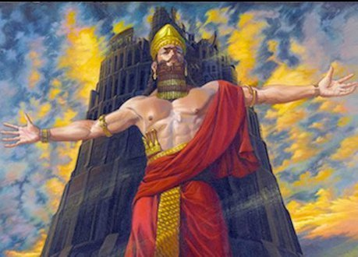
H. C. Leupold
H.C. Leupold, Exposition of Genesis, 1:366.
“For the meaning of the verb form nimrodh, without a doubt, is ‘let us revolt’.”

Slide 26


Slide 27

Genesis 11:1-4
¹ Now the whole earth used the same language and the same words. ² It came about as they journeyed east, that they found a plain in the land of Shinar and settled there. ³ They said to one another, “Come, let us make bricks and burn them thoroughly.” And they used brick for stone, and they used tar for mortar. ⁴ They said, “Come, let us build for ourselves a city, and a tower whose top will reach into heaven, and let us make for ourselves a name, otherwise we will be scattered abroad over the face of the whole earth.”

Slide 28

Zechariah 5:5-11
⁹ Then I lifted up my eyes and looked, and there two women were coming out with the wind in their wings; and they had wings like the wings of a stork, and they lifted up the ephah between the earth and the heavens. ¹⁰ I said to the angel who was speaking with me, “Where are they taking the ephah?” ¹¹ Then he said to me, “To build a temple for her in the land of Shinar; and when it is prepared, she will be set there on her own pedestal.”

Slide 29
Israel's Judgments
Division of the kingdom in 931 B.C. (1 Kgs. 12)
Assyrian judgment in 722 B.C. (2 Kgs. 17)
Babylonian captivity in 586 B.C. (2 Kgs. 25)
Rome Diaspora in A.D. 70 (Luke 19:41-44)

Slide 30


Slide 31
Israel's Judgments
Division of the kingdom in 931 B.C. (1 Kgs. 12)
Assyrian judgment in 722 B.C. (2 Kgs. 17)
Babylonian captivity in 586 B.C. (2 Kgs. 25)
Rome Diaspora in A.D. 70 (Luke 19:41-44)

Slide 32
Ham’s Sons (vs. 6)
  Cush
  Mizraim
  Put
  Canaan

Slide 33
2. Mizraim’s Sons (vs. 13-14)
  Ludim
  Anaim
  Lehabim
  Naphtushim
  Pathrushim
  Calushim
  Caphtorim

Slide 34
2. Mizraim’s Sons (vs. 13-14)
  Ludim
  Anaim
  Lehabim
  Naphtushim
  Pathrushim
  Calushim
  Caphtorim

Slide 35
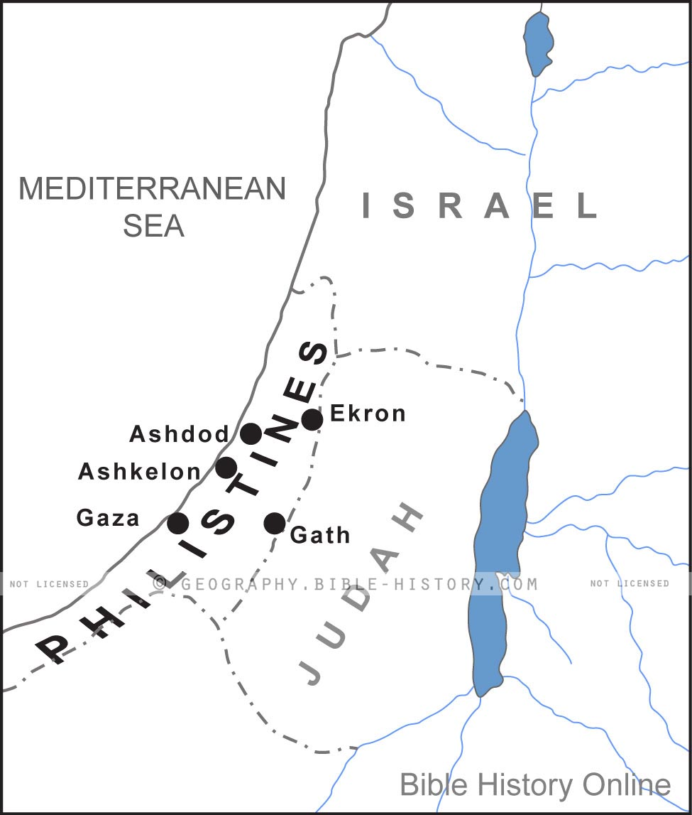

Slide 36
Ham’s Sons (vs. 6)
  Cush
  Mizraim
  Put
  Canaan

Slide 38


Dr. Arnold G. Fruchtenbaum
The Book of Genesis, 200
“In some circles in preceding times, it was taught that the curse of Canaan was upon the Negro or the Black race, which is simply not true to the text. While it is true that Blacks are the descendants of Ham, not all descendants of Ham were black-skinned people. Only one of Ham’s sons was cursed, and that was Canaan. As is known from the Egyptian portrayals of the Canaanites, the Canaanites were not black-skinned; they were white, or it would be more correct to say, olive-skinned. Therefore, black skin has nothing to do with this curse, and the curse of Canaan is not biblical grounds for the enslavement of Blacks.”

Slide 39
4. Canaan’s Sons (vs. 15-18)
  Sidon
  Heth
  Jebusite
  Amorite
  Girgahite
  Hivite
  Arkite
  Sinite
  Arvadite
  Zemaritie
  Hamathite

Slide 40
4. Canaan’s Sons (vs. 15-18)
  Sidon
  Heth
  Jebusite
  Amorite
  Girgahite
  Hivite
  Arkite
  Sinite
  Arvadite
  Zemaritie
  Hamathite

Slide 41
Land Promises Fulfilled in the Time of Joshua (Josh. 11:23; 21:43-45) or Solomon (1 Kgs. 4:21)?
Extended context (Josh 13:1-7; Judges 1:19, 21, 27, 29, 30-36)
Land gained in conquest was only a fraction of what was promised (1 Kgs. 4:25)
Jerusalem not conquered in Joshua’s day (Josh 15:63; 2 Sam 5)
Solomon’s reign extended to the border of Egypt (1 Kgs. 4:21) and not the River of Egypt (Gen. 15:18)
Solomon’s reign was tributary only (1 Kgs. 4:21)
Forever? (Gen 17:7-8, 13, 19)
Reaffirmation of land promises long after Joshua and Solomon’s time (Amos 9:11-15)
Fruchtenbaum, Israelology, 521-22, 631-32

Slide 42
Land Promises Fulfilled in the Time of Joshua (Josh. 11:23; 21:43-45) or Solomon (1 Kgs. 4:21)?
Extended context (Josh 13:1-7; Judges 1:19, 21, 27, 29, 30-36)
Land gained in conquest was only a fraction of what was promised (1 Kgs. 4:25)
Jerusalem not conquered in Joshua’s day (Josh 15:63; 2 Sam 5)
Solomon’s reign extended to the border of Egypt (1 Kgs. 4:21) and not the River of Egypt (Gen. 15:18)
Solomon’s reign was tributary only (1 Kgs. 4:21)
Forever? (Gen 17:7-8, 13, 19)
Reaffirmation of land promises long after Joshua and Solomon’s time (Amos 9:11-15)
Fruchtenbaum, Israelology, 521-22, 631-32

Slide 43
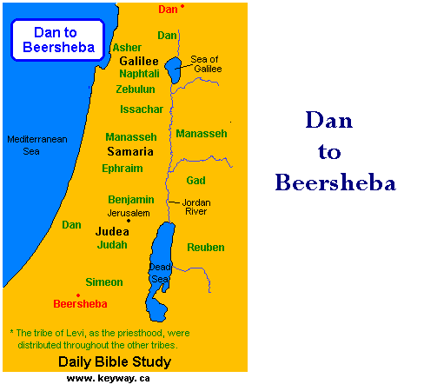

Slide 44


Slide 45
Land Promises Fulfilled in the Time of Joshua (Josh. 11:23; 21:43-45) or Solomon (1 Kgs. 4:21)?
Extended context (Josh 13:1-7; Judges 1:19, 21, 27, 29, 30-36)
Land gained in conquest was only a fraction of what was promised (1 Kgs. 4:25)
Jerusalem not conquered in Joshua’s day (Josh 15:63; 2 Sam 5)
Solomon’s reign extended to the border of Egypt (1 Kgs. 4:21) and not the River of Egypt (Gen. 15:18)
Solomon’s reign was tributary only (1 Kgs. 4:21)
Forever? (Gen 17:7-8, 13, 19)
Reaffirmation of land promises long after Joshua and Solomon’s time (Amos 9:11-15)
Fruchtenbaum, Israelology, 521-22, 631-32

Slide 46
Land Promises Fulfilled in the Time of Joshua (Josh. 11:23; 21:43-45) or Solomon (1 Kgs. 4:21)?
Extended context (Josh 13:1-7; Judges 1:19, 21, 27, 29, 30-36)
Land gained in conquest was only a fraction of what was promised (1 Kgs. 4:25)
Jerusalem not conquered in Joshua’s day (Josh 15:63; 2 Sam 5)
Solomon’s reign extended to the border of Egypt (1 Kgs. 4:21) and not the River of Egypt (Gen. 15:18)
Solomon’s reign was tributary only (1 Kgs. 4:21)
Forever? (Gen 17:7-8, 13, 19)
Reaffirmation of land promises long after Joshua and Solomon’s time (Amos 9:11-15)
Fruchtenbaum, Israelology, 521-22, 631-32

Slide 47
Israel's Judgments
Division of the kingdom in 931 B.C. (1 Kgs. 12)
Assyrian judgment in 722 B.C. (2 Kgs. 17)
Babylonian captivity in 586 B.C. (2 Kgs. 25)
Rome Diaspora in A.D. 70 (Luke 19:41-44)

Slide 48
4. Canaan’s Sons (vs. 15-18)
  Sidon
  Heth
  Jebusite
  Amorite
  Girgahite
  Hivite
  Arkite
  Sinite
  Arvadite
  Zemaritie
  Hamathite

Slide 49


Slide 50


Genesis 15:16
“Then in the fourth generation they will return here, for the wrongdoing of the Amorite is not yet complete.”

Slide 51

Genesis 6:1-4
“¹ Now it came about, when men began to multiply on the face of the land, and daughters were born to them, ² that the sons of God saw that the daughters of men were beautiful; and they took wives for themselves, whomever they chose. ³ Then the Lord said, ‘My Spirit shall not strive with man forever, because he also is flesh; nevertheless his days shall be one hundred and twenty years.’ ⁴ The Nephilim were on the earth in those days, and also afterward, when the sons of God came in to the daughters of men, and they bore children to them. Those were the mighty men who were of old, men of renown.”

Slide 53

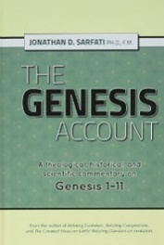
Date of Writing?
Jonathan D. Sarfati, The Genesis Account: A Theological, Historical, and Scientific Commentary on Genesis 1‒11 (Powder Springs, GA: Creation Book Publishers, 2015), 649.
“Here we have a clear dating of this Table of the Nations. It must have been composed while Sodom and the other cites of the plain were still flourishing, and known as landmarks.”

Slide 54
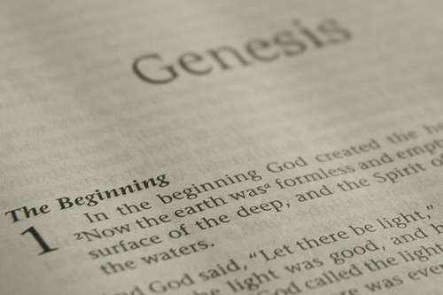
DOCUMENTARY HYPOTHESIS
J – Yahwist (850 B.C.)
E – Elohist (750 B.C.)
D – Deuteronomist (621 B.C.)
P – Priestly code (525 B.C.)

Slide 55
Problems with the Documentary Hypothesis
Jewish and Christian tradition
Mosaic Authorship assumed throughout Scripture (Num. 33:1-2; Dan. 9:11-13; Matt. 19:4-8)
Literary unity
Eyewitness testimony (Exod. 15:27)
Familiarity with Egyptian geography (Gen. 13:10)
Moses the likely writer (Acts 7:22)

Slide 56
Problems with the Documentary Hypothesis
JEDP Documents never discovered
Writing prior to 1500 B.C. (Code of Hamurabi)
Different names for God used for different literary purposes
Editorial insertions added after Moses completed the bulk of the work
Polytheism to monotheism trajectory never proven
Moses relied upon other sources (Gen. 5:1)

Slide 57
GENESIS 10
Outline
  Introduction (1)
  Japheth's line (2-5)
  Ham’s Line (6-20)
  Shem’s line (21-31)
  Conclusion (32)

Slide 60
Table of Nations (Gen 10)
  Shem’s descendants (Gen 10:21-32)
  Semites
  Line leading to Israel
  Eber (Gen 10:21, 25) is origin of the word Hebrews (Gen 14:13)

Slide 61
Dr. Arnold G. Fruchtenbaum
The Book of Genesis, 217
“The line of Shem begins in verse 21: And unto Shem, the father of all the children of Eber. Eber in Hebrew is Ever and is the source of the Hebrew word for ‘Hebrew,’ Ivrit. To be the father of the Hebrews is the main significance of the line of Shem.”

Slide 62
Genesis 3:15
“And I will put enmity Between you and the woman, And between your seed and her seed; He shall bruise you on the head, And you shall bruise him on the heel.”

Slide 63

God’s Messianic Purposes
Beginning in Genesis
Proto-evangelium from Adam & Eve (3:15)
Seth (4:25)
Noah (Gen 5:29)
Shem (9:26)
Abraham (12:3)
Isaac (21:12)
Jacob (25:23)
Judah (49:10)

Slide 64
God’s Messianic Purposes
Beginning in Genesis
Proto-evangelium from Adam & Eve (3:15)
Seth (4:25)
Noah (Gen 5:29)
Shem (9:26)
Abraham (12:3)
Isaac (21:12)
Jacob (25:23)
Judah (49:10)

Slide 65
Shem’s Sons (vs. 22)
  Elam
  Asshur
  Arphachshad
  Lud
  Aram

Slide 66
Shem’s Sons (vs. 22)
  Elam
  Asshur
  Arphachshad
  Lud
  Aram

Slide 67
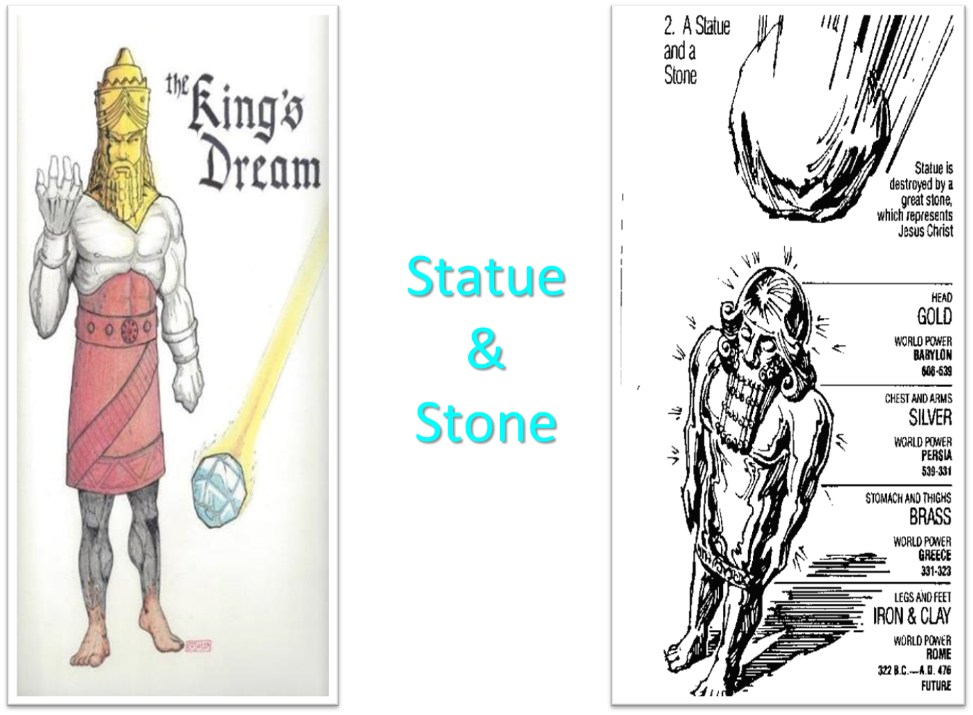

Slide 68


Slide 69
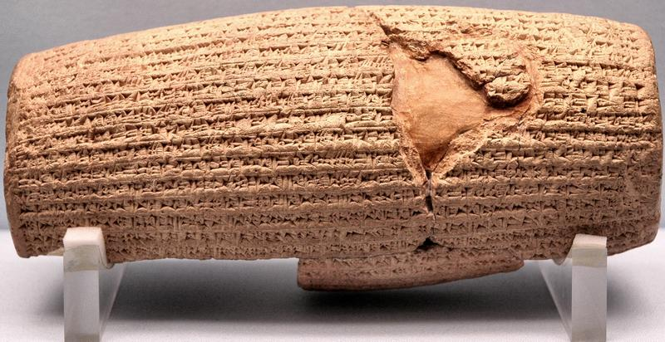
Cyrus Cylinder

Slide 70
Three Returns
 | DATE | DURATION | PERSIAN KING | JEWISH LEADER | SCRIPTURE | PURPOSE | NUMBER OF RETURNEES
1st return | 538–515 B.C. | 23 years | Cyrus (Isa 44:28‒45:1) | Zerubbabel | Ezra 1–6; Isaiah 44:28 | Rebuilding the temple | 50,000
2nd return | 458–457 B.C. | 2 years | Artaxerxes | Ezra | Ezra 7–10 | Adorning of the temple and reforming the people | 2,000
3rd return | 444–432 B.C. | 8 years | Artaxerxes | Nehemiah | Nehemiah | Rebuilding the wall

Slide 71


Slide 72

Ancient Names From Ezekiel 38:1-9
Magog (Central Asia) Rosh (Russia) Meshec (Turkey) Tubal (Turkey) Persia (Iran) Put (Libya) Cush (Sudan) Gomer (Turkey) | Togarmah (Turkey) Sheba (Saudi Arabia) Dedan (Saudi Arabia or Yemen) Tarshish (Spain) Merchants of Tarshish (Conglomeration of Western powers including Europe) Israel

Slide 73


Slide 74
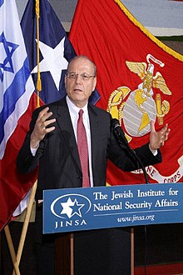
Yoram Ettinger
“Iran's School Textbooks‒Can Congress Afford to Ignore It?,” online: http://theettingerreport.com/Iran-and-MidEast/Iran-s-School-Textbooks-%E2%80%93-can-Congress-afford-to-i.aspx, May 29, 2015, accessed 30 May 2015.
“Iranian school textbooks, such as The Qur'an and Life (Grade 12, p. 125) prepare Iranian children for the Ayatollahs' sublime goal: the apocalyptic, horrifying, millenarian, military battle against the USA and other ‘arrogant oppressors of the world,’ which are ostensibly led by ‘idolatrous devils.’ While the ‘savior’ – the infallible, immortal, divinely ordained and eventual global leader, the Mahdi – has not surfaced yet, Iranian children are taught that the battle is already raging throughout the world, awaiting their sacrifice. School . . .

Slide 75
Yoram Ettinger
“Iran's School Textbooks‒Can Congress Afford to Ignore It?,” online: http://theettingerreport.com/Iran-and-MidEast/Iran-s-School-Textbooks-%E2%80%93-can-Congress-afford-to-i.aspx, May 29, 2015, accessed 30 May 2015.
. . .textbooks of Western democracies are the most authentic reflection of peoples' values and worldview. School textbooks of tyrannies are the most authentic reflection of the nature and mission of the regimes. Iranian school textbooks reflect the strategy and tactics of the Ayatollahs, much more authentically than speeches, interviews, diplomatic statements and conversations conducted by President Rouhani and Foreign Minister Zarif.”

Slide 76
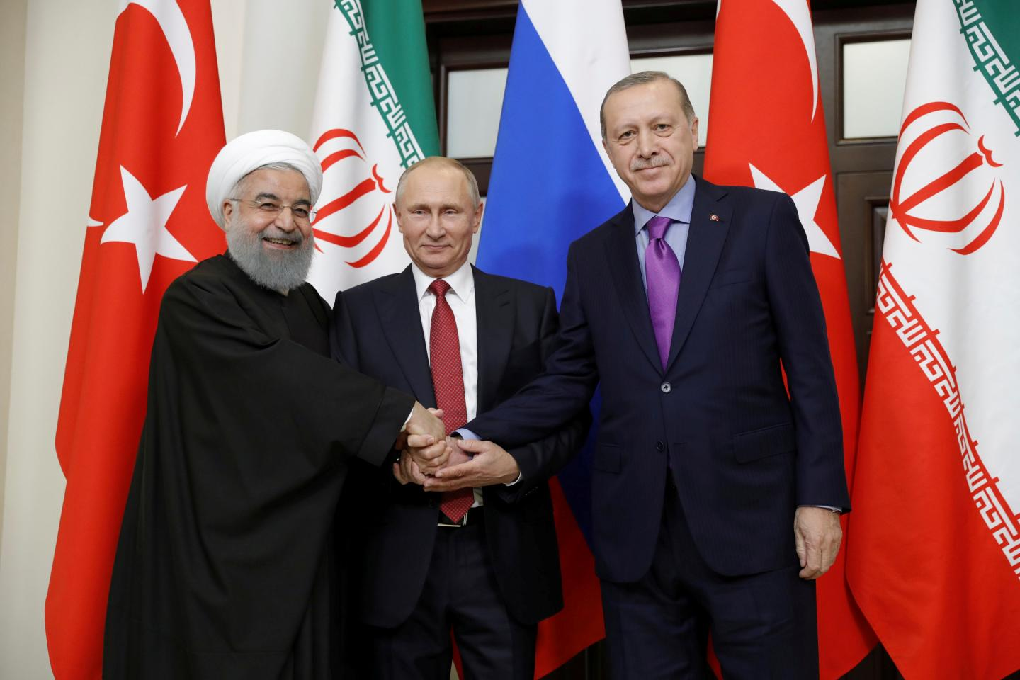

Slide 77

Ron Rhodes
Ron Rhodes, Northern Storm Rising: Russia, Iran, and the Emerging End-Times Military Coalition against Israel (Eugene, OR: Harvest, 2008), pp. 90.
“The unique alignment of nations described in Ezekiel 38 and 39 has never occurred in the past, but it is occurring now.”

Slide 78
Shem’s Sons (vs. 22)
  Elam
  Asshur
  Arphachshad
  Lud
  Aram

Slide 79
Asshur = Assyria
Jonathan D. Sarfati, The Genesis Account: A Theological, Historical, and Scientific Commentary on Genesis 1‒11 (Powder Springs, GA: Creation Book Publishers, 2015), 651.
“Asshur was the ancestor of the Assyrians. Indeed, whenever the English word ‘Assyria’ is used, it is the Hebrew Asshur (‘ashshûr). These Shemitic Assyrians replaced the Hamitic Assyrians of 10:11. Assyria later became a powerful empire noted for its cruelty.”

Slide 81
Shem’s Sons (vs. 22)
  Elam
  Asshur
  Arphachshad
  Lud
  Aram

Slide 82
5. Aram’s Sons (vs. 23)
  Uz
  Hul
  Gether
  Mash

Slide 83
5. Aram’s Sons (vs. 23)
  Uz
  Hul
  Gether
  Mash

Slide 84
Shem’s Sons (vs. 22)
  Elam
  Asshur
  Arphachshad
  Lud
  Aram

Slide 85
Eber’s Sons (vs. 25)
  Peleg
  Joktan

Slide 86
Eber’s Sons (vs. 25)
  Peleg
  Joktan

Slide 87
Genesis 11:1-9
¹ Now the whole earth used the same language and the same words. ² It came about as they journeyed east, that they found a plain in the land of Shinar and settled there. ³ They said to one another, “Come, let us make bricks and burn them thoroughly.” And they used brick for stone, and they used tar for mortar. ⁴ They said, “Come, let us build for ourselves a city, and a tower whose top will . . .

Slide 88
Dr. Arnold G. Fruchtenbaum
The Book of Genesis, 219
“…the name of the one was Peleg. For in his days was the earth divided. The name Peleg means ‘to divide.’ Some identify this event with the continental divide or the continental drift. However, contextually, it more likely refers to the language division of the Tower of Babel judgment. This means that the confusion of tongues occurred during Peleg’s lifetime.”

Slide 89

Dr. Henry M. Morris
The Genesis Record, 260-61
“Evidently this was a most memorable event, and Eber named his son in commemoration of it. The name Peleg means ‘division.’… The big question concerns the meaning of the indicated division of the earth. The most obvious interpretation of this verse is that the division was the division of the peoples at the Tower of Babel, as discussed in Genesis 11. It is significant that some such division is mentioned here in Genesis 10:5 (‘By these were the isles of the Gentiles divided in their lands; every one after his tongue, after their families, in their nations’) and Genesis 10:32 (‘. . . by these were the nations divided in the earth after the flood’).”

Slide 90
Dr. Henry M. Morris
The Genesis Record, 260-61
“These verses seem clearly to refer to a linguistic and geographic division, rather than to an actual splitting of the continents. This is especially clear in verse 5, where the division is specifically ‘after his tongue.’… If it is ever actually proved that the earth once was a single land mass that somehow split apart, with the segments gradually drifting away to form the present continents, then indeed this verse might be understood to refer to such an event. At present, the question of continental drift is still open among scientists; and creationist scientists have pointed to a number of unresolved physical difficulties with the whole idea.”

Slide 91
H. C. Leupold
H.C. Leupold, Exposition of Genesis, 1:378.
“Peleg means ‘division’, for he lived at the time when the earth was divided (niphlegah) and the name given to the man is in memory of this event. The event referred to must be the one under consideration—the Confusion of Tongues.”

Slide 92
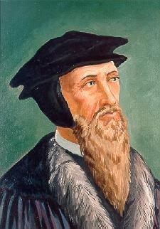
John Calvin
Genesis, 1554 (Edinburgh, UK: Banner of Truth, 1984), p. 324.
“For after he [Moses] has mentioned Arphaxad as the third of the sons of Shem, he then names Peleg, his great grandson, in whose days the languages were divided.”

Slide 93
Eber’s Sons (vs. 25)
  Peleg
  Joktan

Slide 94
Joktan’s Sons (vs. 26-29)
  Alamodad
  Sheleph
  Hazarmaveth
  Jerah
  Hadoram
  Uzal
  Diklah
  Obal
  Abimael
  Sheba
  Ophir
  Havilah
  Jobab

Slide 95
GENESIS 10
Outline
  Introduction (1)
  Japheth's line (2-5)
  Ham’s Line (6-20)
  Shem’s line (21-31)
  Conclusion (32)

Slide 96
Conclusion

Slide 97
GENESIS 10
Outline
  Introduction (1)
  Japheth's line (2-5)
  Ham’s Line (6-20)
  Shem’s line (21-31)
  Conclusion (32)

Slide 98
Outline
  Table of nations (Gen 10)
  Tower of Babel (Gen 11:1-9)
  Genealogy from Shem to Terah (Gen 11:10-32)

Slide 99

“The Lord bless you and keep you; the Lord make his face shine on you and be gracious to you; the Lord turn his face toward you and give you peace.” (NIV)

