Slide 1


Genesis 10‒11
National Dispersion

Slide 2


GENESIS STRUCTURE
  Beginning of the Human race (Gen. 1‒11)
  Beginning of the Hebrew race (Gen. 12‒50)

Slide 3

GENESIS STRUCTURE
  Genesis 1-11 (four events)
    Creation (1-2)
    Fall (3-5)
    Flood (6-9)
    National dispersion (10-11)

Slide 4
GENESIS STRUCTURE
  Genesis 1-11 (four events)
    Creation (1-2)
    Fall (3-5)
    Flood (6-9)
    National dispersion (10-11)

Slide 5


Genesis 3:15
“And I will put enmity Between you and the woman, And between your seed and her seed; He shall bruise you on the head, And you shall bruise him on the heel.”

Slide 6
GENESIS STRUCTURE
  Genesis 1-11 (four events)
    Creation (1-2)
    Fall (3-5)
    Flood (6-9)
    National dispersion (10-11)

Slide 7
GENESIS STRUCTURE
  Genesis 1-11 (four events)
    Creation (1-2)
    Fall (3-5)
    Flood (6-9)
    National dispersion (10-11)

Slide 8
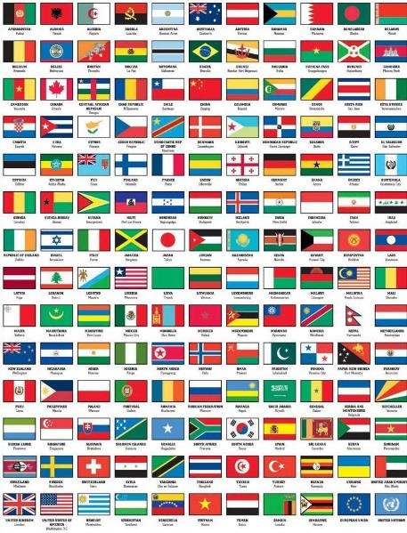
Outline
  Table of nations (Gen 10)
  Tower of Babel (Gen 11:1-9)
  Genealogy from Shem to Terah (Gen 11:10-32)

Slide 9
Outline
  Table of nations (Gen 10)
  Tower of Babel (Gen 11:1-9)
  Genealogy from Shem to Terah (Gen 11:10-32)

Slide 10
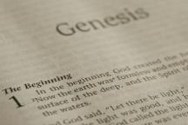
Beginning Themes
Universe Life Man Marriage Evil Clothing | Religion Salvation Language Government Nations Israel
Morris, Genesis Record, 18-20

Slide 11
Genesis 10–11
  Sinful origin of the nations necessitating Israel’s unique birth and redemptive purpose to these nations
  Gen 11:1-9 occurs first and Genesis 10 occurs second (Gen 10:5, 20, 31; 11:1)

Slide 12
Table of Nations (Gen 10)
  Nations emanating from Noah’s three sons
  Birth order: Shem, Ham, Japeth (Gen 10:1)
  Lesser to greater importance relative to Israel (Japheth, Ham, Shem)

Slide 13
GENESIS 10
Outline
  Introduction (1)
  Japheth's line (2-5)
  Ham’s Line (6-20)
  Shem’s line (21-31)
  Conclusion (32)

Slide 14
GENESIS 10
Outline
  Introduction (1)
  Japheth's line (2-5)
  Ham’s Line (6-20)
  Shem’s line (21-31)
  Conclusion (32)

Slide 15
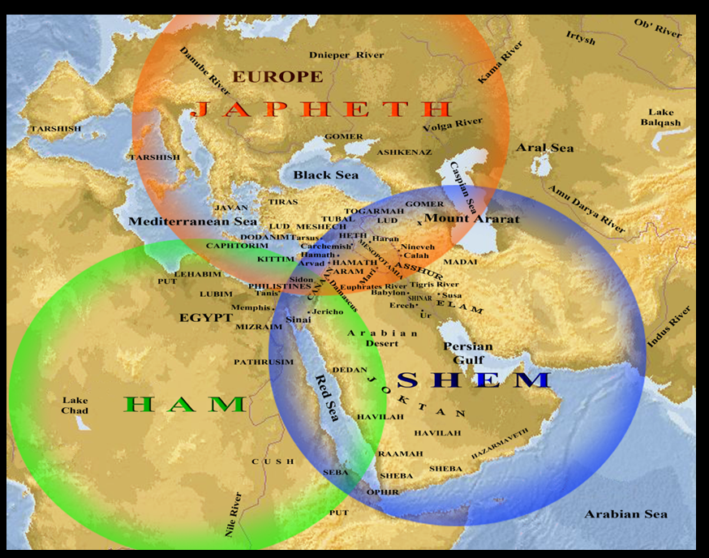

Slide 16
Japheth’s Sons (vs. 2)
  Gomer
  Magog
  Madai
  Javan
  Tubal
  Meshech
  Tiras

Slide 17
1. Gomer’s Sons (vs. 3)
  Ashkenaz
  Riphath
  Togarmah

Slide 18
4. Javan’s Sons (vs. 4)
  Elishah
  Tarshish
  Kittim
  Dodanim

Slide 19
GENESIS 10
Outline
  Introduction (1)
  Japheth's line (2-5)
  Ham’s Line (6-20)
  Shem’s line (21-31)
  Conclusion (32)

Slide 20
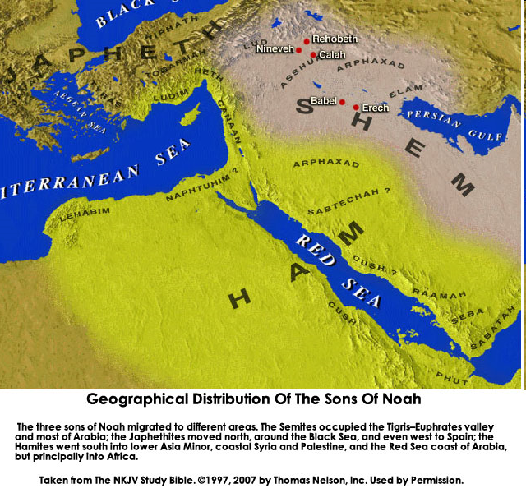

Slide 22
Table of Nations (Gen 10)
  Ham’s descendants (Gen 10:6-20)
  Southwest Asia and Northeast Africa
  Perennial enemies of Israel (Egyptians, Canaanites-Gen 10:15-20)

Slide 23
Ham’s Sons (vs. 6)
  Cush
  Mizraim
  Put
  Canaan

Slide 24


Slide 25

Ancient Names From Ezekiel 38:1-9
Magog (Central Asia) Rosh (Russia) Meshec (Turkey) Tubal (Turkey) Persia (Iran) Put (Libya) Cush (Sudan) Gomer (Turkey) | Togarmah (Turkey) Sheba (Saudi Arabia) Dedan (Saudi Arabia or Yemen) Tarshish (Spain) Merchants of Tarshish (Conglomeration of Western powers including Europe) Israel

Slide 26
Ancient Names From Ezekiel 38:1-9
Magog (Central Asia) Rosh (Russia) Meshec (Turkey) Tubal (Turkey) Persia (Iran) Put (Libya) Cush (Sudan) Gomer (Turkey) | Togarmah (Turkey) Sheba (Saudi Arabia) Dedan (Saudi Arabia or Yemen) Tarshish (Spain) Merchants of Tarshish (Conglomeration of Western powers including Europe) Israel

Slide 27
Ham’s Sons (vs. 6)
  Cush
  Mizraim
  Put
  Canaan

Slide 28
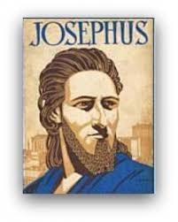
Josephus
Josephus, Antiquities, 1.6.2.
"For of the four sons of Ham, time has not at all hurt the name of Cush; for the Ethiopians, over whom he reigned, are even at this day, both by themselves and by all men in Asia, called Cushites."

Slide 29
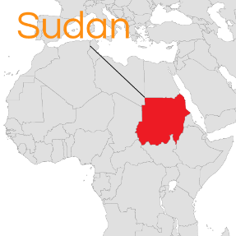
Cush = Sudan
Philip C. Johnson, “Cush,” in Wycliffe Bible Encyclopedia, ed. Howard F. Vos, Charles F. Pfeiffer, John Rea (Chicago: Moody, 1975), p. 1.411.
"The designation, Ethiopia, is misleading for it did not refer to the modern state of Ethiopia...Cush... bordered Egypt on the South,...or modern Sudan."

Slide 30
Ancient Names From Ezekiel 38:1-9
Magog (Central Asia) Rosh (Russia) Meshec (Turkey) Tubal (Turkey) Persia (Iran) Put (Libya) Cush (Sudan) Gomer (Turkey) | Togarmah (Turkey) Sheba (Saudi Arabia) Dedan (Saudi Arabia or Yemen) Tarshish (Spain) Merchants of Tarshish (Conglomeration of Western powers including Europe) Israel

Slide 32

AFP News
online: http://www.dailymail.co.uk/wires/afp/article-5111291/In-Russia-Sudans-Bashir-asks-Putin-protection-US.html/. November 23, 2017 , accessed 12 December 2017.
“Putin meets with Sudanese President Omar al-Bashir. Sudanese President Omar al-Bashir, who is wanted by the International Criminal Court for genocide and war crimes, asks Russia's Vladimir Putin to protect his country from the United States.”

Slide 33
Ham’s Sons (vs. 6)
  Cush
  Mizraim
  Put
  Canaan

Slide 34
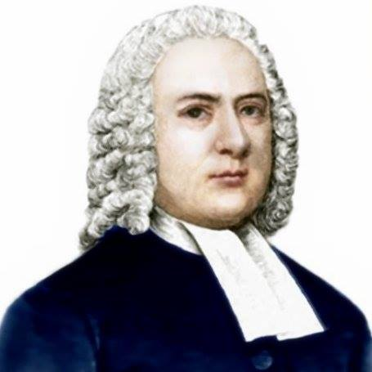

John Gill
Exposition of the Old and New Testaments, 1810
“Mitzraim is a name by which Egypt is frequently called in Scripture, and this man was the father of the Egyptians; and because Egypt was inhabited by a son of Ham, it is sometimes called the land of Ham (Psalm 105:23). The word is of the dual number, and serves to express Egypt, which was divided into two parts, lower and upper Egypt.”

Slide 35
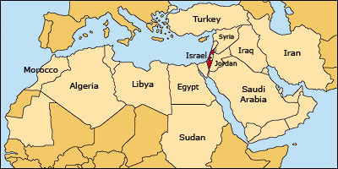

Slide 36
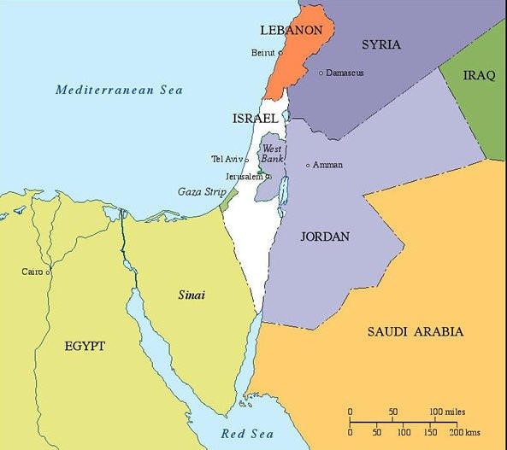

Slide 37


Slide 38
Ham’s Sons (vs. 6)
  Cush
  Mizraim
  Put
  Canaan

Slide 39
Josephus
Josephus, Antiquities, 1.6.2.
"Phut also was the founder of Libya, and called the inhabitants Phutites, from himself: there is also a river in the country of Moors which bears that name; whence it is that we may see the greatest part of the Grecian historiographers mention that river and the adjoining country by the apellation of Phut: but the name it has now has been by change given it from one of the sons of Mesraim, who was called Lybyos."

Slide 40
Ancient Names From Ezekiel 38:1-9
Magog (Central Asia) Rosh (Russia) Meshec (Turkey) Tubal (Turkey) Persia (Iran) Put (Libya) Cush (Sudan) Gomer (Turkey) | Togarmah (Turkey) Sheba (Saudi Arabia) Dedan (Saudi Arabia or Yemen) Tarshish (Spain) Merchants of Tarshish (Conglomeration of Western powers including Europe) Israel

Slide 42
Ham’s Sons (vs. 6)
  Cush
  Mizraim
  Put
  Canaan

Slide 44

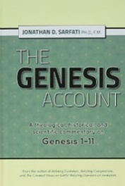
Code of Hammurabi?
Jonathan D. Sarfati, The Genesis Account: A Theological, Historical, and Scientific Commentary on Genesis 1‒11 (Powder Springs, GA: Creation Book Publishers, 2015), 648.
“Hammurabi is famous for the Code of Hammurabi, a set of 282 laws with harsh punishments.29 For example, if a man strikes a pregnant woman and she and her child die, his daughter would be executed (209–210). If a builder builds a house badly and it falls and kills the owner’s son, then the builder’s son would be executed (229–230). This is contrary to biblical law, ‘The son shall not suffer for the iniquity of the father, nor the father suffer for the iniquity of the son’ (Ezekiel 18:20).”

Slide 45


Dr. Arnold G. Fruchtenbaum
The Book of Genesis, 200
“In some circles in preceding times, it was taught that the curse of Canaan was upon the Negro or the Black race, which is simply not true to the text. While it is true that Blacks are the descendants of Ham, not all descendants of Ham were black-skinned people. Only one of Ham’s sons was cursed, and that was Canaan. As is known from the Egyptian portrayals of the Canaanites, the Canaanites were not black-skinned; they were white, or it would be more correct to say, olive-skinned. Therefore, black skin has nothing to do with this curse, and the curse of Canaan is not biblical grounds for the enslavement of Blacks.”

Slide 46
Ham’s Sons (vs. 6)
  Cush
  Mizraim
  Put
  Canaan

Slide 47
1. Cush’s Sons (vs. 7-12)
  Seba
  Havilah
  Sabtah
  Raamah
    Sheba
    Dedan
  Sabteca
  Nimrod

Slide 48
1. Cush’s Sons (vs. 7-12)
  Seba
  Havilah
  Sabtah
  Raamah
    Sheba
    Dedan
  Sabteca
  Nimrod

Slide 49

Ezekiel 38:13
“Sheba and Dedan and the merchants of Tarshish with all its villages will say to you, ‘Have you come to capture spoil? Have you assembled your company to seize plunder, to carry away silver and gold, to take away cattle and goods, to capture great spoil?’”

Slide 50
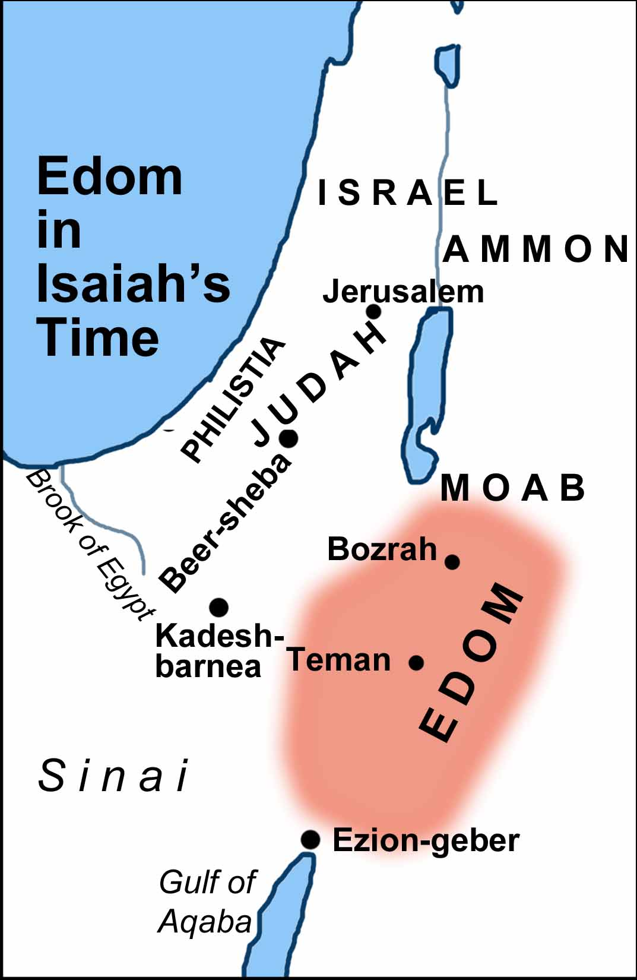

Slide 51
Ancient Names From Ezekiel 38:1-9
Magog (Central Asia) Rosh (Russia) Meshec (Turkey) Tubal (Turkey) Persia (Iran) Put (Libya) Cush (Sudan) Gomer (Turkey) | Togarmah (Turkey) Sheba (Saudi Arabia) Dedan (Saudi Arabia or Yemen) Tarshish (Spain) Merchants of Tarshish (Conglomeration of Western powers including Europe) Israel

Slide 53
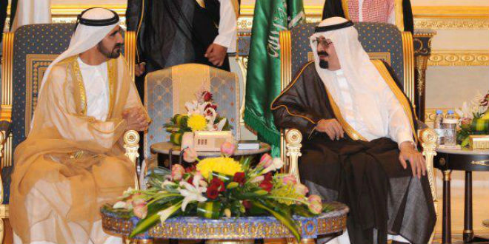
“SAUDI PRINCE: ‘I’LL SIDE WITH ISRAEL’ AGAINST PALESTINIAN UPRISING, [AND] IRAN.”
https://www.breakingisraelnews.com/52468/saudi-prince-ill-side-with-israel-against-palestinian-uprising-middle-east/#bco8FQkRWpkSLkuq.97

Slide 54

TIMES OF INDIA
online: http://tass.com/politics/932980. December 01, 2017 , accessed 12 December 2017.
“Saudi Arabia intercepts second Yemen missile in a month. Saudi Arabia on Thursday intercepted and destroyed a ballistic missile fired from war-torn Yemen, state media reported, the second such attack this month claimed by Iran-backed Huthi rebels.”

Slide 55
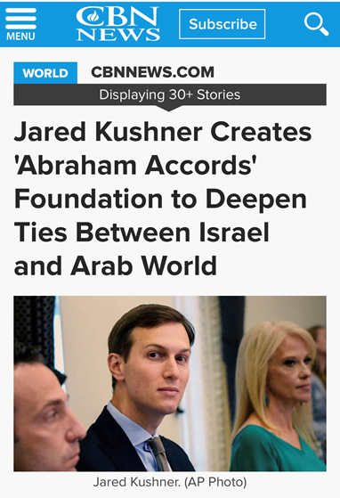

Slide 56
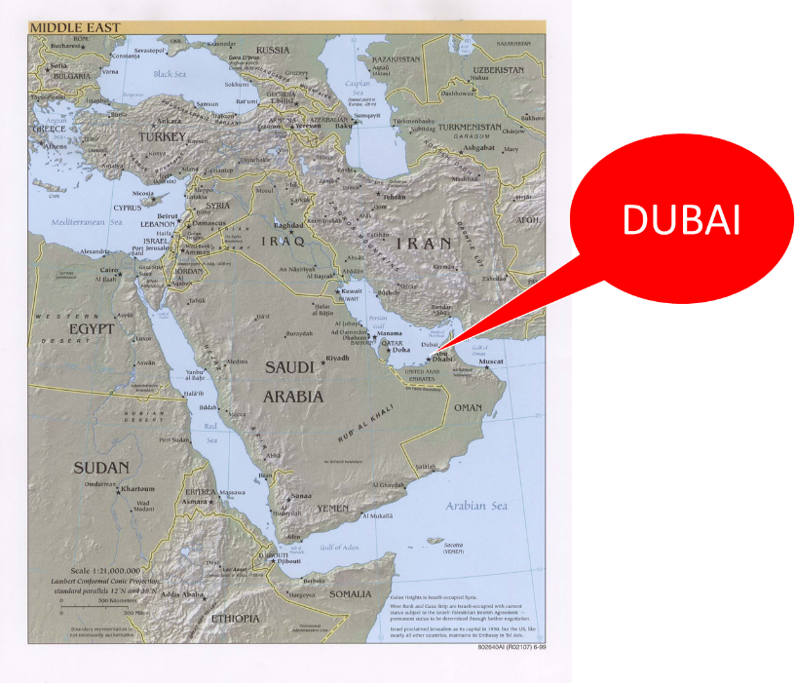

Slide 57


Slide 58
1. Cush’s Sons (vs. 7-12)
  Seba
  Havilah
  Sabtah
  Raamah
    Sheba
    Dedan
  Sabteca
  Nimrod

Slide 59
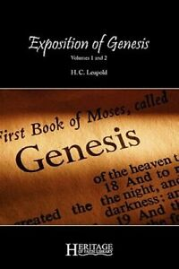
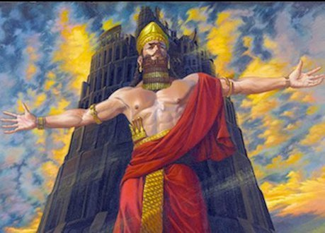
H. C. Leupold
H.C. Leupold, Exposition of Genesis, 1:366.
“For the meaning of the verb form nimrodh, without a doubt, is ‘let us revolt’.”

Slide 60
Dr. Arnold G. Fruchtenbaum
The Book of Genesis, 213
“Verse 9 deals with Nimrod’s relationship to God: He was a mighty hunter before Jehovah. The terminology implies antagonism; antagonism against and in opposition to God.”

Slide 61
The Jerusalem Targum
Jonathan D. Sarfati, The Genesis Account: A Theological, Historical, and Scientific Commentary on Genesis 1‒11 (Powder Springs, GA: Creation Book Publishers, 2015), 642.
The Jerusalem Targum paraphrases this passage as follows: “He was powerful in hunting and in wickedness before the Lord for he was a hunter of the sons of men, as he said to them, ‘Depart from the judgment of the Lord and hear the judgement of Nimrod.’ Therefore, it is said as Nimrod the strong one, strong in hunting, and wickedness before the Lord.”

Slide 62

Names & Titles Demonstrating Satan’s Post-Fall, Earthly Authority
(Job 1:7; 2:2; Luke 4:5-8; Rom. 8:19-22)
Prince of this world (John 12:31; 14:30; 16:11)
God of this age (2 Cor. 4:4)
Prince and power of the air (Eph. 2:2)
Who the believer wrestles with (Eph. 6:12)
Roaring lion (1 Pet. 5:8)
Whole world lies in his power (1 John 5:19)

Slide 63


Slide 64

Genesis 11:1-4
¹ Now the whole earth used the same language and the same words. ² It came about as they journeyed east, that they found a plain in the land of Shinar and settled there. ³ They said to one another, “Come, let us make bricks and burn them thoroughly.” And they used brick for stone, and they used tar for mortar. ⁴ They said, “Come, let us build for ourselves a city, and a tower whose top will reach into heaven, and let us make for ourselves a name, otherwise we will be scattered abroad over the face of the whole earth.”

Slide 65

Daniel 1:1-2
“¹ In the third year of the reign of Jehoiakim king of Judah, Nebuchadnezzar king of Babylon came to Jerusalem and besieged it.² The Lord gave Jehoiakim king of Judah into his hand, along with some of the vessels of the house of God; and he brought them to the land of Shinar, to the house of his god, and he brought the vessels into the treasury of his god.”

Slide 66


Slide 67
Israel's Judgments
Division of the kingdom in 931 B.C. (1 Kgs. 12)
Assyrian judgment in 722 B.C. (2 Kgs. 17)
Babylonian captivity in 586 B.C. (2 Kgs. 25)
Rome Diaspora in A.D. 70 (Luke 19:41-44)

Slide 68
Israel's Judgments
Division of the kingdom in 931 B.C. (1 Kgs. 12)
Assyrian judgment in 722 B.C. (2 Kgs. 17)
Babylonian captivity in 586 B.C. (2 Kgs. 25)
Rome Diaspora in A.D. 70 (Luke 19:41-44)

Slide 69
Zechariah 5:5-11
⁹ Then I lifted up my eyes and looked, and there two women were coming out with the wind in their wings; and they had wings like the wings of a stork, and they lifted up the ephah between the earth and the heavens. ¹⁰ I said to the angel who was speaking with me, “Where are they taking the ephah?” ¹¹ Then he said to me, “To build a temple for her in the land of Shinar; and when it is prepared, she will be set there on her own pedestal.”

Slide 70
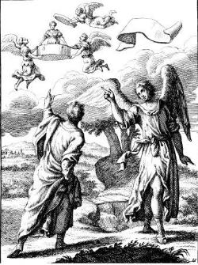
Zechariah 5:5-11
Woman (wickedness)
Ephah (commerce)
House (Temple-2 Sam 7; religion)
Shinar (Gen 10:10; 11:2; Dan 1:2)

Slide 71
Hitchcock The Second Coming of Babylon, 109.
ZECHARIAH 5:5-11 | REVELATION 17–18
Woman sitting in a basket | Woman sitting on beast, seven mountains, many waters (17: 3, 9, 15)
Emphasis on commerce (basket for measuring grain) | Emphasis on commerce (merchant of grain, 18:13)
Woman’s name is wickedness | Woman’s name is Babylon the Great, Mother of Harlots and Abominations of the Earth
Focus on False worship (temple is built for the woman) | Focus on False worship (17:5)
Woman taken to Babylon | Woman called Babylon

Slide 72

“The vision or prophecy (Zec. 5) contains the germ which is afterward expanded and developed in such detail in Rev. 17 and 18.” Pink, The Antichrist, 281.

Slide 73


Ecclesiastes 1:9
“That which has been is that which will be, And that which has been done is that which will be done. So there is nothing new under the sun.”

Slide 74
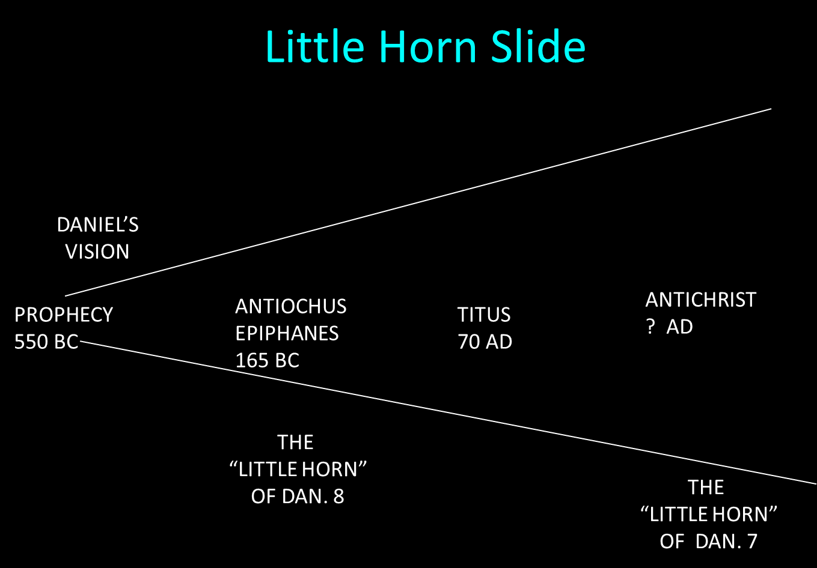

Slide 76
Israel's Judgments
Division of the kingdom in 931 B.C. (1 Kgs. 12)
Assyrian judgment in 722 B.C. (2 Kgs. 17)
Babylonian captivity in 586 B.C. (2 Kgs. 25)
Rome Diaspora in A.D. 70 (Luke 19:41-44)

Slide 77
Ham’s Sons (vs. 6)
  Cush
  Mizraim
  Put
  Canaan

Slide 78
2. Mizraim’s Sons (vs. 13-14)
  Ludim
  Anaim
  Lehabim
  Naphtushim
  Pathrushim
  Calushim
  Caphtorim

Slide 79
2. Mizraim’s Sons (vs. 13-14)
  Ludim
  Anaim
  Lehabim
  Naphtushim
  Pathrushim
  Calushim
  Caphtorim

Slide 80
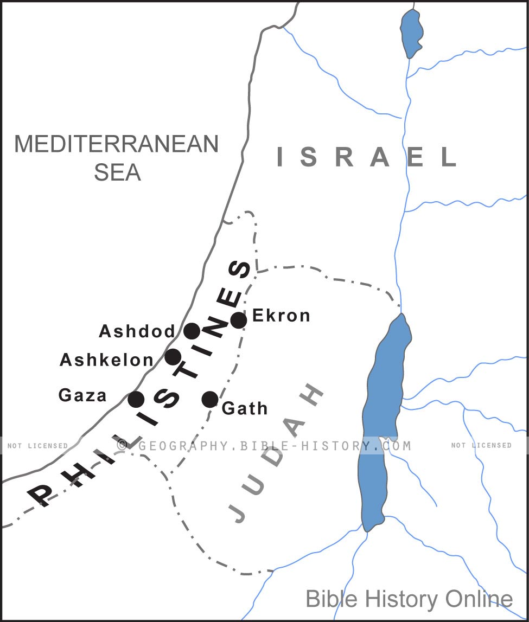

Slide 81
Ham’s Sons (vs. 6)
  Cush
  Mizraim
  Put
  Canaan

Slide 83
Dr. Arnold G. Fruchtenbaum
The Book of Genesis, 200
“In some circles in preceding times, it was taught that the curse of Canaan was upon the Negro or the Black race, which is simply not true to the text. While it is true that Blacks are the descendants of Ham, not all descendants of Ham were black-skinned people. Only one of Ham’s sons was cursed, and that was Canaan. As is known from the Egyptian portrayals of the Canaanites, the Canaanites were not black-skinned; they were white, or it would be more correct to say, olive-skinned. Therefore, black skin has nothing to do with this curse, and the curse of Canaan is not biblical grounds for the enslavement of Blacks.”

Slide 84
4. Canaan’s Sons (vs. 15-18)
  Sidon
  Heth
  Jebusite
  Amorite
  Girgahite
  Hivite
  Arkite
  Sinite
  Arvadite
  Zemaritie
  Hamathite

Slide 85
4. Canaan’s Sons (vs. 15-18)
  Sidon
  Heth
  Jebusite
  Amorite
  Girgahite
  Hivite
  Arkite
  Sinite
  Arvadite
  Zemaritie
  Hamathite

Slide 86
Land Promises Fulfilled in the Time of Joshua (Josh. 11:23; 21:43-45) or Solomon (1 Kgs. 4:21)?
Extended context (Josh 13:1-7; Judges 1:19, 21, 27, 29, 30-36)
Land gained in conquest was only a fraction of what was promised (1 Kgs. 4:25)
Jerusalem not conquered in Joshua’s day (Josh 15:63; 2 Sam 5)
Solomon’s reign extended to the border of Egypt (1 Kgs. 4:21) and not the River of Egypt (Gen. 15:18)
Solomon’s reign was tributary only (1 Kgs. 4:21)
Forever? (Gen 17:7-8, 13, 19)
Reaffirmation of land promises long after Joshua and Solomon’s time (Amos 9:11-15)
Fruchtenbaum, Israelology, 521-22, 631-32

Slide 87
Land Promises Fulfilled in the Time of Joshua (Josh. 11:23; 21:43-45) or Solomon (1 Kgs. 4:21)?
Extended context (Josh 13:1-7; Judges 1:19, 21, 27, 29, 30-36)
Land gained in conquest was only a fraction of what was promised (1 Kgs. 4:25)
Jerusalem not conquered in Joshua’s day (Josh 15:63; 2 Sam 5)
Solomon’s reign extended to the border of Egypt (1 Kgs. 4:21) and not the River of Egypt (Gen. 15:18)
Solomon’s reign was tributary only (1 Kgs. 4:21)
Forever? (Gen 17:7-8, 13, 19)
Reaffirmation of land promises long after Joshua and Solomon’s time (Amos 9:11-15)
Fruchtenbaum, Israelology, 521-22, 631-32

Slide 88
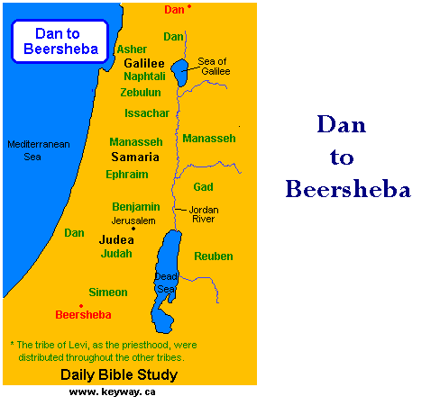

Slide 89


Slide 90
Land Promises Fulfilled in the Time of Joshua (Josh. 11:23; 21:43-45) or Solomon (1 Kgs. 4:21)?
Extended context (Josh 13:1-7; Judges 1:19, 21, 27, 29, 30-36)
Land gained in conquest was only a fraction of what was promised (1 Kgs. 4:25)
Jerusalem not conquered in Joshua’s day (Josh 15:63; 2 Sam 5)
Solomon’s reign extended to the border of Egypt (1 Kgs. 4:21) and not the River of Egypt (Gen. 15:18)
Solomon’s reign was tributary only (1 Kgs. 4:21)
Forever? (Gen 17:7-8, 13, 19)
Reaffirmation of land promises long after Joshua and Solomon’s time (Amos 9:11-15)
Fruchtenbaum, Israelology, 521-22, 631-32

Slide 91
Land Promises Fulfilled in the Time of Joshua (Josh. 11:23; 21:43-45) or Solomon (1 Kgs. 4:21)?
Extended context (Josh 13:1-7; Judges 1:19, 21, 27, 29, 30-36)
Land gained in conquest was only a fraction of what was promised (1 Kgs. 4:25)
Jerusalem not conquered in Joshua’s day (Josh 15:63; 2 Sam 5)
Solomon’s reign extended to the border of Egypt (1 Kgs. 4:21) and not the River of Egypt (Gen. 15:18)
Solomon’s reign was tributary only (1 Kgs. 4:21)
Forever? (Gen 17:7-8, 13, 19)
Reaffirmation of land promises long after Joshua and Solomon’s time (Amos 9:11-15)
Fruchtenbaum, Israelology, 521-22, 631-32

Slide 92
Israel's Judgments
Division of the kingdom in 931 B.C. (1 Kgs. 12)
Assyrian judgment in 722 B.C. (2 Kgs. 17)
Babylonian captivity in 586 B.C. (2 Kgs. 25)
Rome Diaspora in A.D. 70 (Luke 19:41-44)

Slide 93
4. Canaan’s Sons (vs. 15-18)
  Sidon
  Heth
  Jebusite
  Amorite
  Girgahite
  Hivite
  Arkite
  Sinite
  Arvadite
  Zemaritie
  Hamathite

Slide 95


Genesis 15:16
“Then in the fourth generation they will return here, for the wrongdoing of the Amorite is not yet complete.”

Slide 96

Genesis 6:1-4
“¹ Now it came about, when men began to multiply on the face of the land, and daughters were born to them, ² that the sons of God saw that the daughters of men were beautiful; and they took wives for themselves, whomever they chose. ³ Then the Lord said, ‘My Spirit shall not strive with man forever, because he also is flesh; nevertheless his days shall be one hundred and twenty years.’ ⁴ The Nephilim were on the earth in those days, and also afterward, when the sons of God came in to the daughters of men, and they bore children to them. Those were the mighty men who were of old, men of renown.”

Slide 98
Date of Writing?
Jonathan D. Sarfati, The Genesis Account: A Theological, Historical, and Scientific Commentary on Genesis 1‒11 (Powder Springs, GA: Creation Book Publishers, 2015), 649.
“Here we have a clear dating of this Table of the Nations. It must have been composed while Sodom and the other cites of the plain were still flourishing, and known as landmarks.”

Slide 99
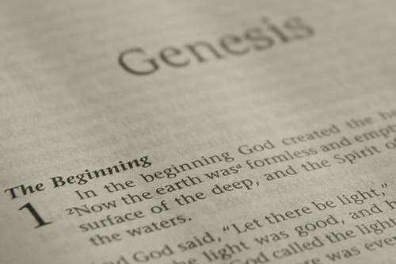
DOCUMENTARY HYPOTHESIS
J – Yahwist (850 B.C.)
E – Elohist (750 B.C.)
D – Deuteronomist (621 B.C.)
P – Priestly code (525 B.C.)

Slide 100
Problems with the Documentary Hypothesis
Jewish and Christian tradition
Mosaic Authorship assumed throughout Scripture (Num. 33:1-2; Dan. 9:11-13; Matt. 19:4-8)
Literary unity
Eyewitness testimony (Exod. 15:27)
Familiarity with Egyptian geography (Gen. 13:10)
Moses the likely writer (Acts 7:22)

Slide 101
Problems with the Documentary Hypothesis
JEDP Documents never discovered
Writing prior to 1500 B.C. (Code of Hamurabi)
Different names for God used for different literary purposes
Editorial insertions added after Moses completed the bulk of the work
Polytheism to monotheism trajectory never proven
Moses relied upon other sources (Gen. 5:1)

Slide 102
Conclusion

Slide 103
GENESIS 10
Outline
  Introduction (1)
  Japheth's line (2-5)
  Ham’s Line (6-20)
  Shem’s line (21-31)
  Conclusion (32)

Slide 104
GENESIS 10
Outline
  Introduction (1)
  Japheth's line (2-5)
  Ham’s Line (6-20)
  Shem’s line (21-31)
  Conclusion (32)

Slide 105

“The Lord bless you and keep you; the Lord make his face shine on you and be gracious to you; the Lord turn his face toward you and give you peace.” (NIV)

