Slide 1
THE RAPTURE
What and When? – Part 55
Andrew Marshall Woods, Th.M., JD., PhD.
Sr. Pastor, Sugar Land Bible Church

Slide 2
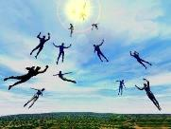
The Rapture Course Overview
What is the Rapture?
When is the Rapture?
Strengthening the Pre-Tribulational case
The opposing views
One second after the Rapture

Slide 3
The Rapture Course Overview
What is the Rapture?
When is the Rapture?
Strengthening the Pre-Tribulational case
The opposing views
One second after the Rapture

Slide 4
What is the Rapture?
An important doctrine
Distinct from the Second Advent
Catching away of all living believers (1 Thess 4:17)
Reunion (1 Thess 4:14-16)
Resurrection (1 Cor 15:50-54)
Exemption from death (1 Cor 15:51, 54-56)
Instantaneous (1 Cor 15:52)
Mystery (1 Cor 15:51)
Imminent (1 Cor 15:51; 1 Thess 4:15)
Traditional doctrine now being recovered

Slide 5
The Rapture Course Overview
What is the Rapture?
When is the Rapture?
Strengthening the Pre-Tribulational case
The opposing views
One second after the Rapture

Slide 6
When is the Rapture?
7 Arguments Favoring the Pre-Tribulation View
Tribulation's purpose concerns Israel (Jer 30:7; Dan 9:24)
No biblical reference to the church on earth during the Tribulation period (Rev 4-22)
Church is promised an exemption from divine wrath (1 Thess 1:10; 5:9; Rom 5:9; Rev 3:10; 6:17)
Rapture is imminent (1 Cor 15:51; 1 Thess 4:15)
Rapture is a comfort (1 Thess 4:18)
Antichrist cannot come to power until the restrainer is removed (2 Thess 2:6-7)
Symbolic parallels (2 Peter 2:5-9)

Slide 7
The Rapture Course Overview
What is the Rapture?
When is the Rapture?
Strengthening the Pre-Tribulational case
The opposing views
One second after the Rapture

Slide 8
Strengthening the Pre-Tribulation Case
John 14:1-4
Revelation 3:10
First Thessalonians 4‒5
Second Thessalonians 2:3a
Matthew 24‒25

Slide 9
The Rapture Course Overview
What is the Rapture?
When is the Rapture?
Strengthening the Pre-Tribulational case
The opposing views
One second after the Rapture

Slide 10
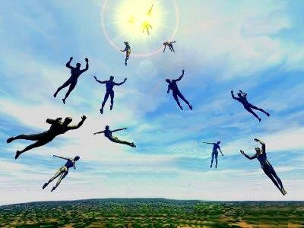
When Will the Rapture Take Place Relative to the Tribulation Period?
Pre-tribulation rapture theory
Mid-tribulation rapture theory
Post-tribulation rapture theory
Pre-wrath rapture theory
Partial rapture theory

Slide 11
Problems with Partial Rapturism?
Every divine blessing is given on the basis of His grace and not human effort (Eph. 2:8-9; Rom. 12:6)
Symbolic parallels mandate that carnal as well as sanctified Christians will be taken up in the rapture (Gen. 19:22)
The promise of the rapture is mentioned in Paul's letter to the carnal Corinthian church (1 Cor. 15:51)
A partial rapture would sever Christ's body (1 Cor 12:12-14)
The partial rapture view subjects believers to God's wrath (Thess 1:10)

Slide 12
Problems with Partial Rapturism?
Partial rapturism makes the Bema Seat Judgment unnecessary (1 Cor. 3:10-15)
Partial rapturists never objectively quantify the exact degree of faithfulness or spiritual maturity that is necessary to participate in the rapture
Partial rapturists appear individually biased
Partial rapturists dispensationally misapply Bible passages (Matt. 25:1-13)
Partial rapturists misapply passages promising a reward to faithful believers (Rev. 3:11)

Slide 13
DESCRIPTION OF THE SEVEN CHURCHES Revelation 2‒3
CHURCH | SCRIPTURE | DESCRIPTION
Ephesus | 2:1-7 | Loveless
Smyrna | 2:8-11 | Persecuted
Pergamum | 2:12-17 | Compromised
Thyatira | 2:18-29 | Corrupt
Sardis | 3:1-6 | Dead
Philadelphia | 3:7-13 | Missionary
Laodicea | 3:14-22 | Man-centered

Slide 14
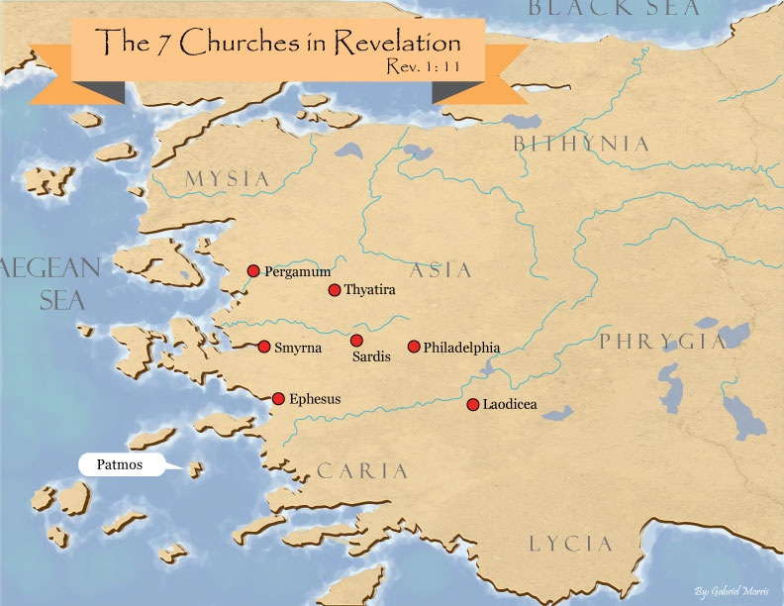

Slide 15
Revelation 3:10
‘Because you have kept the word of My perseverance, I also will keep you from the hour of testing, that hour which is about to come upon the whole world, to test those who dwell on the earth.

Slide 16
Revelation 3:10
‘Because you have kept the word of My perseverance, I also will keep you from the hour of testing, that hour which is about to come upon the whole world, to test those who dwell on the earth.

Slide 17
Revelation 3:10
‘Because you have kept the word of My perseverance, I also will keep you from the hour of testing, that hour which is about to come upon the whole world, to test those who dwell on the earth.

Slide 18
Problems with Beginning the Sentence in Rev. 3:10 with “Because”
Not part of the original manuscripts: chapter & verse divisions & punctuation marks (periods, commas, or exclamation points).
These things were all added by later copyists.
Most English translations separate the two verses with a period.
Thus, it becomes cause for participating in the Rapture and not a cause for their enemies to worship before their feet.
However, the period should be placed in the middle of verse 10.
Thus, it becomes not a cause for participating the Rapture and a cause for their enemies to worship before their feet.
John Niemela, The Interpretation of Revelation 3:10: You Have Kept My Word, CTS Journal; As summarized by Dennis Rokser, A Golden Nugget in Revelation 3:10, Grace for the Race, no. 29.

Slide 19
Problems with Beginning the Sentence in Rev. 3:10 with “Because” (cont’d)
Rev. 3:10b becomes an additional unconditional promise of Rapture participation beyond the promises of Rev. 2:9b.
It is rare to begin a sentence with “because” (hoti) in a causative sense.
Instead, hoti (“because”), when casual in function, usually follows a statement or promise in providing a reason for what preceded it in the sentence.
Thus, Greek sentences rarely begin a sentence with the phrase “Because you have” when explaining the cause or reason for something, as Greek and English texts of Revelation 3:10 unfortunately do today. Instead, the “because” phraseology consistently follows later in the sentence.
John Niemela, The Interpretation of Revelation 3:10: You Have Kept My Word, CTS Journal; As summarized by Dennis Rokser, A Golden Nugget in Revelation 3:10, Grace for the Race, no. 29.

Slide 20
Problems with Beginning the Sentence in Rev. 3:10 with “Because”
Not part of the original manuscripts: chapter & verse divisions & punctuation marks (periods, commas, or exclamation points).
These things were all added by later copyists.
Most English translations separate the two verses with a period.
Thus, it becomes cause for participating in the Rapture and not a cause for their enemies to worship before their feet.
However, the period should be placed in the middle of verse 10.
Thus, it becomes not a cause for participating the Rapture and a cause for their enemies to worship before their feet.
John Niemela, The Interpretation of Revelation 3:10: You Have Kept My Word, CTS Journal; As summarized by Dennis Rokser, A Golden Nugget in Revelation 3:10, Grace for the Race, no. 29.

Slide 21
Revelation 3:10
‘Because you have kept the word of My perseverance, I also will keep you from the hour of testing, that hour which is about to come upon the whole world, to test those who dwell on the earth.

Slide 22
Problems with Beginning the Sentence in Rev. 3:10 with “Because”
Not part of the original manuscripts: chapter & verse divisions & punctuation marks (periods, commas, or exclamation points).
These things were all added by later copyists.
Most English translations separate the two verses with a period.
Thus, it becomes cause for participating in the Rapture and not a cause for their enemies to worship before their feet.
However, the period should be placed in the middle of verse 10.
Thus, it becomes not a cause for participating the Rapture and a cause for their enemies to worship before their feet.
John Niemela, The Interpretation of Revelation 3:10: You Have Kept My Word, CTS Journal; As summarized by Dennis Rokser, A Golden Nugget in Revelation 3:10, Grace for the Race, no. 29.

Slide 23
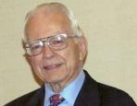
Dr. Roy B. Zuck
Basic Bible Interpretation, p. 43.
“﻿Stephen Langton (ca. 1155–1228), Archbishop of Canterbury, held that spiritual interpretation is superior to literal interpretation. Therefore in the Book of Ruth, the field is the Bible, Ruth represents students, and the reapers are the teachers. Langton is the one who made chapter divisions in the Vulgate Bible.”

Slide 24
Problems with Beginning the Sentence in Rev. 3:10 with “Because”
Not part of the original manuscripts: chapter & verse divisions & punctuation marks (periods, commas, or exclamation points).
These things were all added by later copyists.
Most English translations separate the two verses with a period.
Thus, it becomes cause for participating in the Rapture and not a cause for their enemies to worship before their feet.
However, the period should be placed in the middle of verse 10.
Thus, it becomes not a cause for participating the Rapture and a cause for their enemies to worship before their feet.
John Niemela, The Interpretation of Revelation 3:10: You Have Kept My Word, CTS Journal; As summarized by Dennis Rokser, A Golden Nugget in Revelation 3:10, Grace for the Race, no. 29.

Slide 25
Revelation 3:9-10
⁹ ‘Behold, I will cause those of the synagogue of Satan, who say that they are Jews and are not, but lie—I will make them come and bow down at your feet, and make them know that I have loved you. ¹⁰ ‘Because you have kept the word of My perseverance, I also will keep you from the hour of testing, that hour which is about to come upon the whole world, to test those who dwell on the earth.

Slide 26
Problems with Beginning the Sentence in Rev. 3:10 with “Because”
Not part of the original manuscripts: chapter & verse divisions & punctuation marks (periods, commas, or exclamation points).
These things were all added by later copyists.
Most English translations separate the two verses with a period.
Thus, it becomes cause for participating in the Rapture and not a cause for their enemies to worship before their feet.
However, the period should be placed in the middle of verse 10.
Thus, it becomes not a cause for participating the Rapture and a cause for their enemies to worship before their feet.
John Niemela, The Interpretation of Revelation 3:10: You Have Kept My Word, CTS Journal; As summarized by Dennis Rokser, A Golden Nugget in Revelation 3:10, Grace for the Race, no. 29.

Slide 27
Revelation 3:9-10
⁹ ‘Behold, I will cause those of the synagogue of Satan, who say that they are Jews and are not, but lie—I will make them come and bow down at your feet, and make them know that I have loved you. ¹⁰ ‘Because you have kept the word of My perseverance, I also will keep you from the hour of testing, that hour which is about to come upon the whole world, to test those who dwell on the earth.

Slide 28
Problems with Beginning the Sentence in Rev. 3:10 with “Because”
Not part of the original manuscripts: chapter & verse divisions & punctuation marks (periods, commas, or exclamation points).
These things were all added by later copyists.
Most English translations separate the two verses with a period.
Thus, it becomes cause for participating in the Rapture and not a cause for their enemies to worship before their feet.
However, the period should be placed in the middle of verse 10.
Thus, it becomes not a cause for participating the Rapture and a cause for their enemies to worship before their feet.
John Niemela, The Interpretation of Revelation 3:10: You Have Kept My Word, CTS Journal; As summarized by Dennis Rokser, A Golden Nugget in Revelation 3:10, Grace for the Race, no. 29.

Slide 29
Revelation 3:9-10
⁹ ‘Behold, I will cause those of the synagogue of Satan, who say that they are Jews and are not, but lie—I will make them come and bow down at your feet, and make them know that I have loved you ¹⁰ ‘because you have kept the word of My perseverance. I also will keep you from the hour of testing, that hour which is about to come upon the whole world, to test those who dwell on the earth.

Slide 30
Problems with Beginning the Sentence in Rev. 3:10 with “Because”
Not part of the original manuscripts: chapter & verse divisions & punctuation marks (periods, commas, or exclamation points).
These things were all added by later copyists.
Most English translations separate the two verses with a period.
Thus, it becomes cause for participating in the Rapture and not a cause for their enemies to worship before their feet.
However, the period should be placed in the middle of verse 10.
Thus, it becomes not a cause for participating the Rapture and a cause for their enemies to worship before their feet.
John Niemela, The Interpretation of Revelation 3:10: You Have Kept My Word, CTS Journal; As summarized by Dennis Rokser, A Golden Nugget in Revelation 3:10, Grace for the Race, no. 29.

Slide 31
Revelation 3:9-10
⁹ ‘Behold, I will cause those of the synagogue of Satan, who say that they are Jews and are not, but lie—I will make them come and bow down at your feet, and make them know that I have loved you ¹⁰ ‘because you have kept the word of My perseverance. I also will keep you from the hour of testing, that hour which is about to come upon the whole world, to test those who dwell on the earth.

Slide 32
Problems with Beginning the Sentence in Rev. 3:10 with “Because” (cont’d)
Rev. 3:10b becomes an additional unconditional promise of Rapture participation beyond the promises of Rev. 3:9b.
It is rare to begin a sentence with “because” (hoti) in a causative sense.
Instead, hoti (“because”), when casual in function, usually follows a statement or promise in providing a reason for what preceded it in the sentence.
Thus, Greek sentences rarely begin a sentence with the phrase “Because you have” when explaining the cause or reason for something, as Greek and English texts of Revelation 3:10 unfortunately do today. Instead, the “because” phraseology consistently follows later in the sentence.
John Niemela, The Interpretation of Revelation 3:10: You Have Kept My Word, CTS Journal; As summarized by Dennis Rokser, A Golden Nugget in Revelation 3:10, Grace for the Race, no. 29.

Slide 33
Revelation 3:9-10
⁹ ‘Behold, I will cause those of the synagogue of Satan, who say that they are Jews and are not, but lie—I will make them come and bow down at your feet, and make them know that I have loved you ¹⁰ ‘because you have kept the word of My perseverance. I also will keep you from the hour of testing, that hour which is about to come upon the whole world, to test those who dwell on the earth.

Slide 34
Problems with Beginning the Sentence in Rev. 3:10 with “Because” (cont’d)
Rev. 3:10b becomes an additional unconditional promise of Rapture participation beyond the promises of Rev. 3:9b.
It is rare to begin a sentence with “because” (hoti) in a causative sense.
Instead, hoti (“because”), when casual in function, usually follows a statement or promise in providing a reason for what preceded it in the sentence.
Thus, Greek sentences rarely begin a sentence with the phrase “Because you have” when explaining the cause or reason for something, as Greek and English texts of Revelation 3:10 unfortunately do today. Instead, the “because” phraseology consistently follows later in the sentence.
John Niemela, The Interpretation of Revelation 3:10: You Have Kept My Word, CTS Journal; As summarized by Dennis Rokser, A Golden Nugget in Revelation 3:10, Grace for the Race, no. 29.

Slide 35
Revelation 3:9-10
⁹ ‘Behold, I will cause those of the synagogue of Satan, who say that they are Jews and are not, but lie—I will make them come and bow down at your feet, and make them know that I have loved you. ¹⁰ ‘Because you have kept the word of My perseverance, I also will keep you from the hour of testing, that hour which is about to come upon the whole world, to test those who dwell on the earth.

Slide 36
Problems with Beginning the Sentence in Rev. 3:10 with “Because” (cont’d)
Rev. 3:10b becomes an additional unconditional promise of Rapture participation beyond the promises of Rev. 3:9b.
It is rare to begin a sentence with “because” (hoti) in a causative sense.
Instead, hoti (“because”), when casual in function, usually follows a statement or promise in providing a reason for what preceded it in the sentence.
Thus, Greek sentences rarely begin a sentence with the phrase “Because you have” when explaining the cause or reason for something, as Greek and English texts of Revelation 3:10 unfortunately do today. Instead, the “because” phraseology consistently follows later in the sentence.
John Niemela, The Interpretation of Revelation 3:10: You Have Kept My Word, CTS Journal; As summarized by Dennis Rokser, A Golden Nugget in Revelation 3:10, Grace for the Race, no. 29.

Slide 37
Revelation 3:9-10
⁹ ‘Behold, I will cause those of the synagogue of Satan, who say that they are Jews and are not, but lie—I will make them come and bow down at your feet, and make them know that I have loved you ¹⁰ ‘because you have kept the word of My perseverance. I also will keep you from the hour of testing, that hour which is about to come upon the whole world, to test those who dwell on the earth.

Slide 38
Problems with Beginning the Sentence in Rev. 3:10 with “Because” (cont’d)
Rev. 3:10b becomes an additional unconditional promise of Rapture participation beyond the promises of Rev. 3:9b.
It is rare to begin a sentence with “because” (hoti) in a causative sense.
Instead, hoti (“because”), when casual in function, usually follows a statement or promise in providing a reason for what preceded it in the sentence.
Thus, Greek sentences rarely begin a sentence with the phrase “Because you have” when explaining the cause or reason for something, as Greek and English texts of Revelation 3:10 unfortunately do today. Instead, the “because” phraseology consistently follows later in the sentence.
John Niemela, The Interpretation of Revelation 3:10: You Have Kept My Word, CTS Journal; As summarized by Dennis Rokser, A Golden Nugget in Revelation 3:10, Grace for the Race, no. 29.

Slide 39
Revelation 3:9-10
MacDonald’s Idiomatic Translation (MIT)
“⁹ I would put at your disposal those from the synagogue of Satan who call themselves Jews but are not; they are lying. See: I will make them come and bow down before your feet, and they will know that I loved you ¹⁰ because you kept my enduring word. I also will keep you from the time of trial that is about to come...”

Slide 40
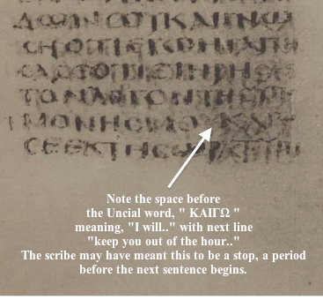
Keith R. Moritz

Slide 41
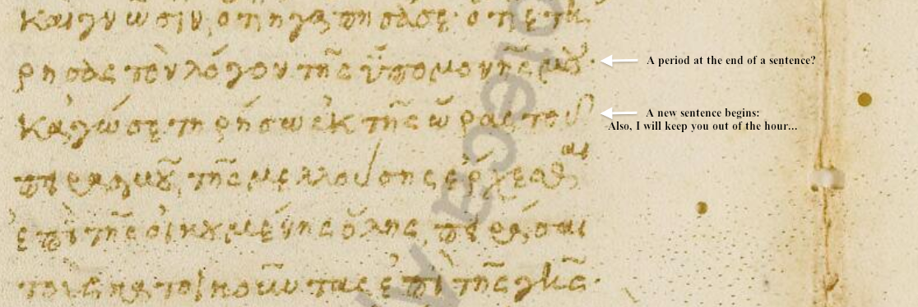
Keith R. Moritz

Slide 42
Problems with Beginning the Sentence in Rev. 3:10 with “Because”
Not part of the original manuscripts: chapter & verse divisions & punctuation marks (periods, commas, or exclamation points).
These things were all added by later copyists.
Most English translations separate the two verses with a period.
Thus, it becomes cause for participating in the Rapture and not a cause for their enemies to worship before their feet.
However, the period should be placed in the middle of verse 10.
Thus, it becomes not a cause for participating the Rapture and a cause for their enemies to worship before their feet.
John Niemela, The Interpretation of Revelation 3:10: You Have Kept My Word, CTS Journal; As summarized by Dennis Rokser, A Golden Nugget in Revelation 3:10, Grace for the Race, no. 29.

Slide 43
Problems with Beginning the Sentence in Rev. 3:10 with “Because” (cont’d)
Rev. 3:10b becomes an additional unconditional promise of Rapture participation beyond the promises of Rev. 2:9b.
It is rare to begin a sentence with “because” (hoti) in a causative sense.
Instead, hoti (“because”), when casual in function, usually follows a statement or promise in providing a reason for what preceded it in the sentence.
Thus, Greek sentences rarely begin a sentence with the phrase “Because you have” when explaining the cause or reason for something, as Greek and English texts of Revelation 3:10 unfortunately do today. Instead, the “because” phraseology consistently follows later in the sentence.
John Niemela, The Interpretation of Revelation 3:10: You Have Kept My Word, CTS Journal; As summarized by Dennis Rokser, A Golden Nugget in Revelation 3:10, Grace for the Race, no. 29.

Slide 44
DESCRIPTION OF THE SEVEN CHURCHES Revelation 2‒3
CHURCH | SCRIPTURE | DESCRIPTION
Ephesus | 2:1-7 | Loveless
Smyrna | 2:8-11 | Persecuted
Pergamum | 2:12-17 | Compromised
Thyatira | 2:18-29 | Corrupt
Sardis | 3:1-6 | Dead
Philadelphia | 3:7-13 | Missionary
Laodicea | 3:14-22 | Man-centered

Slide 46
Revelation 2:22
“Behold, I will throw her on a bed of sickness, and those who commit adultery with her into great tribulation, unless they repent of her deeds.”

Slide 47
Revelation 2:22
“Behold, I will throw her on a bed of sickness, and those who commit adultery with her into great tribulation, unless they repent of her deeds.”

Slide 48
Revelation 7:13-14
“¹³ Then one of the elders responded, saying to me, ‘These who are clothed in the white robes, who are they, and where have they come from?’ ¹⁴ I said to him, ‘My lord, you know.’ And he said to me, ‘These are the ones who come out of the great tribulation, and they have washed their robes and made them white in the blood of the Lamb.’”

Slide 49
Illegitimate Totality Transfer
D. A. Carson, Exegetical Fallacies, 2nd ed. (Grand Rapids, MI: Baker Academic, 1996), 60-61.
“Unwarranted adoption of an expanded semantic field: The fallacy in this instance lies in the supposition that the meaning of a word in a specific context is much broader than the context itself allows and may bring with it the word’s entire semantic range. This step is sometimes called illegitimate totality transfer.”

Slide 50
George Gunn
John 14:1-3 – The Father’s House: Are We There Yet?, 30. www.pre-trib.org
“I ran out of ingredients for the salad, so I decided to make a quick run down to the store. While at the store, I left the car engine running while I made my purchase, thinking that I would be right out again. However, while I was in the store, I ran into my good friend Edward who was running for county supervisor. This resulted in my having to endure a somewhat long-winded rundown on how his campaign was running. Finally, fearing that my car would run out of gas, I ran with great haste out to the parking lot and returned home with the car surely running only on fumes.”

Slide 51
Great Tribulation?
Scripture | Rev 2:22 | Rev 7:13-14
Circumstance | Letter to the Church | Tribulation Period
Situation | Divine Discipline | Divine Wrath
Opening Scroll | Before | After
Daniel’s 70th Week | Before | After
Audience | Church-Age Saint | Tribulation Saint
Church Presence? | Yes | No
Hebrew Context? | No | Yes
51

Slide 52
Distinctions Between 144,000 & Multitude
144,000 | MULTITUDE
Revelation 7:1-8 | Revelation 7:9-17
Numbered | Innumerable
Jews | All nations
Sealed | Slain
Sealed before the Tribulation | Converted out of the Tribulation
Hitchcock and Ice, The Truth Behind Left Behind, 77

Slide 53
DESCRIPTION OF THE SEVEN CHURCHES Revelation 2‒3
CHURCH | SCRIPTURE | DESCRIPTION
Ephesus | 2:1-7 | Loveless
Smyrna | 2:8-11 | Persecuted
Pergamum | 2:12-17 | Compromised
Thyatira | 2:18-29 | Corrupt
Sardis | 3:1-6 | Dead
Philadelphia | 3:7-13 | Missionary
Laodicea | 3:14-22 | Man-centered

Slide 55
Revelation 3:2-3
“² Wake up, and strengthen the things that remain, which were about to die; for I have not found your deeds completed in the sight of My God. ³ So remember what you have received and heard; and keep it, and repent. Therefore if you do not wake up, I will come like a thief, and you will not know at what hour I will come to you.”

Slide 56
Revelation 3:2-3
“² Wake up, and strengthen the things that remain, which were about to die; for I have not found your deeds completed in the sight of My God. ³ So remember what you have received and heard; and keep it, and repent. Therefore if you do not wake up, I will come (hēkō) like a thief, and you will not know at what hour I will come (hēkō) to you.”

Slide 57
Revelation 3:2-3
“² Wake up, and strengthen the things that remain, which were about to die; for I have not found your deeds completed in the sight of My God. ³ So remember what you have received and heard; and keep it, and repent. Therefore if you do not wake up, I will come like a thief (kleptēs), and you will not know at what hour I will come to you.”

Slide 58
When is the Rapture? 7 Arguments Favoring the Pre-Tribulation View
Tribulation's purpose concerns Israel (Jer 30:7; Dan 9:24)
No biblical reference to the church on earth during the Tribulation period (Rev 4-22)
Church is promised an exemption from divine wrath (1 Thess 1:10; 5:9; Rom 5:9; Rev 3:10; 6:17)
Rapture is imminent (1 Cor 15:51; 1 Thess 4:15)
Rapture is a comfort (1 Thess 4:18)
Antichrist cannot come to power until the restrainer is removed (2 Thess 2:6-7)
Symbolic parallels (2 Peter 2:5-9)

Slide 59
John 14:1–4
¹ “Do not let your heart be troubled; believe in God, believe also in Me. ² “In My Father’s house are many dwelling places; if it were not so, I would have told you; for I go to prepare a place for you. ³ “If I go and prepare a place for you, I will come again and receive you to Myself, that where I am, there you may be also. ⁴ “And you know the way where I am going.”

Slide 60
1 Thessalonians 4:13-18
¹³ "But we do not want you to be uninformed, brethren, about those who are asleep, so that you will not grieve as do the rest who have no hope. ¹⁴ For if we believe that Jesus died and rose again, even so God will bring with Him those who have fallen asleep in Jesus. ¹⁵ For this we say to you by the word of the Lord, that we who are alive and remain until the coming of the Lord, will not . . .

Slide 61
1 Thessalonians 4:13-18
...precede those who have fallen asleep. ¹⁶ For the Lord Himself will descend from heaven with a shout, with the voice of the archangel and with the trumpet of God, and the dead in Christ will rise first. ¹⁷ Then we who are alive and remain will be caught up together with them in the clouds to meet the Lord in the air, and so we shall always be with the Lord. ¹⁸ Therefore comfort one another with these words."

Slide 62
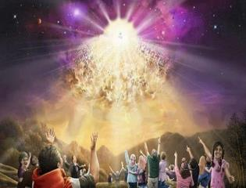
Titus 2:13
“Looking for the blessed hope and the appearing of the glory of our great God and Savior, Christ Jesus.”

Slide 64
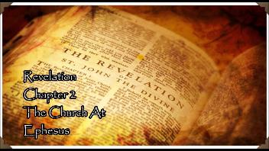
Revelation 2:4-5
“⁴ But I have this against you, that you have left your first love. ⁵ Therefore remember from where you have fallen, and repent and do the deeds you did at first; or else I am coming to you and will remove your lampstand out of its place—unless you repent.”

Slide 65
CONCLUSION

Slide 66
The Rapture Course Overview
What is the Rapture?
When is the Rapture?
Strengthening the Pre-Tribulational case
The opposing views
One second after the Rapture

