Slide 1
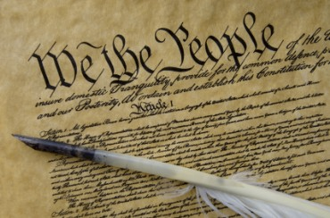
THE BIG LIE: SEPARATION OF CHURCH AND STATE
Dr. Andy Woods
Power Point Update by Dr. Jim McGowan

Slide 2
Acts 13:9-10 (NIV)
“⁹ Then Saul, who was also called Paul, filled with the Holy Spirit, looked straight at Elymas and said, ¹⁰ ‘You are a child of the devil and an enemy of everything that is right! You are full of all kinds of deceit and trickery. Will you never stop perverting the right ways of the Lord?’”

Slide 3
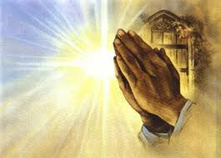
Engle v. Vitale, 370 U.S. 421-22 (1962).
“Almighty God, we acknowledge our dependence upon Thee, and we beg thy blessings upon us, our parents, our teachers, and our country.”

Slide 4
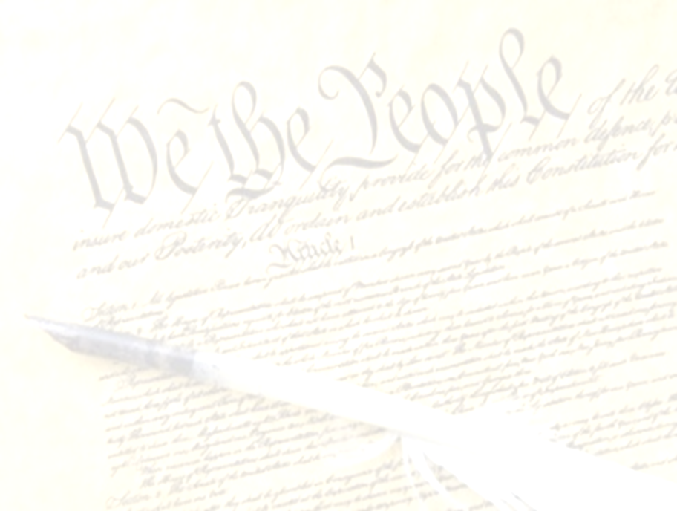
Preview
Read words into the first amendment that simply are not there
Relied upon and took out of context a letter written by Thomas Jefferson more than a decade after the constitution was created
Ignored the legislative activities of those who authored the first amendment
Applied the first amendment to the states although the first amendment describes itself only as a limitation upon federal power

Slide 5
Preview
Ignored the original intent of the fourteenth amendment
Failed to cite a single precedent
Erroneously believed that Christianity causes psychological damage
Acted as the constitution’s amender rather than its interpreter
Selectively applied their newly created separation doctrine only to Judeo-Christian truth while giving alternative non-Christian religions a virtual free pass.

Slide 6
Preview
Read words into the first amendment that simply are not there
Relied upon and took out of context a letter written by Thomas Jefferson more than a decade after the constitution was created
Ignored the legislative activities of those who authored the first amendment
Applied the first amendment to the states although the first amendment describes itself only as a limitation upon federal power

Slide 7
First Amendment
“Congress shall make no law respecting an establishment of religion, or prohibiting the free exercise there of.”

Slide 8
Baer v. Kolmorgen, 181 NYS 2d. 230, 237 (1958).
“Much has been written in recent years concerning Thomas Jefferson’s reference in 1802 to ‘a wall of separation between church and state...’ [It] has received so much attention that one would almost think at times that it is to be found somewhere in our Constitution.”

Slide 9
Article 124 of the Soviet Union Constitution
“In order to ensure to citizens freedom of conscience, the church in the USSR is separated from the state, and the school from the church” (italics added).
Amos J. Peaslee, Constitutions of Nations (Concord, NH: Rumford, 1950), 3:280.

Slide 10
Communist Goals (1963) Congressional Record--Appendix, pp. A34-A35 January 10, 1963 Current Communist Goals EXTENSION OF REMARKS OF HON. A. S. HERLONG, JR. OF FLORIDA IN THE HOUSE OF REPRESENTATIVES Thursday, January 10, 1963
“28. Eliminate prayer or any phase of religious expression in the schools on the ground that it violates the principle of ‘separation of church and state.’"
Skousen, W. Cleon. Naked Communist. Salt Lake City, Utah: Ensign Publishing Co. C. 1961 , 9th edition July 1961.

Slide 11
Preview
Read words into the first amendment that simply are not there
Relied upon and took out of context a letter written by Thomas Jefferson more than a decade after the constitution was created
Ignored the legislative activities of those who authored the first amendment
Applied the first amendment to the states although the first amendment describes itself only as a limitation upon federal power

Slide 12
Origin of Separation Between Church and State
“Believing with you that religion is a matter which lies solely between a man and his God; that he owes account to none other for his faith or his worship; and that the legislative powers of government reach actions only and not opinions, I contemplate with solemn reverence the act of the whole American people which declared that their legislature should ‘make no law respecting an establishment of religion or prohibiting the free exercise thereof,’ thus building a wall of separation between Church and State” (italics added).
Thomas Jefferson, Writings of Thomas Jefferson, Albert Bergh, ed. (Washington D.C.: Thomas Jefferson Memorial Association, 1904), Vol. XVI, p. 281-82, in a letter from Jefferson to the Danbury Baptist Association on January 1, 1802.

Slide 13
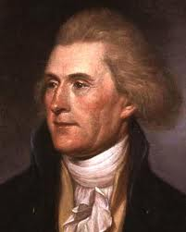
Thomas Jefferson
“One passage, in the paper you enclosed me, must be corrected. It is the following, ‘and all say it was yourself more than any other individual, that planned and established it,’ i.e., the Constitution. I was in Europe when the Constitution was planned, and never saw it till after it was established.”
Thomas Jefferson, The Writings of Thomas Jefferson, 20 vols., ed. Albert Ellery Bergh (Washington D.C: Thomas Jefferson Memorial Association, 1904), 10:325, to Dr. Joseph Priestly on June 19, 1802.

Slide 14
Declaration of Independence
“the Laws of Nature and of Nature’s God,”
“we hold these truths to be self evident, that all men are created equal,”
“they are endowed by their Creator with certain unalienable Rights,”
“appealing to the Supreme Judge of the world for the rectitude of our intentions,”
“with firm reliance on the protection of Divine Providence.”
Church of the Holy Trinity v. U.S., 143 U.S. 457, 467-68 (1892)

Slide 15
Thomas Jefferson
“It was Jefferson, after all, who approved funds for evangelizing Native Americans. It was Jefferson who attended church on federal property for most of his administration, approved still other churches on federal property, and even ordered the marine band to play in his church.”
Mansfield, Ten Tortured Words, 65.

Slide 16
Preview
Read words into the first amendment that simply are not there
Relied upon and took out of context a letter written by Thomas Jefferson more than a decade after the constitution was created
Ignored the legislative activities of those who authored the first amendment
Applied the first amendment to the states although the first amendment describes itself only as a limitation upon federal power

Slide 17
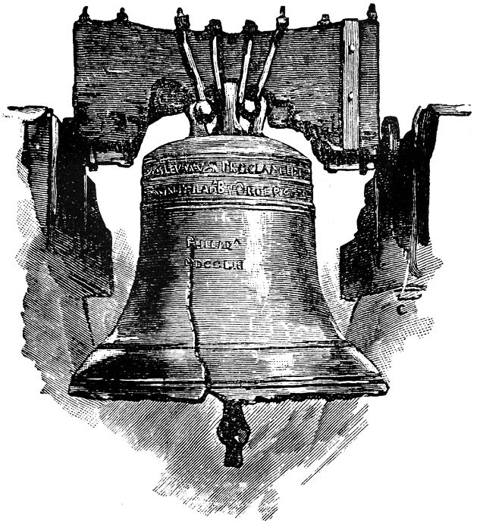

Slide 18
Leviticus 25:10
“And you shall consecrate the fiftieth year, and proclaim liberty throughout [all] the land to all its inhabitants. It shall be a Jubilee for you; and each of you shall return to his possession, and each of you shall return to his family.”

Slide 19
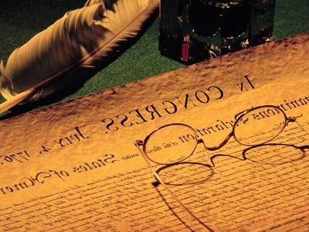
Article III of the Northwest Ordinance
“Religion, morality, and knowledge being necessary to good government and the happiness of mankind, schools and the means of education shall forever be encouraged.”
Documents of American History, Henry S. Commager, ed., 5th ed. (NY: Appleton-Century-Crofts, Inc., 1949), 131.

Slide 20
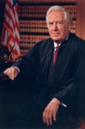
Chief Justice Warren Burger Lynch v. Donnelly, 465 U.S. 668, 673-74 (1984).
"A significant example of the contemporaneous understanding of that Clause is found in the events of the first week of the First Session of the First Congress in 1789. In the very week that Congress approved the Establishment Clause as part of the Bill of Rights for submission to the states, it enacted legislation providing for paid Chaplains for the House and Senate... It is clear that neither the 17 draftsmen of the Constitution who were Members of the First Congress, nor the Congress of 1789, saw any establishment problem in the employment of congressional Chaplains to offer daily prayers in the Congress, a practice that has continued for nearly two centuries. It would be difficult to identify a more striking example of the accommodation of religious belief intended by the Framers."

Slide 21
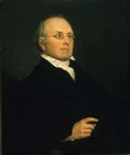
Joseph Story
“Probably at the time of the adoption of the Constitution, and of the amendment to it now under consideration [the First Amendment], the general if not the universal sentiment in America was, that Christianity ought to receive encouragement from the state so far as it was not incompatible with the private rights of conscience and the freedom of religious worship. An attempt to level all religions, and to make it a matter of state policy to hold all in utter indifference, would have created universal disapprobation, if not universal indignation” (underlining mine).
Joseph Story, Commentaries on the Constitution of the United States: With a Preliminary Review of the Constitutional History of the Colonies and the States before the Adoption of the Constitution, 5th ed., 2 vols., ed. Melville M. Bigelow (Boston, MA: Little and Brown, 1891; reprint, Buffalo, NY: Hein, 1994), 2:630-31.

Slide 22
Preview
Read words into the first amendment that simply are not there
Relied upon and took out of context a letter written by Thomas Jefferson more than a decade after the constitution was created
Ignored the legislative activities of those who authored the first amendment
Applied the first amendment to the states although the first amendment describes itself only as a limitation upon federal power

Slide 23
Tenth Amendment
“The powers not delegated to the United States by the Constitution nor prohibited by it to the States are reserved to the States respectively or to the people.”

Slide 24
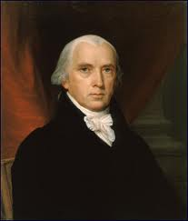
Federalist # 45
“The powers delegated by the proposed Constitution to the federal government, are few and defined. Those which are to remain in the State governments are numerous and indefinite.”
Alexander Hamilton, James Madison, and John Jay, The Federalist Papers, trans. Clinton Rossiter (New York, NY: Penguin, 1961), 292.

Slide 25
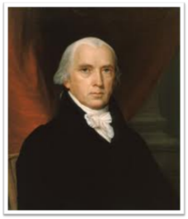
Federalist # 51
“But what is government but the greatest of all reflections on human nature? If men were angels, no government would be necessary. If angels were to govern men, neither external nor internal controls on government would be necessary. In framing a government which is to be administered by men over men, the great difficulty lies in this: you must first enable the government to control the governed; and in the next place oblige it to control itself.”
Alexander Hamilton, James Madison, and John Jay, The Federalist Papers, trans. Clinton Rossiter (New York, NY: Penguin, 1961), 322.

Slide 26
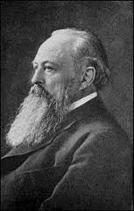
Lord Acton
“All power tends to corrupt and absolute power corrupts absolutely.”

Slide 27
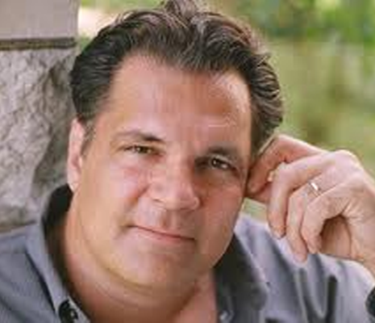
Federalism
“When the founding generation of Americans turned to the business of creating a country, they had just fought a war against a centralized and controlling government. They had no intention of creating an American version of the same evil.”
Mansfield, Ten Tortured Words, 38.

Slide 28
First Amendment
“Congress shall make no law respecting an establishment of religion, or prohibiting the free exercise there of” (italics added).

Slide 29
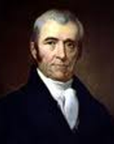
Chief Justice John Marshall
“The Constitution was ordained and established by the people of the United States for themselves, for their own government and not for the government of the individual States.” Therefore, the Bill of Rights “contains no expression indicating an intention to apply them to the state governments.”
Barron v. Baltimore, 32 U.S. 243, 247, 250 (1833).

Slide 30
14th Amendment
“All persons born or naturalized in the United States, and subject to the jurisdiction thereof, are citizens of the United States and of the State wherein they reside. No State shall make or enforce any law which shall abridge the privileges or immunities of the United States; nor shall any State deprive any person of life, liberty, or property, without due process of law; nor to deny to any person within its jurisdiction the equal protection of the laws (italics added).”

Slide 31
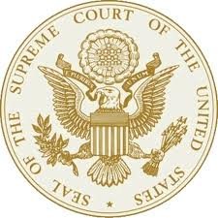
Everson (1947)
“In the words of Jefferson, the clause against establishment of religion by law was intended to erect ‘a wall of separation between church and State’…The First Amendment has erected a wall between church and state. That wall must be kept high and impregnable. We could not approve the slightest breach (italics added).”
Everson v. Board of Education, 330 U.S. 1, 15 (1947).

Slide 32
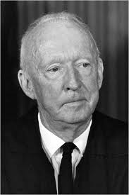
Justice Hugo Black
“Jim Esdale , a Grand Dragon of the Klan and Klan Colleague of [Hugo] Black…noted that ‘Hugo could make the best anti-Catholic speech you ever heard.’”
Philip Hamburger, The Separation of Church and State, 427.

Slide 33
Preview
Ignored the original intent of the fourteenth amendment
Failed to cite a single precedent
Erroneously believed that Christianity causes psychological damage
Acted as the constitution’s amender rather than its interpreter
Selectively applied their newly created separation doctrine only to Judeo-Christian truth while giving alternative non-Christian religions a virtual free pass.

Slide 34
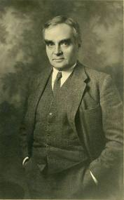
Justice Learned Hand
The Blaine Amendment’s defeat was a “stark testimony to the fact that the adopters of the Fourteenth Amendment never intended to incorporate the establishment clause of the First Amendment against the states.”
Jaffree v. Board of School Commissioners, 554 F. supp. 1104, 1126 (1983).

Slide 35
Preview
Ignored the original intent of the fourteenth amendment
Failed to cite a single precedent
Erroneously believed that Christianity causes psychological damage
Acted as the constitution’s amender rather than its interpreter
Selectively applied their newly created separation doctrine only to Judeo-Christian truth while giving alternative non-Christian religions a virtual free pass.

Slide 36
No Precedent
“Finally, in Engel v. Vitale, only last year, these principles were so universally recognized that the court, without the citation of a single case… reaffirmed them” (italics added).
School District of Abington Township v. Schempp, 374 U.S. 203, 220-21 (1963).

Slide 37
LACK OF PRE-1947 PRECEDENT
CASE | DATE | PRE 1947 CITATIONS | POST 1947 CITATIONS
Levitt v. Committee | 1973 | 0 | 18
Committee v. Nyquist | 1973 | 1 | 99
Stone v. Graham | 1980 | 0 | 9
Marsh v. Chambers | 1982 | 1 | 32
Barton, Myth of Separation, 163-66.

Slide 38
Preview
Ignored the original intent of the fourteenth amendment
Failed to cite a single precedent
Erroneously believed that Christianity causes psychological damage
Acted as the constitution’s amender rather than its interpreter
Selectively applied their newly created separation doctrine only to Judeo-Christian truth while giving alternative non-Christian religions a virtual free pass.

Slide 39
Scripture and Psychological Damage
“But if portions of the New Testament were read without explanation, they could be, and in his specific experience with children Dr. Grayzel observed, had been, psychologically harmful to the child and had caused a divisive force within the social media of the school.”
School District of Abington Township v. Schempp, 374 U.S. 203, 209 (1963).

Slide 40
Preview
Ignored the original intent of the fourteenth amendment
Failed to cite a single precedent
Erroneously believed that Christianity causes psychological damage
Acted as the constitution’s amender rather than its interpreter
Selectively applied their newly created separation doctrine only to Judeo-Christian truth while giving alternative non-Christian religions a virtual free pass.

Slide 41
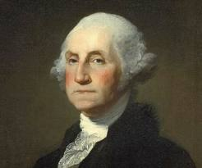
George Washington
“If, in the opinion of the people, the distribution or modification of the Constitutional powers be at any particular wrong, let it be corrected by an amendment the way the Constitution designates. But let there be no change by usurpation; though this may in one instance be the instrument of good, it is the customary weapon by which free governments are destroyed.”
George Washington, American Historical Documents (New York: Barnes and Noble, Inc., 1960), p. 144.

Slide 42
Thomas Jefferson
“You seem…to consider judges as the ultimate arbiters of all constitutional questions; a very dangerous doctrine indeed, and one which would place us under the despotism of an oligarchy. Our judges are as honest as other men, and not more so…and their power the more dangerous as they are in office for life, and not responsible, as the other functionaries are to the elective control. The Constitution has erected no such single tribunal...”
Thomas Jefferson, Writings of Thomas Jefferson, Albert Bergh, ed. (Washington D.C.: Thomas Jefferson Memorial Association, 1904), Vol. XV, p. 277, September 28, 1820.

Slide 43
Thomas Jefferson
“…a mere thing of wax in the hands of the judiciary, which they may twist and shape into any form they please.”
Jefferson, The Writings of Thomas Jefferson, 15:213, in a letter from Jefferson to Judge Spencer Roane on September 6, 1819.

Slide 44
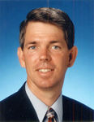
A Legislative Philosophy
“For example, Chief Justice Earl Warren had been the governor of California for ten years prior to his appointment to the court; Justice Hugo Black had been a U.S. Senator for ten years prior to his appointment; Justice Felix Frankfurter had been an assistant to the Secretary of Labor and a founding member of the ACLU; Justice Arthur Goldberg had been the Secretary of Labor and ambassador to the United Nations; Justice William Douglas was chairman of the Securities and Exchange Commission all the justices . . .
Barton, Myth of Separation, 148

Slide 45
A Legislative Philosophy
. . .except Potter Stewart had similar political backgrounds. Justice Potter Stewart, having been a federal judge for four years prior to his appointment, was the only member of the court with extended federal constitutional experience before his appointment. Interestingly Justice Potter Stewart was the only justice who objected to the removal of prayer on the basis of precedent. He alone acted as a judge: the rest acted as politicians.”
Barton, Myth of Separation, 148

Slide 46
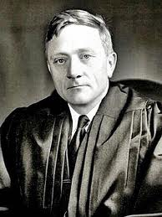
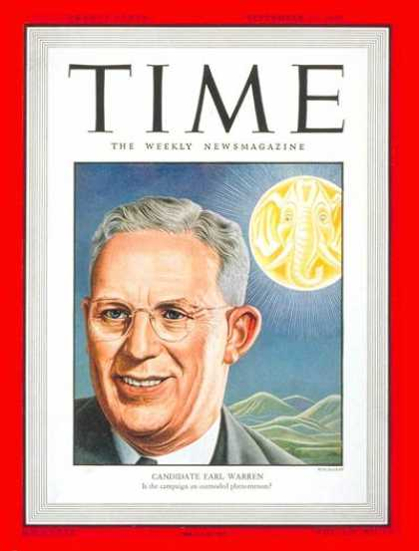
Infamous Warren Court Quip Attributed to Justice William O. Douglas
“With five votes we can do anything”
Owen M. Fiss, “Objectivity and Interpretation,” in Interpreting Law and Literature: A Hermeneutic Reader, ed. Stanford Levinson and Steven Mailloux (Evanston, IL: Northwestern University Press, 1988), 244.

Slide 47
Preview
Ignored the original intent of the fourteenth amendment
Failed to cite a single precedent
Erroneously believed that Christianity causes psychological damage
Acted as the constitution’s amender rather than its interpreter
Selectively applied their newly created separation doctrine only to Judeo-Christian truth while giving alternative non-Christian religions a virtual free pass.

Slide 48
New Age Proselytizing
“I am convinced that the battle for humankind’s future must be waged and won in the public school classrooms by teachers who correctly perceive their role as proselytizers of a new faith: a religion of humanity that recognizes and respects the spark of what theologians call the Divinity in every human being. These teachers must embody the same selfless dedication as the most rabid fundamentalist preachers.”
John Dunphy, “A Religion for the New Age,” The Humanist (January/February 1983): 26

Slide 49
Islamic Proselytizing
In the wake of Sept. 11, an increasing number of California public school students must attend an intensive three-week course on Islam, reports ASSIST NEWS SERVICE. The course mandates that seventh-graders learn the tenets of Islam, study the important figures of the faith, wear a robe, adopt a Muslim name and stage their own jihad…students must memorize many verses in the Koran, are taught to pray “in the name of Allah, the Compassionate, the Merciful” and are instructed to chant, “Praise to Allah, Lord of Creation.”
WorldNetDaily, “Brave New Schools: Islam Required in California District; Course has 7th-Graders Memorizing Koran Verses, Praying to Allah,” online: http://www.wnd.com, accessed 12 October 2009, 1.

Slide 50
Islamic Proselytizing
“We could never teach Christianity like this,” one outraged parent told ANS… “We can’t even mentioned the name of Jesus in public schools…but…they teach Islam as the true religion, and students are taught about Islam and how to pray to Allah. Could you imagine the barrage and problems we would have from the ACLU if Christianity were taught in the public schools, and if we tried to teach about the contributions of Matthew, Mark, Luke, John, and the Apostle Paul? But when it comes to furthering the Islamic religion in public schools, there is not one word from the ACLU, People for the American Way or any body else. This is hypocrisy.”
WorldNetDaily, “Brave New Schools: Islam Required in California District; Course has 7th-Graders Memorizing Koran Verses, Praying to Allah,” online: http://www.wnd.com, accessed 12 October 2009, 1.

Slide 51
Humanist Beliefs
The non-existence or irrelevancy of god
Man as the center of all things
The reality of evolution
Man as an evolved animal rather than a special creature made in the image of his creator
The absence of any absolute morals or values
Confidence in the scientific method to solve the world’s problems.
Eidsmoe, The Christian Legal Advisor, 180-87.

Slide 52
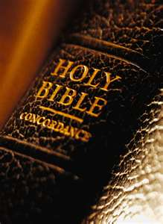
Fundamental Questions Christian Answers
“Who am I?” - a special creation of God
“Where did I come from?” - from God’s design
“Why am I here?” - to know and glorify God
“Where am I going?” - to heaven
“How can I get there?” - only through Jesus Christ

Slide 53
Fundamental Questions Humanistic Answers
“Who am I?” - a biological accident
“Where did I come from?” - from the primordial soup
“Why am I here?” - to fulfill self
“Where am I going?” - toward a planetary new world order
“How can I get there?” - the scientific method

Slide 54
Humanists Call Themselves Religious
Advancement of a religion
“Religious humanists”
“Religious humanism.”
Kurtz, ed., Humanist Manifestos I and II, 8, 10.

Slide 55
Torcaso v. Watkins (1961)
“Among the religions in this country which do not teach what would generally be considered a belief in the existence of God are Buddhism, Taoism, Ethical Culture, Secular Humanism and others” (italics added).
Torcaso v. Watkins, 367 U.S. 488, 495, n. 11 (1961).

Slide 56
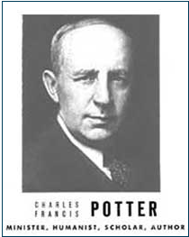
Humanist Proselytizing
“Education is thus a most powerful ally of Humanism, and every public school is a school of Humanism. What can the theistic Sunday-schools, meeting for an hour once a week, and teaching only a fraction of the children, do to stem the tide of a five-day program of humanistic teaching?”
Charles Francis Potter, Humanism: A New Religion (New York: Simon and Schuster, 1930), 128

Slide 57
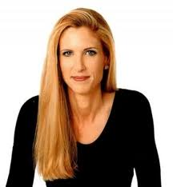
Ann Coulter
“First they claim there is no place for religion in the public square, and then they expand the public square to include everything.”
Ann Coulter, “Foreword,” in Speechless: Silencing the Christians, ed. Donald E. Wildmon (Minneapolis, MN: Vigilante, 2009), xiii.

Slide 58
Preview
Read words into the first amendment that simply are not there
Relied upon and took out of context a letter written by Thomas Jefferson more than a decade after the constitution was created
Ignored the legislative activities of those who authored the first amendment
Applied the first amendment to the states although the first amendment describes itself only as a limitation upon federal power

Slide 59
Preview
Ignored the original intent of the fourteenth amendment
Failed to cite a single precedent
Erroneously believed that Christianity causes psychological damage
Acted as the constitution’s amender rather than its interpreter
Selectively applied their newly created separation doctrine only to Judeo-Christian truth while giving alternative non-Christian religions a virtual free pass.

Slide 60
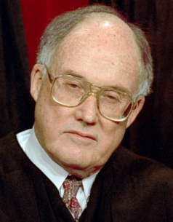
Chief Justice Rehnquist Wallace v. Jaffree, 472 U.S. 38, 107 (1985).
“The absence of a historical basis for this rigid theory of separation”
“Not wholly accurate”
“Can only be dimly perceived”
“Its lack of historical support”
“All but useless as a guide to sound constitutional application”
“It illustrates all too well Benjamin Cardozo’s observation that ‘metaphors in law are to be narrowly watched, for starting as devices to liberate thought, they end often in enslaving it’”

Slide 61
Chief Justice Rehnquist Wallace v. Jaffree, 472 U.S. 38, 107 (1985).
“Mischievous diversion of judges from the actual intentions of the drafters of the Bill of Rights”
“No amount of repetition of historical errors in judicial opinions can make the errors true”
“A metaphor based on bad history”
“A metaphor which has proved useless as a guide to judging”
“It should be frankly and explicitly abandoned.”

