Slide 1


Genesis 10‒11
National Dispersion

Slide 2


GENESIS STRUCTURE
  Beginning of the Human race (Gen. 1‒11)
  Beginning of the Hebrew race (Gen. 12‒50)

Slide 3

GENESIS STRUCTURE
  Genesis 1-11 (four events)
    Creation (1-2)
    Fall (3-5)
    Flood (6-9)
    National dispersion (10-11)

Slide 4
GENESIS STRUCTURE
  Genesis 1-11 (four events)
    Creation (1-2)
    Fall (3-5)
    Flood (6-9)
    National dispersion (10-11)

Slide 5


Genesis 3:15
“And I will put enmity Between you and the woman, And between your seed and her seed; He shall bruise you on the head, And you shall bruise him on the heel.”

Slide 6
GENESIS STRUCTURE
  Genesis 1-11 (four events)
    Creation (1-2)
    Fall (3-5)
    Flood (6-9)
    National dispersion (10-11)

Slide 7
The Flood
(Gen 6–9)
  Events before the flood (Gen 6)
  The flood (Gen 7)
  The abating of the waters (Gen 8)
  Events following the flood (Gen 9)

Slide 8
GENESIS STRUCTURE
  Genesis 1-11 (four events)
    Creation (1-2)
    Fall (3-5)
    Flood (6-9)
    National dispersion (10-11)

Slide 9
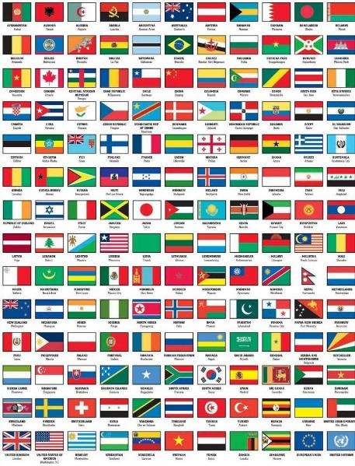
Outline
  Table of nations (Gen 10)
  Tower of Babel (Gen 11:1-9)
  Genealogy from Shem to Terah (Gen 11:10-32)

Slide 10
Outline
  Table of nations (Gen 10)
  Tower of Babel (Gen 11:1-9)
  Genealogy from Shem to Terah (Gen 11:10-32)

Slide 11
Genesis 10–11
  Sinful origin of the nations necessitating Israel’s unique birth and redemptive purpose to these nations
  Gen 11:1-9 occurs first and Genesis 10 occurs second (Gen 10:5, 20, 31; 11:1)

Slide 12


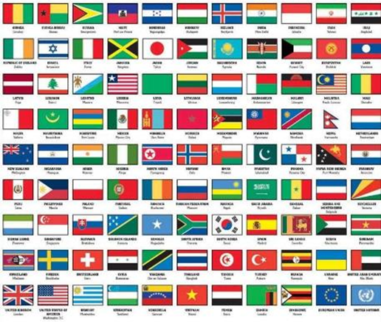
Dr. Arnold G. Fruchtenbaum
The Book of Genesis, 210
“They were divided by languages: everyone after his tongue. This phrase shows that chapter 10 was written after the dispersion of Genesis 11, since that is when the confusion of tongues occurred.”

Slide 13

Genesis 11:1-9
¹ Now the whole earth used the same language and the same words. ² It came about as they journeyed east, that they found a plain in the land of Shinar and settled there. ³ They said to one another, “Come, let us make bricks and burn them thoroughly.” And they used brick for stone, and they used tar for mortar. ⁴ They said, “Come, let us build for ourselves a city, and a tower whose top will . . .

Slide 14
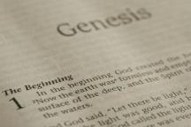
Beginning Themes
Universe Life Man Marriage Evil Clothing | Religion Salvation Language Government Nations Israel
Morris, Genesis Record, 18-20

Slide 15
Beginning Themes
Universe Life Man Marriage Evil Clothing | Religion Salvation Language Government Nations Israel
Morris, Genesis Record, 18-20

Slide 16
GENESIS 10
Outline
  Introduction (1)
  Japheth's line (2-5)
  Ham’s Line (6-20)
  Shem’s line (21-31)
  Conclusion (32)

Slide 17
Table of Nations (Gen 10)
  Nations emanating from Noah’s three sons
  Birth order: Shem, Ham, Japeth (Gen 10:1)
  Lesser to greater importance relative to Israel (Japheth, Ham, Shem)

Slide 18
GENESIS 10
Outline
  Introduction (1)
  Japheth's line (2-5)
  Ham’s Line (6-20)
  Shem’s line (21-31)
  Conclusion (32)

Slide 19
Toledoth
“And These Are the Generations of…”
Introduction to the generations (1:1–2:3)
Generations of the heaven and earth (2:4–4:26)
Generations of Adam (5:1–6:8)
Generations of Noah (6:9–9:29)
Generations of the sons of Noah (10:1–11:9)
Generations of Shem (11:10–26)
Generations of Terah (11:27–25:11)
Generations of Ishmael (25:12-18)
Generations of Isaac (25:19–35:29)
Generations of Esau (36:1–37:1)
Generations of Jacob (37:2–50:26)

Slide 20
Toledoth
“And These Are the Generations of…”
Introduction to the generations (1:1–2:3)
Generations of the heaven and earth (2:4–4:26)
Generations of Adam (5:1–6:8)
Generations of Noah (6:9–9:29)
Generations of the sons of Noah (10:1–11:9)
Generations of Shem (11:10–26)
Generations of Terah (11:27–25:11)
Generations of Ishmael (25:12-18)
Generations of Isaac (25:19–35:29)
Generations of Esau (36:1–37:1)
Generations of Jacob (37:2–50:26)

Slide 21
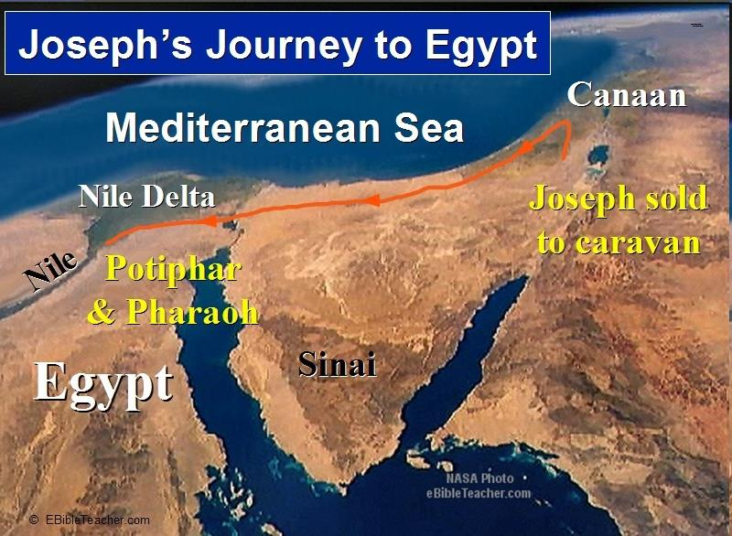

Slide 22

Luke 1:1-4
“¹ Since many have undertaken to compile an account of the things accomplished among us, ² just as they were handed down to us by those who from the beginning were eyewitnesses and servants of the word, ³ it seemed fitting to me as well, having investigated everything carefully from the beginning, to write it out for you in an orderly sequence, most excellent Theophilus; ⁴ so that you may know the exact truth about the things you have been taught.”

Slide 23
GENESIS 10
Outline
  Introduction (1)
  Japheth's line (2-5)
  Ham’s Line (6-20)
  Shem’s line (21-31)
  Conclusion (32)

Slide 24
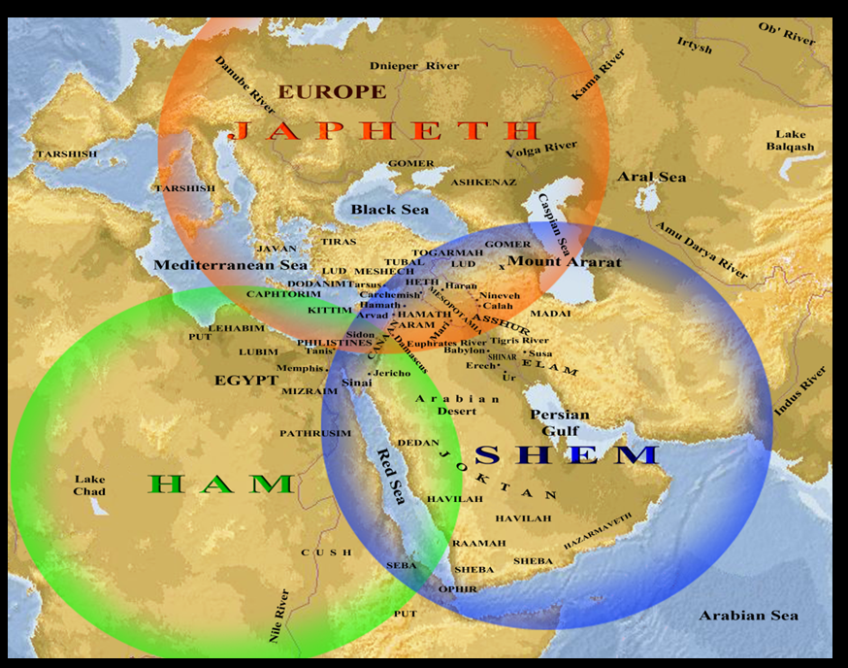

Slide 25
Table of Nations (Gen 10)
  Japheth’s descendants (Gen 10:1-5)
  North and west of Israel
  Europe and North America
  Passed over quickly without much comment because least involvement in the Old Testament

Slide 26
Japheth’s Sons
  Gomer
  Magog
  Madai
  Javan
  Tubal
  Meshech
  Tiras

Slide 27


Slide 28

Ancient Names From Ezekiel 38:1-9
Magog (Central Asia) Rosh (Russia) Meshec (Turkey) Tubal (Turkey) Persia (Iran) Put (Libya) Cush (Sudan) Gomer (Turkey) | Togarmah (Turkey) Sheba (Saudi Arabia) Dedan (Saudi Arabia or Yemen) Tarshish (Spain) Merchants of Tarshish (Conglomeration of Western powers including Europe) Israel

Slide 29
Japheth’s Sons
  Gomer
  Magog
  Madai
  Javan
  Tubal
  Meshech
  Tiras

Slide 30
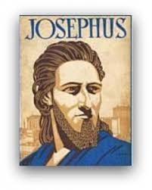
Josephus
Josephus, Antiquities, 1.6.1.
"For Gomer founded those whom the Greeks now call Galatians, [Galls,] but were then called Gomerites.”

Slide 31
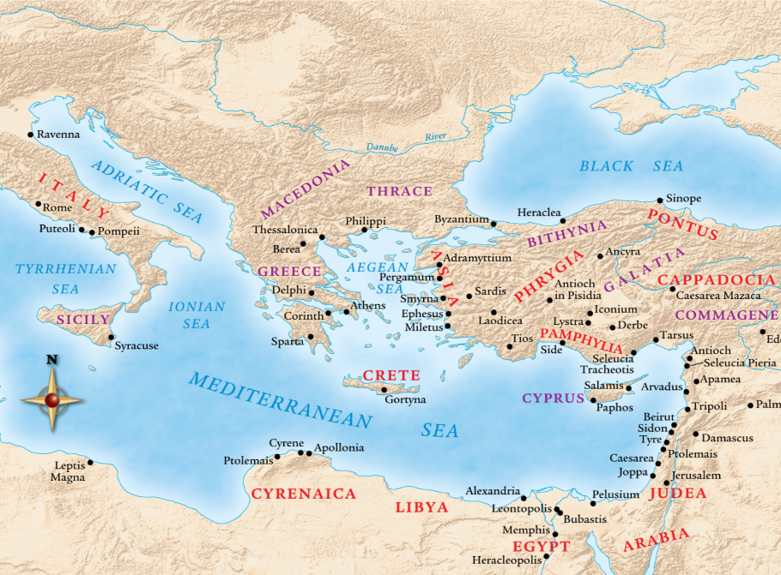

Slide 32
Japheth’s Sons
  Gomer
  Magog
  Madai
  Javan
  Tubal
  Meshech
  Tiras

Slide 33
Josephus
Josephus, Antiquities, 1.6.1.
"Magog founded those that from him were named Magogites, but who are by the Greeks called Scythians."

Slide 35
Japheth’s Sons
  Gomer
  Magog
  Madai
  Javan
  Tubal
  Meshech
  Tiras

Slide 36

Herodotus, Histories, 3:93-94 (450 B.C.)
“The twelfth, the Bactrians as far as the land of the Aegli; these paid three hundred and sixty. The thirteenth, the Pactyic country and Armenia and the lands adjoining as far as the Euxine sea; these paid four hundred…The Moschi, Tibareni, Macrones, Mossynoeci, and Mares, the nineteenth province, were ordered to pay three hundred. The Indians made up the twentieth province. These are more in number than any nation of which we know, and they paid a greater tribute than any other province, namely three hundred and sixty talents of gold dust.”

Slide 37
Japheth’s Sons
  Gomer
  Magog
  Madai
  Javan
  Tubal
  Meshech
  Tiras

Slide 38
Josephus
Josephus, Antiquities, 1.6.1.
"..and the Mosocheni were founded by Mosoch; now they are Cappadocians."

Slide 39

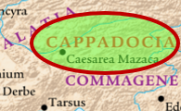
1 Peter 1:1
Peter, an apostle of Jesus Christ, To those who reside as aliens, scattered throughout Pontus, Galatia, Cappadocia, Asia, and Bithynia, who are chosen…

Slide 41
Japheth’s Sons
  Gomer
  Magog
  Madai
  Javan
  Tubal
  Meshech
  Tiras

Slide 42
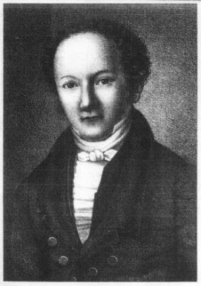
Wilhelm Gesenius
Gesenius' Hebrew and Chaldee Lexicon (Samuel Bagster and Sons, 1847; reprint, Grand Rapids: Baker, 1987), 752.
"pr. n. of a northern nation, mentioned with Tubal and Meshech; undoubtedly the Russians, who are mentioned by the Byzantine writers of the tenth century, under the name the Ros, dwelling to the north of Taurus . . .as dwelling on the river Rha (Wolga)."

Slide 43

Charles L. Feinberg
The Prophecy of Ezekiel: The Glory of the Lord, Paperback ed. (Chicago: Moody, 1969; reprint, Chicago: Moody, 1984), 224.
“The area of origin was stated as out of the uttermost parts, the farthest reaches, of the north. It is well known who has been dominant in this region of the world ever since the end of the last global conflict, an area which has actually kept the entire world in turmoil constantly. Russia is a power that must be reckoned with now, and surely will figure largely in the events that lie head, especially when the church is raptured to her risen Lord.”

Slide 44
Japheth’s Sons
  Gomer
  Magog
  Madai
  Javan
  Tubal
  Meshech
  Tiras

Slide 45
1. Gomer’s Sons
  Ashkenaz
  Riphath
  Togarmah

Slide 46
1. Gomer’s Sons
  Ashkenaz
  Riphath
  Togarmah

Slide 47
Josephus
Josephus, Antiquities, 1.6.1.
"...Thrugramma the Thrugrammeans, who, as the Greeks resolved, were named Phrygians.”

Slide 48

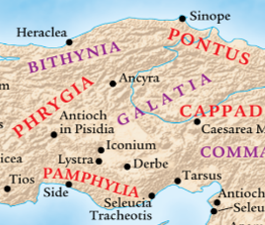
Acts 16:6
“ They passed through the Phrygian and Galatian region, having been forbidden by the Holy Spirit to speak the word in Asia.”

Slide 50
Ancient Names From Ezekiel 38:1-9
Magog (Central Asia) Rosh (Russia) Meshec (Turkey) Tubal (Turkey) Persia (Iran) Put (Libya) Cush (Sudan) Gomer (Turkey) | Togarmah (Turkey) Sheba (Saudi Arabia) Dedan (Saudi Arabia or Yemen) Tarshish (Spain) Merchants of Tarshish (Conglomeration of Western powers including Europe) Israel

Slide 51

Frank Gaffney
War Footing (Annapolis: Naval Institute Press, 2006), 164. Cited in Rhodes, 177.
According to Frank Gaffney, President of the Center for Security Policy, Turkey is transitioning from “a secular democracy with a Muslim society into a state governed by a radical Islamic ideology hostile to Western values and freedoms.”

Slide 52
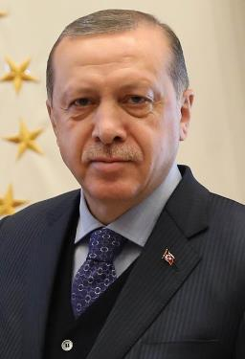
Turkish President Assumes New Sweeping Powers
http://www.israelislamandendtimes.com/turkish-president-and-pm-we-will-gather-together-all-of-the-muslim-world-and-invade-jerusalem/, July 09, 2018, accessed 01 August 2018.
“Turkish President Recep Tayyip Erdogan has assumed sweeping new powers as the country transitions to an executive presidency… Erdogan's new presidential powers are considerable. He can issue decrees with the enforcement of the law and appoint ministers who directly report to him. Erdogan also chooses nine of the 12 constitutional court charges. Under the new system, the post of prime minister is abolished.”

Slide 53
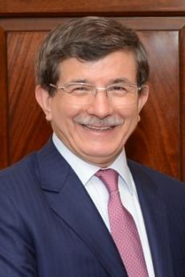
Turkish President and PM:
'We Will Gather Together All Of The Muslim World and Invade Jerusalem,’”
http://www.israelislamandendtimes.com/turkish-president-and-pm-we-will-gather-together-all-of-the-muslim-world-and-invade-jerusalem/, May 30, 2015, accessed 30 May 2015.
“By Allah’s will, Jerusalem belongs to the Kurds, the Turks, the Arabs, and to all Muslims. And as our forefathers fought side by side at Gallipoli, and just as our forefathers went together to liberate Jerusalem with Saladin, we will march together on the same path [to liberate Jerusalem].”

Slide 54
Japheth’s Sons
  Gomer
  Magog
  Madai
  Javan
  Tubal
  Meshech
  Tiras

Slide 55
4. Javan’s Sons
  Elishah
  Tarshish
  Kittim
  Dodanim

Slide 56
4. Javan’s Sons
  Elishah
  Tarshish
  Kittim
  Dodanim

Slide 57
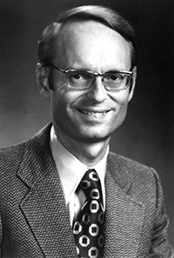
Tarshish = Spain
Ryrie Study Bible, p. 1,421.
“The Ryrie Study Bible indicates that Tarshish “is located in the S of Spain near Gibraltar, 2,500 mi. (4,000 km) W of Palestine [or Israel] and the opposite direction from Nineveh.”

Slide 58
Ezekiel 38:13
“Sheba and Dedan and the merchants of Tarshish with all its villages will say to you, ‘Have you come to capture spoil? Have you assembled your company to seize plunder, to carry away silver and gold, to take away cattle and goods, to capture great spoil?’”

Slide 59
Ezekiel 38:13
“Sheba and Dedan and the merchants of Tarshish with all its villages will say to you, ‘Have you come to capture spoil? Have you assembled your company to seize plunder, to carry away silver and gold, to take away cattle and goods, to capture great spoil?’”

Slide 60
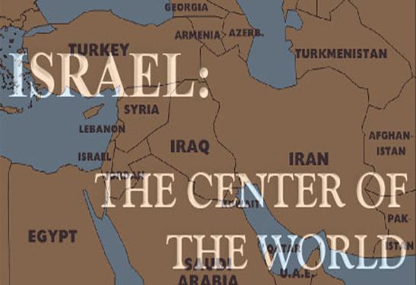
Charles L. Feinberg
The Prophecy of Ezekiel: The Glory of the Lord, Paperback ed. (Chicago: Moody, 1969; reprint, Chicago: Moody, 1984), 223.
“The young lions of Tarshish are taken to mean either the strong leaders and princes or greedy rulers of these commercial communities.”

Slide 61
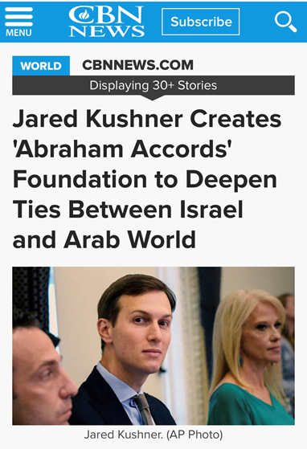

Slide 62
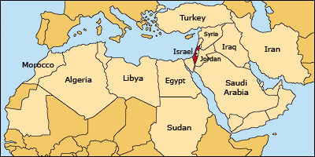

Slide 63
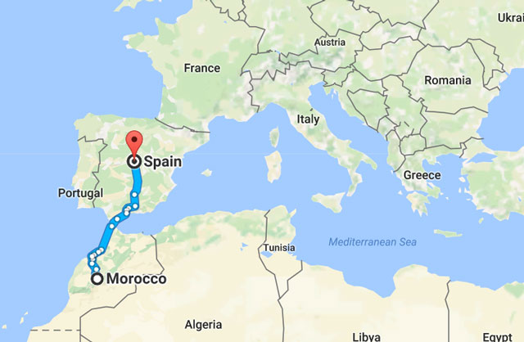

Slide 64
GENESIS 10
Outline
  Introduction (1)
  Japheth's line (2-5)
  Ham’s Line (6-20)
  Shem’s line (21-31)
  Conclusion (32)

Slide 65
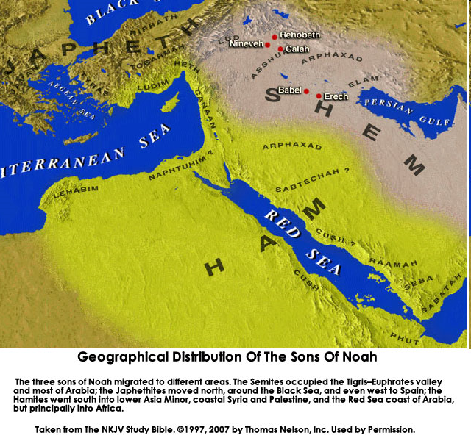

Slide 67
Table of Nations (Gen 10)
  Ham’s descendants (Gen 10:6-20)
  Southwest Asia and Northeast Africa
  Perennial enemies of Israel (Babylonians, Egyptians, Canaanites-Gen 10:15-20)

Slide 68
Ham’s Sons
  Cush
  Mizraim
  Put
  Canaan

Slide 69
Ham’s Sons
  Cush
  Mizraim
  Put
  Canaan

Slide 70
Josephus
Josephus, Antiquities, 1.6.2.
"For of the four sons of Ham, time has not at all hurt the name of Cush; for the Ethiopians, over whom he reigned, are even at this day, both by themselves and by all men in Asia, called Cushites."

Slide 71
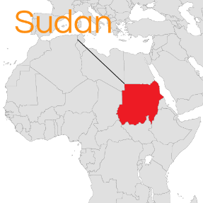
Cush = Sudan
Philip C. Johnson, “Cush,” in Wycliffe Bible Encyclopedia, ed. Howard F. Vos, Charles F. Pfeiffer, John Rea (Chicago: Moody, 1975), p. 1.411.
"The designation, Ethiopia, is misleading for it did not refer to the modern state of Ethiopia...Cush... bordered Egypt on the South,...or modern Sudan."

Slide 72
Ham’s Sons
  Cush
  Mizraim
  Put
  Canaan

Slide 74
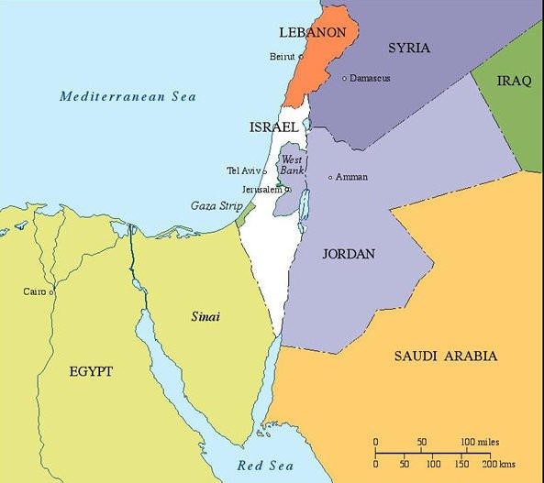

Slide 75
Ham’s Sons
  Cush
  Mizraim
  Put
  Canaan

Slide 76
Josephus
Josephus, Antiquities, 1.6.2.
"Phut also was the founder of Libya, and called the inhabitants Phutites, from himself: there is also a river in the country of Moors which bears that name; whence it is that we may see the greatest part of the Grecian historiographers mention that river and the adjoining country by the apellation of Phut: but the name it has now has been by change given it from one of the sons of Mesraim, who was called Lybyos."

Slide 78
Ham’s Sons
  Cush
  Mizraim
  Put
  Canaan

Slide 80
Ham’s Sons
  Cush
  Mizraim
  Put
  Canaan

Slide 81
1. Cush’s Sons
  Seba
  Havilah
  Sabtah
  Raamah
    Sheba
    Dedan
  Sabteca
  Nimrod

Slide 82
1. Cush’s Sons
  Seba
  Havilah
  Sabtah
  Raamah
    Sheba
    Dedan
  Sabteca
  Nimrod

Slide 83
Ezekiel 38:13
“Sheba and Dedan and the merchants of Tarshish with all its villages will say to you, ‘Have you come to capture spoil? Have you assembled your company to seize plunder, to carry away silver and gold, to take away cattle and goods, to capture great spoil?’”

Slide 84
Ancient Names From Ezekiel 38:1-9
Magog (Central Asia) Rosh (Russia) Meshec (Turkey) Tubal (Turkey) Persia (Iran) Put (Libya) Cush (Sudan) Gomer (Turkey) | Togarmah (Turkey) Sheba (Saudi Arabia) Dedan (Saudi Arabia or Yemen) Tarshish (Spain) Merchants of Tarshish (Conglomeration of Western powers including Europe) Israel

Slide 85
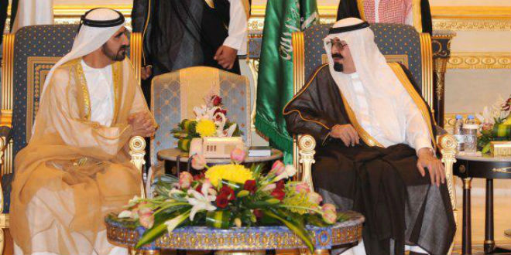
“SAUDI PRINCE: ‘I’LL SIDE WITH ISRAEL’ AGAINST PALESTINIAN UPRISING, [AND] IRAN.”
https://www.breakingisraelnews.com/52468/saudi-prince-ill-side-with-israel-against-palestinian-uprising-middle-east/#bco8FQkRWpkSLkuq.97

Slide 86

TIMES OF INDIA
online: http://tass.com/politics/932980. December 01, 2017 , accessed 12 December 2017.
“Saudi Arabia intercepts second Yemen missile in a month. Saudi Arabia on Thursday intercepted and destroyed a ballistic missile fired from war-torn Yemen, state media reported, the second such attack this month claimed by Iran-backed Huthi rebels.”

Slide 88
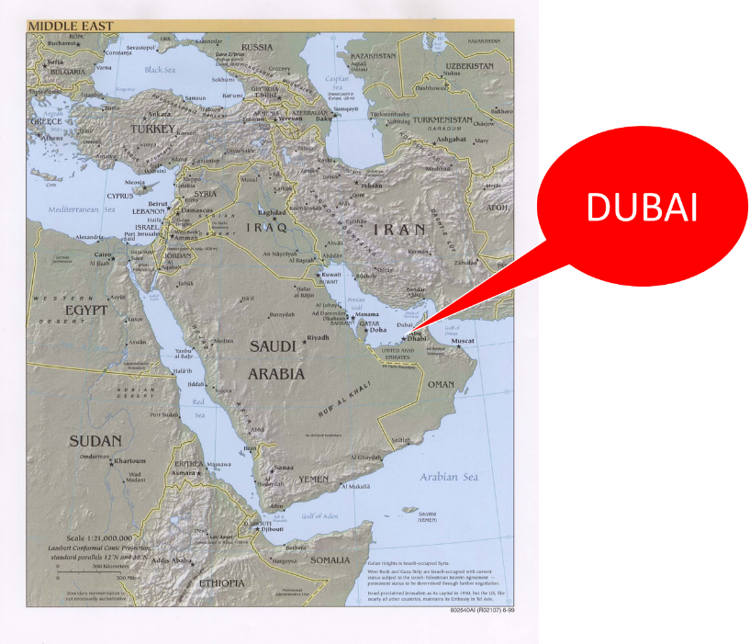

Slide 89
1. Cush’s Sons
  Seba
  Havilah
  Sabtah
  Raamah
    Sheba
    Dedan
  Sabteca
  Nimrod

Slide 90
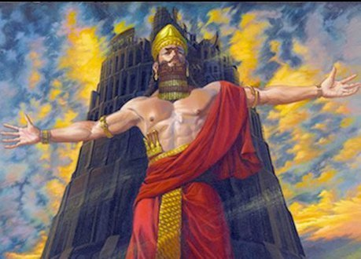
Dr. Arnold G. Fruchtenbaum
The Book of Genesis, 213
“Verse 9 deals with Nimrod’s relationship to God: He was a mighty hunter before Jehovah. The terminology implies antagonism; antagonism against and in opposition to God.”

Slide 91

Names & Titles Demonstrating Satan’s Post-Fall, Earthly Authority
(Job 1:7; 2:2; Luke 4:5-8; Rom. 8:19-22)
Prince of this world (John 12:31; 14:30; 16:11)
God of this age (2 Cor. 4:4)
Prince and power of the air (Eph. 2:2)
Who the believer wrestles with (Eph. 6:12)
Roaring lion (1 Pet. 5:8)
Whole world lies in his power (1 John 5:19)

Slide 92


Slide 93
Genesis 11:1-4
¹ Now the whole earth used the same language and the same words. ² It came about as they journeyed east, that they found a plain in the land of Shinar and settled there. ³ They said to one another, “Come, let us make bricks and burn them thoroughly.” And they used brick for stone, and they used tar for mortar. ⁴ They said, “Come, let us build for ourselves a city, and a tower whose top will reach into heaven, and let us make for ourselves a name, otherwise we will be scattered abroad over the face of the whole earth.”

Slide 94

Daniel 1:1-2
“¹ In the third year of the reign of Jehoiakim king of Judah, Nebuchadnezzar king of Babylon came to Jerusalem and besieged it.² The Lord gave Jehoiakim king of Judah into his hand, along with some of the vessels of the house of God; and he brought them to the land of Shinar, to the house of his god, and he brought the vessels into the treasury of his god.”

Slide 95


Slide 96
Israel's Judgments
Division of the kingdom in 931 B.C. (1 Kgs. 12)
Assyrian judgment in 722 B.C. (2 Kgs. 17)
Babylonian captivity in 586 B.C. (2 Kgs. 25)
Rome Diaspora in A.D. 70 (Luke 19:41-44)

Slide 97
Israel's Judgments
Division of the kingdom in 931 B.C. (1 Kgs. 12)
Assyrian judgment in 722 B.C. (2 Kgs. 17)
Babylonian captivity in 586 B.C. (2 Kgs. 25)
Rome Diaspora in A.D. 70 (Luke 19:41-44)

Slide 98
Zechariah 5:5-11
⁹ Then I lifted up my eyes and looked, and there two women were coming out with the wind in their wings; and they had wings like the wings of a stork, and they lifted up the ephah between the earth and the heavens. ¹⁰ I said to the angel who was speaking with me, “Where are they taking the ephah?” ¹¹ Then he said to me, “To build a temple for her in the land of Shinar; and when it is prepared, she will be set there on her own pedestal.”

Slide 99
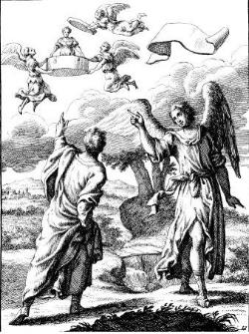
Zechariah 5:5-11
Woman (wickedness)
Ephah (commerce)
House (Temple-2 Sam 7; religion)
Shinar (Gen 10:10; 11:2; Dan 1:2)

Slide 100
Hitchcock The Second Coming of Babylon, 109.
ZECHARIAH 5:5-11 | REVELATION 17–18
Woman sitting in a basket | Woman sitting on beast, seven mountains, many waters (17: 3, 9, 15)
Emphasis on commerce (basket for measuring grain) | Emphasis on commerce (merchant of grain, 18:13)
Woman’s name is wickedness | Woman’s name is Babylon the Great, Mother of Harlots and Abominations of the Earth
Focus on False worship (temple is built for the woman) | Focus on False worship (17:5)
Woman taken to Babylon | Woman called Babylon

Slide 101
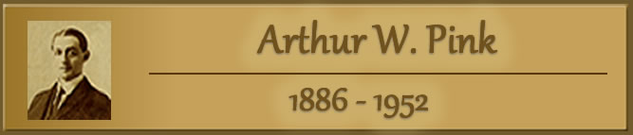
“The vision or prophecy (Zec. 5) contains the germ which is afterward expanded and developed in such detail in Rev. 17 and 18.” Pink, The Antichrist, 281.

Slide 102


Ecclesiastes 1:9
“That which has been is that which will be, And that which has been done is that which will be done. So there is nothing new under the sun.”

Slide 103
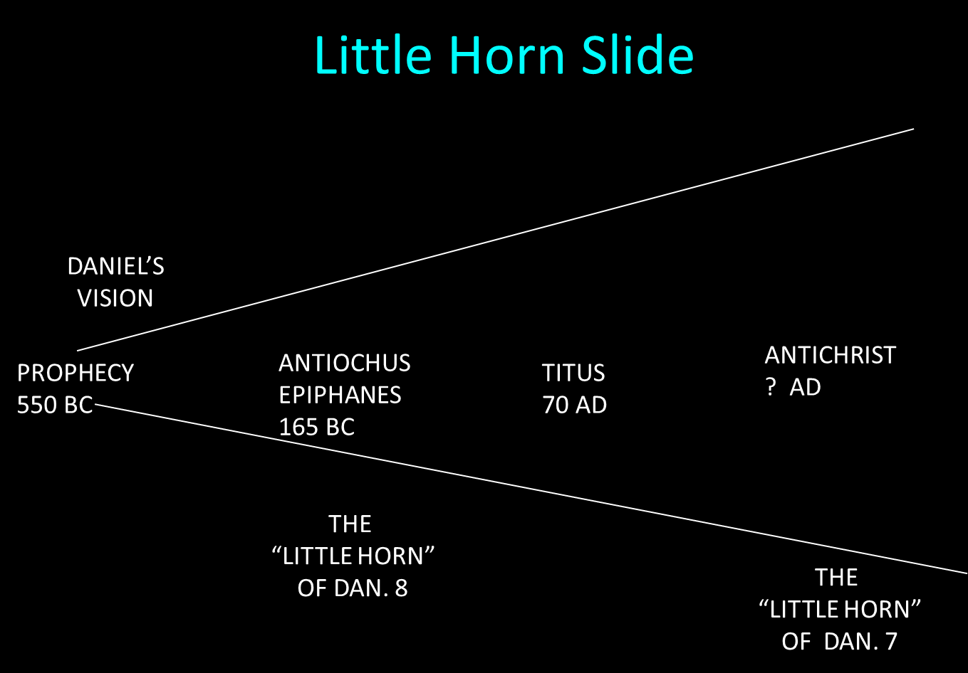

Slide 105
Israel's Judgments
Division of the kingdom in 931 B.C. (1 Kgs. 12)
Assyrian judgment in 722 B.C. (2 Kgs. 17)
Babylonian captivity in 586 B.C. (2 Kgs. 25)
Rome Diaspora in A.D. 70 (Luke 19:41-44)

Slide 106
Ham’s Sons
  Cush
  Mizraim
  Put
  Canaan

Slide 107
2. Mizraim’s Sons
  Ludim
  Anaim
  Lehabim
  Naphtushim
  Pathrushim
  Calushim
  Caphtorim

Slide 108
2. Mizraim’s Sons
  Ludim
  Anaim
  Lehabim
  Naphtushim
  Pathrushim
  Calushim
  Caphtorim

Slide 109
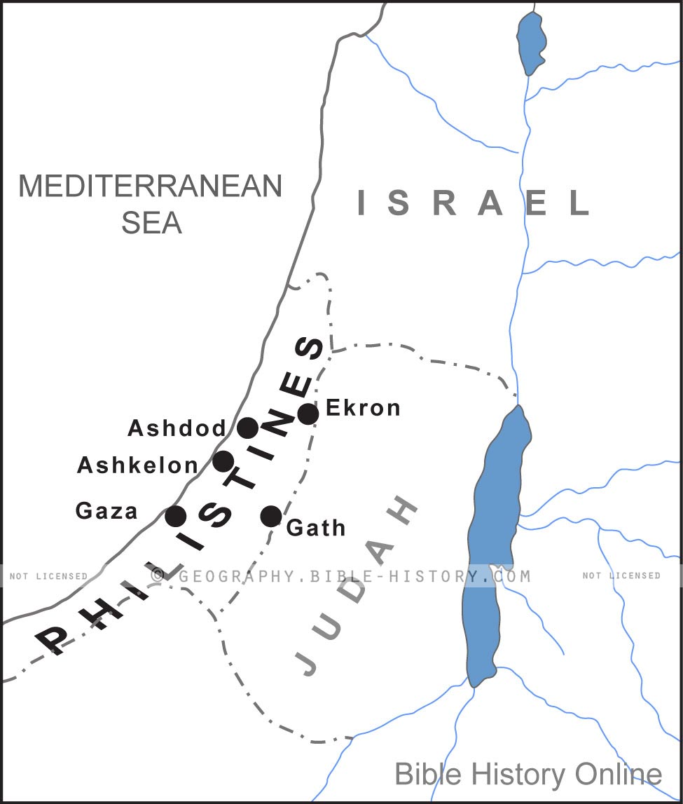

Slide 110
Ham’s Sons
  Cush
  Mizraim
  Put
  Canaan

Slide 112
4. Canaan’s Sons
  Sidon
  Heth
  Jebusite
  Amorite
  Girgahite
  Hivite
  Arkite
  Sinite
  Arvadite
  Zemaritie
  Hamathite

Slide 113
4. Canaan’s Sons
  Sidon
  Heth
  Jebusite
  Amorite
  Girgahite
  Hivite
  Arkite
  Sinite
  Arvadite
  Zemaritie
  Hamathite

Slide 114
4. Canaan’s Sons
  Sidon
  Heth
  Jebusite
  Amorite
  Girgahite
  Hivite
  Arkite
  Sinite
  Arvadite
  Zemaritie
  Hamathite

Slide 115


Slide 116


Genesis 15:16
“Then in the fourth generation they will return here, for the wrongdoing of the Amorite is not yet complete.”

Slide 117


Slide 118
GENESIS 10
Outline
  Introduction (1)
  Japheth's line (2-5)
  Ham’s Line (6-20)
  Shem’s line (21-31)
  Conclusion (32)

Slide 121

Table of Nations (Gen 10)
  Shem’s descendants (Gen 10:21-32)
  Semites
  Line leading to Israel
  Eber (Gen 10:21, 25) is origin of the word Hebrews (Gen 14:13)

Slide 122
Dr. Arnold G. Fruchtenbaum
The Book of Genesis, 217
“The line of Shem begins in verse 21: And unto Shem, the father of all the children of Eber. Eber in Hebrew is Ever and is the source of the Hebrew word for “Hebrew,” Ivrit. To be the father of the Hebrews is the main significance of the line of Shem.”

Slide 123
Genesis 3:15
“And I will put enmity Between you and the woman, And between your seed and her seed; He shall bruise you on the head, And you shall bruise him on the heel.”

Slide 124
God’s Messianic Purposes
Beginning in Genesis
Proto-evangelium from Adam & Eve (3:15)
Seth (4:25)
Noah (Gen 5:29)
Shem (9:26)
Abraham (12:3)
Isaac (21:12)
Jacob (25:23)
Judah (49:10)

Slide 125
God’s Messianic Purposes
Beginning in Genesis
Proto-evangelium from Adam & Eve (3:15)
Seth (4:25)
Noah (Gen 5:29)
Shem (9:26)
Abraham (12:3)
Isaac (21:12)
Jacob (25:23)
Judah (49:10)

Slide 126
Shem’s Sons
  Elam
  Asshur
  Arphachshad
  Lud
  Aram

Slide 127
Shem’s Sons
  Elam
  Asshur
  Arphachshad
  Lud
  Aram

Slide 128


Slide 129
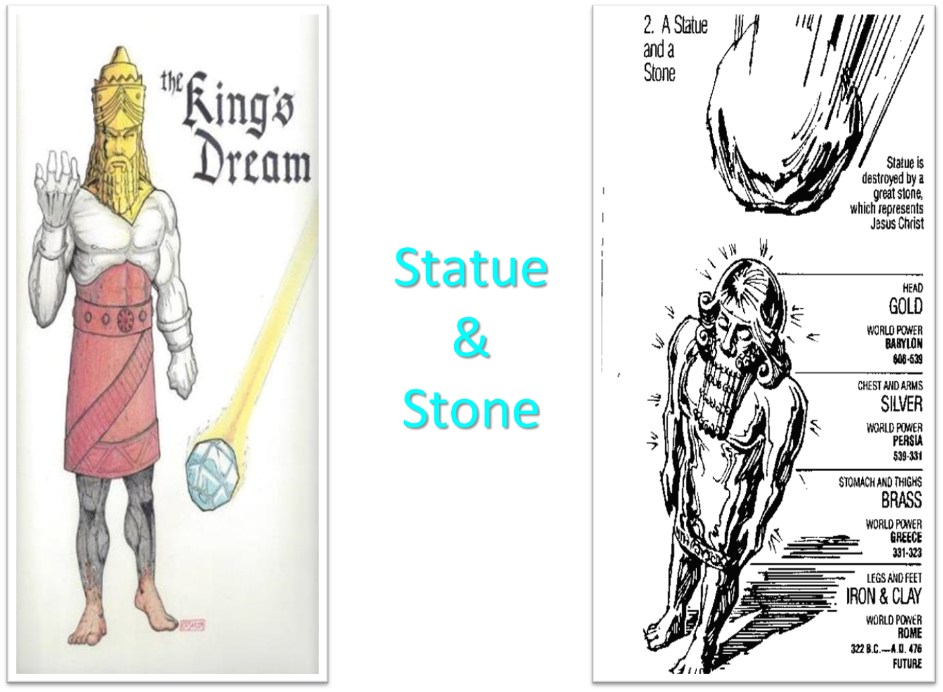

Slide 130
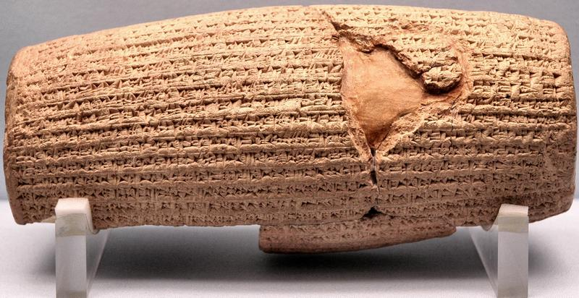
Cyrus Cylinder

Slide 131
Three Returns
 | DATE | DURATION | PERSIAN KING | JEWISH LEADER | SCRIPTURE | PURPOSE | NUMBER OF RETURNEES
1st return | 538–515 B.C. | 23 years | Cyrus (Isa 44:28‒45:1) | Zerubbabel | Ezra 1–6; Isaiah 44:28 | Rebuilding the temple | 50,000
2nd return | 458–457 B.C. | 2 years | Artaxerxes | Ezra | Ezra 7–10 | Adorning of the temple and reforming the people | 2,000
3rd return | 444–432 B.C. | 8 years | Artaxerxes | Nehemiah | Nehemiah | Rebuilding the wall

Slide 132


Slide 133
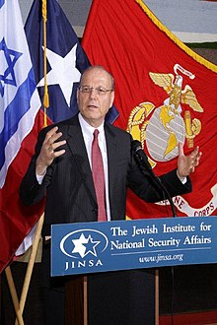
Yoram Ettinger
“Iran's School Textbooks‒Can Congress Afford to Ignore It?,” online: http://theettingerreport.com/Iran-and-MidEast/Iran-s-School-Textbooks-%E2%80%93-can-Congress-afford-to-i.aspx, May 29, 2015, accessed 30 May 2015.
“Iranian school textbooks, such as The Qur'an and Life (Grade 12, p. 125) prepare Iranian children for the Ayatollahs' sublime goal: the apocalyptic, horrifying, millenarian, military battle against the USA and other "arrogant oppressors of the world," which are ostensibly led by "idolatrous devils." While the "savior" – the infallible, immortal, divinely ordained and eventual global leader, the Mahdi – has not surfaced yet, Iranian children are taught that the battle is already raging throughout the world, awaiting their sacrifice. School . . .

Slide 134
Yoram Ettinger
“Iran's School Textbooks‒Can Congress Afford to Ignore It?,” online: http://theettingerreport.com/Iran-and-MidEast/Iran-s-School-Textbooks-%E2%80%93-can-Congress-afford-to-i.aspx, May 29, 2015, accessed 30 May 2015.
. . .textbooks of Western democracies are the most authentic reflection of peoples' values and worldview. School textbooks of tyrannies are the most authentic reflection of the nature and mission of the regimes. Iranian school textbooks reflect the strategy and tactics of the Ayatollahs, much more authentically than speeches, interviews, diplomatic statements and conversations conducted by President Rouhani and Foreign Minister Zarif.”

Slide 135
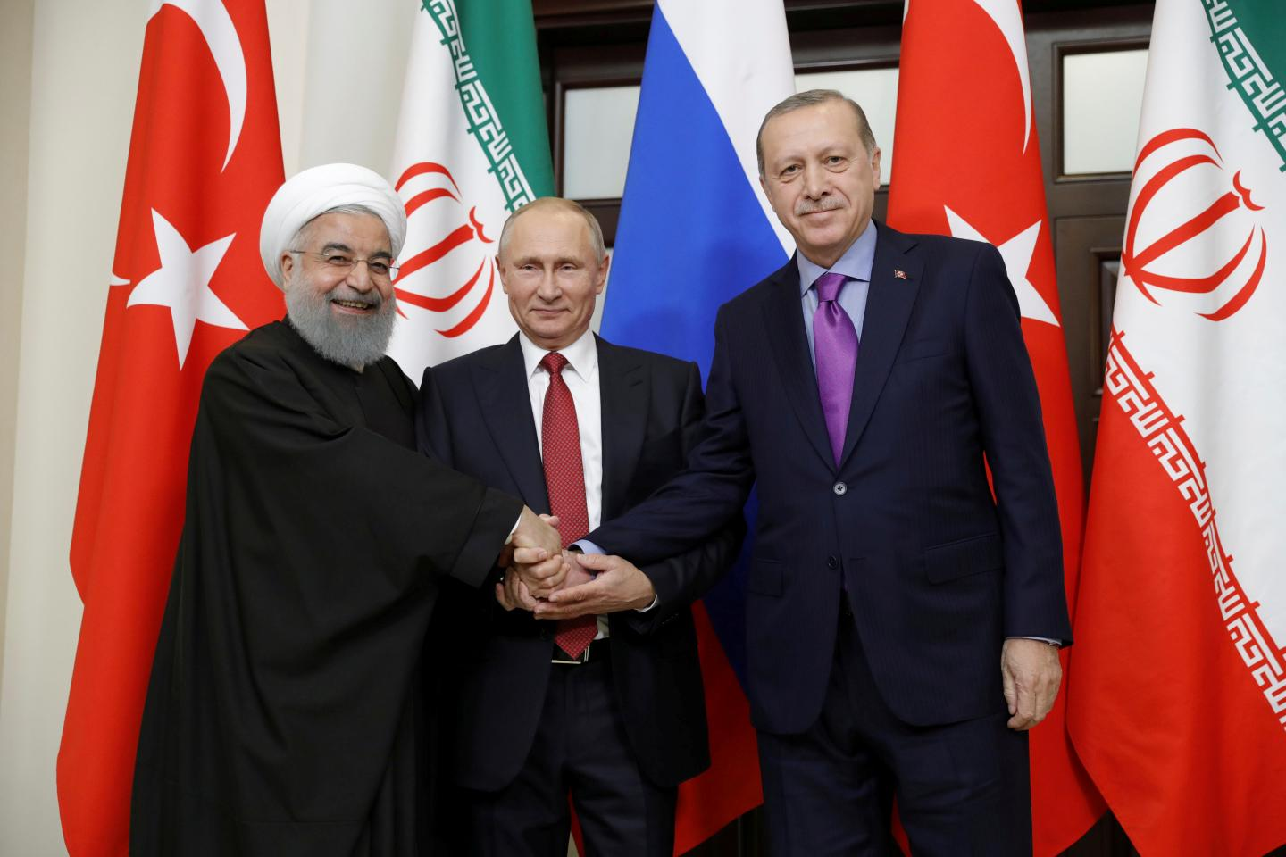

Slide 136

Ron Rhodes
Ron Rhodes, Northern Storm Rising: Russia, Iran, and the Emerging End-Times Military Coalition against Israel (Eugene, OR: Harvest, 2008), pp. 90.
“The unique alignment of nations described in Ezekiel 38 and 39 has never occurred in the past, but it is occurring now.”

Slide 137
Shem’s Sons
  Elam
  Asshur
  Arphachshad
  Lud
  Aram

Slide 139
Shem’s Sons
  Elam
  Asshur
  Arphachshad
  Lud
  Aram

Slide 140
5. Aram’s Sons
  Uz
  Hul
  Gether
  Mash

Slide 141
5. Aram’s Sons
  Uz
  Hul
  Gether
  Mash

Slide 142
Shem’s Sons
  Elam
  Asshur
  Arphachshad
  Lud
  Aram

Slide 143
Eber’s Sons
  Peleg
  Joktan

Slide 144
Eber’s Sons
  Peleg
  Joktan

Slide 145
Dr. Arnold G. Fruchtenbaum
The Book of Genesis, 219
“…the name of the one was Peleg. For in his days was the earth divided. The name Peleg means ‘to divide.’ Some identify this event with the continental divide or the continental drift. However, contextually, it more likely refers to the language division of the Tower of Babel judgment. This means that the confusion of tongues occurred during Peleg’s lifetime.”

Slide 146

Dr. Henry M. Morris
The Genesis Record, 260-61
“Evidently this was a most memorable event, and Eber named his son in commemoration of it. The name Peleg means ‘division.’… The big question concerns the meaning of the indicated division of the earth. The most obvious interpretation of this verse is that the division was the division of the peoples at the Tower of Babel, as discussed in Genesis 11. It is significant that some such division is mentioned here in Genesis 10:5 (‘By these were the isles of the Gentiles divided in their lands; every one after his tongue, after their families, in their nations’) and Genesis 10:32 (‘. . . by these were the nations divided in the earth after the flood’).”

Slide 147
Dr. Henry M. Morris
The Genesis Record, 260-61
“These verses seem clearly to refer to a linguistic and geographic division, rather than to an actual splitting of the continents. This is especially clear in verse 5, where the division is specifically ‘after his tongue.’… If it is ever actually proved that the earth once was a single land mass that somehow split apart, with the segments gradually drifting away to form the present continents, then indeed this verse might be understood to refer to such an event. At present, the question of continental drift is still open among scientists; and creationist scientists have pointed to a number of unresolved physical difficulties with the whole idea.”

Slide 148
Eber’s Sons
  Peleg
  Joktan

Slide 149
Joktan’s Sons
  Alamodad
  Sheleph
  Hazarmaveth
  Jerah
  Hadoram
  Uzal
  Diklah
  Obal
  Abimael
  Sheba
  Ophir
  Havilah
  Jobab

Slide 150
GENESIS 10
Outline
  Introduction (1)
  Japheth's line (2-5)
  Ham’s Line (6-20)
  Shem’s line (21-31)
  Conclusion (32)

Slide 151
Conclusion

Slide 152
GENESIS 10
Outline
  Introduction (1)
  Japheth's line (2-5)
  Ham’s Line (6-20)
  Shem’s line (21-31)
  Conclusion (32)

Slide 153
Outline
  Table of nations (Gen 10)
  Tower of Babel (Gen 11:1-9)
  Genealogy from Shem to Terah (Gen 11:10-32)

Slide 154

“The Lord bless you and keep you; the Lord make his face shine on you and be gracious to you; the Lord turn his face toward you and give you peace.” (NIV)

