Slide 1
THE RAPTURE
What and When? – Part 54
Andrew Marshall Woods, Th.M., JD., PhD.
Sr. Pastor, Sugar Land Bible Church

Slide 2
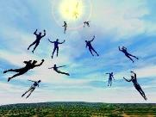
The Rapture Course Overview
What is the Rapture?
When is the Rapture?
Strengthening the Pre-Tribulational case
The opposing views
One second after the Rapture

Slide 3
The Rapture Course Overview
What is the Rapture?
When is the Rapture?
Strengthening the Pre-Tribulational case
The opposing views
One second after the Rapture

Slide 4
What is the Rapture?
An important doctrine
Distinct from the Second Advent
Catching away of all living believers (1 Thess 4:17)
Reunion (1 Thess 4:14-16)
Resurrection (1 Cor 15:50-54)
Exemption from death (1 Cor 15:51, 54-56)
Instantaneous (1 Cor 15:52)
Mystery (1 Cor 15:51)
Imminent (1 Cor 15:51; 1 Thess 4:15)
Traditional doctrine now being recovered

Slide 5
The Rapture Course Overview
What is the Rapture?
When is the Rapture?
Strengthening the Pre-Tribulational case
The opposing views
One second after the Rapture

Slide 6
When is the Rapture?
7 Arguments Favoring the Pre-Tribulation View
Tribulation's purpose concerns Israel (Jer 30:7; Dan 9:24)
No biblical reference to the church on earth during the Tribulation period (Rev 4-22)
Church is promised an exemption from divine wrath (1 Thess 1:10; 5:9; Rom 5:9; Rev 3:10; 6:17)
Rapture is imminent (1 Cor 15:51; 1 Thess 4:15)
Rapture is a comfort (1 Thess 4:18)
Antichrist cannot come to power until the restrainer is removed (2 Thess 2:6-7)
Symbolic parallels (2 Peter 2:5-9)

Slide 7
The Rapture Course Overview
What is the Rapture?
When is the Rapture?
Strengthening the Pre-Tribulational case
The opposing views
One second after the Rapture

Slide 8
Strengthening the Pre-Tribulation Case
John 14:1-4
Revelation 3:10
First Thessalonians 4‒5
Second Thessalonians 2:3a
Matthew 24‒25

Slide 9
The Rapture Course Overview
What is the Rapture?
When is the Rapture?
Strengthening the Pre-Tribulational case
The opposing views
One second after the Rapture

Slide 10
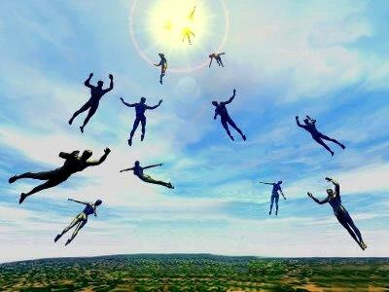
When Will the Rapture Take Place Relative to the Tribulation Period?
Pre-tribulation rapture theory
Mid-tribulation rapture theory
Post-tribulation rapture theory
Pre-wrath rapture theory
Partial rapture theory

Slide 11
Problems with Partial Rapturism?
Every divine blessing (Grace Package) is given on the basis of His grace and not human effort (Eph. 2:8-9; Rom. 12:6)
Symbolic parallels mandate that carnal as well as sanctified Christians will be taken up in the rapture (Gen. 19:22)
The promise of the rapture is mentioned in Paul's letter to the carnal Corinthian church (1 Cor. 15:51)
A partial rapture would sever Christ's body (1 Cor 12:12-14)
The partial rapture view subjects believers to God's wrath (Thess 1:10)

Slide 12
Problems with Partial Rapturism?
Partial rapturism makes the Bema Seat Judgment unnecessary (1 Cor. 3:10-15)
Partial rapturists never objectively quantify the exact degree of faithfulness or spiritual maturity that is necessary to participate in the rapture
Partial rapturists appear individually biased
Partial rapturists dispensationally misapply Bible passages (Matt. 25:1-13)
Partial rapturists misapply passages promising a reward to faithful believers (Rev. 3:11)

Slide 14
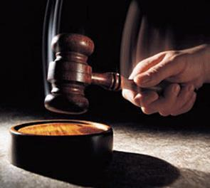
Why?
Not to judge sin (John 19:30)
Not to determine salvation (John 5:24)
But rather to give or not give rewards

Slide 15
Scripture’s Five Crowns (Rev 4:10: 3:11; 2 John 8)
SCRIPTURE | CROWN | PURPOSE
1 Cor. 9:24-27 | Incorruptible | Gaining mastery over the flesh
1 Thess. 2:19-20 | Rejoicing | Soul winning
Jas. 1:12; Rev. 2:10 | Life | Enduring trials
1 Pet. 5:2-4 | Glory | Shepherding God’s people
2 Tim. 4:8 | Righteousness | Longing for His appearing

Slide 16
1 Corinthians 3:15
“If any man’s (carnal believer’s) work is burned up, he will suffer loss; but he himself will be saved, yet so as through fire.”

Slide 17
1 Corinthians 9:24-27
“²⁴ Do you not know that those who run in a race all run, but only one receives the prize? Run in such a way that you may win. ²⁵ Everyone who competes in the games exercises self-control in all things. They then do it to receive a perishable wreath, but we an imperishable. ²⁶ Therefore I run in such a way, as not without aim; I box in such a way, as not beating the air; ²⁷ but I discipline my body and make it my slave, so that, after I have preached to others, I myself will not be disqualified.”

Slide 18
2 John 8
“Watch yourselves, that you do not lose what we have accomplished, but that you may receive a full reward.”

Slide 19
Revelation 3:11
“I am coming quickly; hold fast what you have, so that no one will take your crown.”

Slide 20
Samuel Hoyt
“The Judgment Seat of Christ in Theological Perspective,” Part 2, Bibliotheca Sacra, electronic media.
“The judgment seat of Christ might be compared to a commencement ceremony. At graduation there is some measure of disappointment and remorse that one did not do better and work harder. However, at such an event the overwhelming emotion is joy, not remorse. The graduates do not leave the auditorium weeping because they did not earn better grades. Rather, they are thankful that they have been graduated, and they are grateful for what they did achieve. To overdo the sorrow aspect of the judgment seat of Christ is to make heaven hell. To under do the sorrow aspect is to make faithfulness inconsequential” (underlining mine).

Slide 21
Inheritance vs. Reward
Distinctive? | GIFT | REWARD
Received by? | All believers | Some believers
Basis? | God’s child | Faithfulness
Example? | Inheritance | Crown
Scripture? | Colossians 1:12 | 1 Cor. 3:15 1 Cor. 9:24-27 2 John 8 Rev. 3:11
Dennis Rokser, UNRAVELING A CONFUSING VERSE: ANOTHER LOOK AT “INHERITING THE KINGDOM OF GOD, p. 4.

Slide 22
2 Timothy 4:8
“In the future there is laid up for me the crown of righteousness, which the Lord, the righteous Judge, will award to me on that day; and not only to me, but also to all who have loved His appearing.”

Slide 23
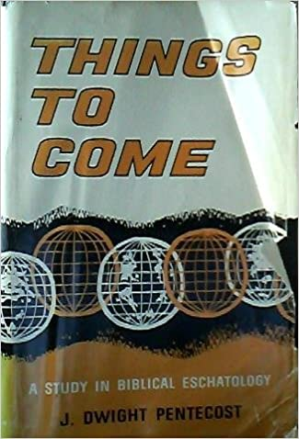
J. Dwight Pentecost
Things to Come, Page 163
“This [2 Tim. 4:8] is used by the adherents of this position to show that the rapture must be a partial one. However, it is to be noticed that the subject of the translation is not in view in this passage, but rather the question of reward. The Second Advent was intended by God to be a purifying hope (1 John 3:3). Because of such purifying a new life is produced because of the expectancy of the Lord's return. Therefore, those that truly ‘love his appearing’ will experience a new kind of life which will bring a reward.”

Slide 24
Problems with Partial Rapturism?
Every divine blessing is given on the basis of His grace and not human effort (Eph. 2:8-9; Rom. 12:6)
Symbolic parallels mandate that carnal as well as sanctified Christians will be taken up in the rapture (Gen. 19:22)
The promise of the rapture is mentioned in Paul's letter to the carnal Corinthian church (1 Cor. 15:51)
A partial rapture would sever Christ's body (1 Cor 12:12-14)
The partial rapture view subjects believers to God's wrath (Thess 1:10)

Slide 25
Problems with Partial Rapturism?
Partial rapturism makes the Bema Seat Judgment unnecessary (1 Cor. 3:10-15)
Partial rapturists never objectively quantify the exact degree of faithfulness or spiritual maturity that is necessary to participate in the rapture
Partial rapturists appear individually biased
Partial rapturists dispensationally misapply Bible passages (Matt. 25:1-13)
Partial rapturists misapply passages promising a reward to faithful believers (Rev. 3:11)

Slide 26
DESCRIPTION OF THE SEVEN CHURCHES Revelation 2‒3
CHURCH | SCRIPTURE | DESCRIPTION
Ephesus | 2:1-7 | Loveless
Smyrna | 2:8-11 | Persecuted
Pergamum | 2:12-17 | Compromised
Thyatira | 2:18-29 | Corrupt
Sardis | 3:1-6 | Dead
Philadelphia | 3:7-13 | Missionary
Laodicea | 3:14-22 | Man-centered

Slide 27
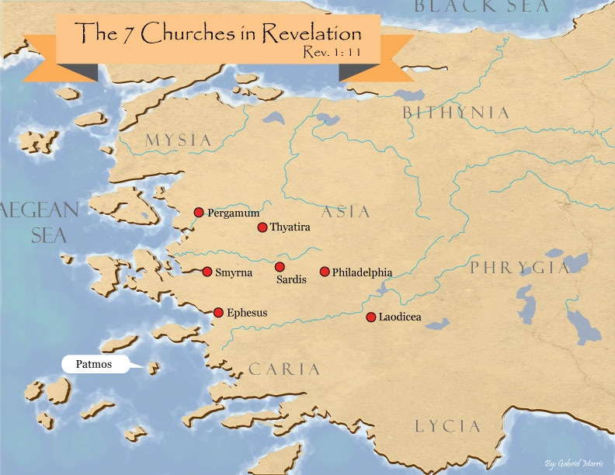

Slide 28
Revelation 3:10
‘Because you have kept the word of My perseverance, I also will keep you from the hour of testing, that hour which is about to come upon the whole world, to test those who dwell on the earth.

Slide 29
Revelation 3:10
‘Because you have kept the word of My perseverance, I also will keep you from the hour of testing, that hour which is about to come upon the whole world, to test those who dwell on the earth.

Slide 30
Revelation 3:10
‘Because you have kept the word of My perseverance, I also will keep you from the hour of testing, that hour which is about to come upon the whole world, to test those who dwell on the earth.

Slide 31
Problems with Beginning the Sentence in Rev. 3:10 with “Because”
Not part of the original manuscripts: chapter & verse divisions & punctuation marks (periods, commas, or exclamation points).
These things were all added by later copyists.
Most English translations separate the two verses with a period.
Thus, it becomes cause for participating the Rapture and not a cause for their enemies to worship before their feet.
However, the period should be placed in the middle of verse 10.
Thus, it becomes not a cause for participating the Rapture and a cause for their enemies to worship before their feet.
John Niemela, The Interpretation of Revelation 3:10: You Have Kept My Word, CTS Journal; As summarized by Dennis Rokser, A Golden Nugget in Revelation 3:10, Grace for the Race, no. 29.

Slide 32
Problems with Beginning the Sentence in Rev. 3:10 with “Because” (cont’d)
Rev. 3:10b becomes an additional unconditional promise of Rapture participation beyond the promises of Rev. 2:9b.
It is rare to begin a sentence with “because” (hoti) in a causative sense.
Instead, hoti (“because”), when casual in function, usually follows a statement or promise in providing a reason for what preceded it in the sentence.
Thus, Greek sentences rarely begin a sentence with the phrase “Because you have” when explaining the cause or reason for something, as Greek and English texts of Revelation 3:10 unfortunately do today. Instead, the “because” phraseology consistently follows later in the sentence.
John Niemela, The Interpretation of Revelation 3:10: You Have Kept My Word, CTS Journal; As summarized by Dennis Rokser, A Golden Nugget in Revelation 3:10, Grace for the Race, no. 29.

Slide 33
Problems with Beginning the Sentence in Rev. 3:10 with “Because”
Not part of the original manuscripts: chapter & verse divisions & punctuation marks (periods, commas, or exclamation points).
These things were all added by later copyists.
Most English translations separate the two verses with a period.
Thus, it becomes cause for participating the Rapture and not a cause for their enemies to worship before their feet.
However, the period should be placed in the middle of verse 10.
Thus, it becomes not a cause for participating the Rapture and a cause for their enemies to worship before their feet.
John Niemela, The Interpretation of Revelation 3:10: You Have Kept My Word, CTS Journal; As summarized by Dennis Rokser, A Golden Nugget in Revelation 3:10, Grace for the Race, no. 29.

Slide 34
Revelation 3:10
‘Because you have kept the word of My perseverance, I also will keep you from the hour of testing, that hour which is about to come upon the whole world, to test those who dwell on the earth.

Slide 35
Problems with Beginning the Sentence in Rev. 3:10 with “Because”
Not part of the original manuscripts: chapter & verse divisions & punctuation marks (periods, commas, or exclamation points).
These things were all added by later copyists.
Most English translations separate the two verses with a period.
Thus, it becomes cause for participating the Rapture and not a cause for their enemies to worship before their feet.
However, the period should be placed in the middle of verse 10.
Thus, it becomes not a cause for participating the Rapture and a cause for their enemies to worship before their feet.
John Niemela, The Interpretation of Revelation 3:10: You Have Kept My Word, CTS Journal; As summarized by Dennis Rokser, A Golden Nugget in Revelation 3:10, Grace for the Race, no. 29.

Slide 36
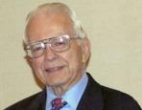
Dr. Roy B. Zuck
Basic Bible Interpretation, p. 43.
“﻿Stephen Langton (ca. 1155–1228), Archbishop of Canterbury, held that spiritual interpretation is superior to literal interpretation. Therefore in the Book of Ruth, the field is the Bible, Ruth represents students, and the reapers are the teachers. Langton is the one who made chapter divisions in the Vulgate Bible.”

Slide 37
Problems with Beginning the Sentence in Rev. 3:10 with “Because”
Not part of the original manuscripts: chapter & verse divisions & punctuation marks (periods, commas, or exclamation points).
These things were all added by later copyists.
Most English translations separate the two verses with a period.
Thus, it becomes cause for participating the Rapture and not a cause for their enemies to worship before their feet.
However, the period should be placed in the middle of verse 10.
Thus, it becomes not a cause for participating the Rapture and a cause for their enemies to worship before their feet.
John Niemela, The Interpretation of Revelation 3:10: You Have Kept My Word, CTS Journal; As summarized by Dennis Rokser, A Golden Nugget in Revelation 3:10, Grace for the Race, no. 29.

Slide 38
Revelation 3:9-10
⁹ ‘Behold, I will cause those of the synagogue of Satan, who say that they are Jews and are not, but lie—I will make them come and bow down at your feet, and make them know that I have loved you. ¹⁰ ‘Because you have kept the word of My perseverance, I also will keep you from the hour of testing, that hour which is about to come upon the whole world, to test those who dwell on the earth.

Slide 39
Problems with Beginning the Sentence in Rev. 3:10 with “Because”
Not part of the original manuscripts: chapter & verse divisions & punctuation marks (periods, commas, or exclamation points).
These things were all added by later copyists.
Most English translations separate the two verses with a period.
Thus, it becomes cause for participating the Rapture and not a cause for their enemies to worship before their feet.
However, the period should be placed in the middle of verse 10.
Thus, it becomes not a cause for participating the Rapture and a cause for their enemies to worship before their feet.
John Niemela, The Interpretation of Revelation 3:10: You Have Kept My Word, CTS Journal; As summarized by Dennis Rokser, A Golden Nugget in Revelation 3:10, Grace for the Race, no. 29.

Slide 40
Revelation 3:9-10
⁹ ‘Behold, I will cause those of the synagogue of Satan, who say that they are Jews and are not, but lie—I will make them come and bow down at your feet, and make them know that I have loved you. ¹⁰ ‘Because you have kept the word of My perseverance, I also will keep you from the hour of testing, that hour which is about to come upon the whole world, to test those who dwell on the earth.

Slide 41
Problems with Beginning the Sentence in Rev. 3:10 with “Because”
Not part of the original manuscripts: chapter & verse divisions & punctuation marks (periods, commas, or exclamation points).
These things were all added by later copyists.
Most English translations separate the two verses with a period.
Thus, it becomes cause for participating the Rapture and not a cause for their enemies to worship before their feet.
However, the period should be placed in the middle of verse 10.
Thus, it becomes not a cause for participating the Rapture and a cause for their enemies to worship before their feet.
John Niemela, The Interpretation of Revelation 3:10: You Have Kept My Word, CTS Journal; As summarized by Dennis Rokser, A Golden Nugget in Revelation 3:10, Grace for the Race, no. 29.

Slide 42
Revelation 3:9-10
⁹ ‘Behold, I will cause those of the synagogue of Satan, who say that they are Jews and are not, but lie—I will make them come and bow down at your feet, and make them know that I have loved you ¹⁰ ‘because you have kept the word of My perseverance. I also will keep you from the hour of testing, that hour which is about to come upon the whole world, to test those who dwell on the earth.

Slide 43
Problems with Beginning the Sentence in Rev. 3:10 with “Because”
Not part of the original manuscripts: chapter & verse divisions & punctuation marks (periods, commas, or exclamation points).
These things were all added by later copyists.
Most English translations separate the two verses with a period.
Thus, it becomes cause for participating the Rapture and not a cause for their enemies to worship before their feet.
However, the period should be placed in the middle of verse 10.
Thus, it becomes not a cause for participating the Rapture and a cause for their enemies to worship before their feet.
John Niemela, The Interpretation of Revelation 3:10: You Have Kept My Word, CTS Journal; As summarized by Dennis Rokser, A Golden Nugget in Revelation 3:10, Grace for the Race, no. 29.

Slide 44
Revelation 3:9-10
⁹ ‘Behold, I will cause those of the synagogue of Satan, who say that they are Jews and are not, but lie—I will make them come and bow down at your feet, and make them know that I have loved you ¹⁰ ‘because you have kept the word of My perseverance. I also will keep you from the hour of testing, that hour which is about to come upon the whole world, to test those who dwell on the earth.

Slide 45
Problems with Beginning the Sentence in Rev. 3:10 with “Because” (cont’d)
Rev. 3:10b becomes an additional unconditional promise of Rapture participation beyond the promises of Rev. 3:9b.
It is rare to begin a sentence with “because” (hoti) in a causative sense.
Instead, hoti (“because”), when casual in function, usually follows a statement or promise in providing a reason for what preceded it in the sentence.
Thus, Greek sentences rarely begin a sentence with the phrase “Because you have” when explaining the cause or reason for something, as Greek and English texts of Revelation 3:10 unfortunately do today. Instead, the “because” phraseology consistently follows later in the sentence.
John Niemela, The Interpretation of Revelation 3:10: You Have Kept My Word, CTS Journal; As summarized by Dennis Rokser, A Golden Nugget in Revelation 3:10, Grace for the Race, no. 29.

Slide 46
Revelation 3:9-10
⁹ ‘Behold, I will cause those of the synagogue of Satan, who say that they are Jews and are not, but lie—I will make them come and bow down at your feet, and make them know that I have loved you ¹⁰ ‘because you have kept the word of My perseverance. I also will keep you from the hour of testing, that hour which is about to come upon the whole world, to test those who dwell on the earth.

Slide 47
Problems with Beginning the Sentence in Rev. 3:10 with “Because” (cont’d)
Rev. 3:10b becomes an additional unconditional promise of Rapture participation beyond the promises of Rev. 3:9b.
It is rare to begin a sentence with “because” (hoti) in a causative sense.
Instead, hoti (“because”), when casual in function, usually follows a statement or promise in providing a reason for what preceded it in the sentence.
Thus, Greek sentences rarely begin a sentence with the phrase “Because you have” when explaining the cause or reason for something, as Greek and English texts of Revelation 3:10 unfortunately do today. Instead, the “because” phraseology consistently follows later in the sentence.
John Niemela, The Interpretation of Revelation 3:10: You Have Kept My Word, CTS Journal; As summarized by Dennis Rokser, A Golden Nugget in Revelation 3:10, Grace for the Race, no. 29.

Slide 48
Revelation 3:9-10
⁹ ‘Behold, I will cause those of the synagogue of Satan, who say that they are Jews and are not, but lie—I will make them come and bow down at your feet, and make them know that I have loved you. ¹⁰ ‘Because you have kept the word of My perseverance, I also will keep you from the hour of testing, that hour which is about to come upon the whole world, to test those who dwell on the earth.

Slide 49
Problems with Beginning the Sentence in Rev. 3:10 with “Because” (cont’d)
Rev. 3:10b becomes an additional unconditional promise of Rapture participation beyond the promises of Rev. 3:9b.
It is rare to begin a sentence with “because” (hoti) in a causative sense.
Instead, hoti (“because”), when casual in function, usually follows a statement or promise in providing a reason for what preceded it in the sentence.
Thus, Greek sentences rarely begin a sentence with the phrase “Because you have” when explaining the cause or reason for something, as Greek and English texts of Revelation 3:10 unfortunately do today. Instead, the “because” phraseology consistently follows later in the sentence.
John Niemela, The Interpretation of Revelation 3:10: You Have Kept My Word, CTS Journal; As summarized by Dennis Rokser, A Golden Nugget in Revelation 3:10, Grace for the Race, no. 29.

Slide 50
Revelation 3:9-10
⁹ ‘Behold, I will cause those of the synagogue of Satan, who say that they are Jews and are not, but lie—I will make them come and bow down at your feet, and make them know that I have loved you ¹⁰ ‘because you have kept the word of My perseverance. I also will keep you from the hour of testing, that hour which is about to come upon the whole world, to test those who dwell on the earth.

Slide 51
Problems with Beginning the Sentence in Rev. 3:10 with “Because” (cont’d)
Rev. 3:10b becomes an additional unconditional promise of Rapture participation beyond the promises of Rev. 3:9b.
It is rare to begin a sentence with “because” (hoti) in a causative sense.
Instead, hoti (“because”), when casual in function, usually follows a statement or promise in providing a reason for what preceded it in the sentence.
Thus, Greek sentences rarely begin a sentence with the phrase “Because you have” when explaining the cause or reason for something, as Greek and English texts of Revelation 3:10 unfortunately do today. Instead, the “because” phraseology consistently follows later in the sentence.
John Niemela, The Interpretation of Revelation 3:10: You Have Kept My Word, CTS Journal; As summarized by Dennis Rokser, A Golden Nugget in Revelation 3:10, Grace for the Race, no. 29.

Slide 52
Revelation 3:9-10
MacDonald’s Idiomatic Translation (MIT)
“⁹ I would put at your disposal those from the synagogue of Satan who call themselves Jews but are not; they are lying. See: I will make them come and bow down before your feet, and they will know that I loved you ¹⁰ because you kept my enduring word. I also will keep you from the time of trial that is about to come...”

Slide 53
Revelation 3:10
‘Because you have kept the word of My perseverance, I also will keep you from the hour of testing, that hour which is about to come upon the whole world, to test those who dwell on the earth.

Slide 54
Problems with Beginning the Sentence in Rev. 3:10 with “Because”
Not part of the original manuscripts: chapter & verse divisions & punctuation marks (periods, commas, or exclamation points).
These things were all added by later copyists.
Most English translations separate the two verses with a period.
Thus, it becomes cause for participating the Rapture and not a cause for their enemies to worship before their feet.
However, the period should be placed in the middle of verse 10.
Thus, it becomes not a cause for participating the Rapture and a cause for their enemies to worship before their feet.
John Niemela, The Interpretation of Revelation 3:10: You Have Kept My Word, CTS Journal; As summarized by Dennis Rokser, A Golden Nugget in Revelation 3:10, Grace for the Race, no. 29.

Slide 55
Problems with Beginning the Sentence in Rev. 3:10 with “Because” (cont’d)
Rev. 3:10b becomes an additional unconditional promise of Rapture participation beyond the promises of Rev. 2:9b.
It is rare to begin a sentence with “because” (hoti) in a causative sense.
Instead, hoti (“because”), when casual in function, usually follows a statement or promise in providing a reason for what preceded it in the sentence.
Thus, Greek sentences rarely begin a sentence with the phrase “Because you have” when explaining the cause or reason for something, as Greek and English texts of Revelation 3:10 unfortunately do today. Instead, the “because” phraseology consistently follows later in the sentence.
John Niemela, The Interpretation of Revelation 3:10: You Have Kept My Word, CTS Journal; As summarized by Dennis Rokser, A Golden Nugget in Revelation 3:10, Grace for the Race, no. 29.

Slide 56
DESCRIPTION OF THE SEVEN CHURCHES Revelation 2‒3
CHURCH | SCRIPTURE | DESCRIPTION
Ephesus | 2:1-7 | Loveless
Smyrna | 2:8-11 | Persecuted
Pergamum | 2:12-17 | Compromised
Thyatira | 2:18-29 | Corrupt
Sardis | 3:1-6 | Dead
Philadelphia | 3:7-13 | Missionary
Laodicea | 3:14-22 | Man-centered

Slide 58
Revelation 2:22
“Behold, I will throw her on a bed of sickness, and those who commit adultery with her into great tribulation, unless they repent of her deeds.”

Slide 59
Revelation 2:22
“Behold, I will throw her on a bed of sickness, and those who commit adultery with her into great tribulation, unless they repent of her deeds.”

Slide 60
Revelation 7:13-14
“¹³ Then one of the elders responded, saying to me, ‘These who are clothed in the white robes, who are they, and where have they come from?’ ¹⁴ I said to him, ‘My lord, you know.’ And he said to me, ‘These are the ones who come out of the great tribulation, and they have washed their robes and made them white in the blood of the Lamb.’”

Slide 61
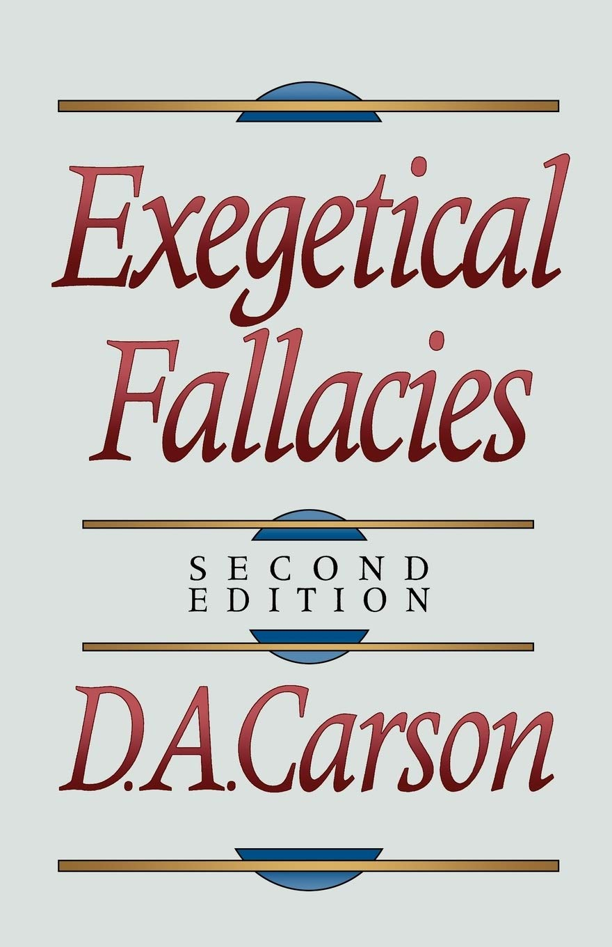
Illegitimate Totality Transfer
D. A. Carson, Exegetical Fallacies, 2nd ed. (Grand Rapids, MI: Baker Academic, 1996), 60-61.
“Unwarranted adoption of an expanded semantic field: The fallacy in this instance lies in the supposition that the meaning of a word in a specific context is much broader than the context itself allows and may bring with it the word’s entire semantic range. This step is sometimes called illegitimate totality transfer.”

Slide 62
George Gunn
John 14:1-3 – The Father’s House: Are We There Yet?, 30. www.pre-trib.org
“I ran out of ingredients for the salad, so I decided to make a quick run down to the store. While at the store, I left the car engine running while I made my purchase, thinking that I would be right out again. However, while I was in the store, I ran into my good friend Edward who was running for county supervisor. This resulted in my having to endure a somewhat long-winded rundown on how his campaign was running. Finally, fearing that my car would run out of gas, I ran with great haste out to the parking lot and returned home with the car surely running only on fumes.”

Slide 63
CONCLUSION

Slide 64
The Rapture Course Overview
What is the Rapture?
When is the Rapture?
Strengthening the Pre-Tribulational case
The opposing views
One second after the Rapture

