Slide 1
THE RAPTURE
What and When? – Part 53
Andrew Marshall Woods, Th.M., JD., PhD.
Sr. Pastor, Sugar Land Bible Church

Slide 2
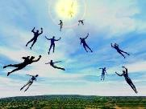
The Rapture Course Overview
What is the Rapture?
When is the Rapture?
Strengthening the Pre-Tribulational case
The opposing views
One second after the Rapture

Slide 3
The Rapture Course Overview
What is the Rapture?
When is the Rapture?
Strengthening the Pre-Tribulational case
The opposing views
One second after the Rapture

Slide 4
What is the Rapture?
An important doctrine
Distinct from the Second Advent
Catching away of all living believers (1 Thess 4:17)
Reunion (1 Thess 4:14-16)
Resurrection (1 Cor 15:50-54)
Exemption from death (1 Cor 15:51, 54-56)
Instantaneous (1 Cor 15:52)
Mystery (1 Cor 15:51)
Imminent (1 Cor 15:51; 1 Thess 4:15)
Traditional doctrine now being recovered

Slide 5
The Rapture Course Overview
What is the Rapture?
When is the Rapture?
Strengthening the Pre-Tribulational case
The opposing views
One second after the Rapture

Slide 6
When is the Rapture?
7 Arguments Favoring the Pre-Tribulation View
Tribulation's purpose concerns Israel (Jer 30:7; Dan 9:24)
No biblical reference to the church on earth during the Tribulation period (Rev 4-22)
Church is promised an exemption from divine wrath (1 Thess 1:10; 5:9; Rom 5:9; Rev 3:10; 6:17)
Rapture is imminent (1 Cor 15:51; 1 Thess 4:15)
Rapture is a comfort (1 Thess 4:18)
Antichrist cannot come to power until the restrainer is removed (2 Thess 2:6-7)
Symbolic parallels (2 Peter 2:5-9)

Slide 7
The Rapture Course Overview
What is the Rapture?
When is the Rapture?
Strengthening the Pre-Tribulational case
The opposing views
One second after the Rapture

Slide 8
Strengthening the Pre-Tribulation Case
John 14:1-4
Revelation 3:10
First Thessalonians 4‒5
Second Thessalonians 2:3a
Matthew 24‒25

Slide 9
The Rapture Course Overview
What is the Rapture?
When is the Rapture?
Strengthening the Pre-Tribulational case
The opposing views
One second after the Rapture

Slide 10
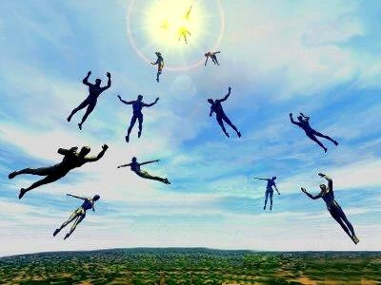
When Will the Rapture Take Place Relative to the Tribulation Period?
Pre-tribulation rapture theory
Mid-tribulation rapture theory
Post-tribulation rapture theory
Pre-wrath rapture theory
Partial rapture theory

Slide 11
Problems with Partial Rapturism?
Every divine blessing (Grace Package) is given on the basis of His grace and not human effort (Eph. 2:8-9; Rom. 12:6)
Symbolic parallels mandate that carnal as well as sanctified Christians will be taken up in the rapture (Gen. 19:22)
The promise of the rapture is mentioned in Paul's letter to the carnal Corinthian church (1 Cor. 15:51)
A partial rapture would sever Christ's body (1 Cor 12:12-14)
The partial rapture view subjects believers to God's wrath (Thess 1:10)

Slide 12
Problems with Partial Rapturism?
Partial rapturism makes the Bema Seat Judgment unnecessary (1 Cor. 3:10-15)
Partial rapturists never objectively quantify the exact degree of faithfulness or spiritual maturity that is necessary to participate in the rapture
Partial rapturists appear individually biased
Partial rapturists dispensationally misapply Bible passages (Matt. 25:1-13)
Partial rapturists misapply passages promising a reward to faithful believers (Rev. 3:11)

Slide 13
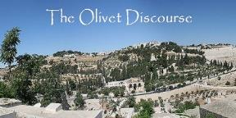
Preview of Matthew 24–25
The problem
The larger context
The immediate context (23:37-39)
The Disciples’ questions (24:1-3)
The Tribulation’s first half (24:4-14)
The Tribulation’s mid-point (24:15-20)
The Tribulation’s second half (24:21-22)
The Second Advent (24:23-31)
Eight parabolic exhortations (24:32‒25:46)

Slide 14
Matthew 24:15-16, 20
“¹⁵ Therefore when you see the abomination of desolation which was spoken of through Daniel the prophet, standing in the holy place (let the reader understand) ¹⁶ then those who are in Judea must flee to the mountains…²⁰ But pray that your flight will not be in the winter, or on a Sabbath.”

Slide 15
1 Corinthians 12:12-13
“¹² For even as the body is one and yet has many members, and all the members of the body, though they are many, are one body, so also is Christ. ¹³ For by one Spirit we were all baptized into one body, whether Jews or Greeks, whether slaves or free, and we were all made to drink of one Spirit.”

Slide 16
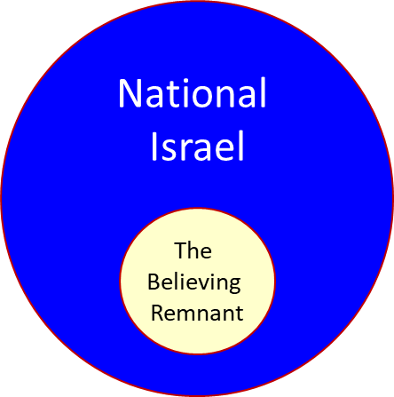

Slide 17
Zechariah 13:8-9
⁸“It will come about in all the land,” Declares the Lord, “That two parts in it will be cut off and perish; But the third will be left in it. ⁹“And I will bring the third part through the fire, Refine them as silver is refined, And test them as gold is tested. They will call on My name, And I will answer them; I will say, ‘They are My people,’ And they will say, ‘The Lord is my God.’ ”

Slide 18
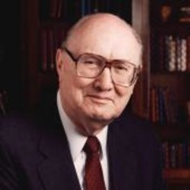
John F. Walvoord
"Christ's Olivet Discourse on the End of the Age Part V: The Parable of the Ten Virgins," Bibliotheca Sacra 129, no. 514 (April 1972): 101.
“Following the strict rules of exegesis, the context indicates that the subject is the second coming of Christ to the earth not the rapture of the church. Although many expositors have attempted to make this whole discourse apply to the church, or at least from Matthew 24:45 make an application of the general truth of Christ's coming to the rapture of the church, as seen in previous study the evidence is quite insufficient.”

Slide 19
John F. Walvoord
"Christ's Olivet Discourse on the End of the Age Part V: The Parable of the Ten Virgins," Bibliotheca Sacra 129, no. 514 (April 1972): 101.
“There is no clear distinction between the illustrations before Matthew 24:45 and those which follow. Neither the church nor the rapture are in view. Inasmuch as the rapture (John 14:1–3) had not yet been revealed, it is questionable whether Christ would have tried to teach His disciples using an illustration of a truth that was not even known to them at this time. Interpretation, therefore, must relate this passage to the context, namely, the doctrine of the second coming of Christ to establish His earthly kingdom.”

Slide 20
John 14:1–4
¹ “Do not let your heart be troubled; believe in God, believe also in Me. ² “In My Father’s house are many dwelling places; if it were not so, I would have told you; for I go to prepare a place for you. ³ “If I go and prepare a place for you, I will come again and receive you to Myself, that where I am, there you may be also. ⁴ “And you know the way where I am going.”

Slide 21
A Comparison of the Olivet and Upper Room Discourses
Discourse | Olivet | Upper Room
Scripture | Matt 24─25 | John 13─17
Location | Mount of Olives | Upper Room
Passion week | Third day | Sixth day
General focus | Farewell: Israel | Hello: Church
Specific focus | Israel’s future | Divine provisions
Prompting | Temple's destruction | Christ's imminent departure
Explanations | Written OT | Unwritten NT
Apostles | Israel (Matt. 19:28) | Church (Eph. 2:20)

Slide 22
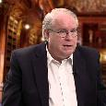
Ron Rhodes
The Big Book of Bible Answers: A Guide to Understanding the Most Challenging Questions (Eugene, OR: Harvest, 2013), 278.
“This view is based on the parable of the 10 virgins—depicting five virgins being prepared and five unprepared (Matthew 25:1–13). This is interpreted to mean that only faithful, and watchful Christians will be raptured . . .Pre-tribulationalists respond that Matthew 25:1–13 has nothing to do with the rapture. Those virgins who are ‘unprepared’ apparently represent people living during the tribulation period who are unprepared for Christ's second coming (seven years after the rapture).”

Slide 23
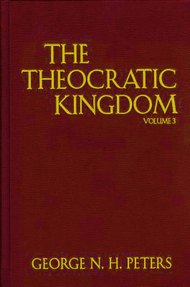
G.N.H. Peters Theocratic Kingdom, 2:332
“It is not simply those who ‘watch’ that shall ‘escape,’ but those, Luke 21:36 who ‘watch and pray always,’ avoiding the corrupting influences around them. The number of translated ones may not be very large (for the number of translated ones given as...types in comparison with the number of those not translated, and with that of the resurrected saints is small so that Dr. Seiss, with whom many concur, is undoubtedly correct in saying: ‘I have no idea that a very large portion of mankind, or even of the professing Church, will be thus taken. The first translation, if I may so speak, will embrace only the select few who watch and pray always,’ etc.””

Slide 24
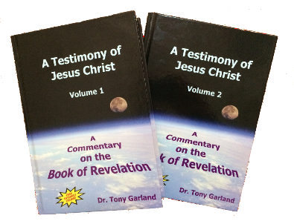
Tony Garland
Anthony Garland, "Q181 : George Peters and the Partial Rapture View," online: www.spiritandtruth.org, accessed 13 August 2015.
“I believe that Peters is mistaken in confounding various thief passages with the coming of the Lord for the church (e.g., Matt. 24:37-44, Luke 17:26-37). Where these passage speak of ‘one taken...another left,’ Peters falls into the common mistake of misinterpreting Second Coming judgment passages as Rapture passages...If we consider various passages where people fail to watch or perform, we find that some very serious consequences result: Left as dead for birds of prey (Mat. 24:28, 37-43; Luke 17:37). Being cut in two with the hypocrites, weeping and gnashing of teeth (Matt. 24:51). Being shut out from the wedding feast . . .

Slide 25
Tony Garland
Anthony Garland, "Q181 : George Peters and the Partial Rapture View," online: www.spiritandtruth.org, accessed 13 August 2015.
… with the Master proclaiming, I do not know you (Matt. 25:12 cf. Matt. 7:23). Being cast into outer darkness, weeping and gnashing of teeth (Matt. 25:30). Although some teach that ‘outer darkness’ is a place where under-performing believers may suffer during the Millennial Kingdom, this seems most unlikely. Jesus clearly states that those Jews who did not believe in Him—the faithless ‘sons of the Kingdom’—were bound for outer darkness (Matt. 8:12)...While not focusing specifically on Rapture-related warning passages here, I hope you can see that the way in which a person interprets various readiness warning passages—whether. . .

Slide 26
Tony Garland
Anthony Garland, "Q181 : George Peters and the Partial Rapture View," online: www.spiritandtruth.org, accessed 13 August 2015.
… they can have in view believers who are securely saved—will have a lot to do with whether a teacher believes that the body of Christ will be sliced into two companies, either at the Rapture or at the entry to the Millennial Kingdom to follow. Peters, while having much to offer concerning the coming Kingdom and eschatology in general, appears to be comfortable with the idea that it is our performance rather than identity that determines our destiny in relation to the Rapture. I take the opposite view: that those who are in Christ are joined to Christ in a way which cannot (and will not) be broken.”

Slide 27
Matthew 24:36-41
³⁶ “But of that day and hour no one knows, not even the angels of heaven, nor the Son, but the Father alone. ³⁷ For the coming of the Son of Man will be just like the days of Noah. ³⁸ For as in those days before the flood they were eating and drinking, marrying and giving in marriage, until the day that Noah entered the ark, ³⁹ and they did not understand until the flood came and took (airō) . . .

Slide 28
Matthew 24:36-41
. . . them all away; so will the coming of the Son of Man be. ⁴⁰ Then there will be two men in the field; one will be taken (paralambanō) and one will be left. ⁴¹ “Two women will be grinding at the mill; one will be taken (paralambanō) and one will be left.”

Slide 29
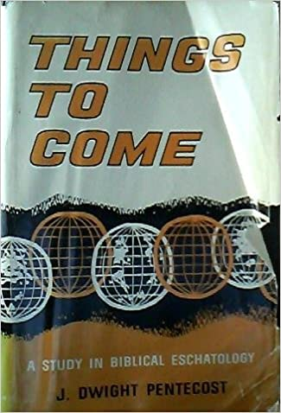
J. Dwight Pentecost
Things to Come, Page 162
“Again, this passage is in that discourse in which the Lord outlined His program for Israel, who was already in the tribulation period. The one taken is taken to judgment and the one left is left for the millennial blessing. Such is not the prospect for the church.”

Slide 30
Luke 21:28, 34-36
“²⁸ But when these things begin to take place, straighten up and lift up your heads, because your redemption is drawing near…³⁴ But be on your guard, so that your hearts will not be weighed down with dissipation and drunkenness and the worries of life, and that this day will not come on you suddenly, like a trap; ³⁵ for it will come upon all those who live on the face of all the earth. ³⁶ But stay alert at all times, praying that you will have strength to escape all these things that are going to take place, and to stand before the Son of Man.”

Slide 31
Luke 21:21, 28, 34-36
“²¹ Then those who are in Judea must flee to the mountains, and those who are in the midst of the city must leave, and those who are in the country must not enter the city…²⁸ But when these things begin to take place, straighten up and lift up your heads, because your redemption is drawing near…³⁴ But be on your guard, so that your hearts will not be weighed down with dissipation and drunkenness and the worries of life, and that this day will not come on you suddenly, like a trap; ³⁵ for . . .

Slide 32
Luke 21:21, 28, 34-36
. . . it will come upon all those who live on the face of all the earth. ³⁶ But stay alert at all times, praying that you will have strength to escape all these things that are going to take place, and to stand before the Son of Man.”

Slide 33
J. Dwight Pentecost
Things to Come, Page 161-62
“It will be observed that the primary reference in this chapter is to the nation of Israel, who was already in the tribulation period, and therefore this is not applicable to the church. The things to be escaped are judgments associated with ‘that day’ (vs. 34), that is, the Day of the Lord. Watchfulness is enjoined upon the church (1 Thessalonians 5:6; Titus 2:13) apart from being found worthy to participate in the translation.”

Slide 34
Problems with Partial Rapturism?
Partial rapturism makes the Bema Seat Judgment unnecessary (1 Cor. 3:10-15)
Partial rapturists never objectively quantify the exact degree of faithfulness or spiritual maturity that is necessary to participate in the rapture
Partial rapturists appear individually biased
Partial rapturists dispensationally misapply Bible passages (Matt. 25:1-13)
Partial rapturists misapply passages promising a reward to faithful believers (Rev. 3:11)

Slide 35
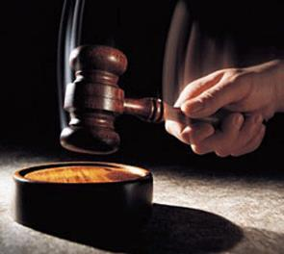
Why?
Not to judge sin (John 19:30)
Not to determine salvation (John 5:24)
But rather to give or not give rewards

Slide 36
Scripture’s Five Crowns (Rev 4:10: 3:11; 2 John 8)
SCRIPTURE | CROWN | PURPOSE
1 Cor. 9:24-27 | Incorruptible | Gaining mastery over the flesh
1 Thess. 2:19-20 | Rejoicing | Soul winning
Jas. 1:12; Rev. 2:10 | Life | Enduring trials
1 Pet. 5:2-4 | Glory | Shepherding God’s people
2 Tim. 4:8 | Righteousness | Longing for His appearing

Slide 37
1 Corinthians 3:15
“If any man’s (carnal believer’s) work is burned up, he will suffer loss; but he himself will be saved, yet so as through fire.”

Slide 38
1 Corinthians 9:24-27
“²⁴ Do you not know that those who run in a race all run, but only one receives the prize? Run in such a way that you may win. ²⁵ Everyone who competes in the games exercises self-control in all things. They then do it to receive a perishable wreath, but we an imperishable. ²⁶ Therefore I run in such a way, as not without aim; I box in such a way, as not beating the air; ²⁷ but I discipline my body and make it my slave, so that, after I have preached to others, I myself will not be disqualified.”

Slide 39
2 John 8
“Watch yourselves, that you do not lose what we have accomplished, but that you may receive a full reward.”

Slide 40
Revelation 3:11
“I am coming quickly; hold fast what you have, so that no one will take your crown.”

Slide 41
Samuel Hoyt
“The Judgment Seat of Christ in Theological Perspective,” Part 2, Bibliotheca Sacra, electronic media.
“The judgment seat of Christ might be compared to a commencement ceremony. At graduation there is some measure of disappointment and remorse that one did not do better and work harder. However, at such an event the overwhelming emotion is joy, not remorse. The graduates do not leave the auditorium weeping because they did not earn better grades. Rather, they are thankful that they have been graduated, and they are grateful for what they did achieve. To overdo the sorrow aspect of the judgment seat of Christ is to make heaven hell. To under do the sorrow aspect is to make faithfulness inconsequential” (underlining mine).

Slide 42
2 Timothy 4:8
“In the future there is laid up for me the crown of righteousness, which the Lord, the righteous Judge, will award to me on that day; and not only to me, but also to all who have loved His appearing.”

Slide 43
J. Dwight Pentecost
Things to Come, Page 163
“This [2 Tim. 4:8] is used by the adherents of this position to show that the rapture must be a partial one. However, it is to be noticed that the subject of the translation is not in view in this passage, but rather the question of reward. The Second Advent was intended by God to be a purifying hope (1 John 3:3). Because of such purifying a new life is produced because of the expectancy of the Lord's return. Therefore, those that truly ‘love his appearing’ will experience a new kind of life which will bring a reward.”

Slide 44
Problems with Partial Rapturism?
Every divine blessing is given on the basis of His grace and not human effort (Eph. 2:8-9; Rom. 12:6)
Symbolic parallels mandate that carnal as well as sanctified Christians will be taken up in the rapture (Gen. 19:22)
The promise of the rapture is mentioned in Paul's letter to the carnal Corinthian church (1 Cor. 15:51)
A partial rapture would sever Christ's body (1 Cor 12:12-14)
The partial rapture view subjects believers to God's wrath (Thess 1:10)

Slide 45
Problems with Partial Rapturism?
Partial rapturism makes the Bema Seat Judgment unnecessary (1 Cor. 3:10-15)
Partial rapturists never objectively quantify the exact degree of faithfulness or spiritual maturity that is necessary to participate in the rapture
Partial rapturists appear individually biased
Partial rapturists dispensationally misapply Bible passages (Matt. 25:1-13)
Partial rapturists misapply passages promising a reward to faithful believers (Rev. 3:11)

Slide 46
DESCRIPTION OF THE SEVEN CHURCHES Revelation 2‒3
CHURCH | SCRIPTURE | DESCRIPTION
Ephesus | 2:1-7 | Loveless
Smyrna | 2:8-11 | Persecuted
Pergamum | 2:12-17 | Compromised
Thyatira | 2:18-29 | Corrupt
Sardis | 3:1-6 | Dead
Philadelphia | 3:7-13 | Missionary
Laodicea | 3:14-22 | Man-centered

Slide 47
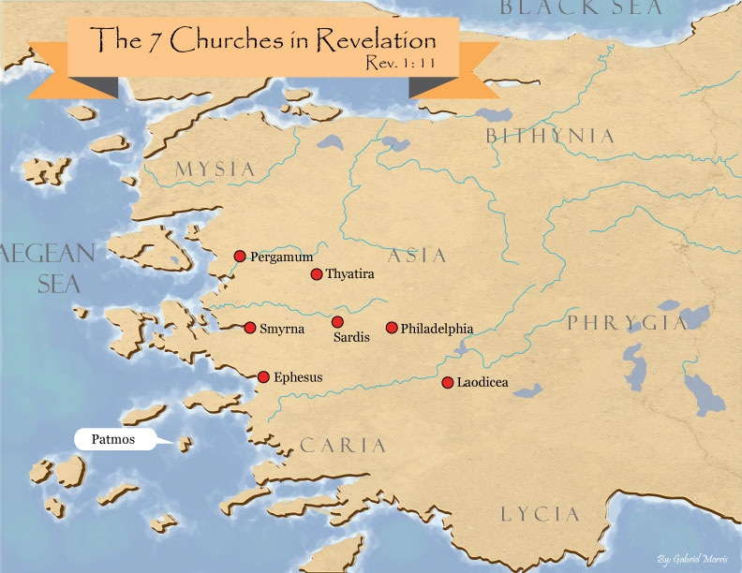

Slide 48
Revelation 3:10
‘Because you have kept the word of My perseverance, I also will keep you from the hour of testing, that hour which is about to come upon the whole world, to test those who dwell on the earth.

Slide 49
Revelation 3:10
‘Because you have kept the word of My perseverance, I also will keep you from the hour of testing, that hour which is about to come upon the whole world, to test those who dwell on the earth.

Slide 50
Revelation 3:10
‘Because you have kept the word of My perseverance, I also will keep you from the hour of testing, that hour which is about to come upon the whole world, to test those who dwell on the earth.

Slide 51
Problems with Beginning the Sentence in Rev. 3:10 with “Because”
Not part of the original manuscripts: chapter & verse divisions & punctuation marks (periods, commas, or exclamation points).
These things were all added by later copyists.
Most English translations separate the two verses with a period.
Thus, it becomes cause for participating the Rapture and not a cause for their enemies to worship before their feet.
However, the period should be placed in the middle of verse 10.
Thus, it becomes not a cause for participating the Rapture and a cause for their enemies to worship before their feet.
John Niemela, The Interpretation of Revelation 3:10: You Have Kept My Word, CTS Journal; As summarized by Dennis Rokser, A Golden Nugget in Revelation 3:10, Grace for the Race, no. 29.

Slide 52
Problems with Beginning the Sentence in Rev. 3:10 with “Because” (cont’d)
Rev. 3:10b becomes an additional unconditional promise of Rapture participation beyond the promises of Rev. 2:9b.
It is rare to begin a sentence with “because” (hoti) in a causative sense.
Instead, hoti (“because”), when casual in function, usually follows a statement or promise in providing a reason for what preceded it in the sentence.
Thus, Greek sentences rarely begin a sentence with the phrase “Because you have” when explaining the cause or reason for something, as Greek and English texts of Revelation 3:10 unfortunately do today. Instead, the “because” phraseology consistently follows later in the sentence.
John Niemela, The Interpretation of Revelation 3:10: You Have Kept My Word, CTS Journal; As summarized by Dennis Rokser, A Golden Nugget in Revelation 3:10, Grace for the Race, no. 29.

Slide 53
Problems with Beginning the Sentence in Rev. 3:10 with “Because”
Not part of the original manuscripts: chapter & verse divisions & punctuation marks (periods, commas, or exclamation points).
These things were all added by later copyists.
Most English translations separate the two verses with a period.
Thus, it becomes cause for participating the Rapture and not a cause for their enemies to worship before their feet.
However, the period should be placed in the middle of verse 10.
Thus, it becomes not a cause for participating the Rapture and a cause for their enemies to worship before their feet.
John Niemela, The Interpretation of Revelation 3:10: You Have Kept My Word, CTS Journal; As summarized by Dennis Rokser, A Golden Nugget in Revelation 3:10, Grace for the Race, no. 29.

Slide 54
Problems with Beginning the Sentence in Rev. 3:10 with “Because”
Not part of the original manuscripts: chapter & verse divisions & punctuation marks (periods, commas, or exclamation points).
These things were all added by later copyists.
Most English translations separate the two verses with a period.
Thus, it becomes cause for participating the Rapture and not a cause for their enemies to worship before their feet.
However, the period should be placed in the middle of verse 10.
Thus, it becomes not a cause for participating the Rapture and a cause for their enemies to worship before their feet.
John Niemela, The Interpretation of Revelation 3:10: You Have Kept My Word, CTS Journal; As summarized by Dennis Rokser, A Golden Nugget in Revelation 3:10, Grace for the Race, no. 29.

Slide 55
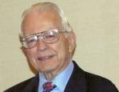
Dr. Roy B. Zuck
Basic Bible Interpretation, p. 43.
“﻿Stephen Langton (ca. 1155–1228), Archbishop of Canterbury, held that spiritual interpretation is superior to literal interpretation. Therefore in the Book of Ruth, the field is the Bible, Ruth represents students, and the reapers are the teachers. Langton is the one who made chapter divisions in the Vulgate Bible.”

Slide 56
Problems with Beginning the Sentence in Rev. 3:10 with “Because”
Not part of the original manuscripts: chapter & verse divisions & punctuation marks (periods, commas, or exclamation points).
These things were all added by later copyists.
Most English translations separate the two verses with a period.
Thus, it becomes cause for participating the Rapture and not a cause for their enemies to worship before their feet.
However, the period should be placed in the middle of verse 10.
Thus, it becomes not a cause for participating the Rapture and a cause for their enemies to worship before their feet.
John Niemela, The Interpretation of Revelation 3:10: You Have Kept My Word, CTS Journal; As summarized by Dennis Rokser, A Golden Nugget in Revelation 3:10, Grace for the Race, no. 29.

Slide 57
Revelation 3:9-10
⁹ ‘Behold, I will cause those of the synagogue of Satan, who say that they are Jews and are not, but lie—I will make them come and bow down at your feet, and make them know that I have loved you. ¹⁰ ‘Because you have kept the word of My perseverance, I also will keep you from the hour of testing, that hour which is about to come upon the whole world, to test those who dwell on the earth.

Slide 58
Problems with Beginning the Sentence in Rev. 3:10 with “Because”
Not part of the original manuscripts: chapter & verse divisions & punctuation marks (periods, commas, or exclamation points).
These things were all added by later copyists.
Most English translations separate the two verses with a period.
Thus, it becomes cause for participating the Rapture and not a cause for their enemies to worship before their feet.
However, the period should be placed in the middle of verse 10.
Thus, it becomes not a cause for participating the Rapture and a cause for their enemies to worship before their feet.
John Niemela, The Interpretation of Revelation 3:10: You Have Kept My Word, CTS Journal; As summarized by Dennis Rokser, A Golden Nugget in Revelation 3:10, Grace for the Race, no. 29.

Slide 59
Revelation 3:9-10
⁹ ‘Behold, I will cause those of the synagogue of Satan, who say that they are Jews and are not, but lie—I will make them come and bow down at your feet, and make them know that I have loved you. ¹⁰ ‘Because you have kept the word of My perseverance, I also will keep you from the hour of testing, that hour which is about to come upon the whole world, to test those who dwell on the earth.

Slide 60
Problems with Beginning the Sentence in Rev. 3:10 with “Because”
Not part of the original manuscripts: chapter & verse divisions & punctuation marks (periods, commas, or exclamation points).
These things were all added by later copyists.
Most English translations separate the two verses with a period.
Thus, it becomes cause for participating the Rapture and not a cause for their enemies to worship before their feet.
However, the period should be placed in the middle of verse 10.
Thus, it becomes not a cause for participating the Rapture and a cause for their enemies to worship before their feet.
John Niemela, The Interpretation of Revelation 3:10: You Have Kept My Word, CTS Journal; As summarized by Dennis Rokser, A Golden Nugget in Revelation 3:10, Grace for the Race, no. 29.

Slide 61
Revelation 3:9-10
⁹ ‘Behold, I will cause those of the synagogue of Satan, who say that they are Jews and are not, but lie—I will make them come and bow down at your feet, and make them know that I have loved you ¹⁰ ‘because you have kept the word of My perseverance. I also will keep you from the hour of testing, that hour which is about to come upon the whole world, to test those who dwell on the earth.

Slide 62
Problems with Beginning the Sentence in Rev. 3:10 with “Because”
Not part of the original manuscripts: chapter & verse divisions & punctuation marks (periods, commas, or exclamation points).
These things were all added by later copyists.
Most English translations separate the two verses with a period.
Thus, it becomes cause for participating the Rapture and not a cause for their enemies to worship before their feet.
However, the period should be placed in the middle of verse 10.
Thus, it becomes not a cause for participating the Rapture and a cause for their enemies to worship before their feet.
John Niemela, The Interpretation of Revelation 3:10: You Have Kept My Word, CTS Journal; As summarized by Dennis Rokser, A Golden Nugget in Revelation 3:10, Grace for the Race, no. 29.

Slide 63
Revelation 3:9-10
⁹ ‘Behold, I will cause those of the synagogue of Satan, who say that they are Jews and are not, but lie—I will make them come and bow down at your feet, and make them know that I have loved you ¹⁰ ‘because you have kept the word of My perseverance. I also will keep you from the hour of testing, that hour which is about to come upon the whole world, to test those who dwell on the earth.

Slide 64
Problems with Beginning the Sentence in Rev. 3:10 with “Because” (cont’d)
Rev. 3:10b becomes an additional unconditional promise of Rapture participation beyond the promises of Rev. 3:9b.
It is rare to begin a sentence with “because” (hoti) in a causative sense.
Instead, hoti (“because”), when casual in function, usually follows a statement or promise in providing a reason for what preceded it in the sentence.
Thus, Greek sentences rarely begin a sentence with the phrase “Because you have” when explaining the cause or reason for something, as Greek and English texts of Revelation 3:10 unfortunately do today. Instead, the “because” phraseology consistently follows later in the sentence.
John Niemela, The Interpretation of Revelation 3:10: You Have Kept My Word, CTS Journal; As summarized by Dennis Rokser, A Golden Nugget in Revelation 3:10, Grace for the Race, no. 29.

Slide 65
Revelation 3:9-10
⁹ ‘Behold, I will cause those of the synagogue of Satan, who say that they are Jews and are not, but lie—I will make them come and bow down at your feet, and make them know that I have loved you ¹⁰ ‘because you have kept the word of My perseverance. I also will keep you from the hour of testing, that hour which is about to come upon the whole world, to test those who dwell on the earth.

Slide 66
Problems with Beginning the Sentence in Rev. 3:10 with “Because” (cont’d)
Rev. 3:10b becomes an additional unconditional promise of Rapture participation beyond the promises of Rev. 3:9b.
It is rare to begin a sentence with “because” (hoti) in a causative sense.
Instead, hoti (“because”), when casual in function, usually follows a statement or promise in providing a reason for what preceded it in the sentence.
Thus, Greek sentences rarely begin a sentence with the phrase “Because you have” when explaining the cause or reason for something, as Greek and English texts of Revelation 3:10 unfortunately do today. Instead, the “because” phraseology consistently follows later in the sentence.
John Niemela, The Interpretation of Revelation 3:10: You Have Kept My Word, CTS Journal; As summarized by Dennis Rokser, A Golden Nugget in Revelation 3:10, Grace for the Race, no. 29.

Slide 67
Revelation 3:9-10
⁹ ‘Behold, I will cause those of the synagogue of Satan, who say that they are Jews and are not, but lie—I will make them come and bow down at your feet, and make them know that I have loved you. ¹⁰ ‘Because you have kept the word of My perseverance, I also will keep you from the hour of testing, that hour which is about to come upon the whole world, to test those who dwell on the earth.

Slide 68
Problems with Beginning the Sentence in Rev. 3:10 with “Because” (cont’d)
Rev. 3:10b becomes an additional unconditional promise of Rapture participation beyond the promises of Rev. 3:9b.
It is rare to begin a sentence with “because” (hoti) in a causative sense.
Instead, hoti (“because”), when casual in function, usually follows a statement or promise in providing a reason for what preceded it in the sentence.
Thus, Greek sentences rarely begin a sentence with the phrase “Because you have” when explaining the cause or reason for something, as Greek and English texts of Revelation 3:10 unfortunately do today. Instead, the “because” phraseology consistently follows later in the sentence.
John Niemela, The Interpretation of Revelation 3:10: You Have Kept My Word, CTS Journal; As summarized by Dennis Rokser, A Golden Nugget in Revelation 3:10, Grace for the Race, no. 29.

Slide 69
Revelation 3:9-10
⁹ ‘Behold, I will cause those of the synagogue of Satan, who say that they are Jews and are not, but lie—I will make them come and bow down at your feet, and make them know that I have loved you ¹⁰ ‘because you have kept the word of My perseverance. I also will keep you from the hour of testing, that hour which is about to come upon the whole world, to test those who dwell on the earth.

Slide 70
Problems with Beginning the Sentence in Rev. 3:10 with “Because” (cont’d)
Rev. 3:10b becomes an additional unconditional promise of Rapture participation beyond the promises of Rev. 3:9b.
It is rare to begin a sentence with “because” (hoti) in a causative sense.
Instead, hoti (“because”), when casual in function, usually follows a statement or promise in providing a reason for what preceded it in the sentence.
Thus, Greek sentences rarely begin a sentence with the phrase “Because you have” when explaining the cause or reason for something, as Greek and English texts of Revelation 3:10 unfortunately do today. Instead, the “because” phraseology consistently follows later in the sentence.
John Niemela, The Interpretation of Revelation 3:10: You Have Kept My Word, CTS Journal; As summarized by Dennis Rokser, A Golden Nugget in Revelation 3:10, Grace for the Race, no. 29.

Slide 71
Revelation 3:9-10
MacDonald’s Idiomatic Translation (MIT)
“⁹ I would put at your disposal those from the synagogue of Satan who call themselves Jews but are not; they are lying. See: I will make them come and bow down before your feet, and they will know that I loved you ¹⁰ because you kept my enduring word. I also will keep you from the time of trial that is about to come...”

Slide 72
Revelation 3:10
‘Because you have kept the word of My perseverance, I also will keep you from the hour of testing, that hour which is about to come upon the whole world, to test those who dwell on the earth.

Slide 73
Problems with Beginning the Sentence in Rev. 3:10 with “Because”
Not part of the original manuscripts: chapter & verse divisions & punctuation marks (periods, commas, or exclamation points).
These things were all added by later copyists.
Most English translations separate the two verses with a period.
Thus, it becomes cause for participating the Rapture and not a cause for their enemies to worship before their feet.
However, the period should be placed in the middle of verse 10.
Thus, it becomes not a cause for participating the Rapture and a cause for their enemies to worship before their feet.
John Niemela, The Interpretation of Revelation 3:10: You Have Kept My Word, CTS Journal; As summarized by Dennis Rokser, A Golden Nugget in Revelation 3:10, Grace for the Race, no. 29.

Slide 74
Problems with Beginning the Sentence in Rev. 3:10 with “Because” (cont’d)
Rev. 3:10b becomes an additional unconditional promise of Rapture participation beyond the promises of Rev. 2:9b.
It is rare to begin a sentence with “because” (hoti) in a causative sense.
Instead, hoti (“because”), when casual in function, usually follows a statement or promise in providing a reason for what preceded it in the sentence.
Thus, Greek sentences rarely begin a sentence with the phrase “Because you have” when explaining the cause or reason for something, as Greek and English texts of Revelation 3:10 unfortunately do today. Instead, the “because” phraseology consistently follows later in the sentence.
John Niemela, The Interpretation of Revelation 3:10: You Have Kept My Word, CTS Journal; As summarized by Dennis Rokser, A Golden Nugget in Revelation 3:10, Grace for the Race, no. 29.

Slide 75
DESCRIPTION OF THE SEVEN CHURCHES Revelation 2‒3
CHURCH | SCRIPTURE | DESCRIPTION
Ephesus | 2:1-7 | Loveless
Smyrna | 2:8-11 | Persecuted
Pergamum | 2:12-17 | Compromised
Thyatira | 2:18-29 | Corrupt
Sardis | 3:1-6 | Dead
Philadelphia | 3:7-13 | Missionary
Laodicea | 3:14-22 | Man-centered

Slide 77
Revelation 2:22
“Behold, I will throw her on a bed of sickness, and those who commit adultery with her into great tribulation, unless they repent of her deeds.”

Slide 78
Revelation 2:22
“Behold, I will throw her on a bed of sickness, and those who commit adultery with her into great tribulation, unless they repent of her deeds.”

Slide 79
Revelation 7:13-14
“¹³ Then one of the elders responded, saying to me, ‘These who are clothed in the white robes, who are they, and where have they come from?’ ¹⁴ I said to him, ‘My lord, you know.’ And he said to me, ‘These are the ones who come out of the great tribulation, and they have washed their robes and made them white in the blood of the Lamb.’”

Slide 80
CONCLUSION

Slide 81
The Rapture Course Overview
What is the Rapture?
When is the Rapture?
Strengthening the Pre-Tribulational case
The opposing views
One second after the Rapture

