Slide 1


Genesis 6‒9
The Flood and Continuation of the Messianic Promise

Slide 2


Slide 3


GENESIS STRUCTURE
  Beginning of the Human race (Gen. 1‒11)
  Beginning of the Hebrew race (Gen. 12‒50)

Slide 4

GENESIS STRUCTURE
  Genesis 1-11 (four events)
    Creation (1-2)
    Fall (3-5)
    Flood (6-9)
    National dispersion (10-11)

Slide 5
GENESIS STRUCTURE
  Genesis 1-11 (four events)
    Creation (1-2)
    Fall (3-5)
    Flood (6-9)
    National dispersion (10-11)

Slide 6


Genesis 3:15
“And I will put enmity Between you and the woman, And between your seed and her seed; He shall bruise you on the head, And you shall bruise him on the heel.”

Slide 7
GENESIS STRUCTURE
  Genesis 1-11 (four events)
    Creation (1-2)
    Fall (3-5)
    Flood (6-9)
    National dispersion (10-11)

Slide 8
The Flood
(Gen 6–9)
  Events before the flood (Gen 6)
  The flood (Gen 7)
  The abating of the waters (Gen 8)
  Events following the flood (Gen 9)

Slide 9

Genesis 8:20–9:29
Post Flood events

Slide 10
Outline
  Noahic Covenant (Gen 8:20–9:17)
  Promise (Gen 8:20-22)
  Provision (Gen 9:1-7)
  Covenant and sign (Gen 9:8-17)
  Post Flood Sin (Gen 9:18-29)

Slide 11
Outline
  Noahic Covenant (Gen 8:20–9:17)
  Promise (Gen 8:20-22)
  Provision (Gen 9:1-7)
  Covenant and sign (Gen 9:8-17)
  Post Flood Sin (Gen 9:18-29)

Slide 12
Outline
  Noahic Covenant (Gen 8:20–9:17)
  Promise (Gen 8:20-22)
  Provision (Gen 9:1-7)
  Covenant and sign (Gen 9:8-17)
  Post Flood Sin (Gen 9:18-29)

Slide 13
Post Flood Sin
(Gen 9:18-29)
  Noah not the fulfillment of Gen 3:15 (Gen 9:18-21)
  Ham’s sin and Canaanites under a curse (Gen 9:22-27; 15:16)
  Noah’s death (Gen 9:28-29)

Slide 14
Post Flood Sin
(Gen 9:18-29)
  Noah not the fulfillment of Gen 3:15 (Gen 9:18-21)
  Ham’s sin and Canaanites under a curse (Gen 9:22-27; 15:16)
  Noah’s death (Gen 9:28-29)

Slide 15

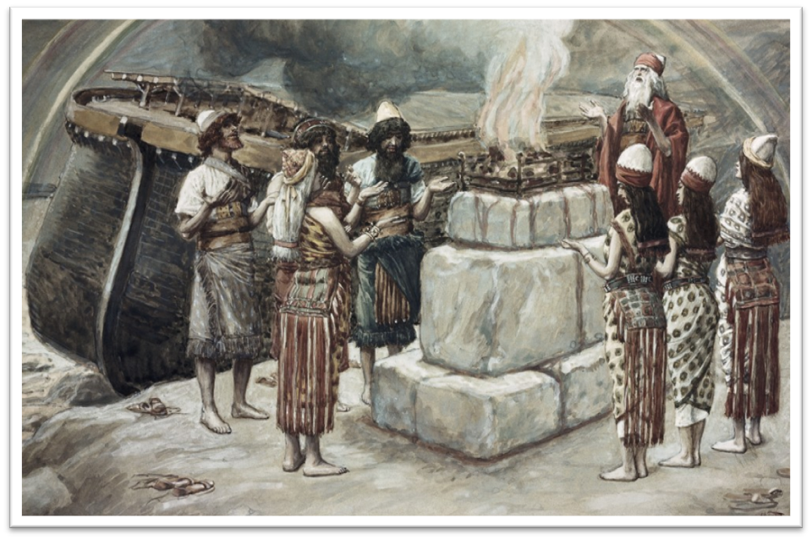
Genesis 8:21
The Lord smelled the soothing aroma; and the Lord said to Himself, “I will never again curse the ground on account of man, for the intent of man’s heart is evil from his youth; and I will never again destroy every living thing, as I have done.

Slide 16
Genesis 3:15
“And I will put enmity Between you and the woman, And between your seed and her seed; He shall bruise you on the head, And you shall bruise him on the heel.”

Slide 17


Slide 18
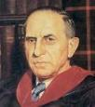

John Murray
Redemption Accomplished and Applied, (Grand Rapids, MI: Eerdmans Publishing Co. 2015 edition), p. 152, 154-55, 165. pp. 152, 154-55, 165
“The crucial test of true faith is endurance to the end, abiding in Christ, and continuance in the Word…He cannot abandon himself to sin; he cannot come under the domination of sin; he cannot be guilty of certain kinds of unfaithfulness…Let us appreciate the doctrine of the perseverance of the saints and recognize that we may entertain the faith of our security in Christ only as we persevere in faith and holiness to the end...The perseverance of the saints reminds us very forcefully that only those who persevere to the end are truly saints.”

Slide 19
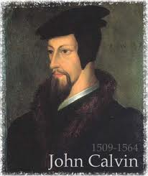
Examples of Old Testament Non-Persevering Saints
Noah (Gen. 9:20-23; Heb. 11:7)
Lot (Gen. 13; 19; 2 Pet. 2:7-8)
Moses (Num. 20:11-12; Deut. 32:5; Matt. 17:1-3; Heb. 11:23-29; Rev. 11:6)
Exodus’ generation (Num. 13‒14; Heb. 11:29)
Samson (Judges 13‒16; Heb. 11:32)
Saul (1 Sam. 28; 31)
Solomon (1 Kgs. 11:4, 9-10)

Slide 20

Examples of New Testament Non-Persevering Saints
Untrustworthy believers (John 2:23-25)
Non-confessing believers (John 12:42)
Ananias and Sapphira (Acts 5:1-11)
Simon the Sorcerer (Acts 8:13)
Immature believers at Corinth (1 Cor. 3:1-3)
Unrewarded believers at Corinth (1 Cor. 3:15)
Disciplined believers at Corinth (1 Cor. 11:27-32)
Demas (2 Tim. 4:10; Col. 4:14)
Immature believers in Hebrews (Heb. 5:11-14)
Seven churches in Asia Minor (Rev. 3:19)

Slide 21

1 Peter 1:5
“⁴ to obtain an inheritance which is imperishable, undefiled, and will not fade away, reserved in heaven for you, ⁵ who are protected by the power of God through faith for a salvation ready to be revealed in the last time.”

Slide 22
Post Flood Sin
(Gen 9:18-29)
  Noah not the fulfillment of Gen 3:15 (Gen 9:18-21)
  Ham’s sin and Canaanites under a curse (Gen 9:22-27; 15:16)
  Noah’s death (Gen 9:28-29)

Slide 23


Dr. Arnold G. Fruchtenbaum
The Book of Genesis, 197-98
“The sin of Ham was that he saw the nakedness of his father. For Ham this was an attack on Noah’s privacy. Ham perhaps showed his disrespect, for he saw the nakedness with glee, and so the moral rectitude of the father was now destroyed. The ‘seeing’ involved a violation of a boundary; the looking was a negative looking. It will be used again in Genesis 19:26, with Lot’s wife looking back; in Exodus 33:20, in that no one can look at God and live; in Judges 13:22, when Manoah said, We shall surely die, because we have seen [or looked upon] God, and in I Samuel 6:19, where those who looked into the ark died....However, it. . .

Slide 24
Dr. Arnold G. Fruchtenbaum
The Book of Genesis, 197-98
... does imply that he looked upon the nakedness of his father with glee; not necessarily to derive sexual pleasure from it, but certainly in a mocking tone, making fun of his father, and so he told his two brethren. The sin of Ham will cause the cursing of his fourth son, and the sin lay in three things: seeing but failing to cover the father himself, as he could have; telling others about it, further shaming him; and deriding his father.”

Slide 25

John 13:19; 14:29
“^{13:19} From now on I am telling you before it comes to pass, so that when it does occur, you may believe that I am He… ^{14:29} Now I have told you before it happens, so that when it happens, you may believe.”

Slide 26
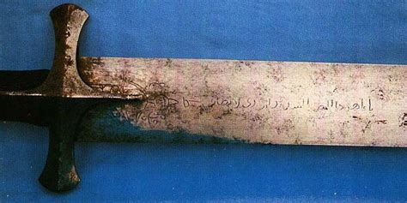
2 Samuel 12:10
“Now then, the sword shall never leave your house, because you have despised Me and have taken the wife of Uriah the Hittite to be your wife.”

Slide 27


Slide 28
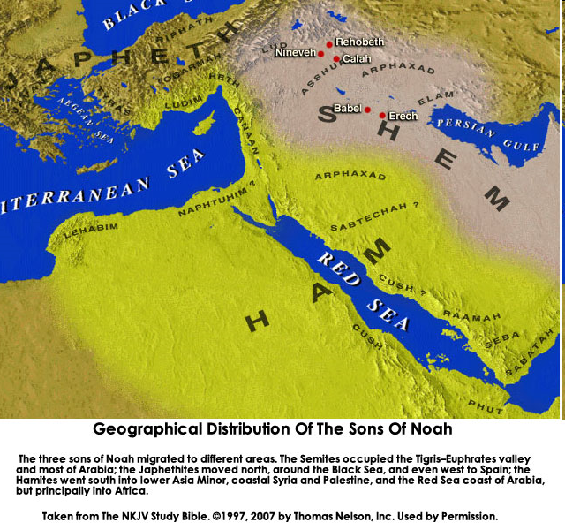

Slide 29

Reminder of God’s Sovereignty
  Messianic promise to come through Shem’s line (Gen 9:26)
  Continues selection of younger over older pattern (Abel over Cain, Seth over Cain, Japheth over Ham, Isaac over Ishmael, Jacob over Esau, Judah and Joseph over their brothers, and Ephraim over Manasseh)

Slide 30
Reminder of God’s Sovereignty
  Messianic promise to come through Shem’s line (Gen 9:26)
  Continues selection of younger over older pattern (Abel over Cain, Seth over Cain, Japheth over Ham, Isaac over Ishmael, Jacob over Esau, Judah and Joseph over their brothers, and Ephraim over Manasseh)

Slide 31
Dr. Arnold G. Fruchtenbaum
The Book of Genesis, 199
“Genesis 9:26 focuses on Shem, combining a blessing and cursing. The blessing is: Blessed be Jehovah the God of Shem. It is the God of Shem and not Shem himself who was blessed. Shem will uniquely possess the knowledge of God. Therefore, the Seed of the Woman will come through Shem and not through Ham or Japheth.”

Slide 32
Genesis 3:15
“And I will put enmity Between you and the woman, And between your seed and her seed; He shall bruise you on the head, And you shall bruise him on the heel.”

Slide 33
God’s Messianic Purposes Beginning in Genesis
Proto-evangelium from Adam & Eve (3:15)
Seth (4:25)
Noah (Gen 5:29)
Shem (9:26)
Abraham (12:3)
Isaac (21:12)
Jacob (25:23)
Judah (49:10)

Slide 34
God’s Messianic Purposes Beginning in Genesis
Proto-evangelium from Adam & Eve (3:15)
Seth (4:25)
Noah (Gen 5:29)
Shem (9:26)
Abraham (12:3)
Isaac (21:12)
Jacob (25:23)
Judah (49:10)

Slide 36
Reminder of God’s Sovereignty
  Messianic promise to come through Shem’s line (Gen 9:26)
  Continues selection of younger over older pattern (Abel over Cain, Seth over Cain, Japheth over Ham, Isaac over Ishmael, Jacob over Esau, Judah and Joseph over their brothers, and Ephraim over Manasseh)

Slide 37
Dr. Arnold G. Fruchtenbaum
The Book of Genesis, 200
“In some circles in preceding times, it was taught that the curse of Canaan was upon the Negro or the Black race, which is simply not true to the text. While it is true that Blacks are the descendants of Ham, not all descendants of Ham were black-skinned people. Only one of Ham’s sons was cursed, and that was Canaan. As is known from the Egyptian portrayals of the Canaanites, the Canaanites were not black-skinned; they were white, or it would be more correct to say, olive-skinned. Therefore, black skin has nothing to do with this curse, and the curse of Canaan is not biblical grounds for the enslavement of Blacks.”

Slide 39
Curse of Ham’s Descendants?
(Gen 9:25-27)
  Curse upon the black race?
  No!
  One race
    All humans are God’s image bearers (Gen. 1:26-27; 9:6; Jas. 3:9)
    Humanity is equally redeemed (Gal. 3:28)
  Morality (Lev. 18; 20) and not race
  Canaanites-Gen. 9:25; 15:16; Joshua

Slide 40
Curse of Ham’s Descendants?
(Gen 9:25-27)
  Curse upon the black race?
  No!
  One race
    All humans are God’s image bearers (Gen. 1:26-27; 9:6; Jas. 3:9)
    Humanity is equally redeemed (Gal. 3:28)
  Morality (Lev. 18; 20) and not race
  Canaanites-Gen. 9:25; 15:16; Joshua

Slide 41
Curse of Ham’s Descendants?
(Gen 9:25-27)
  Curse upon the black race?
  No!
  One race
    All humans are God’s image bearers (Gen. 1:26-27; 9:6; Jas. 3:9)
    Humanity is equally redeemed (Gal. 3:28)
  Morality (Lev. 18; 20) and not race
  Canaanites-Gen. 9:25; 15:16; Joshua

Slide 42
Curse of Ham’s Descendants?
(Gen 9:25-27)
  Curse upon the black race?
  No!
  One race
    All humans are God’s image bearers (Gen. 1:26-27; 9:6; Jas. 3:9)
    Humanity is equally redeemed (Gal. 3:28)
  Morality (Lev. 18; 20) and not race
  Canaanites-Gen. 9:25; 15:16; Joshua

Slide 43
Curse of Ham’s Descendants?
(Gen 9:25-27)
  Curse upon the black race?
  No!
  One race
    All humans are God’s image bearers (Gen. 1:26-27; 9:6; Jas. 3:9)
    Humanity is equally redeemed (Gal. 3:28)
  Morality (Lev. 18; 20) and not race
  Canaanites-Gen. 9:25; 15:16; Joshua

Slide 44


Acts 17:26
“and He made from one man every nation of mankind to live on all the face of the earth, having determined their appointed times and the boundaries of their habitation,”

Slide 45
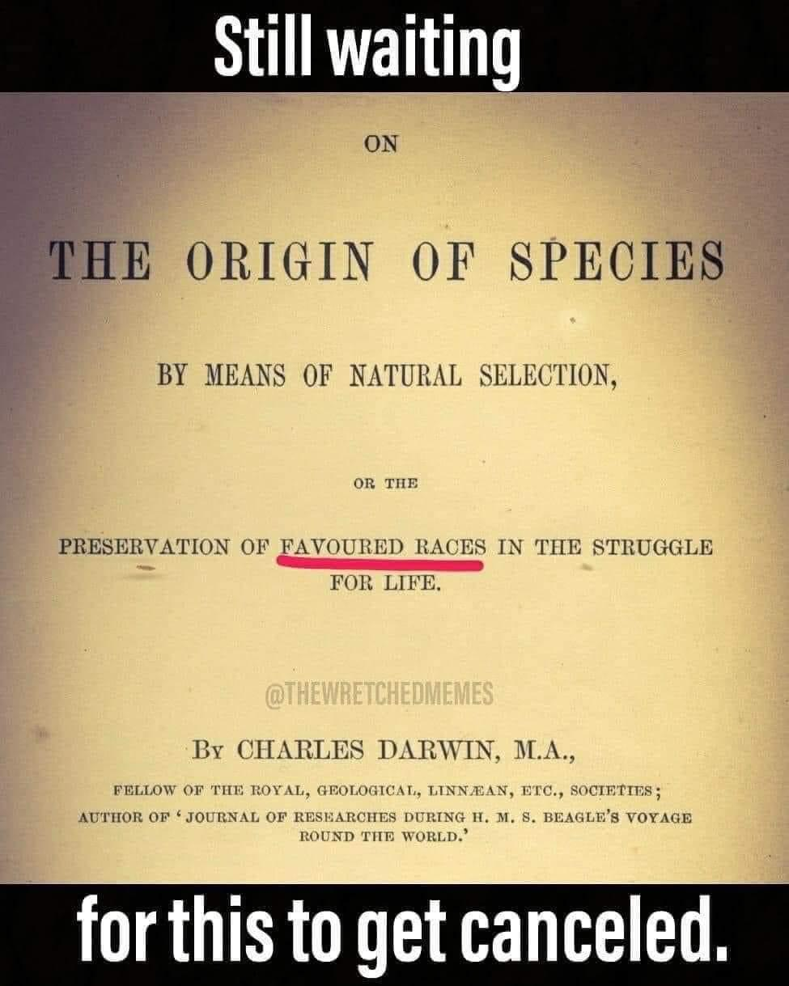

Slide 46
Curse of Ham’s Descendants?
(Gen 9:25-27)
  Curse upon the black race?
  No!
  One race
    All humans are God’s image bearers (Gen. 1:26-27; 9:6; Jas. 3:9)
    Humanity is equally redeemed (Gal. 3:28)
  Morality (Lev. 18; 20) and not race
  Canaanites-Gen. 9:25; 15:16; Joshua

Slide 47


John 3:16
“For God so loved the world, that He gave His only Son, so that everyone who believes in Him will not perish, but have eternal life.”

Slide 48

Revelation 5:9
“And they sang a new song, saying, ‘Worthy are You to take the book and to break its seals; for You were slain, and purchased for God with Your blood men from every tribe and tongue and people and nation.’”

Slide 49

Galatians 3:28 (NASB)
“There is neither Jew nor Greek, there is neither slave nor free man, there is neither male nor female; for you are all one in Christ Jesus.”

Slide 50
Ephesians 2:14 (NASB)
“For He Himself is our peace, who made both groups into one and broke down the barrier of the dividing wall.”

Slide 51
Curse of Ham’s Descendants?
(Gen 9:25-27)
  Curse upon the black race?
  No!
  One race
    All humans are God’s image bearers (Gen. 1:26-27; 9:6; Jas. 3:9)
    Humanity is equally redeemed (Gal. 3:28)
  Morality (Lev. 18; 20) and not race
  Canaanites-Gen. 9:25; 15:16; Joshua

Slide 52
Curse of Ham’s Descendants?
(Gen 9:25-27)
  Curse upon the black race?
  No!
  One race
    All humans are God’s image bearers (Gen. 1:26-27; 9:6; Jas. 3:9)
    Humanity is equally redeemed (Gal. 3:28)
  Morality (Lev. 18; 20) and not race
  Canaanites-Gen. 9:25; 15:16; Joshua

Slide 54
Post Flood Sin
(Gen 9:18-29)
  Noah not the fulfillment of Gen 3:15 (Gen 9:18-21)
  Ham’s sin and Canaanites under a curse (Gen 9:22-27; 15:16)
  Noah’s death (Gen 9:28-29)

Slide 55
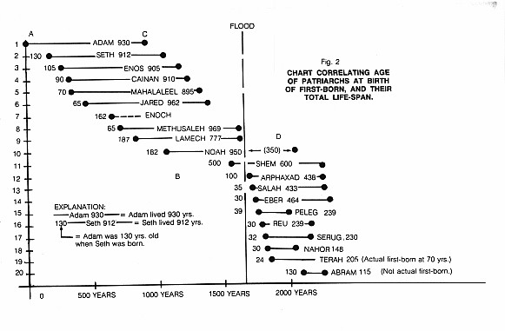

Slide 56
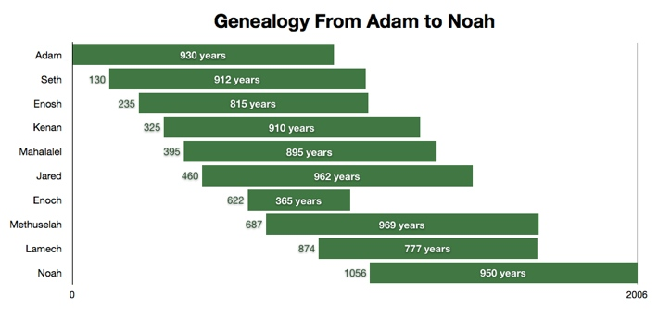

Slide 57
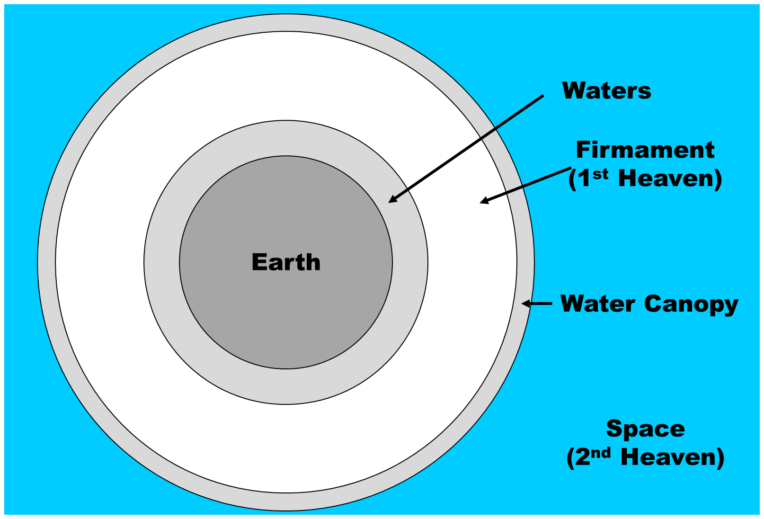

Slide 58
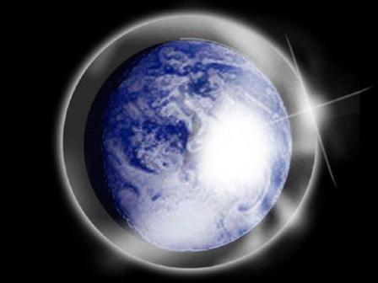

Slide 59
Genesis 3:15
“And I will put enmity Between you and the woman, And between your seed and her seed; He shall bruise you on the head, And you shall bruise him on the heel.”

Slide 60
Ephesians 2:10
“For we are His workmanship, created in Christ Jesus for good works, which God prepared beforehand so that we would walk (peripateō) in them.”

Slide 61
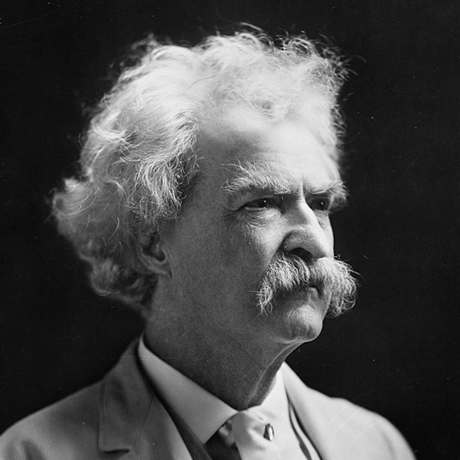
Mark Twain
Autobiography, 2:37
“A myriad of men are born; they labor and sweat and struggle for bread; they squabble and scold and fight; they scramble for little mean advantages over each other. Age creeps upon them and infirmities follow; shames and humiliations bring down their prides and their vanities. Those they love are taken from them, and the joy of life is turned to aching grief. The burden of pain, care, and misery grows heavier year by year. At length ambition is dead, pride is dead, vanity is dead; longing for release is in their place. It comes at last-the only un-poisoned gift earth ever had for them-and they vanish from a world where they were of no consequence; where they achieved nothing, where they were a mistake and a failure and a foolishness; where they left no sign that they have existed-a world that will lament them a day and forget them forever.”

Slide 62
2 Timothy 4:7-8
“⁷ I have fought the good fight, I have finished the course, I have kept the faith; ⁸ in the future there is reserved for me the crown of righteousness, which the Lord, the righteous Judge, will award to me on that day; and not only to me, but also to all who have loved His appearing.”

Slide 63
Conclusion

Slide 64
Genesis 8‒9 Outline
  Abating of the waters (8:1-5)
  Tests for dry land (8:6-14)
  Exit from the ark (8:15-19)
  Post-flood events (8:20‒9:29)

Slide 65
Outline
  Noahic Covenant (Gen 8:20–9:17)
  Promise (Gen 8:20-22)
  Provision (Gen 9:1-7)
  Covenant and sign (Gen 9:8-17)
  Post Flood Sin (Gen 9:18-29)

Slide 66
Post Flood Sin
(Gen 9:18-29)
  Noah not the fulfillment of Gen 3:15 (Gen 9:18-21)
  Ham’s sin and Canaanites under a curse (Gen 9:22-27; 15:16)
  Noah’s death (Gen 9:28-29)

Slide 67
GENESIS STRUCTURE
  Genesis 1-11 (four events)
    Creation (1-2)
    Fall (3-5)
    Flood (6-9)
    National dispersion (10-11)

Slide 68

“The Lord bless you and keep you; the Lord make his face shine on you and be gracious to you; the Lord turn his face toward you and give you peace.” (NIV)

