Slide 1


Genesis 6‒9
The Flood and Continuation of the Messianic Promise

Slide 2


GENESIS STRUCTURE
  Beginning of the Human race (Gen. 1‒11)
  Beginning of the Hebrew race (Gen. 12‒50)

Slide 3

GENESIS STRUCTURE
  Genesis 1-11 (four events)
    Creation (1-2)
    Fall (3-5)
    Flood (6-9)
    National dispersion (10-11)

Slide 4
GENESIS STRUCTURE
  Genesis 1-11 (four events)
    Creation (1-2)
    Fall (3-5)
    Flood (6-9)
    National dispersion (10-11)

Slide 5


Genesis 3:15
“And I will put enmity Between you and the woman, And between your seed and her seed; He shall bruise you on the head, And you shall bruise him on the heel.”

Slide 6
GENESIS STRUCTURE
  Genesis 1-11 (four events)
    Creation (1-2)
    Fall (3-5)
    Flood (6-9)
    National dispersion (10-11)

Slide 7
The Flood
(Gen 6–9)
  Events before the flood (Gen 6)
  The flood (Gen 7)
  The abating of the waters (Gen 8)
  Events following the flood (Gen 9)

Slide 8

Genesis 8:20–9:29
Post Flood events

Slide 9
Outline
  Noahic Covenant (Gen 8:20–9:17)
  Promise (Gen 8:20-22)
  Provision (Gen 9:1-7)
  Covenant and sign (Gen 9:8-17)
  Post Flood Sin (Gen 9:18-29)

Slide 10
Outline
  Noahic Covenant (Gen 8:20–9:17)
  Promise (Gen 8:20-22)
  Provision (Gen 9:1-7)
  Covenant and sign (Gen 9:8-17)
  Post Flood Sin (Gen 9:18-29)

Slide 11
Outline
  Noahic Covenant (Gen 8:20–9:17)
  Promise (Gen 8:20-22)
  Provision (Gen 9:1-7)
  Covenant and sign (Gen 9:8-17)
  Post Flood Sin (Gen 9:18-29)

Slide 12
Post Flood Sin
(Gen 9:18-29)
  Noah not the fulfillment of Gen 3:15 (Gen 9:18-21)
  Ham’s sin and Canaanites under a curse (Gen 9:22-27; 15:16)
  Noah’s death (Gen 9:28-29)

Slide 13
Post Flood Sin
(Gen 9:18-29)
  Noah not the fulfillment of Gen 3:15 (Gen 9:18-21)
  Ham’s sin and Canaanites under a curse (Gen 9:22-27; 15:16)
  Noah’s death (Gen 9:28-29)

Slide 14
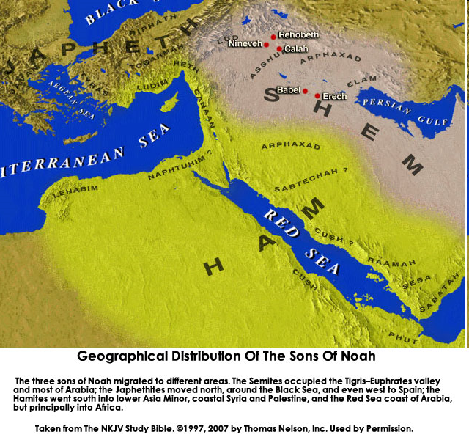

Slide 15

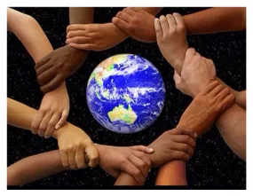
Acts 17:26
“and He made from one man every nation of mankind to live on all the face of the earth, having determined their appointed times and the boundaries of their habitation.”

Slide 16


Titus 3:5
“He saved us, not on the basis of deeds which we did in righteousness, but in accordance with His mercy, by the washing of regeneration [palingenesia] and renewing by the Holy Spirit.”

Slide 17
Matthew 19:28
“And Jesus said to them, ‘Truly I say to you, that you who have followed Me, in the regeneration [palingenesia] when the Son of Man will sit on His glorious throne, you also shall sit upon twelve thrones, judging the twelve tribes of Israel.’”

Slide 18

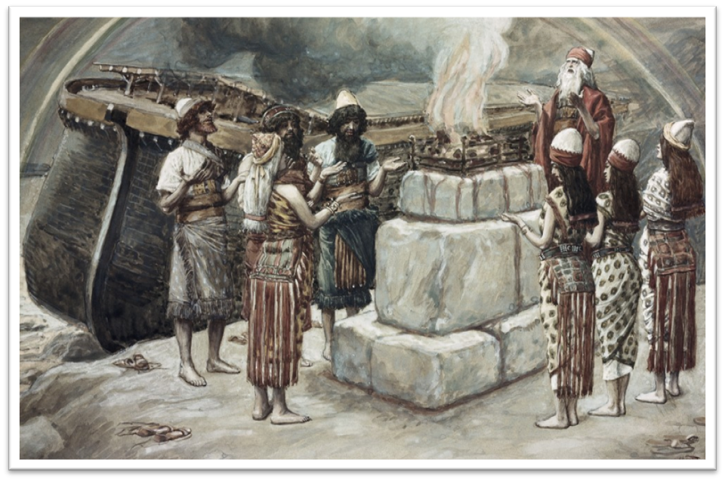
Genesis 8:21
The Lord smelled the soothing aroma; and the Lord said to Himself, “I will never again curse the ground on account of man, for the intent of man’s heart is evil from his youth; and I will never again destroy every living thing, as I have done.[emphasis mine].

Slide 19
Genesis 3:15
“And I will put enmity Between you and the woman, And between your seed and her seed; He shall bruise you on the head, And you shall bruise him on the heel.”

Slide 20

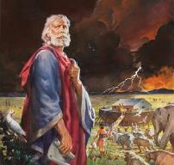
Genesis 6:8-9
“ ⁸ But Noah found favor in the eyes of the Lord. ⁹ These are the records of the generations of Noah. Noah was a righteous man, blameless in his time; Noah walked with God.”

Slide 21


Slide 22
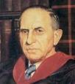

John Murray
Redemption Accomplished and Applied, (Grand Rapids, MI: Eerdmans Publishing Co. 2015 edition), p. 152, 154-55, 165. pp. 152, 154-55, 165
“The crucial test of true faith is endurance to the end, abiding in Christ, and continuance in the Word…He cannot abandon himself to sin; he cannot come under the domination of sin; he cannot be guilty of certain kinds of unfaithfulness…Let us appreciate the doctrine of the perseverance of the saints and recognize that we may entertain the faith of our security in Christ only as we persevere in faith and holiness to the end...The perseverance of the saints reminds us very forcefully that only those who persevere to the end are truly saints.”

Slide 23
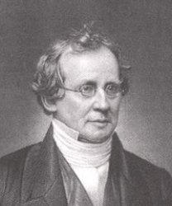
Charles Hodge
A Commentary on the Epistle to the Romans (Grand Rapids, MI: Eerdman’s Publishing, 1983 edition), p. 292.
Calvinist theologian Charles Hodge (1797-1878), in referring to evidence of being elected, said: “The only evidence of election is effectual calling, that is, the production of holiness. And the only evidence of the genuineness of this call and the certainty of our perseverance, is a patient continuance in well doing.”

Slide 24
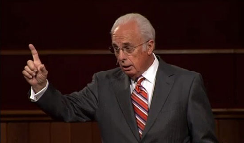
John MacArthur
Saved Without A Doubt, p. 177
“If a person fails to love and obey the Lord through the trials of life, then there is no evidence that he possesses saving faith. How many people do you know who came to church for a while, had a little trouble in their lives, and left? Although they may have made a profession of faith in Christ, they cannot be identified as those who love Him because their lives are not characterized by enduring obedience.”

Slide 25

John Piper
John Piper & Pastoral Staff, TULIP: What We Believe about the Five Points of Calvinism: Position Paper
of the Pastoral Staff (Desiring God Ministries, 1997), 25, cited in Dave Hunt, What Love is This?, 379.
“No Christian can be sure that he is a true believer. Hence, there is an ongoing need to be dedicated to the Lord and to deny ourselves so that we might make it.”

Slide 26

A. W. Pink
Practical Christianity, p. 16.
“Readers, if there is a reserve in your obedience, you are on your way to hell.”

Slide 27
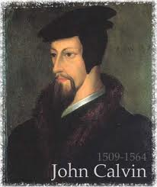
Examples of Old Testament Non-Persevering Saints
Noah (Gen. 9:20-23; Heb. 11:7)
Lot (Gen. 13; 19; 2 Pet. 2:7-8)
Moses (Num. 20:11-12; Deut. 32:5; Matt. 17:1-3; Heb. 11:23-29; Rev. 11:6)
Exodus’ generation (Num. 13‒14; Heb. 11:29)
Samson (Judges 13‒16; Heb. 11:32)
Saul (1 Sam. 28; 31)
Solomon (1 Kgs. 11:4, 9-10)

Slide 28

Examples of New Testament Non-Persevering Saints
Untrustworthy believers (John 2:23-25)
Non-confessing believers (John 12:42)
Ananias and Sapphira (Acts 5:1-11)
Simon the Sorcerer (Acts 8:13)
Immature believers at Corinth (1 Cor. 3:1-3)
Unrewarded believers at Corinth (1 Cor. 3:15)
Disciplined believers at Corinth (1 Cor. 11:27-32)
Demas (2 Tim. 4:10; Col. 4:14)
Immature believers in Hebrews (Heb. 5:11-14)
Seven churches in Asia Minor (Rev. 3:19)

Slide 29

2 Timothy 2:11-13
“It is a trustworthy statement: For if we died with Him, we will also live with Him; ¹² If we endure, we will also reign with Him; If we deny Him, He also will deny us; ¹³ If we are faithless, He remains faithful, for He cannot deny Himself.”

Slide 30
1 Peter 1:5
“⁴to obtain an inheritance which is imperishable, undefiled, and will not fade away, reserved in heaven for you, ⁵ who are protected by the power of God through faith for a salvation ready to be revealed in the last time.”

Slide 31

1 Corinthians 9:24-27
“²⁴ Do you not know that those who run in a race all run, but only one receives the prize? Run in such a way that you may win. ²⁵ Everyone who competes in the games exercises self-control in all things. They then do it to receive a perishable wreath, but we an imperishable. ²⁶ Therefore I run in such a way, as not without aim; I box in such a way, as not beating the air; ²⁷ but I discipline my body and make it my slave, so that, after I have preached to others, I myself will not be disqualified.”

Slide 32
Post Flood Sin
(Gen 9:18-29)
  Noah not the fulfillment of Gen 3:15 (Gen 9:18-21)
  Ham’s sin and Canaanites under a curse (Gen 9:22-27; 15:16)
  Noah’s death (Gen 9:28-29)

Slide 33


Dr. Arnold G. Fruchtenbaum
The Book of Genesis, 197-98
“The sin of Ham was that he saw the nakedness of his father. For Ham this was an attack on Noah’s privacy. Ham perhaps showed his disrespect, for he saw the nakedness with glee, and so the moral rectitude of the father was now destroyed. The ‘seeing’ involved a violation of a boundary; the looking was a negative looking. It will be used again in Genesis 19:26, with Lot’s wife looking back; in Exodus 33:20, in that no one can look at God and live; in Judges 13:22, when Manoah said, We shall surely die, because we have seen [or looked upon] God, and in I Samuel 6:19, where those who looked into the ark died....However, it. . .

Slide 34
Dr. Arnold G. Fruchtenbaum
The Book of Genesis, 197-98
... does imply that he looked upon the nakedness of his father with glee; not necessarily to derive sexual pleasure from it, but certainly in a mocking tone, making fun of his father, and so he told his two brethren. The sin of Ham will cause the cursing of his fourth son, and the sin lay in three things: seeing but failing to cover the father himself, as he could have; telling others about it, further shaming him; and deriding his father.”

Slide 35

John 13:19; 14:29
“¹⁹ From now on I am telling you before it comes to pass, so that when it does occur, you may believe that I am He… ^{14:29} Now I have told you before it happens, so that when it happens, you may believe.”

Slide 36


Slide 37

Reminder of God’s Sovereignty
  Messianic promise to come through Shem’s line (Gen 9:26)
  Continues selection of younger over older pattern (Abel over Cain, Seth over Cain, Japheth over Ham, Isaac over Ishmael, Jacob over Esau, Judah and Joseph over their brothers, and Ephraim over Manasseh)

Slide 38
Reminder of God’s Sovereignty
  Messianic promise to come through Shem’s line (Gen 9:26)
  Continues selection of younger over older pattern (Abel over Cain, Seth over Cain, Japheth over Ham, Isaac over Ishmael, Jacob over Esau, Judah and Joseph over their brothers, and Ephraim over Manasseh)

Slide 39
Dr. Arnold G. Fruchtenbaum
The Book of Genesis, 199
“Genesis 9:26 focuses on Shem, combining a blessing and cursing. The blessing is: Blessed be Jehovah the God of Shem. It is the God of Shem and not Shem himself who was blessed. Shem will uniquely possess the knowledge of God. Therefore, the Seed of the Woman will come through Shem and not through Ham or Japheth.”

Slide 40
Genesis 3:15
“And I will put enmity Between you and the woman, And between your seed and her seed; He shall bruise you on the head, And you shall bruise him on the heel.”

Slide 41
God’s Messianic Purposes Beginning in Genesis
Proto-evangelium from Adam & Eve (3:15)
Seth (4:25)
Noah (Gen 5:29)
Shem (9:26)
Abraham (12:3)
Isaac (21:12)
Jacob (25:23)
Judah (49:10)

Slide 42
God’s Messianic Purposes Beginning in Genesis
Proto-evangelium from Adam & Eve (3:15)
Seth (4:25)
Noah (Gen 5:29)
Shem (9:26)
Abraham (12:3)
Isaac (21:12)
Jacob (25:23)
Judah (49:10)

Slide 44
Reminder of God’s Sovereignty
  Messianic promise to come through Shem’s line (Gen 9:26)
  Continues selection of younger over older pattern (Abel over Cain, Seth over Cain, Japheth over Ham, Isaac over Ishmael, Jacob over Esau, Judah and Joseph over their brothers, and Ephraim over Manasseh)

Slide 45
Dr. Arnold G. Fruchtenbaum
The Book of Genesis, 200
“In some circles in preceding times, it was taught that the curse of Canaan was upon the Negro or the Black race, which is simply not true to the text. While it is true that Blacks are the descendants of Ham, not all descendants of Ham were black-skinned people. Only one of Ham’s sons was cursed, and that was Canaan. As is known from the Egyptian portrayals of the Canaanites, the Canaanites were not black-skinned; they were white, or it would be more correct to say, olive-skinned. Therefore, black skin has nothing to do with this curse, and the curse of Canaan is not biblical grounds for the enslavement of Blacks.”

Slide 46
Curse of Ham’s Descendants?
(Gen 9:25-27)
  Curse upon the black race?
  No!
  One race
    All humans are God’s image bearers (Gen. 1:26-27; 9:6; Jas. 3:9)
    Humanity is equally redeemed (Gal. 3:28)
  Morality (Lev. 18; 20) and not race
  Canaanites-Gen. 9:25; 15:16; Joshua

Slide 47
Curse of Ham’s Descendants?
(Gen 9:25-27)
  Curse upon the black race?
  No!
  One race
    All humans are God’s image bearers (Gen. 1:26-27; 9:6; Jas. 3:9)
    Humanity is equally redeemed (Gal. 3:28)
  Morality (Lev. 18; 20) and not race
  Canaanites-Gen. 9:25; 15:16; Joshua

Slide 48
Curse of Ham’s Descendants?
(Gen 9:25-27)
  Curse upon the black race?
  No!
  One race
    All humans are God’s image bearers (Gen. 1:26-27; 9:6; Jas. 3:9)
    Humanity is equally redeemed (Gal. 3:28)
  Morality (Lev. 18; 20) and not race
  Canaanites-Gen. 9:25; 15:16; Joshua

Slide 49
Curse of Ham’s Descendants?
(Gen 9:25-27)
  Curse upon the black race?
  No!
  One race
    All humans are God’s image bearers (Gen. 1:26-27; 9:6; Jas. 3:9)
    Humanity is equally redeemed (Gal. 3:28)
  Morality (Lev. 18; 20) and not race
  Canaanites-Gen. 9:25; 15:16; Joshua

Slide 50
Curse of Ham’s Descendants?
(Gen 9:25-27)
  Curse upon the black race?
  No!
  One race
    All humans are God’s image bearers (Gen. 1:26-27; 9:6; Jas. 3:9)
    Humanity is equally redeemed (Gal. 3:28)
  Morality (Lev. 18; 20) and not race
  Canaanites-Gen. 9:25; 15:16; Joshua

Slide 51

Acts 17:26
“and He made from one man every nation of mankind to live on all the face of the earth, having determined their appointed times and the boundaries of their habitation,”

Slide 52
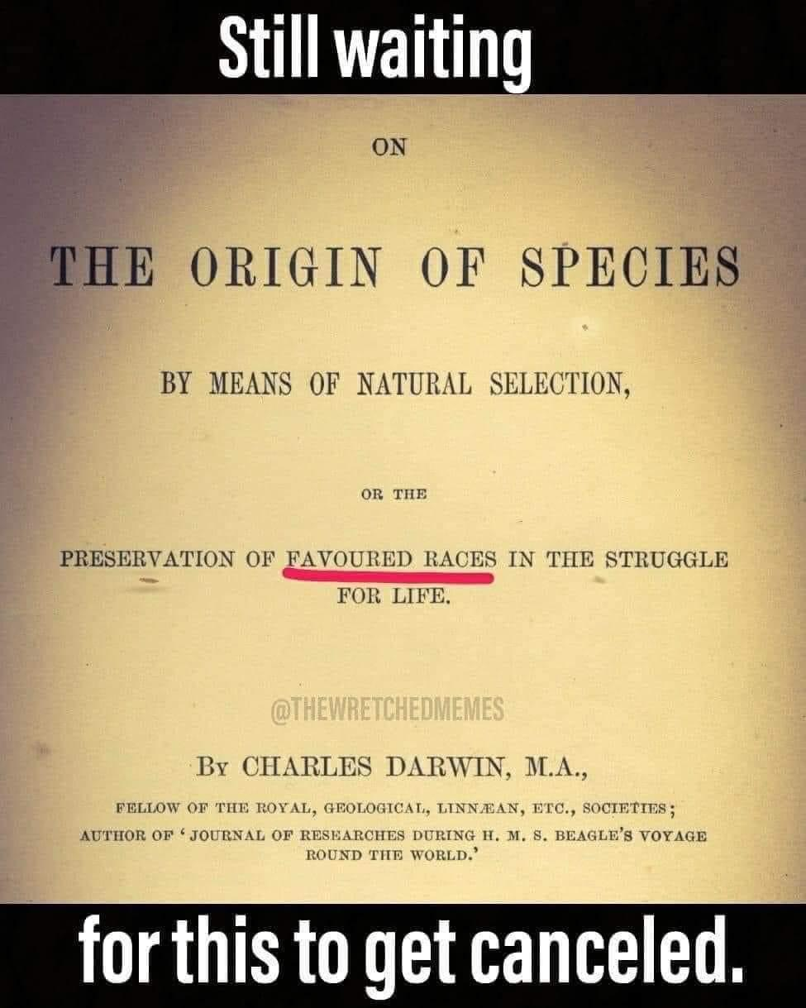

Slide 53
Curse of Ham’s Descendants?
(Gen 9:25-27)
  Curse upon the black race?
  No!
  One race
    All humans are God’s image bearers (Gen. 1:26-27; 9:6; Jas. 3:9)
    Humanity is equally redeemed (Gal. 3:28)
  Morality (Lev. 18; 20) and not race
  Canaanites-Gen. 9:25; 15:16; Joshua

Slide 54


John 3:16
“For God so loved the world, that He gave His only Son, so that everyone who believes in Him will not perish, but have eternal life.”

Slide 55

Revelation 5:9
“And they sang a new song, saying, ‘Worthy are You to take the book and to break its seals; for You were slain, and purchased for God with Your blood men from every tribe and tongue and people and nation.’”

Slide 56
Curse of Ham’s Descendants?
(Gen 9:25-27)
  Curse upon the black race?
  No!
  One race
    All humans are God’s image bearers (Gen. 1:26-27; 9:6; Jas. 3:9)
    Humanity is equally redeemed (Gal. 3:28)
  Morality (Lev. 18; 20) and not race
  Canaanites-Gen. 9:25; 15:16; Joshua

Slide 57
Curse of Ham’s Descendants?
(Gen 9:25-27)
  Curse upon the black race?
  No!
  One race
    All humans are God’s image bearers (Gen. 1:26-27; 9:6; Jas. 3:9)
    Humanity is equally redeemed (Gal. 3:28)
  Morality (Lev. 18; 20) and not race
  Canaanites-Gen. 9:25; 15:16; Joshua

Slide 58
Post Flood Sin
(Gen 9:18-29)
  Noah not the fulfillment of Gen 3:15 (Gen 9:18-21)
  Ham’s sin and Canaanites under a curse (Gen 9:22-27; 15:16)
  Noah’s death (Gen 9:28-29)

Slide 59
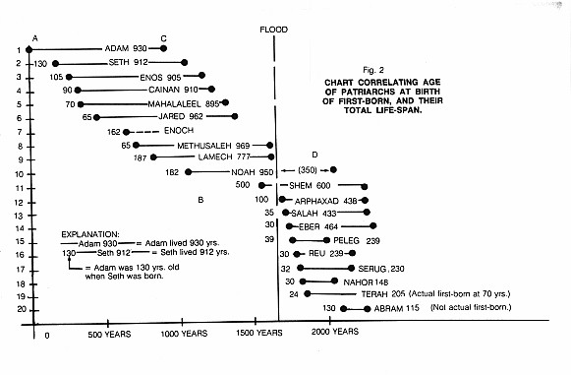

Slide 60
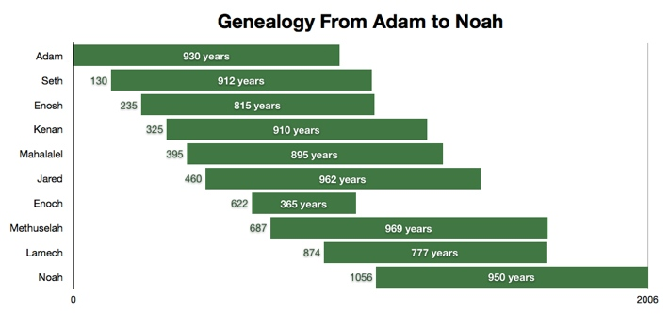

Slide 61
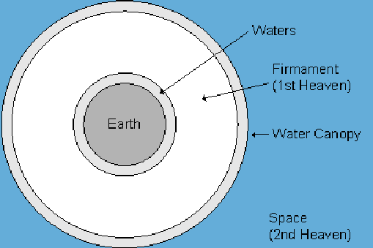

Slide 62
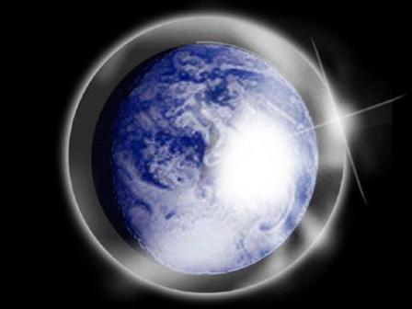

Slide 63
Genesis 3:15
“And I will put enmity Between you and the woman, And between your seed and her seed; He shall bruise you on the head, And you shall bruise him on the heel.”

Slide 64
Conclusion

Slide 65
Genesis 8‒9 Outline
  Abating of the waters (8:1-5)
  Tests for dry land (8:6-14)
  Exit from the ark (8:15-19)
  Post-flood events (8:20‒9:29)

Slide 66
Outline
  Noahic Covenant (Gen 8:20–9:17)
  Promise (Gen 8:20-22)
  Provision (Gen 9:1-7)
  Covenant and sign (Gen 9:8-17)
  Post Flood Sin (Gen 9:18-29)

Slide 67
Post Flood Sin
(Gen 9:18-29)
  Noah not the fulfillment of Gen 3:15 (Gen 9:18-21)
  Ham’s sin and Canaanites under a curse (Gen 9:22-27; 15:16)
  Noah’s death (Gen 9:28-29)

Slide 68
GENESIS STRUCTURE
  Genesis 1-11 (four events)
    Creation (1-2)
    Fall (3-5)
    Flood (6-9)
    National dispersion (10-11)

Slide 69

“The Lord bless you and keep you; the Lord make his face shine on you and be gracious to you; the Lord turn his face toward you and give you peace.” (NIV)

