Slide 1


Genesis 6‒9
The Flood and Continuation of the Messianic Promise

Slide 2


GENESIS STRUCTURE
  Beginning of the Human race (Gen. 1‒11)
  Beginning of the Hebrew race (Gen. 12‒50)

Slide 3

GENESIS STRUCTURE
  Genesis 1-11 (four events)
    Creation (1-2)
    Fall (3-5)
    Flood (6-9)
    National dispersion (10-11)

Slide 4
GENESIS STRUCTURE
  Genesis 1-11 (four events)
    Creation (1-2)
    Fall (3-5)
    Flood (6-9)
    National dispersion (10-11)

Slide 5


Genesis 3:15
“And I will put enmity Between you and the woman, And between your seed and her seed; He shall bruise you on the head, And you shall bruise him on the heel.”

Slide 6
GENESIS STRUCTURE
  Genesis 1-11 (four events)
    Creation (1-2)
    Fall (3-5)
    Flood (6-9)
    National dispersion (10-11)

Slide 7
The Flood
(Gen 6–9)
  Events before the flood (Gen 6)
  The flood (Gen 7)
  The abating of the waters (Gen 8)
  Events following the flood (Gen 9)

Slide 8

Genesis 8:20–9:29
Post Flood events

Slide 9
Outline
  Noahic Covenant (Gen 8:20–9:17)
  Promise (Gen 8:20-22)
  Provision (Gen 9:1-7)
  Covenant and sign (Gen 9:8-17)
  Post Flood Sin (Gen 9:18-29)

Slide 10
Outline
  Noahic Covenant (Gen 8:20–9:17)
  Promise (Gen 8:20-22)
  Provision (Gen 9:1-7)
  Covenant and sign (Gen 9:8-17)
  Post Flood Sin (Gen 9:18-29)

Slide 11
Outline
  Noahic Covenant (Gen 8:20–9:17)
  Promise (Gen 8:20-22)
  Provision (Gen 9:1-7)
  Covenant and sign (Gen 9:8-17)
  Post Flood Sin (Gen 9:18-29)

Slide 12
Noahic Covenant: Promise
(Gen 8:20-22)
  Noah’s initial sacrifice (8:20)
  Divine promise not to flood the earth again (Gen 8:21a)
  Ongoing depravity thus necessitating the work of a future Messiah (Gen 8:21b)
  Uninterrupted season or cycles (Gen 8:22) – global warming?

Slide 13
Outline
  Noahic Covenant (Gen 8:20–9:17)
  Promise (Gen 8:20-22)
  Provision (Gen 9:1-7)
  Covenant and sign (Gen 9:8-17)
  Post Flood Sin (Gen 9:18-29)

Slide 14
Noahic Covenant: Provision
(Gen 9:1-7)
  Re-creation theme (Gen 9:1, 2, 7)
  Man becomes carnivorous (Gen. 1:29-30; 2:17; 9:3)
  Cultural precedent for the Mosaic Law (Gen 9:4; Lev 17:11)

Slide 15
Noahic Covenant: Provision
(Gen 9:1-7)
  Origin of human government (Rom 13:1-7; 1 Pet 2:13-14; Titus 3:1; 1 Tim 2:1-4)
  Capital punishment (Gen 9:5-6)
  Rationale (4:13-15; 6:11; 8:21; 9:6b)
  Scriptural support (Rom 13:4; Matt 26:52)

Slide 16


Genesis 9:6
“Whoever sheds man’s blood, By man his blood shall be shed, For in the image of God He made man.”

Slide 17
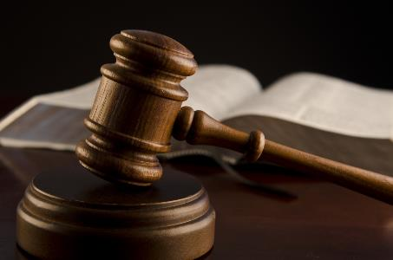
Objections to Capital Punishment
  Sixth commandment?
  Sermon on the Mount?
  We are no longer under the Mosaic Law?
  Deterrence? (Deut 13:10-11; 19:20; Eccl 8:11)
  Executed innocent?
  Racist?
  8th Amendment?
  Pro-life?

Slide 18
Noahic Covenant: Provision
(Gen 9:1-7)
  Re-creation theme (Gen 9:1, 2, 7)
  Man becomes carnivorous (Gen. 1:29-30; 2:17; 9:3)
  Cultural precedent for the Mosaic Law (Gen 9:4; Lev 17:11)

Slide 19
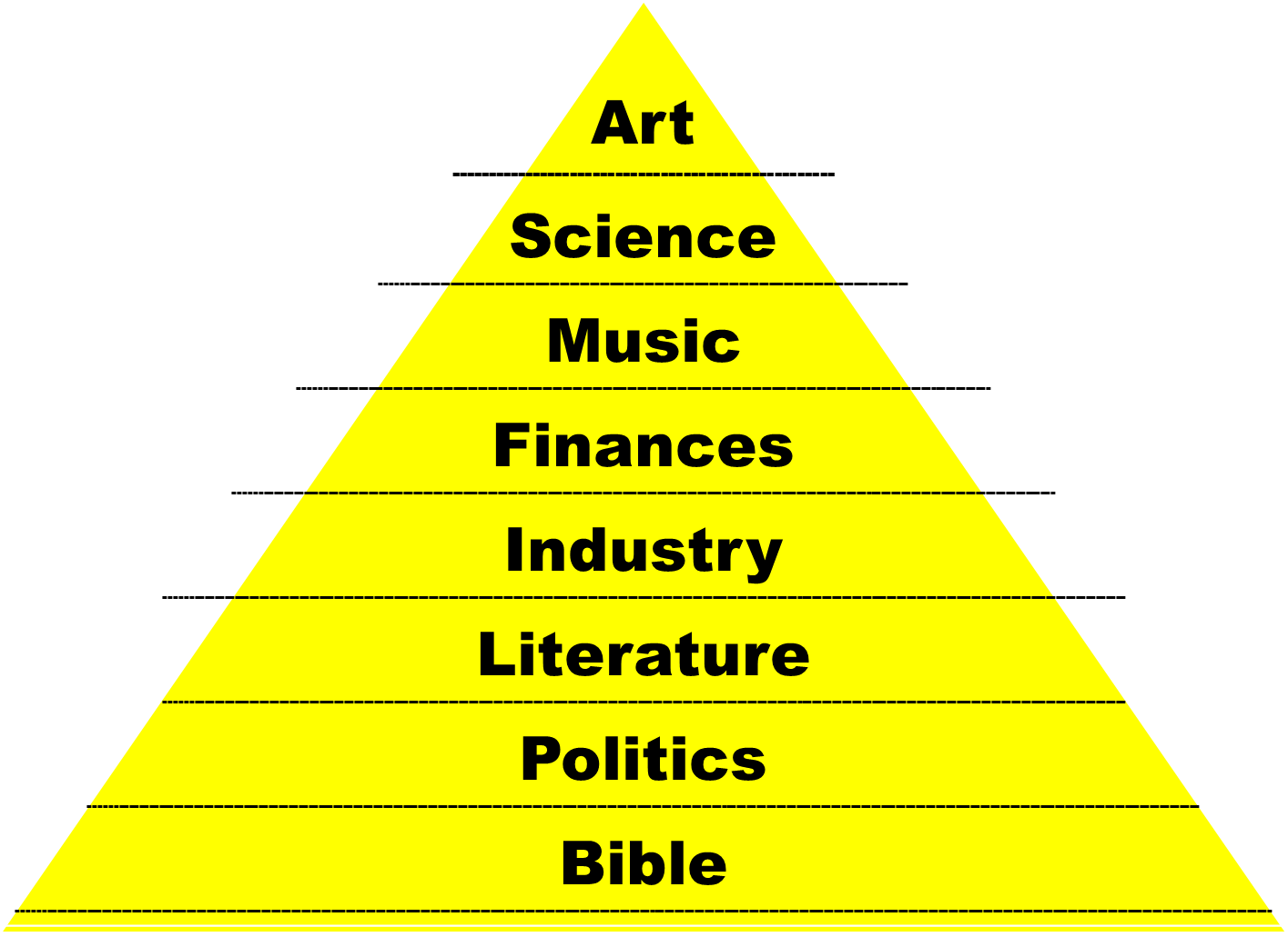

Slide 20
THE DIVINE INSTITUTIONS
Marriage and family (Gen. 1:26-28; 2:18-25)
Labor (Gen. 2:15; 3:19)
Conscience (Gen. 3:22)
Government (Gen. 9:6)
Nationalism (Gen. 11:1-9)

Slide 21
THE DIVINE INSTITUTIONS
Marriage and family (Gen. 1:26-28; 2:18-25)
Labor (Gen. 2:15; 3:19)
Conscience (Gen. 3:22)
Government (Gen. 9:6)
Nationalism (Gen. 11:1-9)

Slide 22
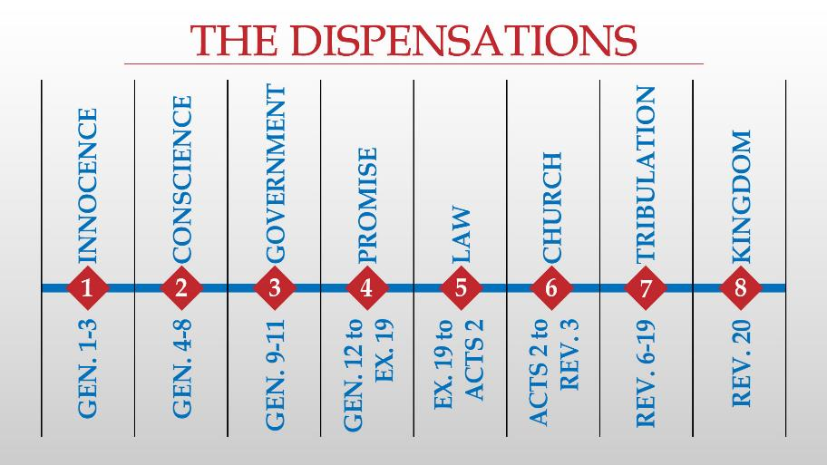

Slide 23

Ephesians 1:10; 3:2 (KJV)
“¹⁰ That in the dispensation [oikonomia] of the fulness of times he might gather together in one all things in Christ, both which are in heaven, and which are on earth; even in him… ² If ye have heard of the dispensation [oikonomia] of the grace of God which is given me to you-ward:”

Slide 24
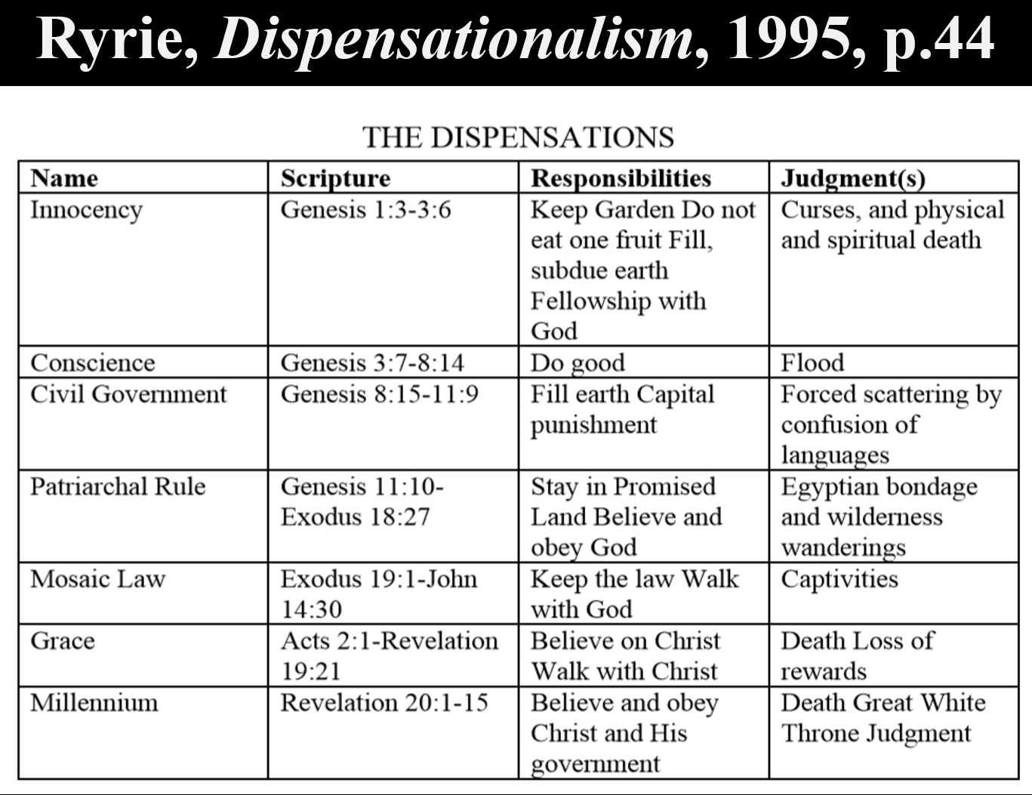

Slide 25


Slide 26
Eden = Probationary Environment
Eden (Genesis 1-2) | Eternal State (Rev 21-22)
Division: light/darkness 1:4 | No night 21:25
Division: land/sea 1:10 | No sea 21:1
Sun & moon 1:16 | No sun & moon 21:23
Garden 2:8-9 | City (21:2)
River flowing out of Eden 2:10 | River flowing from throne 22:1
Gold in the land 2:12 | Gold in the city 21:21
Tree of life in the middle of garden 2:9 | Tree of life throughout city 22:2
Bdellium and onyx stone 2:12 | All manner of stones 21:19
God walking in the garden 3:8 | God dwelling with His people 21:3
Henry Morris, Genesis Record, p.33

Slide 27

Outline
  Noahic Covenant (Gen 8:20–9:17)
  Promise (Gen 8:20-22)
  Provision (Gen 9:1-7)
  Covenant and sign (Gen 9:8-17)
  Post Flood Sin (Gen 9:18-29)

Slide 28
Noahic Covenant
(Gen 9:8-17)
  Covenant promise (Gen. 9:8-11)
  Covenant definition (Gen. 9:9, 11)
  Covenant sign (Gen. 9:12-17)
  Other covenant signs

Slide 29
Noahic Covenant
(Gen 9:8-17)
  Covenant promise (Gen. 9:8-11)
  Covenant definition (Gen. 9:9, 11)
  Covenant sign (Gen. 9:12-17)
  Other covenant signs

Slide 30
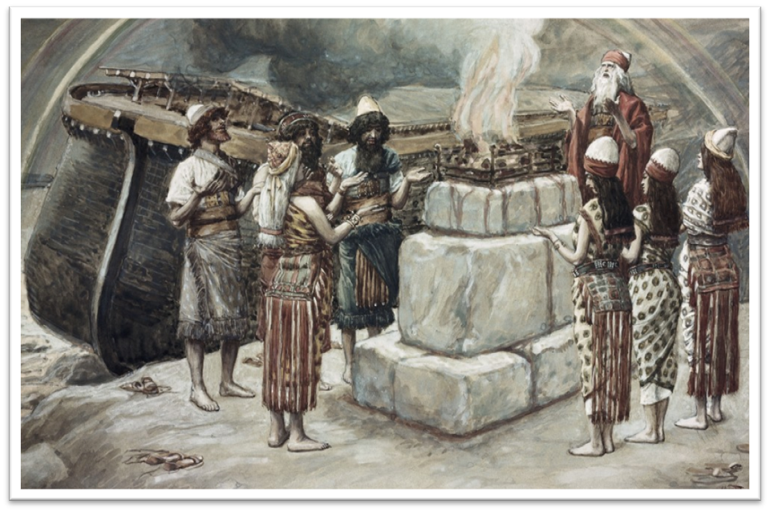
Genesis 8:21
The Lord smelled the soothing aroma; and the Lord said to Himself, “I will never again curse the ground on account of man, for the intent of man’s heart is evil from his youth; and I will never again destroy every living thing, as I have done.[emphasis mine].

Slide 31


Dr. Arnold G. Fruchtenbaum
The Book of Genesis, 188
“That means there will never again be a universal flood, and God will never again destroy the mass of humanity with a universal flood. The next time God destroys the mass of humanity, it is going to be by fire (Isa. 24:5–6, II Pet. 3:10). This promise again indicates the Flood was universal, not local. The language states clearly what had just happened: all flesh (except those on board the ark) and the earth had been destroyed.”

Slide 32
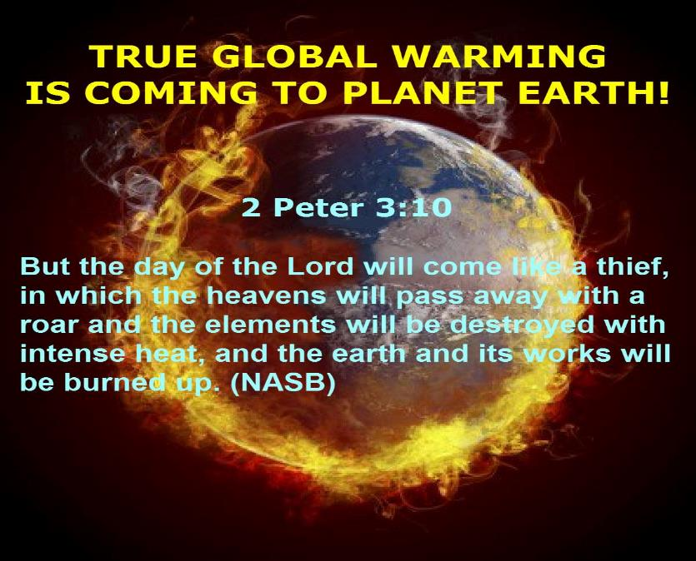

Slide 33
Noahic Covenant
(Gen 9:8-17)
  Covenant promise (Gen. 9:8-11)
  Covenant definition (Gen. 9:9, 11)
  Covenant sign (Gen. 9:12-17)
  Other covenant signs

Slide 34
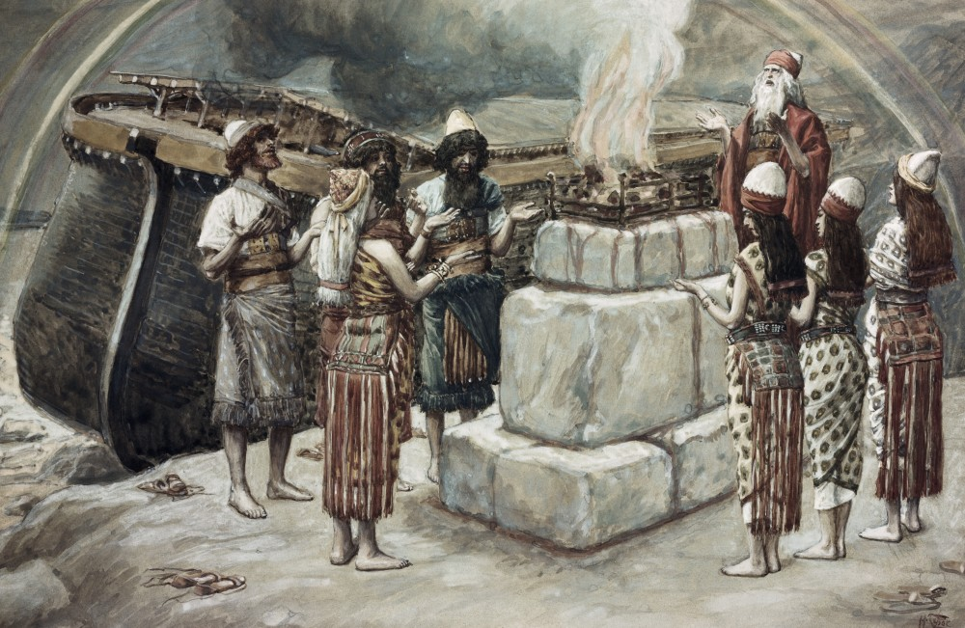
Dr. Arnold G. Fruchtenbaum
The Book of Genesis, 190
“The word covenant appears seven times in this passage (9:9–17).”

Slide 35
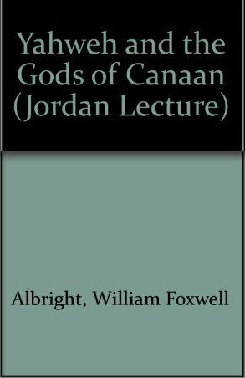
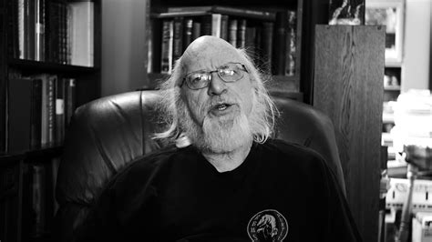
Dr. William F. Albright
Yahweh and the Gods of Canaan, 106-08
“‘Contracts and treaties were common everywhere, but only the Hebrews, so far as we know, made covenants with their gods or God. Being prevailingly caravanners and so ethno-political intruders in the West, the early Hebrews were in constant need of contractual and treaty protection.’ Charles Clough notes, ‘Of course, we Biblicists insist that it was God that made the contracts with man, not the other way around.’”
Charles C. Clough, "Social-Political Implications of the New Covenant," in An Introduction to the New Covenant, ed. Christopher Cone (Hurst, TX: Tyndale Seminary Press, 2013), 277.

Slide 36


Slide 37
Exodus 2:24
“So God heard their groaning; and God remembered His covenant with Abraham, Isaac, and Jacob.”

Slide 38
Ezekiel 36:22
“Therefore, say to the house of Israel, ‘This is what the Lord God says: “It is not for your sake, house of Israel, that I am about to act, but for My holy name, which you have profaned among the nations where you went.”

Slide 39
Noahic vs. Abrahamic & Mosaic Covenants
Name | NOAHIC | ABRAHAMIC | MOSAIC
Human agent | Noah | Abraham | Moses
Scripture | Gen. 8‒9 | Gen. 12‒17 | Exod. 19‒40
Covenant (Berith) | Gen. 9:9 | Gen. 15:18 | Exod. 19:5
Party | World, humanity | Israel, Hebrews | Israel, Hebrews
Israel | Pre-Israel | Post-Israel | Post-Israel

Slide 40
Noahic vs. Abrahamic & Mosaic Covenants
Covenant | NOAHIC | ABRAHAMIC | MOSAIC
Conditional or unconditional | Unconditional | Unconditional | Conditional
Promises | No more flood judgment, enduring earth, capital punishment | Ownership of land, seed, and blessing | Enjoyment or possession of land, seed, and blessing
Sign | Rainbow | Circumcision | Sabbath
Purpose | Restrain & preserve | Redemptive | Redemptive
Directly binding today? | Yes | No | No

Slide 41


Slide 43

Exodus 19:5-6
“Now then, if you will indeed obey My voice and keep My covenant, then you shall be My own possession among all the peoples, for all the earth is Mine; and you shall be to Me a kingdom of priests and a holy nation.’ These are the words that you shall speak to the sons of Israel.”

Slide 44
Noahic Covenant
(Gen 9:8-17)
  Covenant promise (Gen. 9:8-11)
  Covenant definition (Gen. 9:9, 11)
  Covenant sign (Gen. 9:12-17)
  Other covenant signs

Slide 45
Genesis 2:5-6
“⁵ Now no shrub of the field was yet on the earth, and no plant of the field had yet sprouted, for the Lord God had not sent rain upon the earth, and there was no man to cultivate the ground. ⁶ But a mist used to rise from the earth and water the whole surface of the ground.”

Slide 46
Dr. Arnold G. Fruchtenbaum
The Book of Genesis, 189
“In 9:14: And it shall come to pass, when I bring a cloud over the earth, meaning when it rains, the bow shall be seen in the cloud. The rainbow is associated with rain, and there was no rain before the Flood; therefore, no rainbows had been seen before this time.”

Slide 47
Dr. Arnold G. Fruchtenbaum
The Book of Genesis, 189
“The Hebrew word for bow is keshet, the same word used of the battle bow. It is as if God hung up his battle bow on the cloud as a sign of peace in place of being a sign of war...”

Slide 48
Dr. Arnold G. Fruchtenbaum
The Book of Genesis, 175
“The turning point begins with the remembrance of God in verse 1a: And God remembered Noah, and all the beasts, and all the cattle that were with him in the ark. The word remember does not mean remember in the sense that God temporarily forgot about the ark and its inhabitants; rather it means remembering in the sense of movement toward the object. For example, in Genesis 19:29, God remembered Abraham with a view to saving Lot; in Exodus 2:24, God remembered his covenant with the Patriarchs with a view to rescuing Israel; in Jeremiah 2:2, God remembered Israel with a view toward her restoration; in Jeremiah 31:20, God remembered . . .

Slide 49
Dr. Arnold G. Fruchtenbaum
The Book of Genesis, 175
“… Ephraim with a view toward extending mercy to him; and in Luke 1:54–55, God remembered Israel with a view toward sending the Messiah to Israel. Furthermore, the sense was that of God remembering a covenant; although in this case the covenant itself had not yet been made. He said earlier in chapter 6, that He would establish His covenant with Noah. Furthermore, in 7:4 God remembered that the rain would only last forty days. All these usages fit into the word ‘remember.’”

Slide 50
Dr. Arnold G. Fruchtenbaum
The Book of Genesis, 189
“Genesis 9:15 presents the remembrance of the covenant: I will remember my covenant, which is with all humanity, which is between me and you and every living creature of all flesh... Again, [as in 8:1], the word remember is used showing a covenantal relationship and referring to God’s faithfulness to his covenant.”

Slide 52
Exodus 2:24
“So God heard their groaning; and God remembered His covenant with Abraham, Isaac, and Jacob.”

Slide 53

John 10:27-29
“My sheep hear My voice, and I know them, and they follow Me; ²⁸ and I give eternal life to them, and they will never perish [ou mē apóllumi; aiōnia]; and no one will snatch them out of My hand. ²⁹ My Father, who has given them to Me, is greater than all; and no one is able to snatch them out of the Father’s hand.”

Slide 54

Emphatic (Double) Negation?
“Emphatic negation is indicated by οὐ μή plus the aorist subjunctive…This is the strongest way to negate something in Greek...οὐ μή rules out even the idea as being a possibility: ‘ου μή is the most decisive way of negativing someth. in the future…As well, a soteriological theme is frequently found in such statements, especially in John: what is negatived is the possibility of the loss of salvation.
Daniel B. Wallace, Greek Grammar Beyond the Basics: An Exegetical Syntax of the New Testament with Scripture, Subject, and Greek Word Indexes (Grand Rapids: Zondervan, 1996), 468.

Slide 55
2 Timothy 2:11-13
“It is a trustworthy statement: For if we died with Him, we will also live with Him; ¹² If we endure, we will also reign with Him; If we deny Him, He also will deny us; ¹³ If we are faithless, He remains faithful, for He cannot deny Himself.”

Slide 56

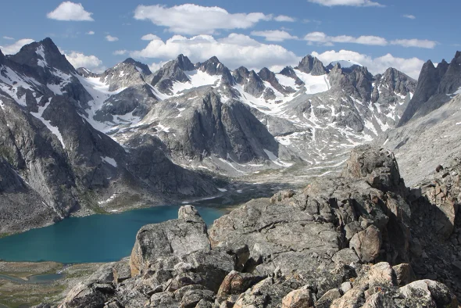
Psalm 90:2
“Before the mountains were born Or You gave birth to the earth and the world, Even from everlasting (olam) to everlasting (olam), You are God.”

Slide 57
Noahic Covenant
(Gen 9:8-17)
  Covenant promise (Gen. 9:8-11)
  Covenant definition (Gen. 9:9, 11)
  Covenant sign (Gen. 9:12-17)
  Other covenant signs

Slide 58
Covenant Signs
  Noahic Covenant: Rainbow (Gen 9)
  Abrahamic Covenant: Circumcision (Gen 17)
  Mosaic Covenant: Sabbath (Exod 20; Lev 25: Jer 25:11; 29:10; 2 Chron 36:21)
  New Covenant: Communion (Luke 22)

Slide 59
Conclusion

Slide 60
Genesis 8‒9 Outline
  Abating of the waters (8:1-5)
  Tests for dry land (8:6-14)
  Exit from the ark (8:15-19)
  Post-flood events (8:20‒9:29)

Slide 61
Outline
  Noahic Covenant (Gen 8:20–9:17)
  Promise (Gen 8:20-22)
  Provision (Gen 9:1-7)
  Covenant and sign (Gen 9:8-17)
  Post Flood Sin (Gen 9:18-29)

Slide 62
Noahic Covenant
(Gen 9:8-17)
  Covenant promise (Gen. 9:8-11)
  Covenant definition (Gen. 9:9, 11)
  Covenant sign (Gen. 9:12-17)
  Other covenant signs

Slide 63
Outline
  Noahic Covenant (Gen 8:20–9:17)
  Promise (Gen 8:20-22)
  Provision (Gen 9:1-7)
  Covenant and sign (Gen 9:8-17)
  Post Flood Sin (Gen 9:18-29)

Slide 64

“The Lord bless you and keep you; the Lord make his face shine on you and be gracious to you; the Lord turn his face toward you and give you peace.” (NIV)

