Slide 1
THE RAPTURE
What and When? – Part 50
Andrew Marshall Woods, Th.M., JD., PhD.
Sr. Pastor, Sugar Land Bible Church

Slide 2
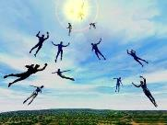
The Rapture Course Overview
What is the Rapture?
When is the Rapture?
Strengthening the Pre-Tribulational case
The opposing views
One second after the Rapture

Slide 3
The Rapture Course Overview
What is the Rapture?
When is the Rapture?
Strengthening the Pre-Tribulational case
The opposing views
One second after the Rapture

Slide 4
What is the Rapture?
An important doctrine
Distinct from the Second Advent
Catching away of all living believers (1 Thess 4:17)
Reunion (1 Thess 4:14-16)
Resurrection (1 Cor 15:50-54)
Exemption from death (1 Cor 15:51, 54-56)
Instantaneous (1 Cor 15:52)
Mystery (1 Cor 15:51)
Imminent (1 Cor 15:51; 1 Thess 4:15)
Traditional doctrine now being recovered

Slide 5
The Rapture Course Overview
What is the Rapture?
When is the Rapture?
Strengthening the Pre-Tribulational case
The opposing views
One second after the Rapture

Slide 6
When is the Rapture?
7 Arguments Favoring the Pre-Tribulation View
Tribulation's purpose concerns Israel (Jer 30:7; Dan 9:24)
No biblical reference to the church on earth during the Tribulation period (Rev 4-22)
Church is promised an exemption from divine wrath (1 Thess 1:10; 5:9; Rom 5:9; Rev 3:10; 6:17)
Rapture is imminent (1 Cor 15:51; 1 Thess 4:15)
Rapture is a comfort (1 Thess 4:18)
Antichrist cannot come to power until the restrainer is removed (2 Thess 2:6-7)
Symbolic parallels (2 Peter 2:5-9)

Slide 7
The Rapture Course Overview
What is the Rapture?
When is the Rapture?
Strengthening the Pre-Tribulational case
The opposing views
One second after the Rapture

Slide 8
Strengthening the Pre-Tribulation Case
John 14:1-4
Revelation 3:10
First Thessalonians 4‒5
Second Thessalonians 2:3a
Matthew 24‒25

Slide 9
The Rapture Course Overview
What is the Rapture?
When is the Rapture?
Strengthening the Pre-Tribulational case
The opposing views
One second after the Rapture

Slide 10
When Will the Rapture Take Place Relative to the Tribulation Period?
Pre-tribulation rapture theory
Mid-tribulation rapture theory
Post-tribulation rapture theory
Pre-wrath rapture theory
Partial rapture theory

Slide 11
Problems with Partial Rapturism?
Every divine blessing is given on the basis of His grace and not human effort (Eph. 2:8-9; Rom. 12:6)
Symbolic parallels mandate that carnal as well as sanctified Christians will be taken up in the rapture (Gen. 19:22)
The promise of the rapture is mentioned in Paul's letter to the carnal Corinthian church (1 Cor. 15:51)
A partial rapture would sever Christ's body (1 Cor 12:12-14)
The partial rapture view subjects believers to God's wrath (Thess 1:10)

Slide 12
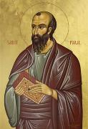
1 Corinthians 3:1-3 (NKJV)
4 KINDS OF PEOPLE
¹ And I, brethren, could not speak to you as to spiritual people but as to carnal, as to babes in Christ. ² I fed you with milk and not with solid food; for until now you were not able to receive it, and even now you are still not able; ³ for you are still carnal. For where there are envy, strife, and divisions among you, are you not carnal and behaving like mere men?

Slide 13
Notes:
Ray Steadman – “1st Californians”
Unbelievers vs Categories of Believers
Unbelievers – ψυχικός psuchikós; Natural, pertaining to the natural as distinguished from the spiritual
Spiritual Believers – πνευματικός pneumatikós; of persons who are spiritual, enlightened by the Holy Spirit
Infant Believers – σάρκινος sárkinos; with propensities of the flesh unto sin; νήπιος nḗpios; an infant, child, baby without any definite limitation of age. (This relates to immaturity and lack of instruction)
Carnal Believers – σαρκικός sarkikós; tendency to satisfy the flesh, implying sinfulness, sinful propensity, carnal (This relates to disobedience and open rebellion)

Slide 14
1 Corinthians 3:15
“If any man’s work is burned up, he will suffer loss; but he himself will be saved, yet so as through fire.”

Slide 15
1 Corinthians 1:2
“To the church of God which is in Corinth, to those who have been sanctified in Christ Jesus, saints by calling, with all who in every place call on the name of our Lord Jesus Christ, their Lord and ours.”

Slide 16
1 Corinthians 6:19-20
“¹⁹ Or do you not know that your body is a temple of the Holy Spirit within you, whom you have from God, and that you are not your own? ²⁰ For you have been bought for a price: therefore, glorify God in your body.”

Slide 17
Three Tenses of Salvation
Phase | Justification | Sanctification | Glorification
Tense | Past | Present | Future
Saved from sin’s: | Penalty | Power | Presence
Scripture | Eph 2:8-9; Titus 3:5 | Philip 2:12 | Rom 5:10
Nature | Single | Dual | Single

Slide 18
Three Tenses of Salvation
Phase | Justification | Sanctification | Glorification
Tense | Past | Present | Future
Saved from sin’s: | Penalty | Power | Presence
Scripture | Eph 2:8-9; Titus 3:5 | Philip 2:12 | Rom 5:10
Nature | Single | Dual | Single

Slide 19
1 Corinthians 15:50-51
“⁵⁰ Now I say this, brethren, that flesh and blood cannot inherit the kingdom of God; nor does the perishable inherit the imperishable. ⁵¹ Behold, I tell you a mystery; we will not all sleep, but we will all be changed.”

Slide 20
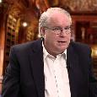
Ron Rhodes
The Big Book of Bible Answers: A Guide to Understanding the Most Challenging Questions (Eugene, OR: Harvest, 2013), 279.
“First Corinthians 15:51 settles the issue, for it specifically tells us that 'we shall all be changed.' 'We' here includes even the carnal believers in the Corinthian church, to whom Paul was writing. None are excluded, for 'all' will be changed.”

Slide 21
Problems with Partial Rapturism?
Every divine blessing is given on the basis of His grace and not human effort (Eph. 2:8-9; Rom. 12:6)
Symbolic parallels mandate that carnal as well as sanctified Christians will be taken up in the rapture (Gen. 19:22)
The promise of the rapture is mentioned in Paul's letter to the carnal Corinthian church (1 Cor. 15:51)
A partial rapture would sever Christ's body (1 Cor 12:12-14)
The partial rapture view subjects believers to God's wrath (Thess 1:10)

Slide 22
Colossians 1:18
“He is also the head of the body, the church; and He is the beginning, the firstborn from the dead, so that He Himself will come to have first place in everything.”

Slide 23
1 Corinthians 12:12-13
“¹² For even as the body is one and yet has many members, and all the members of the body, though they are many, are one body, so also is Christ. ¹³ For by one Spirit we were all baptized into one body, whether Jews or Greeks, whether slaves or free, and we were all made to drink of one Spirit.”

Slide 24
1 Corinthians 12:25-27
“²⁵ so that there may be no division in the body, but that the parts may have the same care for one another. ²⁶ And if one part of the body suffers, all the parts suffer with it; if a part is honored, all the parts rejoice with it. ²⁷ Now you are Christ’s body, and individually parts of it.”

Slide 25
Ron Rhodes
The Big Book of Bible Answers: A Guide to Understanding the Most Challenging Questions (Eugene, OR: Harvest, 2013), 279.
“If part of God's people were removed from the earth while the rest of God's people were left behind, as the partial rapture theory teaches, then Christ's body, the church, would be severed and mutilated. It is doubtful that Christ would allow this to happen to His own body. In fact, in 1 Corinthians 12:26, Paul explained, ‘And if one member suffers, all the members suffer with it; if one member is honored, all the members rejoice with it.’…Moreover, the Spirit's baptism places all believers in Christ body (1 Corinthians 12:13) and therefore all believers will be raptured (1 Thessalonians 4:16–17). The partial rapture theory denies the perfect unity in the body of Christ (1 Corinthians 12:12–13).”

Slide 26
What is the Rapture?
An important doctrine
Distinct from the Second Advent
Catching away of all living believers (1 Thess 4:17)
Reunion (1 Thess 4:14-16)
Resurrection (1 Cor 15:50-54)
Exemption from death (1 Cor 15:51, 54-56)
Instantaneous (1 Cor 15:52)
Mystery (1 Cor 15:51)
Imminent (1 Cor 15:51; 1 Thess 4:15)
Traditional doctrine now being recovered

Slide 27
1 Thessalonians 4:13-18
¹³ "But we do not want you to be uninformed, brethren, about those who are asleep, so that you will not grieve as do the rest who have no hope. ¹⁴ For if we believe that Jesus died and rose again, even so God will bring with Him those who have fallen asleep in Jesus. ¹⁵ For this we say to you by the word of the Lord, that we who are alive and remain until the coming of the Lord, will not precede those who ...

Slide 28
1 Thessalonians 4:13-18
. . . have fallen asleep. ¹⁶ For the Lord Himself will descend from heaven with a shout, with the voice of the archangel and with the trumpet of God, and the dead in Christ will rise first. ¹⁷ Then we who are alive and remain will be caught up together with them in the clouds to meet the Lord in the air, and so we shall always be with the Lord. ¹⁸ Therefore comfort one another with these words."

Slide 29
Reunion (1 Thess 4:14-16)
Thessalonians’ concern (1 Thess 4:13)
Dead “in Christ” (Christians) resurrected first
Alive “in Christ” (Christians) resurrected second
Both deceased and living Christians are taken to be with the Lord
Do not grieve as the world grieves (1 Thess 4:13)
Be comforted (1 Thess 4:18)

Slide 30
1 Thessalonians 4:13-18
¹³ "But we do not want you to be uninformed, brethren, about those who are asleep, so that you will not grieve as do the rest who have no hope. ¹⁴ For if we believe that Jesus died and rose again, even so God will bring with Him those who have fallen asleep in Jesus. ¹⁵ For this we say to you by the word of the Lord, that we who are alive and remain until the coming of the Lord, will not precede those who . . .

Slide 31
1 Thessalonians 4:13-18
. . . have fallen asleep. ¹⁶ For the Lord Himself will descend from heaven with a shout, with the voice of the archangel and with the trumpet of God, and the dead in Christ will rise first. ¹⁷ Then we who are alive and remain will be caught up together with them in the clouds to meet the Lord in the air, and so we shall always be with the Lord. ¹⁸ Therefore comfort one another with these words."

Slide 32
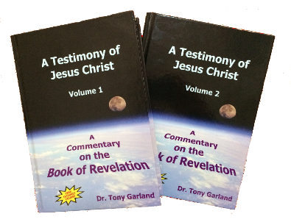
Tony Garland
Anthony Garland, "Q181 : George Peters and the Partial Rapture View," online: www.spiritandtruth.org, accessed 13 August 2015.
“To believe in a partial rapture one must either embrace the notion that salvation is insecure and can be lost or that unity with Christ is not the determining factor in whether we miss the rapture or even the kingdom to follow. But what does Paul say about who is taken in the Rapture (1 Th. 4:15-18)? ‘For this we say to you by the word of the Lord, that we who are alive and remain until the coming of the Lord will by no means precede those who are asleep. For the Lord Himself will descend from heaven with a shout, with the voice of an archangel, and with the trumpet of God. And the dead in Christ will rise first…”

Slide 33
Tony Garland
Anthony Garland, "Q181 : George Peters and the Partial Rapture View," online: www.spiritandtruth.org, accessed 13 August 2015.
“…Then we who are alive and remain shall be caught up together with them in the clouds to meet the Lord in the air. And thus we shall always be with the Lord. Therefore comfort one another with these words.’ Notice that it is the dead, in Christ that rise first. If all of the dead in Christ are taken at the Rapture, how can it be consistent to conclude that some of the living who are also in Christ are left behind? If this were to be true, we would have the rather strange situation where the living saints would be better off dead prior to the Rapture in order to be sure they were among those taken!”

Slide 34
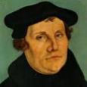
Christian Anti-Semitism
“First, their synagogues should be set on fire…Secondly, their homes should likewise be broken down and destroyed… Thirdly, they should be deprived of their prayer books and Talmuds…”

Slide 35
Christian Anti-Semitism
“…Fourthly, their rabbis must be forbidden under threat of death to teach any more… Fifthly, passport and traveling privileges should be absolutely forbidden to the Jews… Sixthly, they ought to be stopped from usury (charging interest on loans…”

Slide 36
Christian Anti-Semitism
“Seventhly, let the young and strong Jews and Jewesses be given the flail, the ax, the hoe, the spade, the distaff, and spindle, and let the earn their bread by the sweat of their noses…We ought to drive the rascally lazy bones out of our system...”

Slide 37
Christian Anti-Semitism
“…Therefore away with them… To sum up, dear princes and nobles who have Jews in your domains, if this advice of mine does not suit you, then find a better one so that you and we may all be free of this insufferable devilish burden–the Jews.”
Martin Luther, Concerning the Jews and Their Lies, cited in Michael Brown’s Our Hands Are Stained with Blood, pp. 14-15.

Slide 38
Problems with Partial Rapturism?
Every divine blessing is given on the basis of His grace and not human effort (Eph. 2:8-9; Rom. 12:6)
Symbolic parallels mandate that carnal as well as sanctified Christians will be taken up in the rapture (Gen. 19:22)
The promise of the rapture is mentioned in Paul's letter to the carnal Corinthian church (1 Cor. 15:51)
A partial rapture would sever Christ's body (1 Cor 12:12-14)
The partial rapture view subjects believers to God's wrath (Thess 1:10)

Slide 39
When is the Rapture?
7 Arguments Favoring the Pre-Tribulation View
Tribulation's purpose concerns Israel (Jer 30:7; Dan 9:24)
No biblical reference to the church on earth during the Tribulation period (Rev 4-22)
Church is promised an exemption from divine wrath (1 Thess 1:10; 5:9; Rom 5:9; Rev 3:10; 6:17)
Rapture is imminent (1 Cor 15:51; 1 Thess 4:15)
Rapture is a comfort (1 Thess 4:18)
Antichrist cannot come to power until the restrainer is removed (2 Thess 2:6-7)
Symbolic parallels (2 Peter 2:5-9)

Slide 40
Promised Exemption from Divine Wrath
The promise (1 Thess 1:10; 5:9; Rom 5:9; 8:1; Rev 3:10)
Tribulation = divine wrath/anger (Rev 6:16-17; 11:18; 14:10; 15:1, 7; 16:1, 19; 19:15)

Slide 42
Mark Hitchcock
Could the Rapture Happen Today? (Sisters, OR: Multnomah, 2005), 68.
“All believers are promised exemption from God's wrath. The partial rapture view creates a kind of a Protestant purgatory on earth during the Tribulation period. The only difference between this idea and the Catholic view of purgatory is that it would be on earth before death.”

Slide 43
Problems with Partial Rapturism?
Partial rapturism makes the Bema Seat Judgment unnecessary (1 Cor. 3:10-15)
Partial rapturists never objectively quantify the exact degree of faithfulness or spiritual maturity that is necessary to participate in the rapture
Partial rapturists appear individually biased
Partial rapturists dispensationally misapply Bible passages (Matt. 25:1-13)
Partial rapturists misapply passages promising a reward to faithful believers (Rev. 3:11)

Slide 44
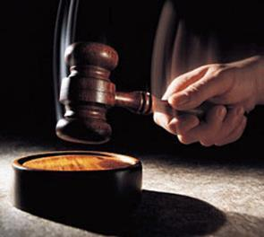
Why?
Not to judge sin (John 19:30)
Not to determine salvation (John 5:24)
But rather to give or not give rewards

Slide 45
Scripture’s Five Crowns (Rev 4:10: 3:11; 2 John 8)
SCRIPTURE | CROWN | PURPOSE
1 Cor. 9:24-27 | Incorruptible | Gaining mastery over the flesh
1 Thess. 2:19-20 | Rejoicing | Soul winning
Jas. 1:12; Rev. 2:10 | Life | Enduring trials
1 Pet. 5:2-4 | Glory | Shepherding God’s people
2 Tim. 4:8 | Righteousness | Longing for His appearing

Slide 46
1 Corinthians 3:10-15
“¹⁰ According to the grace of God which was given to me, like a wise master builder I laid a foundation, and another is building on it. But each man must be careful how he builds on it. ¹¹ For no man can lay a foundation other than the one which is laid, which is Jesus Christ. ¹² Now if any man builds on the foundation with gold, silver, precious stones, wood, hay, straw. ¹⁴ If any man’s work . . .

Slide 47
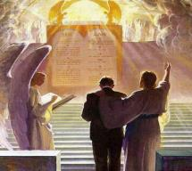
1 Corinthians 3:10-15
... which he has built on it remains, he will receive a reward. ¹⁵ If any man’s work is burned up, he will suffer loss; but he himself will be saved, yet so as through fire.”

Slide 48
Scripture’s Four Judgments
Name | Sheep and Goat | Judgment of the Jews | Bema Seat | Great White Throne
Scripture | Matt 25:31-46 | Ezek 20:33-44 | 1 Cor 3:10-15 | Rev 20:11-15
Place | Earth, Jerusalem | Earth, wilderness | Heaven | Earth
Audience | Gentile Tribulation survivors | Jewish Tribulation survivors | Church Age believers | All unsaved
When | After Tribulation | After Tribulation | After rapture | After Millennium
Purpose | Saved Gentiles enter kingdom | Saved Jews enter kingdom | Reward believers | Degree of punishment in hell
Evaluation | Treatment of Christ’s brethren | Passing under shepherd’s rod | Works taken through fire | Not in the book; judged by books

Slide 50
Problems with Partial Rapturism?
Partial rapturism makes the Bema Seat Judgment unnecessary (1 Cor. 3:10-15)
Partial rapturists never objectively quantify the exact degree of faithfulness or spiritual maturity that is necessary to participate in the rapture
Partial rapturists appear individually biased
Partial rapturists dispensationally misapply Bible passages (Matt. 25:1-13)
Partial rapturists misapply passages promising a reward to faithful believers (Rev. 3:11)

Slide 51
Mark Hitchcock
Could the Rapture Happen Today? (Sisters, OR: Multnomah, 2005), 68.
“If the timing of our translation to heaven depends on our own spiritual maturity or readiness, how ready do we have to be? What degree of maturity or readiness is required to make it in the first group? The Bible never says.”

Slide 52
Lordship Salvation 7 Problems
Changes the gospel
Places an impossible burden upon the unsaved
Confuses justification with sanctification
Confuses the result of with requirement for salvation
Fails to make basic dispensational distinctions
Ignores the reality of a carnal Christian
Destroys the assurance of salvation

Slide 53
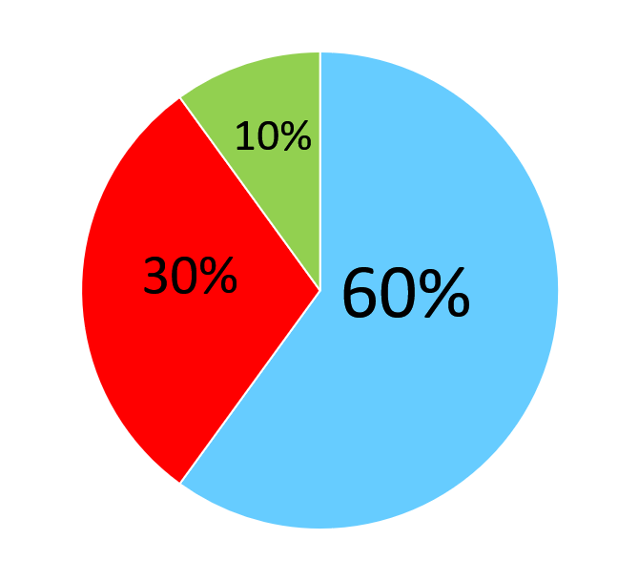

Slide 54
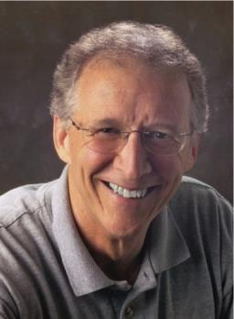
John Piper
“No Christian can be sure that he is a true believer. Hence, there is an ongoing need to be dedicated to the Lord and to deny ourselves so that we might make it.”
John Piper and Pastoral Staff, TULIP: What We Believe about the Five Points of Calvinism: Position Paper of the Pastoral Staff (Desiring God Ministries, 1997), 25, cited in Dave Hunt, What Love is This?, 379.

Slide 55
John Piper
“What causes me to be anxious is the possibility that I may not be a Christian—that I might be fake / that everything I’ve ever done might be a farce—those are horrible, horrible thoughts; right?”
John Piper’s Interview on Family Life Radio April 14, 2020
https://www.familylife.com/podcast/familylife-today/strategies-for-standing-firm-through-coronavirus/

Slide 56
R.C. Sproul, Jr.
“A while back I had one of those moments… Suddenly the question hit me: ‘R.C. what if you are not one of the redeemed? What if your destiny is not heaven after all, but hell?’ Let me tell you that I was flooded in my body with the chill that went from my head to the bottom of my spine. I was terrified. I begin to take stock of my life, and I looked at my performance. My sins came pouring into my mind, and the more I looked at myself the worst I felt. I thought, ‘maybe it’s really true. Maybe I’m not saved after all.’...Then I remembered John 6:68. Jesus had been giving out hard teaching, and many of His former followers had left Him. When He asked Peter if he was also going to leave, Peter said, ‘where else can we go? Only you have the words of eternal life.’ In other words, Peter was also uncomfortable, but he realized that being uncomfortable with Jesus was better than any other option.”
“Assurance of Salvation” (Tabletalk, Ligonier Ministries, 1989), p. 20

Slide 57
R.T. Kendall
R. T. Kendall, Calvin and English Calvinism to 1649
(Oxford: Oxford University Press, 1979), 2.
Interestingly, it has been recorded that “nearly all of the Puritan ‘divines’ [men who were Calvinistic and taught perseverance] went through great dread and despair on their deathbeds as they realized their lives did not give perfect evidence that they were elect.”

Slide 58
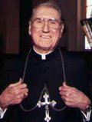
Cardinal John O’Connor of NY
quoted in Samuel Howe Verhovek, Cardinal Defends a Jailed Bishop Who Warned Cuomo on Abortion, New York Times, February 1, 1990.
“Church teaching is that I don't know, at any given moment, what my eternal future will be… I can hope, pray, do my very best – but I still don't know. Pope John II doesn't absolutely know that he will go to heaven, nor does mother Theresa of Calcutta, unless either has had a special divine revelation.”

Slide 59
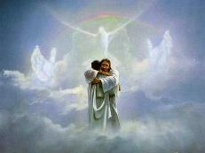
John 5:24
“Truly, truly, I say to you, he who hears My word, and believes Him who sent Me, has eternal life, and does not come into judgment, but has passed out of death into life.”

Slide 60
Acts 16:30-31
“³⁰ and after he brought them out, he said, ‘Sirs, what must I do to be saved?’³¹ They said, ‘Believe in the Lord Jesus, and you will be saved, you and your household.’”

Slide 61
1 John 5:13
“These things I have written to you who believe in the name of the Son of God, so that you may know that you have eternal life.”

Slide 62
DTS Doctrinal Statement Article XI—Assurance
“We believe it is the privilege, not only of some, but of all by the Spirit through faith who are born again in Christ as revealed in the Scriptures, to be assured of their salvation from the very day they take Him to be their Savior and that this assurance is not founded upon any fancied discovery of their own worthiness or fitness, but wholly upon the testimony of God in His written Word, exciting within His children filial love...”

Slide 63
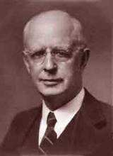
Lewis Sperry Chafer, Salvation: A Clear Doctrinal Analysis (Grand Rapids: Zondervan, 1977), 60. Italics added
Lewis Sperry Chafer
“There is a normal Christian experience. There are new and blessed emotions and desires. Old things do pass away; and behold all things do become new; but all such experiences are but secondary evidences, as to the fact of salvation, in that they grow out of that positive repose of faith which is the primary evidence.”

Slide 64
Problems with Partial Rapturism?
Partial rapturism makes the Bema Seat Judgment unnecessary (1 Cor. 3:10-15)
Partial rapturists never objectively quantify the exact degree of faithfulness or spiritual maturity that is necessary to participate in the rapture
Partial rapturists appear individually biased
Partial rapturists dispensationally misapply Bible passages (Matt. 25:1-13)
Partial rapturists misapply passages promising a reward to faithful believers (Rev. 3:11)

Slide 65
Mark Hitchcock
Could the Rapture Happen Today? (Sisters, OR: Multnomah, 2005), 68.
“Every person I have ever met who believes in the partial Rapture view believes that he or she will be included in the first group that goes before the Tribulation. They always believe in the pre-Tribulationist view for themselves. It's those other unfortunate believers who will have to go through varying degrees of tribulation before they can be caught up to heaven. But why believe that you are worthy for this special reward while other believers are not? It is inconsistent.”

Slide 66
Problems with Partial Rapturism?
Partial rapturism makes the Bema Seat Judgment unnecessary (1 Cor. 3:10-15)
Partial rapturists never objectively quantify the exact degree of faithfulness or spiritual maturity that is necessary to participate in the rapture
Partial rapturists appear individually biased
Partial rapturists dispensationally misapply Bible passages (Matt. 25:1-13)
Partial rapturists misapply passages promising a reward to faithful believers (Rev. 3:11)

Slide 67
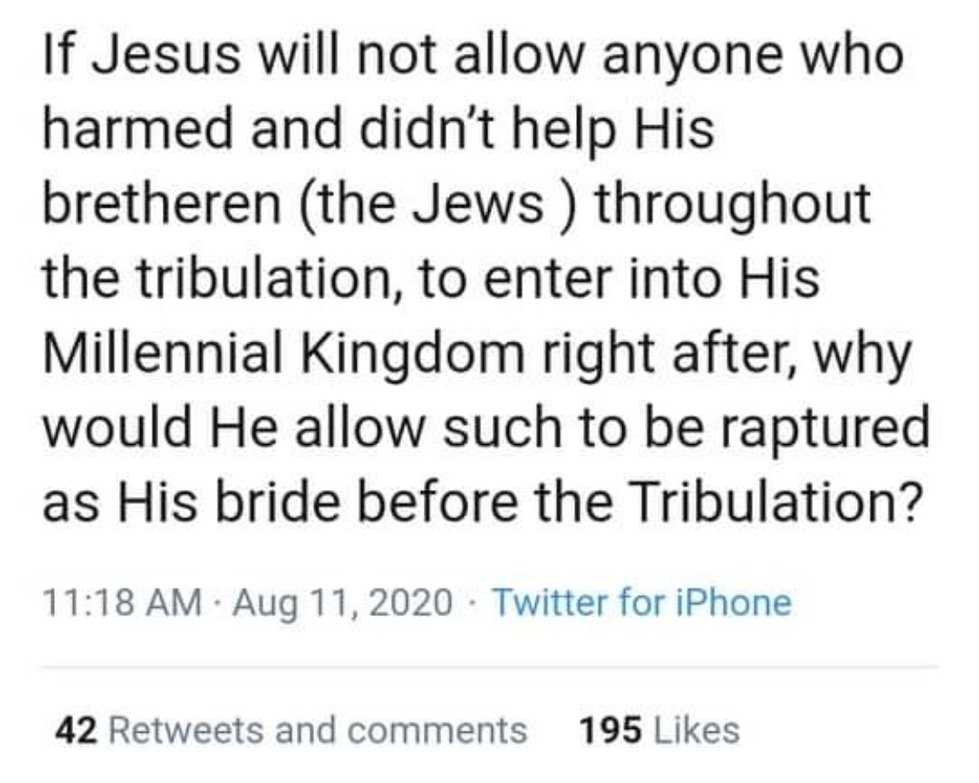

Slide 68
Preview of Matthew 24–25
The problem
The larger context
The immediate context (23:37-39)
The Disciples’ questions (24:1-3)
The Tribulation’s first half (24:4-14)
The Tribulation’s mid-point (24:15-20)
The Tribulation’s second half (24:21-22)
The Second Advent (24:23-31)
Eight parabolic exhortations (24:32‒25:46)

Slide 69
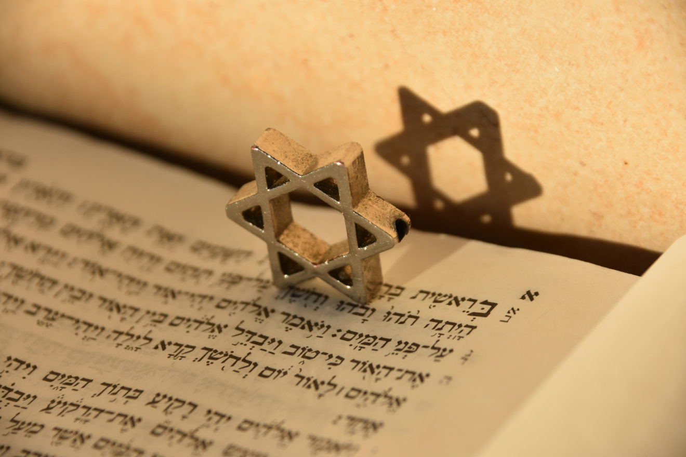
Matthew 24:15-16, 20
“¹⁵ Therefore when you see the abomination of desolation which was spoken of through Daniel the prophet, standing in the holy place (let the reader understand) ¹⁶ then those who are in Judea must flee to the mountains…²⁰ But pray that your flight will not be in the winter, or on a Sabbath.”

Slide 70
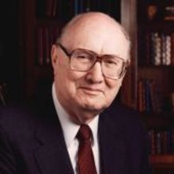
John F. Walvoord
"Christ's Olivet Discourse on the End of the Age Part V: The Parable of the Ten Virgins," Bibliotheca Sacra 129, no. 514 (April 1972): 101.
“Following the strict rules of exegesis, the context indicates that the subject is the second coming of Christ to the earth not the rapture of the church. Although many expositors have attempted to make this whole discourse apply to the church, or at least from Matthew 24:45 make an application of the general truth of Christ's coming to the rapture of the church, as seen in previous study the evidence is quite insufficient.”

Slide 71
John F. Walvoord
"Christ's Olivet Discourse on the End of the Age Part V: The Parable of the Ten Virgins," Bibliotheca Sacra 129, no. 514 (April 1972): 101.
“There is no clear distinction between the illustrations before Matthew 24:45 and those which follow. Neither the church nor the rapture are in view. Inasmuch as the rapture (John 14:1–3) had not yet been revealed, it is questionable whether Christ would have tried to teach His disciples using an illustration of a truth that was not even known to them at this time. Interpretation, therefore, must relate this passage to the context, namely, the doctrine of the second coming of Christ to establish His earthly kingdom.”

Slide 72
A Comparison of the Olivet and Upper Room Discourses
Discourse | Olivet | Upper Room
Scripture | Matt 24─25 | John 13─17
Location | Mount of Olives | Upper Room
Passion week | Third day | Sixth day
General focus | Farewell: Israel | Hello: Church
Specific focus | Israel’s future | Divine provisions
Prompting | Temple's destruction | Christ's imminent departure
Explanations | Written OT | Unwritten NT
Apostles | Israel (Matt. 19:28) | Church (Eph. 2:20)

Slide 73
Ron Rhodes
The Big Book of Bible Answers: A Guide to Understanding the Most Challenging Questions (Eugene, OR: Harvest, 2013), 278.
“This view is based on the parable of the 10 virgins—depicting five virgins being prepared and five unprepared (Matthew 25:1–13). This is interpreted to mean that only faithful, and watchful Christians will be raptured...Pre-tribulationalists respond that Matthew 25:1–13 has nothing to do with the rapture. Those virgins who are ‘unprepared’ apparently represent people living during the tribulation period who are unprepared for Christ's second coming (seven years after the rapture).”

Slide 74
Tony Garland
Anthony Garland, "Q181 : George Peters and the Partial Rapture View," online: www.spiritandtruth.org, accessed 13 August 2015.
“I believe that Peters is mistaken in confounding various thief passages with the coming of the Lord for the church (e.g., Matt. 24:37-44, Luke 17:26-37). Where these passage speak of ‘one taken...another left,’ Peters falls into the common mistake of misinterpreting Second Coming judgment passages as Rapture passages...If we consider various passages where people fail to watch or perform, we find that some very serious consequences result: Left as dead for birds of prey (Mat. 24:28, 37-43; Luke 17:37). Being cut in two with the hypocrites, weeping and gnashing of teeth (Matt. 24:51). Being shut out from the wedding feast with the . . .”

Slide 75
Tony Garland
Anthony Garland, "Q181 : George Peters and the Partial Rapture View," online: www.spiritandtruth.org, accessed 13 August 2015.
“…Master proclaiming, I do not know you (Matt. 25:12 cf. Matt. 7:23). Being cast into outer darkness, weeping and gnashing of teeth (Matt. 25:30). Although some teach that ‘outer darkness’ is a place where under-performing believers may suffer during the Millennial Kingdom, this seems most unlikely. Jesus clearly states that those Jews who did not believe in Him—the faithless ‘sons of the Kingdom’—were bound for outer darkness (Matt. 8:12)...While not focusing specifically on Rapture-related warning passages here, I hope you can see that the way in which a person interprets various readiness warning passages—whether they can have in . . .”

Slide 76
Tony Garland
Anthony Garland, "Q181 : George Peters and the Partial Rapture View," online: www.spiritandtruth.org, accessed 13 August 2015.
“…view believers who are securely saved—will have a lot to do with whether a teacher believes that the body of Christ will be sliced into two companies, either at the Rapture or at the entry to the Millennial Kingdom to follow. Peters, while having much to offer concerning the coming Kingdom and eschatology in general, appears to be comfortable with the idea that it is our performance rather than identity that determines our destiny in relation to the Rapture. I take the opposite view: that those who are in Christ are joined to Christ in a way which cannot (and will not) be broken.”

Slide 77
Matthew 24:36-41
³⁶ “But of that day and hour no one knows, not even the angels of heaven, nor the Son, but the Father alone. ³⁷ For the coming of the Son of Man will be just like the days of Noah. ³⁸ For as in those days before the flood they were eating and drinking, marrying and giving in marriage, until the day that Noah entered the ark, ³⁹ and they did not understand until the flood came and took (airō) them all away; so will the . . .

Slide 78
Matthew 24:36-41
. . .coming of the Son of Man be. ⁴⁰ Then there will be two men in the field; one will be taken (paralambanō) and one will be left. ⁴¹ “Two women will be grinding at the mill; one will be taken (paralambanō) and one will be left.”

Slide 79
J. Dwight Pentecost
Things to Come, Page 162
“Again, this passage is in that discourse in which the Lord outlined His program for Israel, who was already in the tribulation period. The one taken is taken to judgment and the one left is left for the millennial blessing. Such is not the prospect for the church.”

Slide 80
Luke 21:28, 34-36
“²⁸ But when these things begin to take place, straighten up and lift up your heads, because your redemption is drawing near…³⁴ But be on your guard, so that your hearts will not be weighed down with dissipation and drunkenness and the worries of life, and that this day will not come on you suddenly, like a trap; ³⁵ for it will come upon all those who live on the face of all the earth. ³⁶ But stay alert at all times, praying that you will have strength to escape all these things that are going to take place, and to stand before the Son of Man.”

Slide 81
Luke 21:21, 28, 34-36
“²¹ Then those who are in Judea must flee to the mountains, and those who are in the midst of the city must leave, and those who are in the country must not enter the city…²⁸ But when these things begin to take place, straighten up and lift up your heads, because your redemption is drawing near…³⁴ But be on your guard, so that your hearts will not be weighed down with dissipation and drunkenness and the worries of life, and that this day will not come on you suddenly, like a trap; …

Slide 82
Luke 21:21, 28, 34-36
. . .³⁵ for it will come upon all those who live on the face of all the earth. ³⁶ But stay alert at all times, praying that you will have strength to escape all these things that are going to take place, and to stand before the Son of Man.”

Slide 83
J. Dwight Pentecost
Things to Come, Page 161-62
“It will be observed that the primary reference in this chapter is to the nation of Israel, who was already in the tribulation period, and therefore this is not applicable to the church. The things to be escaped are judgments associated with ‘that day’ (vs. 34), that is, the Day of the Lord. Watchfulness is enjoined upon the church (1 Thessalonians 5:6; Titus 2:13) apart from being found worthy to participate in the translation.”

Slide 84
Problems with Partial Rapturism?
Partial rapturism makes the Bema Seat Judgment unnecessary (1 Cor. 3:10-15)
Partial rapturists never objectively quantify the exact degree of faithfulness or spiritual maturity that is necessary to participate in the rapture
Partial rapturists appear individually biased
Partial rapturists dispensationally misapply Bible passages (Matt. 25:1-13)
Partial rapturists misapply passages promising a reward to faithful believers (Rev. 3:11)

Slide 85
Scripture’s Five Crowns (Rev 4:10: 3:11; 2 John 8)
SCRIPTURE | CROWN | PURPOSE
1 Cor. 9:24-27 | Incorruptible | Gaining mastery over the flesh
1 Thess. 2:19-20 | Rejoicing | Soul winning
Jas. 1:12; Rev. 2:10 | Life | Enduring trials
1 Pet. 5:2-4 | Glory | Shepherding God’s people
2 Tim. 4:8 | Righteousness | Longing for His appearing

Slide 86
1 Corinthians 3:15
“If any man’s work is burned up, he will suffer loss; but he himself will be saved, yet so as through fire.”

Slide 87
1 Corinthians 9:24-27
“²⁴ Do you not know that those who run in a race all run, but only one receives the prize? Run in such a way that you may win. ²⁵ Everyone who competes in the games exercises self-control in all things. They then do it to receive a perishable wreath, but we an imperishable. ²⁶ Therefore I run in such a way, as not without aim; I box in such a way, as not beating the air; ²⁷ but I discipline my body and make it my slave, so that, after I have preached to others, I myself will not be disqualified.”

Slide 88
2 John 8
“Watch yourselves, that you do not lose what we have accomplished, but that you may receive a full reward.”

Slide 89
Revelation 3:11
“I am coming quickly; hold fast what you have, so that no one will take your crown.”

Slide 90
2 Timothy 4:8
“In the future there is laid up for me the crown of righteousness, which the Lord, the righteous Judge, will award to me on that day; and not only to me, but also to all who have loved His appearing.”

Slide 91
J. Dwight Pentecost
Things to Come, Page 163
“This [2 Tim. 4:8] is used by the adherents of this position to show that the rapture must be a partial one. However, it is to be noticed that the subject of the translation is not in view in this passage, but rather the question of reward. The Second Advent was intended by God to be a purifying hope (1 John 3:3). Because of such purifying a new life is produced because of the expectancy of the Lord's return. Therefore, those that truly ‘love his appearing’ will experience a new kind of life which will bring a reward.”

Slide 92
Problems with Partial Rapturism?
Every divine blessing is given on the basis of His grace and not human effort (Eph. 2:8-9; Rom. 12:6)
Symbolic parallels mandate that carnal as well as sanctified Christians will be taken up in the rapture (Gen. 19:22)
The promise of the rapture is mentioned in Paul's letter to the carnal Corinthian church (1 Cor. 15:51)
A partial rapture would sever Christ's body (1 Cor 12:12-14)
The partial rapture view subjects believers to God's wrath (Thess 1:10)

Slide 93
Problems with Partial Rapturism?
Partial rapturism makes the Bema Seat Judgment unnecessary (1 Cor. 3:10-15)
Partial rapturists never objectively quantify the exact degree of faithfulness or spiritual maturity that is necessary to participate in the rapture
Partial rapturists appear individually biased
Partial rapturists dispensationally misapply Bible passages (Matt. 25:1-13)
Partial rapturists misapply passages promising a reward to faithful believers (Rev. 3:11)

Slide 94
Revelation 3:10
‘Because you have kept the word of My perseverance, I also will keep you from the hour of testing, that hour which is about to come upon the whole world, to test those who dwell on the earth.

Slide 95
Revelation 3:9-10
⁹ ‘Behold, I will cause those of the synagogue of Satan, who say that they are Jews and are not, but lie—I will make them come and bow down at your feet, and make them know that I have loved you. ¹⁰ ‘Because you have kept the word of My perseverance, I also will keep you from the hour of testing, that hour which is about to come upon the whole world, to test those who dwell on the earth.

Slide 96
Problems with Beginning the Sentence in Rev. 3:10 with “Because”
Not part of the original manuscripts: chapter & verse divisions & punctuation marks (periods, commas, or exclamation points).
These things were all added by later copyists.
Most English translations separate the two verses with a period.
Thus, it becomes cause for participating the Rapture and not a cause for their enemies to worship before their feet.
However, the period should be placed in the middle of verse 10.
Thus, it becomes not a cause for participating the Rapture and a cause for their enemies to worship before their feet.
John Niemela, The Interpretation of Revelation 3:10: You Have Kept My Word, CTS Journal; As summarized by Dennis Rokser, A Golden Nugget in Revelation 3:10, Grace for the Race, no. 29.

Slide 97
Problems with Beginning the Sentence in Rev. 3:10 with “Because” (cont’d)
Rev. 3:10b becomes an additional unconditional promise of Rapture participation beyond the promises of Rev. 2:9b.
It is rare to begin a sentence with “because” (hoti) in a causative sense.
Instead, hoti (“because”), when casual in function, usually follows a statement or promise in providing a reason for what preceded it in the sentence.
Thus, Greek sentences rarely begin a sentence with the phrase “Because you have” when explaining the cause or reason for something, as Greek and English texts of Revelation 3:10 unfortunately do today. Instead, the “because” phraseology consistently follows later in the sentence.
John Niemela, The Interpretation of Revelation 3:10: You Have Kept My Word, CTS Journal; As summarized by Dennis Rokser, A Golden Nugget in Revelation 3:10, Grace for the Race, no. 29.

Slide 98
Revelation 3:9-10
MacDonald’s Idiomatic Translation (MIT)
“⁹ I would put at your disposal those from the synagogue of Satan who call themselves Jews but are not; they are lying. See: I will make them come and bow down before your feet, and they will know that I loved you ¹⁰ because you kept my enduring word. I also will keep you from the time of trial that is about to come...”

Slide 99
Revelation 3:10
‘Because you have kept the word of My perseverance, I also will keep you from the hour of testing, that hour which is about to come upon the whole world, to test those who dwell on the earth.

Slide 100
CONCLUSION

Slide 101
The Rapture Course Overview
What is the Rapture?
When is the Rapture?
Strengthening the Pre-Tribulational case
The opposing views
One second after the Rapture

