Slide 1
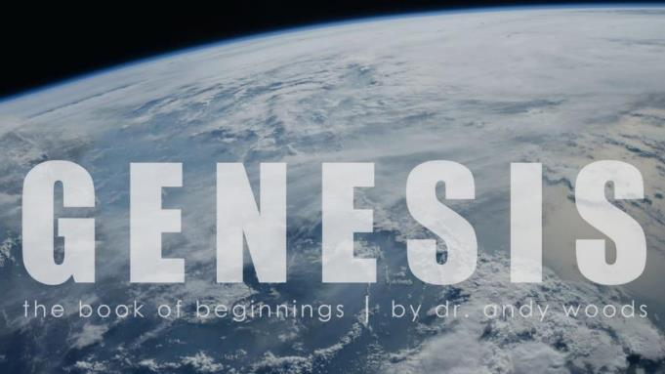
Genesis 6‒9
The Flood and Continuation of the Messianic Promise

Slide 2
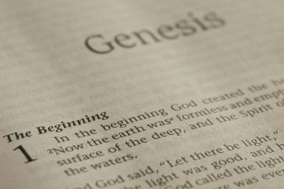
GENESIS STRUCTURE
Beginning of the Human race (Gen. 1‒11)
Beginning of the Hebrew race (Gen. 12‒50)

Slide 3
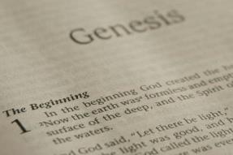
GENESIS STRUCTURE
Genesis 1-11 (four events)
Creation (1-2)
Fall (3-5)
Flood (6-9)
National dispersion (10-11)

Slide 4
GENESIS STRUCTURE
Genesis 1-11 (four events)
Creation (1-2)
Fall (3-5)
Flood (6-9)
National dispersion (10-11)

Slide 5
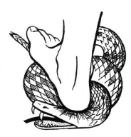
Genesis 3:15
“And I will put enmity Between you and the woman, And between your seed and her seed; He shall bruise you on the head, And you shall bruise him on the heel.”

Slide 6
GENESIS STRUCTURE
Genesis 1-11 (four events)
Creation (1-2)
Fall (3-5)
Flood (6-9)
National dispersion (10-11)

Slide 7
The Flood (Gen 6–9)
Events before the flood (Gen 6)
The flood (Gen 7)
The abating of the waters (Gen 8)
Events following the flood (Gen 9)

Slide 8
Genesis 8:20–9:29 Post Flood events

Slide 9
Outline
Noahic Covenant (Gen 8:20–9:17)
Promise (Gen 8:20-22)
Provision (Gen 9:1-7)
Covenant and sign (Gen 9:8-17)
Post Flood Sin (Gen 9:18-29)

Slide 10
Outline
Noahic Covenant (Gen 8:20–9:17)
Promise (Gen 8:20-22)
Provision (Gen 9:1-7)
Covenant and sign (Gen 9:8-17)
Post Flood Sin (Gen 9:18-29)

Slide 11
Outline
Noahic Covenant (Gen 8:20–9:17)
Promise (Gen 8:20-22)
Provision (Gen 9:1-7)
Covenant and sign (Gen 9:8-17)
Post Flood Sin (Gen 9:18-29)

Slide 12
Noahic Covenant: Promise (Gen 8:20-22)
Noah’s initial sacrifice (8:20)
Divine promise not to flood the earth again (Gen 8:21a)
Ongoing depravity thus necessitating the work of a future Messiah (Gen 8:21b)
Uninterrupted season or cycles (Gen 8:22) – global warming?

Slide 13
Outline
Noahic Covenant (Gen 8:20–9:17)
Promise (Gen 8:20-22)
Provision (Gen 9:1-7)
Covenant and sign (Gen 9:8-17)
Post Flood Sin (Gen 9:18-29)

Slide 14
Noahic Covenant: Provision (Gen 9:1-7)
Re-creation theme (Gen 9:1, 2, 7)
Man becomes carnivorous (Gen. 1:29-30; 2:17; 9:3)
Cultural precedent for the Mosaic Law (Gen 9:4; Lev 17:11)

Slide 15
Noahic Covenant: Provision (Gen 9:1-7)
Origin of human government (Rom 13:1-7; 1 Pet 2:13-14; Titus 3:1; 1 Tim 2:1-4)
Capital punishment (Gen 9:5-6)
Rationale (4:13-15; 6:11; 8:21; 9:6b)
Scriptural support (Rom 13:4; Matt 26:52)

Slide 16
Noahic Covenant: Provision (Gen 9:1-7)
Origin of human government (Rom 13:1-7; 1 Pet 2:13-14; Titus 3:1; 1 Tim 2:1-4)
Capital punishment (Gen 9:5-6)
Rationale (4:13-15; 6:11; 8:21; 9:6b)
Scriptural support (Rom 13:4; Matt 26:52)

Slide 17
Genesis 9:6
“Whoever sheds man’s blood, By man his blood shall be shed, For in the image of God He made man.”

Slide 18
Noahic Covenant: Provision (Gen 9:1-7)
Origin of human government (Rom 13:1-7; 1 Pet 2:13-14; Titus 3:1; 1 Tim 2:1-4)
Capital punishment (Gen 9:5-6)
Rationale (4:13-15; 6:11; 8:21; 9:6b)
Scriptural support (Rom 13:4; Matt 26:52)

Slide 19
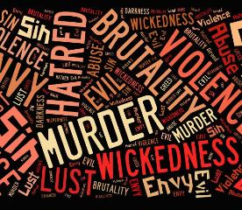
Genesis 6:11
“Now the earth was corrupt in the sight of God, and the earth was filled with violence [חָמָס; chamas].”

Slide 20
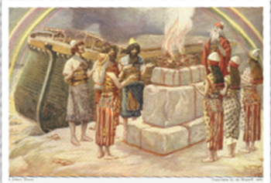
Genesis 8:21
The Lord smelled the soothing aroma; and the Lord said to Himself, “I will never again curse the ground on account of man, for the intent of man’s heart is evil from his youth; and I will never again destroy every living thing, as I have done.[emphasis mine].

Slide 21
Genesis 9:6
“Whoever sheds man’s blood, By man his blood shall be shed, For in the image of God He made man.”

Slide 22
Noahic Covenant: Provision (Gen 9:1-7)
Origin of human government (Rom 13:1-7; 1 Pet 2:13-14; Titus 3:1; 1 Tim 2:1-4)
Capital punishment (Gen 9:5-6)
Rationale (4:13-15; 6:11; 8:21; 9:6b)
Scriptural support (Rom 13:4; Matt 26:52)

Slide 23
Romans 13:3-4
“³ For rulers are not a cause of fear for good behavior, but for evil. Do you want to have no fear of authority? Do what is good and you will have praise from the same; ⁴ for it is a minister of God to you for good. But if you do what is evil, be afraid; for it does not bear the sword for nothing; for it is a minister of God, an avenger who brings wrath on the one who practices evil.”

Slide 24
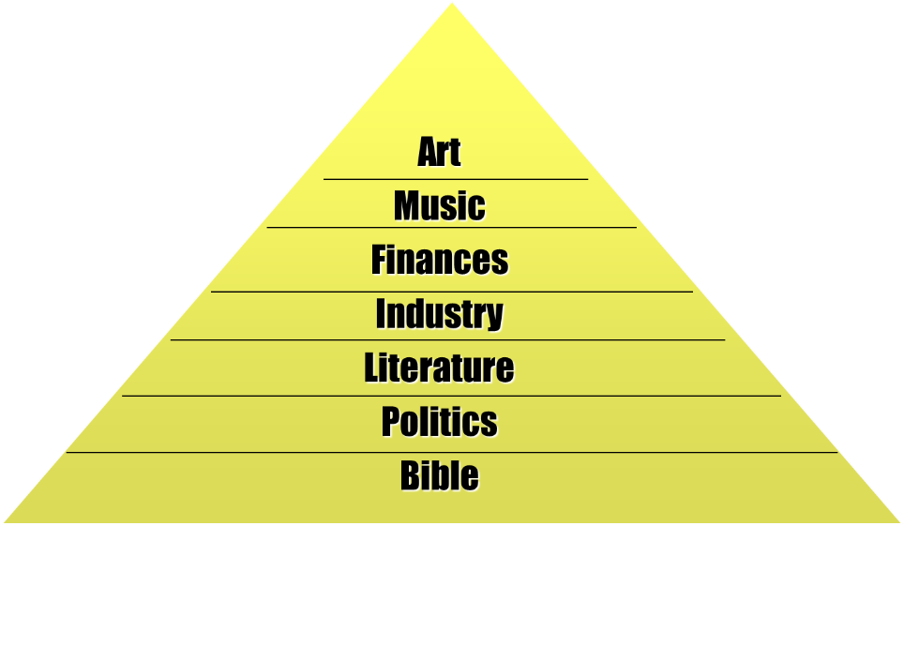

Slide 25
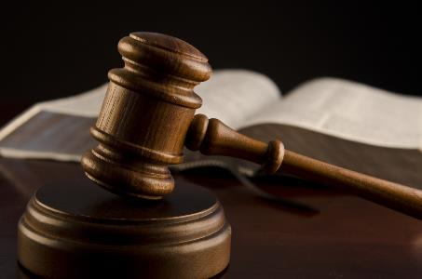
Objections to Capital Punishment
Sixth commandment?
Sermon on the Mount?
We are no longer under the Mosaic Law?
Deterrence? (Deut 13:10-11; 19:20; Eccl 8:11)
Executed innocent?
Racist?
8th Amendment?
Pro-life?

Slide 26
Objections to Capital Punishment
Sixth commandment?
Sermon on the Mount?
We are no longer under the Mosaic Law?
Deterrence? (Deut 13:10-11; 19:20; Eccl 8:11)
Executed innocent?
Racist?
8th Amendment?
Pro-life?

Slide 27
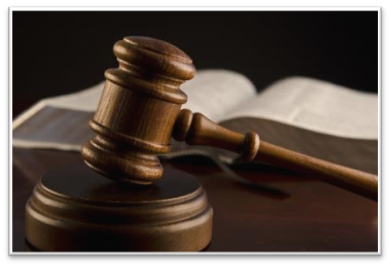
Exodus 20:13
“You shall not murder [רָצַח; ratsach].”

Slide 28
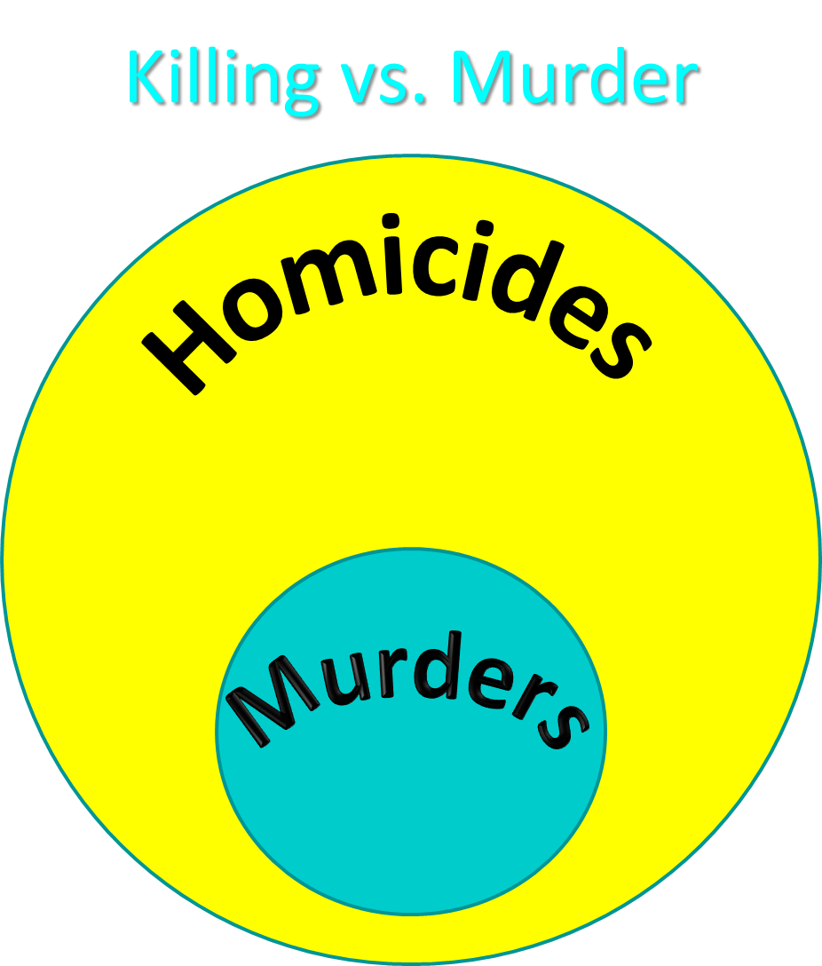

Slide 29
Genesis 9:6
“Whoever sheds man’s blood, By man his blood shall be shed, For in the image of God He made man.”

Slide 30
Objections to Capital Punishment
Sixth commandment?
Sermon on the Mount?
We are no longer under the Mosaic Law?
Deterrence? (Deut 13:10-11; 19:20; Eccl 8:11)
Executed innocent?
Racist?
8th Amendment?
Pro-life?

Slide 31
Objections to Capital Punishment
Sixth commandment?
Sermon on the Mount?
We are no longer under the Mosaic Law?
Deterrence? (Deut 13:10-11; 19:20; Eccl 8:11)
Executed innocent?
Racist?
8th Amendment?
Pro-life?

Slide 32
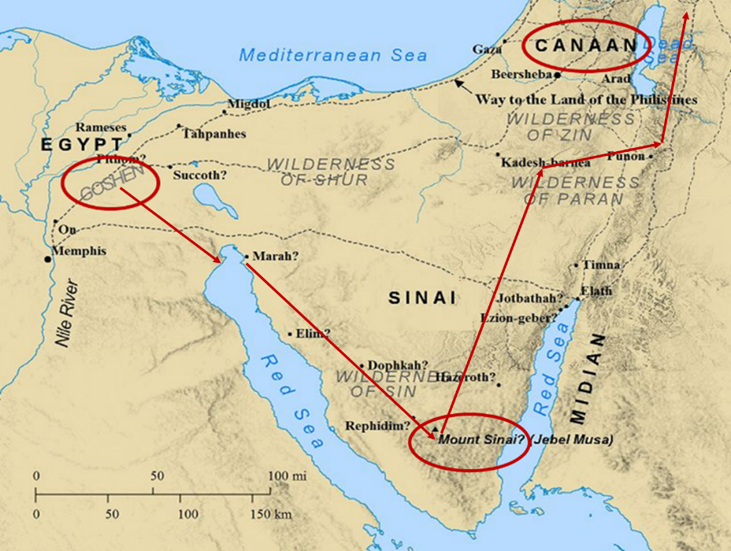

Slide 33
Noahic vs. Abrahamic & Mosaic Covenants
Name | NOAHIC | ABRAHAMIC | MOSAIC
Human agent | Noah | Abraham | Moses
Scripture | Gen. 8‒9 | Gen. 12‒17 | Exod. 19‒40
Covenant (Berith) | Gen. 9:9 | Gen. 15:18 | Exod. 19:5
Party | World, humanity | Israel, Hebrews | Israel, Hebrews
Israel | Pre-Israel | Post-Israel | Post-Israel

Slide 34
Noahic vs. Abrahamic & Mosaic Covenants
Covenant | NOAHIC | ABRAHAMIC | MOSAIC
Conditional or unconditional | Unconditional | Unconditional | Conditional
Promises | No more flood judgment, enduring earth, capital punishment | Ownership of land, seed, and blessing | Enjoyment or possession of land, seed, and blessing
Sign | Rainbow | Circumcision | Sabbath
Purpose | Restrain & preserve | Redemptive | Redemptive
Directly binding today? | Yes | No | No

Slide 35
Psalm 147:19-20
“He declares His words to Jacob, His statutes and His ordinances to Israel. He has not dealt thus with any nation; And as for His ordinances, they have not known them. Praise the Lord!”

Slide 36
Objections to Capital Punishment
Sixth commandment?
Sermon on the Mount?
We are no longer under the Mosaic Law?
Deterrence? (Deut 13:10-11; 19:20; Eccl 8:11)
Executed innocent?
Racist?
8th Amendment?
Pro-life?

Slide 37
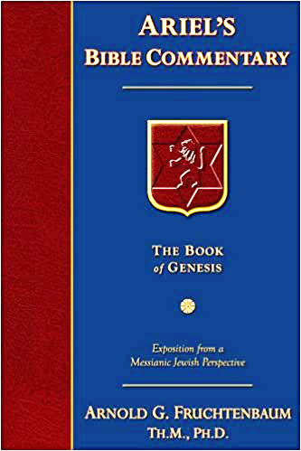
Dr. Arnold G. Fruchtenbaum
The Book of Genesis, 186
“It is God Who mandates capital punishment...God has already exercised this prerogative of divine retribution with the Flood. However, there is also now to be human retribution, in 9:6: Whosoever sheds man’s blood, by man shall his blood be shed. Man now has the authority to put another man to death. Capital punishment requires legal execution, and this enactment sets the stage for human government. Under the Noahic Covenant, the mandatory death penalty was only for the crime of premeditated murder. Later, the Mosaic Covenant will add other crimes requiring the death penalty, but as far as the Noahic Covenant goes, it is mandatory only for premeditated murder. The purpose is not to deter crime, but to punish …

Slide 38
Dr. Arnold G. Fruchtenbaum
The Book of Genesis, 186
…the evildoer. Much of the argument today about the use of capital punishment concerns whether it does or does not deter crime. Biblically speaking, that is irrelevant and not the issue. The issue for the Bible is punishing the evildoer, not reforming him or her. Genesis 9:6 concludes by giving the reason why there will be both divine and human retribution for the shedding of human blood: For in the image of God made he man. Therefore, although after the Fall it is a marred image, the image of God is still there.”

Slide 39
Genesis 9:6
“Whoever sheds man’s blood, By man his blood shall be shed, For in the image of God He made man.”

Slide 40
Deuteronomy 13:10-11
“So you shall stone him to death because he has sought to seduce you from the Lord your God who brought you out from the land of Egypt, out of the house of slavery. Then all Israel will hear and be afraid, and will never again do such a wicked thing among you.”

Slide 41
Ecclesiastes 8:11
“Because the sentence against an evil deed is not executed quickly, therefore the hearts of the sons of men among them are given fully to do evil.”

Slide 42
Objections to Capital Punishment
Sixth commandment?
Sermon on the Mount?
We are no longer under the Mosaic Law?
Deterrence? (Deut 13:10-11; 19:20; Eccl 8:11)
Executed innocent?
Racist?
8th Amendment?
Pro-life?

Slide 43
Objections to Capital Punishment
Sixth commandment?
Sermon on the Mount?
We are no longer under the Mosaic Law?
Deterrence? (Deut 13:10-11; 19:20; Eccl 8:11)
Executed innocent?
Racist?
8th Amendment?
Pro-life?

Slide 44
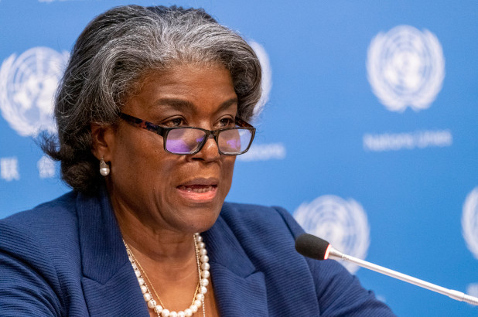
BIDEN UN AMBASSADOR SAYS ‘WHITE SUPREMACY’ IS ‘WEAVED’ INTO US FOUNDING DOCUMENTS – EMILY JACOBS, APRIL 15, 2021 https://nypost.com/2021/04/15/biden-un-ambassador-says-white-supremacy-weaved-into-us-founding/
UN Ambassador Linda Thomas-Greenfield
“Biden’s USA Ambassador to the UN Linda Thomas-Greenfield told the Human Rights Council that ‘…the original sin of slavery weaved white supremacy into our founding documents and principles.’ Of the 47 member states on the council, notable nations include China, Cuba, Libya, Nigeria, North Korea, Pakistan, Qatar, Russia, Saudi Arabia, Somalia, Sudan and Venezuela.”

Slide 45
Objections to Capital Punishment
Sixth commandment?
Sermon on the Mount?
We are no longer under the Mosaic Law?
Deterrence? (Deut 13:10-11; 19:20; Eccl 8:11)
Executed innocent?
Racist?
8th Amendment?
Pro-life?

Slide 46
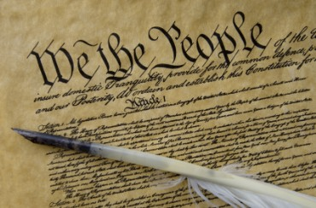
Eighth Amendment
“Excessive bail shall not be required, nor excessive fines imposed, nor cruel and unusual punishments inflicted.”

Slide 47
Fifth Amendment
“No person shall be held to answer for a capital, or otherwise infamous crime, unless on a presentment or indictment of a grand jury, except in cases arising in the land or naval forces, or in the militia, when in actual service in time of war or public danger; nor shall any person be subject for the same offense to be twice put in jeopardy of life or limb; nor shall be compelled in any criminal case to be a witness against himself, nor be deprived of life, liberty, or property, without due process of law; nor shall private property be taken for public use, without just compensation.”

Slide 48
Objections to Capital Punishment
Sixth commandment?
Sermon on the Mount?
We are no longer under the Mosaic Law?
Deterrence? (Deut 13:10-11; 19:20; Eccl 8:11)
Executed innocent?
Racist?
8th Amendment?
Pro-life?

Slide 49
Luke 19:41-44
“When He approached Jerusalem, He saw the city and wept over it, ⁴² saying, ‘If you had known in this day, even you, the things which make for peace! But now they have been hidden from your eyes. ⁴³ For the days will come upon you when your enemies will throw…

Slide 50
Luke 19:41-44
. . .up a barricade against you, and surround you and hem you in on every side, ⁴⁴ and they will level you to the ground and your children within you, and they will not leave in you one stone upon another, because you did not recognize the time of your visitation.’”

Slide 51
ABORTION OR CAPITAL PUNISHMENT?
 | ABORTION | CAPITAL PUNISHMENT
Birth? | Unborn | Born
Crime? | No crime | Committed a crime
Trial? | Not tried by a jury of peers | Tried by a jury of peers
Guilt? | Innocent | Guilty

Slide 52
Noahic Covenant: Provision (Gen 9:1-7)
Re-creation theme (Gen 9:1, 2, 7)
Man becomes carnivorous (Gen. 1:29-30; 2:17; 9:3)
Cultural precedent for the Mosaic Law (Gen 9:4; Lev 17:11)

Slide 53
THE DIVINE INSTITUTIONS
Marriage and family (Gen. 1:26-28; 2:18-25)
Labor (Gen. 2:15; 3:19)
Conscience (Gen. 3:22)
Government (Gen. 9:6)
Nationalism (Gen. 11:1-9)

Slide 54
THE DIVINE INSTITUTIONS
Marriage and family (Gen. 1:26-28; 2:18-25)
Labor (Gen. 2:15; 3:19)
Conscience (Gen. 3:22)
Government (Gen. 9:6)
Nationalism (Gen. 11:1-9)

Slide 55
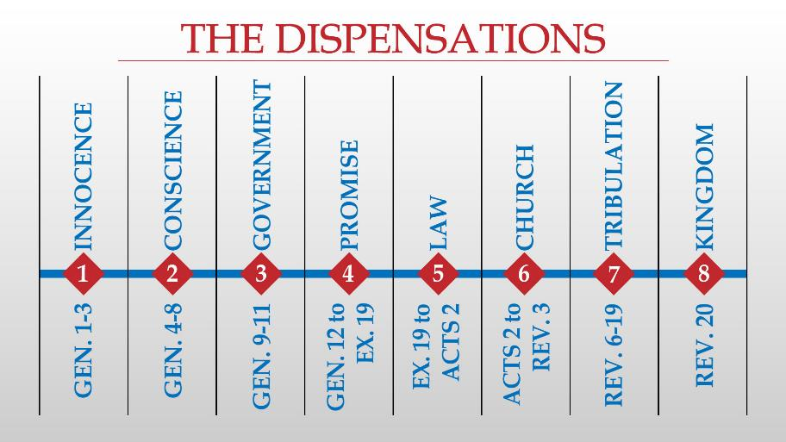

Slide 56
Ephesians 1:10; 3:2 (KJV)
“¹⁰ That in the dispensation [oikonomia] of the fulness of times he might gather together in one all things in Christ, both which are in heaven, and which are on earth; even in him… ² If ye have heard of the dispensation [oikonomia] of the grace of God which is given me to you-ward:”

Slide 59
Eden = Probationary Environment
Eden (Genesis 1-2) | Eternal State (Rev 21-22)
Division: light/darkness 1:4 | No night 21:25
Division: land/sea 1:10 | No sea 21:1
Sun & moon 1:16 | No sun & moon 21:23
Garden 2:8-9 | City (21:2)
River flowing out of Eden 2:10 | River flowing from throne 22:1
Gold in the land 2:12 | Gold in the city 21:21
Tree of life in the middle of garden 2:9 | Tree of life throughout city 22:2
Bdellium and onyx stone 2:12 | All manner of stones 21:19
God walking in the garden 3:8 | God dwelling with His people 21:3
Henry Morris, Genesis Record, p.33

Slide 60
Conclusion

Slide 61
Genesis 8‒9 Outline
Abating of the waters (8:1-5)
Tests for dry land (8:6-14)
Exit from the ark (8:15-19)
Post-flood events (8:20‒9:29)

Slide 62
Outline
Noahic Covenant (Gen 8:20–9:17)
Promise (Gen 8:20-22)
Provision (Gen 9:1-7)
Covenant and sign (Gen 9:8-17)
Post Flood Sin (Gen 9:18-29)

Slide 63
Noahic Covenant: Provision (Gen 9:1-7)
Re-creation theme (Gen 9:1, 2, 7)
Man becomes carnivorous (Gen. 1:29-30; 2:17; 9:3)
Cultural precedent for the Mosaic Law (Gen 9:4; Lev 17:11)

Slide 64
Noahic Covenant: Provision (Gen 9:1-7)
Origin of human government (Rom 13:1-7; 1 Pet 2:13-14; Titus 3:1; 1 Tim 2:1-4)
Capital punishment (Gen 9:5-6)
Rationale (8:21; 6:11; 9:6b)
Scriptural support (Rom 13:4; Matt 26:52)

Slide 65
Outline
Noahic Covenant (Gen 8:20–9:17)
Promise (Gen 8:20-22)
Provision (Gen 9:1-7)
Covenant and sign (Gen 9:8-17)
Post Flood Sin (Gen 9:18-29)

Slide 66
“The Lord bless you and keep you; the Lord make his face shine on you and be gracious to you; the Lord turn his face toward you and give you peace.” (NIV)

