Slide 1
PRACTICAL RIGHTEOUSNESS
Dr. Andy Woods
Senior Pastor – Sugar Land Bible Church
President – Chafer Theological Seminary

Slide 2
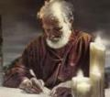
Answering Eleven Questions
Who wrote it? – James
What do we know about the author? – Christ’s ½ Brother
Who was the audience? – Believing Jews in the Diaspora
Where was if written from? – Jerusalem
When was the book written? – A.D. 44‒47
What was the book’s occasion? – Practical righteousness
What is the book’s purpose? – Achieving practical righteousness
What is the book about? – Practical righteousness
What is the book’s theme? – Daily living
What makes the book different? – Practicality
How is the book organized? – Faith and Wisdom

Slide 3
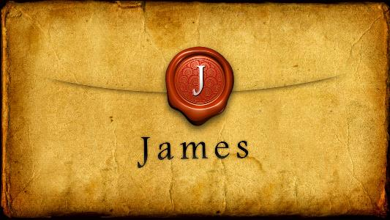
JAMES STRUCTURE
Faith (James 1:1‒3:12)
Wisdom (James 3:13‒5:20)

Slide 4
JAMES STRUCTURE
Faith (James 1:1‒3:12)
Wisdom (James 3:13‒5:20)

Slide 5
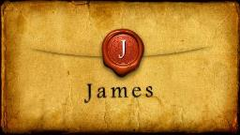
JAMES STRUCTURE
Faith (1:1–3:12)
Trials (1:2-18)
Obedience to the Word (1:19-27)
Favoritism (2:1-13)
Faith manifesting works (2:14-26)
Tongue (3:1-12)

Slide 6
JAMES STRUCTURE
Faith (James 1:1‒3:12)
Wisdom (James 3:13‒5:20)

Slide 7
Structure
Wisdom (3:13–5:20)
Wisdom defined (3:13-18)
Spirituality (4:1-12)
Commerce (4:13-17)
Use of wealth (5:1-6)
Waiting for the Lord’s return (5:7-12)
Prayer (5:13-18)
Restoration of the erring brother (5:19-20)

Slide 8
Structure
Wisdom (3:13–5:20)
Wisdom defined (3:13-18)
Spirituality (4:1-12)
Commerce (4:13-17)
Use of wealth (5:1-6)
Waiting for the Lord’s return (5:7-12)
Prayer (5:13-18)
Restoration of the erring brother (5:19-20)

Slide 9
Wisdom (3:13-18)
Wisdom is demonstrated by her actions (3:13)
Human or earthly wisdom (3:14-16)
Heavenly wisdom (3:17-18)

Slide 10
Structure
Wisdom (3:13–5:20)
Wisdom defined (3:13-18)
Spirituality (4:1-12)
Commerce (4:13-17)
Use of wealth (5:1-6)
Waiting for the Lord’s return (5:7-12)
Prayer (5:13-18)
Restoration of the erring brother (5:19-20)

Slide 11
Spiritual Life (4:1-12)
Avoid wrangling (4:1-3)
Avoid worldliness (4:4-6)
Essence of spiritual wisdom (4:7-12)

Slide 12
Structure
Wisdom (3:13–5:20)
Wisdom defined (3:13-18)
Spirituality (4:1-12)
Commerce (4:13-17)
Use of wealth (5:1-6)
Waiting for the Lord’s return (5:7-12)
Prayer (5:13-18)
Restoration of the erring brother (5:19-20)

Slide 13
Commercial Life (4:13-17)
The Need to Plan while Depending Upon God (4:13-15)
The Problem of Planning without Depending Upon God (4:16-17)

Slide 14
Structure
Wisdom (3:13–5:20)
Wisdom defined (3:13-18)
Spirituality (4:1-12)
Commerce (4:13-17)
Use of wealth (5:1-6)
Waiting for the Lord’s return (5:7-12)
Prayer (5:13-18)
Restoration of the erring brother (5:19-20)

Slide 15
Use of Wealth (5:1-6)
Predicted judgment coming on rich oppressors (5:1-3)
Reasons for coming judgment (5:4-6)

Slide 16
Structure
Wisdom (3:13–5:20)
Wisdom defined (3:13-18)
Spirituality (4:1-12)
Commerce (4:13-17)
Use of wealth (5:1-6)
Waiting for the Lord’s return (5:7-12)
Prayer (5:13-18)
Restoration of the erring brother (5:19-20)

Slide 17
Waiting for the Lord’s Return (5:7-12)
The Example of the Farmer (5:7)
The Impact of Imminency (5:8-9)
Old Testament Examples of Patience (5:10-12)

Slide 18
Structure
Wisdom (3:13–5:20)
Wisdom defined (3:13-18)
Spirituality (4:1-12)
Commerce (4:13-17)
Use of wealth (5:1-6)
Waiting for the Lord’s return (5:7-12)
Prayer (5:13-18)
Restoration of the erring brother (5:19-20)

Slide 19
Wisdom in Prayer (5:13-18)
Types of prayer (5:13-16b)
Power of prayer (5:16c-18)

Slide 20
Wisdom in Prayer (5:13-18)
Types of prayer (5:13-16b)
Power of prayer (5:16c-18)

Slide 21
I. Types of Prayer (5:13-16a)
Afflicted: prayer of dependence (13a)
Happy: prayer of praise (13b)
Sick: elders’ prayer (14-15)
Sinful: prayer of confession (16a)
Sick: intercessory prayer (16b)

Slide 22
I. Types of Prayer (5:13-16a)
Afflicted: prayer of dependence (13a)
Happy: prayer of praise (13b)
Sick: elders’ prayer (14-15)
Sinful: prayer of confession (16a)
Sick: intercessory prayer (16b)

Slide 23
I. Types of Prayer (5:13-16a)
Afflicted: prayer of dependence (13a)
Happy: prayer of praise (13b)
Sick: elders’ prayer (14-15)
Sinful: prayer of confession (16a)
Sick: intercessory prayer (16b)

Slide 24
I. Types of Prayer (5:13-16a)
Afflicted: prayer of dependence (13a)
Happy: prayer of praise (13b)
Sick: elders’ prayer (14-15)
Sinful: prayer of confession (16a)
Sick: intercessory prayer (16b)

Slide 25
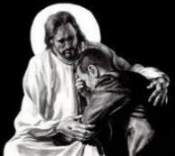
Revelation 21:4
“and He will wipe away every tear from their eyes; and there will no longer be any death; there will no longer be any mourning, or crying, or pain; the first things have passed away.”

Slide 26
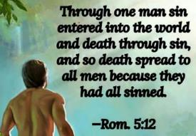
Genesis 3:19
“By the sweat of your face You will eat bread, Till you return to the ground, Because from it you were taken; For you are dust, And to dust you shall return.”

Slide 27
2 Cor. 4:16
Therefore we do not lose heart, but though our outer man is decaying, yet our inner man is being renewed day by day.

Slide 28
Romans 8:19-23
¹⁹ “For the anxious longing of the creation waits eagerly for the revealing of the sons of God. 20 For the creation was subjected to futility, not willingly, but because of Him who subjected it, in hope ²¹ that the creation itself also will be set free from its slavery to corruption into the freedom of the glory of the children of God. ²² For we know that the whole creation groans and suffers the pains of childbirth . . .

Slide 29
Romans 8:19-23
. . .together until now. ²³ And not only this, but also we ourselves, having the first fruits of the Spirit, even we ourselves groan within ourselves, waiting eagerly for our adoption as sons, the redemption of our body.”

Slide 30
I. Types of Prayer (5:13-16a)
Afflicted: prayer of dependence (13a)
Happy: prayer of praise (13b)
Sick: elders’ prayer (14-15)
Sinful: prayer of confession (16a)
Sick: intercessory prayer (16b)

Slide 31
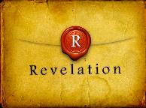
Revelation 1:6; 5:10
“and He has made us to be a kingdom, priests to His God and Father—to Him be the glory and the dominion forever and ever. Amen…You have made them to be a kingdom and priests to our God; and they will reign [basileuō] upon the earth [gē].”

Slide 32
I. Types of Prayer (5:13-16a)
Afflicted: prayer of dependence (13a)
Happy: prayer of praise (13b)
Sick: elders’ prayer (14-15)
Sinful: prayer of confession (16a)
Sick: intercessory prayer (16b)

Slide 33
Wisdom in Prayer (5:13-18)
Types of prayer (5:13-16b)
Power of prayer (5:16c-18)

Slide 34
II. Power of Prayer (5:16-18)
General statement (16c)
Example of Elijah (17-18)

Slide 35
II. Power of Prayer (5:16-18)
General statement (16c)
Example of Elijah (17-18)

Slide 36
Answering Eleven Questions
Who wrote it? – James
What do we know about the author? – Christ’s ½ Brother
Who was the audience? – Believing Jews in the Diaspora
Where was if written from? – Jerusalem
When was the book written? – A.D. 44‒47
What was the book’s occasion? – Practical righteousness
What is the book’s purpose? – Achieving practical righteousness
What is the book about? – Practical righteousness
What is the book’s theme? – Daily living
What makes the book different? – Practicality
How is the book organized? – Faith and Wisdom

Slide 37
Audience
Jewish (1:1)
Persecution (Acts 8:1-4; 11:19)
In Babylon-Mesopotamia or North-Central Turkey?
Believers (Jas 1:2-4)

Slide 38
II. Power of Prayer (5:16-18)
General statement (16c)
Example of Elijah (17-18)

Slide 39
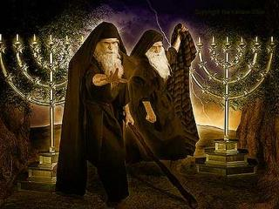
Identity of the Two Witnesses?
Symbolic view
Elijah and Enoch
Moses and Elijah like
Moses and Elijah literal

Slide 40
Identity of the Two Witnesses
CATEGORY | REVELATION 11 | MOSES & ELIJAH
Protection | Rev. 11:5 | Num. 16:35; 2 Kgs. 1:10-14
Activities | Rev. 11:6 | Exod. 7:12-21; 1 Kgs. 17:1
Duration | Rev. 11:3 | Luke 4:25; Jas. 5:17
Rapture | Rev. 11:12 | 2 Kgs. 2:11

Slide 41
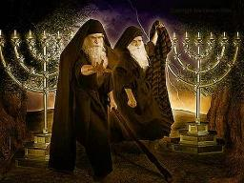
Identity of the 2 Witnesses: Moses and Elijah
Transfiguration (Matt 17:3)
Ministries cut short in the OT (2 Kgs 2:11-12; Num 20:12)
Future appearance predicted in the OT (Mal 4:5-6; Jude 9)
Never fulfilled in the NT (Luke 1:17; John 1:21)

Slide 42
CONCLUSION

Slide 43
Wisdom in Prayer (5:13-18)
Types of prayer (5:13-16b)
Power of prayer (5:16c-18)

Slide 44
Structure
Wisdom (3:13–5:20)
Wisdom defined (3:13-18)
Spirituality (4:1-12)
Commerce (4:13-17)
Use of wealth (5:1-6)
Waiting for the Lord’s return (5:7-12)
Prayer (5:13-18)
Restoration of the erring brother (5:19-20)

