Slide 1


Genesis 6‒9
The Flood and Continuation of the Messianic Promise

Slide 2


GENESIS STRUCTURE
  Beginning of the Human race (Gen. 1‒11)
  Beginning of the Hebrew race (Gen. 12‒50)

Slide 3

GENESIS STRUCTURE
  Genesis 1-11 (four events)
    Creation (1-2)
    Fall (3-5)
    Flood (6-9)
    National dispersion (10-11)

Slide 4
GENESIS STRUCTURE
  Genesis 1-11 (four events)
    Creation (1-2)
    Fall (3-5)
    Flood (6-9)
    National dispersion (10-11)

Slide 5


Genesis 3:15
“And I will put enmity Between you and the woman, And between your seed and her seed; He shall bruise you on the head, And you shall bruise him on the heel.”

Slide 6
GENESIS STRUCTURE
  Genesis 1-11 (four events)
    Creation (1-2)
    Fall (3-5)
    Flood (6-9)
    National dispersion (10-11)

Slide 7
The Flood
(Gen 6–9)
  Events before the flood (Gen 6)
  The flood (Gen 7)
  The abating of the waters (Gen 8)
  Events following the flood (Gen 9)

Slide 8

Genesis 8:20–9:29
Post Flood events

Slide 9
Outline
  Noahic Covenant (Gen 8:20–9:17)
  Promise (Gen 8:20-22)
  Provision (Gen 9:1-7)
  Covenant and sign (Gen 9:8-17)
  Post Flood Sin (Gen 9:18-29)

Slide 10
Outline
  Noahic Covenant (Gen 8:20–9:17)
  Promise (Gen 8:20-22)
  Provision (Gen 9:1-7)
  Covenant and sign (Gen 9:8-17)
  Post Flood Sin (Gen 9:18-29)

Slide 11
Outline
  Noahic Covenant (Gen 8:20–9:17)
  Promise (Gen 8:20-22)
  Provision (Gen 9:1-7)
  Covenant and sign (Gen 9:8-17)
  Post Flood Sin (Gen 9:18-29)

Slide 12
Noahic Covenant: Promise
(Gen 8:20-22)
  Noah’s initial sacrifice (8:20)
  Divine promise not to flood the earth again (Gen 8:21a)
  Ongoing depravity thus necessitating the work of a future Messiah (Gen 8:21b)
  Uninterrupted season or cycles (Gen 8:22) – global warming?

Slide 13
Outline
  Noahic Covenant (Gen 8:20–9:17)
  Promise (Gen 8:20-22)
  Provision (Gen 9:1-7)
  Covenant and sign (Gen 9:8-17)
  Post Flood Sin (Gen 9:18-29)

Slide 14
Noahic Covenant: Provision
(Gen 9:1-7)
  Re-creation theme (Gen 9:1, 2, 7)
  Man becomes carnivorous (Gen. 1:29-30; 2:17; 9:3)
  Cultural precedent for the Mosaic Law (Gen 9:4; Lev 17:11)

Slide 15
Noahic Covenant: Provision
(Gen 9:1-7)
  Origin of human government (Rom 13:1-7; 1 Pet 2:13-14; Titus 3:1; 1 Tim 2:1-4)
  Capital punishment (Gen 9:5-6)
  Rationale (8:21; 6:11; 9:6b)
  Scriptural support (Rom 13:4; Matt 26:52)

Slide 16
Noahic Covenant: Provision
(Gen 9:1-7)
  Origin of human government (Rom 13:1-7; 1 Pet 2:13-14; Titus 3:1; 1 Tim 2:1-4)
  Capital punishment (Gen 9:5-6)
  Rationale (8:21; 6:11; 9:6b)
  Scriptural support (Rom 13:4; Matt 26:52)

Slide 17


Genesis 9:6
“Whoever sheds man’s blood, By man his blood shall be shed, For in the image of God He made man.”

Slide 18
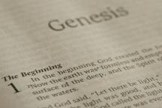
Beginning Themes
Universe Life Man Marriage Evil Clothing | Religion Salvation Language Government Nations Israel
Morris, Genesis Record, 18-20

Slide 19
Beginning Themes
Universe Life Man Marriage Evil Clothing | Religion Salvation Language Government Nations Israel
Morris, Genesis Record, 18-20

Slide 20
THE DIVINE INSTITUTIONS
Marriage and family (Gen. 1:26-28; 2:18-25)
Labor (Gen. 2:15; 3:19)
Conscience (Gen. 3:22)
Government (Gen. 9:6)
Nationalism (Gen. 11:1-9)

Slide 21
THE DIVINE INSTITUTIONS
Marriage and family (Gen. 1:26-28; 2:18-25)
Labor (Gen. 2:15; 3:19)
Conscience (Gen. 3:22)
Government (Gen. 9:6)
Nationalism (Gen. 11:1-9)

Slide 22

Romans 13:3-5
“For rulers are not a cause of fear for good behavior, but for evil. Do you want to have no fear of authority? Do what is good and you will have praise from the same; for it [government] is a minister of God to you for good. But if you do what is evil, be afraid; for it [government] does not bear the sword for nothing; for it [government] is a minister of God, an avenger who brings wrath on the one who practices evil.”

Slide 23
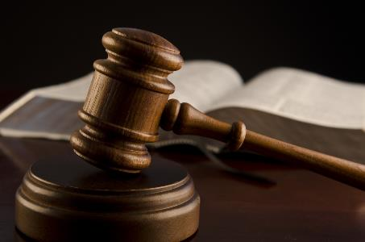
1 Peter 2:13-14
“Submit yourselves for the Lord’s sake to every human institution, whether to a king as the one in authority, or to governors as sent by him for the punishment of evildoers and the praise of those who do right.”

Slide 24
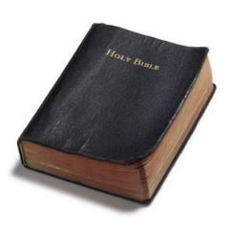
Founders’ Sources
34% Bible
8.3% Baron Montesquieu
7.9% William Blackstone
2.9% John Locke
Donald S. Lutz, The Origins of American Constitutionalism (Baton Rouge, LA: Louisiana State University Press, 1988), 141.

Slide 25
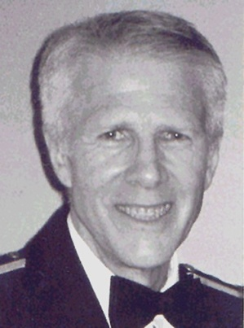
John Locke
“Locke frequently cited the Bible in his political writings. In his first treatise on government he cited the Bible eighty times. Forty-two of these citations are from Genesis, mostly chapters 1 and 3. Twenty-two biblical citations appear in his second treatise in which he argued that parents have authority over their children based upon the creation of Adam and Eve and their offspring. He also argued that man has the right to possess property since God gave the earth to Adam and later to Noah. He based the social compact which government is established upon ‘that Paction which God made with Noah after the Deluge.’ His basic doctrines of parental authority, private property, and social compact were based on the historical existence of Adam and Noah."
John Eidsmoe, Christianity and the Constitution: The Faith of Our Founding Fathers (Grand Rapids, MI: Baker, 1987), 61.

Slide 26


Slide 27

Synthetic Outline
  Chiasm in “Aramaic” ( Dan. 2-7)
1. Gentile History (2)
  2. Protection (3)
    3. Revelation to a gentile king (4)
    3'. Revelation to a gentile king (5)
  2. Protection (6)
1. Gentile history (7)

Slide 28
Synthetic Outline
  Chiasm in “Aramaic” ( Dan. 2-7)
1. Gentile History (2)
  2. Protection (3)
    3. Revelation to a gentile king (4)
    3'. Revelation to a gentile king (5)
  2. Protection (6)
1. Gentile history (7)

Slide 29

Principles of Civil Disobedience
“Crystal” clear conflict between the laws of man and God
Exhaustion of all creative legal remedies
A willingness to “pay the consequences”
Maintaining of respect for civil authorities

Slide 30
Baker Faces Prison for Refusing to Bake Same-Sex Wedding Cake
“Jack Phillips is a baker who declined to bake a wedding cake for a same-sex couple because his Christian belief is that marriage exists only between a man and woman. Now a Colorado judge has ordered him to bake cakes for same-sex marriages, and if Phillips refuses, he could go to jail.”
Ken Klukowski, “Baker Faces Prison for Refusing to Bake Same-Sex Wedding Cake,” online: http://www.breitbart.com/Big-Government/2013/12/12/Christian-Baker-Willing-to-Go-to-Jail-for-Declining-Gay-Wedding-Cake, 12 December 2013, accessed 16 May 2014.

Slide 31
Oregon Declares War on Aaron & Melissa Klein
“In yet another example of gay activist overreach, an Oregon official has not only burdened a Christian couple with a ridiculous fine, he has imposed a gag order on them…In one of the most egregious anti-Christian acts committed by a state official in recent memory, Oregon Labor Commissioner Brad Avakian not only upheld the ridiculous $135,000 fine levied against Aaron and Melissa Klein for declining to bake a cake for a lesbian commitment ceremony, but he ordered the Kleins to ‘cease and desist’ from making any public comments about their religious convictions relative to this case.”
http://www.onenewsnow.com/perspectives/michael-brown/2015/07/06/oregon-declares-war-on-christian-faith

Slide 32
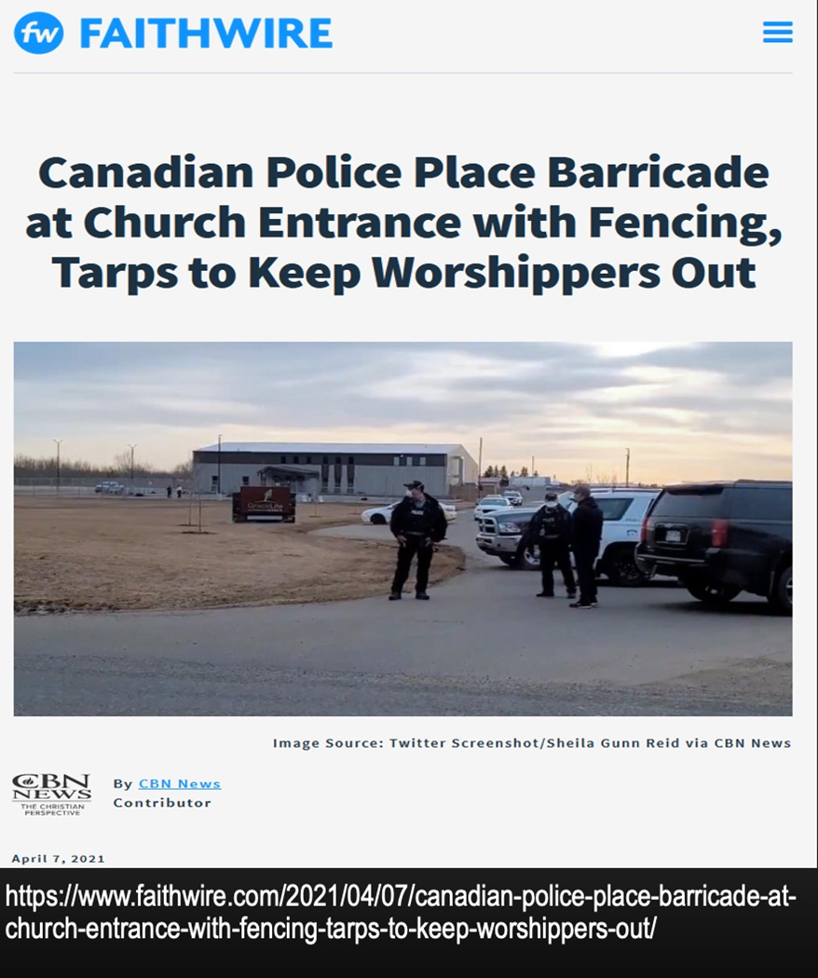

Slide 33
Noahic Covenant: Provision
(Gen 9:1-7)
  Origin of human government (Rom 13:1-7; 1 Pet 2:13-14; Titus 3:1; 1 Tim 2:1-4)
  Capital punishment (Gen 9:5-6)
  Rationale (6:11; 8:21; 9:6b)
  Scriptural support (Rom 13:4; Matt 26:52)

Slide 34
Genesis 9:6
“Whoever sheds man’s blood, By man his blood shall be shed, For in the image of God He made man.”

Slide 35
Noahic Covenant: Provision
(Gen 9:1-7)
  Origin of human government (Rom 13:1-7; 1 Pet 2:13-14; Titus 3:1; 1 Tim 2:1-4)
  Capital punishment (Gen 9:5-6)
  Rationale (6:11; 8:21; 9:6b)
  Scriptural support (Rom 13:4; Matt 26:52)

Slide 36

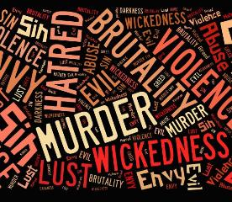
Genesis 6:11
“Now the earth was corrupt in the sight of God, and the earth was filled with violence [חָמָס; chamas].”

Slide 37
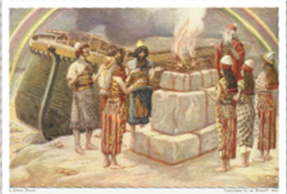
Genesis 8:21
The Lord smelled the soothing aroma; and the Lord said to Himself, “I will never again curse the ground on account of man, for the intent of man’s heart is evil from his youth; and I will never again destroy every living thing, as I have done.[emphasis mine].

Slide 38
Genesis 9:6
“Whoever sheds man’s blood, By man his blood shall be shed, For in the image of God He made man.”

Slide 39
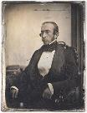
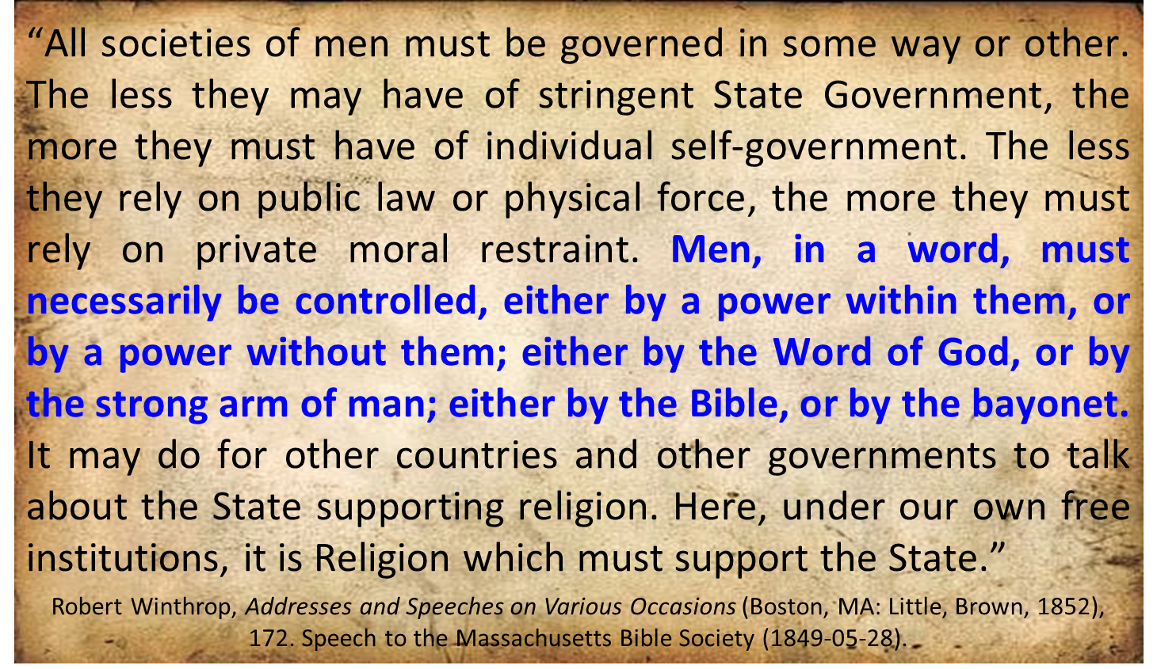
Robert Charles Winthrop

Slide 40
Noahic Covenant: Provision
(Gen 9:1-7)
  Origin of human government (Rom 13:1-7; 1 Pet 2:13-14; Titus 3:1; 1 Tim 2:1-4)
  Capital punishment (Gen 9:5-6)
  Rationale (6:11; 8:21; 9:6b)
  Scriptural support (Rom 13:4; Matt 26:52)

Slide 41
Romans 13:3-5
“For rulers are not a cause of fear for good behavior, but for evil. Do you want to have no fear of authority? Do what is good and you will have praise from the same; for it is a minister of God to you for good. But if you do what is evil, be afraid; for it does not bear the sword for nothing; for it is a minister of God, an avenger who brings wrath on the one who practices evil.”

Slide 42
1 Peter 2:13-14
“Submit yourselves for the Lord’s sake to every human institution, whether to a king as the one in authority, or to governors as sent by him for the punishment of evildoers and the praise of those who do right.”

Slide 43

Genesis 1:27
God created man in His own image, in the image of God He created him; male and female He created them.

Slide 44
Genesis 6:11
“Now the earth was corrupt in the sight of God, and the earth was filled with violence [חָמָס; chamas].”

Slide 45
Genesis 9:6
“Whoever sheds man’s blood, By man his blood shall be shed, For in the image of God He made man.”

Slide 46
Genesis 5:1-2
“¹ This is the book of the generations of Adam. In the day when God created man, He made him in the likeness of God. ² He created them male and female, and He blessed them and named them Man in the day when they were created.”

Slide 47
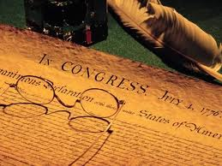
Declaration of Independence
“the Laws of Nature and of Nature’s God,”
“we hold these truths to be self evident, that all men are created equal,”
“they are endowed by their Creator with certain unalienable Rights,”
“appealing to the Supreme Judge of the world for the rectitude of our intentions,”
“with firm reliance on the protection of Divine Providence.”
Church of the Holy Trinity v. U.S., 143 U.S. 457, 467-68 (1892)

Slide 48
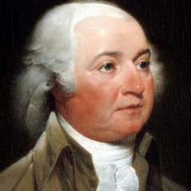
John Adams
John Adams - America's second President "Rights [are] antecedent to all earthly government; Rights... cannot be repealed or restrained by human laws; Rights [are] derived from the great Legislature of the universe."
John Adams, The Works of John Adams, Second President of the United States, ed. Charles Francis Adams, 10 vols. (Boston: Little, Brown, 1856), 3:449.

Slide 49
Declaration of Independence
“We hold these truths to be self-evident, that all men are created equal, that they are endowed by their Creator with certain unalienable Rights, that among these are Life, Liberty and the pursuit of Happiness.”
“That TO SECURE THESE RIGHTS, Governments are instituted among Men, deriving their just powers from the consent of the governed,”
“That whenever any Form of Government becomes destructive of these ends, it is the Right of the People to alter or to abolish it, and to institute new Government…”
Declaration of Independence, In Congress, July 4, 1776, The unanimous Declaration of the thirteen united States of America

Slide 50
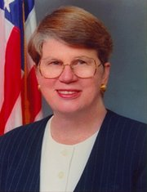
Speech by Attorney General Janet Reno, Newark, New Jersey, May 5, 1995. Quoted in James Bovard, “Waco Must Get a Hearing,” Wall Street Journal, May 15, 1995.
Former Attorney General Janet Reno
“You are part of a government that has given its people more freedom…than any other government in the history of the world.”

Slide 51
Objections to Capital Punishment
  Sixth commandment?
  Sermon on the Mount?
  We are no longer under the Mosaic Law?
  Deterrence? (Deut 13:10-11; 19:20; Eccl 8:11)
  Executed innocent?
  Racist?
  8th Amendment?
  Pro-life?

Slide 52
Objections to Capital Punishment
  Sixth commandment?
  Sermon on the Mount?
  We are no longer under the Mosaic Law?
  Deterrence? (Deut 13:10-11; 19:20; Eccl 8:11)
  Executed innocent?
  Racist?
  8th Amendment?
  Pro-life?

Slide 53
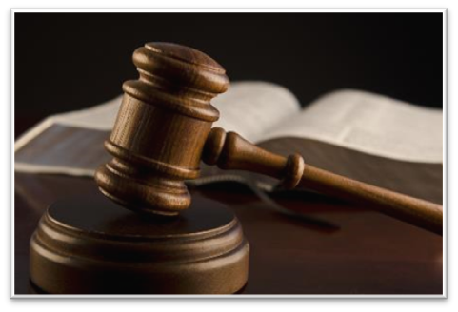
Exodus 20:13
“You shall not murder [רָצַח; ratsach].”

Slide 54
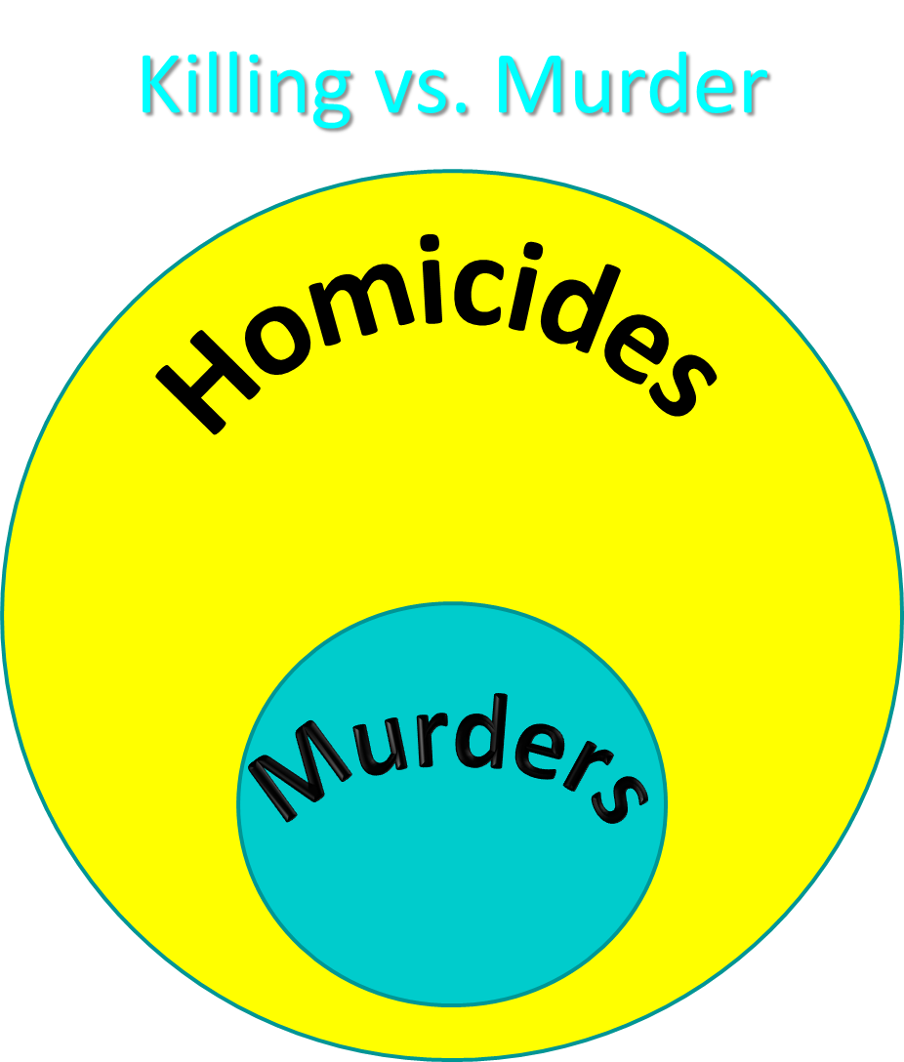

Slide 55
Objections to Capital Punishment
  Sixth commandment?
  Sermon on the Mount?
  We are no longer under the Mosaic Law?
  Deterrence? (Deut 13:10-11; 19:20; Eccl 8:11)
  Executed innocent?
  Racist?
  8th Amendment?
  Pro-life?

Slide 56
Objections to Capital Punishment
  Sixth commandment?
  Sermon on the Mount?
  We are no longer under the Mosaic Law?
  Deterrence? (Deut 13:10-11; 19:20; Eccl 8:11)
  Executed innocent?
  Racist?
  8th Amendment?
  Pro-life?

Slide 57


Slide 58
Noahic vs. Abrahamic & Mosaic Covenants
Name | NOAHIC | ABRAHAMIC | MOSAIC
Human agent | Noah | Abraham | Moses
Scripture | Gen. 8‒9 | Gen. 12‒17 | Exod. 19‒40
Covenant (Berith) | Gen. 9:9 | Gen. 15:18 | Exod. 19:5
Party | World, humanity | Israel, Hebrews | Israel, Hebrews
Israel | Pre-Israel | Post-Israel | Post-Israel

Slide 59
Noahic vs. Abrahamic & Mosaic Covenants
Covenant | NOAHIC | ABRAHAMIC | MOSAIC
Conditional or unconditional | Unconditional | Unconditional | Conditional
Promises | No more flood judgment, enduring earth, capital punishment | Ownership of land, seed, and blessing | Enjoyment or possession of land, seed, and blessing
Sign | Rainbow | Circumcision | Sabbath
Purpose | Restrain & preserve | Redemptive | Redemptive
Directly binding today? | Yes | No | No

Slide 60
Objections to Capital Punishment
  Sixth commandment?
  Sermon on the Mount?
  We are no longer under the Mosaic Law?
  Deterrence? (Deut 13:10-11; 19:20; Eccl 8:11)
  Executed innocent?
  Racist?
  8th Amendment?
  Pro-life?

Slide 61


Dr. Arnold G. Fruchtenbaum
The Book of Genesis, 186
“It is God Who mandates capital punishment...God has already exercised this prerogative of divine retribution with the Flood. However, there is also now to be human retribution, in 9:6: Whosoever sheds man’s blood, by man shall his blood be shed. Man now has the authority to put another man to death. Capital punishment requires legal execution, and this enactment sets the stage for human government. Under the Noahic Covenant, the mandatory death penalty was only for the crime of premeditated murder. Later, the Mosaic Covenant will add other crimes requiring the death penalty, but as far as the Noahic Covenant goes, it is mandatory only for premeditated murder. The purpose is not to deter crime, but to punish …

Slide 62
Dr. Arnold G. Fruchtenbaum
The Book of Genesis, 186
…the evildoer. Much of the argument today about the use of capital punishment concerns whether it does or does not deter crime. Biblically speaking, that is irrelevant and not the issue. The issue for the Bible is punishing the evildoer, not reforming him or her. Genesis 9:6 concludes by giving the reason why there will be both divine and human retribution for the shedding of human blood: For in the image of God made he man. Therefore, although after the Fall it is a marred image, the image of God is still there.”

Slide 63

Deuteronomy 13:10-11
“So you shall stone him to death because he has sought to seduce you from the Lord your God who brought you out from the land of Egypt, out of the house of slavery. Then all Israel will hear and be afraid, and will never again do such a wicked thing among you.”

Slide 64
Ecclesiastes 8:11
“Because the sentence against an evil deed is not executed quickly, therefore the hearts of the sons of men among them are given fully to do evil.”

Slide 65
Objections to Capital Punishment
  Sixth commandment?
  Sermon on the Mount?
  We are no longer under the Mosaic Law?
  Deterrence? (Deut 13:10-11; 19:20; Eccl 8:11)
  Executed innocent?
  Racist?
  8th Amendment?
  Pro-life?

Slide 66
Objections to Capital Punishment
  Sixth commandment?
  Sermon on the Mount?
  We are no longer under the Mosaic Law?
  Deterrence? (Deut 13:10-11; 19:20; Eccl 8:11)
  Executed innocent?
  Racist?
  8th Amendment?
  Pro-life?

Slide 67
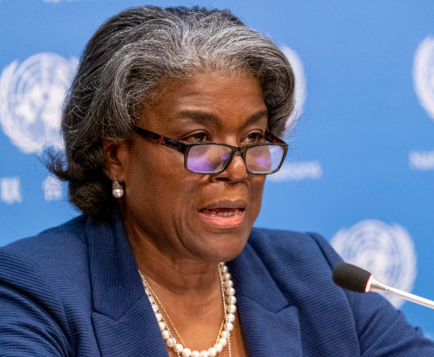

Slide 68
Objections to Capital Punishment
  Sixth commandment?
  Sermon on the Mount?
  We are no longer under the Mosaic Law?
  Deterrence? (Deut 13:10-11; 19:20; Eccl 8:11)
  Executed innocent?
  Racist?
  8th Amendment?
  Pro-life?

Slide 69
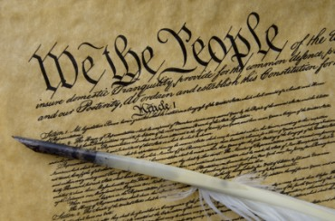
Eighth Amendment
“Excessive bail shall not be required, nor excessive fines imposed, nor cruel and unusual punishments inflicted.”

Slide 70
Fifth Amendment
“No person shall be held to answer for a capital, or otherwise infamous crime, unless on a presentment or indictment of a grand jury, except in cases arising in the land or naval forces, or in the militia, when in actual service in time of war or public danger; nor shall any person be subject for the same offense to be twice put in jeopardy of life or limb; nor shall be compelled in any criminal case to be a witness against himself, nor be deprived of life, liberty, or property, without due process of law; nor shall private property be taken for public use, without just compensation.”

Slide 71
Objections to Capital Punishment
  Sixth commandment?
  Sermon on the Mount?
  We are no longer under the Mosaic Law?
  Deterrence? (Deut 13:10-11; 19:20; Eccl 8:11)
  Executed innocent?
  Racist?
  8th Amendment?
  Pro-life?

Slide 72
ABORTION OR CAPITAL PUNISHMENT?
 | ABORTION | CAPITAL PUNISHMENT
Birth? | Unborn | Born
Crime? | No crime | Committed a crime
Trial? | Not tried by a jury of peers | Tried by a jury of peers
Guilt? | Innocent | Guilty

Slide 73
Noahic Covenant: Provision
(Gen 9:1-7)
  Re-creation theme (Gen 9:1, 2, 7)
  Man becomes carnivorous (Gen. 1:29-30; 2:17; 9:3)
  Cultural precedent for the Mosaic Law (Gen 9:4; Lev 17:11)

Slide 74
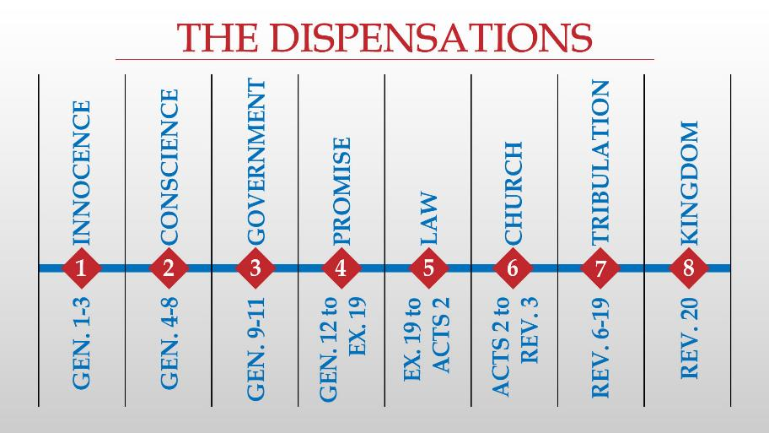

Slide 75
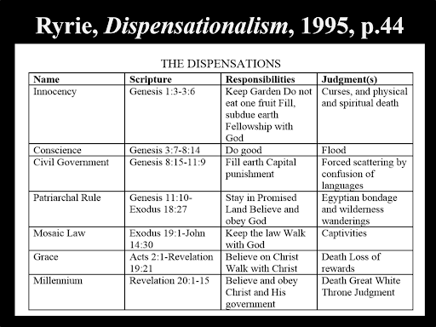

Slide 76
Conclusion

Slide 77
Genesis 8‒9 Outline
  Abating of the waters (8:1-5)
  Tests for dry land (8:6-14)
  Exit from the ark (8:15-19)
  Post-flood events (8:20‒9:29)

Slide 78
Outline
  Noahic Covenant (Gen 8:20–9:17)
  Promise (Gen 8:20-22)
  Provision (Gen 9:1-7)
  Covenant and sign (Gen 9:8-17)
  Post Flood Sin (Gen 9:18-29)

Slide 79
Noahic Covenant: Provision
(Gen 9:1-7)
  Re-creation theme (Gen 9:1, 2, 7)
  Man becomes carnivorous (Gen. 1:29-30; 2:17; 9:3)
  Cultural precedent for the Mosaic Law (Gen 9:4; Lev 17:11)

Slide 80
Noahic Covenant: Provision
(Gen 9:1-7)
  Origin of human government (Rom 13:1-7; 1 Pet 2:13-14; Titus 3:1; 1 Tim 2:1-4)
  Capital punishment (Gen 9:5-6)
  Rationale (8:21; 6:11; 9:6b)
  Scriptural support (Rom 13:4; Matt 26:52)

Slide 81

“The Lord bless you and keep you; the Lord make his face shine on you and be gracious to you; the Lord turn his face toward you and give you peace.” (NIV)

