Slide 1
PRACTICAL RIGHTEOUSNESS
Dr. Andy Woods
Senior Pastor – Sugar Land Bible Church
President – Chafer Theological Seminary

Slide 2
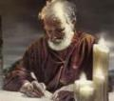
Answering Eleven Questions
Who wrote it? – James
What do we know about the author? – Christ’s ½ Brother
Who was the audience? – Believing Jews in the Diaspora
Where was if written from? – Jerusalem
When was the book written? – A.D. 44‒47
What was the book’s occasion? – Practical righteousness
What is the book’s purpose? – Achieving practical righteousness
What is the book about? – Practical righteousness
What is the book’s theme? – Daily living
What makes the book different? – Practicality
How is the book organized? – Faith and Wisdom

Slide 3
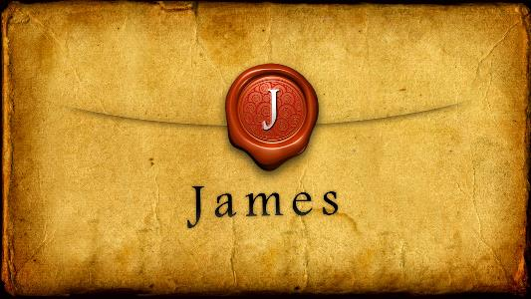
JAMES STRUCTURE
Faith (James 1:1‒3:12)
Wisdom (James 3:13‒5:20)

Slide 4
JAMES STRUCTURE
Faith (James 1:1‒3:12)
Wisdom (James 3:13‒5:20)

Slide 5
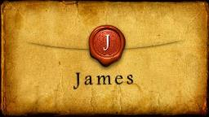
JAMES STRUCTURE
Faith (1:1–3:12)
Trials (1:2-18)
Obedience to the Word (1:19-27)
Favoritism (2:1-13)
Faith manifesting works (2:14-26)
Tongue (3:1-12)

Slide 6
JAMES STRUCTURE
Faith (James 1:1‒3:12)
Wisdom (James 3:13‒5:20)

Slide 7
Structure
Wisdom (3:13–5:20)
Wisdom defined (3:13-18)
Spirituality (4:1-12)
Commerce (4:13-17)
Use of wealth (5:1-6)
Waiting for the Lord’s return (5:7-12)
Prayer (5:13-18)
Restoration of the erring brother (5:19-20)

Slide 8
Structure
Wisdom (3:13–5:20)
Wisdom defined (3:13-18)
Spirituality (4:1-12)
Commerce (4:13-17)
Use of wealth (5:1-6)
Waiting for the Lord’s return (5:7-12)
Prayer (5:13-18)
Restoration of the erring brother (5:19-20)

Slide 9
Wisdom (3:13-18)
Wisdom is demonstrated by her actions (3:13)
Human or earthly wisdom (3:14-16)
Heavenly wisdom (3:17-18)

Slide 10
Structure
Wisdom (3:13–5:20)
Wisdom defined (3:13-18)
Spirituality (4:1-12)
Commerce (4:13-17)
Use of wealth (5:1-6)
Waiting for the Lord’s return (5:7-12)
Prayer (5:13-18)
Restoration of the erring brother (5:19-20)

Slide 11
Spiritual Life (4:1-12)
Avoid wrangling (4:1-3)
Avoid worldliness (4:4-6)
Essence of spiritual wisdom (4:7-12)

Slide 12
Structure
Wisdom (3:13–5:20)
Wisdom defined (3:13-18)
Spirituality (4:1-12)
Commerce (4:13-17)
Use of wealth (5:1-6)
Waiting for the Lord’s return (5:7-12)
Prayer (5:13-18)
Restoration of the erring brother (5:19-20)

Slide 13
Commercial Life (4:13-17)
The Need to Plan while Depending Upon God (4:13-15)
The Problem of Planning without Depending Upon God (4:16-17)

Slide 14
Structure
Wisdom (3:13–5:20)
Wisdom defined (3:13-18)
Spirituality (4:1-12)
Commerce (4:13-17)
Use of wealth (5:1-6)
Waiting for the Lord’s return (5:7-12)
Prayer (5:13-18)
Restoration of the erring brother (5:19-20)

Slide 15
Use of Wealth (5:1-6)
Predicted judgment coming on rich oppressors (5:1-3)
Reasons for coming judgment (5:4-6)

Slide 16
II. Reasons for the Coming Judgment (5:4-6)
Unpaid wages (5:4)
Wanton luxury (5:5)
Condemnation of the innocent (5:6)

Slide 17
Structure
Wisdom (3:13–5:20)
Wisdom defined (3:13-18)
Spirituality (4:1-12)
Commerce (4:13-17)
Use of wealth (5:1-6)
Waiting for the Lord’s return (5:7-12)
Prayer (5:13-18)
Restoration of the erring brother (5:19-20)

Slide 18
Waiting for the Lord’s Return (5:7-12)
The Example of the Farmer (5:7)
The Impact of Imminency (5:8-9)
Old Testament Examples of Patience (5:10-12)

Slide 19
Waiting for the Lord’s Return (5:7-12)
The Example of the Farmer (5:7)
The Impact of Imminency (5:8-9)
Old Testament Examples of Patience (5:10-12)

Slide 21
John 14:1–4
¹ “Do not let your heart be troubled; believe in God, believe also in Me. ² “In My Father’s house are many dwelling places; if it were not so, I would have told you; for I go to prepare a place for you. ³ “If I go and prepare a place for you, I will come again and receive you to Myself, that where I am, there you may be also. ⁴ “And you know the way where I am going.”

Slide 22
1 Thessalonians 4:13-15
¹³ "But we do not want you to be uninformed, brethren, about those who are asleep, so that you will not grieve as do the rest who have no hope. ¹⁴ For if we believe that Jesus died and rose again, even so God will bring with Him those who have fallen asleep in Jesus. ¹⁵ For this we say to you by the word of the Lord, that we who are alive and remain until the coming of the Lord, will not precede those who have fallen asleep.

Slide 23
1 Corinthians 15:51
“Behold, I tell you a mystery; we will not all sleep, but we will all be changed.”

Slide 24
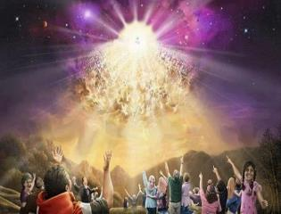
Titus 2:13
“Looking for the blessed hope and the appearing of the glory of our great God and Savior, Christ Jesus.”

Slide 25
1 John 3:2-3
^{“2} Beloved, now we are children of God, and it has not appeared as yet what we will be. We know that when He appears, we will be like Him, because we will see Him just as He is. ³ And everyone who has this hope set on Him purifies himself, just as He is pure.”

Slide 26
J. Dwight Pentecost
Prophecy For Today, Page 20
“A short time ago, I took occasion to go through the New Testament to mark each reference to the coming of the Lord Jesus Christ and to observe the use made of that teaching about His coming. I was struck a new with the fact that almost without exception, when the coming of Christ is mentioned in the New Testament, it is followed by an exhortation to godliness and holy living.”

Slide 27
1 John 3:2-3
^{“2} Beloved, now we are children of God, and it has not appeared as yet what we will be. We know that when He appears, we will be like Him, because we will see Him just as He is. ³ And everyone who has this hope set on Him purifies himself, just as He is pure.”

Slide 28
Matthew 24:46-50
^{“46} Blessed is that slave whom his master finds so doing when he comes. ⁴⁷ Truly I say to you that he will put him in charge of all his possessions. ⁴⁸ But if that evil slave says in his heart, ‘My master is not coming for a long time,’ ⁴⁹ and he begins to beat his fellow slaves, and he eats and drinks with those habitually drunk; ⁵⁰ then the master of that slave will come on a day that he does not expect, and at an hour that he does not know.”

Slide 29
Audience
Jewish (1:1)
Persecution (Acts 8:1-4; 11:19)
In Babylon-Mesopotamia or North-Central Turkey?
Believers (Jas 1:2-4)

Slide 30
James 1:1
“¹ James, a bond-servant of God and of the Lord Jesus Christ, To the twelve tribes who are dispersed abroad: Greetings.”

Slide 31
UNIQUE CHARACTERISTICS
Sermon on Mt | Concise
OT | High quality GK
Illustrations from nature & daily living | Proverbs & Amos of the NT
Undeveloped Christology | Imperatives (54)
Practical | Oldest book in NT
Many literary devices | Difficult to outline

Slide 32
Waiting for the Lord’s Return (5:7-12)
The Example of the Farmer (5:7)
The Impact of Imminency (5:8-9)
Old Testament Examples of Patience (5:10-12)

Slide 33
II. The Impact of Imminency (5:8-9)
On strength (5:8)
On complaining (5:9)

Slide 34
II. The Impact of Imminency (5:8-9)
On strength (5:8)
On complaining (5:9)

Slide 35
James 5:8-9
“You too be patient; strengthen your hearts, for the coming of the Lord is near [engizō]. ⁹ Do not complain, brethren, against one another, so that you yourselves may not be judged; behold, the Judge is standing right at the door.”

Slide 36
James 5:8-9
“You too be patient; strengthen your hearts, for the coming of the Lord is near [engizō]. ⁹ Do not complain, brethren, against one another, so that you yourselves may not be judged; behold, the Judge is standing right at the door.”

Slide 37
James 5:8-9
“You too be patient; strengthen your hearts, for the coming of the Lord is near [engizō]. ⁹ Do not complain, brethren, against one another, so that you yourselves may not be judged; behold, the Judge is standing right at the door.”

Slide 38
James 5:8-9
“You too be patient; strengthen your hearts, for the coming of the Lord is near [engizō]. ⁹ Do not complain, brethren, against one another, so that you yourselves may not be judged; behold, the Judge is standing right at the door.”

Slide 39
Messengers of the Kingdom In Matthew
John the Baptist – 3:2
Jesus Christ – 4:17
12 Apostles – 10:5-7
Seventy – Luke 10:1, 9
Toussaint, Behold the King, 18-20

Slide 40
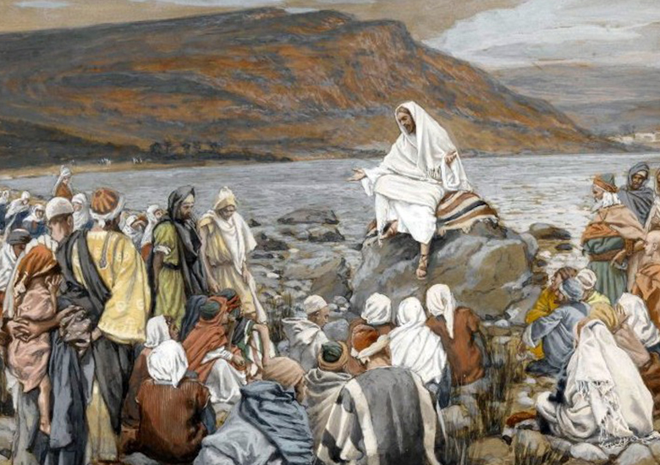
Matthew 3:1-2
“Now in those days John the Baptist came, preaching in the wilderness of Judea, saying, ‘Repent, for the kingdom of heaven is at hand.”

Slide 41
Matthew 4:17
“From that time Jesus began to preach and say, ‘Repent, for the kingdom of heaven is at hand.’”

Slide 42
Matthew 10:5-7
“These twelve Jesus sent out after instructing them: “Do not go in the way of the Gentiles, and do not enter any city of the Samaritans; ⁶ but rather go to the lost sheep of the house of Israel. ⁷ And as you go, preach, saying, ‘The kingdom of heaven is at hand [engizō].’”

Slide 43
Luke 10:9
“Now after this the Lord appointed seventy others, and sent them in pairs ahead of Him to every city and place where He Himself was going to come…and heal those in it who are sick, and say to them, ‘The kingdom of God has come near to you.’”

Slide 44
II. The Impact of Imminency (5:8-9)
On strength (5:8)
On complaining (5:9)

Slide 45
James 5:8-9
“⁸ You too be patient; strengthen your hearts, for the coming of the Lord is near [engizō]. ⁹ Do not complain, brethren, against one another, so that you yourselves may not be judged; behold, the Judge is standing right at the door.”

Slide 46
James 5:8-9
“⁸ You too be patient; strengthen your hearts, for the coming of the Lord is near [engizō]. ⁹ Do not complain, brethren, against one another, so that you yourselves may not be judged; behold, the Judge is standing right at the door.”

Slide 47
James 5:8-9
“⁸ You too be patient; strengthen your hearts, for the coming of the Lord is near [engizō]. ⁹ Do not complain, brethren, against one another, so that you yourselves may not be judged; behold, the Judge is standing right at the door.”

Slide 48
James 5:8-9
“⁸ You too be patient; strengthen your hearts, for the coming of the Lord is near [engizō]. ⁹ Do not complain, brethren, against one another, so that you yourselves may not be judged; behold, the Judge is standing right at the door.”

Slide 49
James 5:8-9
“⁸ You too be patient; strengthen your hearts, for the coming of the Lord is near [engizō]. ⁹ Do not complain, brethren, against one another, so that you yourselves may not be judged; behold, the Judge is standing right at the door.”

Slide 50
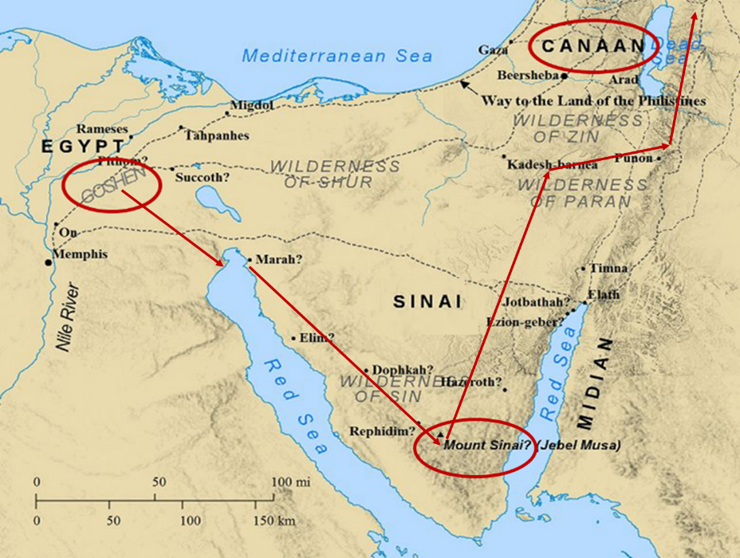

Slide 51
James 5:8-9
“⁸ You too be patient; strengthen your hearts, for the coming of the Lord is near [engizō]. ⁹ Do not complain, brethren, against one another, so that you yourselves may not be judged; behold, the Judge is standing right at the door.”

Slide 52
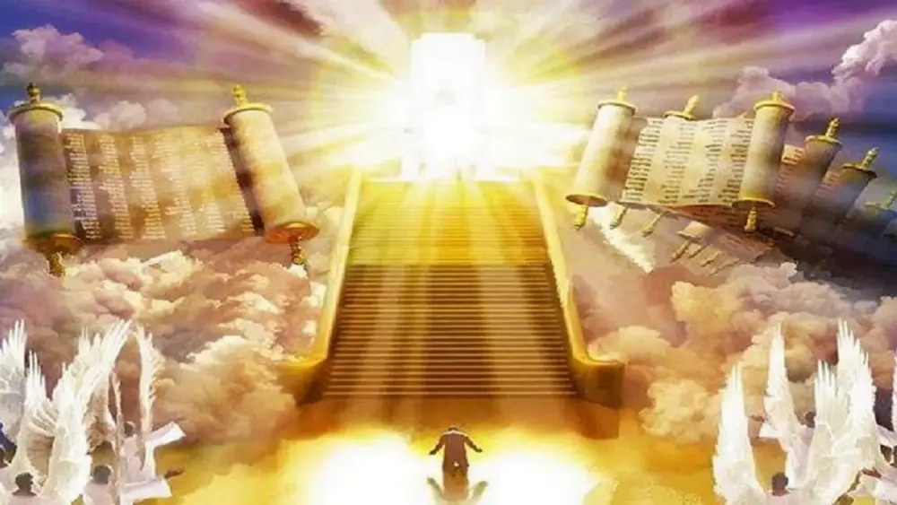
1 Corinthians 4:5
“Therefore do not go on passing judgment before the time, but wait until the Lord comes who will both bring to light the things hidden in the darkness and disclose the motives of men’s hearts; and then each man’s praise will come to him from God.”
Notes:
Rapture and Bema

Slide 53
1 John 3:2-3
^{“2} Beloved, now we are children of God, and it has not appeared as yet what we will be. We know that when He appears, we will be like Him, because we will see Him just as He is. ³ And everyone who has this hope set on Him purifies himself, just as He is pure.”

Slide 54
Waiting for the Lord’s Return (5:7-12)
The Example of the Farmer (5:7)
The Impact of Imminency (5:8-9)
Old Testament Examples of Patience (5:10-12)

Slide 55
III. Old Testament Examples of Patience (5:10-12)
The Old Testament Prophets (5:10)
The Patriarch Job (5:11-12)

Slide 56
III. Old Testament Examples of Patience (5:10-12)
The Old Testament Prophets (5:10)
The Patriarch Job (5:11-12)

Slide 57
III. Old Testament Examples of Patience (5:10-12)
The Old Testament Prophets (5:10)
The Patriarch Job (5:11-12)

Slide 58
Scripture’s Five Crowns (Rev 4:10: 3:11; 2 John 8)
SCRIPTURE | CROWN | PURPOSE
1 Cor. 9:24-27 | Incorruptible | Gaining mastery over the flesh
1 Thess. 2:19-20 | Rejoicing | Soul winning
Jas. 1:12; Rev. 2:10 | Life | Enduring trials
1 Pet. 5:2-4 | Glory | Shepherding God’s people
2 Tim. 4:8 | Righteousness | Longing for His appearing

Slide 59
Date (AD 44-47)
AD 70
AD 62-63
AD 49
AD 48-49
Sermon on the Mt
Primitive congregational worship (Jas 2:2; 3:1; 5:14)
Jas 1:1 = Acts 8:1-4; 11:19

Slide 60
CONCLUSION

Slide 61
Waiting for the Lord’s Return (5:7-12)
The Example of the Farmer (5:7)
The Impact of Imminency (5:8-9)
Old Testament Examples of Patience (5:10-12)

Slide 62
Structure
Wisdom (3:13–5:20)
Wisdom defined (3:13-18)
Spirituality (4:1-12)
Commerce (4:13-17)
Use of wealth (5:1-6)
Waiting for the Lord’s return (5:7-12)
Prayer (5:13-18)
Restoration of the erring brother (5:19-20)

