Slide 1
PRACTICAL RIGHTEOUSNESS
Dr. Andy Woods
Senior Pastor – Sugar Land Bible Church
President – Chafer Theological Seminary

Slide 2
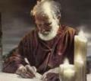
Answering Eleven Questions
Who wrote it? – James
What do we know about the author? – Christ’s ½ Brother
Who was the audience? – Believing Jews in the Diaspora
Where was if written from? – Jerusalem
When was the book written? – A.D. 44‒47
What was the book’s occasion? – Practical righteousness
What is the book’s purpose? – Achieving practical righteousness
What is the book about? – Practical righteousness
What is the book’s theme? – Daily living
What makes the book different? – Practicality
How is the book organized? – Faith and Wisdom

Slide 3
JAMES STRUCTURE
Faith (James 1:1‒3:12)
Wisdom (James 3:13‒5:20)

Slide 4
JAMES STRUCTURE
Faith (James 1:1‒3:12)
Wisdom (James 3:13‒5:20)

Slide 5
JAMES STRUCTURE
Faith (1:1–3:12)
Trials (1:2-18)
Obedience to the Word (1:19-27)
Favoritism (2:1-13)
Faith manifesting works (2:14-26)
Tongue (3:1-12)

Slide 6
JAMES STRUCTURE
Faith (1:1–3:12)
Trials (1:2-18)
Obedience to the Word (1:19-27)
Favoritism (2:1-13)
Faith manifesting works (2:14-26)
Tongue (3:1-12)

Slide 7
James 1:2-18
Trials – Jas 1:2-18
Rejoicing during trials – Jas 1:2-12
Command not to charge God with temptation – Jas 1:13-18

Slide 8
JAMES STRUCTURE
Faith (1:1–3:12)
Trials (1:2-18)
Obedience to the Word (1:19-27)
Favoritism (2:1-13)
Faith manifesting works (2:14-26)
Tongue (3:1-12)

Slide 9
Faith Obeys God (James 1:19-27)
Need for Slowness in Speaking & Anger (1:19-20)
Need for Obedience to God’s Word (1:21-25)
Need for True Religion (1:26-27)

Slide 10
JAMES STRUCTURE
Faith (1:1–3:12)
Trials (1:2-18)
Obedience to the Word (1:19-27)
Favoritism (2:1-13)
Faith manifesting works (2:14-26)
Tongue (3:1-12)

Slide 11
Favoritism (2:1-13)
Command: no favoritism (2:1)
Situation: favoritism in the assembly (2:2-3)
Reasoning: favoritism is contrary to God’s character & purposes (2:4-13)

Slide 12
JAMES STRUCTURE
Faith (1:1–3:12)
Trials (1:2-18)
Obedience to the Word (1:19-27)
Favoritism (2:1-13)
Faith manifesting works (2:14-26)
Tongue (3:1-12)

Slide 13
Three Tenses of Salvation
Phase | Justification | Sanctification | Glorification
Tense | Past | Present | Future
Saved from sin’s: | Penalty | Power | Presence
Scripture | Eph 2:8-9; Titus 3:5 | Philip 2:12 | Rom 5:10
Nature | Single | Dual | Single

Slide 14
Faith Obeys God (James 1:19-27)
Need for Slowness in Speaking & Anger (1:19-20)
Need for Obedience to God’s Word (1:21-25)
Need for True Religion (1:26-27)

Slide 15
Favoritism (2:1-13)
Command: no favoritism (2:1)
Situation: favoritism in the assembly (2:2-3)
Reasoning: favoritism is contrary to God’s character & purposes (2:4-13)

Slide 16
III. Reasoning: Favoritism is Contrary to God’s Character & Purposes (2:4-13)
We judge where God has not (4)
God elects all (2:5)
Rich oppressors (2:6-7)
Favoritism violates God’s Law (2:8-11)
God will judge those showing favoritism (2:12-13)

Slide 17
JAMES STRUCTURE
Faith (1:1–3:12)
Trials (1:2-18)
Obedience to the Word (1:19-27)
Favoritism (2:1-13)
Faith manifesting works (2:14-26)
Tongue (3:1-12)

Slide 18
Faith Manifesting Works (2:14-26)
Thesis: works accompany useful faith (2:14)
Five illustrations (2:15-26)
Needy brother (2:15-17)
Demonic monotheist (2:18-19)
Abraham (2:20-24)
Rahab (2:25)
Lifeless corpse (2:26)

Slide 19
Faith Manifesting Works (2:14-26)
Thesis: works accompany useful faith (2:14)
Five illustrations (2:15-26)
Needy brother (2:15-17)
Demonic monotheist (2:18-19)
Abraham (2:20-24)
Rahab (2:25)
Lifeless corpse (2:26)

Slide 20
Harmony Between Paul and James
 | PAUL | JAMES
Justification | Declaration of innocence before God | Evidence of usefulness of believer's faith before man
Save | Justification | Sanctification
Faith | Saving faith | Serving faith
Works | Favor with God | Believer's moral deeds

Slide 21
Lewis Sperry Chafer
Systematic Theology (Grand Rapids, MI: Kregel Publications, 1993), vol. 7, 148.
“In its larger usage, the word faith represents at least four varied ideas: (1) As above, it can be personal confidence in God. This the most common aspect of faith may be subdivided into three features: (a) Saving faith, which is the inwrought confidence in God’s promises and provisions respecting the Savior that leads one to elect to repose upon and trust in the One who alone can save. (b) Serving faith, which contemplates as true the fact of divinely bestowed gifts and all details respecting divine appointments for service. This faith is always a personal matter, and so one believer should not become a pattern for another. That such faith with its personal characteristic may be kept inviolate, …

Slide 22
Lewis Sperry Chafer
Systematic Theology (Grand Rapids, MI: Kregel Publications, 1993), vol. 7, 148.
“…the Apostle writes: “Hast thou faith? have it to thyself before God” (Rom. 14:22). Great injury may be wrought if one Christian imitates another in matters of appointment for service. (c) Sanctifying or sustaining faith, which lays hold of the power of God for one’s daily life. It is the life lived in dependence upon God, working upon a new life-principle (Rom. 6:4). The justified one, having become what he is by faith, must go ahead living on the same principle of utter dependence upon God.”

Slide 23
Romans 12:3-8
“³ For through the grace given to me I say to everyone among you not to think more highly of himself than he ought to think; but to think so as to have sound judgment, as God has allotted to each a measure of faith. ⁴ For just as we have many members in one body and all the members do not have the same function, ⁵ so we, who are many, are one body in Christ, and individually members one of another.…

Slide 24
Romans 12:3-8
…“⁶ Since we have gifts that differ according to the grace given to us, each of us is to exercise them accordingly: if prophecy, according to the proportion of his faith; ⁷ if service, in his serving; or he who teaches, in his teaching; ⁸ or he who exhorts, in his exhortation; he who gives, with liberality; he who leads, with diligence; he who shows mercy, with cheerfulness.”

Slide 25
Harmony Between Paul and James
 | PAUL | JAMES
Justification | Declaration of innocence before God | Evidence of usefulness of believer's faith before man
Save | Justification | Sanctification
Faith | Saving faith | Serving faith
Works | Favor with God | Believer's moral deeds

Slide 26
Three Tenses of Salvation
Phase | Justification | Sanctification | Glorification
Tense | Past | Present | Future
Saved from sin’s: | Penalty | Power | Presence
Scripture | Eph 2:8-9; Titus 3:5 | Philip 2:12 | Rom 5:10
Nature | Single | Dual | Single

Slide 27
James 1:19-23
“¹⁹ This you know, my beloved brethren. But everyone must be quick to hear, slow to speak and slow to anger; ²⁰ for the anger of man does not achieve the righteousness of God. ²¹ Therefore, putting aside all filthiness and all that remains of wickedness, in humility receive the word implanted, which is able to save [sōzō] your souls. ²² But prove yourselves doers of the word, and not merely hearers who delude themselves. ²³ For if anyone is a hearer of the word and not a doer, he is like a man who looks at his natural face in a mirror.”

Slide 28
James 5:19-20
“¹⁹ My brethren, if any among you strays from the truth and one turns him back, ²⁰ let him know that he who turns a sinner from the error of his way will save [sōzō] his soul from death and will cover a multitude of sins.”

Slide 29
Faith Manifesting Works (2:14-26)
Thesis: works accompany useful faith (2:14)
Five illustrations (2:15-26)
Needy brother (2:15-17)
Demonic monotheist (2:18-19)
Abraham (2:20-24)
Rahab (2:25)
Lifeless corpse (2:26)

Slide 30
Faith Manifesting Works (2:14-26)
Thesis: works accompany useful faith (2:14)
Five illustrations (2:15-26)
Needy brother (2:15-17)
Demonic monotheist (2:18-19)
Abraham (2:20-24)
Rahab (2:25)
Lifeless corpse (2:26)

Slide 31
Harmony Between Paul and James
 | PAUL | JAMES
Justification | Declaration of innocence before God | Evidence of usefulness of believer's faith before man
Save | Justification | Sanctification
Faith | Saving faith | Serving faith
Works | Favor with God | Believer's moral deeds

Slide 32
Faith Manifesting Works (2:14-26)
Thesis: works accompany useful faith (2:14)
Five illustrations (2:15-26)
Needy brother (2:15-17)
Demonic monotheist (2:18-19)
Abraham (2:20-24)
Rahab (2:25)
Lifeless corpse (2:26)

Slide 33
Harmony Between Paul and James
 | PAUL | JAMES
Justification | Declaration of innocence before God | Evidence of usefulness of believer's faith before man
Save | Justification | Sanctification
Faith | Saving faith | Serving faith
Works | Favor with God | Believer's moral deeds

Slide 34
William Hendriksen
“Many trusted in his name; i.e., because of the manner in which his power was displayed they accepted him as a great prophet and perhaps even as the Messiah. This, however, is not the same as saying that they surrendered their hearts to him. Not all faith is saving faith...”
William Hendriksen, A Commentary on the Gospel of John, 3d ed. (London: Banner of Truth Trust, 1964), p. 127. (1978). Bibliotheca Sacra, 135. (1978). Bibliotheca Sacra, 135.

Slide 35
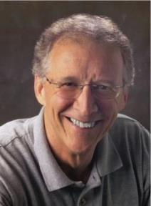
John Piper
“No Christian can be sure that he is a true believer. Hence, there is an ongoing need to be dedicated to the Lord and to deny ourselves so that we might make it.”
John Piper and Pastoral Staff, TULIP: What We Believe about the Five Points of Calvinism: Position Paper of the Pastoral Staff (Desiring God Ministries, 1997), 25, cited in Dave Hunt, What Love is This?, 379.

Slide 36
John Piper
“What causes me to be anxious is the possibility that I may not be a Christian—that I might be fake / that everything I’ve ever done might be a farce—those are horrible, horrible thoughts; right?”
John Piper’s Interview on Family Life Radio April 14, 2020 https://www.familylife.com
/podcast/ familylife-today/strategies-for-standing-firm-through-coronavirus/

Slide 37
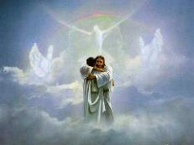
John 5:24
“Truly, truly, I say to you, he who hears My word, and believes Him who sent Me, has eternal life, and does not come into judgment, but has passed out of death into life.”

Slide 38
Acts 16:30-31
“³⁰ and after he brought them out, he said, ‘Sirs, what must I do to be saved?’³¹ They said, ‘Believe in the Lord Jesus, and you will be saved, you and your household.’”

Slide 39
Head Faith vs. Heart Faith? (2:19)
An apples and oranges comparison
Faith in Jesus Christ?
Plan of Salvation not open to the demons
The demons do believe (Matt. 8:28-29)

Slide 40
James 2:14-26
“James does not call the belief of the demons a mere ‘recognition,’ but he states they actually ‘believe.’ In fact, their faith does cause them to ‘tremble.’ James’s point is that even the faith of demons results in some practical manifestation in their lives, so should not the genuine faith of these believers result in some profitable and demonstrable works toward other believers in need?”
Dennis Rokser, Faith & Works: A Clarification of “Faith Without Works is Dead,” p. 25

Slide 41
Faith Manifesting Works (2:14-26)
Thesis: works accompany useful faith (2:14)
Five illustrations (2:15-26)
Needy brother (2:15-17)
Demonic monotheist (2:18-19)
Abraham (2:20-24)
Rahab (2:25)
Lifeless corpse (2:26)

Slide 42
Harmony Between Paul and James
 | PAUL | JAMES
Justification | Declaration of innocence before God | Evidence of usefulness of believer's faith before man
Save | Justification | Sanctification
Faith | Saving faith | Serving faith
Works | Favor with God | Believer's moral deeds

Slide 43
James 2:17, 20, 26
“¹⁷ Even so faith, if it has no works, is dead [nekros], being by itself... ²⁰ But are you willing to recognize, you foolish fellow, that faith without works is useless [argos]?...²⁶ For just as the body without the spirit is dead [nekros], so also faith without works is dead [nekros].”

Slide 44
Audience
Jewish (1:1)
Persecution (Acts 8:1-4; 11:19)
In Babylon-Mesopotamia or North-Central Turkey?
Believers (Jas 1:2-4)

Slide 45
James 1:1
“James, a bond-servant of God and of the Lord Jesus Christ, To the twelve tribes who are dispersed abroad: Greetings.”

Slide 46
Harmony Between Paul and James
 | PAUL | JAMES
Justification | Declaration of innocence before God | Evidence of usefulness of believer's faith before man
Save | Justification | Sanctification
Faith | Saving faith | Serving faith
Works | Favor with God | Believer's moral deeds

Slide 47
Matthew 12:33-37
“³³ Either make the tree good and its fruit good, or make the tree bad and its fruit bad; for the tree is known by its fruit. ³⁴ You brood of vipers, how can you, being evil, speak what is good? For the mouth speaks out of that which fills the heart. ³⁵ The good man brings out of his good treasure what is good; and the evil man brings out of his evil treasure what is evil. ³⁶ But I tell you that every careless word that people speak, they shall give an accounting for it in the day of judgment. ³⁷ For by your words you will be justified [dikaioō], and by your words you will be condemned.”

Slide 48
John Calvin
James 2:23 (Calvin Cath Epist)
“They who seek to prove from this passage of James that the works of Abraham were imputed for righteousness, must necessarily confess that Scripture is perverted by him; for however they may turn and twist, they can never make the effect to be its own cause. The passage is quoted from Moses. (Gen. 15:6.) The imputation of righteousness which Moses mentions, preceded more than thirty years the work by which they would have Abraham to have been justified. Since faith was imputed to Abraham fifteen years before the birth of Isaac, this could not surely have been done through the work of sacrificing him.”
Notes:
Outline

Slide 49
John Calvin
James 2:23 (Calvin Cath Epist)
“I consider that all those are bound fast by an indissoluble knot, who imagine that righteousness was imputed to Abraham before God, because he sacrificed his son Isaac, who was not yet born when the Holy Spirit declared that Abraham was justified. It hence necessarily follows that something posterior is pointed out here.”
Notes:
Outline

Slide 50
Harmony Between Paul and James
 | PAUL | JAMES
Justification | Declaration of innocence before God | Evidence of usefulness of believer's faith before man
Save | Justification | Sanctification
Faith | Saving faith | Serving faith
Works | Favor with God | Believer's moral deeds

Slide 51
James 2:22
“You see that faith was working with his works, and as a result of the works, faith was perfected [teleioō].”

Slide 52
Hebrews 5:14
“But solid food is for the mature [teleios], who because of practice have their senses trained to discern good and evil.”

Slide 53
James 2:24
“You see that a man is justified [dikaioō] by works and not by faith alone.”

Slide 54
Matthew 12:33-37
“³³ Either make the tree good and its fruit good, or make the tree bad and its fruit bad; for the tree is known by its fruit. ³⁴ You brood of vipers, how can you, being evil, speak what is good? For the mouth speaks out of that which fills the heart. ³⁵ The good man brings out of his good treasure what is good; and the evil man brings out of his evil treasure what is evil. ³⁶ But I tell you that every careless word that people speak, they shall give an accounting for it in the day of judgment. ³⁷ For by your words you will be justified [dikaioō], and by your words you will be condemned.”

Slide 55
Harmony Between Paul and James
 | PAUL | JAMES
Justification | Declaration of innocence before God | Evidence of usefulness of believer's faith before man
Save | Justification | Sanctification
Faith | Saving faith | Serving faith
Works | Favor with God | Believer's moral deeds

Slide 56
Faith Manifesting Works (2:14-26)
Thesis: works accompany useful faith (2:14)
Five illustrations (2:15-26)
Needy brother (2:15-17)
Demonic monotheist (2:18-19)
Abraham (2:20-24)
Rahab (2:25)
Lifeless corpse (2:26)

Slide 57
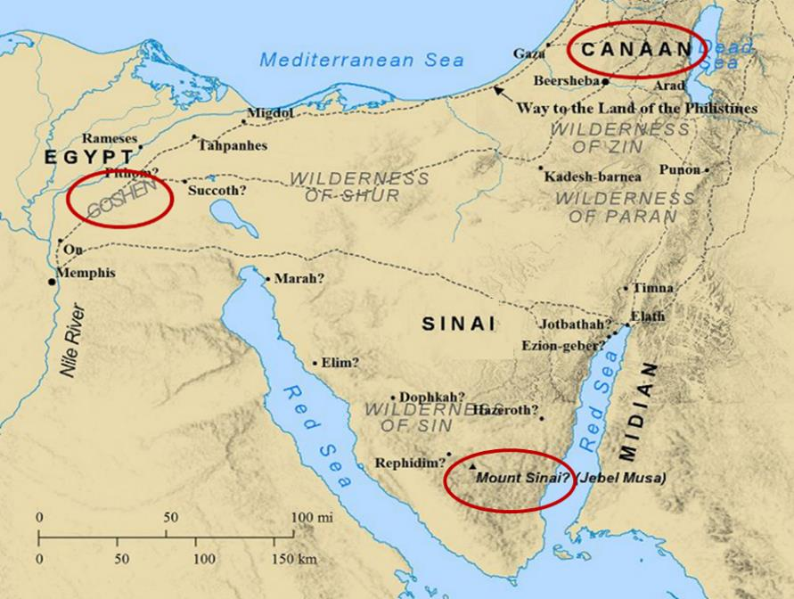

Slide 58
James 2:25
“In the same way, was not Rahab the harlot also justified [dikaioō] by works when she received the messengers and sent them out by another way?”

Slide 59
Matthew 12:33-37
“³³ Either make the tree good and its fruit good, or make the tree bad and its fruit bad; for the tree is known by its fruit. ³⁴ You brood of vipers, how can you, being evil, speak what is good? For the mouth speaks out of that which fills the heart. ³⁵ The good man brings out of his good treasure what is good; and the evil man brings out of his evil treasure what is evil. ³⁶ But I tell you that every careless word that people speak, they shall give an accounting for it in the day of judgment. ³⁷ For by your words you will be justified [dikaioō], and by your words you will be condemned.”

Slide 60
Harmony Between Paul and James
 | PAUL | JAMES
Justification | Declaration of innocence before God | Evidence of usefulness of believer's faith before man
Save | Justification | Sanctification
Faith | Saving faith | Serving faith
Works | Favor with God | Believer's moral deeds

Slide 61
Faith Manifesting Works (2:14-26)
Thesis: works accompany useful faith (2:14)
Five illustrations (2:15-26)
Needy brother (2:15-17)
Demonic monotheist (2:18-19)
Abraham (2:20-24)
Rahab (2:25)
Lifeless corpse (2:26)

Slide 62
James 2:14-26
“The word ‘dead’ in Scripture always carries the idea of ‘separation,’ never nonexistence. At physical death there is a separation of the soul and spirit from a person’s body, yet that person continues to exist either in Heaven or Hell. When we see the body of a deceased person lying in an open casket at a funeral, we do not conclude that the person never really existed in the first place.”
Dennis Rokser, Faith & Works: A Clarification of “Faith Without Works is Dead,” p. 22

Slide 63
James 2:14-26
“Just as there is a separation of the soul and spirit from the body without denying the reality of the soul and spirit, James is not denying the existence or reality of initial faith in Christ for first-tense salvation among his readers whose faith was separated from good works.”
Dennis Rokser, Faith & Works: A Clarification of “Faith Without Works is Dead,” p. 22

Slide 64
Harmony Between Paul and James
 | PAUL | JAMES
Justification | Declaration of innocence before God | Evidence of usefulness of believer's faith before man
Save | Justification | Sanctification
Faith | Saving faith | Serving faith
Works | Favor with God | Believer's moral deeds

Slide 65
1 Corinthians 3:10-12
“¹⁰ According to the grace of God which was given to me, like a wise master builder I laid a foundation, and another is building on it. But each man must be careful how he builds on it. ¹¹ For no man can lay a foundation other than the one which is laid, which is Jesus Christ. ¹² Now if any man builds on the foundation with gold, silver, precious stones, wood, hay, straw…”

Slide 66
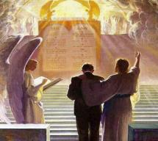
1 Corinthians 3:14-15
“¹⁴ If any man’s work which he has built on it remains, he will receive a reward. ¹⁵ If any man’s work is burned up, he will suffer loss; but he himself will be saved, yet so as through fire.”

Slide 67
CONCLUSION

Slide 68
Faith Manifesting Works (2:14-26)
Thesis: works accompany useful faith (2:14)
Five illustrations (2:15-26)
Needy brother (2:15-17)
Demonic monotheist (2:18-19)
Abraham (2:20-24)
Rahab (2:25)
Lifeless corpse (2:26)

Slide 69
JAMES STRUCTURE
Faith (1:1–3:12)
Trials (1:2-18)
Obedience to the Word (1:19-27)
Favoritism (2:1-13)
Faith manifesting works (2:14-26)
Tongue (3:1-12)

