Slide 1


Genesis 4‒5
The First Murder and Continuation of the Messianic Promise

Slide 2

GENESIS STRUCTURE
  Beginning of the Human race (Gen. 1‒11)
  Beginning of the Hebrew race (Gen. 12‒50)

Slide 3

GENESIS STRUCTURE
  Genesis 1-11 (four events)
    Creation (1-2)
    Fall (3-5)
    Flood (6-9)
    National dispersion (10-11)

Slide 4
GENESIS STRUCTURE
  Genesis 1-11 (four events)
    Creation (1-2)
    Fall (3-5)
    Flood (6-9)
    National dispersion (10-11)

Slide 5

Genesis 3 Outline
  3:1-5 Temptation by the serpent
  3:6 Sin of Adam and Eve
  3:7-13 Results of the sin
  3:14-19 Imposition of divine judgments
  3:20-24 God’s provision in spite of the sin

Slide 6


Genesis 3:15
“And I will put enmity Between you and the woman, And between your seed and her seed; He shall bruise you on the head, And you shall bruise him on the heel.”

Slide 7
Genesis 4 Outline
  First murder (Gen 4:1-15)
  Ungodly line of Cain (4:16-24)
  Godly line of Seth (4:25-26)

Slide 8
Genealogy
(Gen 5)
  Line through which the messianic blessing (Gen. 3:15) would come
  From Adam (Gen. 5:1) to Noah (Gen. 5:32)
  Knowledge of the protevangelium (Gen. 3:15) was obviously passed down given Adam’s advanced age at his death (Gen. 5:5)

Slide 9

Genesis 5 Outline
  Introduction (5:1-2)
  Adam (5:3-5)
  Seth (5:6-8)
  Enosh (5:9-11)
  Kenan (5:12-14)
  Mahalalel (5:15-17)

Slide 10
Genesis 5 Outline
  Jared (5:18-20)
  Enoch (5:21-24)
  Methuselah (5:25-27)
  Lamech (5:28-31)
  Noah (5:32)

Slide 11
Genesis 5 Outline
  Introduction (5:1-2)
  Adam (5:3-5)
  Seth (5:6-8)
  Enosh (5:9-11)
  Kenan (5:12-14)
  Mahalalel (5:15-17)

Slide 12
Genesis 5 Outline
  Introduction (5:1-2)
  Adam (5:3-5)
  Seth (5:6-8)
  Enosh (5:9-11)
  Kenan (5:12-14)
  Mahalalel (5:15-17)

Slide 13
Six-Fold Pattern
Genesis 5:3-5
  Name & meaning: Adam; Man
  Age at birth of seed-son: 130 years
  Additional years lived: 800 years
  Begat other sons & daughters: Yes
  Total years lived: 930 years
  Death: Yes

Slide 14
Six-fold Repetition: Significance
(Gen 5)
    Names indicate historicity (1 Chron. 1:1-4; Luke 3:36-38; Heb. 11:4-7)
    Age of patriarch at birth of seed-son demonstrate no genealogical gaps
    Begetting of other sons and daughters explains the population explosion (Gen. 4:14, 17; 6:1)

Slide 15
Six-fold Repetition: Significance
(Gen 5)
    Long patriarchal ages at time of death indicate ante-diluvian conditions
    Repetition of “and he died” shows the reality of the curse (Gen 2:17; 3:19)
    Monotony allows easy memorization and immediately draws attention to deviations

Slide 16
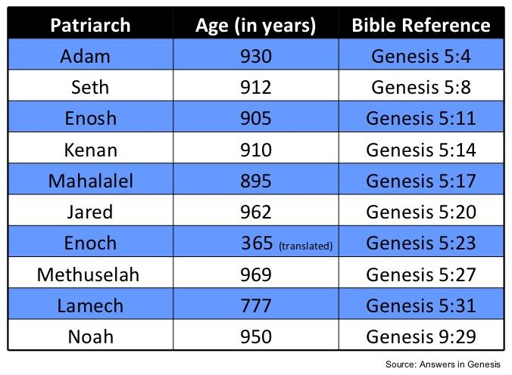

Slide 17
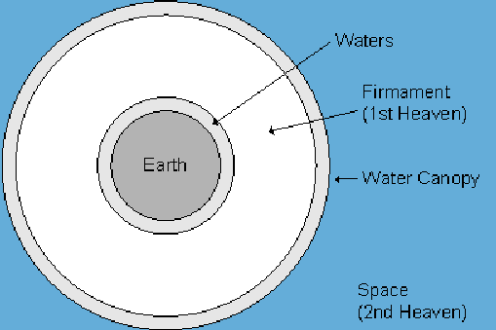

Slide 18
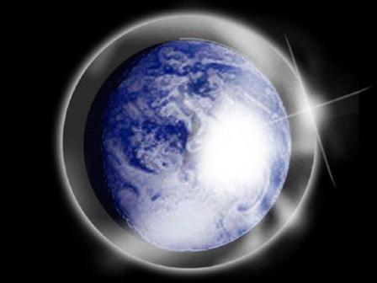

Slide 19

Day 2 Canopy Theory
(Gen 1:6-8)
Implied – Gen. 1:6-7; Ps. 148:4
Explains
  Long life spans of early man – Gen. 5:5, 27
  Strange beasts – (Gen. 1:24-25; Job 40‒41)
  Where the flood waters came from – (Gen. 2:5-6)
  Why man’s post-flood life span cut short – (Gen. 11:24-25)

Slide 20
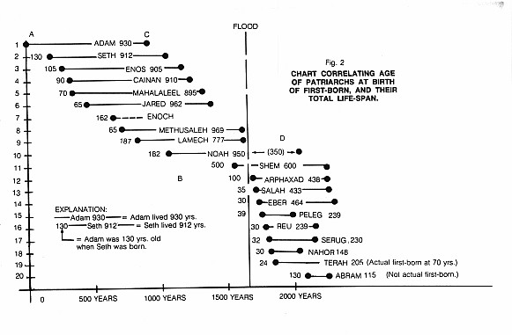

Slide 21

Dr. Henry M. Morris
The Genesis Record, 58-61
“...the upper waters would provide a sort of protective canopy (‘a tent to dwell in’) for earth’s inhabitants, and the space between would provide an atmospheric reservoir to maintain the breath of life...The ‘waters above the firmament’ thus probably constituted a vast blanket of water vapor above the troposphere and possibly above the stratosphere as well, in the high-temperature region now known as the ionosphere, and extending far into space. They could not have been the clouds of water...there was no ‘rain upon the earth’ in those days (Genesis 2:5), nor any ‘bow in the cloud’ (Genesis 9:13), both of which must have been present if these upper waters represented merely the regime of clouds which functions in the present hydrologic economy.”

Slide 22
Dr. Henry M. Morris
The Genesis Record, 58-61
“The concept of an antediluvian water canopy over the earth has appeared in many writings, both ancient and modern...Furthermore, a vapor canopy could be more easily maintained aloft and would serve much more effectively as a marvelous sustainer of vigorous life conditions on the earth...Since water vapor has the ability both to transmit incoming solar radiation and to retain and disperse much of the radiation reflected from the earth’s surface, it would serve as a global greenhouse, maintaining an essentially uniformly pleasant warm temperature all over the world...The combination of warm temperature and adequate moisture everywhere would be conducive later to extensive stands of lush vegetation all over the world, with no barren deserts or ice caps.”

Slide 23
Dr. Henry M. Morris
The Genesis Record, 58-61
“A vapor canopy would also be highly effective in filtering out ultraviolet radiations, cosmic rays, and other destructive energies from outer space. These are known to be the source of both somatic and genetic mutations, which decrease the viability of the individual and the species, respectively. Thus the canopy would contribute effectively to human and animal health and longevity...Later, when needed, these upper waters would provide the reservoir from which God would send the great Flood, to save the godly remnant from the hopelessly corrupt population of that day...”

Slide 24

Dr. Arnold G. Fruchtenbaum
The Book of Genesis Record, 141
“The years here are normal years. They are not months, as some people have tried to make them, again, only to accommodate the assumption that no one could have ever lived as long as the Bible shows them living. If months were indicated rather than years, some of these people would have given birth to children while they were themselves children.”

Slide 25
Six-fold Repetition: Significance
(Gen 5)
    Long patriarchal ages at time of death indicate ante-diluvian conditions
    Repetition of “and he died” shows the reality of the curse (Gen 2:17; 3:19)
    Monotony allows easy memorization and immediately draws attention to deviations

Slide 26

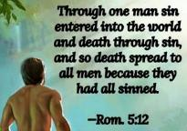
Genesis 2:16-17
“¹⁶ The Lord God commanded the man, saying, ‘From any tree of the garden you may eat freely; ¹⁷ but from the tree of the knowledge of good and evil you shall not eat, for in the day that you eat from it you will surely die (muwth).’”

Slide 27
Genesis 3:19
“By the sweat of your face You will eat bread, Till you return to the ground, Because from it you were taken; For you are dust, And to dust you shall return.”

Slide 28

Romans 5:12
“Therefore, just as through one man sin entered into the world, and death through sin, and so death spread to all men, because all sinned—.”

Slide 29

1 Corinthians 15:50-51
“⁵⁰ Now I say this, brethren, that flesh and blood cannot inherit the kingdom of God; nor does the perishable inherit the imperishable. ⁵¹ Behold, I tell you a mystery; we will not all sleep, but we will all be changed.”

Slide 30
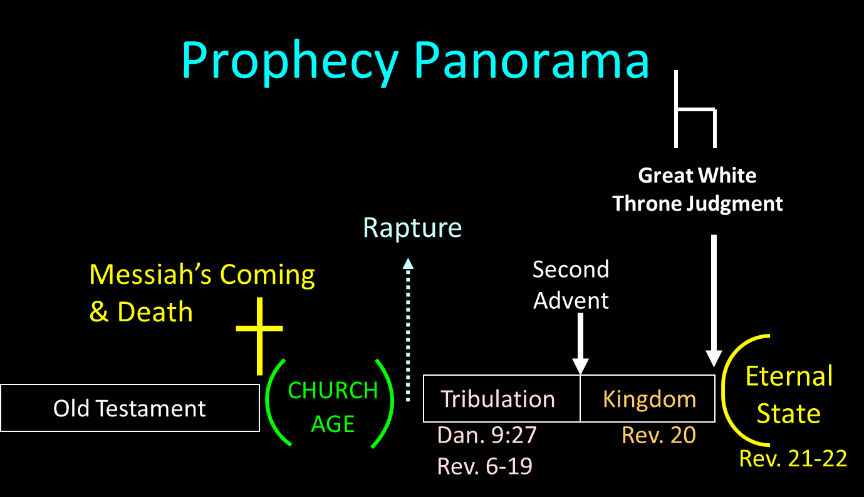

Slide 31

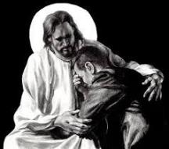
Revelation 21:4
“and He will wipe away every tear from their eyes; and there will no longer be any death; there will no longer be any mourning, or crying, or pain; the first things have passed away.”

Slide 32
Revelation 21:4
“and He will wipe away every tear from their eyes; and there will no longer be any death; there will no longer be any mourning, or crying, or pain; the first things have passed away.”

Slide 33
Six-fold Repetition: Significance
(Gen 5)
    Long patriarchal ages at time of death indicate ante-diluvian conditions
    Repetition of “and he died” shows the reality of the curse (Gen 2:17; 3:19)
    Monotony allows easy memorization and immediately draws attention to deviations

Slide 34
Genesis 5 Outline
  Introduction (5:1-2)
  Adam (5:3-5)
  Seth (5:6-8)
  Enosh (5:9-11)
  Kenan (5:12-14)
  Mahalalel (5:15-17)

Slide 35
Six-Fold Pattern
Genesis 5:6-8
  Name & meaning: Seth; Substitute
  Age at birth of seed-son: 105 years
  Additional years lived: 807 years
  Begat other sons & daughters: Yes
  Total years lived: 912 years
  Death: Yes

Slide 36

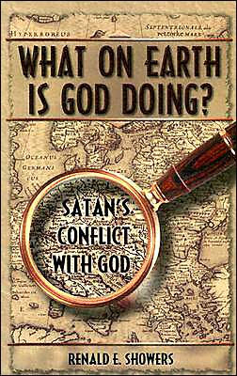
Renald Showers
What on Earth is God Doing: Satan’s Conflict with God (Bellmawr, NJ: Friends of Israel, 2003), 226.
“In His war against Satan, God counteracted the murder of Abel by giving Adam and Eve another godly son named Seth (Gen. 4:25). Since this name means ‘substitute,’ it is apparent that God meant Seth to be a substitute for Abel. (H. C. Leupold, Exposition of Genesis, p. 226). The genealogies found in Genesis 5; 11:10–32; and Luke 3:23–38 reveal that God also intended the Redeemer to come through Seth’s line of descent.”

Slide 37
Genesis 5 Outline
  Introduction (5:1-2)
  Adam (5:3-5)
  Seth (5:6-8)
  Enosh (5:9-11)
  Kenan (5:12-14)
  Mahalalel (5:15-17)

Slide 38
Six-Fold Pattern
Genesis 5:9-11
  Name & meaning: Enosh; Frailty
  Age at birth of seed-son: 90 years
  Additional years lived: 815 years
  Begat other sons & daughters: Yes
  Total years lived: 905 years
  Death: Yes

Slide 39
Genesis 5 Outline
  Introduction (5:1-2)
  Adam (5:3-5)
  Seth (5:6-8)
  Enosh (5:9-11)
  Kenan (5:12-14)
  Mahalalel (5:15-17)

Slide 40
Six-Fold Pattern
Genesis 5:12-14
  Name & meaning: Kenan; smith
  Age at birth of seed-son: 70 years
  Additional years lived: 840 years
  Begat other sons & daughters: Yes
  Total years lived: 910 years
  Death: Yes

Slide 41
Genesis 5 Outline
  Introduction (5:1-2)
  Adam (5:3-5)
  Seth (5:6-8)
  Enosh (5:9-11)
  Kenan (5:12-14)
  Mahalalel (5:15-17)

Slide 42
Six-Fold Pattern
Genesis 5:15-17
  Name & meaning: Mahalalel; praise God
  Age at birth of seed-son: 65 years
  Additional years lived: 830 years
  Begat other sons & daughters: Yes
  Total years lived: 895 years
  Death: Yes

Slide 43
Genesis 5 Outline
  Jared (5:18-20)
  Enoch (5:21-24)
  Methuselah (5:25-27)
  Lamech (5:28-31)
  Noah (5:32)

Slide 44
Six-Fold Pattern
Genesis 5:18-20
  Name & meaning: Jared; descent
  Age at birth of seed-son: 162 years
  Additional years lived: 800 years
  Begat other sons & daughters: Yes
  Total years lived: 962 years
  Death: Yes

Slide 45
Genesis 5 Outline
  Jared (5:18-20)
  Enoch (5:21-24)
  Methuselah (5:25-27)
  Lamech (5:28-31)
  Noah (5:32)

Slide 46
Six-Fold Pattern
Genesis 5:21-24
  Name & meaning: Enoch; dedication
  Age at birth of seed-son: 65 years
  Additional years lived: 300 years
  Begat other sons & daughters: Yes
  Total years lived: 365 years
  Death: No!

Slide 47
LINEAGE OF ADAM
UNGODLY LINE | GODLY LINE
CAIN | SETH
ENOCH | ENOSH
IRAD | KENAN
MEHUJAEL | MAHALALEL
METHUSHAEL | JARED
LAMECH | ENOCH
JUBA, TUBAL-CAIN | METHUSELAH
 | LAMECH
 | NOAH
 | SHEM, HAM, JAPHETH

Slide 48
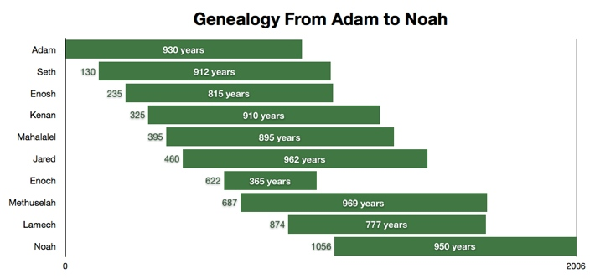

Slide 49
Genealogy: Adam to Noah
(Gen 5)
Hope that the curse would be done away with
  Enoch’s translation (5:24)
  Meaning of Methuselah’s name (Gen. 5:27; 6:3; 1 Pet. 3:20)
  Lamech mistakenly believed that Noah was the fulfillment of Genesis 3:15 (Gen. 5:29; 3:17; 4:1; Dan. 11:37)

Slide 50
Genealogy: Adam to Noah
(Gen 5)
Hope that the curse would be done away with
  Enoch’s translation (5:24)
  Meaning of Methuselah’s name (Gen. 5:27; 6:3; 1 Pet. 3:20)
  Lamech mistakenly believed that Noah was the fulfillment of Genesis 3:15 (Gen. 5:29; 3:17; 4:1; Dan. 11:37)

Slide 52
LINEAGE OF ADAM
UNGODLY LINE | GODLY LINE
CAIN | SETH
ENOCH | ENOSH
IRAD | KENAN
MEHUJAEL | MAHALALEL
METHUSHAEL | JARED
LAMECH | ENOCH
JUBA, TUBAL-CAIN | METHUSELAH
 | LAMECH
 | NOAH
 | SHEM, HAM, JAPHETH

Slide 53
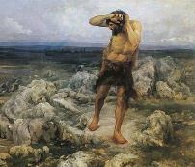
Ungodly Line of Cain
(Gen 4:16-24)
  Evil line that will not bring forth the Messiah (Gen 3:15)
    Continuation of Cain’s line (4:16-18)
    Immorality (4:19)
    Technological but not spiritual advancement (4:20-22)
    More immorality (4:23a)
    Violence (4:23b)
    Humanistic (4:24)

Slide 54
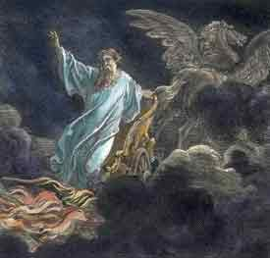
Exemption from Death
(1 Cor 15:54-56)
Enoch (Gen 5)
Elijah (2 Kings 2)
Christ (Acts 1:11; Rev 12:5)
Philip (Acts 8:39)
Paul (2 Cor 12:2, 4)
John (Rev 4:1-2)
Two witnesses (Rev 11)

Slide 55

1 Corinthians 15:50-51
“⁵⁰ Now I say this, brethren, that flesh and blood cannot inherit the kingdom of God; nor does the perishable inherit the imperishable. ⁵¹ Behold, I tell you a mystery; we will not all sleep, but we will all be changed.”

Slide 56
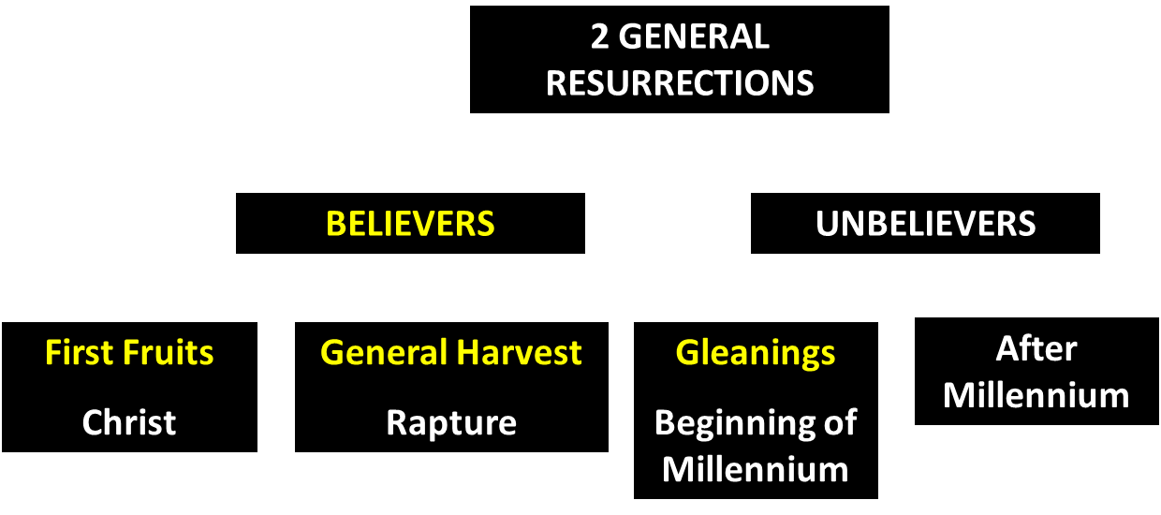
God’s Resurrection Program

Slide 57
1 Corinthians 15:50-51
“⁵⁰ Now I say this, brethren, that flesh and blood cannot inherit the kingdom of God; nor does the perishable inherit the imperishable. ⁵¹ Behold, I tell you a mystery; we will not all sleep, but we will all be changed.”

Slide 58
Genesis 5 Outline
  Jared (5:18-20)
  Enoch (5:21-24)
  Methuselah (5:25-27)
  Lamech (5:28-31)
  Noah (5:32)

Slide 59
Six-Fold Pattern
Genesis 5:25-27
  Name & meaning: Methuselah; when he dies it shall be sent
  Age at birth of seed-son: 187 years
  Additional years lived: 782 years
  Begat other sons & daughters: Yes
  Total years lived: 969 years
  Death: Yes

Slide 60
Dr. Arnold G. Fruchtenbaum
The Book of Genesis Record, 137
“In Hebrew, Methuselah may mean ‘man of the spear, or more likely ‘when he dies, it shall be sent.’ If this is true, his name was given to him prophetically. ‘It shall be sent’ was a prophecy of the Flood, as Methuselah’s father, who was also functioning as a prophet according to Jude 14–15, gave him this name. Indeed, according to the chronology of Genesis, the very year Methuselah died was when the Flood came.”

Slide 62
Genealogy: Adam to Noah
(Gen 5)
Hope that the curse would be done away with
  Enoch’s translation (5:24)
  Meaning of Methuselah’s name (Gen. 5:27; 6:3; 1 Pet. 3:20)
  Lamech mistakenly believed that Noah was the fulfillment of Genesis 3:15 (Gen. 5:29; 3:17; 4:1; Dan. 11:37)

Slide 63

Genesis 6:1-4
“¹ Now it came about, when men began to multiply on the face of the land, and daughters were born to them, ² that the sons of God saw that the daughters of men were beautiful; and they took wives for themselves, whomever they chose. ³ Then the Lord said, ‘My Spirit shall not strive with man forever, because he also is flesh; nevertheless his days shall be one hundred and twenty years.’ ⁴ The Nephilim were on the earth in those days, and also afterward, when the sons of God came in to the daughters of men, and they bore children to them. Those were the mighty men who were of old, men of renown.”

Slide 64
Genesis 5 Outline
  Jared (5:18-20)
  Enoch (5:21-24)
  Methuselah (5:25-27)
  Lamech (5:28-31)
  Noah (5:32)

Slide 65
Six-Fold Pattern
Genesis 5:28-31
  Name & meaning: Lamech; warrior
  Age at birth of seed-son: 182 years
  Additional years lived: 595 years
  Begat other sons & daughters: Yes
  Total years lived: 777 years
  Death: Yes

Slide 66
Genealogy: Adam to Noah
(Gen 5)
Hope that the curse would be done away with
  Enoch’s translation (5:24)
  Meaning of Methuselah’s name (Gen. 5:27; 6:3; 1 Pet. 3:20)
  Lamech mistakenly believed that Noah was the fulfillment of Genesis 3:15 (Gen. 5:29; 3:17; 4:1; Dan. 11:37)

Slide 67
Genesis 3:15
“And I will put enmity Between you and the woman, And between your seed and her seed; He shall bruise you on the head, And you shall bruise him on the heel.”

Slide 68

Genesis 4:1
“Now the man had relations with his wife Eve, and she conceived and gave birth to Cain, and she said, ‘I have gotten a manchild with the help of the Lord.’”

Slide 69
Genesis 4:1
“Now the man had relations with his wife Eve, and she conceived and gave birth to Cain, and she said, ‘I have gotten a manchild with the help of the Lord.’”

Slide 70
Genesis 5:29
“Now he called his name Noah, saying, ‘This one will give us rest from our work and from the toil of our hands arising from the ground which the Lord has cursed.’”

Slide 71
Genesis 3:17
“Then to Adam He said, ‘Because you have listened to the voice of your wife, and have eaten from the tree about which I commanded you, saying, ‘You shall not eat from it’; Cursed is the ground because of you; In toil you will eat of it All the days of your life.’”

Slide 72
Dr. Arnold G. Fruchtenbaum
The Book of Genesis Record, 138-39
“Then comes the break from the norm. In Genesis 5:29, Lamech names his seed-son: He called his name Noah: saying, This same shall comfort us. The Hebrew word for comfort is nacham; hence, Noah means “comfort.” Here again is a word play that only works in Hebrew. The name was given on the assumption that Noah was the Seed of the Woman or the Messiah: This same shall comfort us in our work and in the toil of our hands, which comes because of the ground which Jehovah had cursed, in reference to the Adamic curse.”

Slide 73
Dr. Arnold G. Fruchtenbaum
The Book of Genesis Record, 138-39
“Lamech made the same mistake that Eve made. When Cain was born, Eve thought that he was the Messiah. When Lamech sired Noah, he recognized that Noah was going to play an important role in human history. But he misinterpreted that role, and Lamech thought that Noah was the Messiah and would remove the Adamic curse from the earth. So Lamech recognized that Noah was a special person in the will and plan of God, but made the wrong application.”

Slide 74
Daniel 11:37
“He will show no regard for the gods of his fathers or for the desire of women, nor will he show regard for any other god; for he will magnify himself above them all.”

Slide 75
Genesis 5 Outline
  Jared (5:18-20)
  Enoch (5:21-24)
  Methuselah (5:25-27)
  Lamech (5:28-31)
  Noah (5:32)

Slide 76
Noah
Genesis 5:32
  Name & meaning: Noah; comfort
  Age at birth of sons: 500 years
  Sons: Shem, Ham, Japheth

Slide 77
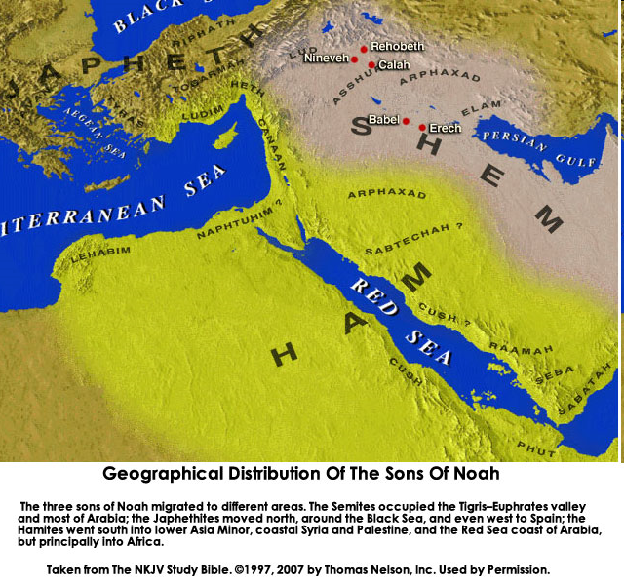

Slide 78

Genesis 11:1-4
¹ Now the whole earth used the same language and the same words. ² It came about as they journeyed east, that they found a plain in the land of Shinar and settled there. ³ They said to one another, “Come, let us make bricks and burn them thoroughly.” And they used brick for stone, and they used tar for mortar. ⁴ They said, “Come, let us build for ourselves a city, and a tower whose top will reach into heaven, and let us make for ourselves a name, otherwise we will be scattered abroad over the face of the whole earth.”

Slide 79
Dr. Arnold G. Fruchtenbaum
The Book of Genesis Record, 141
“A second observation is that all these ten names are Hebrew names and only make sense in Hebrew, although Jewish history has not yet begun. Moreover, all these people and their names existed prior to the Tower of Babel in Genesis 11, again indicating that the first language was the Hebrew language.”

Slide 81
Dr. Arnold G. Fruchtenbaum
The Book of Genesis Record, 142
“Adam lived until the 56th year of Lamech, the father of Noah. This means the tradition as told from Adam to his descendants was only once removed from Lamech and only twice removed from Noah.”

Slide 82
Ungodly Line of Cain
(Gen 4:16-24)
  Evil line that will not bring forth the Messiah (Gen 3:15)
    Continuation of Cain’s line (4:16-18)
    Immorality (4:19)
    Technological but not spiritual advancement (4:20-22)
    More immorality (4:23a)
    Violence (4:23b)
    Humanistic (4:24)

Slide 83

Genesis 11:6
The Lord said, “Behold, they are one people, and they all have the same language. And this is what they began to do, and now nothing which they purpose to do will be impossible for them.”

Slide 84
Conclusion

Slide 85
Genesis 5 Outline
  Introduction (5:1-2)
  Adam (5:3-5)
  Seth (5:6-8)
  Enosh (5:9-11)
  Kenan (5:12-14)
  Mahalalel (5:15-17)

Slide 86
Genesis 5 Outline
  Jared (5:18-20)
  Enoch (5:21-24)
  Methuselah (5:25-27)
  Lamech (5:28-31)
  Noah (5:32)

Slide 87

“The Lord bless you and keep you; the Lord make his face shine on you and be gracious to you; the Lord turn his face toward you and give you peace.” (NIV)

