Slide 1
THE RAPTURE
What and When? – Part 35
Andrew Marshall Woods, Th.M., JD., PhD.
Sr. Pastor, Sugar Land Bible Church

Slide 2
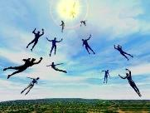
The Rapture Course Overview
What is the Rapture?
When is the Rapture?
Strengthening the Pre-Tribulational case
The opposing views
One second after the Rapture

Slide 3
The Rapture Course Overview
What is the Rapture?
When is the Rapture?
Strengthening the Pre-Tribulational case
The opposing views
One second after the Rapture

Slide 4
What is the Rapture?
An important doctrine
Distinct from the Second Advent
Catching away of all living believers (1 Thess 4:17)
Reunion (1 Thess 4:14-16)
Resurrection (1 Cor 15:50-54)
Exemption from death (1 Cor 15:51, 54-56)
Instantaneous (1 Cor 15:52)
Mystery (1 Cor 15:51)
Imminent (1 Cor 15:51; 1 Thess 4:15)
Traditional doctrine now being recovered

Slide 5
The Rapture Course Overview
What is the Rapture?
When is the Rapture?
Strengthening the Pre-Tribulational case
The opposing views
One second after the Rapture

Slide 6
When is the Rapture?
7 Arguments Favoring the Pre-Tribulation View
Tribulation's purpose concerns Israel (Jer 30:7; Dan 9:24)
No biblical reference to the church on earth during the Tribulation period (Rev 4-22)
Church is promised an exemption from divine wrath (1 Thess 1:10; 5:9; Rom 5:9; Rev 3:10; 6:17)
Rapture is imminent (1 Cor 15:51; 1 Thess 4:15)
Rapture is a comfort (1 Thess 4:18)
Antichrist cannot come to power until the restrainer is removed (2 Thess 2:6-7)
Symbolic parallels (2 Peter 2:5-9)

Slide 7
The Rapture Course Overview
What is the Rapture?
When is the Rapture?
Strengthening the Pre-Tribulational case
The opposing views
One second after the Rapture

Slide 8
Strengthening the Pre-Tribulation Case
John 14:1-4
Revelation 3:10
First Thessalonians 4‒5
Second Thessalonians 2:3a
Matthew 24‒25

Slide 9
The Rapture Course Overview
What is the Rapture?
When is the Rapture?
Strengthening the Pre-Tribulational case
The opposing views
One second after the Rapture

Slide 10
When Will the Rapture Take Place Relative to the Tribulation Period?
Pre-tribulation rapture theory
Mid-tribulation rapture theory
Post-tribulation rapture theory
Pre-wrath rapture theory
Partial rapture theory

Slide 11
When is the Rapture?
7 Arguments Favoring the Pre-Tribulation View
Tribulation's purpose concerns Israel (Jer 30:7; Dan 9:24)
No biblical reference to the church on earth during the Tribulation period (Rev 4-22)
Church is promised an exemption from divine wrath (1 Thess 1:10; 5:9; Rom 5:9; Rev 3:10; 6:17)
Rapture is imminent (1 Cor 15:51; 1 Thess 4:15)
Rapture is a comfort (1 Thess 4:18)
Antichrist cannot come to power until the restrainer is removed (2 Thess 2:6-7)
Symbolic parallels (2 Peter 2:5-9)

Slide 12
When Will the Rapture Take Place Relative to the Tribulation Period?
Pre-tribulation rapture theory
Mid-tribulation rapture theory
Post-tribulation rapture theory
Pre-wrath rapture theory
Partial rapture theory

Slide 14
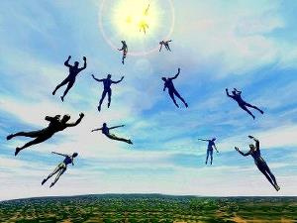
What is the Rapture?
An important doctrine
Distinct from the Second Advent
Catching away of all living believers (1 Thess 4:17)
Reunion (1 Thess 4:14-16)
Resurrection (1 Cor 15:50-54)
Exemption from death (1 Cor 15:51, 54-56)
Instantaneous (1 Cor 15:52)
Mystery (1 Cor 15:51)
Imminent (1 Cor 15:51; 1 Thess 4:15)
Traditional doctrine now being recovered

Slide 15
Rapture Distinct from Second Advent
RAPTURE (1 Thess 4:13-18; 1 Cor 15:51-58) | SECOND COMING (Rev 19:11-16)
Christ comes in the air (1 Thess 4:16-17) | Christ comes to the earth (Zech 14:4)
For His saints (1 Thess 4:15-17) | With His saints (Rev 19:14)
Blessing (1 Thess 4:18) | Judgment (Rev 19:15)
Effects only believers (1 Thess 4:16) | Effects both believers & unbelievers (Rev 19:15)

Slide 16
Rapture Distinct from Second Advent
RAPTURE (1 Thess 4:13-18; 1 Cor 15:51-58) | SECOND COMING (Rev 19:11-16)
Invisible (1 Thess 4:16) | Visible to all (Rev 1:7)
Announced only by an archangel (1 Thess 4:16) | Involves myriads of angels (Jude 14)
Resurrection (1 Cor 15: 51) | No resurrection
Rescue of the Church (1 Thess 1:10) | Rescue of Israel (Matt 23:37-39)

Slide 17
Post-tribulation Rapture Theory
According to 1 Thessalonians 4:16 and 1 Corinthians 15:52, the rapture will take place at the sounding of the last trumpet which, according to Matthew 24:30-31, will take place upon Christ's return at the end of the Tribulation period.
The Rapture is found in Revelation 19:11-21.
According to Revelation 20:4-6, the resurrection of all believers will transpire at the end of the Tribulation period thereby necessitating that the rapture will also take place at this time.

Slide 18
Post-tribulation Rapture Theory
Although the church is exempted from God's wrath, the church will be on the earth during the entire Tribulation period because the Book of Revelation portrays God's people being supernaturally protected from many of the apocalyptic judgments during this time period.
The post-tribulational rapture position has been the dominant view held by theologians throughout the history of the church.

Slide 19
Post-tribulation Rapture Theory
According to 1 Thessalonians 4:16 and 1 Corinthians 15:52, the rapture will take place at the sounding of the last trumpet which, according to Matthew 24:30-31, will take place upon Christ's return at the end of the Tribulation period.
The Rapture is found in Revelation 19:11-21.
According to Revelation 20:4-6, the resurrection of all believers will transpire at the end of the Tribulation period thereby necessitating that the rapture will also take place at this time.

Slide 20
1 Thessalonians 4:13-18
¹³ "But we do not want you to be uninformed, brethren, about those who are asleep, so that you will not grieve as do the rest who have no hope. ¹⁴ For if we believe that Jesus died and rose again, even so God will bring with Him those who have fallen asleep in Jesus. ¹⁵ For this we say to you by the word of the Lord, that we who are alive and remain until the coming of the Lord, will not precede those who . . .

Slide 21
1 Thessalonians 4:13-18
. . . have fallen asleep. ¹⁶ For the Lord Himself will descend from heaven with a shout, with the voice of the archangel and with the trumpet of God, and the dead in Christ will rise first. ¹⁷ Then we who are alive and remain will be caught up together with them in the clouds to meet the Lord in the air, and so we shall always be with the Lord. ¹⁸ Therefore comfort one another with these words."

Slide 22
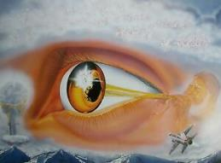
1 Corinthians 15:52
“in a moment, in the twinkling of an eye, at the last trumpet; for the trumpet will sound, and the dead will be raised imperishable, and we will be changed.”

Slide 23
Matthew 24:30-31
“³⁰ And then the sign of the Son of Man will appear in the sky, and then all the tribes of the earth will mourn, and they will see the Son of Man coming on the clouds of the sky with power and great glory. ³¹ And He will send forth His angels with a great trumpet and they will gather together [episynagō] His elect from the four winds, from one end of the sky to the other.”

Slide 24
Last Trump?
1 THESSALONIANS 4:13-18 | MATTHEW 24:30-31
Sounded before Christ returns to the earth | Sounded when Christ returns to the earth
Trump of an Archangel | Mention of many angels
No mention of angels regathering | Angels regather the elect

Slide 25
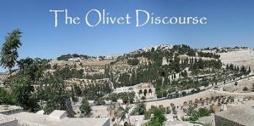
Thomas Ice
"Matthew 24:31: Rapture or Second Coming?," online: www.pre-trib.org, accessed 19 March 2014, 2.
“In 1 Thessalonians 4 believers are gathered in the air and taken to heaven, while in Matthew 24 they are gathered after Christ's arrival to earth.”

Slide 26
John A. Sproule
"An Exegetical Defense of Pretribulationalism" (Th.D. diss., Grace Theological Seminary, 1981), 53.
“Where does Paul mention the darkening of the sun (Matt. 24:29), the moon not giving its light (Matt. 24:29), the stars falling from the sky (Matt. 24:29), the powers of the heavens being shaken (Matt. 24:29), all the tribes of the earth mourning (Matt. 24:30), all the world seeing the coming of the Son of Man (Matt. 24:30), or God sending forth angels (Matt.24:31)?”

Slide 27
Paul D. Feinberg
"Response: Paul D. Feinberg," in The Rapture: Pre-, Mid-, or Posttribulational, ed. Richard R. Reiter (Grand Rapids: Zondervan, 1984), 225.
“Notice what happens when you examine both passages carefully. In Matthew the Son of Man comes on the clouds, while in 1 Thessalonians 4 the ascending believers are in them. In Matthew the angels gather the elect; in 1 Thessalonians the Lord Himself (note the emphasis) gathers the believers. Thessalonians only speaks of the voice of the archangel. In the Olivet Discourse nothing is said about a resurrection, while in the latter text it is the central point. In the two passages the differences in what will take place prior to the appearance of Christ is striking. Moreover, the order of ascent is absent from Matthew in spite of the fact that it is the central part of the epistle.”

Slide 28
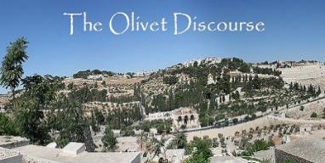
Matthew 24:31
³¹ “And He will send forth His angels with a great trumpet and they will gather together [episynagō] His elect from the four winds, from one end of the sky to the other.”

Slide 29
Matthew 23:37-39
³⁷ “Jerusalem, Jerusalem, who kills the prophets and stones those who are sent to her! How often I wanted to gather [episynagō] your children together, the way a hen gathers [episynagō] her chicks under her wings, and you were unwilling. ³⁸ Behold, your house is being left to you desolate! ³⁹ For I say to you, from now on you will not see Me until you say, ‘Blessed is He who comes in the name of the Lord!’”

Slide 30
Isaiah 27:13
“It will come about also in that day that a great trumpet will be blown, and those who were perishing in the land of Assyria and who were scattered in the land of Egypt will come and worship the Lord in the holy mountain at Jerusalem.”

Slide 31
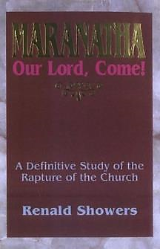
Renald Showers
Maranatha Our Lord, Come!: A Definitive Study of the Rapture of the Church (Bellmawr, NJ: Friends of Israel, 1995), 182-83.
“First, because of Israel's persistent rebellion against God, He declared that He would scatter the Jews ‘into all the winds’ (Ezek. 5:10, 12) or ‘toward all winds’ (Ezek. 17:21). In Zechariah 2:6 God stated that He did scatter them abroad ‘as four winds of the heavens.’ ... God did scatter the Jews all over the world. Next, God also declared that in the future Israel would be gathered from the east, west, north, and south, ‘from the ends of the earth’ (Isa. 43:5-7). We should note that in the context of this promise, God called Israel His ‘chosen’ (vv. 10, 20)...”

Slide 32
Renald Showers
Maranatha Our Lord, Come!: A Definitive Study of the Rapture of the Church (Bellmawr, NJ: Friends of Israel, 1995), 182-83.
“Just as Jesus indicated that the gathering of His elect from the four directions of the world will take place in conjunction with ‘a great trumpet’ (literal translation of the Greek text of Mt. 24:21), so Isaiah 27:13 teaches that the scattered children of Israel will be gathered to their homeland in conjunction with the blowing of ‘a great trumpet’ (literal translation of the Hebrew)... Gerhard Friedrich wrote that in that future eschatological day ‘a great horn shall be blown (Is. 27:13)’ and the exiled will be brought back by that signal. Again he asserted that in conjunction with the blowing of the great trumpet of Isaiah 27:13, ‘There follows the gathering of Israel and the return of the dispersed to Zion.’"

Slide 33
Renald Showers
Maranatha Our Lord, Come!: A Definitive Study of the Rapture of the Church (Bellmawr, NJ: Friends of Israel, 1995), 182-83.
“It is significant to note that Isaiah 27:13, which foretells this future regathering of Israel, is the only specific reference in the Old Testament to a ‘great’ trumpet. Although Isaiah 11:11-12 does not refer to a great trumpet, it is parallel to Isaiah 27:13 because it refers to the same regathering of Israel. In its context, this passage indicates that when the Messiah (a root of Jesse, vv. 1, 10) comes to rule and transform the world as an ‘ensign’ (a banner), He will gather together the scattered remnant of His people Israel ‘from the four corners of the earth.’”

Slide 34
Post-tribulation Rapture Theory
According to 1 Thessalonians 4:16 and 1 Corinthians 15:52, the rapture will take place at the sounding of the last trumpet which, according to Matthew 24:30-31, will take place upon Christ's return at the end of the Tribulation period.
The Rapture is found in Revelation 19:11-21.
According to Revelation 20:4-6, the resurrection of all believers will transpire at the end of the Tribulation period thereby necessitating that the rapture will also take place at this time.

Slide 36
What is the Rapture?
An important doctrine
Distinct from the Second Advent
Catching away of all living believers (1 Thess 4:17)
Reunion (1 Thess 4:14-16)
Resurrection (1 Cor 15:50-54)
Exemption from death (1 Cor 15:51, 54-56)
Instantaneous (1 Cor 15:52)
Mystery (1 Cor 15:51)
Imminent (1 Cor 15:51; 1 Thess 4:15)
Traditional doctrine now being recovered

Slide 37
1 Thessalonians 4:13-18
¹³ "But we do not want you to be uninformed, brethren, about those who are asleep, so that you will not grieve as do the rest who have no hope. ¹⁴ For if we believe that Jesus died and rose again, even so God will bring with Him those who have fallen asleep in Jesus. ¹⁵ For this we say to you by the word of the Lord, that we who are alive and remain until the coming of the Lord, will not precede those who . . .

Slide 38
1 Thessalonians 4:13-18
. . . have fallen asleep. ¹⁶ For the Lord Himself will descend from heaven with a shout, with the voice of the archangel and with the trumpet of God, and the dead in Christ will rise first. ¹⁷ Then we who are alive and remain will be caught up [harpazō] together with them in the clouds to meet the Lord in the air, and so we shall always be with the Lord. ¹⁸ Therefore comfort one another with these words."

Slide 39
Catching Away of All Living Believers (1 Thess 4:17)
Harpazo = seized or caught up by force
Harpazo (Greek) = rapere (Latin) = rapture (English)

Slide 40
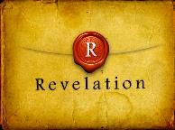
Revelation 19:11
“And I saw heaven opened, and behold, a white horse, and He who sat on it is called Faithful and True, and in righteousness He judges and wages war.”

Slide 41
Revelation 5:9-10
“ ⁹ And they sang a new song, saying, ‘Worthy are You to take the book and to break its seals; for You were slain, and purchased for God with Your blood men from every tribe and tongue and people and nation. ¹⁰ You have made them to be a kingdom and priests to our God; and they will reign upon the earth.’”

Slide 42
Zechariah 14:4
“In that day, His feet will stand on the Mount of Olives, which is in front of Jerusalem on the east; and the Mount of Olives will be split in its middle from east to west by a very large valley, so that half of the mountain will move toward the north and the other half toward the south.”

Slide 43
John 14:1–4
¹ “Do not let your heart be troubled; believe in God, believe also in Me. ² “In My Father’s house are many dwelling places; if it were not so, I would have told you; for I go to prepare a place for you. ³ “If I go and prepare a place for you, I will come again and receive you to Myself, that where I am, there you may be also. ⁴ “And you know the way where I am going.”

Slide 44
Parallels
JOHN 14:1-4 | 1 THESS 4:13-18
trouble (1) | sorrow (13)
Believe (1) | believe (14)
God, me (1) | Jesus, God (14)
told you (2) | say to you (15)
come again (3) | coming of the Lord (15)
receive, you (3) | caught up (17)
to myself (3) | to meet the Lord (17)
be where I am (3) | ever be with the Lord (17)
J. B. Smith, A Revelation of Jesus Christ: A Commentary on the Book of Revelation, 311-13

Slide 45
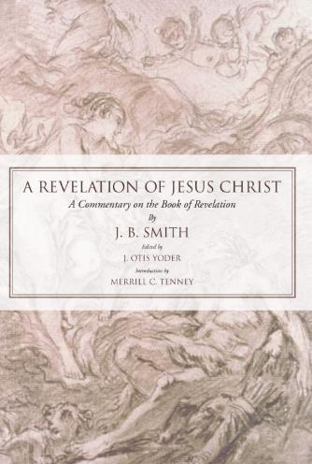
J. B. Smith
A Revelation of Jesus Christ: A Commentary on the Book of Revelation (Scottdale, PA: Herald Press, 1961), pp. 312-13.
“The words or phrases are almost an exact parallel. They follow one another in both passages in exactly the same order. Only the righteous are dealt with in each case. There is not a single irregularity in the progression of words from first to last. Either column takes the believer from the troubles of earth to the glories of heaven.”

Slide 46
J. B. Smith
A Revelation of Jesus Christ: A Commentary on the Book of Revelation (Scottdale, PA: Herald Press, 1961), pp. 312.
“Hence it is impossible that one sentence or even one phrase can be alike in the two lists…And finally not one word in the two lists is used in the same relation or connection...It would be difficult if not impossible to find elsewhere any two important passages of Scripture that are so diverse in the words employed and so opposite in their implications. . . . We believe the comparison of the words of these two passages . . . describe different events.”

Slide 47
Post-tribulation Rapture Theory
According to 1 Thessalonians 4:16 and 1 Corinthians 15:52, the rapture will take place at the sounding of the last trumpet which, according to Matthew 24:30-31, will take place upon Christ's return at the end of the Tribulation period.
The Rapture is found in Revelation 19:11-21.
According to Revelation 20:4-6, the resurrection of all believers will transpire at the end of the Tribulation period thereby necessitating that the rapture will also take place at this time.

Slide 48
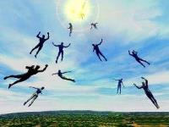
What is the Rapture?
An important doctrine
Distinct from the Second Advent
Catching away of all living believers (1 Thess 4:17)
Reunion (1 Thess 4:14-16)
Resurrection (1 Cor 15:50-54)
Exemption from death (1 Cor 15:51, 54-56)
Instantaneous (1 Cor 15:52)
Mystery (1 Cor 15:51)
Imminent (1 Cor 15:51; 1 Thess 4:15)
Traditional doctrine now being recovered

Slide 49
1 Thessalonians 4:13-18
...have fallen asleep. ¹⁶ For the Lord Himself will descend from heaven with a shout, with the voice of the archangel and with the trumpet of God, and the dead in Christ will rise first. ¹⁷ Then we who are alive and remain will be caught up [harpazō] together with them in the clouds to meet the Lord in the air, and so we shall always be with the Lord. ¹⁸ Therefore comfort one another with these words."

Slide 50
1 Corinthians 15:50-51
“⁵⁰ Now I say this, brethren, that flesh and blood cannot inherit the kingdom of God; nor does the perishable inherit the imperishable. ⁵¹ Behold, I tell you a mystery; we will not all sleep, but we will all be changed.”

Slide 51
Revelation 20:4-6
“⁴ Then I saw thrones, and they sat on them, and judgment was given to them. And I saw the souls of those who had been beheaded because of their testimony of Jesus and because of the word of God, and those who had not worshiped the beast or his image, and had not received the mark on their forehead and on their hand; and they came to life [zaō] and reigned with Christ for a thousand years….

Slide 52
Revelation 20:4-6
…⁵ The rest of the dead did not come to life [zaō] until the thousand years were completed. This is the first resurrection [anastasis]. ⁶ Blessed and holy is the one who has a part in the first resurrection [anastasis]; over these the second death has no power, but they will be priests of God and of Christ and will reign with Him for a thousand years.”

Slide 54
George Eldon Ladd
The Blessed Hope (Grand Rapids: Eerdmans, 1956), 165.
According to posttribulationalist George Ladd, "With the exception of one passage, the author will grant that the Scripture nowhere explicitly states that the Church will go through the Great Tribulation… However, in one passage, Revelation 20, the Resurrection is placed at the return of Christ in glory. This is more than an inference…which requires a posttribulation view...”

Slide 55
Revelation 20:4-6
“⁴ Then I saw thrones, and they sat on them, and judgment was given to them. And I saw the souls of those who had been beheaded because of their testimony of Jesus and because of the word of God, and those who had not worshiped the beast or his image, and had not received the mark on their forehead and on their hand; and they came to life [zaō] and reigned with Christ for a thousand years….

Slide 56
Norman Geisler
Systematic Theology, vol. 4
(Minneapolis, MN: Bethany, 2004), 654.
“Revelation 20:4-6 is speaking of the believers who have died during the Tribulation, not those resurrected at the Rapture" (1 Thess. 4:13-18; 1 Cor. 15:50-58).”

Slide 57
Revelation 20:4-6
“⁴ Then I saw thrones, and they sat on them, and judgment was given to them. And I saw the souls of those who had been beheaded because of their testimony of Jesus and because of the word of God, and those who had not worshiped the beast or his image, and had not received the mark on their forehead and on their hand; and they came to life [zaō] and reigned with Christ for a thousand years….

Slide 58
Revelation 20:4-6
…⁵ The rest of the dead did not come to life [zaō] until the thousand years were completed. This is the first resurrection [anastasis]. ⁶ Blessed and holy is the one who has a part in the first resurrection [anastasis]; over these the second death has no power, but they will be priests of God and of Christ and will reign with Him for a thousand years.”

Slide 59
1 Thessalonians 4:13-18
¹³ "But we do not want you to be uninformed, brethren, about those who are asleep, so that you will not grieve as do the rest who have no hope. ¹⁴ For if we believe that Jesus died and rose again, even so God will bring with Him those who have fallen asleep in Jesus. ¹⁵ For this we say to you by the word of the Lord, that we who are alive and remain until the coming of the Lord, will not precede those who . . .

Slide 60
1 Thessalonians 4:13-18
. . . have fallen asleep. ¹⁶ For the Lord Himself will descend from heaven with a shout, with the voice of the archangel and with the trumpet of God, and the dead in Christ will rise first. ¹⁷ Then we who are alive and remain will be caught up [harpazō] together with them in the clouds to meet the Lord in the air, and so we shall always be with the Lord. ¹⁸ Therefore comfort one another with these words."

Slide 61
1 Corinthians 15:50-51
“⁵⁰ Now I say this, brethren, that flesh and blood cannot inherit the kingdom of God; nor does the perishable inherit the imperishable. ⁵¹ Behold, I tell you a mystery; we will not all sleep, but we will all be changed.”

Slide 62
Charles Ryrie
What You Should Know About the Rapture, Current Christian Issues (Chicago: Moody, 1981), 63-64.
“...Revelation 20:4 speaks only of a resurrection of the dead, not of a translation of living people, a truth that is prominent and a vital part of the other descriptions of the rapture in 1 Thessalonians 4:13-18 and 1 Corinthians 15:51-58).”

Slide 63
Revelation 20:4-6
…⁵ The rest of the dead did not come to life [zaō] until the thousand years were completed. This is the first resurrection [anastasis]. ⁶ Blessed and holy is the one who has a part in the first resurrection [anastasis]; over these the second death has no power, but they will be priests of God and of Christ and will reign with Him for a thousand years.”

Slide 66
Post-tribulation Rapture Theory
Although the church is exempted from God's wrath, the church will be on the earth during the entire Tribulation period because the Book of Revelation portrays God's people being supernaturally protected from many of the apocalyptic judgments during this time period.
The post-tribulational rapture position has been the dominant view held by theologians throughout the history of the church.

Slide 67
When is the Rapture?
7 Arguments Favoring the Pre-Tribulation View
Tribulation's purpose concerns Israel (Jer 30:7; Dan 9:24)
No biblical reference to the church on earth during the Tribulation period (Rev 4-22)
Church is promised an exemption from divine wrath (1 Thess 1:10; 5:9; Rom 5:9; Rev 3:10; 6:17)
Rapture is imminent (1 Cor 15:51; 1 Thess 4:15)
Rapture is a comfort (1 Thess 4:18)
Antichrist cannot come to power until the restrainer is removed (2 Thess 2:6-7)
Symbolic parallels (2 Peter 2:5-9)

Slide 68
Promised Exemption from Divine Wrath
The promise (1 Thess 1:10; 5:9; Rom 5:9; 8:1; Rev 3:10)
Tribulation = divine wrath/anger (Rev 6:16-17; 11:18; 14:10; 15:1, 7; 16:1, 19; 19:15)

Slide 69
Protection Through the Tribulation?
(Revelation 3:10)
Like the protection in Goshen (Exod. 8:22, 24; 9;4, 6; 11:4-7; Rev. 9:4; 16:2)
Effective? Rev. 6:9-11; 7:13-14; 13:10, 15; 20:4

Slide 70
Protection Through the Tribulation?
(Revelation 3:10)
Like the protection in Goshen (Exod. 8:22, 24; 9;4, 6; 11:4-7; Rev. 9:4; 16:2)
Effective? Rev. 6:9-11; 7:13-14; 13:10, 15; 20:4

Slide 71
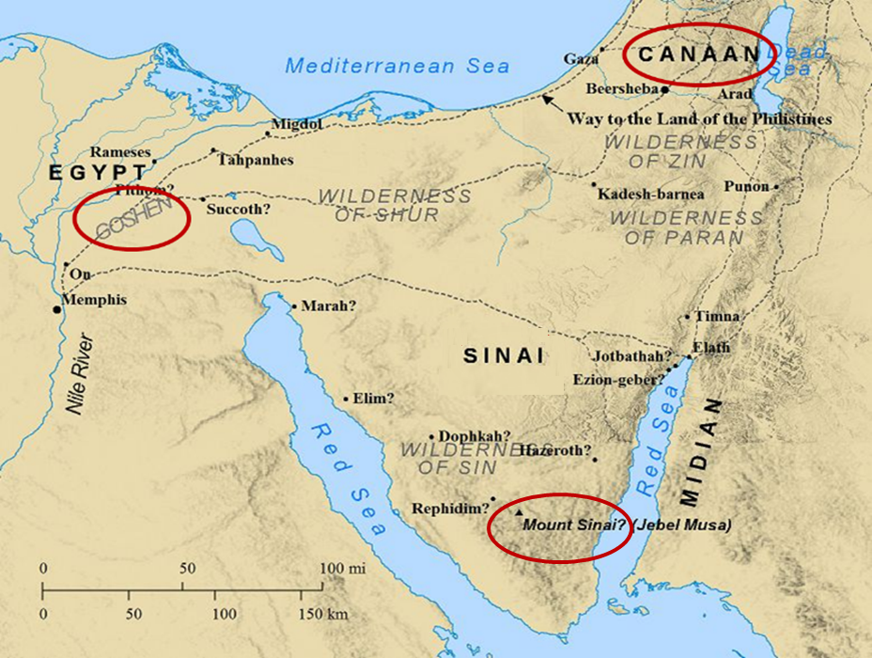

Slide 72
Protection Through the Tribulation?
(Revelation 3:10)
Like the protection in Goshen (Exod. 8:22, 24; 9;4, 6; 11:4-7; Rev. 9:4; 16:2)
Effective? Rev. 6:9-11; 7:13-14; 13:10, 15; 20:4

Slide 73
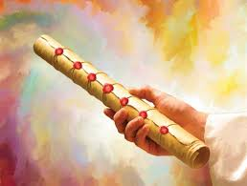
1st Six Seals (Revelation 6)
SEAL 1 – 6:1-2 – Advent of antichrist
SEAL 2 – 6:3-4 – War
SEAL 3 – 6:5-6 – Famine
SEAL 4 – 6:7-8 – Death
SEAL 5 – 6:9-11 – Martyrdoms
SEAL 6 – 6:12-17 – Cosmic disturbances

Slide 74
Distinctions Between 144,000 & Multitude
144,000 | MULTITUDE
Revelation 7:1-8 | Revelation 7:9-17
Numbered | Innumerable
Jews | All nations
Sealed | Slain
Sealed before the Tribulation | Converted out of the Tribulation
Hitchcock and Ice, The Truth Behind Left Behind, 77

Slide 75
Protection Through the Tribulation?
(Revelation 3:10)
Like the protection in Goshen (Exod. 8:22, 24; 9;4, 6; 11:4-7; Rev. 9:4; 16:2)
Effective? Rev. 6:9-11; 7:13-14; 13:10, 15; 20:4

Slide 76
Revelation 3:10
“Because you have kept the word of My perseverance, I also will keep you from the hour [hōra] of testing, that hour which is about to come upon the whole world, to test those who dwell on the earth.”

Slide 77
Charles Ryrie
What You Should Know About the Rapture, Current Christian Issues (Chicago: Moody, 1981), 116-17.
“However, the promise of Revelation 3:10 not only guarantees being kept from the trials of the Tribulation period but being kept from the time period of the Tribulation. The promise is not, I will keep you from the trials. It is I will keep you from the hour of the trials...But how clear and plain is the promise. ‘I...will keep you from the hour of testing.’ Not just from any persecution, but from the coming time that will affect the whole earth. (The only way to escape worldwide trouble is not to be on the earth.) And not just from the events, but from the time. And the only way to escape the time when the events take place is not to be in a place where time ticks on. The only place that meets those qualifications is heaven.”

Slide 78
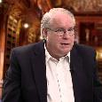
Ron Rhodes
The End Times in Chronological Order: A Complete Overview to Understanding Bible Prophecy (Eugene, OR: Harvest, 2012), 50.
“The posttribulational view, expressed in the writings of George Eldon Ladd, Robert Gundry, and others, is the view that Christ will rapture the church after the tribulation period at the second coming of Christ. This means the church will go through the time of judgment prophesied in the book of Revelation, but believers will be kept from Satan's wrath during the tribulation (Revelation 3:10). Pretribulationalists (such as myself) respond, however, that Revelation 3:10 indicates that believers will be saved out of or separated from (Greek: ek) the actual time period of the tribulation.”

Slide 79
Norman Geisler
Systematic Theology, vol. 4
(Minneapolis, MN: Bethany, 2004), 654.
“In context, the statement about being saved 'out of' (Gk: ek) the time of trial does mean saved from it (not through it). One cannot be saved from an entire hour by being in any part of it.”

Slide 80
Post-tribulation Rapture Theory
Although the church is exempted from God's wrath, the church will be on the earth during the entire Tribulation period because the Book of Revelation portrays God's people being supernaturally protected from many of the apocalyptic judgments during this time period.
The post-tribulational rapture position has been the dominant view held by theologians throughout the history of the church.

Slide 81
George Eldon Ladd
The Blessed Hope (Grand Rapids: Eerdmans, 1956), 31.
According to posttribulationalist George Ladd, "every church father who deals with the subject expects the church to suffer at the hands of the Antichrist" and "the prevailing view is post-tribulational premillennialism.”

Slide 82
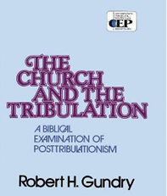
Robert H. Gundry
The Church and the Tribulation (Grand Rapids: Zondervan, 1973), 173.
Gundry similarly concludes, "Until Augustine in the fourth century, the early Church generally held to the premillennarian understanding of Biblical eschatology...And it was post-tribulational.”

Slide 83
What is the Rapture?
An important doctrine
Distinct from the Second Advent
Catching away of all living believers (1 Thess 4:17)
Reunion (1 Thess 4:14-16)
Resurrection (1 Cor 15:50-54)
Exemption from death (1 Cor 15:51, 54-56)
Instantaneous (1 Cor 15:52)
Mystery (1 Cor 15:51)
Imminent (1 Cor 15:51; 1 Thess 4:15)
Traditional doctrine now being recovered

Slide 84
Post-tribulationalism’s Appeal to Antiquity?
First, the issue is not when the view became popular but if it is taught in the Bible.
Second, the notion that the earliest Church Fathers were universally post-tribulational is a highly debatable proposition.
Third, prophetic truth is designed by the Holy Spirit to become progressively more understandable as the world approaches the allotted time period when the prophecies will be fulfilled.

Slide 85
Post-tribulationalism’s Appeal to Antiquity?
First, the issue is not when the view became popular but if it is taught in the Bible.
Second, the notion that the earliest Church Fathers were universally post-tribulational is a highly debatable proposition.
Third, prophetic truth is designed by the Holy Spirit to become progressively more understandable as the world approaches the allotted time period when the prophecies will be fulfilled.

Slide 86
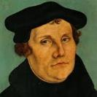
“I ask for the Scripture, and Eck offers me the Fathers. I ask for the sun, and he shows me his lanterns. I ask, ‘where is your Scripture proof?’ and he adduces Ambrose and Cyril…With all due respect to the Fathers, I prefer the authority of Scripture.”
Martin Luther
Quoted by F.W. Farrar, History of interpretation (NY: E.P. Dutton and Company, 1886), 327.

Slide 87
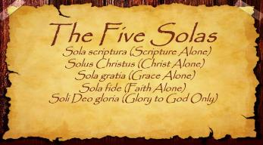
The Five Solas (Alone or By Itself)
Solus Christus – Christ alone
Sola Fide – faith alone
Sola Gratia – grace alone
Sola Scriptura – Scripture alone
Soli Deo Gloria – To the glory of God alone

Slide 88
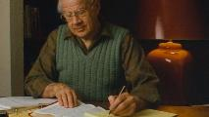
J. Dwight Pentecost Things to Come, Page 168
“If the same line of reasoning were followed one would not accept the doctrine of justification by faith, for it was not clearly taught until the Reformation. The failure to discern the teaching of Scripture does not nullify that teaching.”

Slide 89
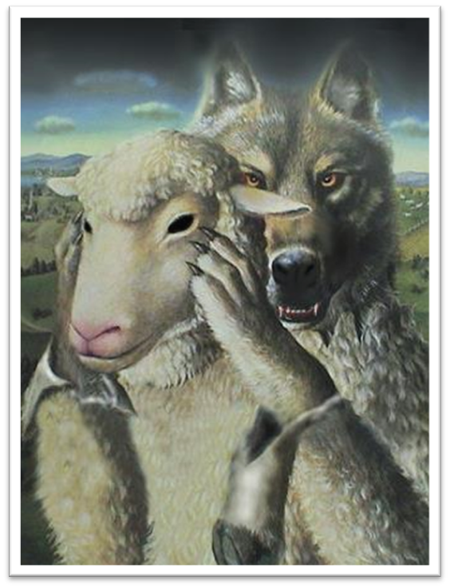
Acts 20:29
“For I know this, that after my departure savage wolves will come in among you, not sparing the flock.” (Italics added).

Slide 90
Post-tribulationalism’s Appeal to Antiquity?
First, the issue is not when the view became popular but if it is taught in the Bible.
Second, the notion that the earliest Church Fathers were universally post-tribulational is a highly debatable proposition.
Third, prophetic truth is designed by the Holy Spirit to become progressively more understandable as the world approaches the allotted time period when the prophecies will be fulfilled.

Slide 91
J. Dwight Pentecost Things to Come, Page 168
“The early church lived in the light of the belief in the imminent return of Christ. Their expectation was that Christ might return at any time. Pre-tribulationism is the only position consistent with this doctrine of imminence.”

Slide 92
Jesse Forest Silver
The Lord’s Return: Seen in History and in Scripture as Premillennial and Imminent (NY: Revell, 1914), 62-64.
Silver says of the apostolic fathers that “they expected the return of the Lord in their day…They believed the time was imminent because the Lord had taught them to live in a watchful attitude.” Concerning the ante Nicene fathers, he says: “by tradition they knew the faith of the apostles. They taught the doctrine of the imminent and pre-millennial return of the Lord.”

Slide 93
Second Epistle of Clement to the Corinthians 4.15. (A.D. 95‒140)
“Wherefore let us every hour expect the kingdom of God in love and righteousness; because we know not the day of God's appearing.”

Slide 94
Didache 16.1. (A.D. 120)
“Watch for your life's sake. Let not your lamps be quenched, nor your loins unloosed; but be ready, for you know not the hour in which our Lord will come.”

Slide 95
Epistle of Barnabas 21. (A.D. 70‒135)
“For the day is at hand on which all things shall perish with the evil [one]. The Lord is near, and His reward.”

Slide 96
Pseudo Ephraem (4th-6th century A.D.)
“Why therefore do we not reject every care of earthly actions and prepare ourselves for the meeting of the Lord Christ, so that he may draw us from the confusion, which overwhelms all the world…For all the saints and the elect of God are gathered, prior to the tribulation that is to come, and are taken to the Lord lest they see the confusion that is to overwhelm the world because of our sins.”

Slide 97
Post-tribulationalism’s Appeal to Antiquity?
First, the issue is not when the view became popular but if it is taught in the Bible.
Second, the notion that the earliest Church Fathers were universally post-tribulational is a highly debatable proposition.
Third, prophetic truth is designed by the Holy Spirit to become progressively more understandable as the world approaches the allotted time period when the prophecies will be fulfilled.

Slide 98
“The Rapture” a Traditional Doctrine Now Being Recovered
Sola scriptura
Negative influence of Augustine and Origen
Pseudo Ephraem (4th-6th century A.D.)
Progressive illumination

Slide 99
Jude 3
“Beloved, while I was making every effort to write you about our common salvation, I felt the necessity to write to you appealing that you contend earnestly for the faith which was once for all handed down to the saints.”

Slide 100
Revelation 22:18-19
“I testify to everyone who hears the words of the prophecy of this book: if anyone adds to them, God will add to him the plagues which are written in this book; ¹⁹ and if anyone takes away from the words of the book of this prophecy, God will take away his part from the tree of life and from the holy city, which are written in this book.”

Slide 101
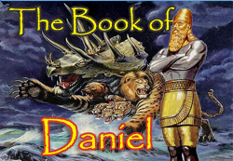
Daniel 12:4, 9
“⁴ But as for you, Daniel, conceal these words and seal up the book until the end of time; many will go back and forth, and knowledge will increase...⁹ Go your way, Daniel, for these words are concealed and sealed up until the end time.”

Slide 102
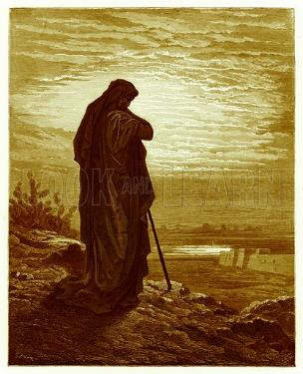
Amos 8:12
“People will stagger from sea to sea And from the north even to the east; They will go to and fro to seek the word of the Lord, But they will not find it.”

Slide 103
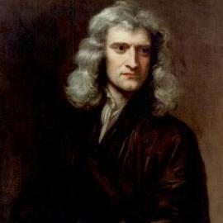
Sir Isaac Newton (1642–1727)
"About the time of the end, a body of men will be raised up who will turn their attention to the Prophecies, and insist upon their literal interpretation, in the midst of much clamor and opposition."
Isaac Newton cited in Nathaniel West, The Thousand Years in Both Testaments, 462.

Slide 104
Daniel 8:27
“Then I, Daniel, was exhausted and sick for days. Then I got up again and carried on the king’s business; but I was astounded at the vision, and there was none to explain it.”

Slide 105
1 Peter 1:10-11
¹⁰ As to this salvation, the prophets who prophesied of the grace that would come to you made careful searches and inquiries, ¹¹ seeking to know what person or time the Spirit of Christ within them was indicating as He predicted the sufferings of Christ and the glories to follow.

Slide 106
History of Doctrine
Canon (A.D. 180)
Christology (A.D. 500)
Atonement (A.D. 1100)
Salvation (A.D. 1500)
Eschatology (A.D. 1800)

Slide 107
James Orr
The Progress of Dogma (Grand Rapids: Eerdmans, 1952), 21-31.
Orr outlines the progress of Christian dogma in a similar way. “The second century was the age of Apologetics. The doctrine of God and especially the Trinity then took center stage in the third and fourth centuries as the Church dealt with the Monarchian, Arian, and Macedonian controversies. Anthropology then became the Church's focus in the early fifth century during the Augustinian and Pelagian controversies...The late fifth and then sixth and seventh centuries were characterized by an ecclesiastical interest in Christological (Nestorian, Eutychian, Monphysite, Monothelite) matters. In the . . .

Slide 108
James Orr
The Progress of Dogma (Grand Rapids: Eerdmans, 1952), 21-31.
“. . .sixteenth century the reformers focused upon salvific or Soteriological concerns. Finally, the Church gave itself to correcting a Mythical and Mediaeval pre-reformation Eschatology.” Thus, Eschatology was the last of the branches of theology to be systematized since it was not designed to be progressively unsealed or illuminated by the Holy Spirit until just before the fulfillment of the predicted events (Dan. 12:4, 8-9).

Slide 109
Conclusion

Slide 110
When Will the Rapture Take Place Relative to the Tribulation Period?
Pre-tribulation rapture theory
Mid-tribulation rapture theory
Post-tribulation rapture theory
Pre-wrath rapture theory
Partial rapture theory

Slide 111
Post-tribulation Rapture Theory
According to 1 Thessalonians 4:16 and 1 Corinthians 15:52, the rapture will take place at the sounding of the last trumpet which, according to Matthew 24:30-31, will take place upon Christ's return at the end of the Tribulation period.
The Rapture is found in Revelation 19:11-21.
According to Revelation 20:4-6, the resurrection of all believers will transpire at the end of the Tribulation period thereby necessitating that the rapture will also take place at this time.

Slide 112
Post-tribulation Rapture Theory
Although the church is exempted from God's wrath, the church will be on the earth during the entire Tribulation period because the Book of Revelation portrays God's people being supernaturally protected from many of the apocalyptic judgments during this time period.
The post-tribulational rapture position has been the dominant view held by theologians throughout the history of the church.

Slide 113
When Will the Rapture Take Place Relative to the Tribulation Period?
Pre-tribulation rapture theory
Mid-tribulation rapture theory
Post-tribulation rapture theory
Pre-wrath rapture theory
Partial rapture theory

