Slide 1
PRACTICAL RIGHTEOUSNESS
Dr. Andy Woods
Senior Pastor – Sugar Land Bible Church
President – Chafer Theological Seminary

Slide 2
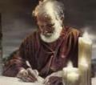
Answering Eleven Questions
Who wrote it? – James
What do we know about the author? – Christ’s ½ Brother
Who was the audience? – Believing Jews in the Diaspora
Where was if written from? – Jerusalem
When was the book written? – A.D. 44‒47
What was the book’s occasion? – Practical righteousness
What is the book’s purpose? – Achieving practical righteousness
What is the book about? – Practical righteousness
What is the book’s theme? – Daily living
What makes the book different? – Practicality
How is the book organized? – Faith and Wisdom

Slide 3
JAMES STRUCTURE
Faith (James 1:1‒3:12)
Wisdom (James 3:13‒5:20)

Slide 4
JAMES STRUCTURE
Faith (James 1:1‒3:12)
Wisdom (James 3:13‒5:20)

Slide 5
JAMES STRUCTURE
Faith (1:1–3:12)
Trials (1:2-18)
Obedience to the Word (1:19-27)
Favoritism (2:1-13)
Faith manifesting works (2:14-26)
Tongue (3:1-12)

Slide 6
JAMES STRUCTURE
Faith (1:1–3:12)
Trials (1:2-18)
Obedience to the Word (1:19-27)
Favoritism (2:1-13)
Faith manifesting works (2:14-26)
Tongue (3:1-12)

Slide 7
James 1:2-18
Trials – Jas 1:2-18
Rejoicing during trials – Jas 1:2-12
Command not to charge God with temptation – Jas 1:13-18

Slide 8
JAMES STRUCTURE
Faith (1:1–3:12)
Trials (1:2-18)
Obedience to the Word (1:19-27)
Favoritism (2:1-13)
Faith manifesting works (2:14-26)
Tongue (3:1-12)

Slide 9
Faith Obeys God (James 1:19-27)
Need for Slowness in Speaking & Anger (1:19-20)
Need for Obedience to God’s Word (1:21-25)
Need for True Religion (1:26-27)

Slide 10
JAMES STRUCTURE
Faith (1:1–3:12)
Trials (1:2-18)
Obedience to the Word (1:19-27)
Favoritism (2:1-13)
Faith manifesting works (2:14-26)
Tongue (3:1-12)

Slide 11
Favoritism (2:1-13)
Command: no favoritism (2:1)
Situation: favoritism in the assembly (2:2-3)
Reasoning: favoritism is contrary to God’s character & purposes (2:4-13)

Slide 12
JAMES STRUCTURE
Faith (1:1–3:12)
Trials (1:2-18)
Obedience to the Word (1:19-27)
Favoritism (2:1-13)
Faith manifesting works (2:14-26)
Tongue (3:1-12)

Slide 13
James 2:17, 20, 26
“¹⁷ Even so faith, if it has no works, is dead [nekros], being by itself... ²⁰ But are you willing to recognize, you foolish fellow, that faith without works is useless [argos]?...²⁶ For just as the body without the spirit is dead [nekros], so also faith without works is dead [nekros].”

Slide 14
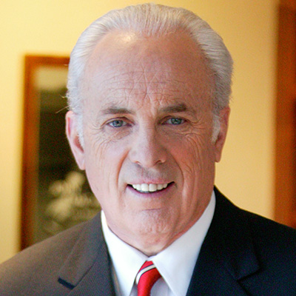
John MacArthur
MACARTHUR STUDY BIBLE (revised edition). Comment on James 2:17.
“faith by itself… is dead: Just as professed compassion without action is phony, the kind of faith that is without works is mere empty profession, not genuine saving faith.”

Slide 15
John MacArthur
FAITH WORKS (page 149)
“Faith in this context is clearly saving faith (v. 1). James is speaking of eternal salvation. He has referred to ‘the word implanted, which is able to save your souls’ in 1:21. Here he has the same salvation in view. He is not disputing whether faith saves. Rather, he is opposing the notion that faith can be a passive, fruitless, intellectual exercise and still save. Where there are no works, we must assume no faith exists either.”

Slide 16
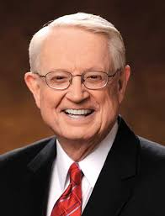
Charles Swindoll
THE SWINDOLL STUDY BIBLE
“First, Paul is looking at the root of our salvation, while James is looking at the fruit after salvation. Paul emphasizes the point that at the time of conversion, the root of salvation is faith alone. James sees that the faith that saves us does not remain alone, though we are saved by faith alone. After salvation, there are things that will inevitably happen in our lives that show the reality of our salvation . . . Can a faith that is not validated save? The answer is clearly implied by James’s argument: No, that phony kind of faith cannot save anyone.”

Slide 17
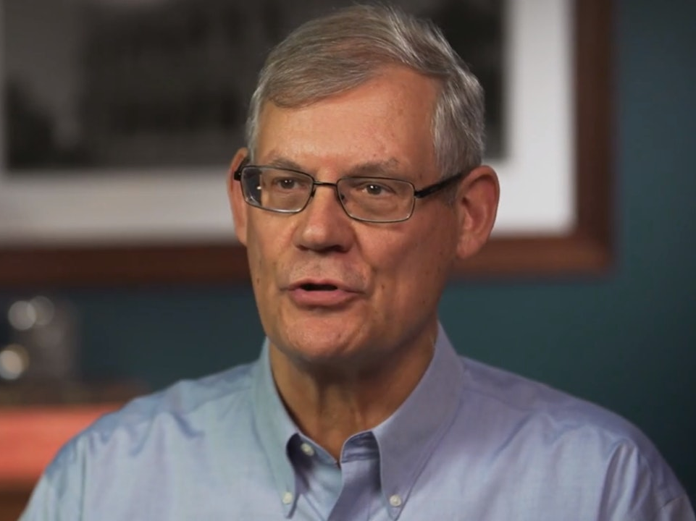
Douglas J. Moo
THE PILLAR NEW TESTAMENT COMMENTARY
“In what way is such faith ‘dead’? In the sense that it does not attain its purpose: it cannot save (v. 14) or justify (v. 24). Critical to understanding the argument of the section and integrating it successfully into a broader biblical perspective is the recognition that James is not arguing that works must be added to faith. His point, rather, is that genuine biblical faith will inevitably be characterized by works . . . James, in a sense, proposes for us in these verses a ‘test’ by which we determine the genuineness of faith: deeds of obedience to the will of God.”

Slide 18
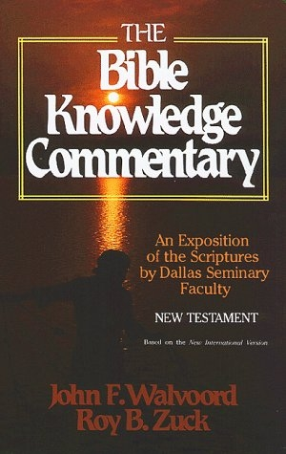
J. Ronald Blue
THE BIBLE KNOWLEDGE COMMENTARY
“Just as the law of love gives no excuse for respect of persons, so the possession of faith gives no license to dispense with good works. A believer must not only demonstrate his love by ready acceptance of others, but he must also demonstrate his faith by responsible aid to others. James went on in his letter to emphasize the expression of true faith, to outline the evidence of true faith, and finally to cite examples of true faith. Comment on 2:14. Can such faith save him? A negative answer is anticipated in the Greek. Merely claiming to have faith is not enough. Genuine faith is evidenced by works.”

Slide 19
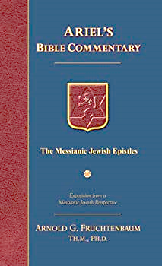
Dr. Arnold G. Fruchtenbaum
The Messianic Jewish Epistles, 251-52, 54
Comment on James 2:14. “The meaning of justification: for Paul the word justification meant acquittal, and Paul was concerned with legal justification in that no man can gain justification by means of works, specifically the works of the Law; for Jacob/James, the meaning of justification was vindication, and he was concerned with the justification of one’s profession of faith in that his claim must be demonstrated by his works, specifically the works of love and faith . . . Fourth, Jacob/James’s point is a faith that saves is a faith that is expected to produce works. Fifth, a living faith will authenticate itself in the production of works.”

Slide 20
Dr. Arnold G. Fruchtenbaum
The Messianic Jewish Epistles, 251-52, 54
“Sixth, while faith and works are two opposing elements insofar as the means of salvation is concerned, they are, nevertheless, both involved in salvation. One is the means of salvation and the other is the evidence of salvation.” Comment on James 2:15-17: “Faith without works is a dead faith. It is dead in itself; it is not merely outwardly barren, but it is dead inwardly. It is lifeless. It shows that it is not true saving faith because true saving faith will reveal itself by works, which are the fruits of faith. This very same concept is taught in the Sermon on the Mount (Matt 5:14-16).”

Slide 21
Charles C. Ryrie
THE RYRIE STUDY BIBLE. Comment on James 2:14.
Comment on James 2:14. “Can a non-working, dead, spurious faith save a person? James is not saying that we are saved by works, but that faith that does not produce good works is a dead faith. James was not refuting the Pauline doctrine of justification by true faith, but a perversion of it. Both Paul and James define faith as a living, productive trust in Christ. Genuine faith cannot be ‘dead’ to morality or barren to works.”

Slide 22
Warren W. Wiersbe
THE BIBLE EXPOSITION COMMENTARY
Comment on James 2:14. “The question in James 2:14 should read, ‘Can that kind of faith save him?’ What kind? The kind of faith that is never seen in practical works. The answer is no! Any declaration of faith that does not result in a changed life and good works is a false declaration. That kind of faith is dead faith. ‘Even so faith, if it hath not works, is dead, being alone’ (James 2:17). The great theologian, John Calvin, wrote, ‘It is faith alone that justifies, but faith that justifies can never be alone.’ The word alone in James 2:17 simply means ‘by itself.’ True saving faith can never be by itself: it always brings life, and life produces good works.”

Slide 23
Warren W. Wiersbe
THE BIBLE EXPOSITION COMMENTARY
Comment on James 2:18-19. “But it is not a saving experience to believe and tremble. A person can be enlightened in his mind and even stirred in his heart and be lost forever. True saving faith involves something more, something that can be seen and recognized: a changed life. ‘Show me thy faith without thy works,’ challenged James, ‘and I will show thee my faith by my works’ (James 2:18).”

Slide 24
Warren W. Wiersbe
THE BIBLE EXPOSITION COMMENTARY
Comment on James 2:20-26. “True saving faith leads to action. Dynamic faith is not Intellectual contemplation or emotional consternation; it leads to obedience on the part of the will. And this obedience is not an isolated event: it continues throughout the whole life. It leads to works . . . It is important that each professing Christian examine his own heart and life and make sure that he possesses true saving faith, dynamic faith. ‘Examine yourselves, whether ye be in the faith; prove your own selves’ (2 Cor. 13:5a). Satan is the great deceiver; one of his devices is imitation. If he can convince a person that counterfeit faith is true faith, he has that person in his power.”

Slide 25
Answering Eleven Questions
Who wrote it? – James
What do we know about the author? – Christ’s ½ Brother
Who was the audience? – Believing Jews in the Diaspora
Where was if written from? – Jerusalem
When was the book written? – A.D. 44‒47
What was the book’s occasion? – Practical righteousness
What is the book’s purpose? – Achieving practical righteousness
What is the book about? – Practical righteousness
What is the book’s theme? – Daily living
What makes the book different? – Practicality
How is the book organized? – Faith and Wisdom

Slide 26
Three Tenses of Salvation
Phase | Justification | Sanctification | Glorification
Tense | Past | Present | Future
Saved from sin’s: | Penalty | Power | Presence
Scripture | Eph 2:8-9; Titus 3:5 | Philip 2:12 | Rom 5:10
Nature | Single | Dual | Single

Slide 27
Three Tenses of Salvation
Phase | Justification | Sanctification | Glorification
Tense | Past | Present | Future
Saved from sin’s: | Penalty | Power | Presence
Scripture | Eph 2:8-9; Titus 3:5 | Philip 2:12 | Rom 5:10
Nature | Single | Dual | Single

Slide 28
Faith Obeys God (James 1:19-27)
Need for Slowness in Speaking & Anger (1:19-20)
Need for Obedience to God’s Word (1:21-25)
Need for True Religion (1:26-27)

Slide 29
Favoritism (2:1-13)
Command: no favoritism (2:1)
Situation: favoritism in the assembly (2:2-3)
Reasoning: favoritism is contrary to God’s character & purposes (2:4-13)

Slide 30
III. Reasoning: Favoritism is Contrary to God’s Character & Purposes (2:4-13)
We judge where God has not (4)
God elects all (2:5)
Rich oppressors (2:6-7)
Favoritism violates God’s Law (2:8-11)
God will judge those showing favoritism (2:12-13)

Slide 31
Harmony Between Paul and James
 | PAUL | JAMES
Phase of Salvation | Justification | Sanctification
Tense of Salvation | First tense | Second tense
Issue | Self righteous Judaism | Dead orthodoxy
Genesis | Gen 15:6 | Gen 22

Slide 32
Harmony Between Paul and James
 | PAUL | JAMES
Justification | Declaration of innocence before God | Evidence of the usefulness believer's faith before man
Save | Justification | Sanctification
Faith | Saving faith | Serving faith
Works | Favor with God | Believer's moral deeds

Slide 33
Lewis Sperry Chafer
Systematic Theology (Grand Rapids, MI: Kregel Publications, 1993), vol. 7, 148.
“In its larger usage, the word faith represents at least four varied ideas: (1) As above, it can be personal confidence in God. This the most common aspect of faith may be subdivided into three features: (a) Saving faith, which is the inwrought confidence in God’s promises and provisions respecting the Savior that leads one to elect to repose upon and trust in the One who alone can save. (b) Serving faith, which contemplates as true the fact of divinely bestowed gifts and all details respecting divine appointments for service. This faith is always a personal matter, and so one believer should not become a pattern for another. That such faith with its personal characteristic may be kept inviolate, …

Slide 34
Lewis Sperry Chafer
Systematic Theology (Grand Rapids, MI: Kregel Publications, 1993), vol. 7, 148.
“…the Apostle writes: “Hast thou faith? have it to thyself before God” (Rom. 14:22). Great injury may be wrought if one Christian imitates another in matters of appointment for service. (c) Sanctifying or sustaining faith, which lays hold of the power of God for one’s daily life. It is the life lived in dependence upon God, working upon a new life-principle (Rom. 6:4). The justified one, having become what he is by faith, must go ahead living on the same principle of utter dependence upon God.”

Slide 35
Romans 12:3-8
“³ For through the grace given to me I say to everyone among you not to think more highly of himself than he ought to think; but to think so as to have sound judgment, as God has allotted to each a measure of faith. ⁴ For just as we have many members in one body and all the members do not have the same function, ⁵ so we, who are many, are one body in Christ, and individually members one of another.”

Slide 36
Romans 12:3-8
“⁶ Since we have gifts that differ according to the grace given to us, each of us is to exercise them accordingly: if prophecy, according to the proportion of his faith; ⁷ if service, in his serving; or he who teaches, in his teaching; ⁸ or he who exhorts, in his exhortation; he who gives, with liberality; he who leads, with diligence; he who shows mercy, with cheerfulness.”

Slide 37
William Hendriksen
“Many trusted in his name; i.e., because of the manner in which his power was displayed they accepted him as a great prophet and perhaps even as the Messiah. This, however, is not the same as saying that they surrendered their hearts to him. Not all faith is saving faith...”
William Hendriksen, A Commentary on the Gospel of John, 3d ed. (London: Banner of Truth Trust, 1964), p. 127. (1978). Bibliotheca Sacra, 135. (1978). Bibliotheca Sacra, 135.

Slide 38
Harmony Between Paul and James
 | PAUL | JAMES
Justification | Declaration of innocence before God | Evidence of the usefulness believer's faith before man
Save | Justification | Sanctification
Faith | Saving faith | Serving faith
Works | Favor with God | Believer's moral deeds

Slide 39
1 Corinthians 3:10-12
“¹⁰ According to the grace of God which was given to me, like a wise master builder I laid a foundation, and another is building on it. But each man must be careful how he builds on it. ¹¹ For no man can lay a foundation other than the one which is laid, which is Jesus Christ. ¹² Now if any man builds on the foundation with gold, silver, precious stones, wood, hay, straw…”

Slide 40
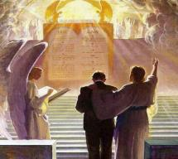
1 Corinthians 3:14-15
“¹⁴ If any man’s work which he has built on it remains, he will receive a reward. ¹⁵ If any man’s work is burned up, he will suffer loss; but he himself will be saved, yet so as through fire.”

Slide 41
James 2:17, 20, 26
“¹⁷ Even so faith, if it has no works, is dead [nekros], being by itself... ²⁰ But are you willing to recognize, you foolish fellow, that faith without works is useless [argos]?...²⁶ For just as the body without the spirit is dead [nekros], so also faith without works is dead [nekros].”

Slide 42
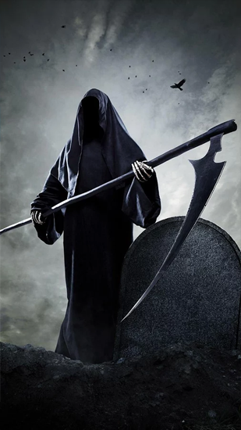
“Death” in the Old Testament
māwet: “Death is the consequences and the punishment of sin. It originated with sin. A grand theme of the Old Testament is God’s holiness, which separates Him from all that is in harmony with His character. Death, then, in the Old Testament means ultimate separation from God due to sin.”
Elmer B. Smick, “māwet," in Theological Wordbook of the Old Testament, ed. R. Laird Harris and Gleason L. Archer and Bruce K. Waltke(Chicago: Moody, 1980), 1:1169.

Slide 43
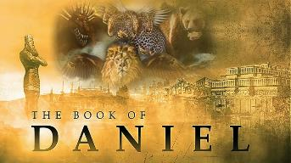
Daniel 12:2
“Many of those who sleep in the dust of the ground will awake, these to everlasting (olam) life, but the others to disgrace and everlasting (olam) contempt.”

Slide 44
“Death” in the Old Testament
thanatos: “that separation (whether natural or violent) of the soul from the body by which the life on earth is ended.”
Joseph Henry Thayer, Death - Thanatos, Greek-English Lexicon of the New Testament Being Grmm's Wilke's Clavis Novi Testamenti (Grand Rapids: Zondervan, 1977), 282.

Slide 45
Matthew 25:46
“These will go away into eternal (aiōnios) punishment, but the righteous into eternal (aiōnios) life.”

Slide 46
Luke 16:22-25
“²² Now the poor man died and was carried away by the angels to Abraham’s bosom; and the rich man also died and was buried. ²³ In Hades he lifted up his eyes, being in torment, and saw Abraham far away and Lazarus in his bosom. ²⁴ And he cried out and said, ‘Father Abraham, have mercy on me, and send Lazarus so that he may dip the tip of his finger in water and cool off my tongue, for I am in agony in this flame.’ ²⁵ But Abraham said, ‘Child, remember that during your life you received your good things, and likewise Lazarus bad things; but now he is being comforted here, and you are in agony.”

Slide 47
1 Timothy 5:6
“But she who gives herself to wanton pleasure is dead even while she lives.”

Slide 48
James 2:17, 20, 26
“¹⁷ Even so faith, if it has no works, is dead [nekros], being by itself... ²⁰ But are you willing to recognize, you foolish fellow, that faith without works is useless [argos]?...²⁶ For just as the body without the spirit is dead [nekros], so also faith without works is dead [nekros].”

Slide 49
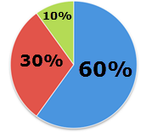

Slide 50
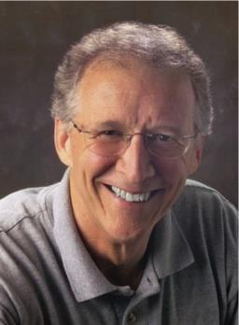
John Piper
“No Christian can be sure that he is a true believer. Hence, there is an ongoing need to be dedicated to the Lord and to deny ourselves so that we might make it.”
John Piper and Pastoral Staff, TULIP: What We Believe about the Five Points of Calvinism: Position Paper of the Pastoral Staff (Desiring God Ministries, 1997), 25, cited in Dave Hunt, What Love is This?, 379.

Slide 51
John Piper
“What causes me to be anxious is the possibility that I may not be a Christian—that I might be fake / that everything I’ve ever done might be a farce—those are horrible, horrible thoughts; right?”
John Piper’s Interview on Family Life Radio April 14, 2020
https://www.familylife.com/podcast/familylife-today/strategies-for-standing-firm-through-coronavirus/

Slide 52
R.C. Sproul, Jr.
“A while back I had one of those moments… Suddenly the question hit me: ‘R.C. what if you are not one of the redeemed? What if your destiny is not heaven after all, but hell?’ Let me tell you that I was flooded in my body with the chill that went from my head to the bottom of my spine. I was terrified. I begin to take stock of my life, and I looked at my performance. My sins came pouring into my mind, and the more I looked at myself the worst I felt. I thought, ‘maybe it’s really true. Maybe I’m not saved after all.’...Then I remembered John 6:68. Jesus had been giving out hard teaching, and many of His former followers had left Him. When He asked Peter if he was also going to leave, Peter said, ‘where else can we go? Only you have the words of eternal life.’ In other words, Peter was also uncomfortable, but he realized that being uncomfortable with Jesus was better than any other option.”
“Assurance of Salvation” (Tabletalk, Ligonier Ministries, 1989), p. 20

Slide 53
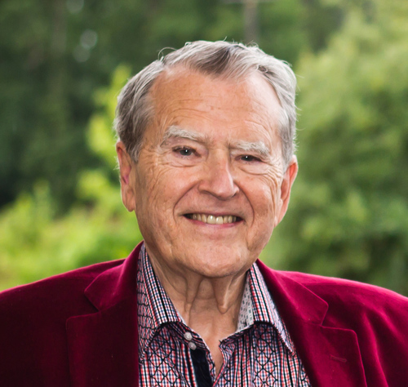
R.T. Kendall
R. T. Kendall, Calvin and English Calvinism to 1649
(Oxford: Oxford University Press, 1979), 2.
Interestingly, it has been recorded that “nearly all of the Puritan ‘divines’ [men who were Calvinistic and taught perseverance] went through great dread and despair on their deathbeds as they realized their lives did not give perfect evidence that they were elect.”

Slide 54
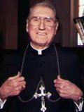
Cardinal John O’Connor of NY
quoted in Samuel Howe Verhovek, Cardinal Defends a Jailed Bishop Who Warned Cuomo on Abortion, New York Times, February 1, 1990.
“Church teaching is that I don't know, at any given moment, what my eternal future will be… I can hope, pray, do my very best – but I still don't know. Pope John II doesn't absolutely know that he will go to heaven, nor does mother Theresa of Calcutta, unless either has had a special divine revelation.”

Slide 55
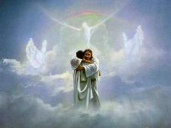
John 5:24
“Truly, truly, I say to you, he who hears My word, and believes Him who sent Me, has eternal life, and does not come into judgment, but has passed out of death into life.”

Slide 56
Acts 16:30-31
“³⁰ and after he brought them out, he said, ‘Sirs, what must I do to be saved?’³¹ They said, ‘Believe in the Lord Jesus, and you will be saved, you and your household.’”

Slide 57
1 John 5:13
“These things I have written to you who believe in the name of the Son of God, so that you may know that you have eternal life.”

Slide 58
DTS Doctrinal Statement Article XI—Assurance
“We believe it is the privilege, not only of some, but of all by the Spirit through faith who are born again in Christ as revealed in the Scriptures, to be assured of their salvation from the very day they take Him to be their Savior and that this assurance is not founded upon any fancied discovery of their own worthiness or fitness, but wholly upon the testimony of God in His written Word, exciting within His children filial love...”

Slide 59
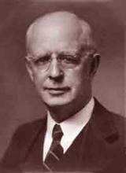
Lewis Sperry Chafer, Salvation: A Clear Doctrinal Analysis (Grand Rapids: Zondervan, 1977), 60. Italics added
Lewis Sperry Chafer
“There is a normal Christian experience. There are new and blessed emotions and desires. Old things do pass away; and behold all things do become new; but all such experiences are but secondary evidences, as to the fact of salvation, in that they grow out of that positive repose of faith which is the primary evidence.”

Slide 60
Faith Manifesting Works (2:14-26)
Thesis: works accompany useful faith (2:14)
Five illustrations (2:15-26)
Needy brother (2:15-17)
Demonic monotheist (2:18-19)
Abraham (2:20-24)
Rahab (2:25)
Lifeless corpse (2:26)

Slide 61
Faith Manifesting Works (2:14-26)
Thesis: works accompany useful faith (2:14)
Five illustrations (2:15-26)
Needy brother (2:15-17)
Demonic monotheist (2:18-19)
Abraham (2:20-24)
Rahab (2:25)
Lifeless corpse (2:26)

Slide 62
Faith Manifesting Works (2:14-26)
Thesis: works accompany useful faith (2:14)
Five illustrations (2:15-26)
Needy brother (2:15-17)
Demonic monotheist (2:18-19)
Abraham (2:20-24)
Rahab (2:25)
Lifeless corpse (2:26)

Slide 63
Faith Manifesting Works (2:14-26)
Thesis: works accompany useful faith (2:14)
Five illustrations (2:15-26)
Needy brother (2:15-17)
Demonic monotheist (2:18-19)
Abraham (2:20-24)
Rahab (2:25)
Lifeless corpse (2:26)

Slide 64
Faith Manifesting Works (2:14-26)
Thesis: works accompany useful faith (2:14)
Five illustrations (2:15-26)
Needy brother (2:15-17)
Demonic monotheist (2:18-19)
Abraham (2:20-24)
Rahab (2:25)
Lifeless corpse (2:26)

Slide 65
William Hendriksen
“Many trusted in his name; i.e., because of the manner in which his power was displayed they accepted him as a great prophet and perhaps even as the Messiah. This, however, is not the same as saying that they surrendered their hearts to him. Not all faith is saving faith...”
William Hendriksen, A Commentary on the Gospel of John, 3d ed. (London: Banner of Truth Trust, 1964), p. 127. (1978). Bibliotheca Sacra, 135. (1978). Bibliotheca Sacra, 135.

Slide 66
Faith Manifesting Works (2:14-26)
Thesis: works accompany useful faith (2:14)
Five illustrations (2:15-26)
Needy brother (2:15-17)
Demonic monotheist (2:18-19)
Abraham (2:20-24)
Rahab (2:25)
Lifeless corpse (2:26)

Slide 67
Faith Manifesting Works (2:14-26)
Thesis: works accompany useful faith (2:14)
Five illustrations (2:15-26)
Needy brother (2:15-17)
Demonic monotheist (2:18-19)
Abraham (2:20-24)
Rahab (2:25)
Lifeless corpse (2:26)

Slide 68
Faith Manifesting Works (2:14-26)
Thesis: works accompany useful faith (2:14)
Five illustrations (2:15-26)
Needy brother (2:15-17)
Demonic monotheist (2:18-19)
Abraham (2:20-24)
Rahab (2:25)
Lifeless corpse (2:26)

Slide 69
CONCLUSION

Slide 70
Faith Manifesting Works (2:14-26)
Thesis: works accompany useful faith (2:14)
Five illustrations (2:15-26)
Needy brother (2:15-17)
Demonic monotheist (2:18-19)
Abraham (2:20-24)
Rahab (2:25)
Lifeless corpse (2:26)

