Slide 1


Genesis 4‒5
The First Murder and Continuation of the Messianic Promise

Slide 2

GENESIS STRUCTURE
  Beginning of the Human race (Gen. 1‒11)
  Beginning of the Hebrew race (Gen. 12‒50)

Slide 3

GENESIS STRUCTURE
  Genesis 1-11 (four events)
    Creation (1-2)
    Fall (3-5)
    Flood (6-9)
    National dispersion (10-11)

Slide 4
GENESIS STRUCTURE
  Genesis 1-11 (four events)
    Creation (1-2)
    Fall (3-5)
    Flood (6-9)
    National dispersion (10-11)

Slide 5

Genesis 3 Outline
  3:1-5 Temptation by the serpent
  3:6 Sin of Adam and Eve
  3:7-13 Results of the sin
  3:14-19 Imposition of divine judgments
  3:20-24 God’s provision in spite of the sin

Slide 6


Genesis 3:15
“And I will put enmity Between you and the woman, And between your seed and her seed; He shall bruise you on the head, And you shall bruise him on the heel.”

Slide 7
Genesis 4 Outline
  First murder (Gen 4:1-15)
  Ungodly line of Cain (4:16-24)
  Godly line of Seth (4:25-26)

Slide 8
Genealogy
(Gen 5)
  Line through which the messianic blessing (Gen. 3:15) would come
  From Adam (Gen. 5:1) to Noah (Gen. 5:32)
  Knowledge of the protevangelium (Gen. 3:15) was obviously passed down given Adam’s advanced age at his death (Gen. 5:5)

Slide 9

Genesis 5 Outline
  Introduction (5:1-2)
  Adam (5:3-5)
  Seth (5:6-8)
  Enosh (5:9-11)
  Kenan (5:12-14)
  Mahalalel (5:15-17)

Slide 10
Genesis 5 Outline
  Jared (5:18-20)
  Enoch (5:21-24)
  Methuselah (5:25-27)
  Lamech (5:28-31)
  Noah (5:32)

Slide 11
Genesis 5 Outline
  Introduction (5:1-2)
  Adam (5:3-5)
  Seth (5:6-8)
  Enosh (5:9-11)
  Kenan (5:12-14)
  Mahalalel (5:15-17)

Slide 12
Genesis 5:1-2
“¹ This is the book of the generations of Adam. In the day when God created man, He made him in the likeness of God. ² He created them male and female, and He blessed them and named them Man in the day when they were created.”

Slide 13
Genesis 5:1-2
“¹ This is the book of the generations of Adam. In the day when God created man, He made him in the likeness of God. ² He created them male and female, and He blessed them and named them Man in the day when they were created.”

Slide 14
Toledoth
“And These Are the Generations of…”
Introduction to the generations (1:1–2:3)
Generations of the heaven and earth (2:4–4:26)
Generations of Adam (5:1–6:8)
Generations of Noah (6:9–9:29)
Generations of the sons of Noah (10:1–11:9)
Generations of Shem (11:10–26)
Generations of Terah (11:27–25:11)
Generations of Ishmael (25:12-18)
Generations of Isaac (25:19–35:29)
Generations of Esau (36:1–37:1)
Generations of Jacob (37:2–50:26)

Slide 15
Toledoth
“And These Are the Generations of…”
Introduction to the generations (1:1–2:3)
Generations of the heaven and earth (2:4–4:26)
Generations of Adam (5:1–6:8)
Generations of Noah (6:9–9:29)
Generations of the sons of Noah (10:1–11:9)
Generations of Shem (11:10–26)
Generations of Terah (11:27–25:11)
Generations of Ishmael (25:12-18)
Generations of Isaac (25:19–35:29)
Generations of Esau (36:1–37:1)
Generations of Jacob (37:2–50:26)

Slide 16
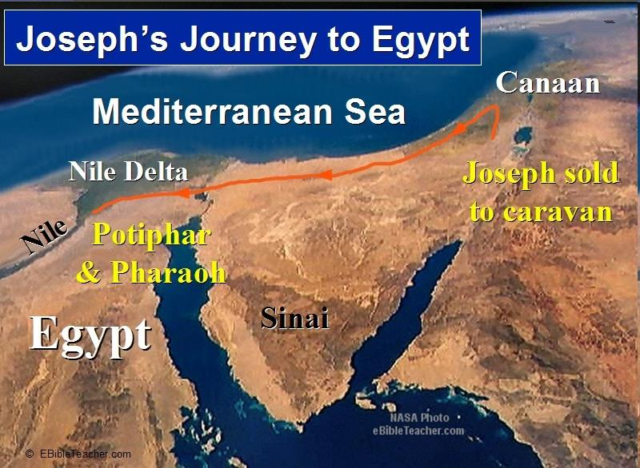

Slide 17

Luke 1:1-4
“¹ Since many have undertaken to compile an account of the things accomplished among us, ² just as they were handed down to us by those who from the beginning were eyewitnesses and servants of the word, ³ it seemed fitting to me as well, having investigated everything carefully from the beginning, to write it out for you in an orderly sequence, most excellent Theophilus; ⁴ so that you may know the exact truth about the things you have been taught.”

Slide 18
Genesis 5:1-2
“¹ This is the book of the generations of Adam. In the day when God created man, He made him in the likeness of God. ² He created them male and female, and He blessed them and named them Man in the day when they were created.”

Slide 19
The Two Most Influential Men in World History
 | ADAM | JESUS
Single action | Disobedience | Obedience
Tree | Knowledge | Cross
Universal impact | Curse | Blessing
Birth | Physical | Spiritual
Adam | First | Last

Slide 20

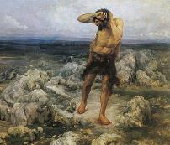
Ungodly Line of Cain
(Gen 4:16-24)
  Evil line that will not bring forth the Messiah (Gen 3:15)
    Continuation of Cain’s line (4:16-18)
    Immorality (4:19)
    Technological but not spiritual advancement (4:20-22)
    Violence (4:23-24)

Slide 21
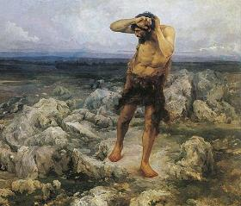
Technological Advancement
Genesis 4:20-22
  Livestock – Gen. 4:20
  Music – Gen. 4:21
  Metallurgy – Gen. 4:22

Slide 22
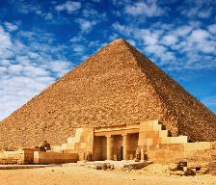
The Genius of Ancient Man
(Gen 4:19)
  The Palace at Knossos on Crete
  La Bastida in Spain
  The Great Pyramids of Egypt
  The Stonehenge of England
  The Great Wall of China
  The architecture of the Incas
Landis, Don. "Ancient Man ‒ Genius or Primitive?" In Searching for Adam: Genesis & the Truth About Man's Origin, edited by Terry Mortenson, 415-44. Green Forest, AR: Master Books, 2016.

Slide 23

Dr. Henry M. Morris
The Genesis Record, 147-48
“Musical instruments, another important aspect of modern culture, were also an early development. All of these things, in addition, confirm the necessary coexistence of a written language for formal communications. This is further intimated by use of the word ‘book’ in Genesis 5:1. More and more modern archaeological discoveries today are verifying the high degree of technology possessed by the earliest men, thus indirectly validating this Biblical testimony.”

Slide 24
Genesis 5:1-2
“¹ This is the book of the generations of Adam. In the day when God created man, He made him in the likeness of God. ² He created them male and female, and He blessed them and named them Man in the day when they were created.”

Slide 25
Genesis 5:1-2
“¹ This is the book of the generations of Adam. In the day when God created man, He made him in the likeness of God. ² He created them male and female, and He blessed them and named them Man in the day when they were created.”

Slide 26

Genesis 1:27
God created man in His own image, in the image of God He created him; male and female He created them.

Slide 27

Genesis 9:6
“Whoever sheds man’s blood, By man his blood shall be shed, For in the image of God He made man.”

Slide 28
Genesis 5:1-2
“¹ This is the book of the generations of Adam. In the day when God created man, He made him in the likeness of God. ² He created them male and female, and He blessed them and named them Man in the day when they were created.”

Slide 29
Genesis 1:27
God created man in His own image, in the image of God He created him; male and female He created them.

Slide 30
Genesis 5:1-2
“¹ This is the book of the generations of Adam. In the day when God created man, He made him in the likeness of God. ² He created them male and female, and He blessed them and named them Man in the day when they were created.”

Slide 31
Genesis 1:28
God blessed them; and God said to them, “Be fruitful and multiply, and fill the earth, and subdue it; and rule over the fish of the sea and over the birds of the sky and over every living thing that moves on the earth.”

Slide 32
Genesis 5:1-2
“¹ This is the book of the generations of Adam. In the day when God created man, He made him in the likeness of God. ² He created them male and female, and He blessed them and named them Man in the day when they were created.”

Slide 33
Genesis 5:1-2
“¹ This is the book of the generations of Adam. In the day when God created man, He made him in the likeness of God. ² He created them male and female, and He blessed them and named them Man in the day when they were created.”

Slide 34
Genesis 1:1–2:3 Outline
Original creation on the first day (Gen 1:1)
Original creation in its unfilled and unformed state (Gen 1:2)
Creation week (Gen 1:3–2:3): “And God said,” “good”
  First day 1:3-5
  Second day 1:6-8
  Third day 1:9-13
  Fourth day 1:14-19
  Fifth day 1:20-23
  Sixth day 1:24-31
  Seventh day 2:1-3

Slide 35
Genesis 5 Outline
  Introduction (Gen 5:1-2)
  Adam (5:3-5)
  Seth (5:6-8)
  Enosh (5:9-11)
  Kenan (5:12-14)
  Mahalalel (5:15-17)

Slide 36
Genesis 5:1-3
“¹ This is the book of the generations of Adam. In the day when God created man, He made him in the likeness of God. ² He created them male and female, and He blessed them and named them Man in the day when they were created. ³ When Adam had lived one hundred and thirty years, he became the father of a son in his own likeness, according to his image, and named him Seth.”

Slide 37
Genesis 9:6
“Whoever sheds man’s blood, By man his blood shall be shed, For in the image of God He made man.”

Slide 38


1 Corinthians 15:21-22
“²¹ For since by a man came death, by a man also came the resurrection of the dead. ²² For as in Adam all die, so also in Christ all will be made alive.”

Slide 39

Romans 5:12
“Therefore, just as through one man sin entered into the world, and death through sin, and so death spread to all men, because all sinned—.”

Slide 40
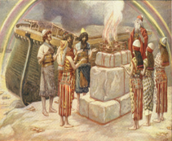
Genesis 8:21
The Lord smelled the soothing aroma; and the Lord said to Himself, “I will never again curse the ground on account of man, for the intent of man’s heart is evil from his youth; and I will never again destroy every living thing, as I have done.[emphasis mine].

Slide 41


Jeremiah 17:9
“The heart is more deceitful than all else And is desperately sick; Who can understand it?.”

Slide 42
Mark 7:20-23
“²⁰ And He was saying, ‘That which proceeds out of the man, that is what defiles the man. ²¹ For from within, out of the heart of men, proceed the evil thoughts, fornications, thefts, murders, adulteries, ²² deeds of coveting and wickedness, as well as deceit, sensuality, envy, slander, pride and foolishness. ²³ All these evil things proceed from within and defile the man.’”

Slide 43
Six-Fold Pattern
Genesis 5:3-5
  Name & meaning: Adam; Man
  Age at birth of seed-son: 130 years
  Additional years lived: 800 years
  Begat other sons & daughters: Yes
  Total years lived: 930 years
  Death: Yes

Slide 44
Six-fold Repetition: Significance
(Gen 5)
    Names indicate historicity (1 Chron. 21:1-4; Luke 3:36-38; Heb. 11:4-7)
    Age of patriarch at birth of seed-son demonstrate no genealogical gaps
    Begetting of other sons and daughters explains the population explosion (Gen. 4:14, 17; 6:1)

Slide 45
Six-fold Repetition: Significance
(Gen 5)
    Long patriarchal ages at time of death indicate ante-diluvian conditions
    Repetition of “and he died” shows the reality of the curse (Gen 2:17; 3:19)
    Monotony allows easy memorization and immediately draws attention to deviations

Slide 46
Six-fold Repetition: Significance
(Gen 5)
    Names indicate historicity (1 Chron. 21:1-4; Luke 3:36-38; Heb. 11:4-7)
    Age of patriarch at birth of seed-son demonstrate no genealogical gaps
    Begetting of other sons and daughters explains the population explosion (Gen. 4:14, 17; 6:1)

Slide 47
Six-fold Repetition: Significance
(Gen 5)
    Names indicate historicity (1 Chron. 21:1-4; Luke 3:36-38; Heb. 11:4-7)
    Age of patriarch at birth of seed-son demonstrate no genealogical gaps
    Begetting of other sons and daughters explains the population explosion (Gen. 4:14, 17; 6:1)

Slide 48

James Barr
“Probably, so far as I know, there is no professor of Hebrew or Old Testament at any world-class university who does not believe that the writer(s) of Genesis 1–11 intended to convey to their readers the ideas that: (a) creation took place in a series of six days which were the same as the days of 24 hours we now experience. (b) the figures contained in the Genesis genealogies provided by simple addition a chronology from the beginning of the world up to later stages in the biblical story (c) Noah’s flood was understood to be world-wide and extinguish …
“Letter from Professor James Barr to David C.C. Watson of the UK, dated 23 April 1984.” Cited in Jonathan Sarfati, Refuting Compromise: A Biblical and Scientific Refutation of "Progressive Creationism" (Billions of Years), as Popularized by Astronomer Hugh Ross. Updated and expanded ed. (Powder Springs, GA: Creation Book Publishers, 2014), 134-35.

Slide 49
James Barr
…human and animal life except for those in the ark. Or, to put it negatively, the apologetic arguments which suppose the ‘days’ of creation to be long eras of time, the figures of years not to be chronological, and the flood to be a merely local Mesopotamian flood, are not taken seriously by any such professors, as far as I know.”
“Letter from Professor James Barr to David C.C. Watson of the UK, dated 23 April 1984.” Cited in Jonathan Sarfati, Refuting Compromise: A Biblical and Scientific Refutation of "Progressive Creationism" (Billions of Years), as Popularized by Astronomer Hugh Ross. Updated and expanded ed. (Powder Springs, GA: Creation Book Publishers, 2014), 134-35.

Slide 50

AUTHORSHIP
Charles Darwin
Karl Marx
Julius Wellhausen
John Dewey
Sigmund Freud
John Maynard Keynes
Soren Kierkegaard

Slide 51

Dr. Arnold G. Fruchtenbaum
The Book of Genesis Record, 141
“A third observation is that there are no gaps in the genealogy. Some try to put gaps into the genealogy in order to accommodate the scientific long age of man, but the wording does not allow for that. If the text only said begat, then that would be permissible since the word ‘begat’ does not always require direct father/son relationship. It could mean grandfather, great grandfather, or ancestors and so on. Nevertheless, the wording in this section does not allow for that interpretation. The text does not say simply begat. It gives the years before and after the birth of the seed-son. So this type of language simply does not allow gaps to occur.”

Slide 52
Genealogical Gaps?
Internal
  Seth is a descendant of Adam and Eve replacing Abel (4:25)
  Seth named Enosh (4:26)
  Lamech named Noah (5:29)
Jude 14

Slide 53
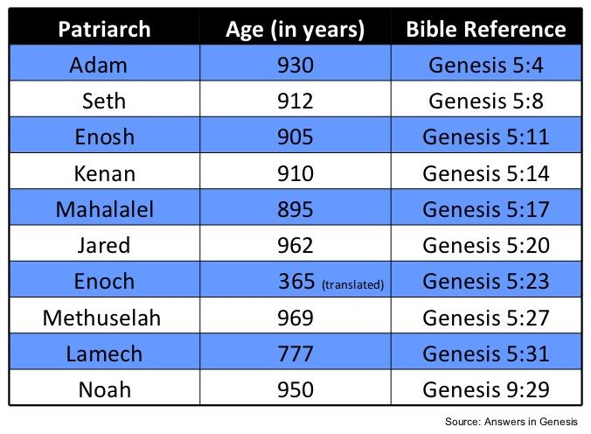

Slide 54
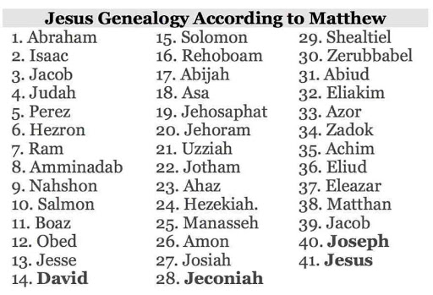

Slide 55
Genealogical Gaps?
Matthew 1:1-17?
  Matt 1:8-9; 1 Chr 3:10-12
  Larger portion of history
  Age of father at the time the son is born
  Matt 1:17 (3 groups of 14)
  Gematria (sum of Hebrew letters in David’s name adds up to 14)

Slide 56
Matthew’s Purposes
Earliest Gospel written to Hebrew-Christians
To explain that Jesus in whom they had believed was indeed the long-awaited Jewish Messiah
To explain why the kingdom had been postponed despite the fact that the king had arrived
To explain the interim program of God during the kingdom’s absence

Slide 57
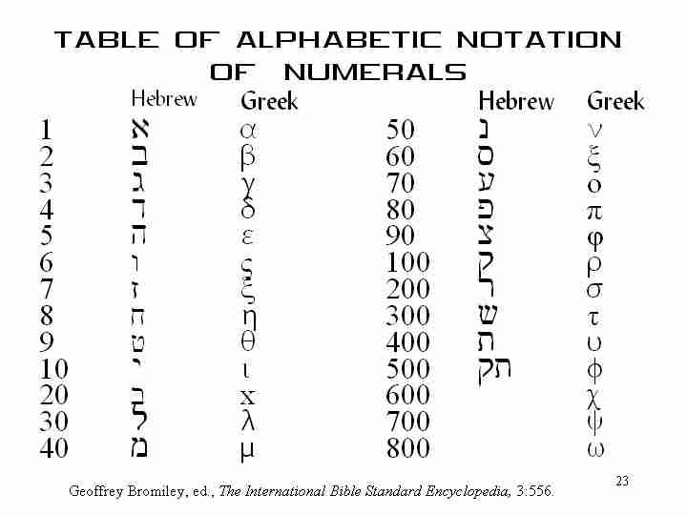

Slide 58
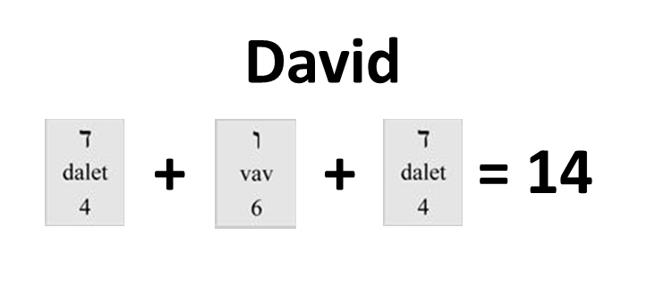

Slide 59
Six-fold Repetition: Significance
(Gen 5)
    Names indicate historicity (1 Chron. 21:1-4; Luke 3:36-38; Heb. 11:4-7)
    Age of patriarch at birth of seed-son demonstrate no genealogical gaps
    Begetting of other sons and daughters explains the population explosion (Gen. 4:14, 17; 6:1)

Slide 60

Dr. Henry M. Morris
The Genesis Record, 143
“If it is further assumed that, on the average, these children grew to maturity, married, and began to have children of their own by the time their parents were eighty years old, and that the parents lived through an average of five such ‘generations,’ or four hundred years, then it can easily be calculated that the earth had acquired within its first eight hundred years (presumably approximately the lifetime of Cain, as a minimum) a population of at least one hundred and twenty thousand. It is probable that the figure was much more than this, since people lived to greater ages than assumed and probably had many more children than assumed.”

Slide 61

Genesis 6:1-4
“¹ Now it came about, when men began to multiply on the face of the land, and daughters were born to them, ² that the sons of God saw that the daughters of men were beautiful; and they took wives for themselves, whomever they chose. ³ Then the Lord said, ‘My Spirit shall not strive with man forever, because he also is flesh; nevertheless his days shall be one hundred and twenty years.’ ⁴ The Nephilim were on the earth in those days, and also afterward, when the sons of God came in to the daughters of men, and they bore children to them. Those were the mighty men who were of old, men of renown.”

Slide 62
Dr. Henry M. Morris
The Genesis Record, 144
“The ancient quibble about ‘Cain’s wife’ is thus seen to be quite trivial. Long before Cain died, there was a large population in the earth. By the time of the Deluge, 1,656 years after Creation by the Ussher chronology, even using the above conservative assumptions, the world population would have been at least seven billion people!”

Slide 63
Six-fold Repetition: Significance
(Gen 5)
    Long patriarchal ages at time of death indicate ante-diluvian conditions
    Repetition of “and he died” shows the reality of the curse (Gen 2:17; 3:19)
    Monotony allows easy memorization and immediately draws attention to deviations

Slide 64
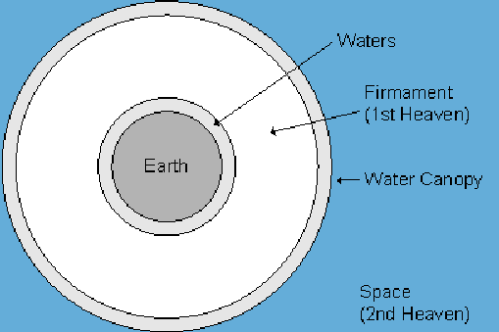

Slide 65
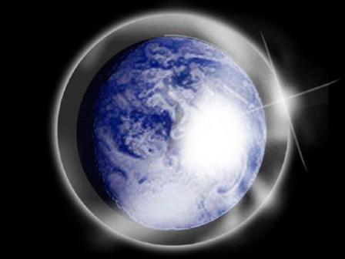

Slide 66
Day 2 Canopy Theory
(Gen 1:6-8)
Implied – Gen. 1:6-7; Ps. 148:4
Explains
  Long life spans of early man – Gen. 5:5, 27
  Strange beasts – (Gen. 1:24-25; Job 40‒41)
  Where the flood waters came from – (Gen. 2:5-6)
  Why man’s post-flood life span cut short – (Gen. 11:24-25)

Slide 67
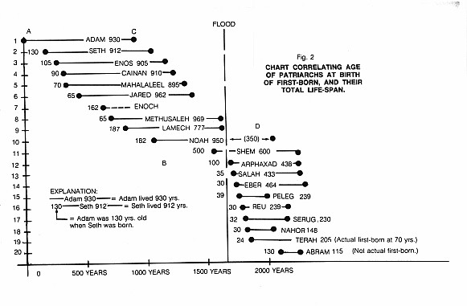

Slide 68
Dr. Henry M. Morris
The Genesis Record, 58-61
“...the upper waters would provide a sort of protective canopy (‘a tent to dwell in’) for earth’s inhabitants, and the space between would provide an atmospheric reservoir to maintain the breath of life...The ‘waters above the firmament’ thus probably constituted a vast blanket of water vapor above the troposphere and possibly above the stratosphere as well, in the high-temperature region now known as the ionosphere, and extending far into space. They could not have been the clouds of water...there was no ‘rain upon the earth’ in those days (Genesis 2:5), nor any ‘bow in the cloud’ (Genesis 9:13), both of which must have been present if these upper waters represented merely the regime of clouds which functions in the present hydrologic economy.”

Slide 69
Dr. Henry M. Morris
The Genesis Record, 58-61
“The concept of an antediluvian water canopy over the earth has appeared in many writings, both ancient and modern...Furthermore, a vapor canopy could be more easily maintained aloft and would serve much more effectively as a marvelous sustainer of vigorous life conditions on the earth...Since water vapor has the ability both to transmit incoming solar radiation and to retain and disperse much of the radiation reflected from the earth’s surface, it would serve as a global greenhouse, maintaining an essentially uniformly pleasant warm temperature all over the world...The combination of warm temperature and adequate moisture everywhere would be conducive later to extensive stands of lush vegetation all over the world, with no barren deserts or ice caps.”

Slide 70
Dr. Henry M. Morris
The Genesis Record, 58-61
“A vapor canopy would also be highly effective in filtering out ultraviolet radiations, cosmic rays, and other destructive energies from outer space. These are known to be the source of both somatic and genetic mutations, which decrease the viability of the individual and the species, respectively. Thus the canopy would contribute effectively to human and animal health and longevity...Later, when needed, these upper waters would provide the reservoir from which God would send the great Flood, to save the godly remnant from the hopelessly corrupt population of that day...”

Slide 71
Dr. Arnold G. Fruchtenbaum
The Book of Genesis Record, 141
“The years here are normal years. They are not months, as some people have tried to make them, again, only to accommodate the assumption that no one could have ever lived as long as the Bible shows them living. If months were indicated rather than years, some of these people would have given birth to children while they were themselves children.”

Slide 72
Six-fold Repetition: Significance
(Gen 5)
    Long patriarchal ages at time of death indicate ante-diluvian conditions
    Repetition of “and he died” shows the reality of the curse (Gen 2:17; 3:19)
    Monotony allows easy memorization and immediately draws attention to deviations

Slide 73
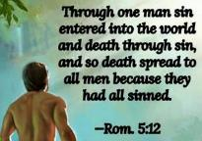
Genesis 2:16-17
“¹⁶ The Lord God commanded the man, saying, ‘From any tree of the garden you may eat freely; ¹⁷ but from the tree of the knowledge of good and evil you shall not eat, for in the day that you eat from it you will surely die (muwth).’”

Slide 74
Genesis 3:19
“By the sweat of your face You will eat bread, Till you return to the ground, Because from it you were taken; For you are dust, And to dust you shall return.”

Slide 75
Romans 5:12
“Therefore, just as through one man sin entered into the world, and death through sin, and so death spread to all men, because all sinned—.”

Slide 76
Six-fold Repetition: Significance
(Gen 5)
    Long patriarchal ages at time of death indicate ante-diluvian conditions
    Repetition of “and he died” shows the reality of the curse (Gen 2:17; 3:19)
    Monotony allows easy memorization and immediately draws attention to deviations

Slide 77
Genesis 5 Outline
  Introduction (5:1-2)
  Adam (5:3-5)
  Seth (5:6-8)
  Enosh (5:9-11)
  Kenan (5:12-14)
  Mahalalel (5:15-17)

Slide 78
Six-Fold Pattern
Genesis 5:6-8
  Name & meaning: Seth; Substitute
  Age at birth of seed-son: 105 years
  Additional years lived: 807 years
  Begat other sons & daughters: Yes
  Total years lived: 912 years
  Death: Yes

Slide 79

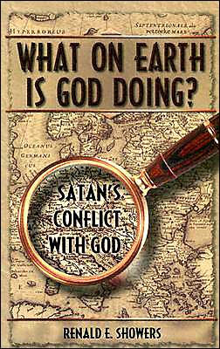
Renald Showers
What on Earth is God Doing: Satan’s Conflict with God (Bellmawr, NJ: Friends of Israel, 2003), 226.
“In His war against Satan, God counteracted the murder of Abel by giving Adam and Eve another godly son named Seth (Gen. 4:25). Since this name means ‘substitute,’ it is apparent that God meant Seth to be a substitute for Abel. (H. C. Leupold, Exposition of Genesis, p. 226). The genealogies found in Genesis 5; 11:10–32; and Luke 3:23–38 reveal that God also intended the Redeemer to come through Seth’s line of descent.”

Slide 80
Genesis 5 Outline
  Introduction (5:1-2)
  Adam (5:3-5)
  Seth (5:6-8)
  Enosh (5:9-11)
  Kenan (5:12-14)
  Mahalalel (5:15-17)

Slide 81
Six-Fold Pattern
Genesis 5:9-11
  Name & meaning: Enosh; Frailty
  Age at birth of seed-son: 90 years
  Additional years lived: 815 years
  Begat other sons & daughters: Yes
  Total years lived: 905 years
  Death: Yes

Slide 82
Genesis 5 Outline
  Introduction (5:1-2)
  Adam (5:3-5)
  Seth (5:6-8)
  Enosh (5:9-11)
  Kenan (5:12-14)
  Mahalalel (5:15-17)

Slide 83
Six-Fold Pattern
Genesis 5:12-14
  Name & meaning: Kenan; smith
  Age at birth of seed-son: 70 years
  Additional years lived: 840 years
  Begat other sons & daughters: Yes
  Total years lived: 910 years
  Death: Yes

Slide 84
Genesis 5 Outline
  Introduction (5:1-2)
  Adam (5:3-5)
  Seth (5:6-8)
  Enosh (5:9-11)
  Kenan (5:12-14)
  Mahalalel (5:15-17)

Slide 85
Six-Fold Pattern
Genesis 5:15-17
  Name & meaning: Mahalalel; praise God
  Age at birth of seed-son: 65 years
  Additional years lived: 830 years
  Begat other sons & daughters: Yes
  Total years lived: 895 years
  Death: Yes

Slide 86
Genesis 5 Outline
  Jared (5:18-20)
  Enoch (5:21-24)
  Methuselah (5:25-27)
  Lamech (5:28-31)
  Noah (5:32)

Slide 87
Six-Fold Pattern
Genesis 5:18-20
  Name & meaning: Jared; descent
  Age at birth of seed-son: 162 years
  Additional years lived: 800 years
  Begat other sons & daughters: Yes
  Total years lived: 962 years
  Death: Yes

Slide 88
Genesis 5 Outline
  Jared (5:18-20)
  Enoch (5:21-24)
  Methuselah (5:25-27)
  Lamech (5:28-31)
  Noah (5:32)

Slide 89
Six-Fold Pattern
Genesis 5:21-24
  Name & meaning: Enoch; dedication
  Age at birth of seed-son: 65 years
  Additional years lived: 300 years
  Begat other sons & daughters: Yes
  Total years lived: 365 years
  Death: No!

Slide 90
LINEAGE OF ADAM
UNGODLY LINE | GODLY LINE
CAIN | SETH
ENOCH | ENOSH
IRAD | KENAN
MEHUJAEL | MAHALALEL
METHUSHAEL | JARED
LAMECH | ENOCH
JUBA, TUBAL-CAIN | METHUSELAH
 | LAMECH
 | NOAH
 | SHEM, HAM, JAPHETH

Slide 91
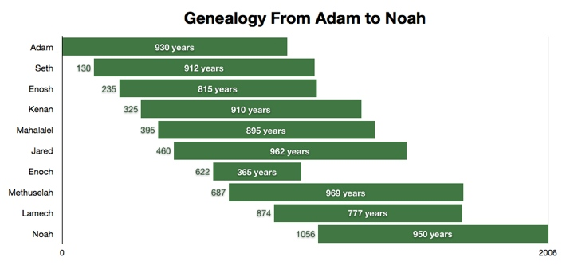

Slide 92
Genealogy: Adam to Noah
(Gen 5)
Hope that the curse would be done away with
  Enoch’s translation (5:24)
  Meaning of Methuselah’s name (Gen. 5:27; 6:3; 1 Pet. 3:20)
  Lamech mistakenly believed that Noah was the fulfillment of Genesis 3:15 (Gen. 5:29; 3:17; 4:1; Dan. 11:37)

Slide 93
Genealogy: Adam to Noah
(Gen 5)
Hope that the curse would be done away with
  Enoch’s translation (5:24)
  Meaning of Methuselah’s name (Gen. 5:27; 6:3; 1 Pet. 3:20)
  Lamech mistakenly believed that Noah was the fulfillment of Genesis 3:15 (Gen. 5:29; 3:17; 4:1; Dan. 11:37)

Slide 95
LINEAGE OF ADAM
UNGODLY LINE | GODLY LINE
CAIN | SETH
ENOCH | ENOSH
IRAD | KENAN
MEHUJAEL | MAHALALEL
METHUSHAEL | JARED
LAMECH | ENOCH
JUBA, TUBAL-CAIN | METHUSELAH
 | LAMECH
 | NOAH
 | SHEM, HAM, JAPHETH

Slide 96
Ungodly Line of Cain
(Gen 4:16-24)
  Evil line that will not bring forth the Messiah (Gen 3:15)
    Continuation of Cain’s line (4:16-18)
    Immorality (4:19)
    Technological but not spiritual advancement (4:20-22)
    More immorality (4:23a)
    Violence (4:23b)
    Humanistic (4:24)

Slide 97
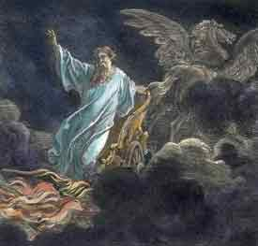
Exemption from Death
(1 Cor 15:54-56)
Enoch (Gen 5)
Elijah (2 Kings 2)
Christ (Acts 1:11; Rev 12:5)
Philip (Acts 8:39)
Paul (2 Cor 12:2, 4)
John (Rev 4:1-2)
Two witnesses (Rev 11)

Slide 98

1 Corinthians 15:50-51
“⁵⁰ Now I say this, brethren, that flesh and blood cannot inherit the kingdom of God; nor does the perishable inherit the imperishable. ⁵¹ Behold, I tell you a mystery; we will not all sleep, but we will all be changed.”

Slide 99
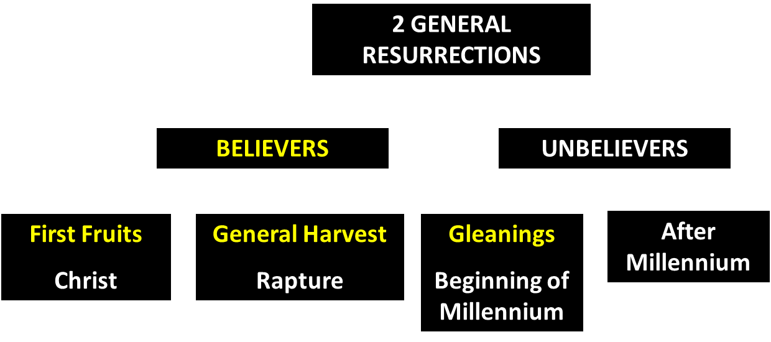
God’s Resurrection Program

Slide 100
Genesis 5 Outline
  Jared (5:18-20)
  Enoch (5:21-24)
  Methuselah (5:25-27)
  Lamech (5:28-31)
  Noah (5:32)

Slide 101
Six-Fold Pattern
Genesis 5:25-27
  Name & meaning: Methuselah; when he dies it shall be sent
  Age at birth of seed-son: 187 years
  Additional years lived: 782 years
  Begat other sons & daughters: Yes
  Total years lived: 969 years
  Death: Yes

Slide 102
Dr. Arnold G. Fruchtenbaum
The Book of Genesis Record, 137
“In Hebrew, Methuselah may mean ‘man of the spear, or more likely ‘when he dies, it shall be sent.’ If this is true, his name was given to him prophetically. ‘It shall be sent’ was a prophecy of the Flood, as Methuselah’s father, who was also functioning as a prophet according to Jude 14–15, gave him this name. Indeed, according to the chronology of Genesis, the very year Methuselah died was when the Flood came.”

Slide 104
Genealogy: Adam to Noah
(Gen 5)
Hope that the curse would be done away with
  Enoch’s translation (5:24)
  Meaning of Methuselah’s name (Gen. 5:27; 6:3; 1 Pet. 3:20)
  Lamech mistakenly believed that Noah was the fulfillment of Genesis 3:15 (Gen. 5:29; 3:17; 4:1; Dan. 11:37)

Slide 105
Genesis 6:1-4
“¹ Now it came about, when men began to multiply on the face of the land, and daughters were born to them, ² that the sons of God saw that the daughters of men were beautiful; and they took wives for themselves, whomever they chose. ³ Then the Lord said, ‘My Spirit shall not strive with man forever, because he also is flesh; nevertheless his days shall be one hundred and twenty years.’ ⁴ The Nephilim were on the earth in those days, and also afterward, when the sons of God came in to the daughters of men, and they bore children to them. Those were the mighty men who were of old, men of renown.”

Slide 106
Genesis 5 Outline
  Jared (5:18-20)
  Enoch (5:21-24)
  Methuselah (5:25-27)
  Lamech (5:28-31)
  Noah (5:32)

Slide 107
Six-Fold Pattern
Genesis 5:28-31
  Name & meaning: Lamech; warrior
  Age at birth of seed-son: 182 years
  Additional years lived: 595 years
  Begat other sons & daughters: Yes
  Total years lived: 777 years
  Death: Yes

Slide 108
Genealogy: Adam to Noah
(Gen 5)
Hope that the curse would be done away with
  Enoch’s translation (5:24)
  Meaning of Methuselah’s name (Gen. 5:27; 6:3; 1 Pet. 3:20)
  Lamech mistakenly believed that Noah was the fulfillment of Genesis 3:15 (Gen. 5:29; 3:17; 4:1; Dan. 11:37)

Slide 109
Genesis 3:15
“And I will put enmity Between you and the woman, And between your seed and her seed; He shall bruise you on the head, And you shall bruise him on the heel.”

Slide 110

Genesis 4:1
“Now the man had relations with his wife Eve, and she conceived and gave birth to Cain, and she said, ‘I have gotten a manchild with the help of the Lord.’”

Slide 111
Genesis 4:1
“Now the man had relations with his wife Eve, and she conceived and gave birth to Cain, and she said, ‘I have gotten a manchild with the help of the Lord.’”

Slide 112
Genesis 5:29
“Now he called his name Noah, saying, ‘This one will give us rest from our work and from the toil of our hands arising from the ground which the Lord has cursed.’”

Slide 113

Genesis 3:17
“Then to Adam He said, ‘Because you have listened to the voice of your wife, and have eaten from the tree about which I commanded you, saying, ‘You shall not eat from it’; Cursed is the ground because of you; In toil you will eat of it All the days of your life.’”

Slide 114
Dr. Arnold G. Fruchtenbaum
The Book of Genesis Record, 138-39
“Then comes the break from the norm. In Genesis 5:29, Lamech names his seed-son: He called his name Noah: saying, This same shall comfort us. The Hebrew word for comfort is nacham; hence, Noah means “comfort.” Here again is a word play that only works in Hebrew. The name was given on the assumption that Noah was the Seed of the Woman or the Messiah: This same shall comfort us in our work and in the toil of our hands, which comes because of the ground which Jehovah had cursed, in reference to the Adamic curse.”

Slide 115
Dr. Arnold G. Fruchtenbaum
The Book of Genesis Record, 138-39
“Lamech made the same mistake that Eve made. When Cain was born, Eve thought that he was the Messiah. When Lamech sired Noah, he recognized that Noah was going to play an important role in human history. But he misinterpreted that role, and Lamech thought that Noah was the Messiah and would remove the Adamic curse from the earth. So Lamech recognized that Noah was a special person in the will and plan of God, but made the wrong application.”

Slide 116
Daniel 11:37
“He will show no regard for the gods of his fathers or for the desire of women, nor will he show regard for any other god; for he will magnify himself above them all.”

Slide 117
Genesis 5 Outline
  Jared (5:18-20)
  Enoch (5:21-24)
  Methuselah (5:25-27)
  Lamech (5:28-31)
  Noah (5:32)

Slide 118
Noah
Genesis 5:32
  Name & meaning: Noah; comfort
  Age at birth of sons: 500 years
  Sons: Shem, Ham, Japheth

Slide 119
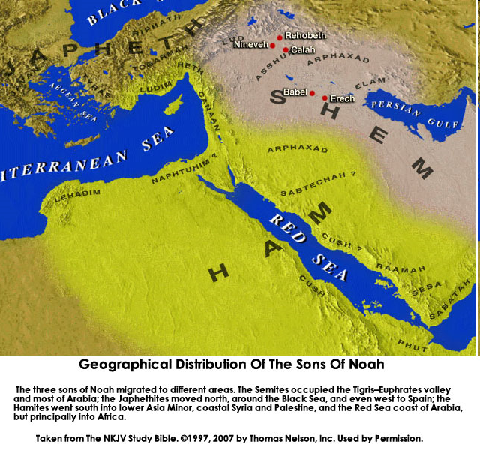

Slide 120

Genesis 11:1-4
¹ Now the whole earth used the same language and the same words. ² It came about as they journeyed east, that they found a plain in the land of Shinar and settled there. ³ They said to one another, “Come, let us make bricks and burn them thoroughly.” And they used brick for stone, and they used tar for mortar. ⁴ They said, “Come, let us build for ourselves a city, and a tower whose top will reach into heaven, and let us make for ourselves a name, otherwise we will be scattered abroad over the face of the whole earth.”

Slide 121
Dr. Arnold G. Fruchtenbaum
The Book of Genesis Record, 141
“A second observation is that all these ten names are Hebrew names and only make sense in Hebrew, although Jewish history has not yet begun. Moreover, all these people and their names existed prior to the Tower of Babel in Genesis 11, again indicating that the first language was the Hebrew language.”

Slide 123
Dr. Arnold G. Fruchtenbaum
The Book of Genesis Record, 142
“Adam lived until the 56th year of Lamech, the father of Noah. This means the tradition as told from Adam to his descendants was only once removed from Lamech and only twice removed from Noah.”

Slide 124
Ungodly Line of Cain
(Gen 4:16-24)
  Evil line that will not bring forth the Messiah (Gen 3:15)
    Continuation of Cain’s line (4:16-18)
    Immorality (4:19)
    Technological but not spiritual advancement (4:20-22)
    More immorality (4:23a)
    Violence (4:23b)
    Humanistic (4:24)

Slide 125

Genesis 11:6
The Lord said, “Behold, they are one people, and they all have the same language. And this is what they began to do, and now nothing which they purpose to do will be impossible for them.”

Slide 126
Conclusion

Slide 127
Genesis 5 Outline
  Introduction (5:1-2)
  Adam (5:3-5)
  Seth (5:6-8)
  Enosh (5:9-11)
  Kenan (5:12-14)
  Mahalalel (5:15-17)

Slide 128
Genesis 5 Outline
  Jared (5:18-20)
  Enoch (5:21-24)
  Methuselah (5:25-27)
  Lamech (5:28-31)
  Noah (5:32)

Slide 129

“The Lord bless you and keep you; the Lord make his face shine on you and be gracious to you; the Lord turn his face toward you and give you peace.” (NIV)

