Slide 1
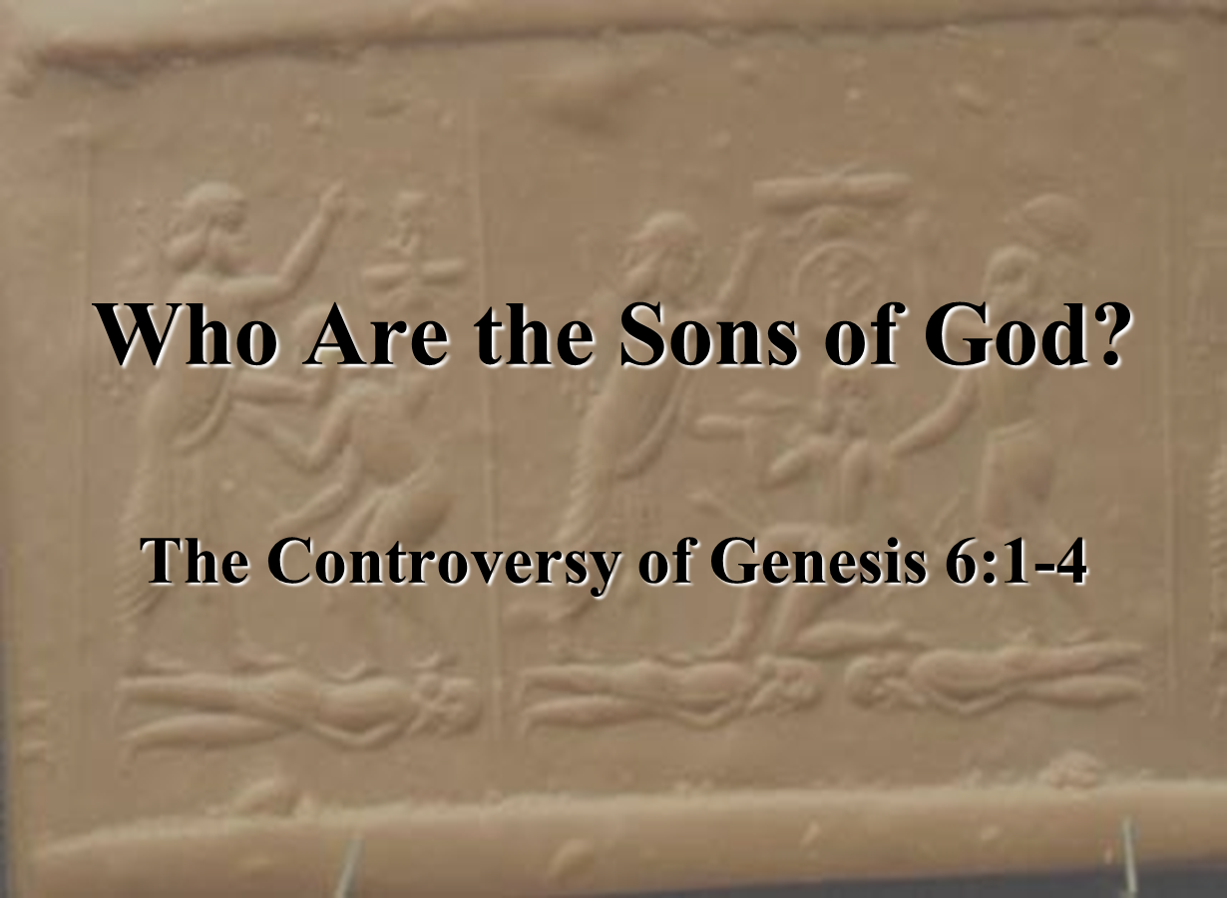

Dr. Andy Woods
Senior Pastor – Sugar Land Bible Church
President – Chafer Theological Seminary

Slide 2

Preview of Angelology
Good angels
Satanology
Demonology
Gen. 6:1-4 controversy

Slide 3

Genesis 6:1-4
“¹ Now it came about, when men began to multiply on the face of the land, and daughters were born to them, ² that the sons of God saw that the daughters of men were beautiful; and they took wives for themselves, whomever they chose. ³ Then the Lord said, ‘My Spirit shall not strive with man forever, because he also is flesh; nevertheless his days shall be one hundred and twenty years.’ ⁴ The Nephilim were on the earth in those days, and also afterward, when the sons of God came in to the daughters of men, and they bore children to them. Those were the mighty men who were of old, men of renown.”

Slide 4
Genesis 6:1-4
“¹ Now it came about, when men began to multiply on the face of the land, and daughters were born to them, ² that the sons of God saw that the daughters of men were beautiful; and they took wives for themselves, whomever they chose. ³ Then the Lord said, ‘My Spirit shall not strive with man forever, because he also is flesh; nevertheless his days shall be one hundred and twenty years.’ ⁴ The Nephilim were on the earth in those days, and also afterward, when the sons of God came in to the daughters of men, and they bore children to them. Those were the mighty men who were of old, men of renown.”

Slide 5
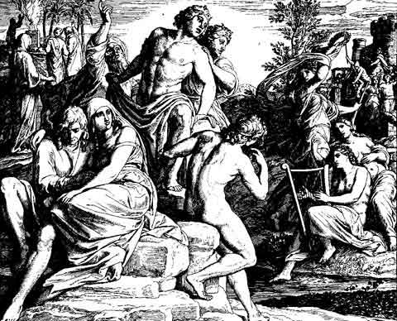
Alternative Views
Intermarriage between the Godly line of Seth and the ungodly lines of Cain
Polygamous Cainite despots
Fallen angels procreating with human women

Slide 6
Alternative Views
Intermarriage between the Godly line of Seth and the ungodly lines of Cain
Polygamous Cainite despots
Fallen angels procreating with human women

Slide 7


Renald Showers
Those Invisible Spirits Called Angels (Bellmawr, NJ: Friends of Israel, 1997), 96-97.
“﻿...it is interesting to note that the Sethite Line-Cainite View does not begin until the fourth century A.D. This makes it the newest of the three major views. The New Catholic Encyclopedia states that this view ‘that sees in these sons of God the Sethites and in the daughters of men the Cainites dates from the fourth century and is influenced by theological concern for maintaining the spirituality of the Angels.’ This seems to imply that the major motivation for starting this view was not exegesis of Scripture but opposition to the angel view...”

Slide 8
Alternative Views
Intermarriage between the Godly line of Seth and the ungodly lines of Cain
Polygamous Cainite despots
Fallen angels procreating with human women

Slide 9

Genesis 4:23
Lamech said to his wives, “Adah and Zillah, Listen to my voice, You wives of Lamech, Give heed to my speech, For I have killed a man for wounding me; And a boy for striking me.”

Slide 10
Alternative Views
Intermarriage between the Godly line of Seth and the ungodly lines of Cain
Polygamous Cainite despots
Fallen angels procreating with human women

Slide 11

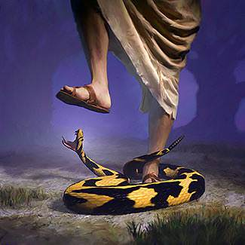
Genesis 3:15
“And I will put enmity Between you and the woman, And between your seed and her seed; He shall bruise you on the head, And you shall bruise him on the heel.”

Slide 12
Genesis 3:15
“And I will put enmity Between you and the woman, And between your seed and her seed; He shall bruise you on the head, And you shall bruise him on the heel.”

Slide 13
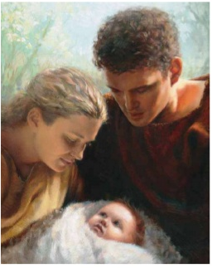
Genesis 4:1
“Now the man had relations with his wife Eve, and she conceived and gave birth to Cain, and she said, ‘I have gotten a manchild with the help of the Lord.’”

Slide 14
Genesis 4:1
“Now the man had relations with his wife Eve, and she conceived and gave birth to Cain, and she said, ‘I have gotten a manchild with the help of the Lord.’”

Slide 15
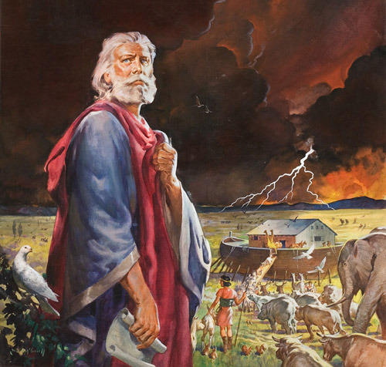
Genesis 5:29
“Now he called his name Noah, saying, ‘This one will give us rest from our work and from the toil of our hands arising from the ground which the Lord has cursed.’”

Slide 16

Genesis 3:17
“Then to Adam He said, ‘Because you have listened to the voice of your wife, and have eaten from the tree about which I commanded you, saying, ‘You shall not eat from it’; Cursed is the ground because of you; In toil you will eat of it All the days of your life.’”

Slide 17

Daniel 11:37
“He will show no regard for the gods of his fathers or for the desire of women, nor will he show regard for any other god; for he will magnify himself above them all.”

Slide 18
Genesis 3:15
“And I will put enmity Between you and the woman, And between your seed and her seed; He shall bruise you on the head, And you shall bruise him on the heel.”

Slide 19
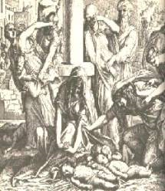
Satanic Attempts to Stop Messiah
Herod; Mt.2;Rev 12:4
Cain; Gen. 4, 1 Jn. 3:12
Pharaoh; Ex. 1
Athaliah; 2 Chron. 22
Haman; Esther
Matt 4:5-7

Slide 20

Satan’s Progressive Defeat
Initial eviction from heaven (Isa 14:12-15; Ezek 28:12-17)
Eden (Gen 3:15)
Pre-diluvian world (1 Pet 3:19-20)
Cross (John 12:31; 16:11; Col 2:15; Heb 2:14; 1 John 3:8)
Mid point of the Tribulation (Rev 12:9)
Beginning of millennium (Rev 20:2-3)
End of millennium (Rev 20:10)

Slide 21
DOES NOT REFER TO ANGELS | DOES REFER TO ANGELS
Millard Erickson | John MacArthur
J. Sidlow Baxter | Henry Morris
Warren Wiersbe | Arnold Fruchtenbaum
Paul Enns | Robert Lightner
Gleason Archer | D. Edmond Hiebert
John Sailhammer | James Boice
Wayne Grudem | Robert Morey
Meredith Kline | M. R. DeHann
Leupold | Charles Ryrie
Williamson, unpublished paper, DTS

Slide 22
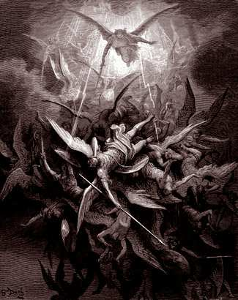
Lesson Overview
Defense of the Angel View
  Old Testament
  New Testament
  Tradition
  Objections

Slide 23
Lesson Overview
Defense of the Angel View
  Old Testament
  New Testament
  Tradition
  Objections

Slide 24
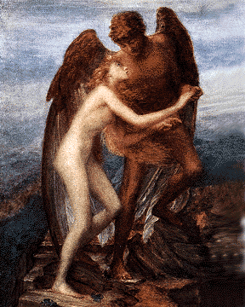
Sons of God?
Men (6:1) versus the sons of God (6:2)
Old Testament uses (Gen 6:2, 4; Job 1:6; 2:1; 38:7)
Septuagint (LXX)

Slide 25
Sons of God?
Men (6:1) versus the sons of God (6:2)
Old Testament uses (Gen 6:2, 4; Job 1:6; 2:1; 38:7)
Septuagint (LXX)

Slide 26
Genesis 6:1-4
“¹ Now it came about, when men began to multiply on the face of the land, and daughters were born to them, ² that the sons of God saw that the daughters of men were beautiful; and they took wives for themselves, whomever they chose. ³ Then the Lord said, ‘My Spirit shall not strive with man forever, because he also is flesh; nevertheless his days shall be one hundred and twenty years.’ ⁴ The Nephilim were on the earth in those days, and also afterward, when the sons of God came in to the daughters of men, and they bore children to them. Those were the mighty men who were of old, men of renown.”

Slide 27
Sons of God?
Men (6:1) versus the sons of God (6:2)
Old Testament uses (Gen 6:2, 4; Job 1:6; 2:1; 38:7)
Septuagint (LXX)

Slide 28

Job 1:6
“Now there was a day when the sons of God came to present themselves before the Lord, and Satan also came among them.”

Slide 29

Ezekiel 28:14, 16
“¹⁴ You were the anointed cherub who covers, And I placed you there. You were on the holy mountain of God; You walked in the midst of the stones of fire.”… ¹⁶ By the abundance of your trade You were internally filled with violence, And you sinned; Therefore I have cast you as profane From the mountain of God. And I have destroyed you, O covering cherub, From the midst of the stones of fire.”

Slide 30
Job 2:1
“Again there was a day when the sons of God came to present themselves before the Lord, and Satan also came among them to present himself before the Lord.”

Slide 31
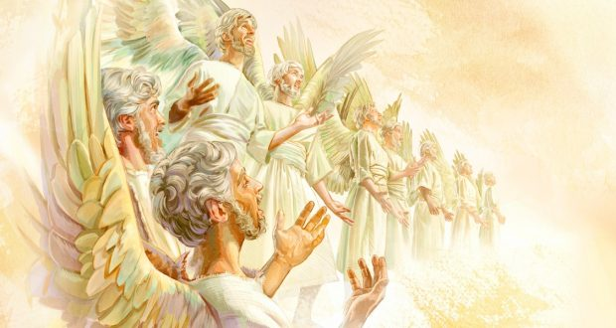
Job 38:7
“When the morning stars sang together
And all the sons of God shouted for joy?”

Slide 32

Deuteronomy 14:1
“You are the sons of the Lord your God; you shall not cut yourselves nor shave your forehead for the sake of the dead.”

Slide 33
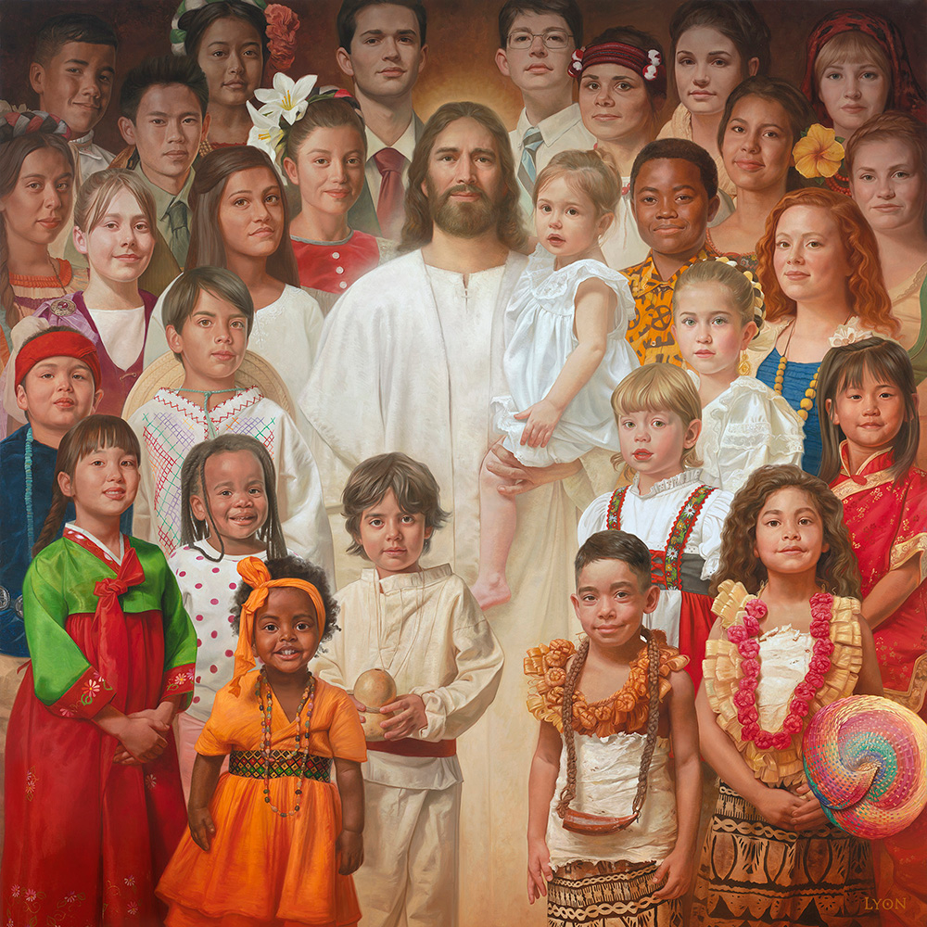
Romans 8:14
“For all who are being led by the Spirit of God, these are sons of God.”

Slide 34
Sons of God?
Men (6:1) versus the sons of God (6:2)
Old Testament uses (Gen 6:2, 4; Job 1:6; 2:1; 38:7)
Septuagint (LXX)

Slide 35
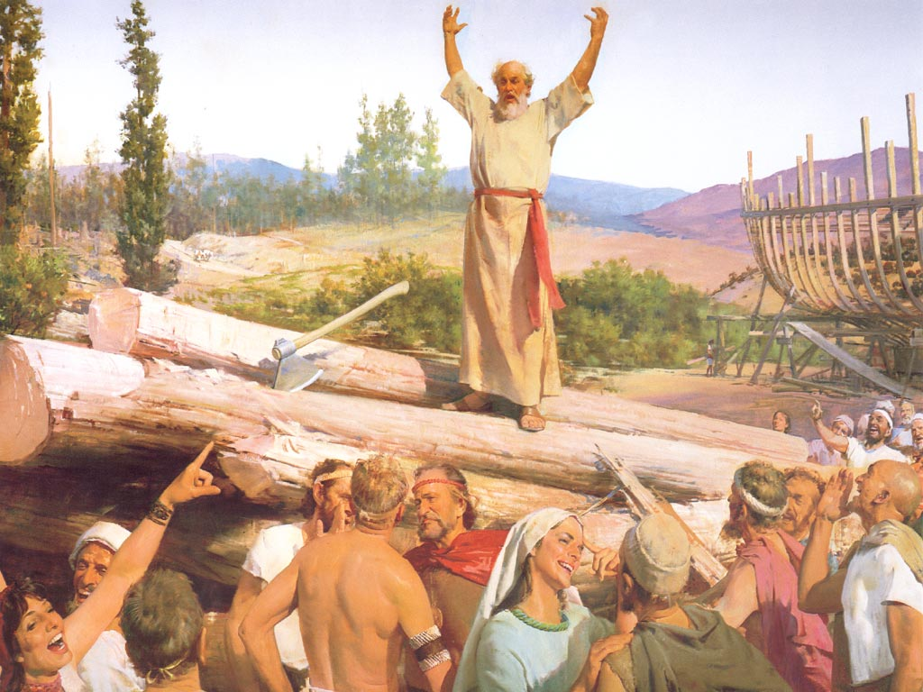
Additional Arguments From Genesis 6
Nephilim (Gen 6:4)
Noah’s perfection (6:9)
Evil of pre-flood humanity (Gen 6:3, 5-7, 11-13)
Necessity of the flood

Slide 36
Additional Arguments From Genesis 6
Nephilim (Gen 6:4)
Noah’s perfection (6:9)
Evil of pre-flood humanity (Gen 6:3, 5-7, 11-13)
Necessity of the flood

Slide 37
Genesis 6:1-4
“¹ Now it came about, when men began to multiply on the face of the land, and daughters were born to them, ² that the sons of God saw that the daughters of men were beautiful; and they took wives for themselves, whomever they chose. ³ Then the Lord said, ‘My Spirit shall not strive with man forever, because he also is flesh; nevertheless his days shall be one hundred and twenty years.’ ⁴ The Nephilim were on the earth in those days, and also afterward, when the sons of God came in to the daughters of men, and they bore children to them. Those were the mighty men who were of old, men of renown.”

Slide 38
Additional Arguments From Genesis 6
Nephilim (Gen 6:4)
Noah’s perfection (6:9)
Evil of pre-flood humanity (Gen 6:3, 5-7, 11-13)
Necessity of the flood

Slide 39

Genesis 6:8-9
“ ⁸ But Noah found favor in the eyes of the Lord. ⁹ These are the records of the generations of Noah. Noah was a righteous man, blameless in his time; Noah walked with God.”

Slide 40

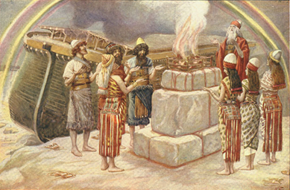
Genesis 8:21
The Lord smelled the soothing aroma; and the Lord said to Himself, “I will never again curse the ground on account of man, for the intent of man’s heart is evil from his youth; and I will never again destroy every living thing, as I have done.[emphasis mine].

Slide 41
Romans 3:23
“for all have sinned and fall short of the glory of God.”

Slide 42
Genesis 6:8-9
“ ⁸ But Noah found favor in the eyes of the Lord. ⁹ These are the records of the generations of Noah. Noah was a righteous man, blameless in his time; Noah walked with God.”

Slide 43
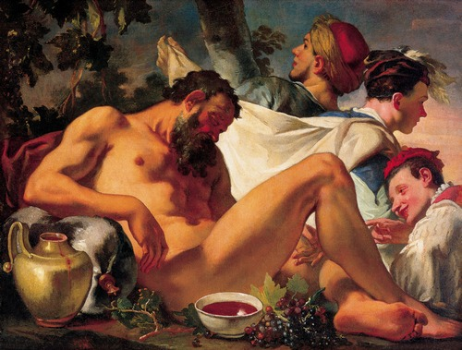
Genesis 9:20-21
“²⁰ Then Noah began farming and planted a vineyard. ²¹ He drank of the wine and became drunk, and uncovered himself inside his tent.”

Slide 44
Genesis 6:8-9
“ ⁸ But Noah found favor in the eyes of the Lord. ⁹ These are the records of the generations of Noah. Noah was a righteous man, blameless in his time; Noah walked with God.”

Slide 45
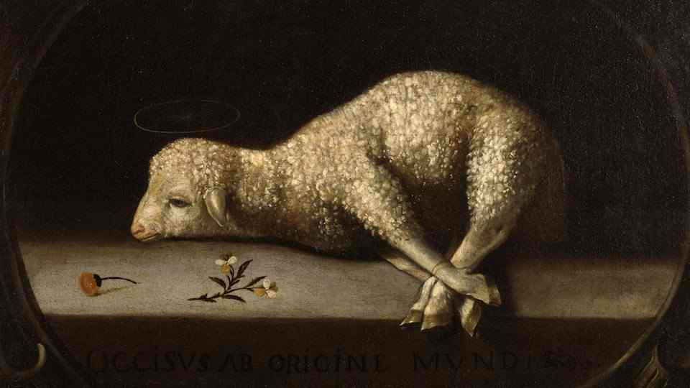
Exodus 12:5
“Your lamb shall be an unblemished male a year old; you may take it from the sheep or from the goats.”

Slide 46
Genesis 3:15
“And I will put enmity Between you and the woman, And between your seed and her seed; He shall bruise you on the head, And you shall bruise him on the heel.”

Slide 47
God’s Messianic Purposes Beginning in Genesis
Proto evangelium (3:15, 21)
Seth (4:25)
Noah (Gen 5:29)
Shem (9:26)
Abraham (12:3)
Isaac (21:12)
Jacob (25:23)
Judah (49:10)

Slide 48
Genesis 6:11-13
“¹¹ Now the earth was corrupt in the sight of God, and the earth was filled with violence. ¹² God looked on the earth, and behold, it was corrupt; for all flesh had corrupted their way upon the earth. ¹³ Then God said to Noah, “The end of all flesh has come before Me; for the earth is filled with violence because of them; and behold, I am about to destroy them with the earth.”

Slide 49
Additional Arguments From Genesis 6
Nephilim (Gen 6:4)
Noah’s perfection (6:9)
Evil of pre-flood humanity (Gen 6:3, 5-7, 11-13)
Necessity of the flood

Slide 50
Genesis 6:1-4
“¹ Now it came about, when men began to multiply on the face of the land, and daughters were born to them, ² that the sons of God saw that the daughters of men were beautiful; and they took wives for themselves, whomever they chose. ³ Then the Lord said, ‘My Spirit shall not strive with man forever, because he also is flesh; nevertheless his days shall be one hundred and twenty years.’ ⁴ The Nephilim were on the earth in those days, and also afterward, when the sons of God came in to the daughters of men, and they bore children to them. Those were the mighty men who were of old, men of renown.”

Slide 51
Genesis 6:5-7
“⁵ Then the Lord saw that the wickedness of man was great on the earth, and that every intent of the thoughts of his heart was only evil continually. ⁶ The Lord was sorry that He had made man on the earth, and He was grieved in His heart. ⁷ The Lord said, “I will blot out man whom I have created from the face of the land, from man to animals to creeping things and to birds of the sky; for I am sorry that I have made them.”

Slide 52
Genesis 6:11-13
“¹¹ Now the earth was corrupt in the sight of God, and the earth was filled with violence. ¹² God looked on the earth, and behold, it was corrupt; for all flesh had corrupted their way upon the earth. ¹³ Then God said to Noah, “The end of all flesh has come before Me; for the earth is filled with violence because of them; and behold, I am about to destroy them with the earth.”

Slide 53
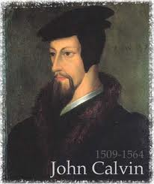
Total Depravity
What total depravity is not:
  Man is as evil as he can possibly be & indulges every possible sin
  Man is incapable of doing good things
    Gen. 3:22
    Matt. 7:11
    Acts 10:1-2
    Rom. 2:14-15

Slide 54
Henry Clarence Thiessen
“The Scriptures speak of human nature as totally depraved. However, the doctrine of ‘total depravity’ is easily misunderstood and misinterpreted. From the negative standpoint, it is important to know both what it does not mean and what it does mean. This does not mean that every sinner is devoid of all qualities pleasing to men; that he commits or is prone to every form of sin; or that he is bitterly opposed to God as it is possible for him to be. Jesus recognize the existence of pleasing qualities in some individuals (Mark 10:21); He said that the scribes and Pharisees…

Slide 55
Henry Clarence Thiessen
. . .did some things God demanded (Matt. 23:23); Paul asserted that some Gentiles ‘do instinctively the things of the law’ (Rom. 2:14); God told Abraham that the iniquity of the Amorites would grow worse (Gen. 15:16); and Paul says that ‘evil men and imposters will proceed from bad to worse’ (2 Tim. 3:13).”
Henry Clarence Thiessen, Lectures in Systematic Theology, rev. ed. (Grand Rapids: Eerdmans, 1979), 191.

Slide 56
CONCLUSION

Slide 57
Preview of Angelology
Good angels
Satanology
Demonology
Gen. 6:1-4 controversy

Slide 58
Additional Arguments From Genesis 6
Nephilim (Gen 6:4)
Noah’s perfection (6:9)
Evil of pre-flood humanity (Gen 6:3, 5-7, 11-13)
Necessity of the flood

