Slide 1


Dr. Andy Woods
Senior Pastor – Sugar Land Bible Church
President – Chafer Theological Seminary

Slide 2

“After These Things”
(Rev. 4‒22)
Before the Tribulation (4‒5)
During the Tribulation (6‒19)
After the Tribulation (20‒22)
  Kingdom (20:1-10)
  Great White Throne Judgment (20:11-15)
  Destruction of the Earth (21:1)
  New Heaven and New Earth (21‒22)

Slide 3
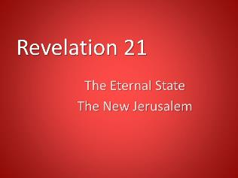
The Eternal State
Revelation 21‒22
The New Heavens & Earth (21:1-8)
The New Jerusalem (21:9‒22:5)
Epilogue (22:6-21)

Slide 4
The Eternal State
Revelation 21‒22
The New Heavens & Earth (21:1-8)
The New Jerusalem (21:9‒22:5)
Epilogue (22:6-21)

Slide 5
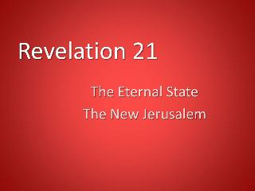
I. The New Heavens & Earth
Revelation 21:1-8
A New Creation (1)
A New City (2)
A New Fellowship (3)
A New Order (4-5)
A New Satisfaction (6)
A New Realization (7)
A New Holiness (8)

Slide 6
The Eternal State
Revelation 21‒22
The New Heavens & Earth (21:1-8)
The New Jerusalem (21:9‒22:5)
Epilogue (22:6-21)

Slide 7
II. The New Jerusalem
Revelation 21:9‒22:5
Four Titles (9-10)
Glory (11)
Construction (12-14)
Measurements (15-17)
Materials (18-21)
Relationship to God (22-23)
Relationship to the Nations (24-26)
Holiness (27)
Contents (22:1-5)

Slide 8
II. The New Jerusalem
Revelation 21:9‒22:5
Four Titles (9-10)
Glory (11)
Construction (12-14)
Measurements (15-17)
Materials (18-21)
Relationship to God (22-23)
Relationship to the Nations (24-26)
Holiness (27)
Contents (22:1-5)

Slide 9
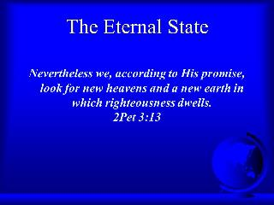
E. The City’s Materials
Revelation 21:18-21
Its Wall (18)
Its Foundations (19-20)
Its Gate (21a)
Its Street (21b)

Slide 10
E. The City’s Materials
Revelation 21:18-21
Its Wall (18)
Its Foundations (19-20)
Its Gate (21a)
Its Street (21b)

Slide 11
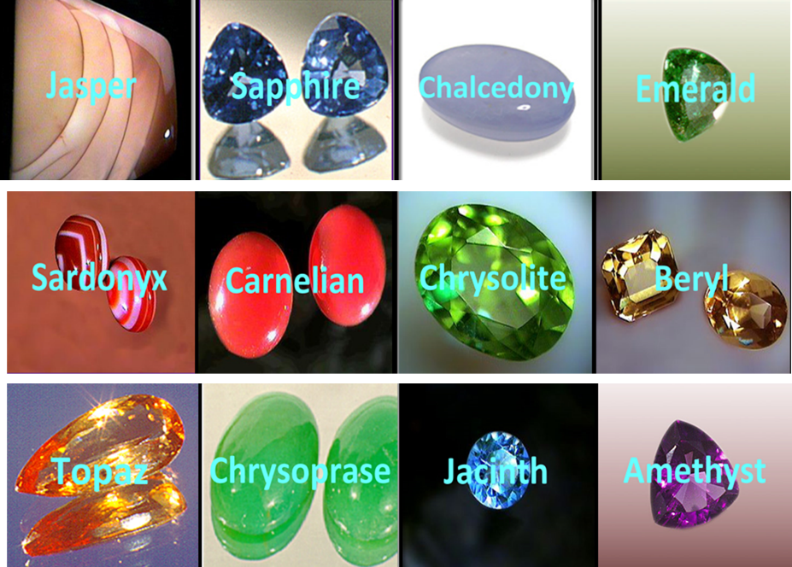

Slide 12
E. The City’s Materials
Revelation 21:18-21
Its Wall (18)
Its Foundations (19-20)
Its Gate (21a)
Its Street (21b)

Slide 13

Charles Ryrie
The Ryrie Study Bible
“21:19–20 chalcedony. Probably a greenish-blue agate stone. (The exact composition and color of all these precious stones is unknown.) sardonyx. Red and white stone. sardius. Bright red. chrysolite. Golden in color. beryl. Sea green. topaz. Yellow-green. chrysoprase. Apple green. jacinth. Blue. amethyst. Purple.”

Slide 15
E. The City’s Materials
Revelation 21:18-21
Its Wall (18)
Its Foundations (19-20)
Its Gate (21a)
Its Street (21b)

Slide 16
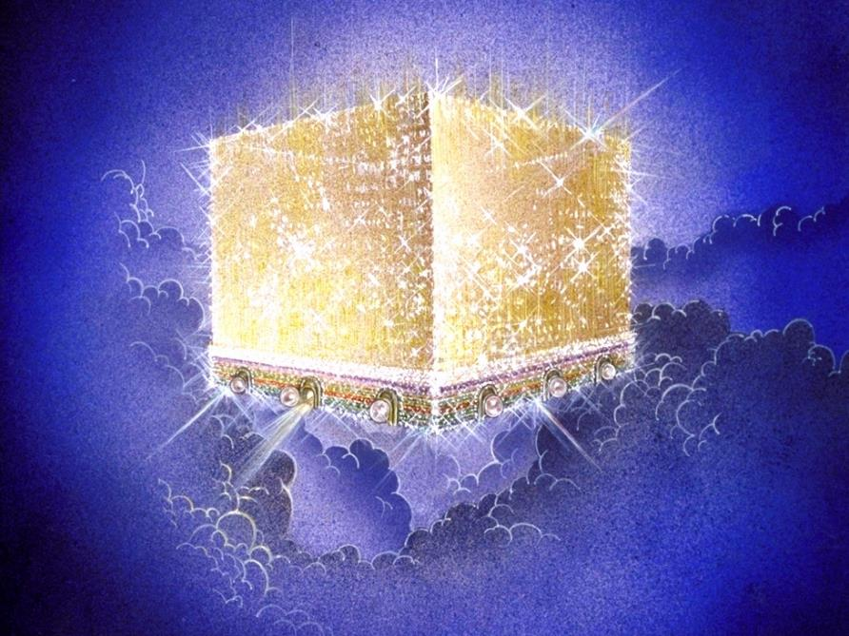
Notes:
Every city needs light. God, the ultimate source of power, illumines the city from his glory. Have you ever taken time to look at a sunset just after it has rained? As the sun sets, there is a kind of a glow cast on everything. It captures the spirit. This is just a little foretaste of the glory and splendor of heaven.

Slide 17
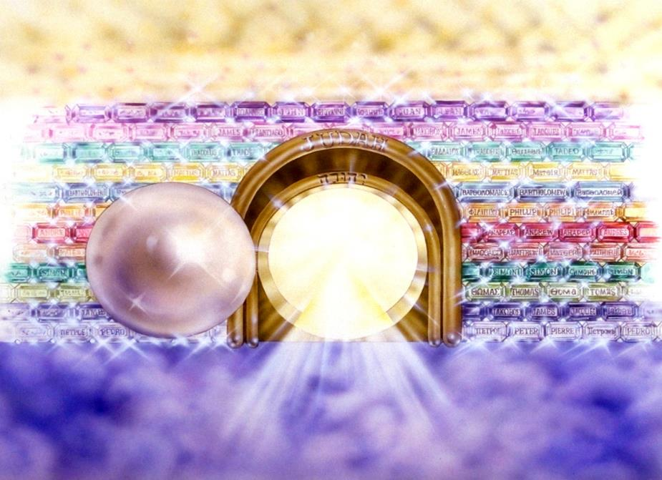
Notes:
Here you see an artist’s ideas of…
12 Gates = 12 Tribes of Israel
12 Foundation Stones = 12 Apostles of the Church

Slide 18
E. The City’s Materials
Revelation 21:18-21
Its Wall (18)
Its Foundations (19-20)
Its Gate (21a)
Its Street (21b)

Slide 19

Notes:
And the streets are made of what? Gold. When a man heard he was about to die, he desperately gathered up his life’s greatest accumulation—gold bars. When he did finally enter heaven, toting the heaven load, one angel poked another angel in the ribs. He said, “Hey, look, that guy brought pavement!”

Slide 20
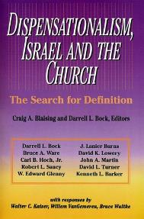
David L. Turner
“The New Jerusalem in Revelation 21:1-22:5; Consummation of a Biblical Continuum,” Dispensationalism, Israel, and the Church, ed., Craig A. Blaising and Darrell L. Bock (Grand Rapids: Zondervan, 1992), 277.
“Perhaps the absence of oysters large enough to produce such pearls and the absence of sufficient gold to pave such a city (viewed literally 1380 miles squared and high) is viewed as sufficient reason not to take these images as fully literal!…the preceding discussion serves to warn against a ‘hyper-literal’ approach to apocalyptic imagery….”

Slide 21
II. The New Jerusalem
Revelation 21:9‒22:5
Four Titles (9-10)
Glory (11)
Construction (12-14)
Measurements (15-17)
Materials (18-21)
Relationship to God (22-23)
Relationship to the Nations (24-26)
Holiness (27)
Contents (22:1-5)

Slide 22
E. The City’s Relationship to God
Revelation 21:22-23
No Temple (22)
No Luminaries (23)

Slide 23
E. The City’s Relationship to God
Revelation 21:22-23
No Temple (22)
No Luminaries (23)

Slide 24
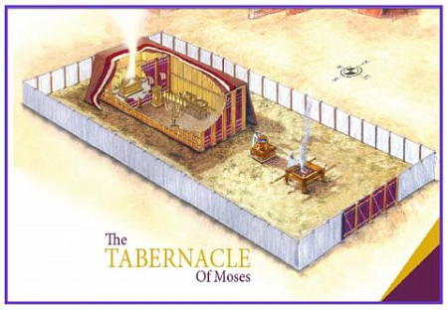

Slide 25
Israel’s Four Temples
Solomon’s pre exilic temple (Kings and Chronicles)
Zerubbabel’s post exilic temple (Ezra 1-6; John 2:20)
Antichrist's temple (Dan 9:27; Matt 24:15; 2 Thess 2:4; Rev 11:1-2)
Millennial temple (Ezek 40-48)

Slide 26


Slide 27


Slide 28
E. The City’s Relationship to God
Revelation 21:22-23
No Temple (22)
No Luminaries (23)

Slide 29
Millennium and Eternal State
 | Rev. 20:1-10 | Rev. 21–22
Time | 20:4 | 22:5
Luminaries | Isa. 30:26 | 21:23; 22:5
Temple | Ezek. 40–48 | 21:22
Death | Isa. 65:20 | 21:4
Satanic activity | 20:7 | 20:10
Rebellion | 20:8-9 | 21:27

Slide 30

Genesis 1:1-3
“¹ In the beginning God created the heavens and the earth. ² The earth was formless and void, and darkness was over the surface of the deep, and the Spirit of God was moving over the surface of the waters. ³ Then God said, ‘Let there be light’; and there was light.”

Slide 31
Deuteronomy 4:19
“And beware not to lift up your eyes to heaven and see the sun and the moon and the stars, all the host of heaven, and be drawn away and worship them and serve them, those which the Lord your God has allotted to all the peoples under the whole heaven.”

Slide 32
II. The New Jerusalem
Revelation 21:9‒22:5
Four Titles (9-10)
Glory (11)
Construction (12-14)
Measurements (15-17)
Materials (18-21)
Relationship to God (22-23)
Relationship to the Nations (24-26)
Holiness (27)
Contents (22:1-5)

Slide 33

Genesis 11:1-4
¹ Now the whole earth used the same language and the same words. ² It came about as they journeyed east, that they found a plain in the land of Shinar and settled there. ³ They said to one another, “Come, let us make bricks and burn them thoroughly.” And they used brick for stone, and they used tar for mortar. ⁴ They said, “Come, let us build for ourselves a city, and a tower whose top will reach into heaven, and let us make for ourselves a name, otherwise we will be scattered abroad over the face of the whole earth.”

Slide 34

Genesis 11:6
The Lord said, “Behold, they are one people, and they all have the same language. And this is what they began to do, and now nothing which they purpose to do will be impossible for them.”

Slide 35
Spread of the Mother-Child Cult
 | Mother | Child
Assyria | Ishtar | Tammuz
Phoenicia | Astarte | Baal
Egypt | Isis | Osirus/Horus
Greece | Aphrodite | Eros
Rome | Venus | Cupid
Asia | Cybele | Desius
India | Isi | Aswara
Roman Catholicism | Mary | Jesus
Israel | Queen of Heaven (Jer. 7:18; 44:17) | Tammuz (Ezek. 8:14-15)
Alexander Hislop, Two Babylons

Slide 36
God’s Doctrine of Nations
Since Babel | Deut. 32:8; Acts 17:26
Millennium | Isaiah 2:4; 66:18; Zech. 14:16-18 Rev.12:5; 20:3
Eternal State | Rev. 21:24, 26

Slide 37

Zechariah 14:16-18
“Then it will come about that any who are left of all the nations that went against Jerusalem will go up from year to year to worship the King, the Lord of hosts, and to celebrate the Feast of Booths. ¹⁷ And it will be that whichever of the families of the earth does not go up to Jerusalem to worship the King, the Lord of hosts, there will be no rain on them. ¹⁸ If the family of Egypt does not go up or enter, then no rain will fall on them; it will be the plague with which the Lord smites the nations who do not go up to celebrate the Feast of Booths.”

Slide 38


Revelation 12:5
“And she gave birth to a son, a male child, who is to rule all the nations with a rod of iron; and her child was caught up to God and to His throne.”

Slide 39
God’s Doctrine of Nations
Since Babel | Deut. 32:8; Acts 17:26
Millennium | Isaiah 2:4; 66:18; Zech. 14:16-18 Rev.12:5; 20:3
Eternal State | Rev. 21:24, 26

Slide 40
Eden = Probationary Environment
Eden (Genesis 1-2) | Eternal State (Rev 21-22)
Division: light/darkness 1:4 | No night 21:25
Division: land/sea 1:10 | No sea 21:1
Sun & moon 1:16 | No sun & moon 21:23
Garden 2:8-9 | City (21:2)
River flowing out of Eden 2:10 | River flowing from throne 22:1
Gold in the land 2:12 | Gold in the city 21:21
Tree of life in the middle of garden 2:9 | Tree of life throughout city 22:2
Bdellium and onyx stone 2:12 | All manner of stones 21:19
God walking in the garden 3:8 | God dwelling with His people 21:3
Henry Morris, Genesis Record, p.33

Slide 41
Zechariah 14:16-18
“Then it will come about that any who are left of all the nations that went against Jerusalem will go up from year to year to worship the King, the Lord of hosts, and to celebrate the Feast of Booths. ¹⁷ And it will be that whichever of the families of the earth does not go up to Jerusalem to worship the King, the Lord of hosts, there will be no rain on them. ¹⁸ If the family of Egypt does not go up or enter, then no rain will fall on them; it will be the plague with which the Lord smites the nations who do not go up to celebrate the Feast of Booths.”

Slide 42
II. The New Jerusalem
Revelation 21:9‒22:5
Four Titles (9-10)
Glory (11)
Construction (12-14)
Measurements (15-17)
Materials (18-21)
Relationship to God (22-23)
Relationship to the Nations (24-26)
Holiness (27)
Contents (22:1-5)

Slide 43
Revelation 21:8
“But for the cowardly and unbelieving and abominable and murderers and immoral persons and sorcerers and idolaters and all liars, their part will be in the lake that burns with fire and brimstone, which is the second death.”

Slide 44

Philippians 3:9
“and may be found in Him, not having a righteousness of my own derived from the Law, but that which is through faith in Christ, the righteousness which comes from God on the basis of faith.”

Slide 45
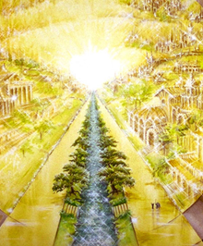
Eternal State is Future
No Satan (Rev 20:10)
No sea (Rev 21:1)
No death, crying, or pain (Rev 21:4)
No Sun (Rev 22:5)
No Moon (Rev 21:23)
No temple (Rev. 21:22)
No night (Rev 21:25)
No evil (Rev 21:27)
No Tree of Knowledge (22:1)
No curse (Rev 22:3)

Slide 46
II. The New Jerusalem
Revelation 21:9‒22:5
Four Titles (9-10)
Glory (11)
Construction (12-14)
Measurements (15-17)
Materials (18-21)
Relationship to God (22-23)
Relationship to the Nations (24-26)
Holiness (27)
Contents (22:1-5)

Slide 47
I. The City’s Contents
Revelation 22:1-5
Its River (1)
Its Trees (2)
No Curse (3a)
God’s Presence (3b-5)

Slide 48
I. The City’s Contents
Revelation 22:1-5
Its River (1)
Its Trees (2)
No Curse (3a)
God’s Presence (3b-5)

Slide 49
Revelation 22:1
“Then he showed me a river of the water of life, clear as crystal, coming from the throne of God and of the Lamb.”

Slide 50
Eden = Probationary Environment
Eden (Genesis 1-2) | Eternal State (Rev 21-22)
Division: light/darkness 1:4 | No night 21:25
Division: land/sea 1:10 | No sea 21:1
Sun & moon 1:16 | No sun & moon 21:23
Garden 2:8-9 | City (21:2)
River flowing out of Eden 2:10 | River flowing from throne 22:1
Gold in the land 2:12 | Gold in the city 21:21
Tree of life in the middle of garden 2:9 | Tree of life throughout city 22:2
Bdellium and onyx stone 2:12 | All manner of stones 21:19
God walking in the garden 3:8 | God dwelling with His people 21:3
Henry Morris, Genesis Record, p.33

Slide 51

Revelation 3:21
promise to the overcomers
“He who overcomes, I will grant [future tense of didōmi] to him to sit down with Me on My throne, as I also overcame and sat down [aorist tense of kathizō] with My Father on His throne.”

Slide 52
Revelation 3:21 in Progressive Dispensationalism
“One may object that the throne at the right hand of God is not the Davidic throne, which is earthly. The objection might be raised by appealing to a text like Revelation 3:21, where Jesus distinguishes between ‘my throne,’ in which the overcomer will sit, and the Father’s throne, on which Jesus currently sits. The argument is made that the throne on which Jesus sits in Acts is the Father’s throne, not David’s…this throne of the lamb, set next to the Father, is alluded to again in Revelation 22:1. This is the same throne that Jesus occupies in the consummation! He exercises Davidic rule now even as he will exercises it then.”
Darrell Bock, “The Reign of the Lord Christ,” in Dispensationalism, Israel and the Church, ed. Craig Blaising and Darrell Bock (Grand Rapids: Zondervan, 1992), 50, 62.
Notes:
WRONG!!!

Slide 53


Slide 54
Eternal State is Future
No Satan (Rev 20:10)
No sea (Rev 21:1)
No death, crying, or pain (Rev 21:4)
No Sun (Rev 22:5)
No Moon (Rev 21:23)
No temple (Rev. 21:22)
No night (Rev 21:25)
No evil (Rev 21:27)
No Tree of Knowledge (22:1)
No curse (Rev 22:3)

Slide 55
I. The City’s Contents
Revelation 22:1-5
Its River (1)
Its Trees (2)
No Curse (3a)
God’s Presence (3b-5)

Slide 56
Eden = Probationary Environment
Eden (Genesis 1-2) | Eternal State (Rev 21-22)
Division: light/darkness 1:4 | No night 21:25
Division: land/sea 1:10 | No sea 21:1
Sun & moon 1:16 | No sun & moon 21:23
Garden 2:8-9 | City (21:2)
River flowing out of Eden 2:10 | River flowing from throne 22:1
Gold in the land 2:12 | Gold in the city 21:21
Tree of life in the middle of garden 2:9 | Tree of life throughout city 22:2
Bdellium and onyx stone 2:12 | All manner of stones 21:19
God walking in the garden 3:8 | God dwelling with His people 21:3
Henry Morris, Genesis Record, p.33

Slide 57
Eternal State is Future
No Satan (Rev 20:10)
No sea (Rev 21:1)
No death, crying, or pain (Rev 21:4)
No Sun (Rev 22:5)
No Moon (Rev 21:23)
No temple (Rev. 21:22)
No night (Rev 21:25)
No evil (Rev 21:27)
No Tree of Knowledge (22:1)
No curse (Rev 22:3)

Slide 58
Heaven
Q: Will there be time in Heaven?
Notes:
Will there be time in heaven?
Revelation talks about the leaves of trees bearing fruit each month. The breakdown into months reflects time. So I believe there will be time in heaven.

Slide 59
Genesis 1:14
Then God said, “Let there be lights in the expanse of the heavens to separate the day from the night, and let them be for signs and for seasons and for days and years.”

Slide 60
I. The City’s Contents
Revelation 22:1-5
Its River (1)
Its Trees (2)
No Curse (3a)
God’s Presence (3b-5)

Slide 61
Romans 8:19-22
¹⁹ For the anxious longing of the creation waits eagerly for the revealing of the sons of God. ²⁰ For the creation was subjected to futility, not willingly, but because of Him who subjected it, in hope ²¹ that the creation itself also will be set free from its slavery to corruption into the freedom of the glory of the children of God. ²² For we know that the whole creation groans and suffers the pains of childbirth together until now.

Slide 62
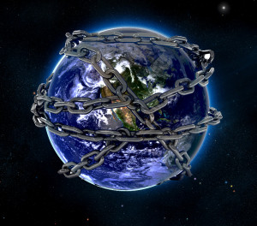
The whole creation groans and suffers!

Slide 63
GENESIS 3: THE FALL OF MAN
“This chapter is the pivot on which the whole Bible turns”
W. H. Griffith Thomas

Slide 64
Genesis 3 Structure
3:1-5 Temptation by the serpent
3:6 Sin of Adam and Eve
3:7-13 Results of the sin
3:14-19 Imposition of divine judgments
3:20-24 God’s provision in spite of the sin

Slide 65
Divine Judgments (3:14-19)
Serpent (3:14-15)
Woman (3:16)
Man (3:17-19)

Slide 66
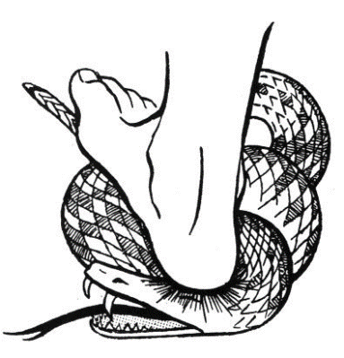
Serpent (3:14-15)
Serpent’s body (3:14)
Protevangelium (3:15)

Slide 67
Woman (3:16)
Painful child birth (3:16a)
Relational conflict (3:16b)

Slide 68
Man (3:17-19)
Painful labor (3:17-19a)
Death (3:19b)

Slide 69
I. The City’s Contents
Revelation 22:1-5
Its River (1)
Its Trees (2)
No Curse (3a)
God’s Presence (3b-5)

Slide 70
Millennium and Eternal State
 | Rev. 20:1-10 | Rev. 21–22
Time | 20:4 | 22:5
Luminaries | Isa. 30:26 | 21:23; 22:5
Temple | Ezek. 40–48 | 21:22
Death | Isa. 65:20 | 21:4
Satanic activity | 20:7 | 20:10
Rebellion | 20:8-9 | 21:27

Slide 71
Genesis 1:1-3
“¹ In the beginning God created the heavens and the earth. ² The earth was formless and void, and darkness was over the surface of the deep, and the Spirit of God was moving over the surface of the waters. ³ Then God said, ‘Let there be light’; and there was light.”

Slide 72
Deuteronomy 4:19
“And beware not to lift up your eyes to heaven and see the sun and the moon and the stars, all the host of heaven, and be drawn away and worship them and serve them, those which the Lord your God has allotted to all the peoples under the whole heaven.”

Slide 73
Mark Hitchcock
101 Answers to the Most Asked Questions About the End Times (Sisters, OR: Multnomah, 2001), 212.
“Christ will rule over His kingdom on this present earth for one thousand years, and He will reign forever. The future kingdom of God has two parts or phases. Phase one is the millennial reign of Christ on this earth (Rev. 20:1–6), and phase two is the eternal state (Rev. 22:5). As I once heard it described, the Millennium is the front porch of eternity.”

Slide 74
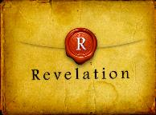
Revelation 5:10
“You have made them to be a kingdom and priests to our God; and they will reign [basileuō] upon the earth [gē].”

Slide 76
Conclusion

Slide 77
II. The New Jerusalem
Revelation 21:9‒22:5
Four Titles (9-10)
Glory (11)
Construction (12-14)
Measurements (15-17)
Materials (18-21)
Relationship to God (22-23)
Relationship to the Nations (24-26)
Holiness (27)
Contents (22:1-5)

Slide 78

“The Lord bless you and keep you; the Lord make his face shine on you and be gracious to you; the Lord turn his face toward you and give you peace.” (NIV)

