Slide 1
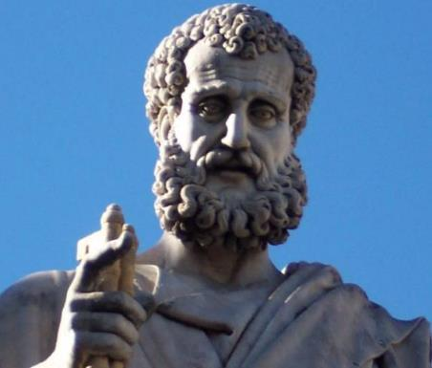

2 Peter
Dr. Andy Woods
Senior Pastor – Sugar Land Bible Church
President – Chafer Theological Seminary

Slide 2

INTRODUCTORY MATTERS
Authorship: Peter
Biography: Gospels & Acts
Date: A.D. 64
Recipients: Regenerated, Asia Minor, Hebrews
Place of writing: Babylon
Occasion for writing: Incipient Gnosticism
Purpose: Insulation from false teaching
Structure: 3 parts
Message: Protection from false teachers
Unique characteristics: Knowledge

Slide 3
STRUCTURE
2 Peter 1 – Call to maturity
2 Peter 2 – Characteristics of false teachers
2 Peter 3 – Doctrine of the false teachers (uniformitarianism)

Slide 4
STRUCTURE
2 Peter 1 – Call to maturity
2 Peter 2 – Characteristics of false teachers
2 Peter 3 – Doctrine of the false teachers (uniformitarianism)

Slide 5
2 PETER
The Call to Maturity (2 Peter 1)

Slide 6
2 PETER
Chapter 1
Introduction (1:1-2)
Call to Growth (1:3-11)
Purpose Statement (1:12-15)
Coming kingdom (1:16-21)

Slide 7
2 PETER
Chapter 1
Introduction (1:1-2)
Call to Growth (1:3-11)
Purpose Statement (1:12-15)
Coming kingdom (1:16-21)

Slide 8
INTRODUCTION
(1:1-2)
Writer (1:1a)
Recipients (1:1b)
Greeting (1:2)

Slide 9
2 PETER
Chapter 1
Introduction (1:1-2)
Call to Growth (1:3-11)
Purpose Statement (1:12-15)
Coming kingdom (1:16-21)

Slide 10
The Call to Growth (1:3-11)
Provisions for Growth (1:3-4)
Portrait of Growth (1:5-7)
Benefits of Growth (1:8-11)

Slide 11
The Call to Growth (1:3-11)
Provisions for Growth (1:3-4)
Portrait of Growth (1:5-7)
Benefits of Growth (1:8-11)

Slide 12
PROVISIONS FOR GROWTH
(1:3-4)
Power (1:3a)
Knowledge (1:3b)
Promises (1:4a)
Participation in the divine nature (1:4b)

Slide 13
The Call to Growth (1:3-11)
Provisions for Growth (1:3-4)
Portrait of Growth (1:5-7)
Benefits of Growth (1:8-11)

Slide 14
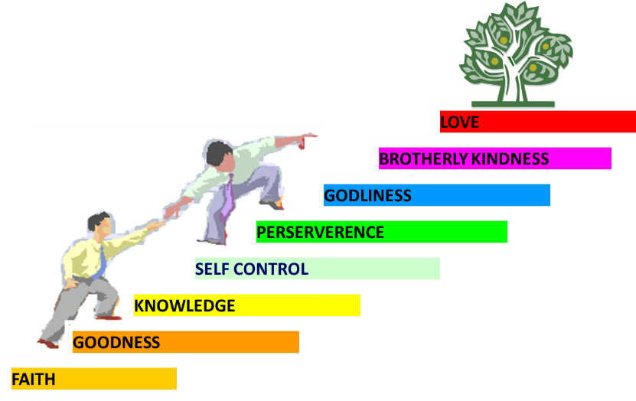
PORTRAIT OF GROWTH
1:5-7

Slide 15
The Call to Growth (1:3-11)
Provisions for Growth (1:3-4)
Portrait of Growth (1:5-7)
Benefits of Growth (1:8-11)

Slide 16
BENEFITS OF GROWTH
1:8-11
Productivity (1:8)
Harmony with identity (1:9)
Sureness of election (1:10a)
Stability (1:10b)
Eternal Reward (1:11)

Slide 17
BENEFITS OF GROWTH
1:8-11
Productivity (1:8)
Harmony with identity (1:9)
Sureness of election (1:10a)
Stability (1:10b)
Eternal Reward (1:11)

Slide 18

2 Peter 1:8-11
⁸ For if these qualities are yours and are increasing, they render you neither useless nor unfruitful in the true knowledge of our Lord Jesus Christ. ⁹ For he who lacks these qualities is blind or short-sighted, having forgotten his purification from his former sins. ¹⁰ Therefore, brethren, be all the more diligent to make certain about His calling and choosing you; for as long as you practice these things, you will never stumble; ¹¹ for in this way the entrance into the eternal kingdom of our Lord and Savior Jesus Christ will be abundantly supplied to you.

Slide 19


Charles Ryrie
The Ryrie Study Bible
“2 Peter 1:11 (RSB:NASB1995U): 1:11 A Christian life that can be rewarded will provide that abundance into heaven.”

Slide 20

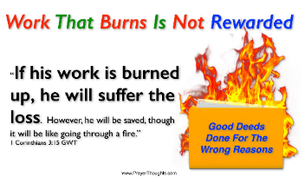
1 Corinthians 3:15
“If any man’s work is burned up, he will suffer loss; but he himself will be saved, yet so as through fire.”

Slide 21
Scripture’s Five Crowns (Rev 4:10: 3:11; 2 John 8)
SCRIPTURE | CROWN | PURPOSE
1 Cor. 9:24-27 | Incorruptible | Gaining mastery over the flesh
1 Thess. 2:19-20 | Rejoicing | Soul winning
Jas. 1:12; Rev. 2:10 | Life | Enduring trials
1 Pet. 5:2-4 | Glory | Shepherding God’s people
2 Tim. 4:8 | Righteousness | Longing for His appearing

Slide 22

1 Corinthians 9:24-27
“Do you not know that those who run in a race all run, but only one receives the prize? Run in such a way that you may win. ²⁵ Everyone who competes in the games exercises self-control in all things. They then do it to receive a perishable wreath, but we an imperishable. ²⁶ Therefore I run in such a way, as not without aim; I box in such a way, as not beating the air; ²⁷ but I discipline my body and make it my slave, so that, after I have preached to others, I myself will not be disqualified.”

Slide 23
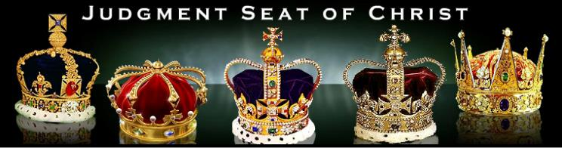
Revelation 3:11
“I am coming quickly; hold fast what you have, so that no one will take your crown.”

Slide 24
John 15:16
“You did not choose Me but I chose you, and appointed you that you would go and bear fruit, and that your fruit would remain, so that whatever you ask of the Father in My name He may give to you.”

Slide 25
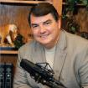
Woodrow Kroll
Woodrow Kroll, Facing Your Final Job Review: The Judgment Seat of Christ, Salvation, and Eternal Rewards (Wheaton, IL: Crossway Books, 2008), 123-124.
“We should never conceive of the loss of rewards as a repossession. God does not take back something he has already awarded to us. At the heavenly bema, we do not suddenly have a quantity of rewards ripped from our hands by the righteous Judge. We are not stripped of rewards as an erring soldier is stripped of his stripes. Not at all… Loss or reward is not like handing back a trophy that was mistakenly given to you. It’s not returning something you earned. It’s forfeiting a reward that you could have earned but failed to do so.”

Slide 26
2 PETER
Chapter 1
Introduction (1:1-2)
Call to Growth (1:3-11)
Purpose Statement (1:12-15)
Coming kingdom (1:16-21)

Slide 27
PURPOSE STATEMENT
V. 12-15
Last Will:
  To Remind You of Previously Revealed Truth to Prepare You for Coming False Teachers

Slide 28

REMEMBRANCE
Has forgotten that he has been cleansed (1:9)
I will always remind you of these things (1:12)
It is right to refresh your memory (1:13)
You will always be able to remember these things (1:15)
I have written both of them as reminders (3:1)
Do not forget (3:8)
Bear in mind (3:15)

Slide 29
2 PETER
Chapter 1
Introduction (1:1-2)
Call to Growth (1:3-11)
Purpose Statement (1:12-15)
Coming kingdom (1:16-21)

Slide 30
2 Peter 1:8-11
⁸ For if these qualities are yours and are increasing, they render you neither useless nor unfruitful in the true knowledge of our Lord Jesus Christ. ⁹ For he who lacks these qualities is blind or short-sighted, having forgotten his purification from his former sins. ¹⁰ Therefore, brethren, be all the more diligent to make certain about His calling and choosing you; for as long as you practice these things, you will never stumble; ¹¹ for in this way the entrance into the eternal kingdom of our Lord and Savior Jesus Christ will be abundantly supplied to you.

Slide 31
RECIPIENTS
North-central portion of modern Turkey (1 Pet. 1:1)
Regenerated (1 Pet. 1:3-4; 2 Pet. 1:1)
Jewish
  Diaspora (1 Pet. 1:1; Jas. 1:1; John 7:35)
  Aliens/sojourners (1 Pet. 1:1)
  Pilgrims (1 Pet. 2:11)
  Distinguished from the Gentiles (1 Pet. 2:12; 4:3)
  1 Pet 2:9 (Exod. 19:6; Rom. 10:19)
  To the church/churches? (1 Pet. 1:1; 2 Pet. 1:1)
  Gal. 2:7-8

Slide 32

Isaiah 9:6-7
⁶ For a child will be born to us, a son will be given to us; And the government will rest on His shoulders; And His name will be called Wonderful Counselor, Mighty God, Eternal Father, Prince of Peace.⁷ There will be no end to the increase of His government or of peace, On the throne of David and over his kingdom, To establish it and to uphold it with justice and righteousness From then on and forevermore. The zeal of the Lord of hosts will accomplish this.

Slide 33
Two Proofs the Kingdom Will Come
V. 16-21
Christ’s Transfiguration (16-18)
Old Testament prediction (19-21)

Slide 34
Two Proofs the Kingdom Will Come
V. 16-21
Christ’s Transfiguration (16-18)
Old Testament prediction (19-21)

Slide 35
PETER’S AUTHORITY
V.16-18
Superior to Gnostics’ Esoteric Knowledge
Eyewitness to Christ’s Transfiguration

Slide 36
Two Proofs the Kingdom Will Come
V. 16-21
Christ’s Transfiguration (16-18)
Old Testament prediction (19-21)

Slide 37
2 Peter 1:19-21
“¹⁹ So we have the prophetic word made more sure, to which you do well to pay attention as to a lamp shining in a dark place, until the day dawns and the morning star arises in your hearts. ²⁰ But know this first of all, that no prophecy of Scripture is a matter of one’s own interpretation, ²¹ for no prophecy was ever made by an act of human will, but men moved by the Holy Spirit spoke from God.”

Slide 38
2 Peter 1:19-21
“¹⁹ So we have the prophetic word made more sure, to which you do well to pay attention as to a lamp shining in a dark place, until the day dawns and the morning star arises in your hearts. ²⁰ But know this first of all, that no prophecy of Scripture is a matter of one’s own interpretation, ²¹ for no prophecy was ever made by an act of human will, but men moved by the Holy Spirit spoke from God.”

Slide 39
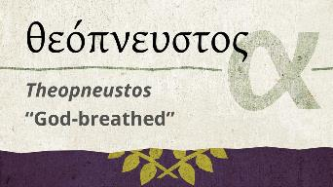
2 Timothy 3:16-17
“All Scripture is inspired by God [theopneustos] and profitable for teaching, for reproof, for correction, for training in righteousness; so that the man of God may be adequate, equipped for every good work.”

Slide 40
2 Peter 1:19-21
“¹⁹ So we have the prophetic word made more sure, to which you do well to pay attention as to a lamp shining in a dark place, until the day dawns and the morning star arises in your hearts. ²⁰ But know this first of all, that no prophecy of Scripture is a matter of one’s own interpretation, ²¹ for no prophecy was ever made by an act of human will, but men moved [pherō] by the Holy Spirit spoke from God.”

Slide 41
INSPIRATION OF SCRIPTURE
V. 20-21
Men Wrote as they were inspired by Holy Spirit
  “pherō” = to carry
    Acts 27:15,17
Opposite of Knowledge of False Teachers
  Which is their own imagination
    Jer. 23:16

Slide 42
2 Peter 1:19-21
“¹⁹ So we have the prophetic word made more sure, to which you do well to pay attention as to a lamp shining in a dark place, until the day dawns and the morning star arises in your hearts. ²⁰ But know this first of all, that no prophecy of Scripture is a matter of one’s own interpretation, ²¹ for no prophecy was ever made by an act of human will, but men moved by the Holy Spirit spoke from God.”

Slide 43
AUTHORITY OF SCRIPTURE
V. 19
More sure than eyewitness testimony
World is in the Dark, Scripture is the Light
Morning Star = Jesus
  Rev. 2:28; 22:16

Slide 44


Slide 45
Jeremiah 31:31-34
“Behold, days are coming,” declares the Lord, “when I will make a new covenant with the house of Israel and with the house of Judah, ³² not like the covenant which I made with their fathers in the day I took them by the hand to bring them out of the land of Egypt, My covenant which they broke, although I was a husband to them,” declares the Lord. ³³ “But this is the covenant which I will make with the house of . . .

Slide 46
Jeremiah 31:31-34
. . . Israel after those days,” declares the Lord, “I will put My law within them and on their heart I will write it; and I will be their God, and they shall be My people. ³⁴ They will not teach again, each man his neighbor and each man his brother, saying, ‘Know the Lord,’ for they will all know Me, from the least of them to the greatest of them,” declares the Lord, “for I will forgive their iniquity, and their sin I will remember no more.”

Slide 47
CONCLUSION

Slide 48
2 PETER
Chapter 1
Introduction (1:1-2)
Call to Growth (1:3-11)
Purpose Statement (1:12-15)
Coming kingdom (1:16-21)

