Slide 1
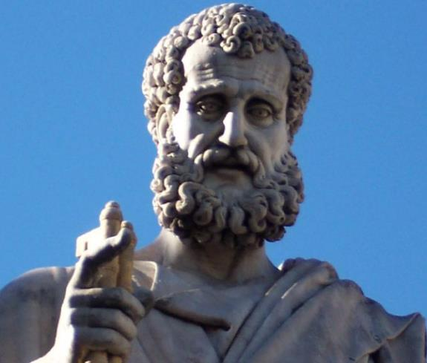

2 Peter
Dr. Andy Woods
Senior Pastor – Sugar Land Bible Church
President – Chafer Theological Seminary

Slide 2
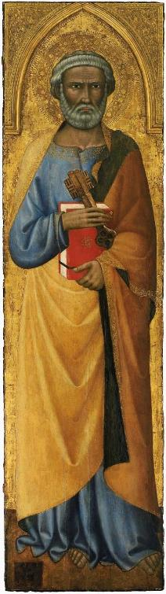
INTRODUCTORY MATTERS
Authorship
Biography
Date
Recipients
Place of writing
Occasion for writing
Purpose
Structure
Message
Unique characteristics

Slide 3
INTRODUCTORY MATTERS
Authorship
Biography
Date
Recipients
Place of writing
Occasion for writing
Purpose
Structure
Message
Unique characteristics

Slide 4
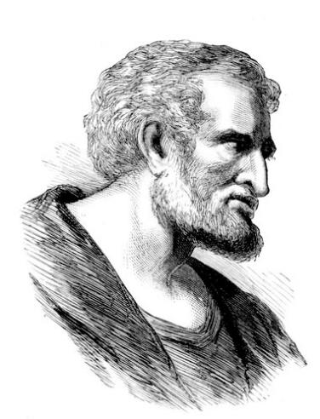
AUTHORSHIP
1:1
1:13-14; John 21:18-19
1:15-18; Matt 17:1-13

Slide 5
ARGUMENTS FOR & AGAINST PETRINE AUTHORSHIP
CRITICISM | ANSWER
Weak External Evidence (Not Cited by Church Fathers Until 3rd Century) | Alternative reasons; Jude
Linguistic Differences between 1 & 2 Peter | Used a Secretary for 1 Peter (5:12)
Different Ideas between 1 & 2 Peter | Different Purposes between 1 & 2 Peter
Lived After Paul (2 Pet 3:15-16) | “All” Means “Known” Pauline Documents
Passing of the fathers (2 Pet 3:4) | Fathers = patriarchs (Rom 9:5)

Slide 6
INTRODUCTORY MATTERS
Authorship
Biography
Date
Recipients
Place of writing
Occasion for writing
Purpose
Structure
Message
Unique characteristics

Slide 7
INTRODUCTORY MATTERS
Authorship
Biography
Date
Recipients
Place of writing
Occasion for writing
Purpose
Structure
Message
Unique characteristics

Slide 8
DATE (A.D. 64)
After
  1 Peter (2 Pet 3:1)
  Paul wrote some of his letters (2 Pet 3:15-16)
Before
  A.D. 70 (destruction of Jerusalem)
  A.D. 68 (Paul’s death)
  A.D. 67 (Peter’s martyrdom)
  A.D. 64 (Neronian persecution)

Slide 9
INTRODUCTORY MATTERS
Authorship
Biography
Date
Recipients
Place of writing
Occasion for writing
Purpose
Structure
Message
Unique characteristics

Slide 10
RECIPIENTS
North-central portion of modern Turkey (1 Pet. 1:1)
Regenerated (1 Pet. 1:3-4; 2 Pet. 1:1)
Jewish
  Diaspora (1 Pet. 1:1; Jas. 1:1; John 7:35)
  Aliens/sojourners (1 Pet. 1:1)
  Pilgrims (1 Pet. 2:11)
  Distinguished from the Gentiles (1 Pet. 2:12; 4:3)
  1 Pet 2:9 (Exod. 19:6; Rom. 10:19)
  To the church/churches? (1 Pet. 1:1; 2 Pet. 1:1)
  Gal. 2:7-8

Slide 11
RECIPIENTS
North-central portion of modern Turkey (1 Pet. 1:1)
Regenerated (1 Pet. 1:3-4; 2 Pet. 1:1)
Jewish
  Diaspora (1 Pet. 1:1; Jas. 1:1; John 7:35)
  Aliens/sojourners (1 Pet. 1:1)
  Pilgrims (1 Pet. 2:11)
  Distinguished from the Gentiles (1 Pet. 2:12; 4:3)
  1 Pet 2:9 (Exod. 19:6; Rom. 10:19)
  To the church/churches? (1 Pet. 1:1; 2 Pet. 1:1)
  Gal. 2:7-8

Slide 12


1 Peter 1:1
“To those who reside as aliens, scattered throughout Pontus, Galatia, Cappadocia, Asia, and Bithynia, who are chosen.”

Slide 13
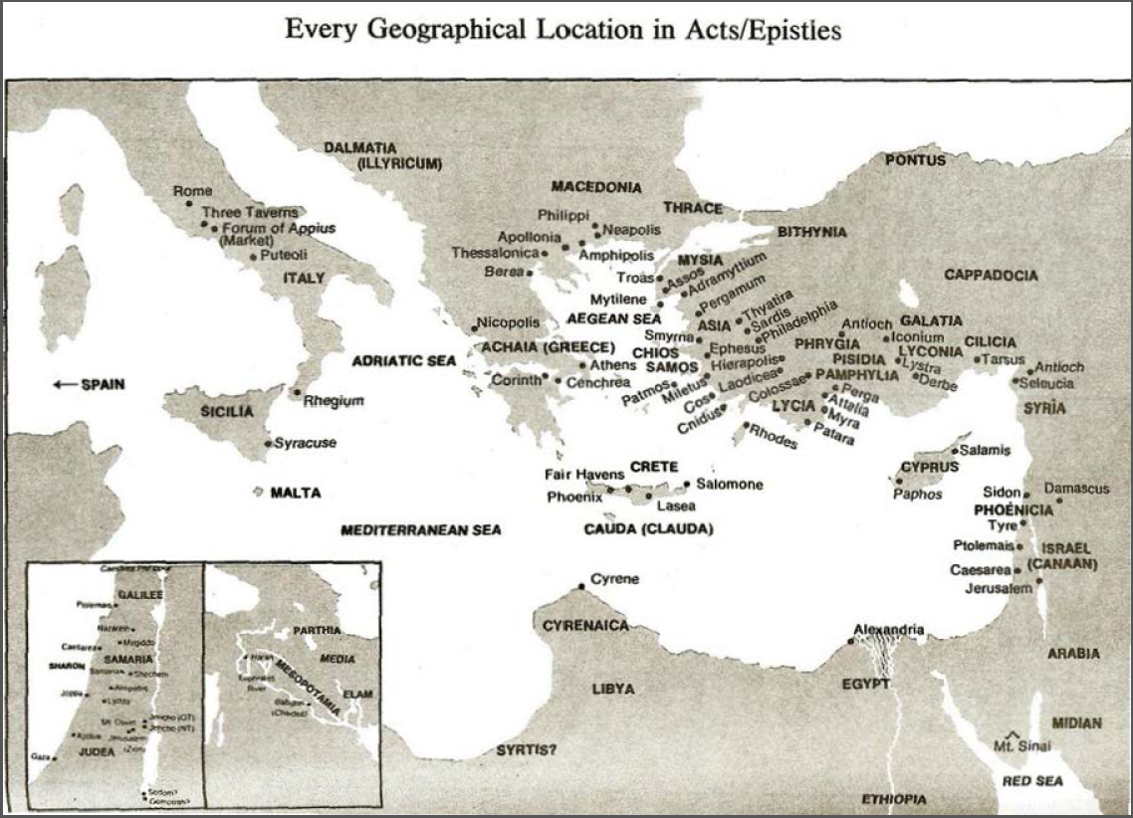

Slide 14
Acts 8:3-4; 11:19
“³ But Saul began ravaging the church, entering house after house, and dragging off men and women, he would put them in prison. ⁴ Therefore, those who had been scattered went about preaching the word…¹⁹ So then those who were scattered because of the persecution that occurred in connection with Stephen made their way to Phoenicia and Cyprus and Antioch, speaking the word to no one except to Jews alone.”

Slide 15
RECIPIENTS
North-central portion of modern Turkey (1 Pet. 1:1)
Regenerated (1 Pet. 1:3-4; 2 Pet. 1:1)
Jewish
  Diaspora (1 Pet. 1:1; Jas. 1:1; John 7:35)
  Aliens/sojourners (1 Pet. 1:1)
  Pilgrims (1 Pet. 2:11)
  Distinguished from the Gentiles (1 Pet. 2:12; 4:3)
  1 Pet 2:9 (Exod. 19:6; Rom. 10:19)
  To the church/churches? (1 Pet. 1:1; 2 Pet. 1:1)
  Gal. 2:7-8

Slide 16
INTRODUCTORY MATTERS
Authorship
Biography
Date
Recipients
Place of writing
Occasion for writing
Purpose
Structure
Message
Unique characteristics

Slide 17

1 Peter 5:13
“She who is in Babylon, chosen together with you, sends you greetings, and so does my son, Mark.”

Slide 18
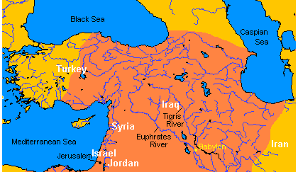
MAP OF NEAR EAST

Slide 19


Slide 20


Slide 21

Charles Ryrie
The Ryrie Study Bible
“1 Peter 5:13 (RSB:NASB1995U): 5:13 She who is in Babylon. The church in Rome, where Peter evidently was writing this letter. My son, Mark. John Mark, the writer of the gospel, who was not Peter’s natural son but his son in the faith.”

Slide 22
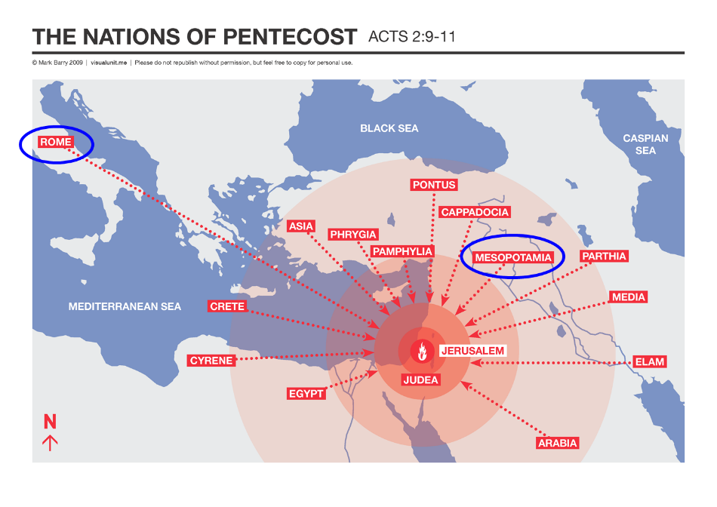

Slide 23
PLACE OF WRITING (1 PET 5:13)
1 Peter 1:1 is literal
Gal 4:25; Rev 11:8
Gal 2:7-8
Rome mentioned elsewhere in Scripture

Slide 24
PLACE OF WRITING (1 PET 5:13)
1 Peter 1:1 is literal
Gal 4:25; Rev 11:8
Gal 2:7-8
Rome mentioned elsewhere in Scripture

Slide 25
1 Peter 1:1
“To those who reside as aliens, scattered throughout Pontus, Galatia, Cappadocia, Asia, and Bithynia, who are chosen.”

Slide 26
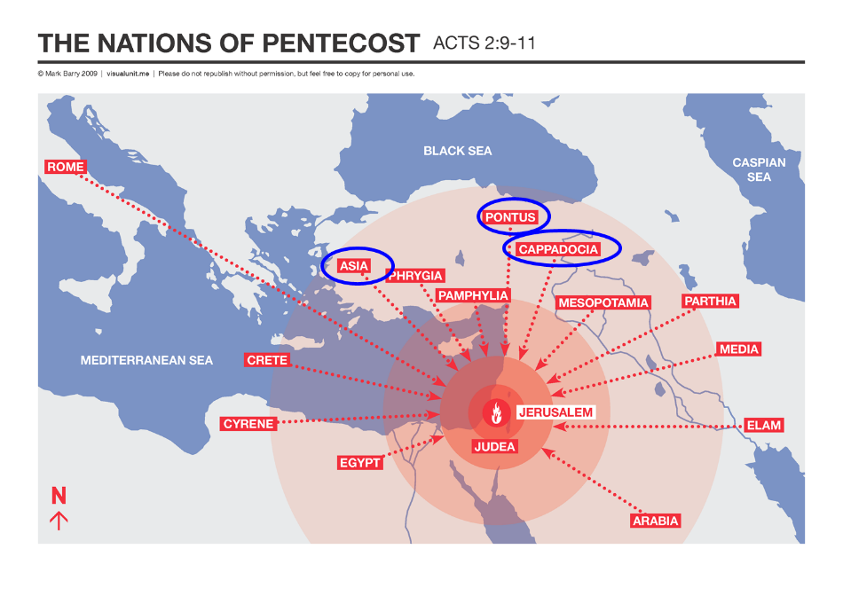

Slide 27
PLACE OF WRITING (1 PET 5:13)
1 Peter 1:1 is literal
Gal 4:25; Rev 11:8
Gal 2:7-8
Rome mentioned elsewhere in Scripture

Slide 28

Galatians 4:24–25
²⁴ This is allegorically speaking, for these women are two covenants: one proceeding from Mount Sinai bearing children who are to be slaves; she is Hagar. ²⁵ Now this Hagar is Mount Sinai in Arabia and corresponds to the present Jerusalem, for she is in slavery with her children.

Slide 29
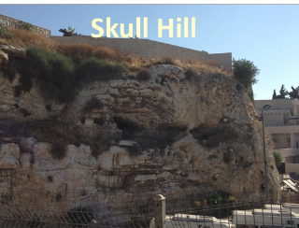
Revelation 11:8
“And their dead bodies will lie in the street of the great city which mystically is called Sodom and Egypt, where also their Lord was crucified.”

Slide 30
PLACE OF WRITING (1 PET 5:13)
1 Peter 1:1 is literal
Gal 4:25; Rev 11:8
Gal 2:7-8
Rome mentioned elsewhere in Scripture

Slide 31

Galatians 2:7-8
“⁷ But on the contrary, seeing that I had been entrusted with the gospel to the uncircumcised, just as Peter had been to the circumcised ⁸ (for He who effectually worked for Peter in his apostleship to the circumcised effectually worked for me also to the Gentiles).”

Slide 32
Babylon’s History After 539 B.C.
Herodotus gives Babylon’s measurements (450 B.C.)
Alexander the Great visits and dies in Babylon (323 B.C.)
Seleucus seizes Babylon (312 B.C.)
Strabo pronounces Babylon’s hanging gardens as one of “seven wonders of the world” (25 B.C)
Babylonians present on Pentecost (Acts 2:9)
Talmud promulgated from Babylon (A.D. 500)
Haukal mentions Babylonian village (A.D. 917)
Babylon known as “Two Mosques” and “Hilah” (A.D. 1100)
Hitchcock and Ice, The Truth Behind Left Behind, 109

Slide 33
Acts 2:9-11
“⁹ Parthians and Medes and Elamites, and residents of Mesopotamia, Judea and Cappadocia, Pontus and Asia, ¹⁰ Phrygia and Pamphylia, Egypt and the districts of Libya around Cyrene, and visitors from Rome, both Jews and proselytes, ¹¹ Cretans and Arabs—we hear them in our own tongues speaking of the mighty deeds of God.”

Slide 35
Josephus
Antiquities, 15.2.2
“But when Hyrcanus was brought into Parthia the king Phraates treated him after a very gentle manner, as having already learned of what an illustrious family he was; on which account he set him free from his bonds, and gave him a habitation at Babylon, where there were Jews in great numbers. These Jews honored Hyrcanus as their high priest and king, as did all the Jewish nation that dwelt as far as Euphrates; which respect was very much to his satisfaction...”

Slide 36
Strabo, Geography, 16.1.5?
“Strabo, who died in A.D. 25, is cited in proof that by this time no city was left. . . . This is an instance of how easily lax quotation or assertion may falsify both an author and an issue, which being once done, other writers too easily follow suit. What Strabo says is: ‘And now indeed [Selucia] has become greater than Babylon, which for the most part has become deserted’ (ἡ δʼ ἔρημοs ἡ πολλή).”
G. H. Lang, The Revelation of Jesus Christ: Select Studies (London: Paternoster, 1948), 302.

Slide 37
PLACE OF WRITING (1 PET 5:13)
1 Peter 1:1 is literal
Gal 4:25; Rev 11:8
Gal 2:7-8
Rome mentioned elsewhere in Scripture

Slide 38
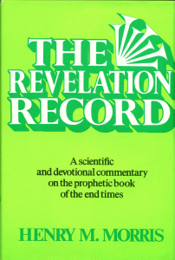
Morris
The Revelation Record, 323
“At the very least, it would be confusing to John’s first century readers, as well as to later generations, for him to write so much about Babylon when he really meant Rome (Paul was not afraid to speak directly against Rome in his writings, so why should John be?) or ‘the false church’ (all the apostles , including John, wrote plainly and scathingly about false teachers and false doctrines in the church and would not hide their teachings by symbols). It must be stressed that Revelation means “unveiling,” not “veiling.” In the absence of any statement in the text to the contrary, therefore, we must assume that the term Babylon applies to the real city of Babylon…”

Slide 39
1 Peter 5:13
“She who is in Babylon, chosen together with you, sends you greetings, and so does my son, Mark.”

Slide 40
1 Corinthians 9:5
“Do we not have a right to take along a believing wife, even as the rest of the apostles and the brothers of the Lord and Cephas?”

Slide 41
Luke 4:38
“Then He got up and left the synagogue, and entered Simon’s home. Now Simon’s mother-in-law was suffering from a high fever, and they asked Him to help her.”

Slide 42
Babylon’s History After 539 B.C.
Herodotus gives Babylon’s measurements (450 B.C.)
Alexander the Great visits and dies in Babylon (323 B.C.)
Seleucus seizes Babylon (312 B.C.)
Strabo pronounces Babylon’s hanging gardens as one of “seven wonders of the world” (25 B.C)
Babylonians present on Pentecost (Acts 2:9)
Talmud promulgated from Babylon (A.D. 500)
Haukal mentions Babylonian village (A.D. 917)
Babylon known as “Two Mosques” and “Hilah” (A.D. 1100)
Hitchcock and Ice, The Truth Behind Left Behind, 109

Slide 44
INTRODUCTORY MATTERS
Authorship
Biography
Date
Recipients
Place of writing
Occasion for writing
Purpose
Structure
Message
Unique characteristics

Slide 45

FALSE TEACHERS ARE COMING!
Heresies of Gnostics:
Salvation via special knowledge “gnosis”
License (indulgence)

Slide 46
OCCASION FOR WRITING
Incipient Gnosticism
  Dualism
    Christology
      Incarnation (2 Pet 2:1)
      Second Advent (2 Pet 3:4)
    License (2 Pet 2:4-18)
  Secret knowledge
    Scripture (2 Pet 1:20)
    Pride (2 Pet 2:10-11)

Slide 47
INTRODUCTORY MATTERS
Authorship
Biography
Date
Recipients
Place of writing
Occasion for writing
Purpose
Structure
Message
Unique characteristics

Slide 48
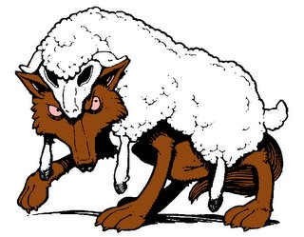
PURPOSE
To build up his readers in the faith so that they will be insulated from the coming false teachers

Slide 49
DIFFERENCES BETWEEN 1 AND 2 PETER
1 PETER | 2 PETER
External opposition | Internal opposition
Persecution | False teaching
Suffering | Error
Hope | Knowledge
Encourage | Expose
Comfort | Caution
Holiness | Maturity
Pain with a purpose | Poison in the pew
Christ exemplified suffering | Christ’s return
Wilkinson and Boa pg. 480 and Nelson’s Complete Book of Charts pg. 466.

Slide 50
INTRODUCTORY MATTERS
Authorship
Biography
Date
Recipients
Place of writing
Occasion for writing
Purpose
Structure
Message
Unique characteristics

Slide 51
STRUCTURE
2 Peter 1 – Call to maturity
2 Peter 2 – Characteristics of false teachers
2 Peter 3 – Doctrine of the false teachers

Slide 52
INTRODUCTORY MATTERS
Authorship
Biography
Date
Recipients
Place of writing
Occasion for writing
Purpose
Structure
Message
Unique characteristics

Slide 53
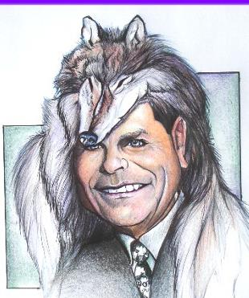
MESSAGE
Protection from the negative influence of the coming false teachers is accomplished through exhortation toward maturity and exposing the characteristics and doctrines of these coming false teachers

Slide 54
INTRODUCTORY MATTERS
Authorship
Biography
Date
Recipients
Place of writing
Occasion for writing
Purpose
Structure
Message
Unique characteristics

Slide 55
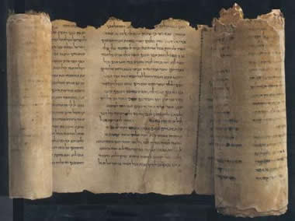
UNIQUE CHARACTERISTICS
Knowledge
Bibliology (1:19-21; 3:2; 15-16)
Destruction of the present world (2 Pet 3:10ff)
Polemical
Peter’s last will and testament (2 Pet 1:14-15)
Similarities with Jude
Remembrance

Slide 56
Order of Paul’s Letters
Galatians (A.D. 49)
1‒2 Thessalonians (A.D. 51)
1‒2 Corinthians (A.D. 56)
Romans (A.D. 57)
Ephesians, Colossians, Philemon, Philippians (A.D. 60‒62)
1 Timothy, Titus (A.D. 62‒66)
2 Timothy (A.D. 67)

Slide 57

REMEMBRANCE
Has forgotten that he has been cleansed (1:9)
I will always remind you of these things (1:12)
It is right to refresh your memory (1:13)
You will always be able to remember these things (1:15)
I have written both of them as reminders (3:1)
Do not forget (3:8)
Bear in mind (3:15)

Slide 58
CONCLUSION

Slide 59
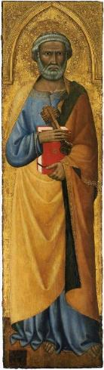
INTRODUCTORY MATTERS
Authorship: Peter
Biography: Gospels & Acts
Date: A.D. 64
Recipients: Regenerated, Asia Minor, Hebrews
Place of writing: Babylon
Occasion for writing: Incipient Gnosticism
Purpose: Insulation from false teaching
Structure: 3 parts
Message: Protection from false teachers
Unique characteristics: Knowledge

