Slide 1
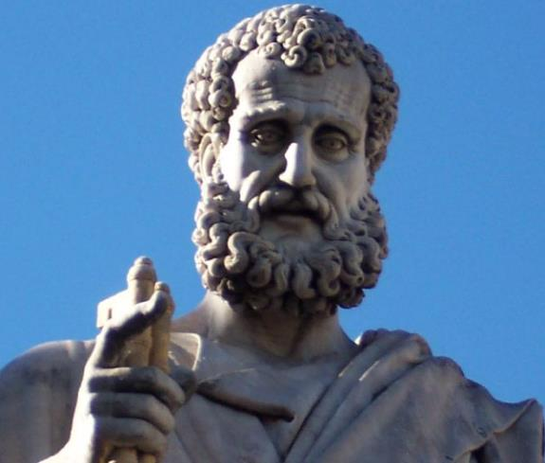

2 Peter
Dr. Andy Woods
Senior Pastor – Sugar Land Bible Church
President – Chafer Theological Seminary

Slide 2
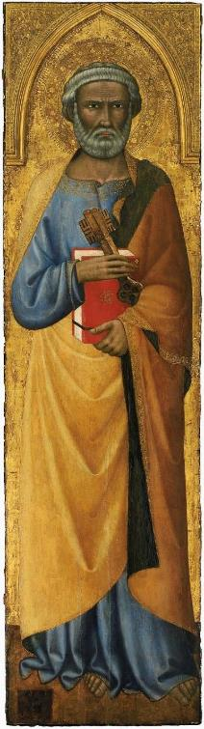
INTRODUCTORY MATTERS
Authorship
Biography
Date
Recipients
Place of writing
Occasion for writing
Purpose
Structure
Message
Unique characteristics

Slide 3
INTRODUCTORY MATTERS
Authorship
Biography
Date
Recipients
Place of writing
Occasion for writing
Purpose
Structure
Message
Unique characteristics

Slide 4
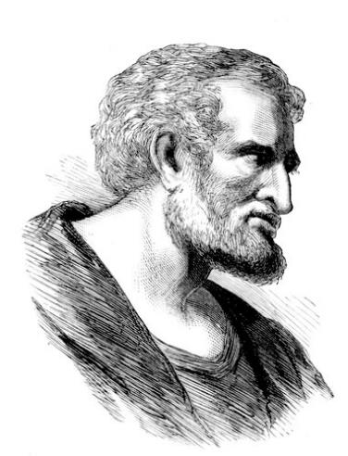
AUTHORSHIP
1:1
1:13-14; John 21:18-19
1:15-18; Matt 17:1-13

Slide 5
ARGUMENTS FOR & AGAINST PETRINE AUTHORSHIP
CRITICISM | ANSWER
Weak External Evidence (Not Cited by Church Fathers Until 3rd Century) | Alternative reasons; Jude
Linguistic Differences between 1 & 2 Peter | Used a Secretary for 1 Peter (5:12)
Different Ideas between 1 & 2 Peter | Different Purposes between 1 & 2 Peter
Lived After Paul (2 Pet 3:15-16) | “All” Means “Known” Pauline Documents
Passing of the fathers (2 Pet 3:4) | Fathers = patriarchs (Rom 9:5)

Slide 6
ARGUMENTS FOR & AGAINST PETRINE AUTHORSHIP
CRITICISM | ANSWER
Weak External Evidence (Not Cited by Church Fathers Until 3rd Century) | Alternative reasons; Jude
Linguistic Differences between 1 & 2 Peter | Used a Secretary for 1 Peter (5:12)
Different Ideas between 1 & 2 Peter | Different Purposes between 1 & 2 Peter
Lived After Paul (2 Pet 3:15-16) | “All” Means “Known” Pauline Documents
Passing of the fathers (2 Pet 3:4) | Fathers = patriarchs (Rom 9:5)

Slide 7
COMPARISON OF 2 PETER AND JUDE
2 PETER | JUDE
1:5 | 3
2:1 | 4
2:4 | 6
2:6-7 | 7
2:10 | 8
2:11 | 9
2:12 | 10
2:13 | 12
2:15 | 11
2:15-17 | 12-13
2:18 | 16
3:2 | 17
3:3 | 18
This chart was taken from Arnold G. Fruchtenbaum, The Messianic Jewish Epistles, Ariel's Bible Commentary (Tustin, CA: Ariel, 2005), 390.

Slide 8
ARGUMENTS FOR & AGAINST PETRINE AUTHORSHIP
CRITICISM | ANSWER
Weak External Evidence (Not Cited by Church Fathers Until 3rd Century) | Alternative reasons; Jude
Linguistic Differences between 1 & 2 Peter | Used a Secretary for 1 Peter (5:12)
Different Ideas between 1 & 2 Peter | Different Purposes between 1 & 2 Peter
Lived After Paul (2 Pet 3:15-16) | “All” Means “Known” Pauline Documents
Passing of the fathers (2 Pet 3:4) | Fathers = patriarchs (Rom 9:5)

Slide 9
ARGUMENTS FOR & AGAINST PETRINE AUTHORSHIP
CRITICISM | ANSWER
Weak External Evidence (Not Cited by Church Fathers Until 3rd Century) | Alternative reasons; Jude
Linguistic Differences between 1 & 2 Peter | Used a Secretary for 1 Peter (5:12)
Different Ideas between 1 & 2 Peter | Different Purposes between 1 & 2 Peter
Lived After Paul (2 Pet 3:15-16) | “All” Means “Known” Pauline Documents
Passing of the fathers (2 Pet 3:4) | Fathers = patriarchs (Rom 9:5)

Slide 10
ORDER OF PAUL’S LETTERS
Galatians (A.D. 49)
1‒2 Thessalonians (A.D. 51)
1‒2 Corinthians (A.D. 56)
Romans (A.D. 57)
Ephesians, Colossians, Philemon, Philippians (A.D. 60‒62)
1 Timothy, Titus (A.D. 62‒66)
2 Timothy (A.D. 67)

Slide 11
ARGUMENTS FOR & AGAINST PETRINE AUTHORSHIP
CRITICISM | ANSWER
Weak External Evidence (Not Cited by Church Fathers Until 3rd Century) | Alternative reasons; Jude
Linguistic Differences between 1 & 2 Peter | Used a Secretary for 1 Peter (5:12)
Different Ideas between 1 & 2 Peter | Different Purposes between 1 & 2 Peter
Lived After Paul (2 Pet 3:15-16) | “All” Means “Known” Pauline Documents
Passing of the fathers (2 Pet 3:4) | Fathers = patriarchs (Rom 9:5)

Slide 12
INTRODUCTORY MATTERS
Authorship
Biography
Date
Recipients
Place of writing
Occasion for writing
Purpose
Structure
Message
Unique characteristics

Slide 13
PETER’S BIOGRAPHY
Peter’s name is mentioned first on all of the lists enumerating the apostles (Matt 10:2-4; Mark 3:13-15; Luke 6:12-13; Acts 1:13).
As one of the inner three, he (along with James and John) witnessed the raising of Jairus' daughter (Mark 5:37) and Christ's transfiguration (Matt. 17:1-5).
Peter denied Christ three times (Matt. 26:56-75) but later repented.

Slide 14
PETER’S BIOGRAPHY
He was an eyewitness of Christ’s crucifixion (1 Pet 5:1), post resurrection (Luke 24:34), and Ascension (Acts 1:9-10).
He was a leading figure in the early church. He presided over the choice of Matthias (Acts 1:15-26). He preached at Pentecost (Acts 2:14-41). He used the keys of the kingdom (Matt 16:19) to open its doors to Jews (Acts 2:14-41), Samaritans (Acts 8:14-25), and Gentiles (Acts 10:1-48).

Slide 15
PETER’S BIOGRAPHY
He ministered in various places in Israel including Jerusalem, Lydda (Acts 9:32-35), Joppa (Acts 9:36-43), Caesarea (Acts 10:1-48), and Syrian Antioch (Gal 2:11).
He was present at the Jerusalem Council (Acts 15). However, after this point, he seems to disappear from Acts.

Slide 16
PETER’S BIOGRAPHY
He traveled extensively, often accompanied by his wife (1 Cor. 9:5). Apparently, he paid a visit to Asia Minor (1:1) and Babylon (1 Pet 5:13).
According to tradition, he finally went to Rome. In Rome he was martyred by being crucified upside down in A.D. 67 or 68 prior to Nero’s death.

Slide 17
INTRODUCTORY MATTERS
Authorship
Biography
Date
Recipients
Place of writing
Occasion for writing
Purpose
Structure
Message
Unique characteristics

Slide 18
DATE (A.D. 64)
After
  1 Peter (2 Pet 3:1)
  Paul wrote some of his letters (2 Pet 3:15-16)
Before
  A.D. 70 (destruction of Jerusalem)
  A.D. 68 (Paul’s death)
  A.D. 67 (Peter’s martyrdom)
  A.D. 64 (Neronian persecution)

Slide 19
DATE (A.D. 64)
After
  1 Peter (2 Pet 3:1)
  Paul wrote some of his letters (2 Pet 3:15-16)
Before
  A.D. 70 (destruction of Jerusalem)
  A.D. 68 (Paul’s death)
  A.D. 67 (Peter’s martyrdom)
  A.D. 64 (Neronian persecution)

Slide 20
DATE (A.D. 64)
After
  1 Peter (2 Pet 3:1)
  Paul wrote some of his letters (2 Pet 3:15-16)
Before
  A.D. 70 (destruction of Jerusalem)
  A.D. 68 (Paul’s death)
  A.D. 67 (Peter’s martyrdom)
  A.D. 64 (Neronian persecution)

Slide 21
EPHESIANS IN 1 PETER (2 Pet. 3:15-16)
EPHESIANS | 1 PETER
1:3 | 1:3
3:5, 10 | 1:12
3:6, 21 | 4:11
3:8 | 1:8
4:2 | 3:9
4:7, 11 | 4:10
4:13, 15 | 2:2
4:17 | 1:14, 18

Slide 22
DATE (A.D. 64)
After
  1 Peter (2 Pet 3:1)
  Paul wrote some of his letters (2 Pet 3:15-16)
Before
  A.D. 70 (destruction of Jerusalem)
  A.D. 68 (Paul’s death)
  A.D. 67 (Peter’s martyrdom)
  A.D. 64 (Neronian persecution)

Slide 23
ORDER OF PAUL’S LETTERS
Galatians (A.D. 49)
1‒2 Thessalonians (A.D. 51)
1‒2 Corinthians (A.D. 56)
Romans (A.D. 57)
Ephesians, Colossians, Philemon, Philippians (A.D. 60‒62)
1 Timothy, Titus (A.D. 62‒66)
2 Timothy (A.D. 67)

Slide 24
DATE (A.D. 64)
After
  1 Peter (2 Pet 3:1)
  Paul wrote some of his letters (2 Pet 3:15-16)
Before
  A.D. 70 (destruction of Jerusalem)
  A.D. 68 (Paul’s death)
  A.D. 67 (Peter’s martyrdom)
  A.D. 64 (Neronian persecution)

Slide 25
INTRODUCTORY MATTERS
Authorship
Biography
Date
Recipients
Place of writing
Occasion for writing
Purpose
Structure
Message
Unique characteristics

Slide 26
RECIPIENTS
North-central portion of modern Turkey (1 Pet. 1:1)
Regenerated (1 Pet. 1:3-4; 2 Pet. 1:1)
Jewish
  Diaspora (1 Pet. 1:1; Jas. 1:1; John 7:35)
  Aliens/sojourners (1 Pet. 1:1)
  Pilgrims (1 Pet. 2:11)
  Distinguished from the Gentiles (1 Pet. 2:12; 4:3)
  1 Pet 2:9 (Exod. 19:6; Rom. 10:19)
  To the church/churches? (1 Pet. 1:1; 2 Pet. 1:1)
  Gal. 2:7-8

Slide 27
RECIPIENTS
North-central portion of modern Turkey (1 Pet. 1:1)
Regenerated (1 Pet. 1:3-4; 2 Pet. 1:1)
Jewish
  Diaspora (1 Pet. 1:1; Jas. 1:1; John 7:35)
  Aliens/sojourners (1 Pet. 1:1)
  Pilgrims (1 Pet. 2:11)
  Distinguished from the Gentiles (1 Pet. 2:12; 4:3)
  1 Pet 2:9 (Exod. 19:6; Rom. 10:19)
  To the church/churches? (1 Pet. 1:1; 2 Pet. 1:1)
  Gal. 2:7-8

Slide 28


1 Peter 1:1
“To those who reside as aliens, scattered throughout Pontus, Galatia, Cappadocia, Asia, and Bithynia, who are chosen.”

Slide 29
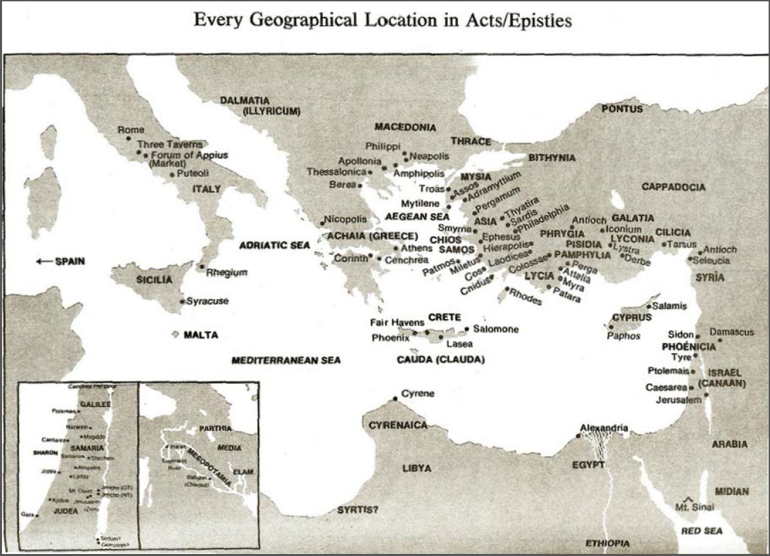

Slide 30
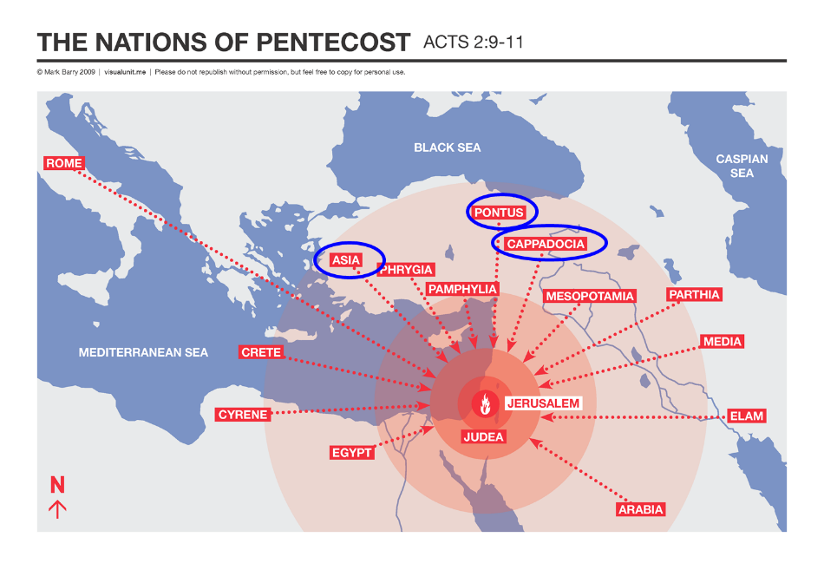

Slide 31
RECIPIENTS
North-central portion of modern Turkey (1 Pet. 1:1)
Regenerated (1 Pet. 1:3-4; 2 Pet. 1:1)
Jewish
  Diaspora (1 Pet. 1:1; Jas. 1:1; John 7:35)
  Aliens/sojourners (1 Pet. 1:1)
  Pilgrims (1 Pet. 2:11)
  Distinguished from the Gentiles (1 Pet. 2:12; 4:3)
  1 Pet 2:9 (Exod. 19:6; Rom. 10:19)
  To the church/churches? (1 Pet. 1:1; 2 Pet. 1:1)
  Gal. 2:7-8

Slide 32
RECIPIENTS
North-central portion of modern Turkey (1 Pet. 1:1)
Regenerated (1 Pet. 1:3-4; 2 Pet. 1:1)
Jewish
  Diaspora (1 Pet. 1:1; Jas. 1:1; John 7:35)
  Aliens/sojourners (1 Pet. 1:1)
  Pilgrims (1 Pet. 2:11)
  Distinguished from the Gentiles (1 Pet. 2:12; 4:3)
  1 Pet 2:9 (Exod. 19:6; Rom. 10:19)
  To the church/churches? (1 Pet. 1:1; 2 Pet. 1:1)
  Gal. 2:7-8

Slide 33
INTRODUCTORY MATTERS
Authorship
Biography
Date
Recipients
Place of writing
Occasion for writing
Purpose
Structure
Message
Unique characteristics

Slide 34

1 Peter 5:13
“She who is in Babylon, chosen together with you, sends you greetings, and so does my son, Mark.”

Slide 35
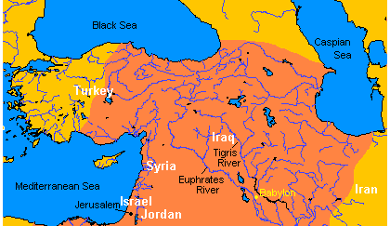
MAP OF NEAR EAST

Slide 36


Slide 37


Slide 38

Charles Ryrie
The Ryrie Study Bible
“1 Peter 5:13 (RSB:NASB1995U): 5:13 She who is in Babylon. The church in Rome, where Peter evidently was writing this letter. My son, Mark. John Mark, the writer of the gospel, who was not Peter’s natural son but his son in the faith.”

Slide 39
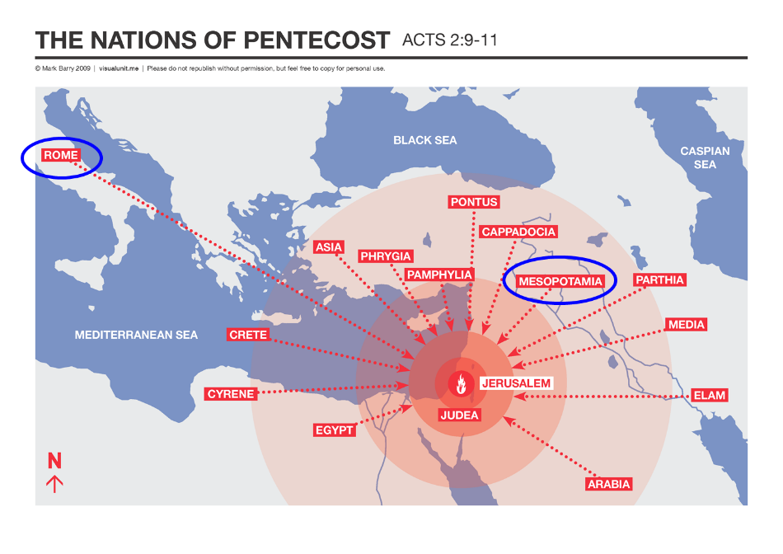

Slide 40
PLACE OF WRITING (1 PET 5:13)
1 Peter 1:1 is literal
Gal 4:25; Rev 11:8
Gal 2:7-8
Rome mentioned elsewhere in Scripture

Slide 41
PLACE OF WRITING (1 PET 5:13)
1 Peter 1:1 is literal
Gal 4:25; Rev 11:8
Gal 2:7-8
Rome mentioned elsewhere in Scripture

Slide 42
1 Peter 1:1
“To those who reside as aliens, scattered throughout Pontus, Galatia, Cappadocia, Asia, and Bithynia, who are chosen.”

Slide 44
PLACE OF WRITING (1 PET 5:13)
1 Peter 1:1 is literal
Gal 4:25; Rev 11:8
Gal 2:7-8
Rome mentioned elsewhere in Scripture

Slide 45

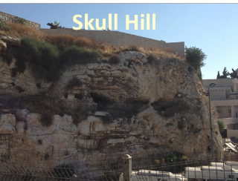
Revelation 11:8
“And their dead bodies will lie in the street of the great city which mystically is called Sodom and Egypt, where also their Lord was crucified.”

Slide 46
PLACE OF WRITING (1 PET 5:13)
1 Peter 1:1 is literal
Gal 4:25; Rev 11:8
Gal 2:7-8
Rome mentioned elsewhere in Scripture

Slide 47

Galatians 2:7-8
“⁷ But on the contrary, seeing that I had been entrusted with the gospel to the uncircumcised, just as Peter had been to the circumcised ⁸ (for He who effectually worked for Peter in his apostleship to the circumcised effectually worked for me also to the Gentiles).”

Slide 48
Babylon’s History After 539 B.C.
Herodotus gives Babylon’s measurements (450 B.C.)
Alexander the Great visits and dies in Babylon (323 B.C.)
Seleucus seizes Babylon (312 B.C.)
Strabo pronounces Babylon’s hanging gardens as one of “seven wonders of the world” (25 B.C)
Babylonians present on Pentecost (Acts 2:9)
Talmud promulgated from Babylon (A.D. 500)
Haukal mentions Babylonian village (A.D. 917)
Babylon known as “Two Mosques” and “Hilah” (A.D. 1100)
Hitchcock and Ice, The Truth Behind Left Behind, 109

Slide 49
Josephus
Antiquities, 15.2.2
“But when Hyrcanus was brought into Parthia the king Phraates treated him after a very gentle manner, as having already learned of what an illustrious family he was; on which account he set him free from his bonds, and gave him a habitation at Babylon, where there were Jews in great numbers. These Jews honored Hyrcanus as their high priest and king, as did all the Jewish nation that dwelt as far as Euphrates; which respect was very much to his satisfaction...”

Slide 50
Strabo, Geography, 16.1.5?
“Strabo, who died in A.D. 25, is cited in proof that by this time no city was left. . . . This is an instance of how easily lax quotation or assertion may falsify both an author and an issue, which being once done, other writers too easily follow suit. What Strabo says is: ‘And now indeed [Selucia] has become greater than Babylon, which for the most part has become deserted’ (ἡ δʼ ἔρημοs ἡ πολλή).”
G. H. Lang, The Revelation of Jesus Christ: Select Studies (London: Paternoster, 1948), 302.

Slide 51
PLACE OF WRITING (1 PET 5:13)
1 Peter 1:1 is literal
Gal 4:25; Rev 11:8
Gal 2:7-8
Rome mentioned elsewhere in Scripture

Slide 52
INTRODUCTORY MATTERS
Authorship
Biography
Date
Recipients
Place of writing
Occasion for writing
Purpose
Structure
Message
Unique characteristics

Slide 53

FALSE TEACHERS ARE COMING!
Heresies of Gnostics:
Salvation via special knowledge “gnosis”
License (indulgence)

Slide 54
OCCASION FOR WRITING
Incipient Gnosticism
  Dualism
    Christology
      Incarnation (2 Pet 2:1)
      Second Advent (2 Pet 3:4)
    License (2 Pet 2:4-18)
  Secret knowledge
    Scripture (2 Pet 1:20)
    Pride (2 Pet 2:10-11)

Slide 55
INTRODUCTORY MATTERS
Authorship
Biography
Date
Recipients
Place of writing
Occasion for writing
Purpose
Structure
Message
Unique characteristics

Slide 56
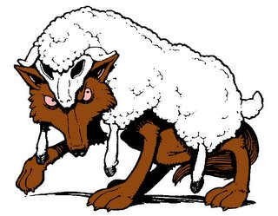
PURPOSE
To build up his readers in the faith so that they will be insulated from the coming false teachers

Slide 57
DIFFERENCES BETWEEN 1 AND 2 PETER
1 PETER | 2 PETER
External opposition | Internal opposition
Persecution | False teaching
Suffering | Error
Hope | Knowledge
Encourage | Expose
Comfort | Caution
Holiness | Maturity
Pain with a purpose | Poison in the pew
Christ exemplified suffering | Christ’s return
Wilkinson and Boa pg. 480 and Nelson’s Complete Book of Charts pg. 466.

Slide 58
INTRODUCTORY MATTERS
Authorship
Biography
Date
Recipients
Place of writing
Occasion for writing
Purpose
Structure
Message
Unique characteristics

Slide 59
STRUCTURE
2 Peter 1 – Call to maturity
2 Peter 2 – Characteristics of false teachers
2 Peter 3 – Doctrine of the false teachers

Slide 60
INTRODUCTORY MATTERS
Authorship
Biography
Date
Recipients
Place of writing
Occasion for writing
Purpose
Structure
Message
Unique characteristics

Slide 61
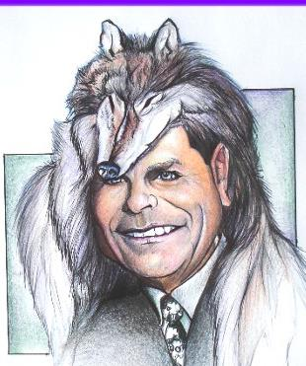
MESSAGE
Protection from the negative influence of the coming false teachers is accomplished through exhortation toward maturity and exposing the characteristics and doctrines of these coming false teachers

Slide 62
INTRODUCTORY MATTERS
Authorship
Biography
Date
Recipients
Place of writing
Occasion for writing
Purpose
Structure
Message
Unique characteristics

Slide 63
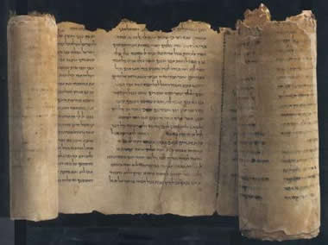
UNIQUE CHARACTERISTICS
Knowledge
Bibliology (1:19-21; 3:2; 15-16)
Destruction of the present world (2 Pet 3:10ff)
Polemical
Peter’s last will and testament (2 Pet 1:14-15)
Similarities with Jude
Remembrance

Slide 64
Order of Paul’s Letters
Galatians (A.D. 49)
1‒2 Thessalonians (A.D. 51)
1‒2 Corinthians (A.D. 56)
Romans (A.D. 57)
Ephesians, Colossians, Philemon, Philippians (A.D. 60‒62)
1 Timothy, Titus (A.D. 62‒66)
2 Timothy (A.D. 67)

Slide 65

REMEMBRANCE
Has forgotten that he has been cleansed (1:9)
I will always remind you of these things (1:12)
It is right to refresh your memory (1:13)
You will always be able to remember these things (1:15)
I have written both of them as reminders (3:1)
Do not forget (3:8)
Bear in mind (3:15)

Slide 66
CONCLUSION

Slide 67
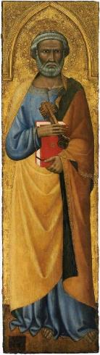
INTRODUCTORY MATTERS
Authorship: Peter
Biography: Gospels & Acts
Date: A.D. 64
Recipients: Regenerated, Asia Minor, Hebrews
Place of writing: Babylon
Occasion for writing: Incipient Gnosticism
Purpose: Insulation from false teaching
Structure: 3 parts
Message: Protection from false teachers
Unique characteristics: Knowledge

