Slide 1
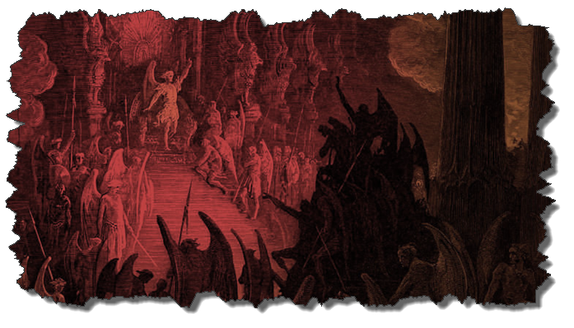
DEMONOLOGY
Dr. Andy Woods
Senior Pastor – Sugar Land Bible Church
President – Chafer Theological Seminary

Slide 2
Preview of Angelology
Good angels
Satanology
Demonology
Gen. 6:1-4 controversy

Slide 3
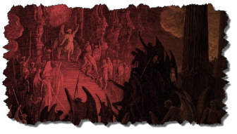
Overview
Existence Origin Personhood Characteristics | Powers Works Demon possession Defense

Slide 4
Overview
Existence Origin Personhood Characteristics | Powers Works Demon possession Defense

Slide 5
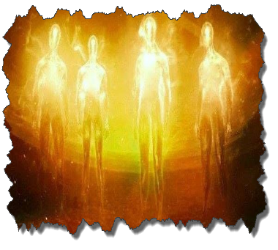
Existence
OT
Deut 32:17
Ps 106:37
NT
Over 100x
All NT writers (except Hebrews)
Christ (Matt 8:29; 10:1; 12:43-45)

Slide 6
Overview
Existence Origin Personhood Characteristics | Powers Works Demon possession Defense

Slide 7
Origin
 | Demons | Fallen Angels
Satan is leader | Matt 12:24 | Matt 25:41; Rev 12:7-9
Spirit beings | Matt 8:16 | Heb 1:14
Capacity to enter people | Matt 12:22; Luke 11:14-15 | John 13:27

Slide 8
Overview
Existence Origin Personhood Characteristics | Powers Works Demon possession Defense

Slide 9
Personhood
Attributes of personhood
Intellect – Acts 19:15
Emotions – Luke 8:28; Jas 2:19
Will – Luke 8:32
Personal pronouns – Mark 1:24-25

Slide 10
Overview
Existence Origin Personhood Characteristics | Powers Works Demon possession Defense

Slide 11
Characteristics
Spirits-Matt 8:16; Eph 6:12
Corrupt
Unclean – Matt 10:1
Evil – Luke 7:21
Rulers of darkness in spiritual wickedness – Eph 6:12
Degrees of wickedness – Matt 12:45

Slide 12
Overview
Existence Origin Personhood Characteristics | Powers Works Demon possession Defense

Slide 13
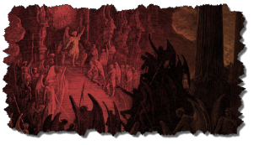
Powers
Great strength (Mark 5:3-4; Acts 19:16) but not omnipotent (Dan 10:13)
Superhuman intelligence (2 Sam. 14:20; Luke 8:28; 20:35-36) but not omniscient (Acts 19:15)
Not confined by physical space or barriers (Mark 5:9) but not omnipresent (Mark 5:12)

Slide 14
Overview
Existence Origin Personhood Characteristics | Powers Works Demon possession Defense

Slide 15
Works
General
Satan’s lack of omnipresence (Job 1:7; 2:2) forces him to work through demons (Matt 12:24; 25:41; Rev 12:7; 2 Cor 12:7)
Work in harmony with one another (Eph 6:11-12)
Influence human government (Dan 10:13, 20)
Promote false religion (1 Cor 10:20; 1 Tim 4:1)

Slide 16
Works (cont’d)
General
Afflict the mind (Mark 5:3, 5)
Afflict the body (Matt 12:22; Mark 9:22; Luke 13:11, 16)
Hinder believers’ prayers (Dan 10:12-20)

Slide 17
Occult Works
NAME | DEFINITION | SCRIPTURE
Divination | Fortune telling | Deut 18:10; Acts 16:16
Spiritism | Contacting the dead | Deut 18:11
Magic | Performance of miraculous powers | Deut 18:11
Pharamkeia | Illicit drug use | Rev 9:20-21; 18:2, 23

Slide 18
Overview
Existence Origin Personhood Characteristics | Powers Works Demon possession Defense

Slide 19
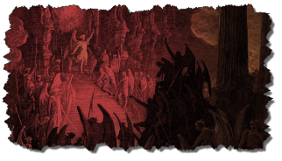
7. Demon Possession
Definition
Cause
Balance – Human evil is not all attributable to Satan/demons – Jer 17:9; Matt 15:19ff; Rev 20:7-9; Zech 14:16-18
Characteristics
Demon possession & the believer

Slide 20
7. Demon Possession
Definition
Cause
Balance – Human evil is not all attributable to Satan/demons – Jer 17:9; Matt 15:19ff; Rev 20:7-9; Zech 14:16-18
Characteristics
Demon possession & the believer

Slide 21
Demon Possession Matt 8:28-34; Mark 5:1-20; 9:17-29; Luke 8:26-39
MANIFESTATION | VERSES | MANIFESTATION | VERSES
Strength | 5:2-4 | Insight | 5:5
Withdrawn | 5:2 | Voice alterations | 5:7
Rage | 5:5 | Seizures & mouth foaming | Mark 9:18
Split personality | 5:6-7 | Uncleanness | Luke 8:27
Resistance against spiritual things | 5:7 | Suicidal tendencies | 5:5

Slide 22
7. Demon Possession
Definition
Cause
Balance – Human evil is not all attributable to Satan/demons – Jer 17:9; Matt 15:19ff; Rev 20:7-9; Zech 14:16-18
Characteristics
Demon possession & the believer

Slide 23
E. The Christian & Demon Possession
Possession? No!
1 Cor 6:19; John 14:16-17; 1 John 4:4
No biblical references to:
A Christian being demon possessed
How to cast a demon out of a Christian
Generation curses?

Slide 24
E. The Christian & Demon Possession
Possession? No!
1 Cor 6:19; John 14:16-17; 1 John 4:4
No biblical references to:
A Christian being demon possessed
How to cast a demon out of a Christian
Generation curses?

Slide 25
John 14:16-17
¹⁶ I will ask the Father, and He will give you another Helper, that He may be with you forever; ¹⁷ that is the Spirit of truth, whom the world cannot receive, because it does not see Him or know Him, but you know Him because He abides with you and will be in you.

Slide 26
E. The Christian & Demon Possession
Possession? No!
1 Cor 6:19; John 14:16-17; 1 John 4:4
No biblical references to:
A Christian being demon possessed
How to cast a demon out of a Christian
Generation curses?

Slide 27
E. The Christian & Demon Possession
Possession? No!
1 Cor 6:19; John 14:16-17; 1 John 4:4
No biblical references to:
A Christian being demon possessed
How to cast a demon out of a Christian
Generation curses?

Slide 28
E. The Christian & Demon Possession
Possession? No!
1 Cor 6:19; John 14:16-17; 1 John 4:4
No biblical references to:
A Christian being demon possessed
How to cast a demon out of a Christian
Generation curses?

Slide 29
E. The Christian & Demon Possession
Possession? No!
1 Cor 6:19; John 14:16-17; 1 John 4:4
No biblical references to:
A Christian being demon possessed
How to cast a demon out of a Christian
Generation curses?

Slide 30
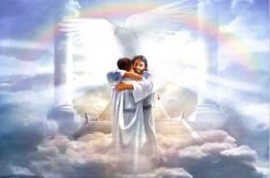
Ephesians 1:3
“Blessed be the God and Father of our Lord Jesus Christ, who has blessed us with every spiritual blessing in the heavenly places in Christ.”

Slide 31
E. The Christian & Demon Possession
Oppression? Yes!
1 Chr 21:1; Luke 13:11, 16; Matt 16:23; Acts 5:3-4; 2 Cor 12:7; Eph 6:12
Temporary
Not loss of salvation
Sometimes the believer opens the door to oppression (Eph 4:26-27)

Slide 32
Overview
Existence Origin Personhood Characteristics | Powers Works Demon possession Defense

Slide 33
Christian’s Defense Against Satan/Demons
God’s responsibility
Believer’s responsibility

Slide 34
Christian’s Defense Against Satan/Demons
God’s responsibility
Believer’s responsibility

Slide 35
Christian’s Defense Against Satan/Demons
God’s responsibility
Divine restraint (Job 1:12; 2:6; 2 Thess 2:6; 1 John 5:18)
Divine intercession (John 17:15; Rom 8:34; Heb 7:25)

Slide 36
Christian’s Defense Against Satan/Demons
God’s responsibility
Divine restraint (Job 1:12; 2:6; 2 Thess 2:6; 1 John 5:18)
Divine intercession (John 17:15; Rom 8:34; Heb 7:25)

Slide 37
2 Thessalonians 2:6-7
“⁶ And you know what restrains him now, so that in his time he will be revealed. ⁷ For the mystery of lawlessness is already at work; only he who now restrains will do so until he is taken out of the way.”

Slide 38
Christian’s Defense Against Satan/Demons
God’s responsibility
Divine restraint (Job 1:12; 2:6; 2 Thess 2:6; 1 John 5:18)
Divine intercession (John 17:15; Rom 8:34; Heb 7:25)

Slide 39
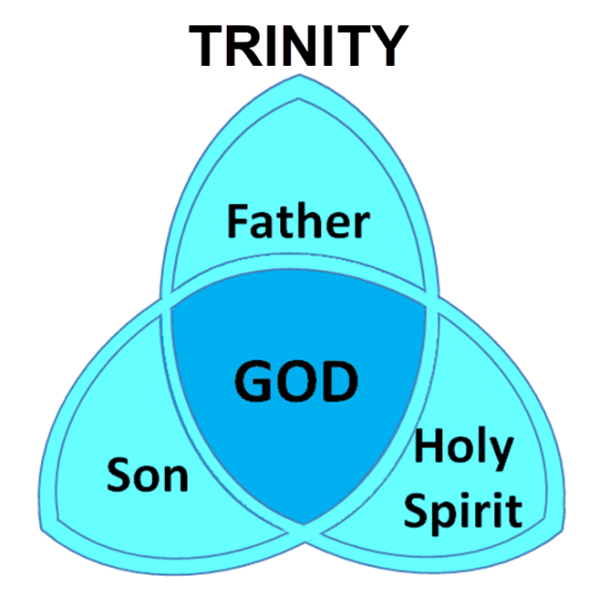

Slide 40
Christian’s Defense Against Satan/Demons
God’s responsibility
Believer’s responsibility

Slide 41
Christian’s Defense Against Satan/Demons
Believer’s responsibility
Our defensive posture (Rev 20:2-3, 10; 2 Pet 2:10-11)
Avoid catering to the flesh (Eph 4:26-27)
Resist (Jas 4:7; 1 Pet 5:8-9; Eph 6:13)
Rely on the Spirit (1 John 4:4)
Put on the full armor of God (Eph 6:10-20)

Slide 42
Christian’s Defense Against Satan/Demons
Believer’s responsibility
Our defensive posture (Rev 20:2-3, 10; 2 Pet 2:10-11)
Avoid catering to the flesh (Eph 4:26-27)
Resist (Jas 4:7; 1 Pet 5:8-9; Eph 6:13)
Rely on the Spirit (1 John 4:4)
Put on the full armor of God (Eph 6:10-20)

Slide 43
Revelation 20:1-3
“¹ Then I saw an angel coming down from heaven, holding the key of the abyss and a great chain in his hand. ² And he laid hold of the dragon, the serpent of old, who is the devil and Satan, and bound him for a thousand years; ³ and he threw him into the abyss, and shut it and sealed it over him, so that he would not deceive the nations any longer, until the thousand years were completed; after these things he must be released for a short time.”

Slide 44
Revelation 20:10
“And the devil who deceived them was thrown into the lake of fire and brimstone, where the beast and the false prophet are also; and they will be tormented day and night forever and ever.”

Slide 45
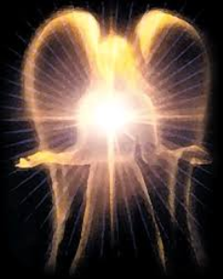
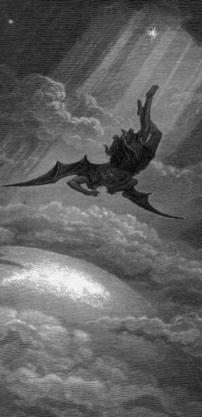
Satan’s Progressive Defeat
Initial eviction from heaven (Isa 14:12-15; Ezek 28:12-17)
Eden (Gen 3:15)
Pre-diluvian world (1 Pet 3:19-20)
Cross (John 12:31; 16:11; Col 2:15; Heb 2:14; 1 John 3:8)
Mid point of the Tribulation (Rev 12:9)
Beginning of millennium (Rev 20:2-3)
End of millennium (Rev 20:10)

Slide 46
Satan’s Progressive Defeat
Initial eviction from heaven (Isa 14:12-15; Ezek 28:12-17)
Eden (Gen 3:15)
Pre-diluvian world (1 Pet 3:19-20)
Cross (John 12:31; 16:11; Col 2:15; Heb 2:14; 1 John 3:8)
Mid point of the Tribulation (Rev 12:9)
Beginning of millennium (Rev 20:2-3)
End of millennium (Rev 20:10)

Slide 47
Revelation 11:15
“Then the seventh angel sounded; and there were loud voices in heaven, saying, ‘The kingdom of the world has become the kingdom of our Lord and of His Christ; and He will reign forever and ever.’”

Slide 48
Ultimate Exodus (Rev 11:15)
Sores | 6th plague (Ex 9:8-12) | 1st bowl (Rev 16:1-2)
Rivers to blood | 1st plague (Ex 7:19-21) | 3rd bowl (Rev 16:4-7)
Darkness | 9th plague (Ex 10:21-23) | 5th bowl (Rev 16:10-11)
Frogs | 2nd plague (Ex 7:25‒8:15) | 6th bowl (Rev 16:13)
Hail | 7th plague (Ex 9:22-26) | 7th bowl (Rev 16:17-21)

Slide 49
Names & Titles Demonstrating Satan’s Post-Fall, Earthly Authority
(Job 1:7; 2:2; Luke 4:5-8; Rom. 8:19-22)
Prince of this world (John 12:31; 14:30; 16:11)
God of this age (2 Cor. 4:4)
Prince and power of the air (Eph. 2:2)
Who the believer wrestles with (Eph. 6:12)
Roaring lion (1 Pet. 5:8)
Whole world lies in his power (1 John 5:19)

Slide 51
Christian’s Defense Against Satan/Demons
Believer’s responsibility
Our defensive posture (Rev 20:2-3, 10; 2 Pet 2:10-11)
Avoid catering to the flesh (Eph 4:26-27)
Resist (Jas 4:7; 1 Pet 5:8-9; Eph 6:13)
Rely on the Spirit (1 John 4:4)
Put on the full armor of God (Eph 6:10-20)

Slide 52
Christian’s Defense Against Satan/Demons
Believer’s responsibility
Our defensive posture (Rev 20:2-3, 10; 2 Pet 2:10-11)
Avoid catering to the flesh (Eph 4:26-27)
Resist (Jas 4:7; 1 Pet 5:8-9; Eph 6:13)
Rely on the Spirit (1 John 4:4)
Put on the full armor of God (Eph 6:10-20)

Slide 53
Christian’s Defense Against Satan/Demons
Believer’s responsibility
Our defensive posture (Rev 20:2-3, 10; 2 Pet 2:10-11)
Avoid catering to the flesh (Eph 4:26-27)
Resist (Jas 4:7; 1 Pet 5:8-9; Eph 6:13)
Rely on the Spirit (1 John 4:4)
Put on the full armor of God (Eph 6:10-20)

Slide 54
Christian’s Defense Against Satan/Demons
Believer’s responsibility
Our defensive posture (Rev 20:2-3, 10; 2 Pet 2:10-11)
Avoid catering to the flesh (Eph 4:26-27)
Resist (Jas 4:7; 1 Pet 5:8-9; Eph 6:13)
Rely on the Spirit (1 John 4:4)
Put on the full armor of God (Eph 6:10-20)

Slide 55
CONCLUSION

Slide 56
Overview
Existence Origin Personhood Characteristics | Powers Works Demon possession Defense

Slide 57
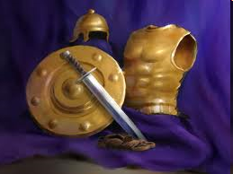
Ephesians
Dressed for Success!

