Slide 1


Dr. Andy Woods
Senior Pastor – Sugar Land Bible Church
President – Chafer Theological Seminary

Slide 2

“After These Things”
(Rev. 4‒22)
Before the Tribulation (4‒5)
During the Tribulation (6‒19)
After the Tribulation (20‒22)
  Kingdom (20:1-10)
  Great White Throne Judgment (20:11-15)
  Destruction of the Earth (21:1)
  New Heaven and New Earth (21‒22)

Slide 3
“After These Things”
(Rev. 4‒22)
Before the Tribulation (4‒5)
During the Tribulation (6‒19)
After the Tribulation (20‒22)
  Kingdom (20:1-10)
  Great White Throne Judgment (20:11-15)
  Destruction of the Earth (21:1)
  New Heaven and New Earth (21‒22)

Slide 4


Slide 5


Slide 6
“After These Things”
(Rev. 4‒22)
Before the Tribulation (4‒5)
During the Tribulation (6‒19)
After the Tribulation (20‒22)
  Kingdom (20:1-10)
  Great White Throne Judgment (20:11-15)
  Destruction of the Earth (21:1)
  New Heaven and New Earth (21‒22)

Slide 7


Slide 8
“After These Things”
(Rev. 4‒22)
Before the Tribulation (4‒5)
During the Tribulation (6‒19)
After the Tribulation (20‒22)
  Kingdom (20:1-10)
  Great White Throne Judgment (20:11-15)
  Destruction of the Earth (21:1)
  New Heaven and New Earth (21‒22)

Slide 9
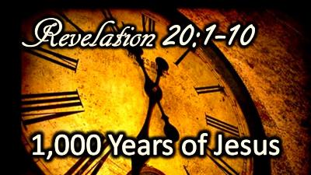
The Millennial Kingdom
Revelation 20:1-10
Satan: The Great Chain (1-3)
Saints: The Great Reign (4-6)
Sinners: The Great Revolt (7-10)
Willmington, Outline Bible, p. 772-73

Slide 10
The Millennial Kingdom
Revelation 20:1-10
Satan: The Great Chain (1-3)
Saints: The Great Reign (4-6)
Sinners: The Great Revolt (7-10)
Willmington, Outline Bible, p. 772-73

Slide 11
I. Satan: The Great Chain
Revelation 20:1-3
The Prisoner (1-2)
The Prison (3)
Willmington, Outline Bible, p. 772-73

Slide 12
The Millennial Kingdom
Revelation 20:1-10
Satan: The Great Chain (1-3)
Saints: The Great Reign (4-6)
Sinners: The Great Revolt (7-10)
Willmington, Outline Bible, p. 772-73

Slide 13
II. Saints: The Great Reign
Revelation 20:4-6
The Resurrection of the Just (4a)
The Rule of the Just (4b-6)
Willmington, Outline Bible, p. 772-73

Slide 14
The Millennial Kingdom
Revelation 20:1-10
Satan: The Great Chain (1-3)
Saints: The Great Reign (4-6)
Sinners: The Great Revolt (7-10)
Willmington, Outline Bible, p. 772-73

Slide 15
III. Sinners: The Great Revolt
Revelation 20:7-10
The Adversary (7)
The Apostasy (8)
The Attack (9a)
The Annihilation (9b-10)
Willmington, Outline Bible, p. 772-73

Slide 16
III. Sinners: The Great Revolt
Revelation 20:7-10
The Adversary (7)
The Apostasy (8)
The Attack (9a)
The Annihilation (9b-10)
Willmington, Outline Bible, p. 772-73

Slide 17

Revelation 20:7-9
“⁷ When the thousand years are completed [teleō], Satan will be released from his prison, ⁸ and will come out to deceive the nations which are in the four corners of the earth, Gog and Magog, to gather them together for the war; the number of them is like the sand of the seashore. ⁹ And they came up on the broad plain of the earth and surrounded the camp of the saints and the beloved city, and fire came down from heaven and devoured them.

Slide 18
III. Sinners: The Great Revolt
Revelation 20:7-10
The Adversary (7)
The Apostasy (8)
The Attack (9a)
The Annihilation (9b-10)
Willmington, Outline Bible, p. 772-73

Slide 19
Revelation 20:7-9
“⁷ When the thousand years are completed, Satan will be released from his prison, ⁸ and will come out to deceive the nations which are in the four corners of the earth, Gog and Magog, to gather them together for the war; the number of them is like the sand of the seashore. ⁹ And they came up on the broad plain of the earth and surrounded the camp of the saints and the beloved city, and fire came down from heaven and devoured them.

Slide 20

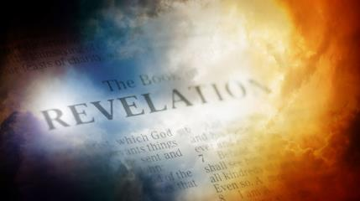
David Hocking
The Book of Revelation: Understanding the Future (Tustin, CA: Hope For Today Publications, 2014), 530. .
“God demonstrates by this one final event that even under the best conditions, mankind‘s problem is the heart. God demonstrates that Satan’s depravity cannot be cured. God demonstrates that He is fully justified in exacting eternal punishment.”

Slide 21
Revelation 20:1-3
“¹ Then I saw an angel coming down from heaven, holding the key of the abyss and a great chain in his hand. ² And he laid hold of the dragon, the serpent of old, who is the devil and Satan, and bound him for a thousand years; ³ and he threw him into the abyss, and shut it and sealed it over him, so that he would not deceive the nations any longer, until the thousand years were completed; after these things he must be released for a short time.”

Slide 22
Revelation 20:7-9
“⁷When the thousand years are completed, Satan will be released from his prison, ⁸ and will come out to deceive the nations which are in the four corners of the earth, Gog and Magog, to gather them together for the war; the number of them is like the sand of the seashore. ⁹ And they came up on the broad plain of the earth and surrounded the camp of the saints and the beloved city, and fire came down from heaven and devoured them.

Slide 23

Revelation 20:7-9
“⁷When the thousand years are completed, Satan will be released from his prison, ⁸ and will come out to deceive the nations which are in the four corners of the earth, Gog and Magog, to gather them together for the war; the number of them is like the sand of the seashore. ⁹And they came up on the broad plain of the earth and surrounded the camp of the saints and the beloved city, and fire came down from heaven and devoured them.”

Slide 25
Millennial Fulfillment?
EZEK. 38-39 | REV. 20:7-9
Northern invasion | All nation invade
Nations identified | Nations unidentified
Invasion leads to Millennium (Ezek 40-48) | Invasion comes at end of Millennium
Invasion leads to Millennium (Ezek 40-48) | Invasion leads to Eternal State (Rev 21-22)
7 months necessary to dispose of the dead (39:12) | Dead disposed of instantaneously (20:9)
Satan not bound prior to invasion | Satan bound prior to invasion (Rev 20:2)
Pentecost, Things To Come, 349-50

Slide 26
David J. MacLeod
David J. MacLeod, “The Fifth ‘Last Thing’: The Release of Satan and Man’s Final Rebellion (Rev. 20: 7–10),” Bibliotheca Sacra 157, no. 626 (April 2000): p. 209.
“How can Gog and Magog refer to a battle in Revelation 19 before the millennium and this battle at the end of the millennium? The most likely explanation is that Antichrist is Gog and will be defeated at the Second Coming. During the millennium his defeat will become a legend among the nations, something like Napoleon’s defeat at Waterloo. Then at the end of the millennial kingdom the Gog and Magog ‘legend’ is applied to a new historical situation (20: 8), with Satan leading the new ‘Gog and Magog.’ Satan will meet his ‘Waterloo’—his ‘Gog and Magog.’”

Slide 27
Revelation 20:7-9
“⁷ When the thousand years are completed, Satan will be released from his prison, ⁸ and will come out to deceive the nations which are in the four corners of the earth, Gog and Magog, to gather them together for the war [polemos]; the number of them is like the sand of the seashore. ⁹ And they came up on the broad plain of the earth and surrounded the camp of the saints and the beloved city, and fire came down from heaven and devoured them.

Slide 28
Revelation 20:7-9
“⁷ When the thousand years are completed, Satan will be released from his prison, ⁸ and will come out to deceive the nations which are in the four corners of the earth, Gog and Magog, to gather them together for the war; the number of them is like the sand of the seashore. ⁹ And they came up on the broad plain of the earth and surrounded the camp of the saints and the beloved city, and fire came down from heaven and devoured them.

Slide 29

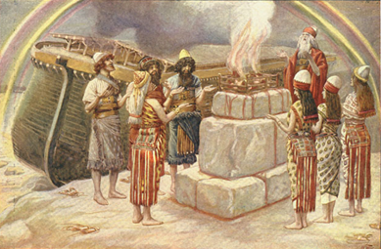
Genesis 8:21
The Lord smelled the soothing aroma; and the Lord said to Himself, “I will never again curse the ground on account of man, for the intent of man’s heart is evil from his youth; and I will never again destroy every living thing, as I have done.[emphasis mine].

Slide 30

Jeremiah 17:9
“The heart is more deceitful than all else And is desperately sick; Who can understand it?.”

Slide 31
Mark 7:20-23
“²⁰ And He was saying, ‘That which proceeds out of the man, that is what defiles the man. ²¹ For from within, out of the heart of men, proceed the evil thoughts, fornications, thefts, murders, adulteries, ²² deeds of coveting and wickedness, as well as deceit, sensuality, envy, slander, pride and foolishness. ²³ All these evil things proceed from within and defile the man.’”

Slide 32
David Hocking
The Book of Revelation: Understanding the Future (Tustin, CA: Hope For Today Publications, 2014), 530.
“God demonstrates by this one final event that even under the best conditions, mankind‘s problem is the heart. God demonstrates that Satan’s depravity cannot be cured. God demonstrates that He is fully justified in exacting eternal punishment.”

Slide 33

Zechariah 14:16-18
“Then it will come about that any who are left of all the nations that went against Jerusalem will go up from year to year to worship the King, the Lord of hosts, and to celebrate the Feast of Booths. ¹⁷ And it will be that whichever of the families of the earth does not go up to Jerusalem to worship the King, the Lord of hosts, there will be no rain on them. ¹⁸ If the family of Egypt does not go up or enter, then no rain will fall on them; it will be the plague with which the Lord smites the nations who do not go up to celebrate the Feast of Booths.”

Slide 34
III. Sinners: The Great Revolt
Revelation 20:7-10
The Adversary (7)
The Apostasy (8)
The Attack (9a)
The Annihilation (9b-10)
Willmington, Outline Bible, p. 772-73

Slide 35
Revelation 20:7-9
“⁷ When the thousand years are completed, Satan will be released from his prison, ⁸ and will come out to deceive the nations which are in the four corners of the earth, Gog and Magog, to gather them together for the war; the number of them is like the sand of the seashore. ⁹ And they came up on the broad plain of the earth and surrounded the camp of the saints and the beloved city, and fire came down from heaven and devoured them.

Slide 36

Isaiah 2:2-3
“Now it will come about that In the last days The mountain of the house of the Lord Will be established as the chief of the mountains, And will be raised above the hills; And all the nations will stream to it.³ And many peoples will come and say, ‘Come, let us go up to the mountain of the Lord, To the house of the God of Jacob; That He may teach us concerning His ways And that we may walk in His paths.’ For the law will go forth from Zion And the word of the Lord from Jerusalem.”

Slide 37
Zechariah 14:16-18
“Then it will come about that any who are left of all the nations that went against Jerusalem will go up from year to year to worship the King, the Lord of hosts, and to celebrate the Feast of Booths. ¹⁷ And it will be that whichever of the families of the earth does not go up to Jerusalem to worship the King, the Lord of hosts, there will be no rain on them. ¹⁸ If the family of Egypt does not go up or enter, then no rain will fall on them; it will be the plague with which the Lord smites the nations who do not go up to celebrate the Feast of Booths.”

Slide 38

Robert Thomas
Four Views on the Book of Revelation, page 207.
“At the end of the Millennium that city will be Satan’s prime objective with his rebel army, because Israel will be a leader among the nations.”

Slide 39
III. Sinners: The Great Revolt
Revelation 20:7-10
The Adversary (7)
The Apostasy (8)
The Attack (9a)
The Annihilation (9b-10)
Willmington, Outline Bible, p. 772-73

Slide 40
D. The Annihilation
Revelation 20:9b-10
Satan’s henchmen are consumed by the fires of heaven (9b)
Satan himself is consumed by the fires of hell (10)
Willmington, Outline Bible, p. 772-73

Slide 41
D. The Annihilation
Revelation 20:9b-10
Satan’s henchmen are consumed by the fires of heaven (9b)
Satan himself is consumed by the fires of hell (10)
Willmington, Outline Bible, p. 772-73

Slide 42
Revelation 20:7-9
“⁷ When the thousand years are completed, Satan will be released from his prison, ⁸ and will come out to deceive the nations which are in the four corners of the earth, Gog and Magog, to gather them together for the war; the number of them is like the sand of the seashore. ⁹ And they came up on the broad plain of the earth and surrounded the camp of the saints and the beloved city, and fire came down from heaven and devoured them.

Slide 43
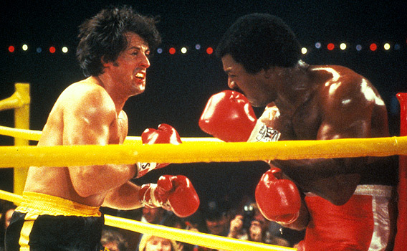
NO DUALISM!
NO CONTEST!

Slide 44

Ezekiel 28:13, 15
“¹³ You were in Eden, the garden of God; Every precious stone was your covering: The ruby, the topaz and the diamond; The beryl, the onyx and the jasper; The lapis lazuli, the turquoise and the emerald; And the gold, the workmanship of your settings and sockets, Was in you. On the day that you were created They were prepared… ¹⁵ You were blameless in your ways From the day you were created Until unrighteousness was found in you.”

Slide 45
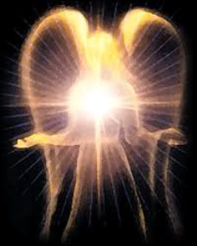
Original State and First Sin
Ezek 28:12-17
  Attributes
    Creature (15)
    Angel (14, 16)
    Powerful (14)
    Without sin (15)
    Beautiful (12-13)
    Intelligent (12)
  Nature of 1st sin (17)

Slide 46
D. The Annihilation
Revelation 20:9b-10
Satan’s henchmen are consumed by the fires of heaven (9b)
Satan himself is consumed by the fires of hell (10)
Willmington, Outline Bible, p. 772-73

Slide 47

Revelation 20:10
“And the devil who deceived them was thrown into the lake of fire and brimstone, where the beast and the false prophet are also; and they will be tormented day and night forever and ever.”

Slide 48
Revelation 20:10
“And the devil who deceived them was thrown into the lake of fire and brimstone, where the beast and the false prophet are also; and they will be tormented day and night forever and ever.”

Slide 49
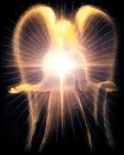

Satan’s Progressive Defeat
Initial eviction from heaven (Isa 14:12-15; Ezek 28:12-17)
Eden (Gen 3:15)
Pre-diluvian world (1 Pet 3:19-20)
Cross (John 12:31; 16:11; Col 2:15; Heb 2:14; 1 John 3:8)
Mid point of the Tribulation (Rev 12:9)
Beginning of millennium (Rev 20:2-3)
End of millennium (Rev 20:10)

Slide 50
Satan’s Progressive Defeat
Initial eviction from heaven (Isa 14:12-15; Ezek 28:12-17)
Eden (Gen 3:15)
Pre-diluvian world (1 Pet 3:19-20)
Cross (John 12:31; 16:11; Col 2:15; Heb 2:14; 1 John 3:8)
Mid point of the Tribulation (Rev 12:9)
Beginning of millennium (Rev 20:2-3)
End of millennium (Rev 20:10)

Slide 51

Genesis 3:15
“And I will put enmity Between you and the woman, And between your seed and her seed; He shall bruise you on the head, And you shall bruise him on the heel.”

Slide 52
Revelation 20:10
“And the devil who deceived them was thrown into the lake of fire and brimstone, where the beast and the false prophet are also; and they will be tormented day and night forever and ever.”

Slide 53
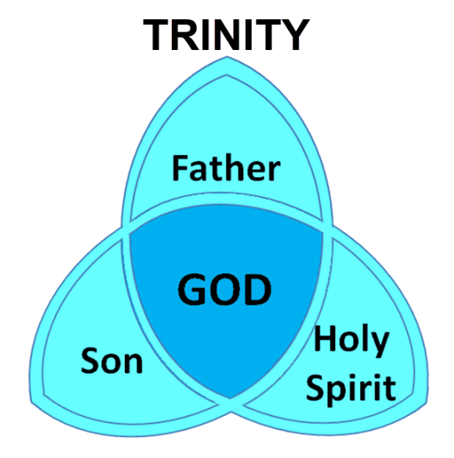

Slide 54
Revelation 20:10
“And the devil who deceived them was thrown into the lake of fire and brimstone, where the beast and the false prophet are also; and they will be tormented day and night forever and ever.”

Slide 55
Revelation 20:10
“And the devil who deceived them was thrown into the lake of fire and brimstone, where the beast and the false prophet are also; and they will be tormented day and night forever and ever.”

Slide 56

Revelation 20:10
“And the devil who deceived them was thrown into the lake of fire and brimstone, where the beast and the false prophet are also; and they will be tormented day and night forever (aiōn) and ever (aiōn).”

Slide 57

Dr. Alan W. Gomes
(Summer 1991). “Evangelicals and the Annihilation of Hell” (Part 2). In the Christian Research Journal. Page 11.
“A punishment [such as torment] that is not felt is not a punishment. It is an odd use of language to speak of an insensate state (i.e., unfeeling), an inanimate object receiving punishment. To say, ‘I punished my car for not starting by slowly plucking out it’s spark plug wires, one by one,’ would invoke laughter, not serious consideration.”

Slide 58
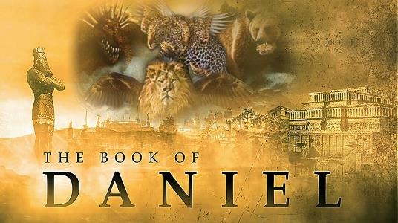
Daniel 12:2
“Many of those who sleep in the dust of the ground will awake, these to everlasting (olam) life, but the others to disgrace and everlasting (olam) contempt.”

Slide 59
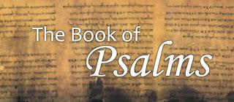
Psalm 90:2
“Before the mountains were born Or You gave birth to the earth and the world, Even from everlasting (olam) to everlasting (olam), You are God.”

Slide 60

Matthew 25:46
“These will go away into eternal (aiōnios) punishment, but the righteous into eternal (aiōnios) life.

Slide 61

Romans 16:26
“but now is manifested, and by the Scriptures of the prophets, according to the commandment of the eternal (aiōnios) God, has been made known to all the nations, leading to obedience of faith.

Slide 62
Revelation 14:11
“And the smoke of their torment goes up forever (aiōn) and ever (aiōn); they have no rest day and night, those who worship the beast and his image, and whoever receives the mark of his name.”

Slide 63
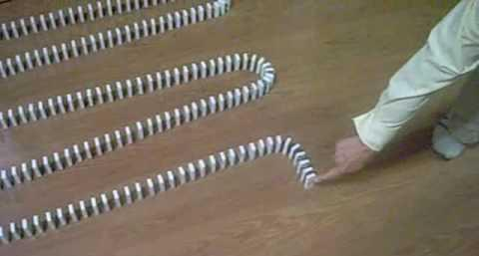
Dominoes in a Row

Slide 64
Conclusion

Slide 65
The Millennial Kingdom
Revelation 20:1-10
Satan: The Great Chain (1-3)
Saints: The Great Reign (4-6)
Sinners: The Great Revolt (7-10)
Willmington, Outline Bible, p. 772-73

Slide 66

“The Lord bless you and keep you; the Lord make his face shine on you and be gracious to you; the Lord turn his face toward you and give you peace.” (NIV)

