Slide 1
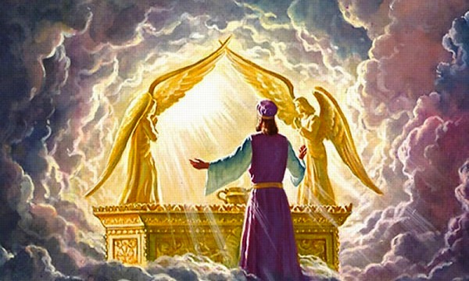
CHRIST’S PRESENT INTERCESSORY MINISTRY
Jim McGowan, Th.D. Sugar Land Bible Church
06-30-2019
Special thanks to The Middletown Bible Church for access to their resources.

Slide 2
CHRIST’S PRESENT MINISTRY OF INTERCESSION
Outline
Introduction
Exposition
Romans 8:34
Hebrew 7:23
John 17
Conclusion

Slide 3
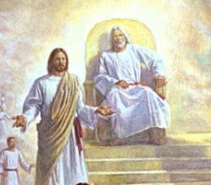
Romans 8:34
“who is the one who condemns? Christ Jesus is He who died, yes, rather who was raised, who is at the right hand of God, who also intercedes for us.”

Slide 4
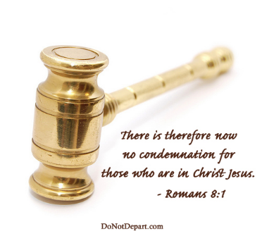
Romans 8:1
“Therefore there is now no condemnation for those who are in Christ Jesus.”

Slide 5
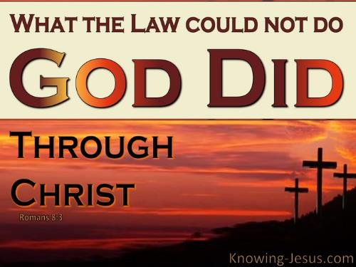
Romans 8:3
“For what the Law could not do, weak as it was through the flesh, God did: sending His own Son in the likeness of sinful flesh and as an offering for sin, He condemned sin in the flesh,”

Slide 6
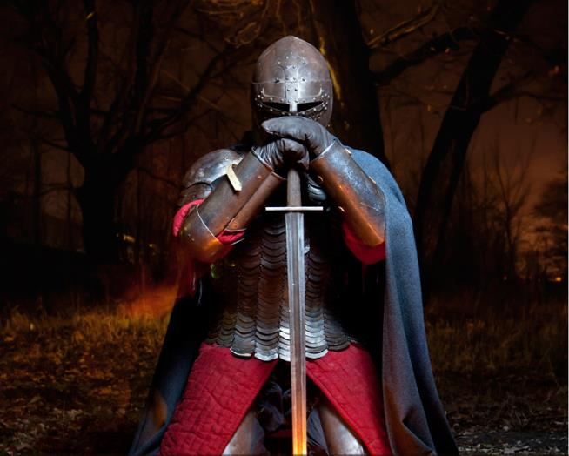
Romans 8:37
“But in all these things we overwhelmingly conquer [huper-nikáō] through Him who loved us.”

Slide 7
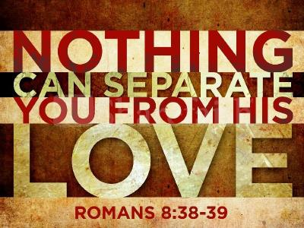
Romans 8:38-39
“³⁸ For I am convinced that neither death, nor life, nor angels, nor principalities, nor things present, nor things to come, nor powers, ³⁹ nor height, nor depth, nor any other created thing, will be able to separate us from the love of God, which is in Christ Jesus our Lord.”

Slide 8
CHRIST’S PRESENT MINISTRY OF INTERCESSION
Outline
Introduction
Exposition
Romans 8:34
Hebrew 7:23
John 17
Conclusion

Slide 9
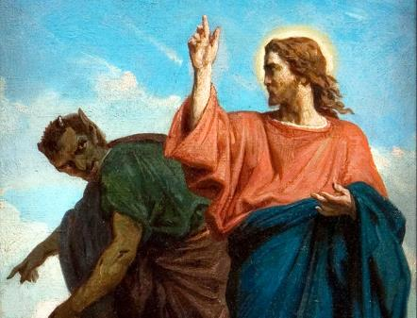
Romans 8:33
“Who will bring a charge against God’s elect? God is the one who justifies;.”

Slide 10
Romans 8:34
“who is the one who condemns? Christ Jesus is He who died, yes, rather who was raised, who is at the right hand of God, who also intercedes for us.”

Slide 11
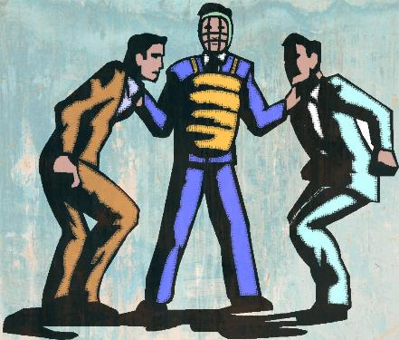
CHRIST’S PRESENT MINISTRY OF INTERCESSION
Intercede
The word ‘intercede’ in this verse means, “to approach or to appeal to someone; to plead with someone on behalf of another person”. This word implies some kind of danger. It involves a person coming between two parties in order to plead on behalf of the party that is in danger, in order to avert that danger.

Slide 12
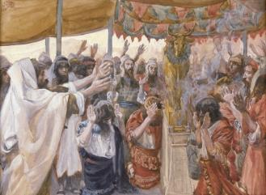
Exodus 32:11
“Then Moses entreated the LORD his God, and said, “O LORD, why does Your anger burn against Your people whom You have brought out from the land of Egypt with great power and with a mighty hand?”

Slide 13
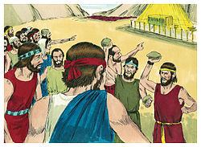
Numbers 14:19–20
“¹⁹ Pardon, I pray, the iniquity of this people according to the greatness of Your lovingkindness, just as You also have forgiven this people, from Egypt even until now.” ²⁰ So the Lord said, “I have pardoned them according to your word;

Slide 14
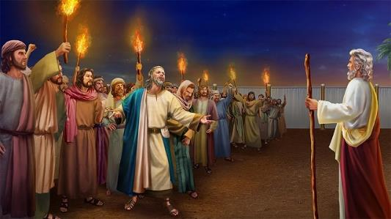
Numbers 16:20–22
²⁰ Then the Lord spoke to Moses and Aaron, saying, ²¹ “Separate yourselves from among this congregation, that I may consume them instantly.” ²² But they fell on their faces and said, “O God, God of the spirits of all flesh, when one man sins, will You be angry with the entire congregation?”

Slide 15
Romans 8:34
“who is the one who condemns? Christ Jesus is He who died, yes, rather who was raised, who is at the right hand of God, who also intercedes for us.”

Slide 16
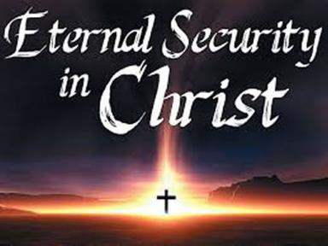
CHRIST’S PRESENT MINISTRY OF INTERCESSION
What does Romans 8:34 teach us?
Christ’s intercession is related to the doctrine of eternal security.

Slide 17
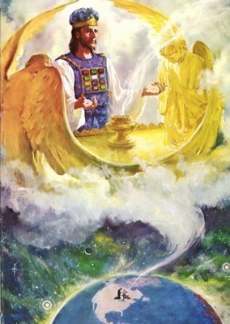
CHRIST’S PRESENT MINISTRY OF INTERCESSION
What does Romans 8:34 teach us?
Christ’s intercession is a present work.

Slide 18
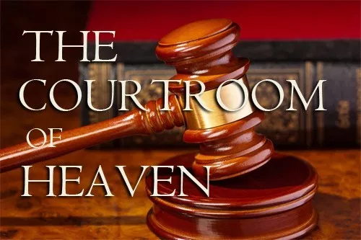
CHRIST’S PRESENT MINISTRY OF INTERCESSION
Christ never loses a case!

Slide 19
CHRIST’S PRESENT MINISTRY OF INTERCESSION
What does Romans 8:34 teach us?
Christ’s intercession is for our benefit.

Slide 20
Romans 8:34
“who is the one who condemns? Christ Jesus is He who died, yes, rather who was raised, who is at the right hand of God, who also intercedes for us.”

Slide 21
Philippians 1:6
“For I am confident of this very thing, that He who began a good work in you will perfect it until the day of Christ Jesus.”

Slide 22
CHRIST’S PRESENT MINISTRY OF INTERCESSION
What does Romans 8:34 teach us?
Christ’s intercession is a heavenly ministry.

Slide 23
Romans 8:34
“who is the one who condemns? Christ Jesus is He who died, yes, rather who was raised, who is at the right hand of God, who also intercedes for us.”

Slide 24
Romans 8:34
“who is the one who condemns? Christ Jesus is He who died, yes, rather who was raised, who is at the right hand of God, who also intercedes for us.”

Slide 25
CHRIST’S PRESENT MINISTRY OF INTERCESSION
Outline
Introduction
Exposition
Romans 8:34
Hebrew 7:23
John 17
Conclusion

Slide 26
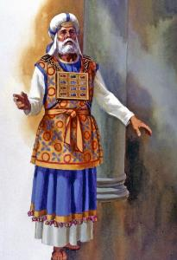
Hebrews 7:23
“The former priests, on the one hand, existed in greater numbers because they were prevented by death from continuing,”

Slide 27
Hebrews 7:24
“but Jesus, on the other hand, because He continues forever, holds His priesthood permanently.”

Slide 28
CHRIST’S PRESENT MINISTRY OF INTERCESSION
J. D. Pentecost
“Those who lived under the Levitical order would no sooner become accustomed to one priest then, because of his death, they would have to become accustomed to another. But because Christ’s priesthood is founded on resurrection life, those who enjoy His ministry will never have to become accustomed to a successor, for He has ‘an unchangeable priesthood.’”
Pentecost, J. D., & Durham, K. (2000). Faith that Endures : a practical commentary on the book of Hebrews (Rev. ed., p. 124). Grand Rapids, MI: Kregel Publications.

Slide 29
Hebrews 7:25
“Therefore He is able also to save forever [KJV ‘to the uttermost’] those who draw near to God through Him, since He always lives to make intercession for them.”

Slide 30
CHRIST’S PRESENT MINISTRY OF INTERCESSION
What does Hebrews 7:25 teach us?
Christ’s intercession is a guarantee to bring us to Abba Father’s desired end for us!

Slide 31
CHRIST’S PRESENT MINISTRY OF INTERCESSION
J. D. Pentecost
The author shows the consequences of having a priest who ministers out of endless resurrection life: “He is also able to save to the uttermost those who come to God through Him.” Here the author is not referring to His saving work as the salvation of sinners from judgment and death, but rather using the words to save in the sense of “to bring to God’s desired end”; that is, to bring them from immaturity to full maturity in Himself.
Pentecost, J. D., & Durham, K. (2000). Faith that Endures : a practical commentary on the book of Hebrews (Rev. ed., p. 124). Grand Rapids, MI: Kregel Publications.

Slide 32
Hebrews 7:25
“Therefore He is able also to save forever [KJV ‘to the uttermost’] those who draw near to God through Him, since He always lives to make intercession for them.”

Slide 33
Hebrews 7:25
(Expanded Translation)
“He [Christ] is continually able to save to the highest standard or quality and completeness, for an unlimited duration of time, those who draw near to God through Him, since He always lives to make intercession for them.”

Slide 34
Three Tenses of Salvation
CHRIST’S PRESENT MINISTRY OF INTERCESSION
Phase | Justification | Sanctification | Glorification
Tense | Past | Present | Future
Saved from sin’s: | Penalty | Power | Presence
Scripture | Eph 2:8-9; Titus 3:5 | Phil. 2:12 | Rom 5:10

Slide 35
Philippians 2:12–13
“¹² So then, my beloved, just as you have always obeyed, not as in my presence only, but now much more in my absence, work out your salvation with fear and trembling; ¹³ for it is God who is at work in you, both to will and to work for His good pleasure.”

Slide 36
Hebrews 7:25
“Therefore He is able also to save forever those who draw near to God through Him, since He always lives to make intercession for them.”

Slide 37
CHRIST’S PRESENT MINISTRY OF INTERCESSION
What does Hebrews 7:25 teach us?
Christ’s intercession is continual!
Christ’s intercession is for believers !
Christ’s intercession is for our benefit!

Slide 38
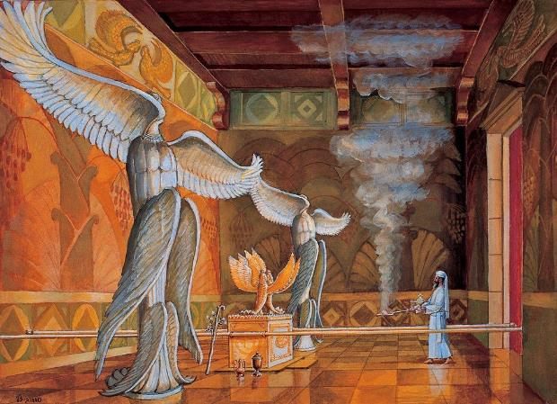
Hebrews 9:24
“For Christ did not enter a holy place made with hands, a mere copy of the true one, but into heaven itself, now to appear in the presence of God for us…”

Slide 39
CHRIST’S PRESENT MINISTRY OF INTERCESSION
Outline
Introduction
Exposition
Romans 8:34
Hebrew 7:23
John 17
Conclusion

Slide 40
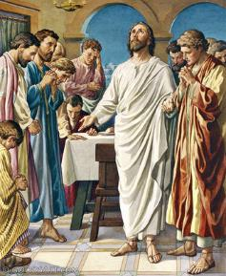
John 17:1
“Jesus spoke these things; and lifting up His eyes to heaven, He said, “Father, the hour has come; glorify Your Son, that the Son may glorify You.”

Slide 41
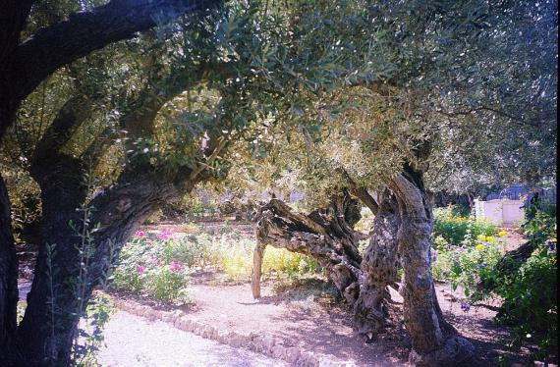
John 18:1
“When Jesus had spoken these words, He went forth with His disciples over the ravine of the Kidron, where there was a garden, in which He entered with His disciples.”

Slide 42
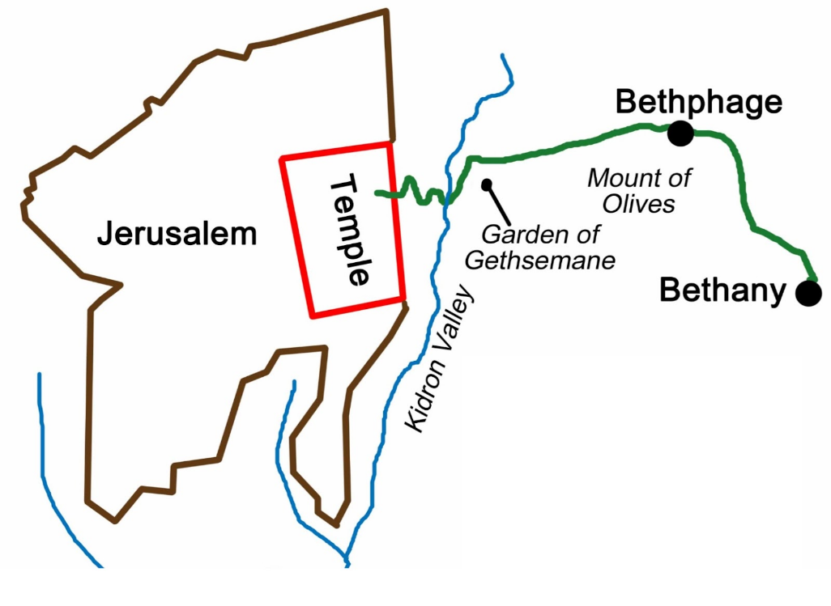
CHRIST’S PRESENT MINISTRY OF INTERCESSION
The Brook of the Kidron, the Garden,
and the Mount of Olives

Slide 43
John 17:4
“I glorified You on the earth, having accomplished the work which You have given Me to do.”

Slide 44
John 17:11
“I am no longer in the world; and yet they themselves are in the world, and I come to You. Holy Father, keep them in Your name, the name which You have given Me, that they may be one even as We are.”

Slide 45
John 17:12
“While I was with them, I was keeping them in Your name which You have given Me; and I guarded them and not one of them perished but the son of perdition, so that the Scripture would be fulfilled.”

Slide 46
John 17:24
“Father, I desire that they also, whom You have given Me, be with Me where I am, so that they may see My glory which You have given Me, for You loved Me before the foundation of the world.”

Slide 47
John 17:11
“I am no longer in the world; and yet they themselves are in the world, and I come to You. Holy Father, keep them in Your name, the name which You have given Me, that they may be one even as We are.”

Slide 48
John 17:15-16
“¹⁵ I do not ask You to take them out of the world, but to keep them from the evil one. ¹⁶ They are not of the world, even as I am not of the world.”

Slide 49
John 17:17
“Sanctify them in the truth; Your word is truth.”

Slide 50
1 Thessalonians 4:3–7
“³ For this is the will of God, your sanctification; that is, that you abstain from sexual immorality; ⁴ that each of you know how to possess his own vessel in sanctification and honor, ⁵ not in lustful passion, like the Gentiles who do not know God; ⁶ and that no man transgress and defraud his brother in the matter because the Lord is the avenger in all these things, just as we also told you before and solemnly warned you. ⁷ For God has not called us for the purpose of impurity, but in sanctification.”

Slide 51
John 17:9
“I ask on their behalf; I do not ask on behalf of the world, but of those whom You have given Me; for they are Yours.”

Slide 52
1 Timothy 2:1–4
“¹ First of all, then, I urge that entreaties and prayers, petitions and thanksgivings, be made on behalf of all men, ² for kings and all who are in authority, so that we may lead a tranquil and quiet life in all godliness and dignity. ³ This is good and acceptable in the sight of God our Savior, ⁴ who desires all men to be saved and to come to the knowledge of the truth.”

Slide 53
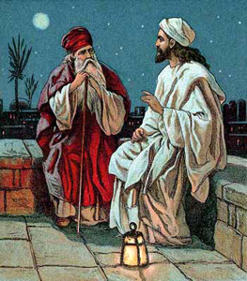
John 3:16
“For God so loved the world, that He gave His only begotten Son, that whoever believes in Him shall not perish, but have eternal life.”

Slide 54
1 Timothy 2:5
“For there is one God, and one mediator also between God and men, the man Christ Jesus…”

Slide 55
1 John 2:1
“My little children, I am writing these things to you so that you may not sin. And if anyone sins, we have an Advocate with the Father, Jesus Christ the righteous”

Slide 56
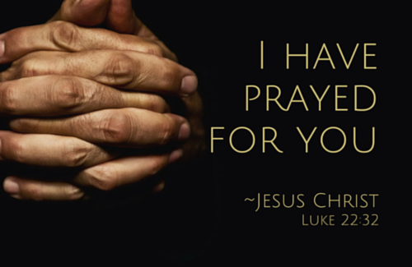
Luke 22:31-32a
“³¹ “Simon, Simon, behold, Satan has demanded permission to sift you like wheat; ³² but I have prayed for you, that your faith may not fail; and you, when once you have turned again, strengthen your brothers.”

Slide 57
CHRIST’S PRESENT MINISTRY OF INTERCESSION
Outline
Introduction
Exposition
Romans 8:34
Hebrew 7:23
John 17
Conclusion

Slide 59
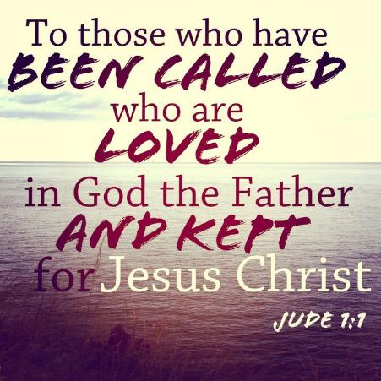
Jude 1
“Jude, a bond-servant of Jesus Christ, and brother of James, To those who are the called, beloved in God the Father, and kept for Jesus Christ:”

Slide 60
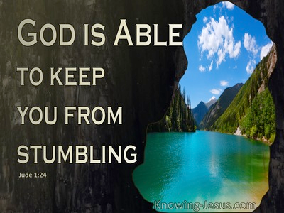
Jude 24a
“²⁴ Now to Him who is able to keep you from stumbling, and to make you stand in the presence of His glory blameless with great joy.”

Slide 61
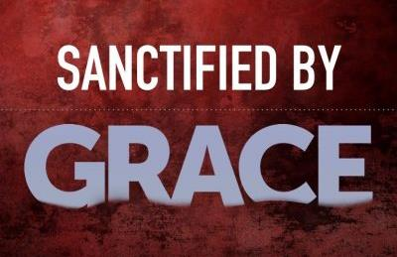
Jude 24b
“²⁴ Now to Him who is able to keep you from stumbling, and to make you stand in the presence of His glory blameless with great joy.”

Slide 62
Ephesians 2:8–9
“⁸ For by grace you have been saved through faith; and that not of yourselves, it is the gift of God; ⁹ not as a result of works, so that no one may boast.”

Slide 63
Jude 24–25
“²⁴ Now to Him who is able to keep you from stumbling, and to make you stand in the presence of His glory blameless with great joy, ²⁵ to the only God our Savior, through Jesus Christ our Lord, be glory, majesty, dominion and authority, before all time and now and forever. Amen.”

Slide 64
CHRIST’S PRESENT INTERCESSORY MINISTRY
Jim McGowan, Th.D. Sugar Land Bible Church
06-30-2019
Special thanks to The Middletown Bible Church for access to their resources.

