Slide 1
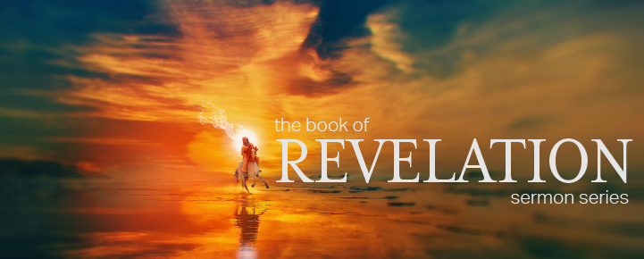
Dr. Andy Woods
Senior Pastor – Sugar Land Bible Church
President – Chafer Theological Seminary

Slide 3
7th Seal & 1st Six Trumpets (Revelation 8‒9)
7th Seal (8:1-6) – Trumpet preparation
1st Trumpet (8:7) – 1/3 vegetation destroyed
2nd Trumpet (8:8-9) – 1/3 ocean destroyed
3rd Trumpet (8:10-11) – 1/3 water destroyed
4th Trumpet (8:12-13) – 1/3 luminaries darkened
5th Trumpet (9:1-12) – Demons released
6th Trumpet (9:13-21) – 1/3 humanity destroyed

Slide 4
7th Seal & 1st Six Trumpets (Revelation 8‒9)
7th Seal (8:1-6) – Trumpet preparation
1st Trumpet (8:7) – 1/3 vegetation destroyed
2nd Trumpet (8:8-9) – 1/3 ocean destroyed
3rd Trumpet (8:10-11) – 1/3 water destroyed
4th Trumpet (8:12-13) – 1/3 luminaries darkened
5th Trumpet (9:1-12) – Demons released
6th Trumpet (9:13-21) – 1/3 humanity destroyed

Slide 5
7th Seal & 1st Six Trumpets (Revelation 8‒9)
7th Seal (8:1-6) – Trumpet preparation
1st Trumpet (8:7) – 1/3 vegetation destroyed
2nd Trumpet (8:8-9) – 1/3 ocean destroyed
3rd Trumpet (8:10-11) – 1/3 water destroyed
4th Trumpet (8:12-13) – 1/3 luminaries darkened
5th Trumpet (9:1-12) – Demons released
6th Trumpet (9:13-21) – 1/3 humanity destroyed

Slide 6
7th Seal & 1st Six Trumpets (Revelation 8‒9)
7th Seal (8:1-6) – Trumpet preparation
1st Trumpet (8:7) – 1/3 vegetation destroyed
2nd Trumpet (8:8-9) – 1/3 ocean destroyed
3rd Trumpet (8:10-11) – 1/3 water destroyed
4th Trumpet (8:12-13) – 1/3 luminaries darkened
5th Trumpet (9:1-12) – Demons released
6th Trumpet (9:13-21) – 1/3 humanity destroyed

Slide 7
7th Seal & 1st Six Trumpets (Revelation 8‒9)
7th Seal (8:1-6) – Trumpet preparation
1st Trumpet (8:7) – 1/3 vegetation destroyed
2nd Trumpet (8:8-9) – 1/3 ocean destroyed
3rd Trumpet (8:10-11) – 1/3 water destroyed
4th Trumpet (8:12-13) – 1/3 luminaries darkened
5th Trumpet (9:1-12) – Demons released
6th Trumpet (9:13-21) – 1/3 humanity destroyed

Slide 8
7th Seal & 1st Six Trumpets (Revelation 8‒9)
7th Seal (8:1-6) – Trumpet preparation
1st Trumpet (8:7) – 1/3 vegetation destroyed
2nd Trumpet (8:8-9) – 1/3 ocean destroyed
3rd Trumpet (8:10-11) – 1/3 water destroyed
4th Trumpet (8:12-13) – 1/3 luminaries darkened
5th Trumpet (9:1-12) – Demons released
6th Trumpet (9:13-21) – 1/3 humanity destroyed

Slide 9
7th Seal & 1st Six Trumpets (Revelation 8‒9)
7th Seal (8:1-6) – Trumpet preparation
1st Trumpet (8:7) – 1/3 vegetation destroyed
2nd Trumpet (8:8-9) – 1/3 ocean destroyed
3rd Trumpet (8:10-11) – 1/3 water destroyed
4th Trumpet (8:12-13) – 1/3 luminaries darkened
5th Trumpet (9:1-12) – Demons released
6th Trumpet (9:13-21) – 1/3 humanity destroyed

Slide 10
7th Seal & 1st Six Trumpets (Revelation 8‒9)
7th Seal (8:1-6) – Trumpet preparation
1st Trumpet (8:7) – 1/3 vegetation destroyed
2nd Trumpet (8:8-9) – 1/3 ocean destroyed
3rd Trumpet (8:10-11) – 1/3 water destroyed
4th Trumpet (8:12-13) – 1/3 luminaries darkened
5th Trumpet (9:1-12) – Demons released
6th Trumpet (9:13-21) – 1/3 humanity destroyed

Slide 12
5 Non-Chronological Parenthetical Insertions
Rev 7 – 144,000 Jews
Rev 10:1-11:14 – Announcement of no more delay and the two witnesses
Rev 12-14 – Israel’s flight, two beasts, six scenes of hope
Rev 16:13-16 – Gathering of the nations to Armageddon
Rev 17:1-19:6 – Babylon’s fall

Slide 13
5 Non-Chronological Parenthetical Insertions
Rev 7 – 144,000 Jews
Rev 10:1-11:14 – Announcement of no more delay and the two witnesses
Rev 12-14 – Israel’s flight, two beasts, six scenes of hope
Rev 16:13-16 – Gathering of the nations to Armageddon
Rev 17:1-19:6 – Babylon’s fall

Slide 14
2. Revelation 10:1‒11:14
Rev 10 – Announcement of no more delay
Rev 11:1-2 – End of the Times of the Gentiles
Rev 11:3-14 – Ministry of the Two Witnesses

Slide 15
2. Revelation 10:1‒11:14
Rev 10 – Announcement of no more delay
Rev 11:1-2 – End of the Times of the Gentiles
Rev 11:3-14 – Ministry of the Two Witnesses

Slide 16
Recapitulation
View that judgments overlap
Seals: 1 2 3 4 5 6 7
Trumpets: 1 2 3 4 5 6 7
Bowls: 1 2 3 4 5 6 7

Slide 17
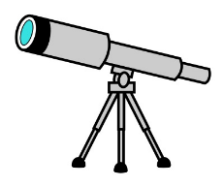
Telescoping
7th judgment releases 1st in next series
Seals: 1 2 3 4 5 6 7
Trumpets: 1 2 3 4 5 6 7
Bowls: 1 2 3 4 5 6 7

Slide 18
No Further Delay (Revelation 10)
The Angel’s Appearance (10:1)
The Angel’s Actions (10:2-7)
The Angel’s Commission (10:8-11)

Slide 19
No Further Delay (Revelation 10)
The Angel’s Appearance (10:1)
The Angel’s Actions (10:2-7)
The Angel’s Commission (10:8-11)

Slide 20
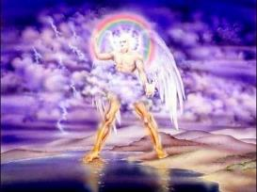
I. The Angel’s Appearance (Revelation 10:1)
Another Angel (10:1a)
The Angel’s Clothes (10:1b)
The Angel’s Head (10:1c)
The Angel’s Face (10:1d)
The Angel’s Legs (10:1e)

Slide 21
I. The Angel’s Appearance (Revelation 10:1)
Another Angel (10:1a)
The Angel’s Clothes (10:1b)
The Angel’s Head (10:1c)
The Angel’s Face (10:1d)
The Angel’s Legs (10:1e)

Slide 22
I. The Angel’s Appearance (Revelation 10:1)
Another Angel (10:1a)
The Angel’s Clothes (10:1b)
The Angel’s Head (10:1c)
The Angel’s Face (10:1d)
The Angel’s Legs (10:1e)

Slide 23
I. The Angel’s Appearance (Revelation 10:1)
Another Angel (10:1a)
The Angel’s Clothes (10:1b)
The Angel’s Head (10:1c)
The Angel’s Face (10:1d)
The Angel’s Legs (10:1e)

Slide 24
I. The Angel’s Appearance (Revelation 10:1)
Another Angel (10:1a)
The Angel’s Clothes (10:1b)
The Angel’s Head (10:1c)
The Angel’s Face (10:1d)
The Angel’s Legs (10:1e)

Slide 25
I. The Angel’s Appearance (Revelation 10:1)
Another Angel (10:1a)
The Angel’s Clothes (10:1b)
The Angel’s Head (10:1c)
The Angel’s Face (10:1d)
The Angel’s Legs (10:1e)

Slide 26
No Further Delay (Revelation 10)
The Angel’s Appearance (10:1)
The Angel’s Actions (10:2-7)
The Angel’s Commission (10:8-11)

Slide 27
II. The Angel’s Actions (Revelation 10:2-7)
What the Angel Holds (10:2a)
What the Angel Does (10:2b)
What the Angel Says (10:3-7)
Concerning the 7 Thunders (10:3-4)
Concerning the 7th Trumpet (10:5-7)

Slide 28
II. The Angel’s Actions (Revelation 10:2-7)
What the Angel Holds (10:2a)
What the Angel Does (10:2b)
What the Angel Says (10:3-7)
Concerning the 7 Thunders (10:3-4)
Concerning the 7th Trumpet (10:5-7)

Slide 30
II. The Angel’s Actions (Revelation 10:2-7)
What the Angel Holds (10:2a)
What the Angel Does (10:2b)
What the Angel Says (10:3-7)
Concerning the 7 Thunders (10:3-4)
Concerning the 7th Trumpet (10:5-7)

Slide 31
II. The Angel’s Actions (Revelation 10:2-7)
What the Angel Holds (10:2a)
What the Angel Does (10:2b)
What the Angel Says (10:3-7)
Concerning the 7 Thunders (10:3-4)
Concerning the 7th Trumpet (10:5-7)

Slide 32
II. The Angel’s Actions (Revelation 10:2-7)
What the Angel Holds (10:2a)
What the Angel Does (10:2b)
What the Angel Says (10:3-7)
Concerning the 7 Thunders (10:3-4)
Concerning the 7th Trumpet (10:5-7)

Slide 33
Hosea 11:10
“They will walk after the Lord, He will roar like a lion; Indeed He will roar And His sons will come trembling from the west.”

Slide 34
Amos 3:8
“A lion has roared! Who will not fear? The Lord God has spoken! Who can but prophesy?”

Slide 35
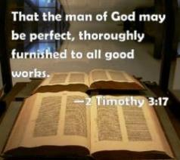
2 Timothy 3:16-17
“¹⁶ All Scripture is inspired by God [theopneustos] and profitable for teaching, for reproof, for correction, for training in righteousness; ¹⁷ so that the man of God may be adequate, equipped for every good work.”

Slide 36
INSPIRATION OF SCRIPTURE 2 Peter 1:20-21
Men Wrote as they were inspired by Holy Spirit
“phero” = to carry
Acts 27:15,17
Opposite of Knowledge of False Teachers
Which is their own imagination
Jer. 23:16

Slide 37
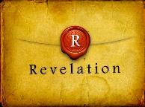
Revelation 1:1
“The Revelation [apokalypsis] of Jesus Christ, which God gave Him to show to His bond-servants, the things which must soon take place; and He sent and communicated it by His angel to His bond-servant John.”

Slide 38
Revelation 22:10
“And he said to me, “Do not seal up the words of the prophecy of this book, for the time is near.”
Notes:
‘to and fro‘ – refers to the increase in knowledge through searching out the scriptures; progressive illumination
Inspiration – not today (2 Tim. 3:16-17; 2 Pet. 1:21)
Revelation – not today (Jude 3; Rev. 22:18-19)
Illumination – for today (Eph. 1:18; 1 Cor. 2:14-15; 1 John 2:27)

Slide 39
Daniel 12:4, 9
“But as for you, Daniel, conceal these words and seal up the book until the end of time; many will go back and forth, and knowledge will increase...Go your way, Daniel, for these words are concealed and sealed up until the end time.”
Notes:
‘to and fro‘ – refers to the increase in knowledge through searching out the scriptures; progressive illumination

Slide 40
Matthew 24:21-22
“²¹ For then there will be a great tribulation, such as has not occurred since the beginning of the world until now, nor ever will. ²² Unless those days had been cut short, no life would have been saved; but for the sake of the elect those days will be cut short.”
Notes:
‘to and fro‘ – refers to the increase in knowledge through searching out the scriptures; progressive illumination

Slide 41
II. The Angel’s Actions (Revelation 10:2-7)
What the Angel Holds (10:2a)
What the Angel Does (10:2b)
What the Angel Says (10:3-7)
Concerning the 7 Thunders (10:3-4)
Concerning the 7th Trumpet (10:5-7)

Slide 42
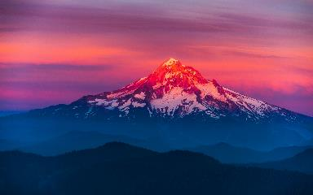
Psalm 90:2
“Before the mountains were born Or You gave birth to the earth and the world, Even from everlasting (olam) to everlasting (olam), You are God.”

Slide 43
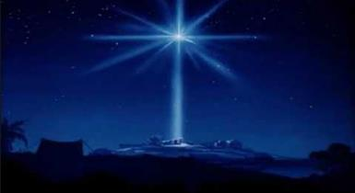
Micah 5:2
“But as for you, Bethlehem Ephrathah, Too little to be among the clans of Judah, From you One will go forth for Me to be ruler in Israel. His goings forth are from long ago, From the days of eternity (olam).”

Slide 44
Romans 16:26
“but now is manifested, and by the Scriptures of the prophets, according to the commandment of the eternal (aiōnios) God, has been made known to all the nations, leading to obedience of faith

Slide 45
Shaping and Populating (Gen 1:1-31)
Day 1 | Light
Day 2 | Water, sky
Day 3 | Land, vegetation
Day 4 | Luminaries
Day 5 | Sea animals, birds
Day 6 | Land animals, man

Slide 46
Revelation 11:15
“Then the seventh angel sounded; and there were loud voices in heaven, saying, ‘The kingdom of the world has become the kingdom of our Lord and of His Christ; and He will reign forever and ever.’”

Slide 47
Romans 16:25-26
^{“25} Now to Him who is able to establish you according to my gospel and the preaching of Jesus Christ, according to the revelation of the mystery which has been kept secret for long ages past, ²⁶ but now is manifested, and by the Scriptures of the prophets, according to the commandment of the eternal God, has been made known to all the nations, leading to obedience of faith

Slide 48
Colossians 1:26
“that is, the mystery which has been hidden from the past ages and generations, but has now been manifested to His.”

Slide 49
“Mystery” Defined
“In the N.T, it [mustērion] denotes, not the mysterious (as with the Eng. word), but that which, being outside the range of unassisted natural apprehension, can be made known only by Divine revelation, and is made known in a manner and at a time appointed by God, and to those who are illumined by His Spirit.”
W. E. Vine, Merrill F. Unger, and William White, Vine's Complete Expository Dictionary of the Old and New Testament Words (Nashville: Nelson, 1996), 424.

Slide 50
Telescoping
7th judgment releases 1st in next series
Seals: 1 2 3 4 5 6 7
Trumpets: 1 2 3 4 5 6 7
Bowls: 1 2 3 4 5 6 7

Slide 52
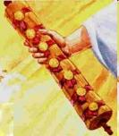
1st Six Seals (Revelation 6)
6:1-2 – Advent of antichrist
6:3-4 – War
6:5-6 – Famine
6:7-8 – Death
6:9-11 – Martyrdoms
6:12-17 – Cosmic disturbances

Slide 53
No Further Delay (Revelation 10)
The Angel’s Appearance (10:1)
The Angel’s Actions (10:2-7)
The Angel’s Commission (10:8-11)

Slide 54
III. The Angel’s Commission (Revelation 10:8-11)
Partake (10:8-10)
Take the book (8)
John’s obedience (9a)
Eat the book (9b)
John’s obedience (10)
Prophesy (10:11)

Slide 55
III. The Angel’s Commission (Revelation 10:8-11)
Partake (10:8-10)
Take the book (8)
John’s obedience (9a)
Eat the book (9b)
John’s obedience (10)
Prophesy (10:11)

Slide 56
III. The Angel’s Commission (Revelation 10:8-11)
Partake (10:8-10)
Take the book (8)
John’s obedience (9a)
Eat the book (9b)
John’s obedience (10)
Prophesy (10:11)

Slide 57
III. The Angel’s Commission (Revelation 10:8-11)
Partake (10:8-10)
Take the book (8)
John’s obedience (9a)
Eat the book (9b)
John’s obedience (10)
Prophesy (10:11)

Slide 58
III. The Angel’s Commission (Revelation 10:8-11)
Partake (10:8-10)
Take the book (8)
John’s obedience (9a)
Eat the book (9b)
John’s obedience (10)
Prophesy (10:11)

Slide 59
III. The Angel’s Commission (Revelation 10:8-11)
Partake (10:8-10)
Take the book (8)
John’s obedience (9a)
Eat the book (9b)
John’s obedience (10)
Prophesy (10:11)

Slide 61
Revelation 11:15
“Then the seventh angel sounded; and there were loud voices in heaven, saying, ‘The kingdom of the world has become the kingdom of our Lord and of His Christ; and He will reign forever and ever.’”

Slide 62
III. The Angel’s Commission (Revelation 10:8-11)
Partake (10:8-10)
Take the book (8)
John’s obedience (9a)
Eat the book (9b)
John’s obedience (10)
Prophesy (10:11)

Slide 63
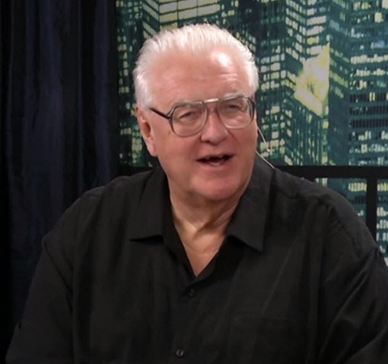
David Hocking
David Hocking, The Book of Revelation: Understanding the Future (Tustin, CA: Hope For Today Publications, 2014), 371.
“To all preachers of the Word of God, God‘s Word must be proclaimed no matter how it affects or offends people. We should speak God‘s truth in love, of course, but there is too much compromise in the pulpits of our churches. The Bible’s message about God‘s wrath and judgment is rarely heard or understood by today’s culture. There is no message more important for our world than that which the Book of Revelation clearly presents. May God help us to be faithful to it, and to heed what it says!”

Slide 65
Conclusion

Slide 66
No Further Delay (Revelation 10)
The Angel’s Appearance (10:1)
The Angel’s Actions (10:2-7)
The Angel’s Commission (10:8-11)

Slide 67
“The Lord bless you and keep you; the Lord make his face shine on you and be gracious to you; the Lord turn his face toward you and give you peace.” (NIV)

