Slide 1
Dr. Andy Woods
Senior Pastor – Sugar Land Bible Church
President – Chafer Theological Seminary

Slide 3
7th Seal & 1st Six Trumpets (Revelation 8‒9)
7th Seal (8:1-6) – Trumpet preparation
1st Trumpet (8:7) – 1/3 vegetation destroyed
2nd Trumpet (8:8-9) – 1/3 ocean destroyed
3rd Trumpet (8:10-11) – 1/3 water destroyed
4th Trumpet (8:12-13) – 1/3 luminaries darkened
5th Trumpet (9:1-12) – Demons released
6th Trumpet (9:13-21) – 1/3 humanity destroyed

Slide 4
7th Seal & 1st Six Trumpets (Revelation 8‒9)
7th Seal (8:1-6) – Trumpet preparation
1st Trumpet (8:7) – 1/3 vegetation destroyed
2nd Trumpet (8:8-9) – 1/3 ocean destroyed
3rd Trumpet (8:10-11) – 1/3 water destroyed
4th Trumpet (8:12-13) – 1/3 luminaries darkened
5th Trumpet (9:1-12) – Demons released
6th Trumpet (9:13-21) – 1/3 humanity destroyed

Slide 5
Telescoping
7th judgment releases 1st in next series
Seals: 1 2 3 4 5 6 7
Trumpets: 1 2 3 4 5 6 7
Bowls: 1 2 3 4 5 6 7

Slide 6
7th Seal & 1st Six Trumpets (Revelation 8‒9)
7th Seal (8:1-6) – Trumpet preparation
1st Trumpet (8:7) – 1/3 vegetation destroyed
2nd Trumpet (8:8-9) – 1/3 ocean destroyed
3rd Trumpet (8:10-11) – 1/3 water destroyed
4th Trumpet (8:12-13) – 1/3 luminaries darkened
5th Trumpet (9:1-12) – Demons released
6th Trumpet (9:13-21) – 1/3 humanity destroyed

Slide 7
7th Seal & 1st Six Trumpets (Revelation 8‒9)
7th Seal (8:1-6) – Trumpet preparation
1st Trumpet (8:7) – 1/3 vegetation destroyed
2nd Trumpet (8:8-9) – 1/3 ocean destroyed
3rd Trumpet (8:10-11) – 1/3 water destroyed
4th Trumpet (8:12-13) – 1/3 luminaries darkened
5th Trumpet (9:1-12) – Demons released
6th Trumpet (9:13-21) – 1/3 humanity destroyed

Slide 8
7th Seal & 1st Six Trumpets (Revelation 8‒9)
7th Seal (8:1-6) – Trumpet preparation
1st Trumpet (8:7) – 1/3 vegetation destroyed
2nd Trumpet (8:8-9) – 1/3 ocean destroyed
3rd Trumpet (8:10-11) – 1/3 water destroyed
4th Trumpet (8:12-13) – 1/3 luminaries darkened
5th Trumpet (9:1-12) – Demons released
6th Trumpet (9:13-21) – 1/3 humanity destroyed

Slide 9
7th Seal & 1st Six Trumpets (Revelation 8‒9)
7th Seal (8:1-6) – Trumpet preparation
1st Trumpet (8:7) – 1/3 vegetation destroyed
2nd Trumpet (8:8-9) – 1/3 ocean destroyed
3rd Trumpet (8:10-11) – 1/3 water destroyed
4th Trumpet (8:12-13) – 1/3 luminaries darkened
5th Trumpet (9:1-12) – Demons released
6th Trumpet (9:13-21) – 1/3 humanity destroyed

Slide 10
7th Seal & 1st Six Trumpets (Revelation 8‒9)
7th Seal (8:1-6) – Trumpet preparation
1st Trumpet (8:7) – 1/3 vegetation destroyed
2nd Trumpet (8:8-9) – 1/3 ocean destroyed
3rd Trumpet (8:10-11) – 1/3 water destroyed
4th Trumpet (8:12-13) – 1/3 luminaries darkened
5th Trumpet (9:1-12) – Demons released
6th Trumpet (9:13-21) – 1/3 humanity destroyed

Slide 11
6. 5th Trumpet (Rev. 9:1-12)
Discharging angel (9:1)
Angel opens the abyss (9:2)
Demons emerge from the abyss (9:3)
Demonic activity (9:4-6)
Demonic description (9:7-10)
Demonic leader (9:11)
Remaining trumpets (9:12)

Slide 12
6. 5th Trumpet (Rev. 9:1-12)
Discharging angel (9:1)
Angel opens the abyss (9:2)
Demons emerge from the abyss (9:3)
Demonic activity (9:4-6)
Demonic description (9:7-10)
Demonic leader (9:11)
Remaining trumpets (9:12)

Slide 13
6. 5th Trumpet (Rev. 9:1-12)
Discharging angel (9:1)
Angel opens the abyss (9:2)
Demons emerge from the abyss (9:3)
Demonic activity (9:4-6)
Demonic description (9:7-10)
Demonic leader (9:11)
Remaining trumpets (9:12)

Slide 14
6. 5th Trumpet (Rev. 9:1-12)
Discharging angel (9:1)
Angel opens the abyss (9:2)
Demons emerge from the abyss (9:3)
Demonic activity (9:4-6)
Demonic description (9:7-10)
Demonic leader (9:11)
Remaining trumpets (9:12)

Slide 15
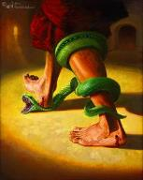
Genesis 3:15
“And I will put enmity Between you and the woman, And between your seed and her seed; He shall bruise you on the head, And you shall bruise him on the heel.”

Slide 17
6. 5th Trumpet (Rev. 9:1-12)
Discharging angel (9:1)
Angel opens the abyss (9:2)
Demons emerge from the abyss (9:3)
Demonic activity (9:4-6)
Demonic description (9:7-10)
Demonic leader (9:11)
Remaining trumpets (9:12)

Slide 18
6. 5th Trumpet (Rev. 9:1-12)
Discharging angel (9:1)
Angel opens the abyss (9:2)
Demons emerge from the abyss (9:3)
Demonic activity (9:4-6)
Demonic description (9:7-10)
Demonic leader (9:11)
Remaining trumpets (9:12)

Slide 19
6. 5th Trumpet (Rev. 9:1-12)
Discharging angel (9:1)
Angel opens the abyss (9:2)
Demons emerge from the abyss (9:3)
Demonic activity (9:4-6)
Demonic description (9:7-10)
Demonic leader (9:11)
Remaining trumpets (9:12)

Slide 20
6. 5th Trumpet (Rev. 9:1-12)
Discharging angel (9:1)
Angel opens the abyss (9:2)
Demons emerge from the abyss (9:3)
Demonic activity (9:4-6)
Demonic description (9:7-10)
Demonic leader (9:11)
Remaining trumpets (9:12)

Slide 21
Recapitulation
View that judgments overlap
Seals: 1 2 3 4 5 6 7
Trumpets: 1 2 3 4 5 6 7
Bowls: 1 2 3 4 5 6 7

Slide 22
Telescoping
7th judgment releases 1st in next series
Seals: 1 2 3 4 5 6 7
Trumpets: 1 2 3 4 5 6 7
Bowls: 1 2 3 4 5 6 7

Slide 23
7th Seal & 1st Six Trumpets (Revelation 8‒9)
7th Seal (8:1-6) – Trumpet preparation
1st Trumpet (8:7) – 1/3 vegetation destroyed
2nd Trumpet (8:8-9) – 1/3 ocean destroyed
3rd Trumpet (8:10-11) – 1/3 water destroyed
4th Trumpet (8:12-13) – 1/3 luminaries darkened
5th Trumpet (9:1-12) – Demons released
6th Trumpet (9:13-21) – 1/3 humanity destroyed

Slide 24
Transitions | Fifth Trumpet | Sixth Trumpet
Scripture: | Rev. 9:1-12 | Rev. 9:13-21
Source: | Abyss | East
Kind of army: | Demonic | Human

Slide 25
7. 6th Trumpet (Rev. 9:13-21)
Army released (9:13-15)
Army’s number (9:16)
Army’s description (9:17)
Army’s destruction (9:18-19)
Humanity’s non-repentance (9:20-21)

Slide 26
7. 6th Trumpet (Rev. 9:13-21)
Army released (9:13-15)
Army’s number (9:16)
Army’s description (9:17)
Army’s destruction (9:18-19)
Humanity’s non-repentance (9:20-21)

Slide 27
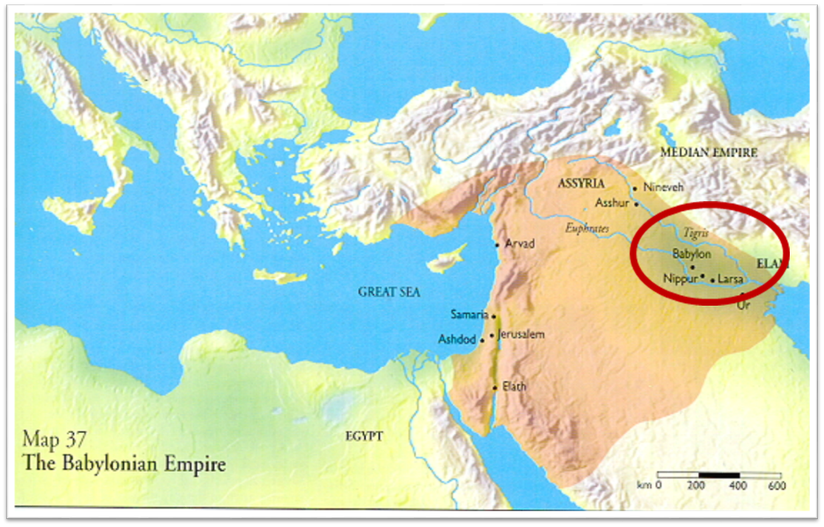

Slide 28
Literal Geography in Revelation Thomas, Revelation 8 to 22: An Exegetical Commentary, 206-207.
Asia | 1:4 | Sardis | 3:1
Ephesus | 2:1 | Philadelphia | 3:7
Smyrna | 2:8 | Laodicea | 3:14
Pergamum | 2:12 | Euphrates | 9:14;16:12
Thyatira | 2:18 | Armageddon | 16:16

Slide 30
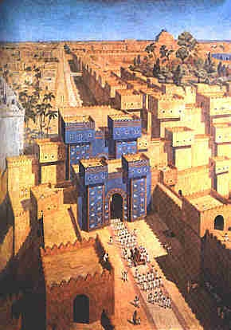
East = Babylon
Genesis 2:8
Genesis 11:2
Matthew 2:2

Slide 31
John 2:4
“And Jesus said to her, ‘Woman, what does that have to do with us? My hour hour [hōra] has not yet come.’”

Slide 32
John 12:27
“Now My soul has become troubled; and what shall I say, ‘Father, save Me from this hour [hōra]’? But for this purpose I came to this hour [hōra]’.”

Slide 33
7. 6th Trumpet (Rev. 9:13-21)
Army released (9:13-15)
Army’s number (9:16)
Army’s description (9:17)
Army’s destruction (9:18-19)
Humanity’s non-repentance (9:20-21)

Slide 34
Robert Thomas
Revelation 8 to 22: An Exegetical Commentary (Chicago: Moody Press, 1992), 408.
Robert Thomas observes that, "no number in Revelation is verifiably a symbolic number.”

Slide 35
7. 6th Trumpet (Rev. 9:13-21)
Army released (9:13-15)
Army’s number (9:16)
Army’s description (9:17)
Army’s destruction (9:18-19)
Humanity’s non-repentance (9:20-21)

Slide 36
7. 6th Trumpet (Rev. 9:13-21)
Army released (9:13-15)
Army’s number (9:16)
Army’s description (9:17)
Army’s destruction (9:18-19)
Humanity’s non-repentance (9:20-21)

Slide 37
7. 6th Trumpet (Rev. 9:13-21)
Army released (9:13-15)
Army’s number (9:16)
Army’s description (9:17)
Army’s destruction (9:18-19)
Humanity’s non-repentance (9:20-21)

Slide 38
Revelation 9:20-21
²⁰ “The rest of mankind, who were not killed by these plagues, did not repent of the works of their hands, so as not to worship demons, and the idols of gold and of silver and of brass and of stone and of wood, which can neither see nor hear nor walk; ²¹ and they did not repent of their murders nor of their sorceries nor of their immorality nor of their thefts.”

Slide 39
Revelation 9:20-21
“The rest of mankind, who were not killed by these plagues, did not repent of the works of their hands, so as not to worship demons, and the idols of gold and of silver and of brass and of stone and of wood, which can neither see nor hear nor walk; ²¹ and they did not repent of their murders nor of their sorceries (pharmakeia) nor of their immorality nor of their thefts.”

Slide 40
Conclusion

Slide 41
7th Seal & 1st Six Trumpets (Revelation 8‒9)
7th Seal (8:1-6) – Trumpet preparation
1st Trumpet (8:7) – 1/3 vegetation destroyed
2nd Trumpet (8:8-9) – 1/3 ocean destroyed
3rd Trumpet (8:10-11) – 1/3 water destroyed
4th Trumpet (8:12-13) – 1/3 luminaries darkened
5th Trumpet (9:1-12) – Demons released
6th Trumpet (9:13-21) – 1/3 humanity destroyed

Slide 42
“The Lord bless you and keep you; the Lord make his face shine on you and be gracious to you; the Lord turn his face toward you and give you peace.” (NIV)

