Slide 1
Law and Grace: An Overview Jim McGowan, Th.D. Sugar Land Bible Church 01-20-2019
…but grace and truth were realized through Jesus Christ - John 1:17
For the Law was given through Moses…
Special thanks to Dr. Vern Peterman for access to his insights and resources.

Slide 2
Session 16 Outline
Review
Purpose, Aim, and Objective
Woe is Me, for I am ruined! (Isaiah 6:1-5)
General Information
Comments and Commentary
Concluding Observations

Slide 3
OUR PURPOSE, AIM AND OBJECTIVE
Law and Grace
…is to Compare and Contrast Law and Grace so as to properly understand these two important themes and how they are related to the life of the New Testament Believer.

Slide 4
C. I. SCOFIELD, D. D.
The Grace of God, The Fundamentals Vol. 3, Chapter VII, p. 98
We have, most of us, been reared and now live under the influence of Galatianism. Protestant theology, alas, is for the most part, thoroughly Galatianized, in that neither law nor grace are given their distinct and separated places, as in the counsels of God, but are mingled together in one incoherent system.
The law is no longer, as in the Divine intent, a ministration of death (2 Cor. 3:7), of cursing (Gal. 3:10), of conviction (Rom. 3:19), because we are taught that we must try to keep it, and that by Divine help we may.
Nor, on the other hand, does grace bring us blessed deliverance from the dominion of sin, for we are kept under the law as a rule of life despite the plain declaration, “Sin shall not have dominion over you: for ye are not under the law, but under grace” (Rom. 6:14). (emphasis mine)

Slide 5
William R. Newell
Romans Verse-by-Verse (p. 274).
Grand Rapids, MI: Christian Classics Ethereal Library.
It is because Reformed theology has kept us Gentiles under the Law,—if not as a means of righteousness, then as “a rule of life,” that all the trouble has arisen. The Law is no more a rule of life than it is a means of righteousness. Walking in the Spirit has now taken the place of walking by ordinances. God has another principle under which He has put his saints: “Ye are not under law, but, under grace!” (italics mine)

Slide 6
Session 16 Outline
Review
Purpose, Aim, and Objective
Woe is Me, for I am ruined! (Isaiah 6:1-5)
General Information
Comments and Commentary
Concluding Observations

Slide 7
Session 16 Outline
Review
Purpose, Aim, and Objective
Woe is Me, for I am ruined! (Isaiah 6:1-5)
General Information
Comments and Commentary
Concluding Observations

Slide 8
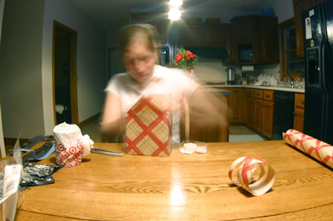
The quick wrap-up of Isaiah 6
Law and Grace: Session 16

Slide 9
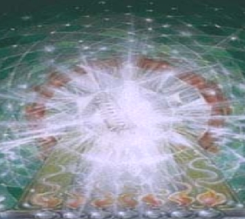
Isaiah 6 from 30,000 ft.
Law and Grace: Session 16
Isaiah 6:1-7, which we will study and compare in more detail in this session, tells of Isaiah’s “visit” to heaven’s throne room.
In v. 8 the Lord commissions Isaiah to speak to Judah.

Slide 10
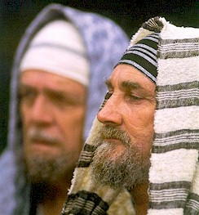
Isaiah 6 from 30,000 ft.
Law and Grace: Session 16
Verses 9-10 describe the “heart disease” which kept the people from responding to Isaiah’s message.

Slide 11
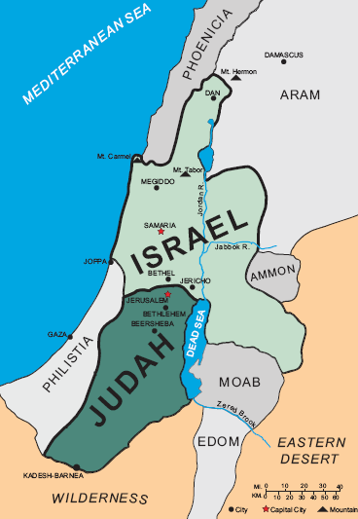
Isaiah 6 from 30,000 ft.
Law and Grace: Session 16
Verses 11-13 describe the coming external conditions in the land of Judah.

Slide 12
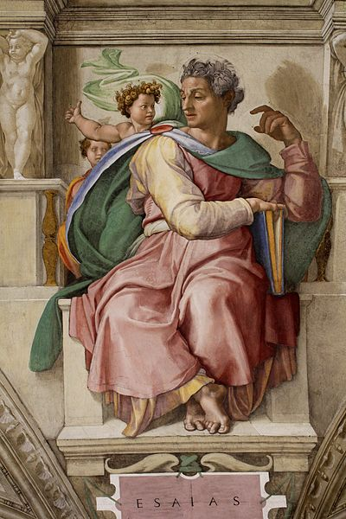
Who is Isaiah? A Hebrew Holy man but…
Law and Grace: Session 16
Isaiah is most certainly a great Hebrew holy man:
A court prophet for several kings of Judah (Uzziah, Jotham, Ahaz and Hezekiah, v.1).

Slide 13
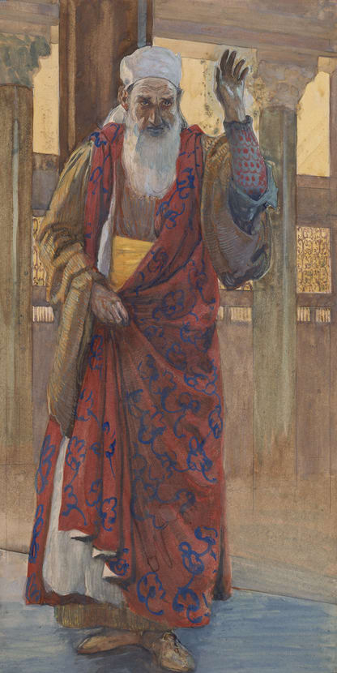
Isaiah 1:1
The vision of Isaiah the son of Amoz concerning Judah and Jerusalem, which he saw during the reigns of Uzziah, Jotham, Ahaz and Hezekiah, kings of Judah.

Slide 14
Hebrews 11:36-40
³⁶ [by faith] others experienced mockings and scourgings, yes, also chains and imprisonment. ³⁷ They were stoned, they were sawn in two, they were tempted, they were put to death with the sword; they went about in sheepskins, in goatskins, being destitute, afflicted, ill-treated ³⁸ (men of whom the world was not worthy), wandering in deserts and mountains and caves and holes in the ground. ³⁹ And all these, having gained approval through their faith, did not receive what was promised, ⁴⁰ because God had provided something better for us, so that apart from us they would not be made perfect.

Slide 15
Who is Isaiah? A Hebrew Holy man but…
Law and Grace: Session 16
Isaiah is most certainly a great Hebrew holy man:
A man whose children’s names (Shearjashub and Maher-shalal-hash-baz) were used of God.

Slide 16
Isaiah 7:3
Then the Lord said to Isaiah, “Go out now to meet Ahaz, you and your son Shear-jashub (a remnant shall return), at the end of the conduit of the upper pool, on the highway to the fuller’s field…
Isaiah 8:1-3
¹ Then the Lord said to me, “Take for yourself a large tablet and write on it in ordinary letters: Swift is the booty, speedy is the prey…³ So I approached the prophetess, and she conceived and gave birth to a son. Then the Lord said to me, “Name him Maher-shalal-hash-baz;…”

Slide 17
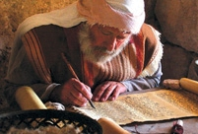
Who is Isaiah? A Hebrew Holy man but…
Law and Grace: Session 16
Isaiah is most certainly a great Hebrew holy man:
The chosen author of 66 chapters of inspired Scripture,
But Isaiah lives, and carries out his ministry, and writes at a time and place when the Mosaic Law was the rule of life.

Slide 18
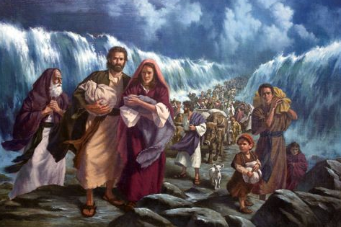
1 Corinthians 10:1–2
¹ For I do not want you to be unaware, brethren, that our fathers were all under the cloud and all passed through the sea; ² and all were baptized into Moses in the cloud and in the sea;…

Slide 19
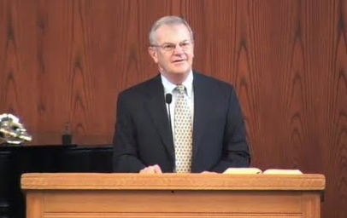
Tom Constable Expository Notes on the Bible, 1 Corinthians 10:1-2
Law and Grace: Session 16
“Baptism is the outward expression of the believer’s identification with the object of his or her faith (cf. Rom. 6:3; Gal. 3:27). Consequently Paul could say the Israelites were baptized into Moses even though they did not undergo literal water baptism in the name of Moses. By following him and submitting to his authority they expressed their identification with him.”

Slide 20
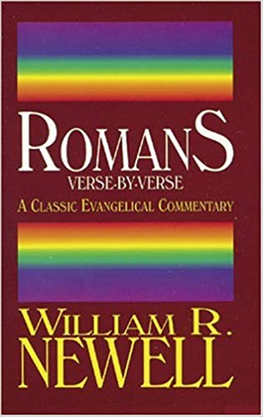
Law and Grace: Session 16
William R. Newell
Romans Verse-by-Verse (p. 274).
“…in 1 Corinthians 10:2, where we read that the fathers of Israel were all “baptized unto (eis) Moses.” Those Israelites …were indeed judicially associated by God with the Mosaic economy,—“into a spiritual union with Moses, and constituted his disciples.” [http://withchrist.org/Newell.pdf]

Slide 21
Romans 5:20–21
²⁰ The Law came in so that the transgression would increase; but where sin increased, grace abounded all the more, ²¹ so that, as sin reigned in death, even so grace would reign through righteousness to eternal life through Jesus Christ our Lord.

Slide 22
Law and Grace: Session 16
Points of Comparison & Contrast
Federal Headship | Adam | Christ
Reigning Principle | DEATH THROUGH SIN | GRACE
Steward | Moses | Christ
Rule of Life | LAW | NEW CREATURE RULE
Whose Works | Self | Christ’s
People Group | Israel | Church
Baptism | INTO MOSES | INTO CHRIST
Ministry Characteristic | DEATH CONDEMNATION | RIGHTEOUSNESS
Nature Of Blessings | Conditional (If) / Earthly | Unconditional / Heavenly
Earthly Difficulties | Curses for disobedience | Growth or discipline

Slide 23
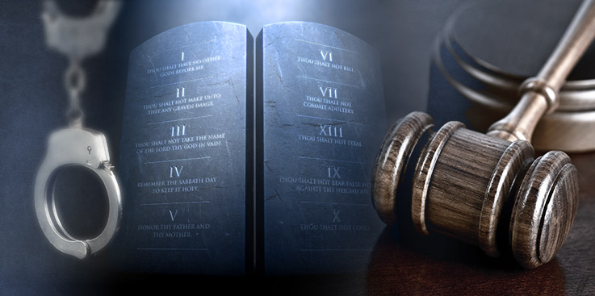
Isaiah 42:21, 24
²¹ The Lord was pleased for His righteousness’ sake To make the law great and glorious.… (cf. Rom. 7:12) ²⁴ Who gave Jacob up for spoil, and Israel to plunderers? Was it not the Lord, against whom we have sinned, And in whose ways they were not willing to walk, And whose law they did not obey?

Slide 24
Session 16 Outline
Review
Purpose, Aim, and Objective
Woe is Me, for I am ruined! (Isaiah 6:1-5)
General Information
Comments and Commentary
Concluding Observations

Slide 25
Isaiah 6:1-5
¹ In the year of King Uzziah’s death I saw the Lord sitting on a throne, lofty and exalted, with the train of His robe filling the temple. ² Seraphim stood above Him, each having six wings: with two he covered his face, and with two he covered his feet, and with two he flew. ³ And one called out to another and said, “Holy, Holy, Holy, is the Lord of hosts, The whole earth is full of His glory.” ⁴ And the foundations of the thresholds trembled at the voice of him who called out, while the temple was filling with smoke. ⁵ Then I said, “Woe is me, for I am ruined! Because I am a man of unclean lips, And I live among a people of unclean lips; For my eyes have seen the King, the Lord of hosts.”

Slide 26
Questions to consider… Isaiah 6:1-5
Law and Grace: Session 16
Coming from the place as God’s own chosen mouthpiece to the people of Israel (Judah), how does Isaiah respond to the realization that he is seeing God?

Slide 27
Questions to consider… Isaiah 6:1-5
Law and Grace: Session 16
As a man who is writing divinely inspired Scripture, how comfortable does Isaiah seem to be with the idea that he is right there in heaven with the one…

Slide 28
Questions to consider… Isaiah 6:1-5
Law and Grace: Session 16
As a man who is writing divinely inspired Scripture, how comfortable does Isaiah seem to be with the idea that he is right there in heaven with the one awesome …

Slide 29
Questions to consider… Isaiah 6:1-5
Law and Grace: Session 16
As a man who is writing divinely inspired Scripture, how comfortable does Isaiah seem to be with the idea that he is right there in heaven with the one awesome holy …

Slide 30
Questions to consider… Isaiah 6:1-5
Law and Grace: Session 16
As a man who is writing divinely inspired Scripture, how comfortable does Isaiah seem to be with the idea that he is right there in heaven with the one awesome holy God?

Slide 31
Questions to consider… Isaiah 6:1-5
Law and Grace: Session 16
Does the Rule of Law equip Isaiah to be in God's presence?

Slide 32
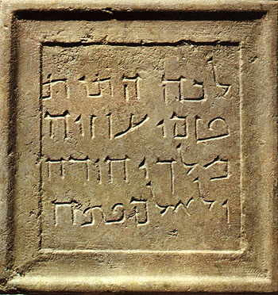
“In the year of King Uzziah's death…” Isaiah 6:1
Law and Grace: Session 16
Isaiah gives us a date and kind of time:
Uzziah has been the most powerful king in Jerusalem since the time of Solomon, almost two centuries before.

Slide 33
“Isaiah” archaeology: Uzziah
Law and Grace: Session 16
A burial plaque was found on the Mount of Olives, located directly across from the Temple Mount, which reads: “Here, the bones of Uzziah, King of Judah, were brought. Do not open.”

Slide 34
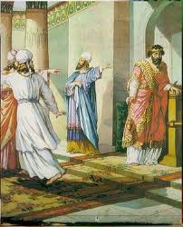
“In the year of King Uzziah's death…” Isaiah 6:1
Law and Grace: Session 16
But King Uzziah, in the last year of his reign 740 B.C., dies a leper because he has become proud, seeking to also be a priest, even though he is not of the tribe of Levi (2 Chron. 26:16-23).

Slide 35
2 Chron. 26:16-21
¹⁶ But when he became strong, his heart was so proud that he acted corruptly, and he was unfaithful to the Lord his God, for he entered the temple of the Lord to burn incense on the altar of incense. ¹⁷ Then Azariah the priest entered after him and with him eighty priests of the Lord, valiant men. ¹⁸ They opposed Uzziah the king and said to him, “It is not for you, Uzziah, to burn incense to the Lord, but for the priests, the sons of Aaron who are consecrated to burn incense. Get out of the sanctuary, for you have been unfaithful and will have no honor from the Lord God.” ¹⁹ But Uzziah, with a . . .

Slide 36
2 Chron. 26:16-21 (cont’d)
…censer in his hand for burning incense, was enraged; and while he was enraged with the priests, the leprosy broke out on his forehead before the priests in the house of the Lord, beside the altar of incense. ²⁰ Azariah the chief priest and all the priests looked at him, and behold, he was leprous on his forehead; and they hurried him out of there, and he himself also hastened to get out because the Lord had smitten him. ²¹ King Uzziah was a leper to the day of his death; and he lived in a separate house, being a leper, for he was cut off from the house of the Lord….

Slide 37
“I saw the Lord…” Isaiah 6:1
Law and Grace: Session 16
Isaiah only briefly describes this vision of Yahweh but he identifies Him first as the sovereign “Lord” (Heb. Adon).
Then Isaiah describes God as seated on His throne, lofty and exalted – His great authority is most awesomely evident.

Slide 38
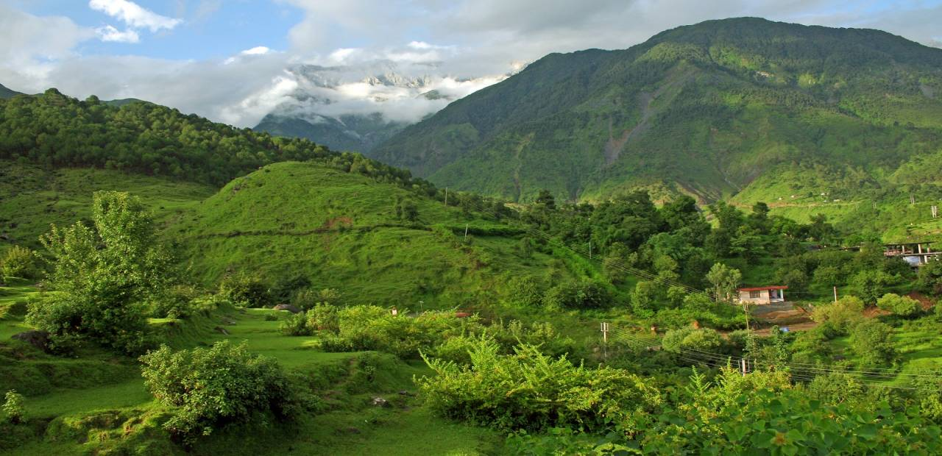
“I saw the Lord…” Isaiah 6:1
Law and Grace: Session 16

Slide 39
“I saw the Lord…” Isaiah 6:1
Law and Grace: Session 16
But Isaiah also says that the ‘train of His robe’ fills the temple with His glory.
God has a filling and majestic presence in the overwhelming heavenly scene, and Isaiah is in the temple in heaven.

Slide 40
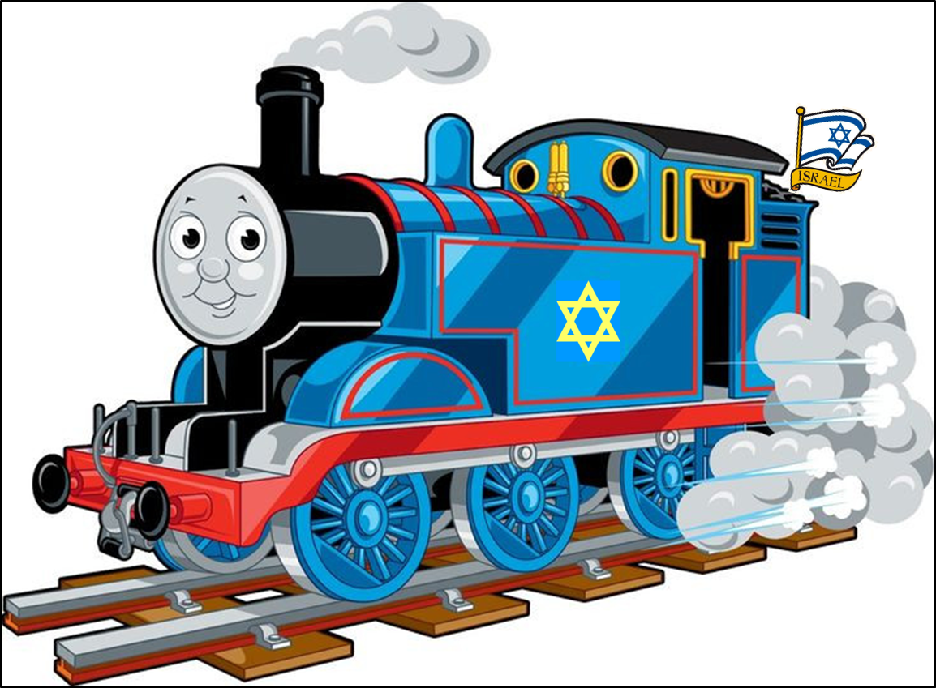
A ‘train’ in Isaiah’s day…
Law and Grace: Session 16

Slide 41
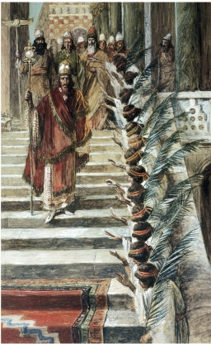
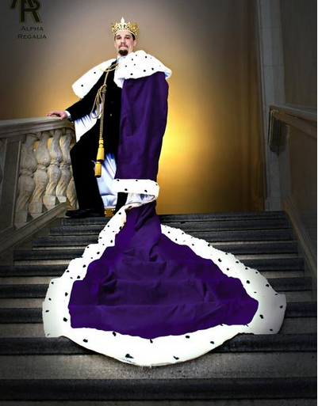
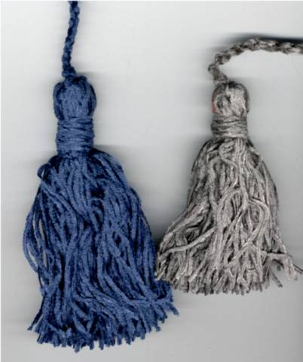
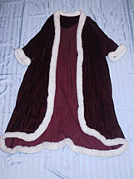
Law and Grace: Session 16
A ‘train’ in Isaiah’s day… Isaiah 6:1
A special train or hem on a robe indicated a position of high honor and respect, such as that of a king or priest (Exodus 28:28-35, 39, especially see 22-26); longer hems, as with long tassels, also meant great and awesome power.

Slide 42
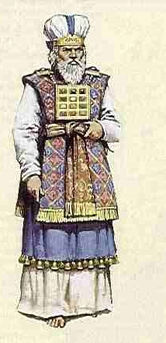
Law and Grace: Session 16
A ‘train’ in Isaiah’s day… Isaiah 6:1
The fact that the train or hem of the Lord’s robe filled the temple with His glory, conveyed the ultimate holiness and the overwhelming power of the Lord.

Slide 43
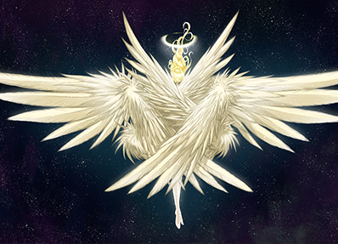
Law and Grace: Session 16
“Seraphim stood above Him…” Isaiah 6:2
‘Seraphim’ is one of a number of classifications of angels found in the Bible.
The English word ‘seraphim’ is a transliteration of the Hebrew word which means, ‘burning ones’.
This is the only clear description of the seraphim in the Bible.

Slide 44
Law and Grace: Session 16
“Seraphim stood above Him…” Isaiah 6:2
Hebrew words that end in “im” indicate plurality, like the English “s”; the singular form of seraphim is seraph.
This seraph is described with having two wings to cover his face, two wings to cover his feet and two wings with which to fly.

Slide 45
Comparison of the Living Beings of Revelation 4 to similar beings from Ezekiel & Isaiah
Living Beings (Rev. 4) | Living Beings (Eze. 1) | Cherubim (Eze. 10) | Seraphim (Isa. 6)
v. 6 midst of & around throne | v. 26 under throne | v. 1 under throne | v. 2 above throne
v. 6 full of eyes before & behind | v. 18 rings full of eyes | v. 12 full of eyes
v. 7 one face each: | v. 6 four faces each: | v. 14 four faces each:
like a lion like an ox (or calf) like a man like an eagle | like a lion like an ox like a man like an eagle | like a lion like a cherub* like a man like an eagle
v. 8 six wings full of eyes within | v. 6 four wings | v. 21 four wings | v. 2 six wings
v. 8 "Holy, holy, holy, Lord God Almighty" |  |  | v. 3 "Holy, holy, holy, Lord of hosts"
v. 8 "which was & is & is to come" |  |  | v. 3 "The whole earth is full of His glory"
 | v. 7 feet straight
 | v. 8 hands under wings
 | v.13 likeness of fire
 | v.16 wheels
* Not as in “baby-like”, but like one of the heavenly creatures called “cherubim”, mentioned in the Bible 27 times in the singular & 67 times in the plural. Adapted from chart by John Fok, Moody Bible Institute student, formerly at http://home.hkstar.com/~johnfok1/

Slide 46
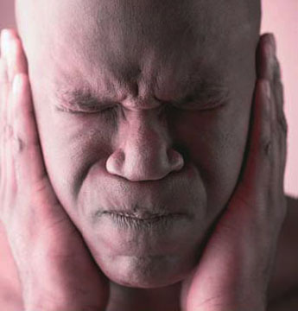
Law and Grace: Session 16
“One called out…” Isaiah 6:3
Literal Hebrew – v. 3 “this one called to this one, and answered…” “The praise of one and then another of the seraphim was so powerful that it shook the heavenly temple to its foundations.” - Constable, T.
What we see in the rest of verses 3-4 is the impact on the heavenly scene from the voice of just the one seraph (see verse 4).

Slide 47
Law and Grace: Session 16
“One called out…” Isaiah 6:3
What is insightful in these two verses is:
What the seraph said, and,
The great magnitude of power with which the one seraph spoke.

Slide 48
Law and Grace: Session 16
“Holy, holy, holy” Isaiah 6:3
So why is it that the seraph doesn’t just say, “Holy” and then move on with it?
HOLY!

Slide 49
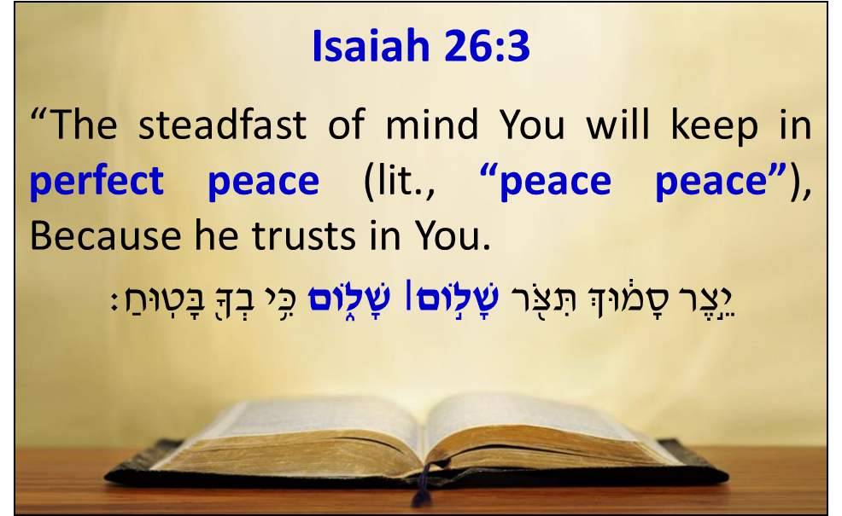
Law and Grace: Session 16
“Holy, holy, holy” Isaiah 6:3
In Hebrew, one way to emphasize something is to say it more than once.

Slide 50
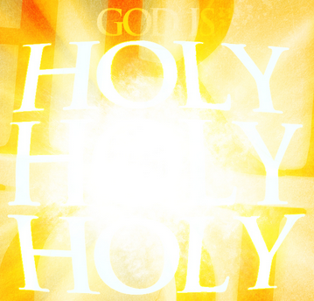
Law and Grace: Session 16
“Holy, holy, holy” Isaiah 6:3
To say something twice was to say it with emphasis, but to say it three times was extraordinary emphasis and ultimate perfection of that quality and character.
So, God is ‘the ultimate’ and unmatched in His quality and magnitude of holiness.

Slide 51
Law and Grace: Session 16
“Holy, holy, holy” Isaiah 6:3
This is the only place in the OT where this phrase “holy, holy, holy,” is used, but it is also used, one time only, in the New Testament, in Revelation 4:8.
In both instances, it is spoken by a six-winged, angelic being in heaven.

Slide 52
Law and Grace: Session 16
“the Lord of hosts” Isaiah 6:3
This title for the Lord NEVER shows up from Genesis through Judges.
However, the prophets, speaking for and from God, wanting their audience to understand who the Lord is use it liberally, 230 times (it is used almost 50 times in Isaiah alone)!

Slide 53
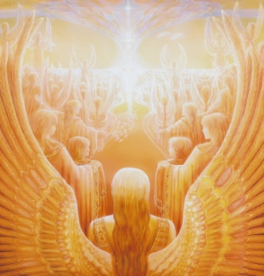
Law and Grace: Session 16
“the Lord of hosts” Isaiah 6:3
The “Lord of hosts”, is the Creator of all the angelic beings who make up the hosts of heaven, and they declare His holiness and do His bidding in heaven and on earth, as He commands it to be done.

Slide 54
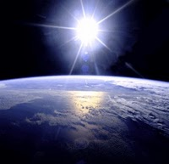
Law and Grace: Session 16
“The whole earth is full of His glory” Isaiah 6:3
Now here we change scenes from heaven to the earth.
This phrase is consistent with the full breadth of God’s eternal purpose…
… to declare and reveal and to share His glory and so to be glorified forever and ever.

Slide 55
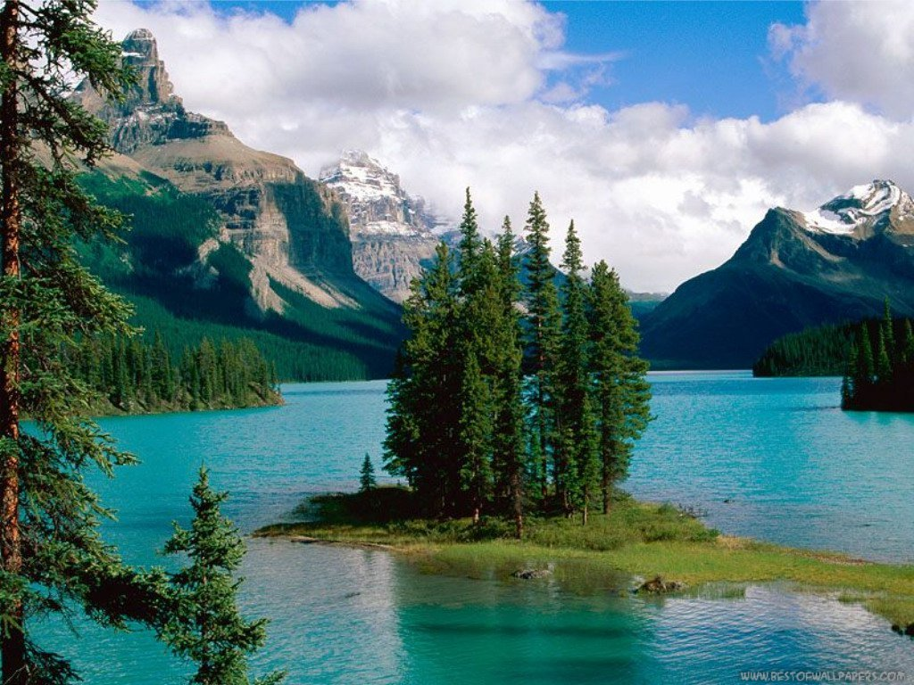
Law and Grace: Session 16
“The whole earth is full of His glory” Isaiah 6:3
In Numbers 14:21 the Lord says, “…all the earth will be filled with the glory of the Lord.”
Glory is the radiant essence of who God is.

Slide 56
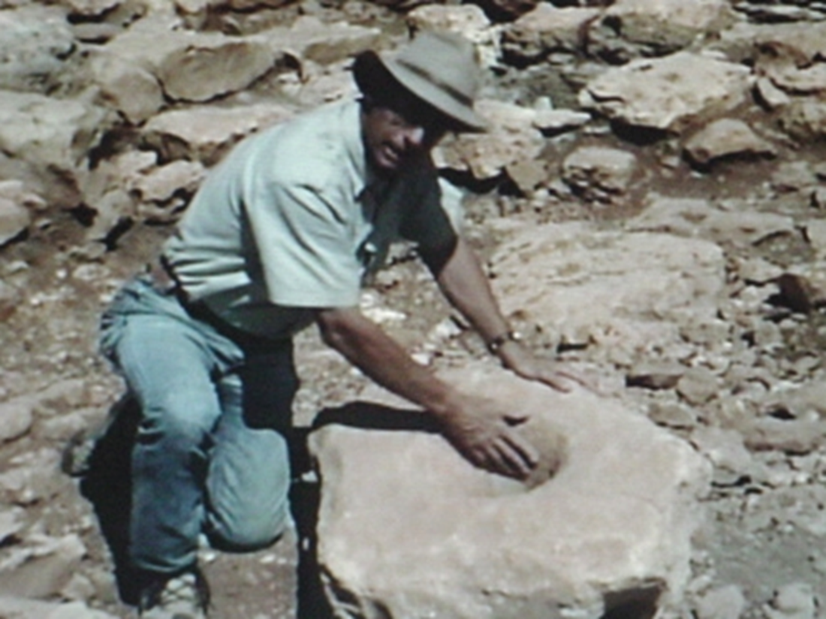
Law and Grace: Session 16
“the foundations of the thresholds trembled” Isaiah 6:4
The Hebrew phrase used here refers to the massive stone gate post and socket assembly used in ancient city gates.
In this instance, the King James Version is closer to the Hebrew text. It says, “the posts of the door moved”.
Dr. Bryant G. Wood showing a gate post base socket found at what is believed to be the City of Ai (Joshua 7 & 8).

Slide 57
Law and Grace: Session 16
“the foundations of the thresholds trembled” Isaiah 6:4
What made these gate post and socket assemblies shake was not the Lord’s voice nor even a group of these seraphim, but just the voice of only one seraph!

Slide 58
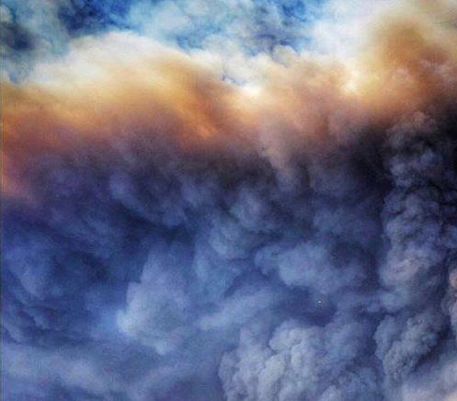
Law and Grace: Session 16
“the temple was filling with smoke” Isaiah 6:4
GLORY

Slide 59
Exodus 40:34–35
³⁴ Then the cloud covered the tent of meeting, and the glory of the LORD filled the tabernacle. ³⁵ Moses was not able to enter the tent of meeting because the cloud had settled on it, and the glory of the LORD filled the tabernacle.
Revelation 15:8
And the temple was filled with smoke from the glory of God and from His power; and no one was able to enter the temple until the seven plagues of the seven angels were finished.

Slide 60
Law and Grace: Session 16
“ISAIAH’S RESPONSE” Isaiah 6:5

Slide 61
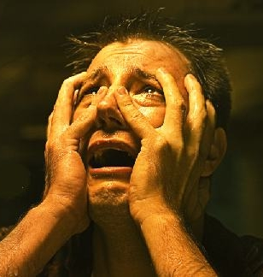
Law and Grace: Session 16
“Woe is me, for I am ruined” Isaiah 6:5
WOE!

Slide 62
Law and Grace: Session 16
“Woe is me, for I am ruined” Isaiah 6:5
This is the first thing that Isaiah observes about himself.
Everything else has been about God and the seraphim and the heavenly realm, but when Isaiah sees who he is, compared to God, he’s ruined!
WOE!

Slide 63
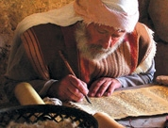
Law and Grace: Session 16
“Woe is me, for I am ruined” Isaiah 6:5
No amount of reading and studying and writing about the Law and no amount of service over the years as God’s mouthpiece prepared Isaiah for this moment.
Isaiah’s character is no match for God’s absolute holiness.
WOE!

Slide 64
Law and Grace: Session 16
“Why the Woe?” Isaiah 6:5
Isaiah had written 6 woes for the people of Judah in chapter 5, but now he applies the 7th woe to himself; the Hebrew word translated “ruined” means to cut off or destroy.
WOE!
WOE!
WOE!
WOE!
WOE!
WOE!
WOE!

Slide 65
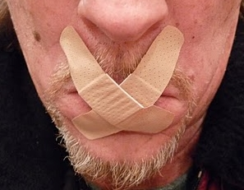
Law and Grace: Session 16
“Why the Woe?” Isaiah 6:5
Isaiah sees himself in terminal trouble (I am ruined!), and he explains why in the next three lines:
“I am a man of unclean lips, and...
“I live among a people of unclean lips”…;
For my eyes have seen the King, the LORD of hosts.”
WOE!

Slide 66
Session 16 Outline
Review
Purpose, Aim, and Objective
Woe is Me, for I am ruined! (Isaiah 6:1-5)
General Information
Comments and Commentary
Concluding Observations

Slide 67
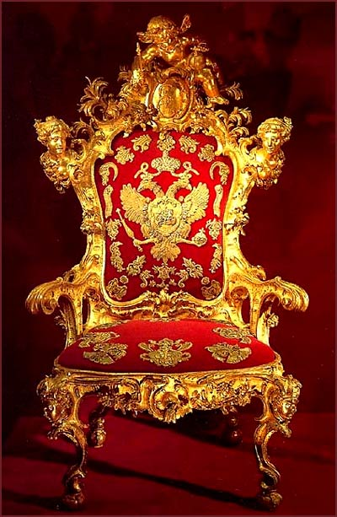
Law and Grace: Session 16
Woe or Wow? Let’s Compare…
The Apostle Paul tells the Ephesian believers that they are seated and enthroned with Christ, who is Himself seated at the right hand of God the Father (Eph. 2:6).
Ephesians 2:4–6
⁴ But God, being rich in mercy, because of His great love with which He loved us, ⁵ …made us alive together with Christ (by grace you have been saved), ⁶ and raised us up with Him, and seated us with Him in the heavenly places in Christ Jesus,

Slide 68
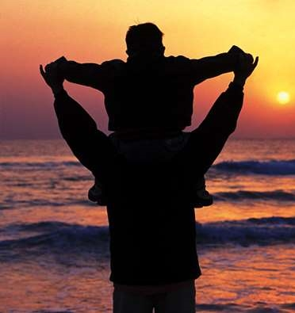
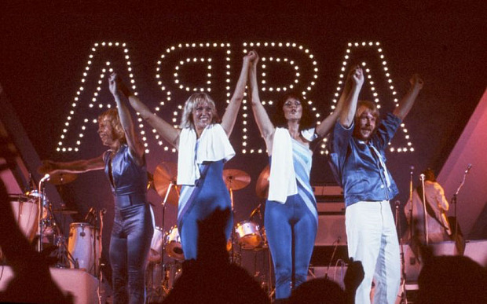
Law and Grace: Session 16
Woe or Wow? Let’s Compare…
The Apostle Paul also tells them that they all have confident access to God the Father (Eph. 2:18; 3:12).
He also says that the believers can approach God as ‘Abba’ (Rom. 8:15; Gal. 4:6).

Slide 69
Ephesians 2:18; 3:12
^{2:18} “for through [Christ] we both have our access in one Spirit to the Father.”… ^{3:12} “in [Christ] we have boldness and confident access through faith in Him.”
Romans 8:15b;
“…you have received a spirit of adoption as sons by which we cry out, “Abba! Father!””
Galatians 4:6
“Because you are sons, God has sent forth the Spirit of His Son into our hearts, crying, “Abba! Father!””

Slide 70
1 John 1:9
If we confess our sins, He is faithful and righteous to forgive us our sins and to cleanse us from all unrighteousness.
1 John 3:21
Beloved, if our heart does not condemn us, we have confidence before God…

Slide 71
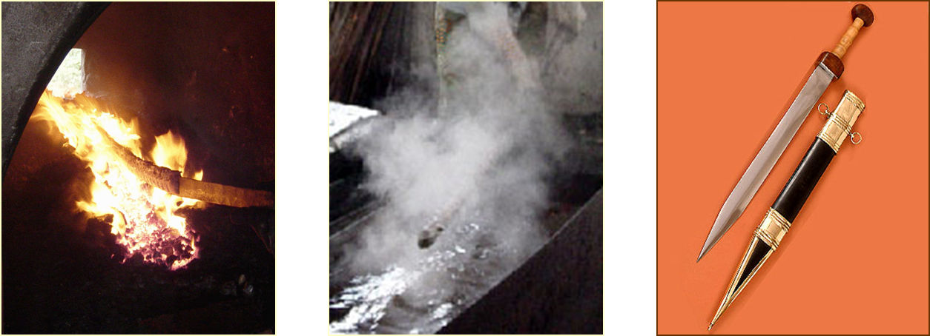
Law and Grace: Session 16
Isaiah was not – we are
Isaiah was not baptized “into Christ” – we are.
Baptized = immersed so as to be radically and permanently changed!

Slide 72
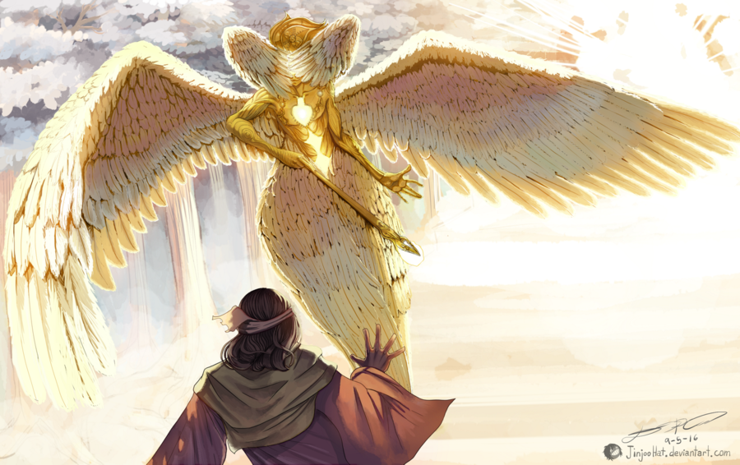
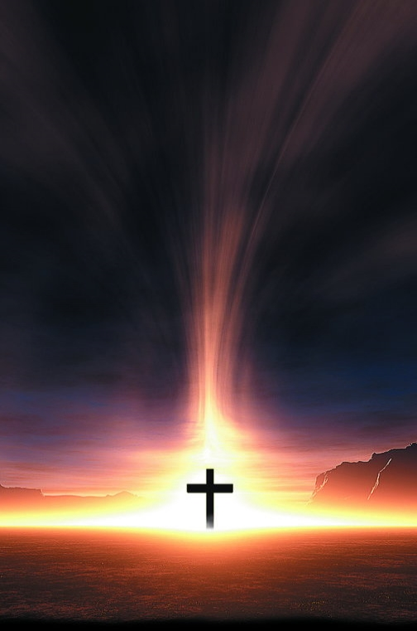
Law and Grace: Session 16
Isaiah was not – we are
Isaiah was truly concerned that He might die – we already truly have.

Slide 73
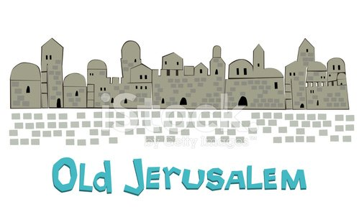
Law and Grace: Session 16
Isaiah was not – we are
Isaiah was not “seated in the heavenlies” – we are!
He was commissioned and sent back to live among his people, the people of Judah, those people with unclean lips that he talked about.

Slide 74
Law and Grace: Session 16
Isaiah was not – we are
When the Apostle Paul talks about our seating with Christ, he speaks of our ‘right now’ positional seating with Christ in the heavenlies.
Ephesians 2:4–6
⁴ But God, being rich in mercy, because of His great love with which He loved us, ⁵ …made us alive together with Christ (by grace you have been saved), ⁶ and raised us up with Him, and seated us with Him in the heavenly places in Christ Jesus,

Slide 75
Law and Grace: Session 16
Isaiah was not – we are
The power and glory and holiness of the Lord, sitting on the throne, lofty and exalted, as conveyed by the robe and the smoke, is the power and glory and holiness that He shares with us who have placed our faith in Him, because we are in Him, seated with Him!

Slide 76
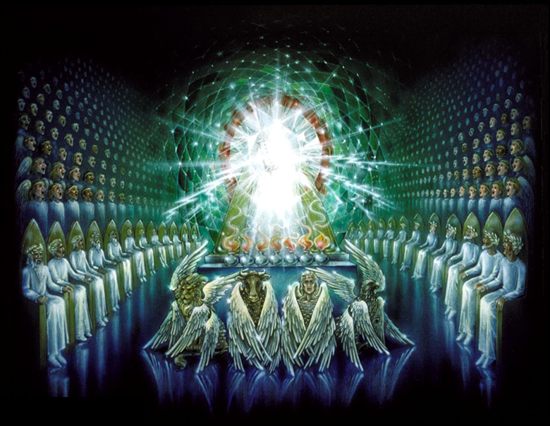
We in the body of Christ
Law and Grace: Session 16
We in the body of Christ, rather than seeing heaven as the place of our undoing, see it as the place of our heart’s home and our citizenship (Phil. 3:20).
Philippians 3:20
For our citizenship is in heaven, from which also we eagerly wait for a Savior, the Lord Jesus Christ;

Slide 77
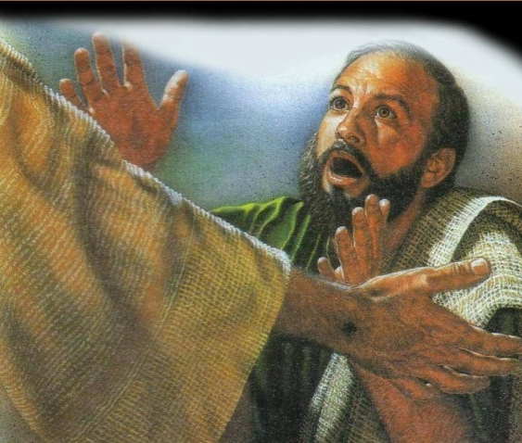
We in the body of Christ
Law and Grace: Session 16
Rather than being aghast at having seen the Lord, we are invited to behold the glory of the Lord even now, until the day when we will see Him (2 Cor. 3:18; 1 John 3:2).

Slide 78
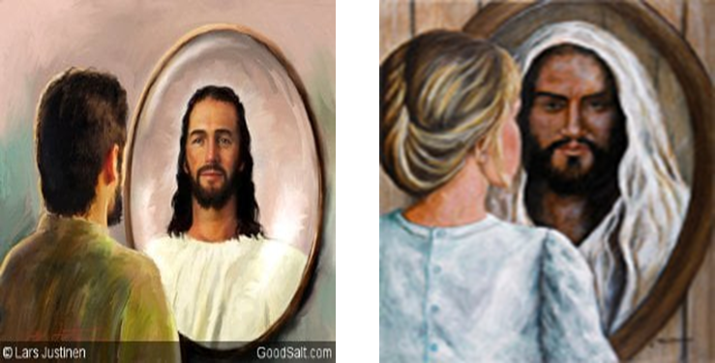
2 Corinthians 3:18
But we all, with unveiled face, beholding as in a mirror the glory of the Lord, are being transformed into the same image from glory to glory, just as from the Lord, the Spirit.

Slide 79
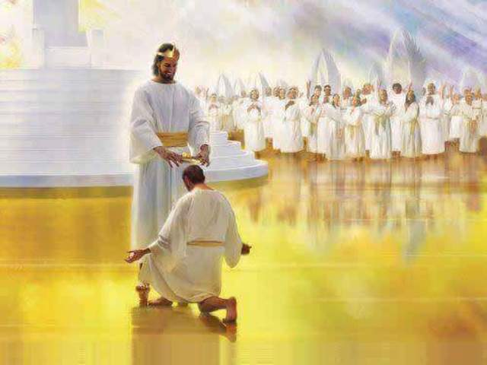
1 John 3:2–3
² Beloved, now we are children of God, and it has not appeared as yet what we will be. We know that when He appears, we will be like Him, because we will see Him just as He is. ³ And everyone who has this hope fixed on Him purifies himself, just as He is pure. .

Slide 80
Law and Grace: An Overview Jim McGowan, Th.D. Sugar Land Bible Church 02-03-2019
…but grace and truth were realized through Jesus Christ - John 1:17
For the Law was given through Moses…
Special thanks to Dr. Vern Peterman for access to his insights and resources.

