Slide 1


Slide 2

The Coming Kingdom
Chapter 17
Dr. Andy Woods
Senior Pastor – Sugar Land Bible Church
President – Chafer Theological Seminary

Slide 3

Kingdom Study Outline
What does the Bible Say About the Kingdom?
The Main Problem with Kingdom Now NT interpretations
Why do some believe that we are in the kingdom now?
Why does it matter?

Slide 4
Response to Kingdom Now Problem Passages
Passages from Christ’s ministry
Passages from Acts
Passages from Paul
Passages from the General letters
Passages from Revelation
Miscellaneous Arguments

Slide 5

2. Is Jesus Now Reigning from David’s Throne?
(Acts 2)
David’s Throne is Earthly
A Davidic heavenly Throne changes its original meaning
No NT verse places Jesus currently of David’s Throne
The Davidic Throne comes into existence only after the Times of the Gentiles have run their course
A present Davidic Throne misunderstands the mystery nature of the Church
A present Davidic Throne misunderstands the parenthetical nature of the Church

Slide 6
2. Is Jesus Now Reigning from David’s Throne?
(Acts 2)
David’s Throne is Earthly
A Davidic heavenly Throne changes its original meaning
No NT verse places Jesus currently of David’s Throne
The Davidic Throne comes into existence only after the Times of the Gentiles have run their course
A present Davidic Throne misunderstands the mystery nature of the Church
A present Davidic Throne misunderstands the parenthetical nature of the Church

Slide 7


1 Kings 2:11-12
“The days that David reigned over Israel were forty years: seven years he reigned in Hebron and thirty-three years he reigned in Jerusalem. And Solomon sat on the throne of David his father, and his kingdom was firmly established.”

Slide 8
2. Is Jesus Now Reigning from David’s Throne?
(Acts 2)
David’s Throne is Earthly
A Davidic heavenly Throne changes its original meaning
No NT verse places Jesus currently of David’s Throne
The Davidic Throne comes into existence only after the Times of the Gentiles have run their course
A present Davidic Throne misunderstands the mystery nature of the Church
A present Davidic Throne misunderstands the parenthetical nature of the Church

Slide 9
Changes | Biblical Davidic Throne | Davidic Throne Now?
Place: | Earth | Heaven
People: | Israel | Gentile Church
Israel: | Converted | Unconverted

Slide 10
2. Is Jesus Now Reigning from David’s Throne?
(Acts 2)
David’s Throne is Earthly
A Davidic heavenly Throne changes its original meaning
No NT verse places Jesus currently of David’s Throne
The Davidic Throne comes into existence only after the Times of the Gentiles have run their course
A present Davidic Throne misunderstands the mystery nature of the Church
A present Davidic Throne misunderstands the parenthetical nature of the Church

Slide 11

Acts 2:30
“And so, because he was a prophet and knew that God had sworn to him with an oath to seat one of his descendants on his throne.”

Slide 12
Acts 2:34-35
“For it was not David who ascended into heaven, but he himself says: ‘The Lord said to my Lord, “Sit at My right hand, Until I make Your enemies a footstool for Your feet.’”

Slide 13

E.R. Craven
“Excursus on the Basileia,” in Revelation of John, J. P. Lange (New York: Scribner, 1874), 97.
“It is assumed by many that the exaltation of ver. 33 constitutes the session on the throne of David of ver. 30. But the assumption is wholly gratuitous. Nowhere in his sermon did the apostle declare the oneness of the two events; and most certainly the exaltation there spoken of does not imply the session as already existing—it may be an exaltation begun, to culminate in a visible occupancy of the throne of David. (The visible establishment by an emperor of the seat of his government in the heart of a once revolted province, does not derogate from his dignity—does not imply an abdication of government in the rest of his empire.).”

Slide 14
E.R. Craven
“Excursus on the Basileia,” in Revelation of John, J. P. Lange (New York: Scribner, 1874), 97.
“But beyond this, not only is the assumption gratuitous; it is against probabilities that amount to certainty. The apostle, be it remembered, was arguing with Jews, to prove that the absent Jesus was the Messiah (ver. 36); he was arguing with those, one of whose most cherished beliefs it was that the Messiah should occupy a visible throne. To suppose that, under such circumstances, he should advance a doctrine at war with this belief without a word of explanation or proof, and that too in a sentence capable of an interpretation consistent therewith, is inconceivable.”

Slide 15
E.R. Craven
“Excursus on the Basileia,” in Revelation of John, J. P. Lange (New York: Scribner, 1874), 97.
“The interpretation suggested by the writer is confirmed not only by its consistency with the previous teachings of our Lord, but by the address delivered by the Apostle Peter shortly after, Acts 3:19, 20. The literal translation of the passage referred to is as follows. . . . “Repent ye, therefore, and be converted, that your sins may be blotted out, in order that the times of refreshing may come from the presence of the Lord, and that He may send the Messiah Jesus, who was appointed unto you, whom the heavens must receive until the times of the restitution of all things,” etc. It is also confirmed by the subsequent teachings of the apostle in his epistles; comp. 1 Peter 1:4–7, 13; 2 Peter 1:11, 16; the kleronomia and apokalypsis of the I Epistle are manifestly synonymous with the basileia and parousia of the II.”

Slide 16
1 Peter 1:4-7, 13
“⁴ to obtain an inheritance which is imperishable and undefiled and will not fade away, reserved in heaven for you, ⁵ who are protected by the power of God through faith for a salvation ready to be revealed in the last time. ⁶ In this you greatly rejoice, even though now for a little while, if necessary, you have been distressed by various trials, ⁷ so that the proof of your faith, being more precious than gold which is . . .

Slide 17
1 Peter 1:4-7, 13
. . . perishable, even though tested by fire, may be found to result in praise and glory and honor at the revelation of Jesus Christ…¹³ Therefore, prepare your minds for action, keep sober in spirit, fix your hope completely on the grace to be brought to you at the revelation of Jesus Christ.”

Slide 18
Colossians 1:12-13
“¹² giving thanks to the Father, who has qualified us to share in the inheritance of the saints in Light. ¹³ For He rescued us from the domain of darkness, and transferred us to the kingdom of His beloved Son.”

Slide 19
2 Peter 1:11, 16
“¹¹ for in this way the entrance into the eternal kingdom of our Lord and Savior Jesus Christ will be abundantly supplied to you…¹⁶ For we did not follow cleverly devised tales when we made known to you the power and coming of our Lord Jesus Christ, but we were eyewitnesses of His majesty.”

Slide 20
Acts 3:19-21
“¹⁹ Therefore repent and return, so that your sins may be wiped away, in order that times of refreshing may come from the presence of the Lord; ²⁰ and that He may send Jesus, the Christ appointed for you,²¹ whom heaven must receive until the period of restoration of all things about which God spoke by the mouth of His holy prophets from ancient time.”

Slide 21
Acts 3:19-21
“¹⁹ Therefore repent and return, so that your sins may be wiped away, in order that [hopōs] times [kairos] of refreshing may come [erchomai] from the presence of the Lord; ²⁰ and [kai] that He may send [apostellō] Jesus, the Christ appointed for you,²¹ whom heaven must receive until the period [chronos] of restoration of all things about which God spoke by the mouth of His holy prophets from ancient time.”

Slide 22

Acts 3:19-21
Stanley D. Toussaint and Jay A. Quine, “No, Not Yet: The Contingency of God’s Promised Kingdom,” Bibliotheca Sacra 164 (April–June 2007): 138, 144.
“The two clauses that follow ὅπως go together. In other words the clause ‘that the times of refreshing may come from the presence of the Lord’ must be taken with the words ‘and that He may send Jesus.’ As Haenchen puts it, ‘The two promises are complementary statements about one and the same event.’ Nothing grammatically separates the promises; in fact they are joined together by the connective καὶ. The noun ἄναψύξεως, translated “refreshing,” is a New Testament hapax legomenon. It is used in Greek literature in various forms to refer to ‘cooling by blowing, refreshing, relieving, resting.’ It occurs in the Septuagint only in Exodus (Eng., 8:15; lxx, v. 11), where it refers to relief from the plague of frogs.”

Slide 23
Acts 3:19-21
Stanley D. Toussaint and Jay A. Quine, “No, Not Yet: The Contingency of God’s Promised Kingdom,” Bibliotheca Sacra 164 (April–June 2007): 138, 141.
“Schweizer correctly observes, ‘The context makes sense only if the ‘times of refreshing’ are the definitive age of salvation. The expression is undoubtedly apocalyptic in origin. . . . The reference, then, is to the eschatological redemption which is promised to Israel if it repents.’ Furthermore the plural καιροὶ, ‘times,’ in Acts 3:19, parallels the plural noun χρονῶν, ‘seasons’ or ‘times,’ in verse 21 (which is translated ‘period’ in the nasb). The two terms refer to the same era, and the plural forms simply emphasize duration. The context makes it clear that the synonyms refer to the future kingdom, with καιροὶ emphasizing the quality of time and χρονῶν emphasizing the duration of the time.”

Slide 24
Acts 3:19-21
John A. McLean, “Did Jesus Correct the Disciples’ View of the Kingdom?,” Bibliotheca Sacra 151, no. 602 (April–June 1994): 223–25.
“Bock argues for two separate time periods for these events in support of his ‘already, not yet’ view on the Davidic kingdom. He says the ‘periods of refreshing’ refer to the present time when sins can be wiped away through repentance, and that the ‘times of restoration of all things’ refers to the millennium. ‘Among the points in support of this distinction is that in the LXX translation by Symmachus, a reference to the descent of the Spirit in Isaiah 32:15 uses the term ἀνάψυξις (refreshment), a term related to the one in Acts 3:20.’ However, the context of Isaiah 32:15 refers to millennial blessings to national Israel, a fact that supports the single-stage restoration view, not a two-phase ‘already, not…

Slide 25
Acts 3:19-21
John A. McLean, “Did Jesus Correct the Disciples’ View of the Kingdom?,” Bibliotheca Sacra 151, no. 602 (April–June 1994): 223–25.
…yet’ restoration. Walker suggests a two-stage restoration in Acts 3:19–21. He, like Bock, maintains that the καιροὶ ἀναψύξεως (‘times of refreshing’) relates to special experiences of grace and blessing in this age, whereas the χρόνων ἀποκαταστάσεως (‘period of restoration’) in verse 21 refers to the climactic age of blessings for the nation of Israel in fulfillment of Old Testament messianic promises. . . .” “The main weakness in dividing these two events into separate time periods is that the text connects the events with a coordinating και (‘and’) in Acts 3:20. The syntactical structure coordinates the two verbs ἔλθωσιν (‘come,’ v. 19) and ἀποστείλῃ (‘send’) of the subordinate clause ὅπως ἂν in . . .

Slide 26
Acts 3:19-21
John A. McLean, “Did Jesus Correct the Disciples’ View of the Kingdom?,” Bibliotheca Sacra 151, no. 602 (April–June 1994): 223–25.
…verse 20 with the two main verbs μετανοήσατε (‘repent’) and ἐπιστρέψατε (‘return’) in verse 19. Repentance and turning to God result in the coming of the times of refreshing and the sending of Jesus Christ at the restoration of all things God spoke about in the prophets. The sending of Jesus Christ will provide the personal presence that will result in the times of refreshing. These results are not events separated by time. They are mutual benefits that will come when the Father sends the Son so that believers may be refreshed in His presence. Conzelmann argues that ‘the parallelism between the two halves of the verse shows that the καιροὶ ἀναψύξεως, ‘times of refreshing,’ are not intervals of respite…

Slide 27
Acts 3:19-21
John A. McLean, “Did Jesus Correct the Disciples’ View of the Kingdom?,” Bibliotheca Sacra 151, no. 602 (April–June 1994): 223–25.
…in the eschatological distress, but rather the final salvation (like the χρόνοι ἀποκαταστάσεως, ‘restoration’).” “The main weakness in dividing these two events into separate time periods is that the text connects the events with a coordinating και (‘and’) in Acts 3:20. The syntactical structure coordinates the two verbs ἔλθωσιν (‘come,’ v. 19) and ἀποστείλῃ (‘send’) of the subordinate clause ὅπως ἂν in verse 20 with the two main verbs μετανοήσατε (‘repent’) and ἐπιστρέψατε (‘return’) in verse 19. Repentance and turning to God result in the coming of the times of refreshing and the sending of Jesus Christ at the restoration of all things God spoke about in the prophets. The sending of Jesus Christ will…

Slide 28
Acts 3:19-21
John A. McLean, “Did Jesus Correct the Disciples’ View of the Kingdom?,” Bibliotheca Sacra 151, no. 602 (April–June 1994): 223–25.
… provide the personal presence that will result in the times of refreshing. These results are not events separated by time. They are mutual benefits that will come when the Father sends the Son so that believers may be refreshed in His presence. Conzelmann argues that ‘the parallelism between the two halves of the verse shows that the καιροὶ ἀναψύξεως, ‘times of refreshing,’ are not intervals of respite in the eschatological distress, but rather the final salvation (like the χρόνοι ἀποκαταστάσεως, ‘restoration’).”

Slide 29

Christ’s Three Offices
Prophet – 1st Coming (Matt. 4:17)
Priest – Present Session (Heb. 4:15)
King – 2nd Coming (Isa. 9:6-7; Matt. 25:31)

Slide 30
Hebrews 10:12-13
“¹² but He, having offered one sacrifice for sins for all time, sat down at the right hand of God, ¹³ waiting from that time onward until His enemies be made a footstool for His feet.”

Slide 31
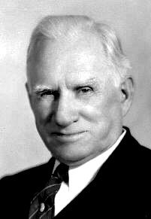
William Newell
The Book of the Revelation (Chicago: Moody, 1935), 82.
“Our Lord is not now on His own throne, the throne of David. He is at the Father’s right hand, on the Father’s throne, and is now the Great High Priest, leading the worship of His saints; and also our Advocate against the enemy. But He is there in an expectant attitude.”

Slide 32
Hebrews 7:3
“Without father, without mother, without genealogy, having neither beginning of days nor end of life, but made like the Son of God, he remains a priest perpetually.”

Slide 33
Hebrews 6:20
“where Jesus has entered as a forerunner for us, having become a high priest forever according to the order of Melchizedek.”

Slide 34

John F. Walvoord
John F. Walvoord, The Millennial Kingdom (Findlay, OH: Dunham, 1959), 203.
“The New Testament has fifty-nine references to David. It also has many references to the present session of Christ. A search of the New Testament reveals that there is not one reference connecting the present session of Christ with the Davidic throne. While this argument is, of course, not conclusive, it is almost incredible that in so many references to David and in so frequent reference to the present session of Christ on the Father’s throne there should be not one reference connecting the two in any authoritative way. The New Testament is totally lacking in positive teaching that the throne of the Father in heaven is to be identified with the Davidic throne. The inference is plain that Christ is seated on the Father’s throne, but that this is not at all the same as being seated on the throne of David.”

Slide 35
2. Is Jesus Now Reigning from David’s Throne?
(Acts 2)
David’s Throne is Earthly
A Davidic heavenly Throne changes its original meaning
No NT verse places Jesus currently of David’s Throne
The Davidic Throne comes into existence only after the Times of the Gentiles have run their course
A present Davidic Throne misunderstands the mystery nature of the Church
A present Davidic Throne misunderstands the parenthetical nature of the Church

Slide 36


Statue
&
Stone

Slide 37

CHART1

Slide 38

J. Dwight Pentecost
"Daniel,” in Bible Knowledge Commentary, Old Testament, ed. John F. Walvoord and Roy B. Zuck (Colorado Springs, CO: Chariot Victor, 1985), 1336.
“Amillennialists hold that this kingdom was established by Christ at His First Advent and that now the church is that kingdom. They argue that: (a) Christianity, like the growing mountain, began to grow and spread geographically and is still doing so; (b) Christ came in the days of the Roman Empire; (c) the Roman Empire fell into the hands of 10 kingdoms (10 toes); (d) Christ is the chief Cornerstone (Eph. 2:20). Premillenarians, however, hold that the kingdom to be established by Christ on earth is yet future. At least six points favor that view: (1) The stone will become a mountain suddenly, not gradually. Christianity did not suddenly fill “the whole earth” (Dan. 2:35) at Christ’s First Advent. (2) Though Christ came in the days of the Roman Empire, He did not destroy it. (3) During Christ’s time on earth the Roman Empire did not have 10 kings at once.”

Slide 39
J. Dwight Pentecost
"Daniel,” in Bible Knowledge Commentary, Old Testament, ed. John F. Walvoord and Roy B. Zuck (Colorado Springs, CO: Chariot Victor, 1985), 1336.
“Yet Nebuchadnezzar’s statue suggests that when Christ comes to establish His kingdom, 10 rulers will be in existence and will be destroyed by Him. (4) Though Christ is now the chief Cornerstone to the church (Eph. 2:20) and “a stone that causes [unbelievers] to stumble” (1 Peter 2:8), He is not yet a smiting Stone as He will be when He comes again. (5) The Stone (Messiah) will crush and end all the kingdoms of the world. But the church has not and will not conquer the world’s kingdoms. (6) The church is not a kingdom with a political realm, but the future Millennium will be. Thus Nebuchadnezzar’s dream clearly teaches premillennialism, that Christ will return to earth to establish His rule on the earth, thereby subduing all nations. The church is not that kingdom.”

Slide 40
2. Is Jesus Now Reigning from David’s Throne?
(Acts 2)
David’s Throne is Earthly
A Davidic heavenly Throne changes its original meaning
No NT verse places Jesus currently of David’s Throne
The Davidic Throne comes into existence only after the Times of the Gentiles have run their course
A present Davidic Throne misunderstands the mystery nature of the Church
A present Davidic Throne misunderstands the parenthetical nature of the Church

Slide 41

Ephesians 2:14-16
“¹⁴ For He Himself is our peace, who made both groups into one and broke down the barrier of the dividing wall, ¹⁵ by abolishing in His flesh the enmity, which is the Law of commandments contained in ordinances, so that in Himself He might make the two into one new man, thus establishing peace, ¹⁶ and might reconcile them both in one body to God through the cross, by it having put to death the enmity.”

Slide 42
Ephesians 3:3-6
“that by revelation there was made known to me the mystery, as I wrote before in brief. ⁴ By referring to this, when you read you can understand my insight into the mystery of Christ, ⁵ which in other generations was not made known to the sons of men, as it has now been revealed to His holy apostles and prophets in the Spirit; ⁶ to be specific, that the Gentiles are fellow heirs and fellow members of the body, and fellow partakers of the promise in Christ Jesus through the gospel”.

Slide 43

Ephesians 3:9
“and to bring to light what is the administration of the mystery which for ages has been hidden in God who created all things.”

Slide 44

Colossians 1:26
“that is, the mystery which has been hidden from the past ages and generations, but has now been manifested to His.”

Slide 45
“Mystery” Defined
“In the N.T, it [mystērion] denotes, not the mysterious (as with the Eng. word), but that which, being outside the range of unassisted natural apprehension, can be made known only by Divine revelation, and is made known in a manner and at a time appointed by God, and to those who are illumined by His Spirit.”
W. E. Vine, Merrill F. Unger, and William White, Vine's Complete Expository Dictionary of the Old and New Testament Words (Nashville: Nelson, 1996), 424.

Slide 46

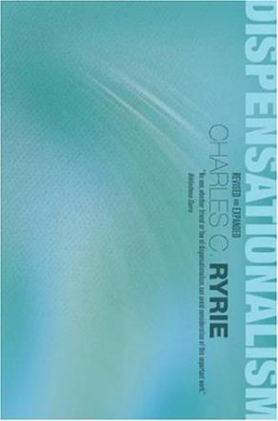
Charles Ryrie
Ryrie, Dispensationalism, 134
Ryrie presents a word study from both the biblical and extra-biblical material and concludes “that the mystery of the equality of Jews and Gentiles in the one body of Christ was unknown and unrevealed in the Old Testament.”

Slide 47
2. Is Jesus Now Reigning from David’s Throne?
(Acts 2)
David’s Throne is Earthly
A Davidic heavenly Throne changes its original meaning
No NT verse places Jesus currently of David’s Throne
The Davidic Throne comes into existence only after the Times of the Gentiles have run their course
A present Davidic Throne misunderstands the mystery nature of the Church
A present Davidic Throne misunderstands the parenthetical nature of the Church

Slide 48

Lewis Sperry Chafer
vol. 4, Systematic Theology (Grand Rapids, MI: Kregel Publications, 1993), 41.
“In fact, the new, hitherto unrevealed purpose of God in the out calling of a heavenly people from Jews and Gentiles is so divergent with respect to the divine purpose toward Israel, which purpose preceded it and will yet follow it, that the term parenthetical, commonly employed to describe the new age purpose, is inaccurate. A parenthetical portion sustains some direct and indirect relation to that which goes before or that which follows; but the present age-purpose is not thus related and therefore is more properly termed an intercalation. The appropriateness of this word will . . .

Slide 49
Lewis Sperry Chafer
vol. 4, Systematic Theology (Grand Rapids, MI: Kregel Publications, 1993), 41.
. . . be seen in the fact that, as an interpolation is formed by inserting a word or phrase into a context, so when intercalation is formed by introducing a day or a period of time into the calendar. The present age of the church is an intercalation into the revealed calendar or program of God as that program was foreseen by the prophets of old. Such, indeed, is the precise character of the present age.”

Slide 50
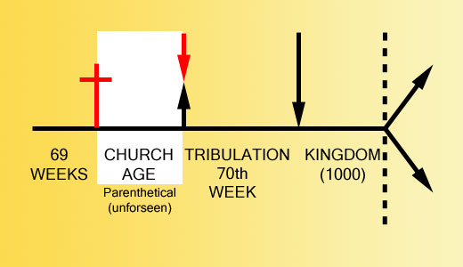

Slide 51
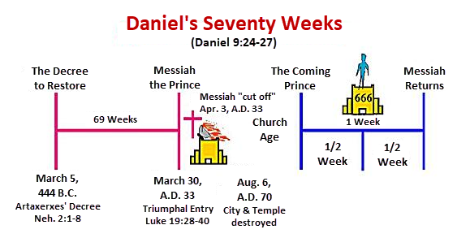

Slide 52
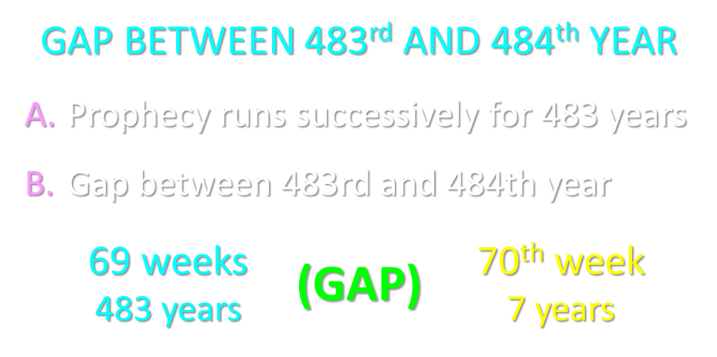

Slide 53
2. Is Jesus Now Reigning from David’s Throne?
(Acts 2)
David’s Throne is Earthly
A Davidic heavenly Throne changes its original meaning
No NT verse places Jesus currently of David’s Throne
The Davidic Throne comes into existence only after the Times of the Gentiles have run their course
A present Davidic Throne misunderstands the mystery nature of the Church
A present Davidic Throne misunderstands the parenthetical nature of the Church

Slide 54

Stephen Nichols
“The Dispensational View of the Davidic Kingdom: A Response to Progressive Dispensationalism,” in The Master’s Perspective on Biblical Prophecy, ed. Richard L. Mayue and Robert L. Thomas, Master’s Perspective Series (Grand Rapids: Kregel, 2002), 54.
“Although the progressive dispensationalists are careful to express their commitment to a future for ethnic Israel and a future, literal fulfillment of Israel’s covenant promise, these views concerning the inaugural fulfillment of Old Testament promise, especially that of the Davidic covenant, and the redefining of the present form of the church mark an aberration from normative dispensationalism. The consistently held offer, rejection, postponement, and fully future fulfillment of the Davidic kingdom is absent from their teaching.”

Slide 55
Stephen Nichols
“The Dispensational View of the Kingdom: A Response to Progressive Dispensationalism,” The Master’s Seminary Journal 7 (Fall 1996): 238.
“From the perspective of dispensational tradition, the current landscape of progressive dispensationalists appears to be a different terrain. The view of the offer, rejection, postponement, and fully future fulfillment of the Davidic kingdom and the corollary view of the church as something different and distinct is and has been the consistent view of normative dispensationalism. By viewing the present form of the church as an inaugural stage of the Davidic kingdom with Christ seated on the Davidic throne in heaven, the progressive dispensational position has distanced itself from this distinguishing feature of dispensationalism. The distinguishing feature of dispensationalism, i.e., the consistent distinction between Israel and the church, is all but absent. Consequently, the legitimacy of calling PD part of the dispensational tradition is questionable.”

Slide 56
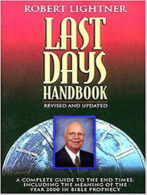
Is Jesus Now Reigning on David’s Throne?
“Many who are classic dispensationalists—and even those who are not dispensationalists at all—question why those who no longer believe in the foundational essentials of dispensationalism still want to be part of the dispensationalism family. This is truly something not yet revealed.”
Robert Lightner, Last Days Handbook (Nashville: Thomas Nelson, 1997), 211.

Slide 57
Is Jesus Now Reigning on David’s Throne?
“The term used by those who still wish to be called dispensationalists but who do not believe some of the basic essentials of dispensationalism. They do not believe God has a program for Israel and one for the church. They believe that Christ is presently on the throne of David in heaven and the Davidic kingdom is being fulfilled now in part.”
Robert Lightner, Last Days Handbook (Nashville: Thomas Nelson, 1997), 233.

Slide 58

Robert Lightner
“Progressive Dispensationalism,” Conservative Theological Journal 4, no. 11 (March 2000): 47–49, 54.
“Progressives are very set on finding various periods within the history of dispensationalism where there have been changes made or developments. They like to talk about the initial period. They like to talk about the classical period and the essentialist or revised period. I personally do not wish to get involved in that kind of breakdown of category. I do not think that is genuine at all. I think that this is an attempt to pave the way for their defense of their own system. What they’re really wanting to say is that since dispensationalism has changed from year to year or decade to decade, why get so excited about this new change that we are introducing?”

Slide 59
Robert Lightner
“Progressive Dispensationalism,” Conservative Theological Journal 4, no. 11 (March 2000): 47–49, 54.
“Our change is just like the other changes. Dispensationalism has always had various people believing certain things about it within dispensationalism. There has been change; therefore, this is just another one of those changes. However, I do not believe the changes are the same at all. To be sure, dispensationalists have always differed, Dr. Walvoord differs at points with Dr. Chafer, Dr. Chafer differs at points with Dr. Ryrie, Dr. Ryrie with Dr. Pentecost, but the core beliefs of dispensationalism have not changed since Darby.”

Slide 60
Robert Lightner
“Progressive Dispensationalism,” Conservative Theological Journal 4, no. 11 (March 2000): 47–49, 54.
“The core beliefs involved are what Ryrie calls the “sine qua non,” which simply means the most essential, bedrock, bases for dispensationalism. First, Ryrie proposed that the sine qua non, the least common denominator, the most basic beliefs, involve distinction between God’s program with Israel and His program with the Church. The first distinction is one part of the sine qua non. A second would be that the view of the distinction between those two programs is based on a literal hermeneutic consistently applied to Scripture.”

Slide 61
Robert Lightner
“Progressive Dispensationalism,” Conservative Theological Journal 4, no. 11 (March 2000): 47–49, 54.
“The third sine qua non is that God has introduced these various economies—dispensations—in the history of time so as to bring the most glory to Himself. God’s major purpose in the world as He implements His sovereign plan is to bring glory to Himself. Certainly, there are other purposes but dispensationalists have always believed the overriding one is for God to bring glory to Himself. In progressive dispensationalism all three of these basic essentials, which Ryrie pointed out and that have been believed from the beginning of the dispensational emphasis, have been rejected.”

Slide 62
Robert Lightner
“Progressive Dispensationalism,” Conservative Theological Journal 4, no. 11 (March 2000): 47–49, 54.
“At least two of them, have been categorically rejected. Namely, a distinction between God’s program for Israel and the Church has been blurred, and the concept of a literal, consistent, interpretation has been replaced by a complementary hermeneutic. The third has been rejected, the glory of God as the primary purpose of God. It has been replaced by a Christological salvific purpose. The salvation of sinners has been the primary purpose of God, progressives say. So it is a salvific purpose rather than a doxological, glory to God purpose that includes salvation.”

Slide 63
Robert Lightner
“Progressive Dispensationalism,” Conservative Theological Journal 4, no. 11 (March 2000): 47–49, 54.
“I think that progressive dispensationalists have made this classification of initial, classical, and essential in order to simply argue that there have been these spurts of growth, development, and change; therefore, their view is just another one. I want to categorically reject that thesis because I think there is a world of difference between various differences within the system and altering the foundation of the system. I liken the three essentials, or sine qua non, as the foundation upon which dispensationalism rests. You can’t be a dispensationalist without these essentials, in my opinion.”

Slide 64
Robert Lightner
“Progressive Dispensationalism,” Conservative Theological Journal 4, no. 11 (March 2000): 47–49, 54.
“The other changes, the differences between how to interpret the New Covenant, for example, and whether or not the Tribulation is another dispensation or a thousand other things such as that, I liken to moving furniture around a room. It doesn’t affect the system. In fact, it’s healthy to have differences as to where this piece of furniture belongs and that one, and you may get tired of it being this way, so you shift it. That doesn’t affect the structure of the house. But the dispensational house is built upon the foundation of the three essentials I just named, and progressive dispensationalism is attacking these essentials.”

Slide 65
Robert Lightner
“Progressive Dispensationalism,” Conservative Theological Journal 4, no. 11 (March 2000): 47–49, 54.
“That is a world of difference between any change, any development that has ever taken place since Darby. So, it’s not fair, it’s a misrepresentation to say that here’s another development just like all the other ones. No, it is not like all the other ones. It is drastically different from all the other ones because it attacks the foundation upon which the system has been built. That is different from moving the furniture around to different places in the dispensational house, or to carry it through more literally the household, the economy, the stewardship. . . . I am not manufacturing these doctrines. These are the core beliefs of progressive dispensationalism and are at great variance with normative dispensationalism.”

Slide 66
2. Is Jesus Now Reigning from David’s Throne?
(Acts 2)
David’s Throne is Earthly
A Davidic heavenly Throne changes its original meaning
No NT verse places Jesus currently of David’s Throne
The Davidic Throne comes into existence only after the Times of the Gentiles have run their course
A present Davidic Throne misunderstands the mystery nature of the Church
A present Davidic Throne misunderstands the parenthetical nature of the Church

Slide 67
CONCLUSION

Slide 68
Response to Kingdom Now Problem Passages
Passages from Christ’s ministry
Passages from Acts
Passages from Paul
Passages from the General letters
Passages from Revelation
Miscellaneous Arguments

