Slide 1
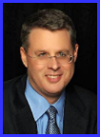
Dr. Andy Woods
Senior Pastor – Sugar Land Bible Church
President – Chafer Theological Seminary

Slide 3
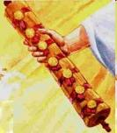
1st Six Seals (Revelation 6)
6:1-2 – Advent of antichrist
6:3-4 – War
6:5-6 – Famine
6:7-8 – Death
6:9-11 – Martyrdoms
6:12-17 – Cosmic disturbances

Slide 4
5 Non-Chronological Parenthetical Insertions
Rev 7-144,000 Jews
Rev 10:1–11:14-Announcement of no more delay and the two witnesses
Rev 12–14-Israel’s flight, two beasts, six scenes of hope
Rev 16:13-16-Gathering of the nations to Armageddon
Rev 17:1–19:6-Babylon’s fall

Slide 6
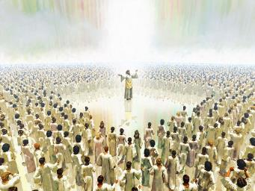
The Coming Spiritual Awakening (Rev. 7:1-17)
The Instruments (7:1-8)
Their sealing (7:1-3)
Their number (7:4)
Their lineage (7:5-8)
The Awakening (7:9-17)
Salvation’s quantity (7:9)
Salvation’s praises (7:10-12)
Salvation’s timing (7:13-14)
Salvation’s provisions (7:15-17)

Slide 7
The Coming Spiritual Awakening (Rev. 7:1-17)
The Instruments (7:1-8)
Their sealing (7:1-3)
Their number (7:4)
Their lineage (7:5-8)
The Awakening (7:9-17)
Salvation’s quantity (7:9)
Salvation’s praises (7:10-12)
Salvation’s timing (7:13-14)
Salvation’s provisions (7:15-17)

Slide 8
The Coming Spiritual Awakening (Rev. 7:1-17)
The Instruments (7:1-8)
Their sealing (7:1-3)
Their number (7:4)
Their lineage (7:5-8)
The Awakening (7:9-17)
Salvation’s quantity (7:9)
Salvation’s praises (7:10-12)
Salvation’s timing (7:13-14)
Salvation’s provisions (7:15-17)

Slide 9
The Coming Spiritual Awakening (Rev. 7:1-17)
The Instruments (7:1-8)
Their sealing (7:1-3)
Their number (7:4)
Their lineage (7:5-8)
The Awakening (7:9-17)
Salvation’s quantity (7:9)
Salvation’s praises (7:10-12)
Salvation’s timing (7:13-14)
Salvation’s provisions (7:15-17)

Slide 10
The Coming Spiritual Awakening (Rev. 7:1-17)
The Instruments (7:1-8)
Their sealing (7:1-3)
Their number (7:4)
Their lineage (7:5-8)
The Awakening (7:9-17)
Salvation’s quantity (7:9)
Salvation’s praises (7:10-12)
Salvation’s timing (7:13-14)
Salvation’s provisions (7:15-17)

Slide 11
The Coming Spiritual Awakening (Rev. 7:1-17)
The Instruments (7:1-8)
Their sealing (7:1-3)
Their number (7:4)
Their lineage (7:5-8)
The Awakening (7:9-17)
Salvation’s quantity (7:9)
Salvation’s praises (7:10-12)
Salvation’s timing (7:13-14)
Salvation’s provisions (7:15-17)

Slide 12
The Coming Spiritual Awakening (Rev. 7:1-17)
The Instruments (7:1-8)
Their sealing (7:1-3)
Their number (7:4)
Their lineage (7:5-8)
The Awakening (7:9-17)
Salvation’s quantity (7:9)
Salvation’s praises (7:10-12)
Salvation’s timing (7:13-14)
Salvation’s provisions (7:15-17)

Slide 13
Distinctions Between 144,000 & Multitude
Revelation 7:1-8
Numbered
Jews
Sealed
Sealed before the Tribulation
Revelation 7:9-17
Innumerable
All nations
Slain
Converted out of the Tribulation
Hitchcock and Ice, The Truth Behind Left Behind, 77

Slide 14
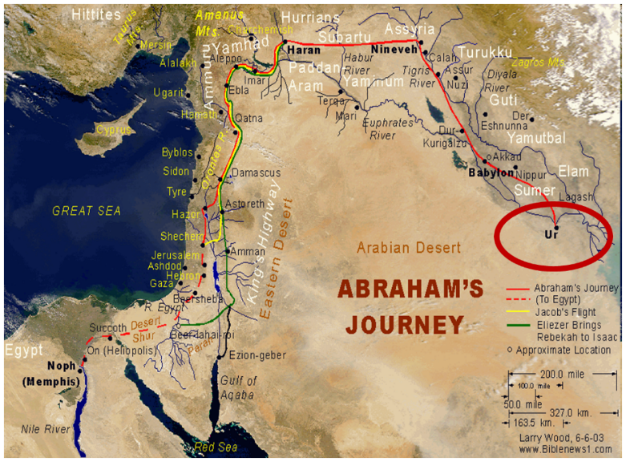

Slide 15
Genesis 12:3
“And I will bless those who bless you, And the one who curses you I will curse. And in you all the families of the earth will be blessed.”

Slide 16
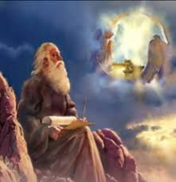
God’s Work Through Israel
Revelation 7 – 144,000 Jews
Revelation 11 – Two Jewish witnesses
Revelation 12 – Israel flees
Revelation 20:9 – Jerusalem in the kingdom
Revelation 21:12 – 13-Gates of the eternal city

Slide 17
God’s Work Through Israel
Revelation 7 – 144,000 Jews
Revelation 11 – Two Jewish witnesses
Revelation 12 – Israel flees
Revelation 20:9 – Jerusalem in the kingdom
Revelation 21:12 – 13-Gates of the eternal city

Slide 18
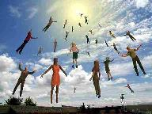
When Will the Rapture Take Place Relative to the Tribulation Period?
Pre-tribulation rapture theory
Mid-tribulation rapture theory
Post-tribulation rapture theory
Pre-wrath rapture theory
Partial rapture theory

Slide 20
MATT 24 / REV 6 PARALLELS
Prediction | Birth pangs (Matt 24) | Seal judgments (Rev 6)
False Christ | 24:5 | 6:2
War | 24:6 | 6:3-4
Famine | 24:7 | 6:5-6
Death | 24:6-7 | 6:7-8
Martyrs | 24:9-13 | 6:9-11
Earthquakes | 24:7 | 6:12-17
Evangelism | 24:14 | 7:1-9

Slide 21
Promise to the Overcomers
Rev 3:21
“He who overcomes, I will grant to him to sit down with Me on My throne, as I also overcame and sat down with My Father on His throne.”

Slide 22
Comparing Revelation 4 & 5
Chapter | Revelation 4 | Revelation 5
God-head Member | Father | Son
Role | Creator | Redeemer
Reason for Worship | Role in Creation (4:11) | Role in Redemption (5:9, 12)

Slide 23
1 John 4:4
“You are from God, little children, and have overcome [nikaō; perfect tense] them; because greater is He who is in you than he who is in the world.”

Slide 24
1 John 5:4-5
^{“4} For whatever is born of God overcomes the world; and this is the victory that has overcome the world—our faith. ⁵ Who is the one who overcomes the world, but he who believes that Jesus is the Son of God?”

Slide 25
Romans 8:37
“But in all these things we overwhelmingly conquer [hypernikaō , present tense] through Him who loved us.”

Slide 26
Revelation 5:5
and one of the elders said to me, “Stop weeping; behold, the Lion that is from the tribe of Judah, the Root of David, has overcome so as to open the book and its seven seals.”

Slide 27
John 16:33
“These things I have spoken to you, so that in Me you may have peace. In the world you have tribulation, but take courage; I have overcome [nikaō; perfect tense] the world.”

Slide 28
The Coming Spiritual Awakening (Rev. 7:1-17)
The Instruments (7:1-8)
Their sealing (7:1-3)
Their number (7:4)
Their lineage (7:5-8)
The Awakening (7:9-17)
Salvation’s quantity (7:9)
Salvation’s praises (7:10-12)
Salvation’s timing (7:13-14)
Salvation’s provisions (7:15-17)

Slide 29
B. Salvation’s Praises (Rev. 7:10-12)
By Gentiles (7:10)
By angels, elders, 4 living creatures (7:11-12)

Slide 30
B. Salvation’s Praises (Rev. 7:10-12)
By Gentiles (7:10)
By angels, elders, 4 living creatures (7:11-12)

Slide 31
Revelation 11:15
¹⁵ “Then the seventh angel sounded; and there were loud voices in heaven, saying, ‘The kingdom of the world has become the kingdom of our Lord and of His Christ; and He will reign forever and ever.’”

Slide 32
B. Salvation’s Praises (Rev. 7:10-12)
By Gentiles (7:10)
By angels, elders, 4 living creatures (7:11-12)

Slide 33
1. Twenty-Four Elders (Rev. 4:4)
Church
Crowned (2:10)
Clothed in White (3:5)
Redeemed (5:8-10)
Enthroned (3:21)
Elders (1 Tim. 3:1-7)
Kingdom of Priests (Rev. 1:6)
Twenty-four (Rev. 1:6)

Slide 34
The Coming Spiritual Awakening (Rev. 7:1-17)
The Instruments (7:1-8)
Their sealing (7:1-3)
Their number (7:4)
Their lineage (7:5-8)
The Awakening (7:9-17)
Salvation’s quantity (7:9)
Salvation’s praises (7:10-12)
Salvation’s timing (7:13-14)
Salvation’s provisions (7:15-17)

Slide 35
C. Salvation’s Timing (Rev. 7:13-14)
Question (7:13)
Answer (7:14)

Slide 36
C. Salvation’s Timing (Rev. 7:13-14)
Question (7:13)
Answer (7:14)

Slide 37
C. Salvation’s Timing (Rev. 7:13-14)
Question (7:13)
Answer (7:14)

Slide 39
1st Six Seals (Revelation 6)
6:1-2 – Advent of antichrist
6:3-4 – War
6:5-6 – Famine
6:7-8 – Death
6:9-11 – Martyrdoms
6:12-17 – Cosmic disturbances

Slide 41
The Coming Spiritual Awakening (Rev. 7:1-17)
The Instruments (7:1-8)
Their sealing (7:1-3)
Their number (7:4)
Their lineage (7:5-8)
The Awakening (7:9-17)
Salvation’s quantity (7:9)
Salvation’s praises (7:10-12)
Salvation’s timing (7:13-14)
Salvation’s provisions (7:15-17)

Slide 42
C. Salvation’s Provision (Rev. 7:15-17)
Their service (7:15)
Their satisfaction (7:16)
Their shepherd (7:17)

Slide 43
C. Salvation’s Provision (Rev. 7:15-17)
Their service (7:15)
Their satisfaction (7:16)
Their shepherd (7:17)

Slide 44
C. Salvation’s Provision (Rev. 7:15-17)
Their service (7:15)
Their satisfaction (7:16)
Their shepherd (7:17)

Slide 45
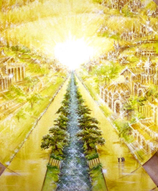
Eternal State is Future
No Satan (Rev 20:10)
No sea (Rev 21:1)
No death, crying, or pain (Rev 21:4)
No Sun (Rev 22:5)
No Moon (Rev 21:23)
No night (Rev 21:25)
No evil (Rev 21:27)
No curse (Rev 22:23)

Slide 46
C. Salvation’s Provision (Rev. 7:15-17)
Their service (7:15)
Their satisfaction (7:16)
Their shepherd (7:17)

Slide 47
Eternal State is Future
No Satan (Rev 20:10)
No sea (Rev 21:1)
No death, crying, or pain (Rev 21:4)
No Sun (Rev 22:5)
No Moon (Rev 21:23)
No night (Rev 21:25)
No evil (Rev 21:27)
No curse (Rev 22:23)

Slide 48
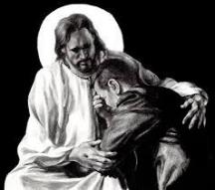
Revelation 21:4
“and He will wipe away every tear from their eyes; and there will no longer be any death; there will no longer be any mourning, or crying, or pain; the first things have passed away.”

Slide 49
Conclusion

Slide 50
The Coming Spiritual Awakening (Rev. 7:1-17)
The Instruments (7:1-8)
Their sealing (7:1-3)
Their number (7:4)
Their lineage (7:5-8)
The Awakening (7:9-17)
Salvation’s quantity (7:9)
Salvation’s praises (7:10-12)
Salvation’s timing (7:13-14)
Salvation’s provisions (7:15-17)

Slide 51
“The Lord bless you and keep you; the Lord make his face shine on you and be gracious to you; the Lord turn his face toward you and give you peace.” (NIV)

