Slide 1
Ecclesiology Session 47
Dr. Andy Woods
Senior Pastor – Sugar Land Bible Church
President – Chafer Theological Seminary

Slide 2
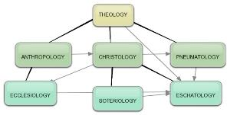
Areas of Systematic Theology
Prolegomena – Introduction
Theology – Study of God
Christology – Study of Christ
Pneumatology – Study of the Holy Spirit
Anthropology – Study of Man
Hamartiology – Study of sin
Soteriology – Study of salvation
Angelology – Study of angels
Ecclesiology – Study of the Church
Eschatology – Study of the end

Slide 3
Ecclesiology Overview
Definition
Universal vs. local
Word pictures
Origin
Israel – Church differences
Intercalation
Purposes
Activities
Government
Officers
Ordinances
Purity

Slide 4
XI. Ordinances
Foot washing?
Communion
Baptism

Slide 5
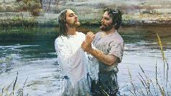
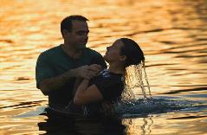
C. Baptism
False views
Baptismal regeneration?
Infant baptism?
Correct view: outward symbol of an inward reality
Mode of baptism
Sprinkling?
Immersion?

Slide 6
C. Baptism
False views
Baptismal regeneration?
Infant baptism?
Correct view: outward symbol of an inward reality
Mode of baptism
Sprinkling?
Immersion?

Slide 7
C. Baptism
False views
Baptismal regeneration?
Infant baptism?
Correct view: outward symbol of an inward reality
Mode of baptism
Sprinkling?
Immersion?

Slide 8
Sprinkling or Immersion?
Sprinkling? Other words (1 Pet. 1:12; 2 Tim. 4:6)
Immersion?
Christ’s baptism (Matt. 3:16; Mark 1:10)
Ethiopian eunuch's baptism (Acts 8:38-39)
Best symbolizes our union with Christ (Rom. 6:3)
Symbolizes a new creation (Gen. 1:6, 9; 2 Pet. 3:5; 2 Cor. 5:17)

Slide 9
Ecclesiology Overview
Definition
Universal vs. local
Word pictures
Origin
Israel – Church differences
Intercalation
Purposes
Activities
Government
Officers
Ordinances
Purity

Slide 10
Purity of the Church
Ecclesiastical separation
Church discipline

Slide 11
Purity of the Church
Ecclesiastical separation
Church discipline

Slide 12
John 17:17, 20-23
“¹⁷ Sanctify them in the truth; Your word is truth…²⁰ I do not ask on behalf of these alone, but for those also who believe in Me through their word; ²¹ that they may all be one; even as You, Father, are in Me and I in You, that they also may be in Us, so that the world may believe that You sent Me. ²² The glory which You have given Me I have given to them, that they may be one, just as We are one; ²³ I in them and You in Me, that they may be perfected in unity, so that the world may know that You sent Me, and loved them, even as You have loved Me.”

Slide 13
John 17:17, 20-23
“¹⁷ Sanctify them in the truth; Your word is truth…²⁰ I do not ask on behalf of these alone, but for those also who believe in Me through their word; ²¹ that they may all be one; even as You, Father, are in Me and I in You, that they also may be in Us, so that the world may believe that You sent Me. ²² The glory which You have given Me I have given to them, that they may be one, just as We are one; ²³ I in them and You in Me, that they may be perfected in unity, so that the world may know that You sent Me, and loved them, even as You have loved Me.”

Slide 14
Lewis Sperry Chafer
vol. 5, Systematic Theology (Grand Rapids, MI: Kregel Publications, 1993), 158.
“Thoughtless and absurd is the modern notion that Christ was praying that denominations which exist in this remote time and in a country then unknown might become organically united in one, and therefore it is the duty of all sects to unite and thus help to answer this prayer. As indicated before, this unity is sought at the hand of the Father, indicating that it is a divine undertaking. It is that, and it results in a unity as organic and vital as that between the Father and the Son. This prayer began to be answered on the Day of Pentecost when believers were by the Spirit baptized into one Body, and is constantly answered whenever a soul is saved and thus joined as a member to the Body of Christ by the same baptism of the Spirit.”

Slide 15
Ecclesiastical Separation
Why separate?
Biblical basis for separation
What to separate from?

Slide 16
Ecclesiastical Separation
Why separate?
Biblical basis for separation
What to separate from?

Slide 17
A. Why Separate?
Not hatred
Gives world a false sense of security
Loss of distinctiveness and power

Slide 18
Ecclesiastical Separation
Why separate?
Biblical basis for separation
What to separate from?

Slide 19
B. Biblical Basis for Separation?
2 Thess. 3:6, 14
1 Cor. 5:11
2 Cor. 6:14-18
Rom. 16:17
Eph. 5:11
Titus 3:9-11
2 John 9-11

Slide 20
2 John 9-11
“⁷ For many deceivers have gone out into the world, those who do not acknowledge Jesus Christ as coming in the flesh. This is the deceiver and the antichrist. ⁸ Watch yourselves, that you do not lose what we have accomplished, but that you may receive a full reward. ⁹ Anyone who goes too far and does not abide in the teaching of Christ, does not have God; the one who abides in the teaching, he has both the Father and the Son. ¹⁰ If anyone comes to you and does not bring this teaching, do not receive him into your house, and do not give him a greeting; ¹¹ for the one who gives him a greeting participates in his evil deeds.”

Slide 21
D. Martyn Lloyd-Jones
Knowing the Times (Carlisle, PA: The Banner of Truth Trust, 1989; reprint, 2001), 161-62.
“To regard a church, or a council of churches, as a forum in which fundamental matters can be debated and discussed, or as an opportunity for witness-bearing, is sheer confusion and muddled thinking. There is to be no discussion about ‘the foundation’, as we have seen. If men do not accept that, they are not brethren and we can have no dialogue with them. We are to preach to such and to evangelize them. Discussion takes place among the brethren who share the same life and subscribe to the same essential truths. It is right and good that brethren should discuss together matters which are not essential to salvation and about which there is, and always has been, and always will be, legitimate differences of opinion. We can do no better at that point than quote the old adage, ‘In things essential, unity, in things indifferent liberty, in all things charity.’”

Slide 22
D. Martyn Lloyd-Jones
Knowing the Times (Carlisle, PA: The Banner of Truth Trust, 1989; reprint, 2001), 161-62.
“Before there can be any real discussion and dialogue and exchange there must be agreement concerning primary and fundamental matters. Without the acceptance of certain axioms and propositions in geometry, for example, it is idle to attempt to solve any problem. If certain people refuse to accept the axioms, and are constantly querying and disputing them, clearly there is no point of contact between them and those who do accept them. It is precisely the same in the realm of the church. Those who question and query, let alone deny, the great cardinal truths that have been accepted throughout the centuries do not belong to the church, and to regard them as brethren is to betray the truth. As we have already reminded ourselves, the apostle Paul tells us clearly what our attitude to them should be: ‘A man that is a heretic after the first and second admonition reject’ (Tit. 3:10).”

Slide 23
D. Martyn Lloyd-Jones
Knowing the Times (Carlisle, PA: The Banner of Truth Trust, 1989; reprint, 2001), 161-62.
“They are to be regarded as unbelievers and need to be called to repentance and acceptance of the truth as it is in Christ Jesus. To give the impression that they are Christians with whom other Christians disagree about certain matters is to confuse the genuine seeker and enquirer who is outside. But such is the position prevailing today. It is based upon a failure to understand the nature of the New Testament church which is ‘the pillar and ground of the truth’ (1 Tim. 3:15). In the same way it is a sheer waste of time to discuss or debate the implications of Christianity with people who are not agreed as to what Christianity is. Failure to realize this constitutes the very essence of the modern confusion.”

Slide 24
Ecclesiastical Separation
Why separate?
Biblical basis for separation
What to separate from?

Slide 25
C. What to Separate From?
False doctrine – 1 Tim. 4:16; Titus 1:9
Divisive persons – Rom. 16:17; Titus 3:9-11
Immorality – 1 Cor. 5:9-11; Eph. 5:11
General disobedience to Scripture –2 Thess. 3:6, 14

Slide 26
C. What to Separate From?
False doctrine – 1 Tim. 4:16; Titus 1:9
Divisive persons – Rom. 16:17; Titus 3:9-11
Immorality – 1 Cor. 5:9-11; Eph. 5:11
General disobedience to Scripture –2 Thess. 3:6, 14

Slide 27
Fundamentals of the Faith
Creation/fall – Rom. 5:14
Inspiration/inerrancy of the Scripture – Matt. 5:18; John 17:17; 2 Tim. 3:16; 2 Pet. 1:20-21
Salvation by faith alone
Eternal existence of heaven/hell – Dan. 12:2; Matt. 25:46
Trinity
Virgin birth of Christ
Deity of Christ
Atoning death of Christ – Isa. 53:3-6; 1 Pet. 2:24
Bodily Resurrection of Christ – John 20:27-28; 1 Cor. 15:14
Bodily Second Advent of Christ – Job 19:25; Zech. 14:4; Acts 1:9-11

Slide 28
Fundamentals of the Faith
Creation/fall – Rom. 5:14
Inspiration/inerrancy of the Scripture – Matt. 5:18; John 17:17; 2 Tim. 3:16; 2 Pet. 1:20-21
Salvation by faith alone
Eternal existence of heaven/hell – Dan. 12:2; Matt. 25:46
Trinity
Virgin birth of Christ
Deity of Christ
Atoning death of Christ – Isa. 53:3-6; 1 Pet. 2:24
Bodily Resurrection of Christ – John 20:27-28; 1 Cor. 15:14
Bodily Second Advent of Christ – Job 19:25; Zech. 14:4; Acts 1:9-11

Slide 29
Fundamentals of the Faith
Creation/fall – Rom. 5:14
Inspiration/inerrancy of the Scripture – Matt. 5:18; John 17:17; 2 Tim. 3:16; 2 Pet. 1:20-21
Salvation by faith alone
Eternal existence of heaven/hell – Dan. 12:2; Matt. 25:46
Trinity
Virgin birth of Christ
Deity of Christ
Atoning death of Christ – Isa. 53:3-6; 1 Pet. 2:24
Bodily Resurrection of Christ – John 20:27-28; 1 Cor. 15:14
Bodily Second Advent of Christ – Job 19:25; Zech. 14:4; Acts 1:9-11

Slide 30
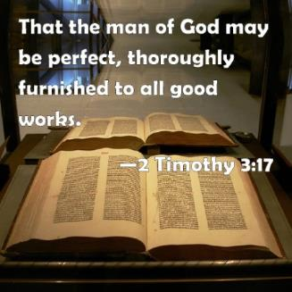
2 Timothy 3:16-17
“All Scripture is inspired by God [theopneustos] and profitable for teaching, for reproof, for correction, for training in righteousness; so that the man of God may be adequate, equipped for every good work.”

Slide 31
INSPIRATION OF SCRIPTURE 2 Peter 1:20-21
Men Wrote as they were inspired by Holy Spirit
“phero” = to carry
Acts 27:15,17
Opposite of Knowledge of False Teachers
Which is their own imagination
Jer. 23:16

Slide 32
John 17:17, 20-23
“¹⁷ Sanctify them in the truth; Your word is truth…²⁰ I do not ask on behalf of these alone, but for those also who believe in Me through their word; ²¹ that they may all be one; even as You, Father, are in Me and I in You, that they also may be in Us, so that the world may believe that You sent Me. ²² The glory which You have given Me I have given to them, that they may be one, just as We are one; ²³ I in them and You in Me, that they may be perfected in unity, so that the world may know that You sent Me, and loved them, even as You have loved Me.”

Slide 33
Matthew 4:4
“But He answered and said, “It is written, ‘Man shall not live on bread alone, but on every word that proceeds out of the mouth of God.’”

Slide 34
Matthew 5:18
“For truly I say to you, until heaven and earth pass away, not the smallest letter or stroke shall pass from the Law until all is accomplished.”

Slide 35
Fundamentals of the Faith
Creation/fall – Rom. 5:14
Inspiration/inerrancy of the Scripture – Matt. 5:18; John 17:17; 2 Tim. 3:16; 2 Pet. 1:20-21
Salvation by faith alone
Eternal existence of heaven/hell – Dan. 12:2; Matt. 25:46
Trinity
Virgin birth of Christ
Deity of Christ
Atoning death of Christ – Isa. 53:3-6; 1 Pet. 2:24
Bodily Resurrection of Christ – John 20:27-28; 1 Cor. 15:14
Bodily Second Advent of Christ – Job 19:25; Zech. 14:4; Acts 1:9-11

Slide 36
John MacArthur
The Gospel According to Jesus, p. 140
"Eternal life is indeed a free gift (Rom. 6:23). Salvation cannot be earned with good deeds or purchased with money. It has already been bought by Christ, who paid the ransom with His blood. But that does not mean there is no cost in terms of salvation's impact on the sinner's life. This paradox may be difficult but it is nevertheless true: salvation is both free and costly. Eternal life brings immediate death to self. 'Knowing this, that our old self was crucified with Him, that our body of sin might be done away with, that we should no longer be slaves to sin' (Rom 6:6). Thus in a sense we pay the ultimate price for salvation when our sinful self is nailed to a cross. It is a total abandonment of self-will, like the grain of wheat that falls to the ground and dies so that it can bear much fruit (cf. John 12:24). It is an exchange of all that we are for all that Christ is. And it denotes implicit obedience, full surrender to the lordship of Christ. Nothing less can qualify as saving faith.”

Slide 37
John MacArthur
Faith Works, p. 25
“Jesus is Lord of all, and the faith He demands involves unconditional surrender…He does not bestow eternal life on those whose hearts remain set against Him.”

Slide 38
John MacArthur
Transcription of The Art of Self-Discipline, part 2, www.gty.org.
“Self discipline comes when you look back to the covenant of your salvation…that is to say when you remember that at the point of your salvation you made a promise to submit to the Lord. You made a pledge at that time to be obedient to Christ. You confessed Him as Lord…And Lord means that He is above all. It’s essential then as believers to remember that we made a covenant of obedience when we confessed Jesus as Lord. We were saved unto obedience which God had before ordained that we should walk…and obedience characterized by good works…and obedience to God's Word. That pledge was inherent in salvation. God at the time you came to Him for salvation promised you forgiveness and eternal life and all the grace necessary to fulfill His will, and the Holy Spirit, and you pledged obedience. And you need to go back and remember that and have the integrity to be faithful to your original promise…”

Slide 39
Lordship Salvation 7 Problems
Changes the gospel
Places an impossible burden upon the unsaved
Confuses justification with sanctification
Confuses the result of with requirement for salvation
Fails to make basic dispensational distinctions
Ignores the reality of a carnal Christian
Destroys the assurance of salvation

Slide 40
Fundamentals of the Faith
Creation/fall – Rom. 5:14
Inspiration/inerrancy of the Scripture – Matt. 5:18; John 17:17; 2 Tim. 3:16; 2 Pet. 1:20-21
Salvation by faith alone
Eternal existence of heaven/hell – Dan. 12:2; Matt. 25:46
Trinity
Virgin birth of Christ
Deity of Christ
Atoning death of Christ – Isa. 53:3-6; 1 Pet. 2:24
Bodily Resurrection of Christ – John 20:27-28; 1 Cor. 15:14
Bodily Second Advent of Christ – Job 19:25; Zech. 14:4; Acts 1:9-11

Slide 41
Fundamentals of the Faith
Creation/fall – Rom. 5:14
Inspiration/inerrancy of the Scripture – Matt. 5:18; John 17:17; 2 Tim. 3:16; 2 Pet. 1:20-21
Salvation by faith alone
Eternal existence of heaven/hell – Dan. 12:2; Matt. 25:46
Trinity
Virgin birth of Christ
Deity of Christ
Atoning death of Christ – Isa. 53:3-6; 1 Pet. 2:24
Bodily Resurrection of Christ – John 20:27-28; 1 Cor. 15:14
Bodily Second Advent of Christ – Job 19:25; Zech. 14:4; Acts 1:9-11

Slide 42
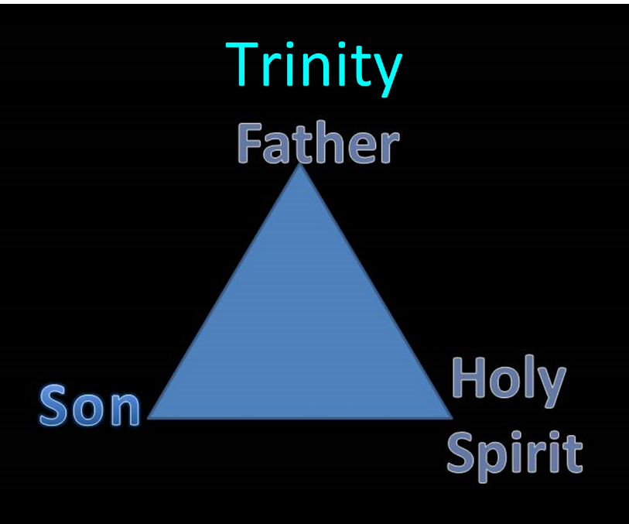

Slide 43
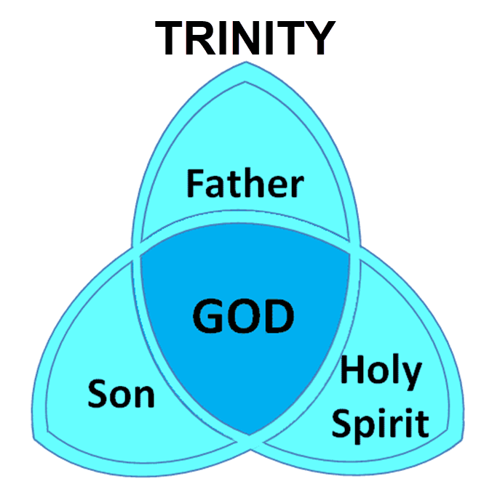

Slide 44
Fundamentals of the Faith
Creation/fall – Rom. 5:14
Inspiration/inerrancy of the Scripture – Matt. 5:18; John 17:17; 2 Tim. 3:16; 2 Pet. 1:20-21
Salvation by faith alone
Eternal existence of heaven/hell – Dan. 12:2; Matt. 25:46
Trinity
Virgin birth of Christ
Deity of Christ
Atoning death of Christ – Isa. 53:3-6; 1 Pet. 2:24
Bodily Resurrection of Christ – John 20:27-28; 1 Cor. 15:14
Bodily Second Advent of Christ – Job 19:25; Zech. 14:4; Acts 1:9-11

Slide 46
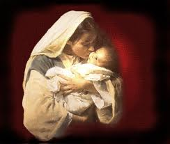
Why the Virgin Birth?
To fulfill OT prophecy
To emphasize Christ’s humanity and deity
To emphasize Christ’s eternality
To maintain Christ’s sinlessness
To protect the bodily atonement
To circumvent the curse of Jeconiah
To vindicate the NT

Slide 47
Fundamentals of the Faith
Creation/fall – Rom. 5:14
Inspiration/inerrancy of the Scripture – Matt. 5:18; John 17:17; 2 Tim. 3:16; 2 Pet. 1:20-21
Salvation by faith alone
Eternal existence of heaven/hell – Dan. 12:2; Matt. 25:46
Trinity
Virgin birth of Christ
Deity of Christ
Atoning death of Christ – Isa. 53:3-6; 1 Pet. 2:24
Bodily Resurrection of Christ – John 20:27-28; 1 Cor. 15:14
Bodily Second Advent of Christ – Job 19:25; Zech. 14:4; Acts 1:9-11

Slide 48
Fundamentals of the Faith
Creation/fall – Rom. 5:14
Inspiration/inerrancy of the Scripture – Matt. 5:18; John 17:17; 2 Tim. 3:16; 2 Pet. 1:20-21
Salvation by faith alone
Eternal existence of heaven/hell – Dan. 12:2; Matt. 25:46
Trinity
Virgin birth of Christ
Deity of Christ
Atoning death of Christ – Isa. 53:3-6; 1 Pet. 2:24
Bodily Resurrection of Christ – John 20:27-28; 1 Cor. 15:14
Bodily Second Advent of Christ – Job 19:25; Zech. 14:4; Acts 1:9-11

Slide 49
Fundamentals of the Faith
Creation/fall – Rom. 5:14
Inspiration/inerrancy of the Scripture – Matt. 5:18; John 17:17; 2 Tim. 3:16; 2 Pet. 1:20-21
Salvation by faith alone
Eternal existence of heaven/hell – Dan. 12:2; Matt. 25:46
Trinity
Virgin birth of Christ
Deity of Christ
Atoning death of Christ – Isa. 53:3-6; 1 Pet. 2:24
Bodily Resurrection of Christ – John 20:27-28; 1 Cor. 15:14
Bodily Second Advent of Christ – Job 19:25; Zech. 14:4; Acts 1:9-11

Slide 50
Fundamentals of the Faith
Creation/fall – Rom. 5:14
Inspiration/inerrancy of the Scripture – Matt. 5:18; John 17:17; 2 Tim. 3:16; 2 Pet. 1:20-21
Salvation by faith alone
Eternal existence of heaven/hell – Dan. 12:2; Matt. 25:46
Trinity
Virgin birth of Christ
Deity of Christ
Atoning death of Christ – Isa. 53:3-6; 1 Pet. 2:24
Bodily Resurrection of Christ – John 20:27-28; 1 Cor. 15:14
Bodily Second Advent of Christ – Job 19:25; Zech. 14:4; Acts 1:9-11

Slide 51
C. What to Separate From?
False doctrine – 1 Tim. 4:16; Titus 1:9
Divisive persons – Rom. 16:17; Titus 3:9-11
Immorality – 1 Cor. 5:9-11; Eph. 5:11
General disobedience to Scripture –2 Thess. 3:6, 14

Slide 52
C. What to Separate From?
False doctrine – 1 Tim. 4:16; Titus 1:9
Divisive persons – Rom. 16:17; Titus 3:9-11
Immorality – 1 Cor. 5:9-11; Eph. 5:11
General disobedience to Scripture –2 Thess. 3:6, 14

Slide 53
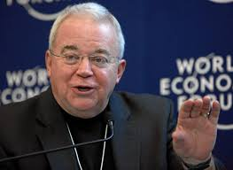
Jim Wallis
Mary Danielson, The Dangerous Truth About the Social-Justice “Gospel,” n. 21
“Abomination is a pretty strong word . . . there is a debate and questions over the meaning of the word ‘abomination.’” (Referring to Leviticus 18:22; as heard on Moody Christian Radio Network, in Chicago, Feb.19, 2008, when asked about government sanctions on civil unions for gays.)

Slide 54
C. What to Separate From?
False doctrine – 1 Tim. 4:16; Titus 1:9
Divisive persons – Rom. 16:17; Titus 3:9-11
Immorality – 1 Cor. 5:9-11; Eph. 5:11
General disobedience to Scripture –2 Thess. 3:6, 14

Slide 55
Conclusion

Slide 56
Ecclesiology Overview
Definition
Universal vs. local
Word pictures
Origin
Israel – Church differences
Intercalation
Purposes
Activities
Government
Officers
Ordinances
Purity

Slide 57
Purity of the Church
Ecclesiastical separation
Church discipline

Slide 58
Ecclesiastical Separation
Why separate?
Biblical basis for separation
What to separate from?

Slide 59
Purity of the Church
Ecclesiastical separation
Church discipline

