Slide 1


Dr. Andy Woods
Senior Pastor – Sugar Land Bible Church
President – Chafer Theological Seminary

Slide 2
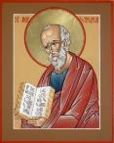
Answering Ten Questions
What is the title – Revelation of Jesus Christ
Who wrote it? – John
Where was it written from? – Patmos
To Whom was it written? – The Seven Churches
When was it written? – A.D. 95
How is it organized (outline)? – 3 part outline
How was it delivered – Seven steps
Why was it written? – Encouragement and holiness
What is it about? – Jesus’ final victory
What makes the book different? – OT relationship

Slide 3

Prologue (Rev. 1:1-8)
Title (1a)
Chain of Communication (1b-2)
Blessing (3)
Author (4a)
Audience (4b)
Greeting (4c)
Source (4d-5a)
Subject (5b-8)

Slide 4

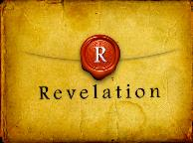
Revelation 1:19
“Therefore write the things which you have seen, and the things which are, and the things which will take place after these things [meta tauta].”

Slide 5

Revelation 1:19
Seen (Chapter 1)
Are (Chapters 2–3)
After these things (Chapters 4–22)

Slide 6
Revelation 1:19
Seen (Chapter 1)
Are (Chapters 2–3)
After these things (Chapters 4–22)

Slide 7
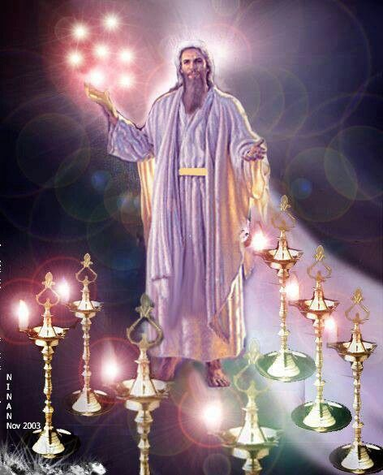

Slide 8
Revelation 1:19
Seen (Chapter 1)
Are (Chapters 2–3)
After these things (Chapters 4–22)

Slide 9



Slide 10
DESCRIPTION OF THE SEVEN CHURCHES Revelation 2‒3
CHURCH | SCRIPTURE | DESCRIPTION
Ephesus | 2:1-7 | Loveless
Smyrna | 2:8-11 | Persecuted
Pergamum | 2:12-17 | Compromised
Thyatira | 2:18-29 | Corrupt
Sardis | 3:1-6 | Dead
Philadelphia | 3:7-13 | Missionary
Laodicea | 3:14-22 | Man-centered

Slide 11
Revelation 1:19
Seen (Chapter 1)
Are (Chapters 2–3)
After these things (Chapters 4–22)

Slide 12
Revelation 1:19
“Therefore write the things which you have seen, and the things which are, and the things which will take place after these things [meta tauta].”

Slide 13
Revelation 4:1
“After these things [meta tauta] I looked, and behold, a door standing open in heaven, and the first voice which I had heard, like the sound of a trumpet speaking with me, said, ‘Come up here, and I will show you what must take place after these things [meta tauta].’”

Slide 14
“After These Things”
(Rev. 4‒22)
Before the Tribulation (4‒5)
During the Tribulation (6‒19)
After the Tribulation (20‒22)
  Kingdom (20:1-10)
  Great White Throne Judgment (20:11-15)
  Destruction of the Earth (21:1)
  New Heaven and New Earth (21‒22)

Slide 15
“After These Things”
(Rev. 4‒22)
Before the Tribulation (4‒5)
During the Tribulation (6‒19)
After the Tribulation (20‒22)
  Kingdom (20:1-10)
  Great White Throne Judgment (20:11-15)
  Destruction of the Earth (21:1)
  New Heaven and New Earth (21‒22)

Slide 16
Comparing Revelation 4 & 5
Chapter | Revelation 4 | Revelation 5
God-head Member | Father | Son
Role | Creator | Redeemer
Reason for Worship | Role in Creation (4:11) | Role in Redemption (5:9, 12)

Slide 17

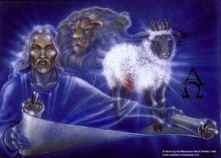
Revelation 5:1-14
An observation (5:1)
A question (5:2)
An investigation (5:3)
A lamentation (5:4)
A consolation (5:5a)
A manifestation (5:5b-6)
A reception (5:7)
A reaction (5:8-14)
Willmington. Outline Bible, 760

Slide 18
“After These Things”
(Rev. 4‒22)
Before the Tribulation (4‒5)
During the Tribulation (6‒19)
After the Tribulation (20‒22)
  Kingdom (20:1-10)
  Great White Throne Judgment (20:11-15)
  Destruction of the Earth (21:1)
  New Heaven and New Earth (21‒22)

Slide 19


Slide 20
1st Six Seals (Revelation 6)
6:1-2 – Advent of antichrist
6:3-4 – War
6:5-6 – Famine
6:7-8 – Death
6:9-11 – Martyrdoms
6:12-17 – Cosmic disturbances

Slide 21
1st Six Seals (Revelation 6)
6:1-2 – Advent of antichrist
6:3-4 – War
6:5-6 – Famine
6:7-8 – Death
6:9-11 – Martyrdoms
6:12-17 – Cosmic disturbances

Slide 22
Recapitulation
View that judgments overlap
Seals: 1 2 3 4 5 6 7
Trumpets: 1 2 3 4 5 6 7
Bowls: 1 2 3 4 5 6 7

Slide 23

Telescoping
7th judgment releases 1st in next series
Seals: 1 2 3 4 5 6 7
Trumpets: 1 2 3 4 5 6 7
Bowls: 1 2 3 4 5 6 7

Slide 24
5 Non-Chronological Parenthetical Insertions
Rev 7-144,000 Jews
Rev 10:1–11:14-Announcement of no more delay and the two witnesses
Rev 12–14-Israel’s flight, two beasts, six scenes of hope
Rev 16:13-16-Gathering of the nations to Armageddon
Rev 17:1–19:6-Babylon’s fall

Slide 25
5 Non-Chronological Parenthetical Insertions
Rev 7-144,000 Jews
Rev 10:1–11:14-Announcement of no more delay and the two witnesses
Rev 12–14-Israel’s flight, two beasts, six scenes of hope
Rev 16:13-16-Gathering of the nations to Armageddon
Rev 17:1–19:6-Babylon’s fall

Slide 26
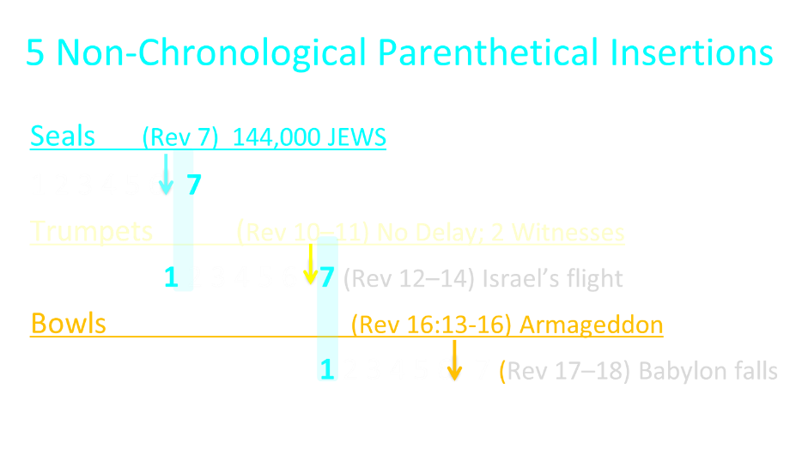

Slide 27
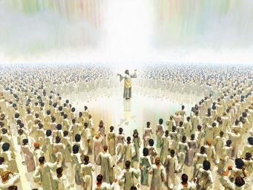
The Coming Spiritual Awakening
(Rev. 7:1-17)
The Instruments (7:1-8)
  Their sealing (7:1-3)
  Their number (7:4)
  Their lineage (7:5-8)
The Awakening (7:9-17)
  Salvation’s quantity (7:9)
  Salvation’s praises (7:10-12)
  Salvation’s timing (7:13-14)
  Salvation’s provisions (7:15-17)

Slide 28
The Coming Spiritual Awakening
(Rev. 7:1-17)
The Instruments (7:1-8)
  Their sealing (7:1-3)
  Their number (7:4)
  Their lineage (7:5-8)
The Awakening (7:9-17)
  Salvation’s quantity (7:9)
  Salvation’s praises (7:10-12)
  Salvation’s timing (7:13-14)
  Salvation’s provisions (7:15-17)

Slide 29
The Coming Spiritual Awakening
(Rev. 7:1-17)
The Instruments (7:1-8)
  Their sealing (7:1-3)
  Their number (7:4)
  Their lineage (7:5-8)
The Awakening (7:9-17)
  Salvation’s quantity (7:9)
  Salvation’s praises (7:10-12)
  Salvation’s timing (7:13-14)
  Salvation’s provisions (7:15-17)

Slide 30
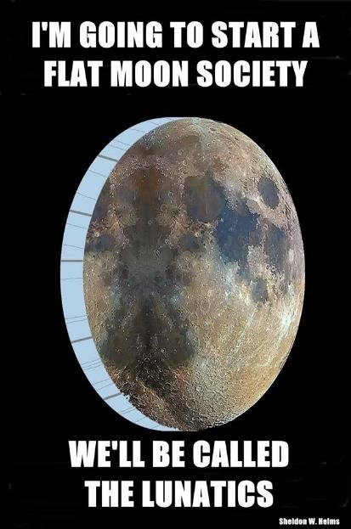

Slide 31
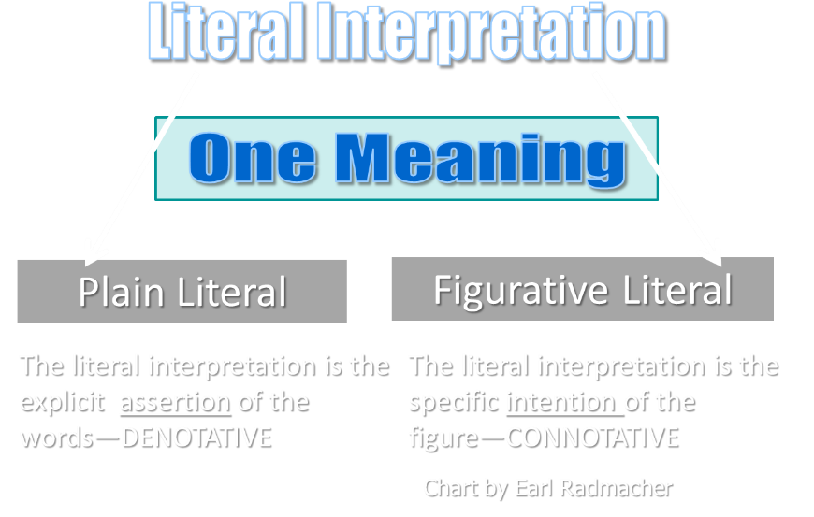

Slide 32
1st Six Seals (Revelation 6)
6:1-2 – Advent of antichrist
6:3-4 – War
6:5-6 – Famine
6:7-8 – Death
6:9-11 – Martyrdoms
6:12-17 – Cosmic disturbances

Slide 34


Slide 35
The Coming Spiritual Awakening
(Rev. 7:1-17)
The Instruments (7:1-8)
  Their sealing (7:1-3)
  Their number (7:4)
  Their lineage (7:5-8)
The Awakening (7:9-17)
  Salvation’s quantity (7:9)
  Salvation’s praises (7:10-12)
  Salvation’s timing (7:13-14)
  Salvation’s provisions (7:15-17)

Slide 36

Robert Thomas
Revelation 8 to 22: An Exegetical Commentary (Chicago: Moody Press, 1992), 408.
Robert Thomas observes that, "no number in Revelation is verifiably a symbolic number.”

Slide 37
Robert Thomas
Revelation 1 to 7: An Exegetical Commentary (Chicago: Moody Press, 1992), 40.
“Of the 404 verses in the Apocalypse, 278 allude to the OT Scripture. No other NT writer uses the OT more than this. Yet the book is marked by an entire absence of formal quotations from the OT.”

Slide 38
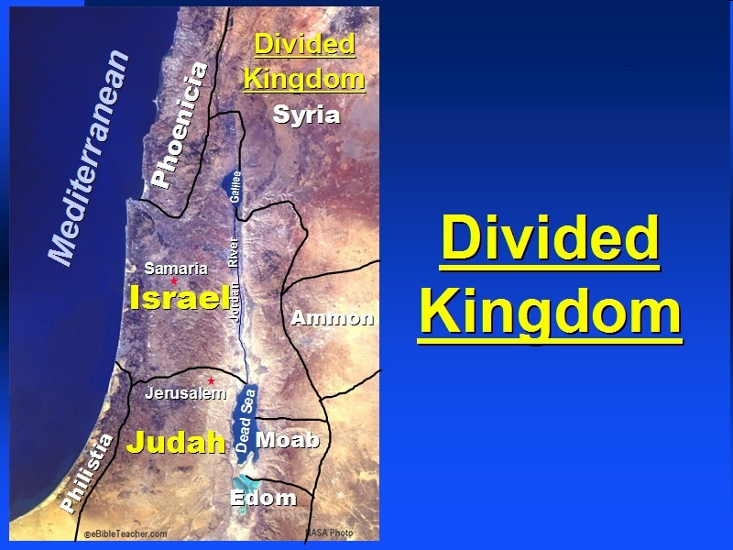

Slide 39
Israel's Judgments
Division of the kingdom in 931 B.C. (1 Kgs. 12)
Assyrian judgment in 722 B.C. (2 Kgs. 17)
Babylonian captivity in 586 B.C. (2 Kgs. 25)

Slide 40
Israel's Judgments
Division of the kingdom in 931 B.C. (1 Kgs. 12)
Assyrian judgment in 722 B.C. (2 Kgs. 17)
Babylonian captivity in 586 B.C. (2 Kgs. 25)

Slide 41


2 Timothy 2:13
“If we are faithless, He remains faithful, for He cannot deny Himself.”

Slide 42
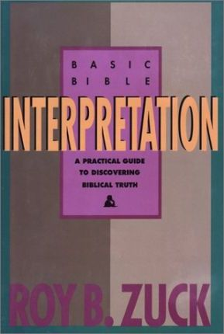
Roy Zuck
Basic Bible Interpretation, 146, 187.
“when John wrote that 144,000 will be sealed…there is no reason not to take these numbers in their normal, literal sense…Since the tribal names are literal and not symbolic, there is no reason to take the numbers symbolically.”

Slide 43
Revelation 1:19
Seen (Chapter 1)
Are (Chapters 2–3)
After these things (Chapters 4–22)

Slide 44
The Coming Spiritual Awakening
(Rev. 7:1-17)
The Instruments (7:1-8)
  Their sealing (7:1-3)
  Their number (7:4)
  Their lineage (7:5-8)
The Awakening (7:9-17)
  Salvation’s quantity (7:9)
  Salvation’s praises (7:10-12)
  Salvation’s timing (7:13-14)
  Salvation’s provisions (7:15-17)

Slide 45
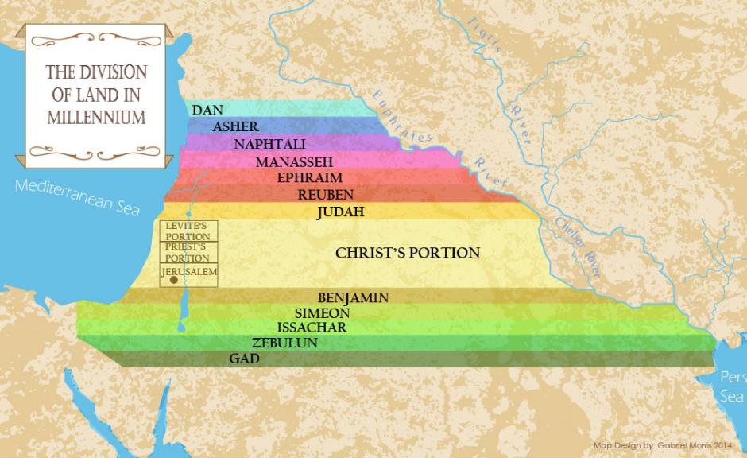

Slide 46
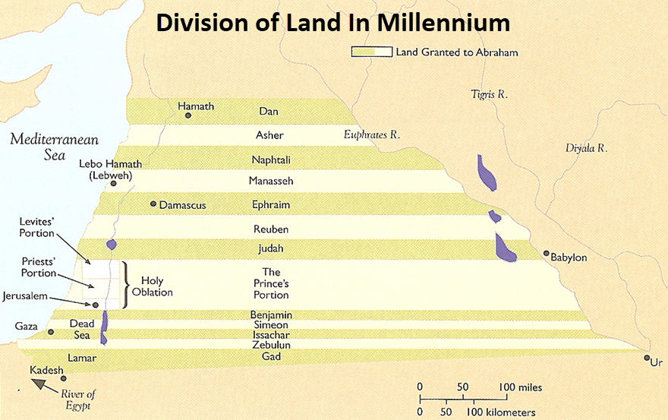

Slide 47
The Coming Spiritual Awakening
(Rev. 7:1-17)
The Instruments (7:1-8)
  Their sealing (7:1-3)
  Their number (7:4)
  Their lineage (7:5-8)
The Awakening (7:9-17)
  Salvation’s quantity (7:9)
  Salvation’s praises (7:10-12)
  Salvation’s timing (7:13-14)
  Salvation’s provisions (7:15-17)

Slide 48
The Coming Spiritual Awakening
(Rev. 7:1-17)
The Instruments (7:1-8)
  Their sealing (7:1-3)
  Their number (7:4)
  Their lineage (7:5-8)
The Awakening (7:9-17)
  Salvation’s quantity (7:9)
  Salvation’s praises (7:10-12)
  Salvation’s timing (7:13-14)
  Salvation’s provisions (7:15-17)

Slide 49
Distinctions Between 144,000 & Multitude
Revelation 7:1-8
Numbered
Jews
Sealed
Sealed before the Tribulation
Revelation 7:9-17
Innumerable
All nations
Slain
Converted out of the Tribulation
Hitchcock and Ice, The Truth Behind Left Behind, 77

Slide 50


Slide 51

Genesis 12:3
“And I will bless those who bless you, And the one who curses you I will curse. And in you all the families of the earth will be blessed.”

Slide 52
God’s Work Through Israel
Revelation 7 – 144,000 Jews
Revelation 11 – Two Jewish witnesses
Revelation 12 – Israel flees
Revelation 20:9 – Jerusalem in the kingdom
Revelation 21:12 – 13-Gates of the eternal city

Slide 53
God’s Work Through Israel
Revelation 7 – 144,000 Jews
Revelation 11 – Two Jewish witnesses
Revelation 12 – Israel flees
Revelation 20:9 – Jerusalem in the kingdom
Revelation 21:12 – 13-Gates of the eternal city

Slide 54
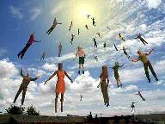
When Will the Rapture Take Place Relative to the Tribulation Period?
Pre-tribulation rapture theory
Mid-tribulation rapture theory
Post-tribulation rapture theory
Pre-wrath rapture theory
Partial rapture theory

Slide 55


Slide 56
MATT 24 / REV 6 PARALLELS
Prediction | Birth pangs (Matt 24) | Seal judgments (Rev 6)
False Christ | 24:5 | 6:2
War | 24:6 | 6:3-4
Famine | 24:7 | 6:5-6
Death | 24:6-7 | 6:7-8
Martyrs | 24:9-13 | 6:9-11
Earthquakes | 24:7 | 6:12-17
Evangelism | 24:14 | 7:1-9

Slide 57


Promise to the Overcomers
Rev 3:21
“He who overcomes, I will grant to him to sit down with Me on My throne, as I also overcame and sat down with My Father on His throne.”

Slide 58
Comparing Revelation 4 & 5
Chapter | Revelation 4 | Revelation 5
God-head Member | Father | Son
Role | Creator | Redeemer
Reason for Worship | Role in Creation (4:11) | Role in Redemption (5:9, 12)

Slide 59


1 John 5:4-5
^{“4} For whatever is born of God overcomes the world; and this is the victory that has overcome the world—our faith. ⁵ Who is the one who overcomes the world, but he who believes that Jesus is the Son of God?”

Slide 60

Romans 8:37
“But in all these things we overwhelmingly conquer [hypernikaō , present tense] through Him who loved us.”

Slide 61
The Coming Spiritual Awakening
(Rev. 7:1-17)
The Instruments (7:1-8)
  Their sealing (7:1-3)
  Their number (7:4)
  Their lineage (7:5-8)
The Awakening (7:9-17)
  Salvation’s quantity (7:9)
  Salvation’s praises (7:10-12)
  Salvation’s timing (7:13-14)
  Salvation’s provisions (7:15-17)

Slide 62

B. Salvation’s Praises
(Rev. 7:10-12)
By Gentiles (7:10)
By angels, elders, 4 living creatures (7:11-12)

Slide 63
B. Salvation’s Praises
(Rev. 7:10-12)
By Gentiles (7:10)
By angels, elders, 4 living creatures (7:11-12)

Slide 64
Revelation 11:15
¹⁵ “Then the seventh angel sounded; and there were loud voices in heaven, saying, ‘The kingdom of the world has become the kingdom of our Lord and of His Christ; and He will reign forever and ever.’”

Slide 65
B. Salvation’s Praises
(Rev. 7:10-12)
By Gentiles (7:10)
By angels, elders, 4 living creatures (7:11-12)

Slide 66
1. Twenty-Four Elders
(Rev. 4:4)
Church
  Crowned (2:10)
  Clothed in White (3:5)
  Redeemed (5:8-10)
  Enthroned (3:21)
  Elders (1 Tim. 3:1-7)
  Kingdom of Priests (Rev. 1:6)
  Twenty-four (Rev. 1:6)

Slide 67
The Coming Spiritual Awakening
(Rev. 7:1-17)
The Instruments (7:1-8)
  Their sealing (7:1-3)
  Their number (7:4)
  Their lineage (7:5-8)
The Awakening (7:9-17)
  Salvation’s quantity (7:9)
  Salvation’s praises (7:10-12)
  Salvation’s timing (7:13-14)
  Salvation’s provisions (7:15-17)

Slide 68

C. Salvation’s Timing
(Rev. 7:13-14)
Question (7:13)
Answer (7:14)

Slide 69
C. Salvation’s Timing
(Rev. 7:13-14)
Question (7:13)
Answer (7:14)

Slide 70
C. Salvation’s Timing
(Rev. 7:13-14)
Question (7:13)
Answer (7:14)

Slide 73
The Coming Spiritual Awakening
(Rev. 7:1-17)
The Instruments (7:1-8)
  Their sealing (7:1-3)
  Their number (7:4)
  Their lineage (7:5-8)
The Awakening (7:9-17)
  Salvation’s quantity (7:9)
  Salvation’s praises (7:10-12)
  Salvation’s timing (7:13-14)
  Salvation’s provisions (7:15-17)

Slide 74
C. Salvation’s Provision
(Rev. 7:15-17)
Their service (7:15)
Their satisfaction (7:16)
Their shepherd (7:17)

Slide 75
C. Salvation’s Provision
(Rev. 7:15-17)
Their service (7:15)
Their satisfaction (7:16)
Their shepherd (7:17)

Slide 76
C. Salvation’s Provision
(Rev. 7:15-17)
Their service (7:15)
Their satisfaction (7:16)
Their shepherd (7:17)

Slide 77
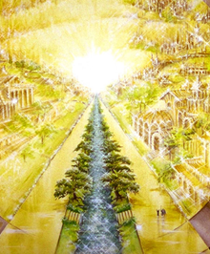
Eternal State is Future
No Satan (Rev 20:10)
No sea (Rev 21:1)
No death, crying, or pain (Rev 21:4)
No Sun (Rev 22:5)
No Moon (Rev 21:23)
No night (Rev 21:25)
No evil (Rev 21:27)
No curse (Rev 22:23)

Slide 78
C. Salvation’s Provision
(Rev. 7:15-17)
Their service (7:15)
Their satisfaction (7:16)
Their shepherd (7:17)

Slide 79
Eternal State is Future
No Satan (Rev 20:10)
No sea (Rev 21:1)
No death, crying, or pain (Rev 21:4)
No Sun (Rev 22:5)
No Moon (Rev 21:23)
No night (Rev 21:25)
No evil (Rev 21:27)
No curse (Rev 22:23)

Slide 80
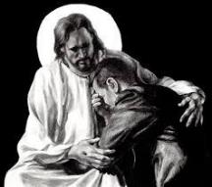
Revelation 21:4
“and He will wipe away every tear from their eyes; and there will no longer be any death; there will no longer be any mourning, or crying, or pain; the first things have passed away.”

Slide 81
Conclusion

Slide 82
The Coming Spiritual Awakening
(Rev. 7:1-17)
The Instruments (7:1-8)
  Their sealing (7:1-3)
  Their number (7:4)
  Their lineage (7:5-8)
The Awakening (7:9-17)
  Salvation’s quantity (7:9)
  Salvation’s praises (7:10-12)
  Salvation’s timing (7:13-14)
  Salvation’s provisions (7:15-17)

Slide 83

“The Lord bless you and keep you; the Lord make his face shine on you and be gracious to you; the Lord turn his face toward you and give you peace.” (NIV)

