Slide 1
THE BOOK OF DANIEL
Dr. Andy Woods

Slide 2
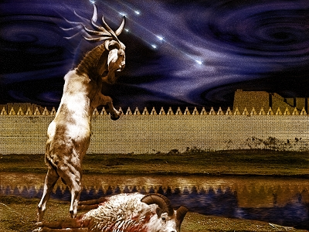
DANIEL 10-12 THE FINAL VISION

Slide 3
CHAPTER AND VERSE IN DANIEL | CHRONOLOGICAL DATE | BIBLICAL DATE
1:1 | 605 | 3rd year of Jehoiakim
2:1 | 603 | 2nd year of Nebuchadnezzar
5 | Sat. night 10/12/539 (Hoehner)
7:1 | 553 | 1st year of Belshazzar
8:1 | 551 | 3rd year of Belshazzar
9:1 | 538 | 1st year of Darius
10:1 | 536 | 3rd year of Cyrus

Slide 4
Chapter 10–12 Outline
The Setting (10:1-3)
Arrival of the Heavenly Messenger (10:4-9)
Explanation of the Heavenly Messenger (10:10–11:1)
The Prophecy of the Heavenly Messenger (11:2–12:13)

Slide 5
IV. The Prophecy of the Heavenly Messenger (11:2–12:13)
Persia (11:2)
Greece (11:3-4)
Ptolemies & Seleucids (11:5-20)
Antiochus IV (11:21-35)
Antichrist (11:36-45)
Tribulation & Millennium (12:1-13)

Slide 6
IV. The Prophecy of the Heavenly Messenger (11:2–12:13)
Persia (11:2)
Greece (11:3-4)
Ptolemies & Seleucids (11:5-20)
Antiochus IV (11:21-35)
Antichrist (11:36-45)
Tribulation & Millennium (12:1-13)

Slide 7
Understanding Daniel’s
Prophetic Perspective
Antichrist
Antiochus IV
(Daniel 11:36-45)
(Daniel 11:21-35)
Far
Fulfillment
Near
Fulfillment
Daniel

Slide 8
The Career of the Antichrist Daniel 11:36-45
His self-magnification (36-37)
His military power (38-39)
His military successes (40-43)
His military defeat (44-45)

Slide 9
The Career of the Antichrist Daniel 11:36-45
His self-magnification (36-37)
His military power (38-39)
His military successes (40-43)
His military defeat (44-45)

Slide 10
The Career of the Antichrist Daniel 11:36-45
His self-magnification (36-37)
His military power (38-39)
His military successes (40-43)
His military defeat (44-45)

Slide 12
John C. Whitcomb Daniel, Page 155
“The Antichrist will lavish his vast resources upon military fortifications and programs and will encourage cooperation by distributing positions of authority and valuable property to his followers.”

Slide 13
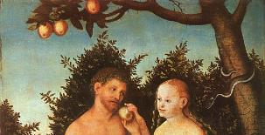
1 John 4:3
“and every spirit that does not confess Jesus is not from God; this is the spirit of the antichrist, of which you have heard that it is coming, and now it is already in the world.”

Slide 14
NO. | CATEGORY | JESUS CHRIST | ANTICHRIST
1. | World prepared in advance | Gal. 4:4 | 2 Thess. 2:7
2. | Revealed at the proper time | Gal. 4:4 | 2 Thess. 2:6
3. | Claim of deity | John 14:9 | 2 Thess. 2:4
4. | Heralded by a forerunner | John 1:23 | Rev. 13:12
5. | Forerunner comes in the Spirit & power of Elijah | Luke 1:17 | 1 Kgs. 8:37-38; Rev. 13:13
6. | Empowered by a higher source | 1 Cor. 6:14 | Rev. 13:14
7. | Member of a Trinity | Phil. 1:2; Acts 5:3-4; John 14:9 | Rev. 16:13; 20:10
8. | Head of a Church | Eph. 5:23 | Rev. 2:9; 3:9
9. | Miracle of worker | Acts 2:22 | 2 Thess. 2:9
10. | Resurrection from the dead | 1 Cor. 15:3-6 | Rev. 13:3, 12, 14

Slide 15
NO. | CATEGORY | JESUS CHRIST | ANTICHRIST
11. | Ruling a political kingdom | Isa. 9:6-7 | Rev. 13:5
12. | Ushering in world peace | Isa. 9:6-7 | Rev. 6:1-4
13. | Activity in the Temple | Luke 2:41-50 | 2 Thess. 2:4
14. | Putting an end to animal sacrifices | Heb. 9:26-29 | Dan. 9:27
15. | Length of ministry | Over 3 years | Rev. 13:5
16. | Sealing ministry | Eph. 4:30 | Rev. 13:16-17
17. | Presentation to Israel as her messiah | John 1:11 | John 5:43
18. | Covenant with Israel | Gen. 15:18 | Dan. 9:27
19. | Reception of worship | Zech. 14:16 | 2 Thess. 2:4
20. | Establishing Jerusalem as the center of worldwide worship | Zech. 14:17 | 2 Thess. 2:4

Slide 16
The Career of the Antichrist Daniel 11:36-45
His self-magnification (36-37)
His military power (38-39)
His military successes (40-43)
His military defeat (44-45)

Slide 17
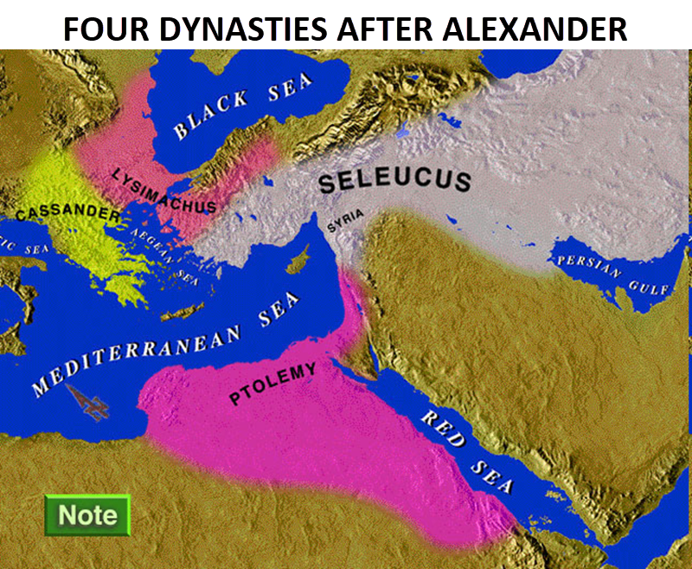

Slide 18
Daniel 9:27
And he will make a firm covenant with the many for one week, but in the middle of the week he will put a stop to sacrifice and grain offering; and on the wing of abominations will come one who makes desolate, even until a complete destruction, one that is decreed, is poured out on the one who makes desolate.

Slide 22
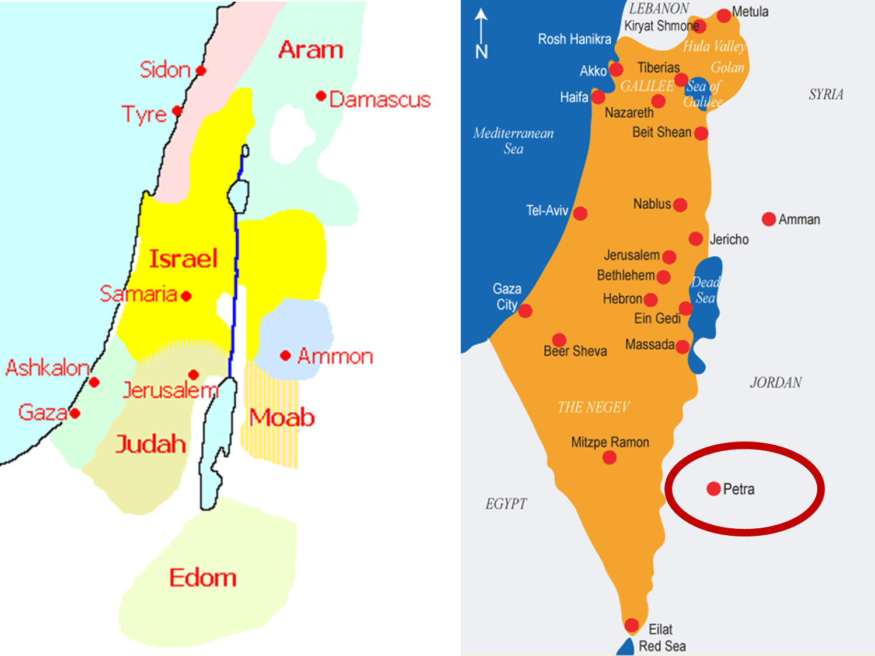

Slide 23
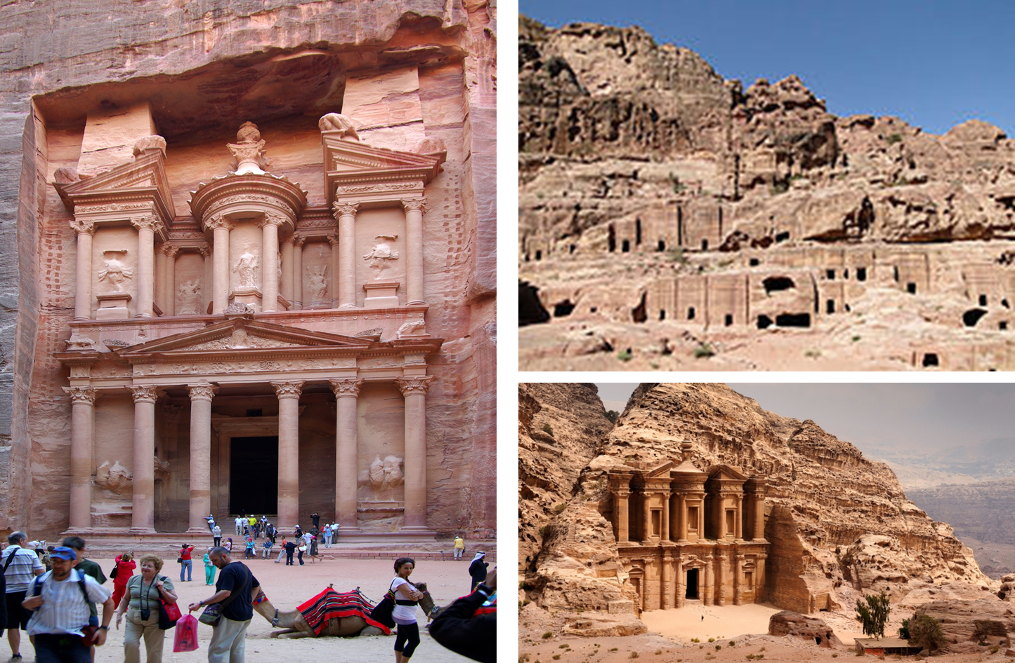

Slide 24
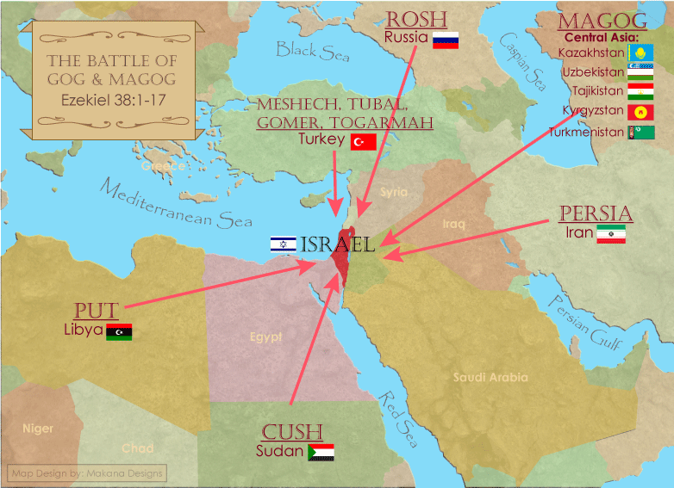

Slide 25
The Career of the Antichrist Daniel 11:36-45
His self-magnification (36-37)
His military power (38-39)
His military successes (40-43)
His military defeat (44-45)

Slide 26
Conclusion

Slide 27
Chapter 10–12 Outline
The Setting (10:1-3)
Arrival of the Heavenly Messenger (10:4-9)
Explanation of the Heavenly Messenger (10:10–11:1)
The Prophecy of the Heavenly Messenger (11:2–12:13)

Slide 28
IV. The Prophecy of the Heavenly Messenger (11:2–12:13)
Persia (11:2)
Greece (11:3-4)
Ptolemies & Seleucids (11:5-20)
Antiochus IV (11:21-35)
Antichrist (11:36-45)
Tribulation & Millennium (12:1-13)

Slide 29
Purpose
To encourage Judah by emphasizing the sovereignty of God during the Babylonian captivity and to teach Judah how to live while outside the land

Slide 30
“The Lord bless you and keep you; the Lord make his face shine on you and be gracious to you; the Lord turn his face toward you and give you peace.” (NIV)

