Slide 1

Ecclesiology
Session 14
Dr. Andy Woods
Senior Pastor – Sugar Land Bible Church
President – Chafer Theological Seminary

Slide 2


Areas of Systematic Theology
Prolegomena – Introduction
Theology – Study of God
Christology – Study of Christ
Pneumatology – Study of the Holy Spirit
Anthropology – Study of Man
Hamartiology – Study of sin
Soteriology – Study of salvation
Angelology – Study of angels
Ecclesiology – Study of the Church
Eschatology – Study of the end

Slide 3
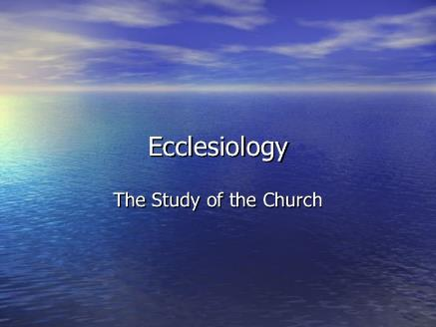
Ecclesiology Overview
Definition
Universal vs. local
Word pictures
Origin
Israel – Church differences
Intercalation
Purposes
Activities
Government
Officers
Ordinances
Purity

Slide 4
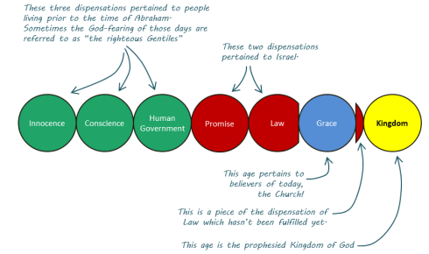
Intercalation
Unconditional program for Israel
Unfulfilled program for Israel
Literal program for Israel
Truthful program for Israel
Future program for Israel
Three inadequate explanations
God is at work today
Present work of God is an interruption, interval, parenthesis, or intercalation in God’s work with Israel
The church will play a role in the millennial kingdom
Dispensational vs. Reformed Theology

Slide 5
Intercalation
Unconditional program for Israel
Unfulfilled program for Israel
Literal program for Israel
Truthful program for Israel
Future program for Israel
Three inadequate explanations
God is at work today
Present work of God is an interruption, interval, parenthesis, or intercalation in God’s work with Israel
The church will play a role in the millennial kingdom
Dispensational vs. Reformed Theology

Slide 6
Evidence of Abrahamic Covenant’s Unconditional Nature
ANE covenant ratification ceremony (Gen 15)
No stated conditions for Israel’s obedience (Gen 15)
Covenant's eternality (Gen 17:7, 13, 19)
Covenant's immutability (Heb 6:13-18)
Trans-generational reaffirmation despite perpetual national disobedience (Jer. 31:35-37)
Walvoord, The Millennial Kingdom, 149-52

Slide 7

Jeremiah 31:35-37
Thus says the Lord, Who gives the sun for light by day And the fixed order of the moon and the stars for light by night, Who stirs up the sea so that its waves roar; The Lord of hosts is His name:³⁶ “If this fixed order departs From before Me,” declares the Lord, “Then the offspring of Israel also will cease From being a nation before Me forever.”³⁷ Thus says the Lord, “If the heavens above can be measured And the foundations of the earth searched out below, Then I will also cast off all the offspring of Israel For all that they have done,” declares the Lord.

Slide 8
Intercalation
Unconditional program for Israel
Unfulfilled program for Israel
Literal program for Israel
Truthful program for Israel
Future program for Israel
Three inadequate explanations
God is at work today
Present work of God is an interruption, interval, parenthesis, or intercalation in God’s work with Israel
The church will play a role in the millennial kingdom
Dispensational vs. Reformed Theology

Slide 9
Land Promises Fulfilled in the Time of Joshua (11:23; 21:43-35) or Solomon (1 Kgs. 4:21)?
Extended context Josh 13:1-7
Judges 1:19, 21, 27, 29-36
Land gained was a fraction of what was promised Num. 34 vs. Gen. 15
Jerusalem unconquered by Joshua Josh 15:63
Border of Egypt; Tributary (1 Kings 4:21)
Forever? Gen 17:8
Amos 9:11-15 Reaffirms land promises
Fruchtenbaum, Israelology, 521-22, 631-32

Slide 10


Slide 11
1 Kings 4:21
“Now Solomon ruled over all the kingdoms from the River to the land of the Philistines and to the border of Egypt; they brought tribute and served Solomon all the days of his life.”

Slide 12
Genesis 13:14-18
“¹⁴ The Lord said to Abram, after Lot had separated from him, ‘Now lift up your eyes and look from the place where you are, northward and southward and eastward and westward; ¹⁵ for all the land which you see, I will give it to you and to your descendants forever…¹⁷ Arise, walk about the land through its length and breadth; for I will give it to you.’ ¹⁸ Then Abram moved his tent and came and dwelt by the oaks of Mamre, which are in Hebron, and there he built an altar to the Lord.”

Slide 13
Israel's Historical Judgments
Division of the kingdom in 931 B.C. (1 Kgs. 12)
Assyrian judgment in 722 B.C. (2 Kgs. 17)
Babylonian captivity in 586 B.C. (2 Kgs. 25)
Roman Judgment in A.D. 70 (Luke 19:41-44)

Slide 14
Intercalation
Unconditional program for Israel
Unfulfilled program for Israel
Literal program for Israel
Truthful program for Israel
Future program for Israel
Three inadequate explanations
God is at work today
Present work of God is an interruption, interval, parenthesis, or intercalation in God’s work with Israel
The church will play a role in the millennial kingdom
Dispensational vs. Reformed Theology

Slide 15

Genesis 13:14-18
“¹⁴ The Lord said to Abram, after Lot had separated from him, ‘Now lift up your eyes and look from the place where you are, northward and southward and eastward and westward; ¹⁵ for all the land which you see, I will give it to you and to your descendants forever…¹⁷ Arise, walk about the land through its length and breadth; for I will give it to you.’ ¹⁸ Then Abram moved his tent and came and dwelt by the oaks of Mamre, which are in Hebron, and there he built an altar to the Lord.”

Slide 16
Intercalation
Unconditional program for Israel
Unfulfilled program for Israel
Literal program for Israel
Truthful program for Israel
Future program for Israel
Three inadequate explanations
God is at work today
Present work of God is an interruption, interval, parenthesis, or intercalation in God’s work with Israel
The church will play a role in the millennial kingdom
Dispensational vs. Reformed Theology

Slide 17

Exodus 2:24
“So God heard their groaning; and God remembered His covenant with Abraham, Isaac, and Jacob.”

Slide 18
Exodus 36:22
“Therefore say to the house of Israel, ‘Thus says the Lord God, “It is not for your sake, O house of Israel, that I am about to act, but for My holy name, which you have profaned among the nations where you went.”

Slide 19
Intercalation
Unconditional program for Israel
Unfulfilled program for Israel
Literal program for Israel
Truthful program for Israel
Future program for Israel
Three inadequate explanations
God is at work today
Present work of God is an interruption, interval, parenthesis, or intercalation in God’s work with Israel
The church will play a role in the millennial kingdom
Dispensational vs. Reformed Theology

Slide 20
Ezekiel 36:24-28
“For I will take you from the nations, gather you from all the lands and bring you into your own land. ²⁵ Then I will sprinkle clean water on you, and you will be clean; I will cleanse you from all your filthiness and from all your idols. ²⁶ Moreover, I will give you a new heart and put a new spirit within you; and I will remove the heart of stone from your flesh and give you a heart of flesh. ²⁷ I will put My Spirit within you and cause you to walk in My statutes, and you will be careful to observe My ordinances. ²⁸ You will live in the land that I gave to your forefathers; so you will be My people, and I will be your God.”

Slide 21
Ezekiel 37:7-11
So I prophesied as I was commanded; and as I prophesied, there was a noise, and behold, a rattling; and the bones came together, bone to its bone. ⁸ And I looked, and behold, sinews were on them, and flesh grew and skin covered them; but there was no breath in them. ⁹ Then He said to me, “Prophesy to the breath, prophesy, son of man, and say to the breath, ‘Thus says the Lord God, “Come from the four winds, O breath, and breathe on these slain, that they come to life.”’” ¹⁰ So I prophesied as He commanded me, and the breath came into them, and they came to life and stood on their feet, an exceedingly great army. ¹¹ Then He said to me, “Son of man, these bones are the whole house of Israel; behold, they say, ‘Our bones are dried up and our hope has perished. We are completely cut off’.”

Slide 22
Intercalation
Unconditional program for Israel
Unfulfilled program for Israel
Literal program for Israel
Truthful program for Israel
Future program for Israel
Three inadequate explanations
God is at work today
Present work of God is an interruption, interval, parenthesis, or intercalation in God’s work with Israel
The church will play a role in the millennial kingdom
Dispensational vs. Reformed Theology

Slide 23
6. Three Inadequate Ways of Explaining Away Israel’s Future
Because Israel broke God’s covenant God canceled Israel’s promises (Jer. 31:35-37)
Israel’s promises have already been fulfilled (Joshua 15:63)
Israel’s are being now spiritually fulfilled in a and through the church (Deut. 30:3)

Slide 24
Jeremiah 31:35-37
Thus says the Lord, Who gives the sun for light by day And the fixed order of the moon and the stars for light by night, Who stirs up the sea so that its waves roar; The Lord of hosts is His name:³⁶ “If this fixed order departs From before Me,” declares the Lord, “Then the offspring of Israel also will cease From being a nation before Me forever.”³⁷ Thus says the Lord, “If the heavens above can be measured And the foundations of the earth searched out below, Then I will also cast off all the offspring of Israel For all that they have done,” declares the Lord.

Slide 25

Deuteronomy 30:3
“Then the Lord your God will restore you from captivity, and have compassion on you, and will gather you again from all the peoples where the Lord your God has scattered you.”

Slide 26
Intercalation
Unconditional program for Israel
Unfulfilled program for Israel
Literal program for Israel
Truthful program for Israel
Future program for Israel
Three inadequate explanations
God is at work today
Present work of God is an interruption, interval, parenthesis, or intercalation in God’s work with Israel
The church will play a role in the millennial kingdom
Dispensational vs. Reformed Theology

Slide 27
Matthew 16:18
I also say to you that you are Peter, and upon this rock I will build [oikodomeō] My church; and the gates of Hades will not overpower it.

Slide 28
Acts 15:14
“Simeon has related how God first concerned Himself about taking from among the Gentiles a people for His name.”

Slide 29
Romans 11:25b
“For I do not want you, brethren, to be uninformed of this mystery—so that you will not be wise in your own estimation—that a partial hardening has happened to Israel until the fullness of the Gentiles has come in.”

Slide 30
Intercalation
Unconditional program for Israel
Unfulfilled program for Israel
Literal program for Israel
Truthful program for Israel
Future program for Israel
Three inadequate explanations
God is at work today
Present work of God is an interruption, interval, parenthesis, or intercalation in God’s work with Israel
The church will play a role in the millennial kingdom
Dispensational vs. Reformed Theology

Slide 31
Ephesians 2:15-16
“by abolishing in His flesh the enmity, which is the Law of commandments contained in ordinances, so that in Himself He might make the two into one new man, thus establishing peace, ¹⁶ and might reconcile them both in one body to God through the cross, by it having put to death the enmity.”

Slide 32
Ephesians 3:3-6
“that by revelation there was made known to me the mystery, as I wrote before in brief. ⁴ By referring to this, when you read you can understand my insight into the mystery of Christ, ⁵ which in other generations was not made known to the sons of men, as it has now been revealed to His holy apostles and prophets in the Spirit; ⁶ to be specific, that the Gentiles are fellow heirs and fellow members of the body, and fellow partakers of the promise in Christ Jesus through the gospel”.

Slide 33

Ephesians 3:9
“and to bring to light what is the administration of the mystery which for ages has been hidden in God who created all things.”

Slide 34
Romans 16:25-26
²⁵ “Now to Him who is able to establish you according to my gospel and the preaching of Jesus Christ, according to the revelation of the mystery which has been kept secret for long ages past, ²⁶ but now is manifested, and by the Scriptures of the prophets, according to the commandment of the eternal God, has been made known to all the nations, leading to obedience of faith.”

Slide 35
Colossians 1:26
“that is, the mystery which has been hidden from the past ages and generations, but has now been manifested to His.”

Slide 36
“Mystery” Defined
“In the N.T, it [mystērion] denotes, not the mysterious (as with the Eng. word), but that which, being outside the range of unassisted natural apprehension, can be made known only by Divine revelation, and is made known in a manner and at a time appointed by God, and to those who are illumined by His Spirit.”
W. E. Vine, Merrill F. Unger, and William White, Vine's Complete Expository Dictionary of the Old and New Testament Words (Nashville: Nelson, 1996), 424.

Slide 37

Lewis Sperry Chafer vol. 4, Systematic Theology (Grand Rapids, MI: Kregel Publications, 1993), 41.
“In fact, the new, hitherto unrevealed purpose of God in the out calling of a heavenly people from Jews and Gentiles is so divergent with respect to the divine purpose toward Israel, which purpose preceded it and will yet follow it, that the term parenthetical, commonly employed to describe the new age purpose, is inaccurate. A parenthetical portion sustains some direct and indirect relation to that which goes before or that which follows; but the present age-purpose is not thus related and therefore is more properly termed an intercalation.”…

Slide 38
Lewis Sperry Chafer, vol. 4, Systematic Theology (Grand Rapids, MI: Kregel Publications, 1993), 41.
Lewis Sperry Chafer
vol. 4, Systematic Theology (Grand Rapids, MI: Kregel Publications, 1993), 41.
…“The appropriateness of this word will be seen in the fact that, as an interpolation is formed by inserting a word or phrase into a context, so when intercalation is formed by introducing a day or a period of time into the calendar. The present age of the church is an intercalation into the revealed calendar or program of God as that program was foreseen by the prophets of old. Such, indeed, is the precise character of the present age.”

Slide 39
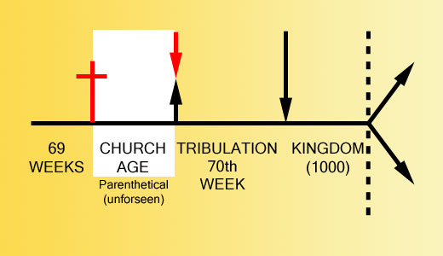

Slide 40
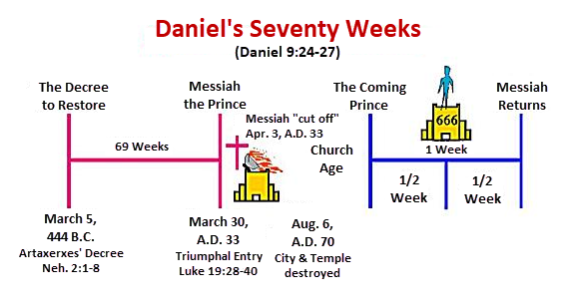

Slide 41
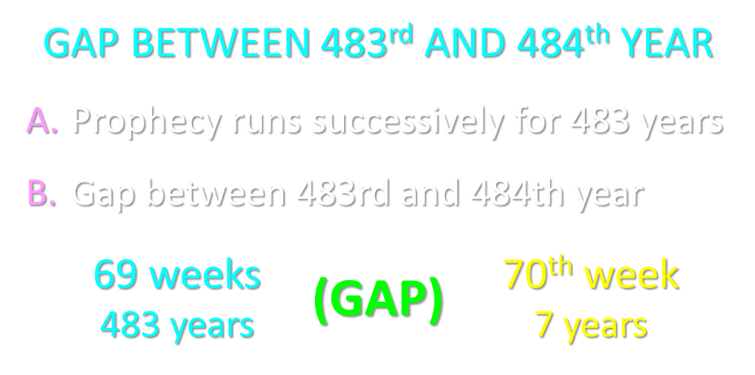

Slide 42
Isaiah 9:6-7
⁶ For a child will be born to us, a son will be given to us; And the government will rest on His shoulders; And His name will be called Wonderful Counselor, Mighty God, Eternal Father, Prince of Peace.⁷ There will be no end to the increase of His government or of peace, On the throne of David and over his kingdom, To establish it and to uphold it with justice and righteousness From then on and forevermore. The zeal of the Lord of hosts will accomplish this.

Slide 43
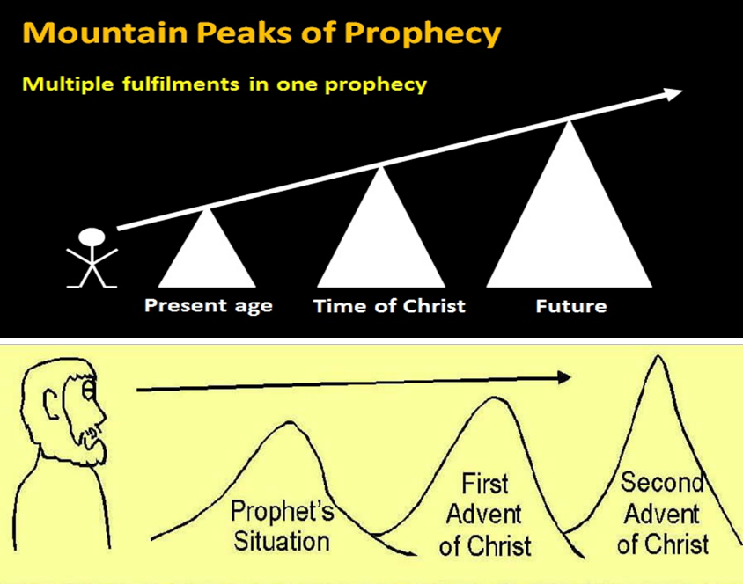

Slide 44
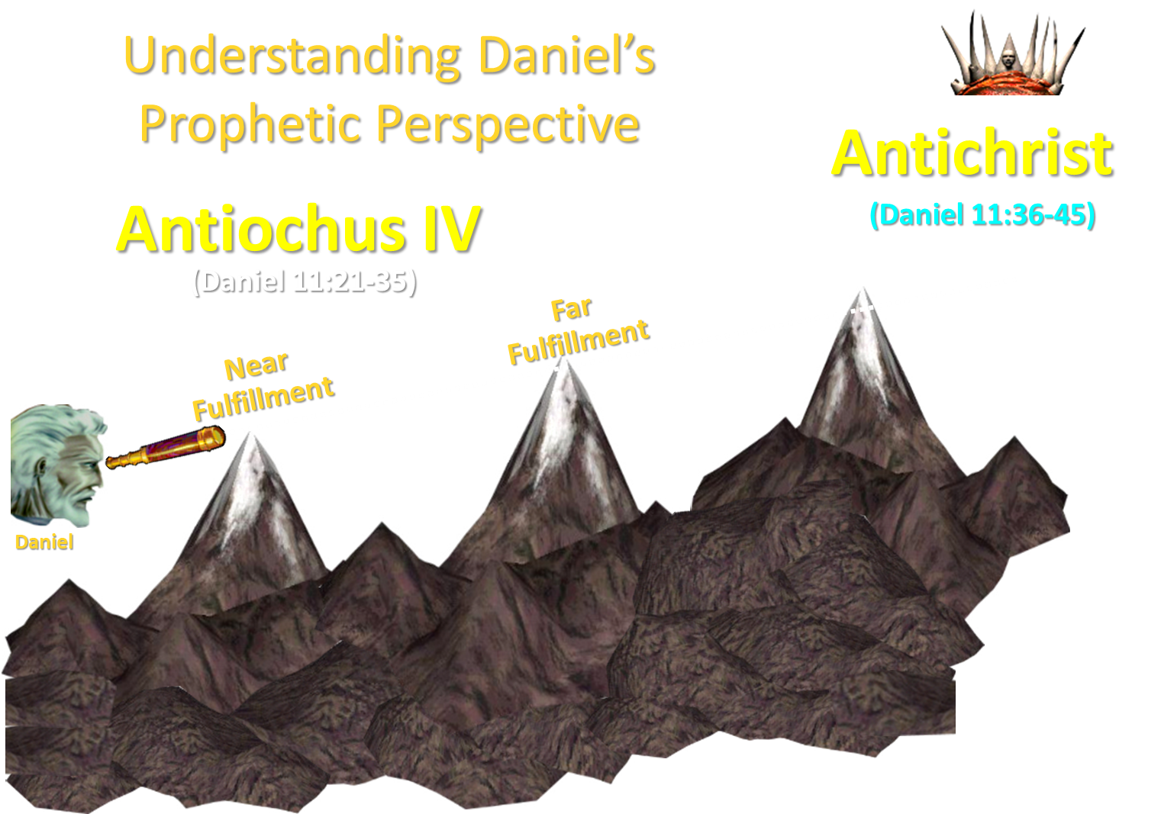

Slide 45


Statue
&
Stone

Slide 46
Romans 11:25b
“For I do not want you, brethren, to be uninformed of this mystery—so that you will not be wise in your own estimation—that a partial hardening has happened to Israel until the fullness of the Gentiles has come in.”

Slide 47
Reformed Theology’s Denial of the Church as an Intercalation
“We’re not dispensationalists here....We believe that the church is essentially Israel. We believe that the answer to, ‘What about the Jews?’ is, ‘Here we are.’ We deny that the church is God’s ‘plan B.’ We deny that we are living in God’s redemptive parenthesis. There, we are again one people. In His holy and heavenly temple there is neither Jew nor Greek, male nor female, pre-mil nor post-mil. There, we are all together, the Israel of God, princes with God, and the ekklesia, the set apart ones.”
From Table Talk magazine, Spring of 1999, p. 2 (inside cover), by R. C. Sproul Jr., editor, emphasis is mine

Slide 48


Slide 49

Ephesians 3:11
“This was in accordance with the eternal purpose which He carried out in Christ Jesus our Lord.”

Slide 50
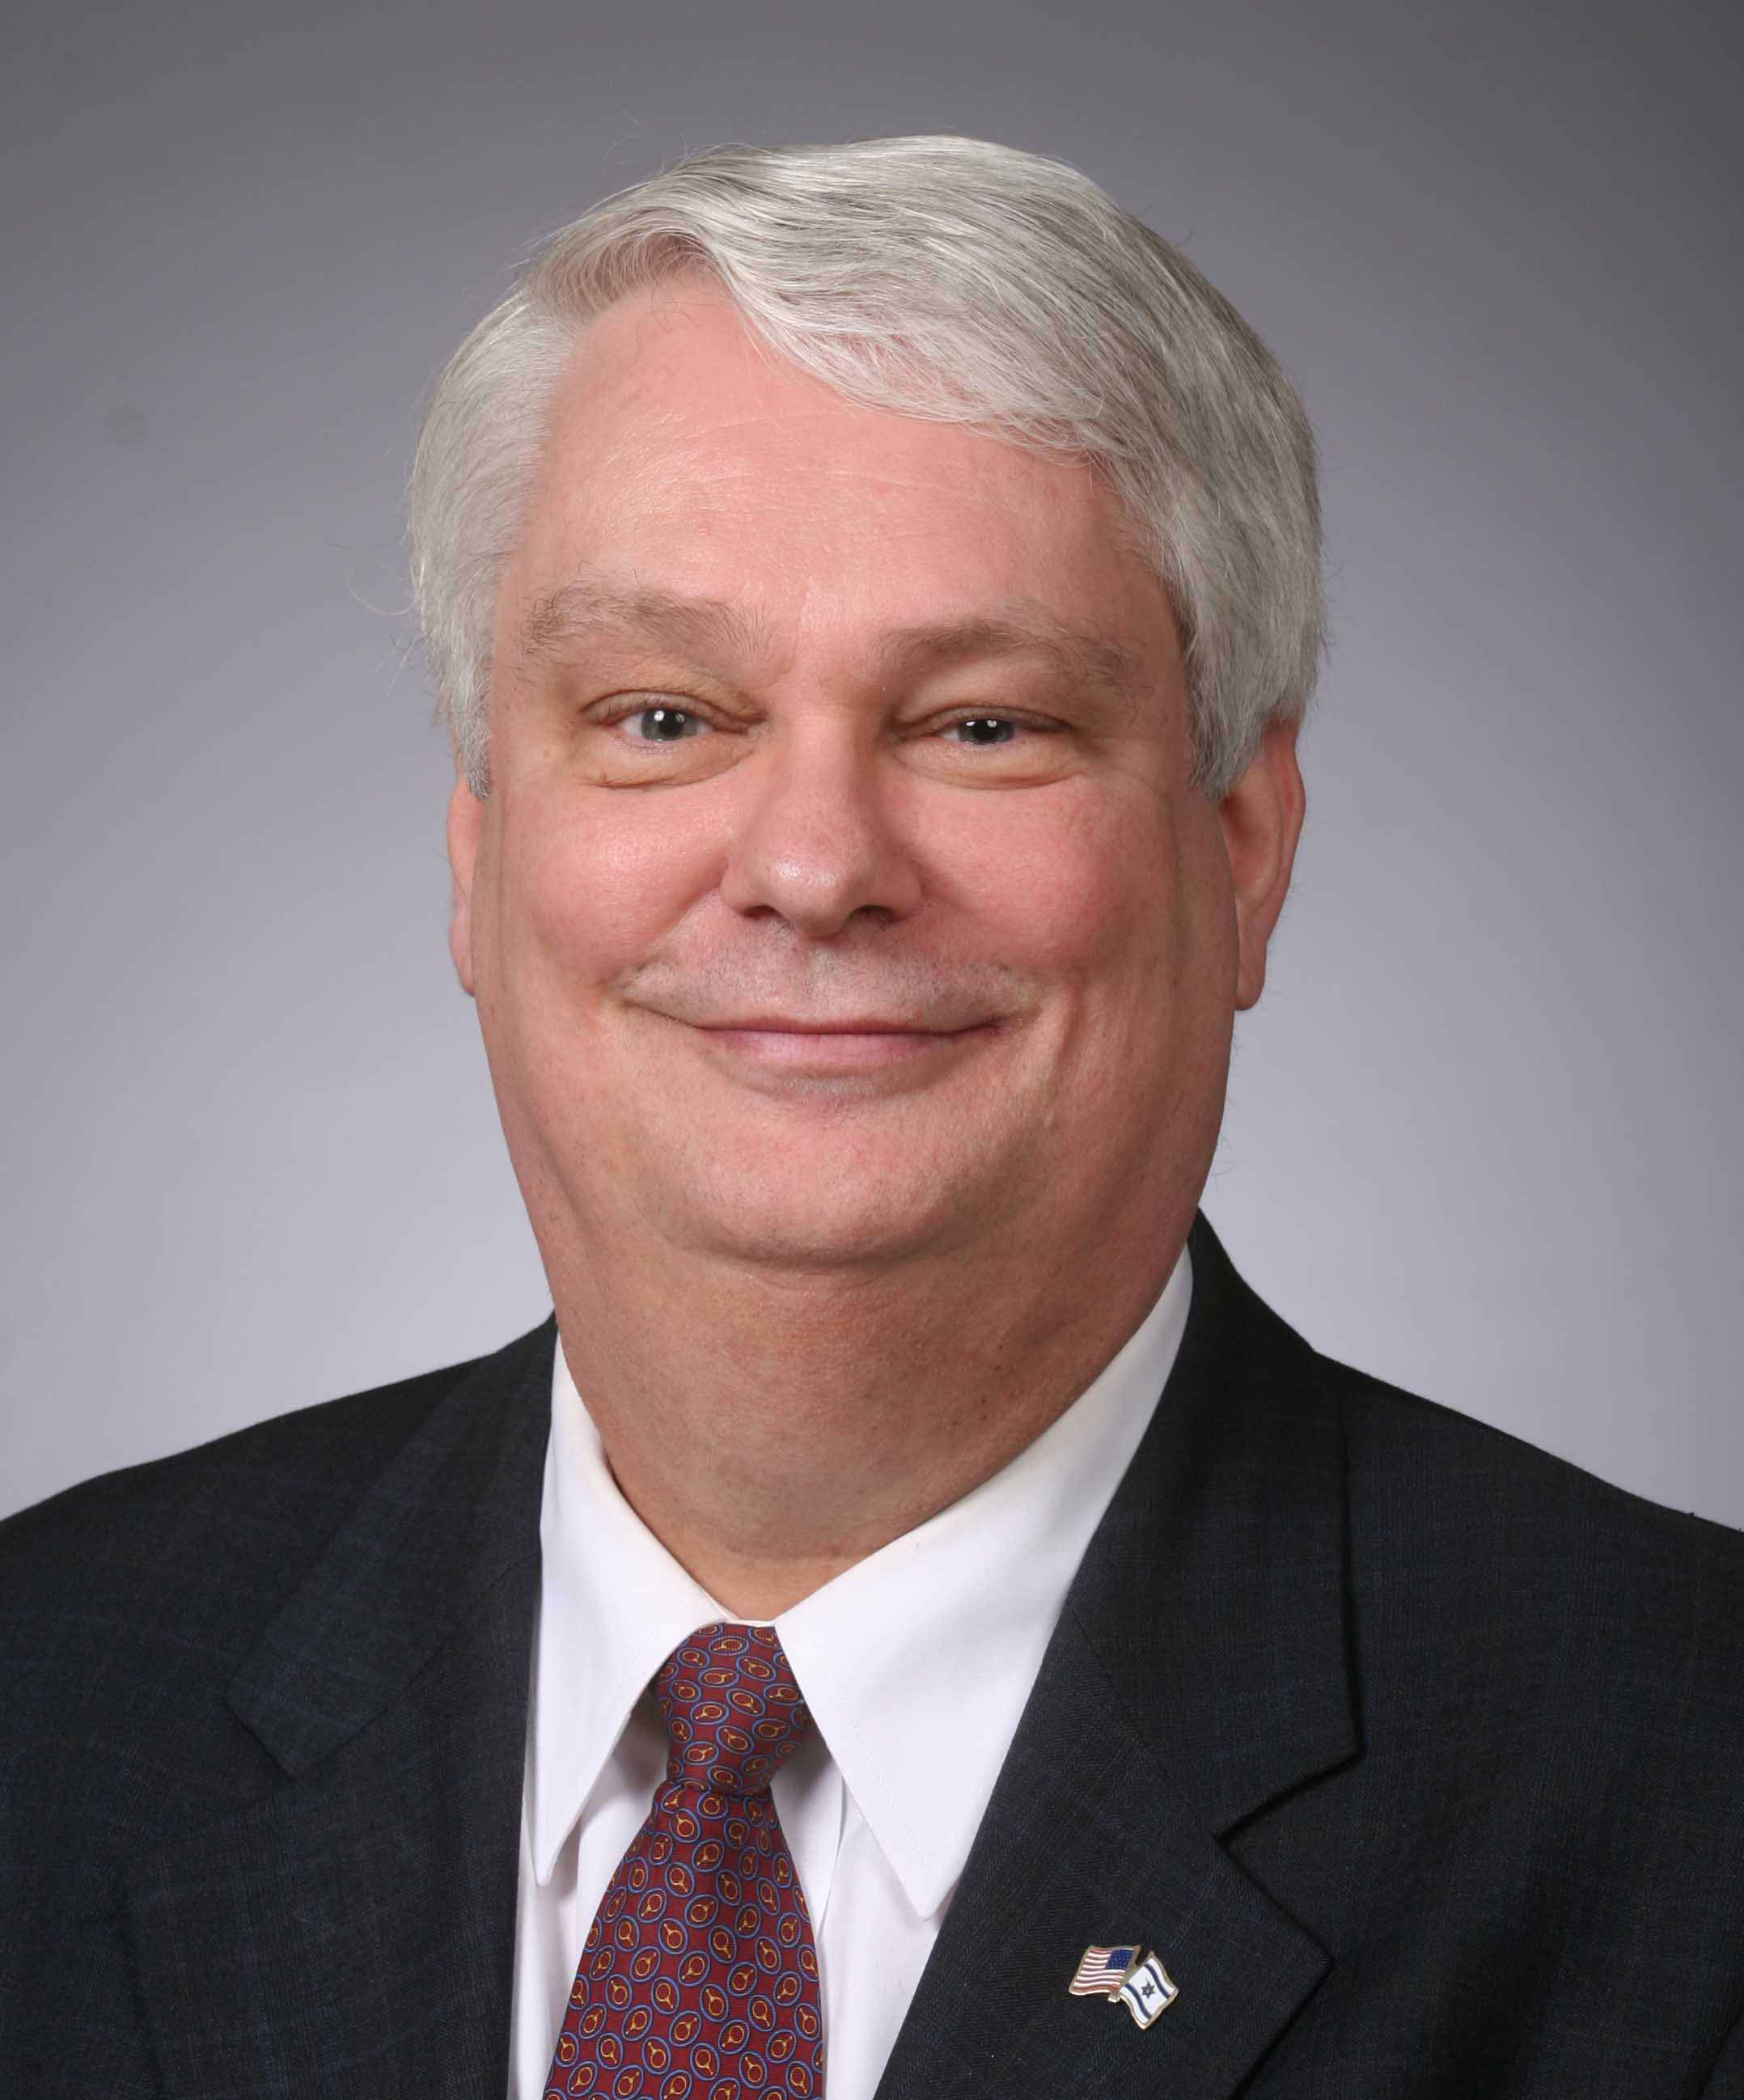
The Church is not “Plan B”
“In almost 35 years since I have become a dispensationalist, I have never heard nor read of a dispensationalist teaching a plan B scenario. Yet opponents often present this straw man in their statement of what we supposedly believe. We believe that God’s single plan has always included the Church, but He did not reveal the church age part of the plan in the Old Testament. . . . Paul states specifically that the church age ‘was in accordance with the eternal purpose which He carried out in Christ Jesus our Lord’ (verse 11). This is why dispensationalists have never taught the so-called plan A and plan B theory that critics suppose we hold. Dispensationalists have always taught that there is a single plan carried out in stages.”
Thomas Ice, “The Uniqueness of the Church,” Pre-Trib Perspectives 8, no. 6 (September 2003): 4.

Slide 51
Intercalation
Unconditional program for Israel
Unfulfilled program for Israel
Literal program for Israel
Truthful program for Israel
Future program for Israel
Three inadequate explanations
God is at work today
Present work of God is an interruption, interval, parenthesis, or intercalation in God’s work with Israel
The church will play a role in the millennial kingdom
Dispensational vs. Reformed Theology

Slide 52
1 Corinthians 6:1-3
¹ “Does any one of you, when he has a case against his neighbor, dare to go to law before the unrighteous and not before the saints? ² Or do you not know that the saints will judge the world? If the world is judged by you, are you not competent to constitute the smallest law courts? ³ Do you not know that we will judge angels? How much more matters of this life?”

Slide 53
2 Timothy 2:11-13
“¹¹ It is a trustworthy statement: For if we died with Him, we will also live with Him; ¹²If we endure, we will also reign with Him; If we deny Him, He also will deny us; ¹³If we are faithless, He remains faithful, for He cannot deny Himself.”

Slide 54
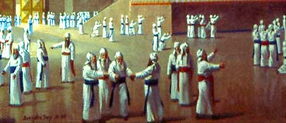
Revelation 5:10
¹⁰ “You have made them to be a kingdom and priests to our God; and they will reign upon the earth.”

Slide 55
Intercalation
Unconditional program for Israel
Unfulfilled program for Israel
Literal program for Israel
Truthful program for Israel
Future program for Israel
Three inadequate explanations
God is at work today
Present work of God is an interruption, interval, parenthesis, or intercalation in God’s work with Israel
The church will play a role in the millennial kingdom
Dispensational vs. Reformed Theology

Slide 56
Reformed Theology’s Denial of the Church as an Intercalation
“We’re not dispensationalists here....We believe that the church is essentially Israel. We believe that the answer to, ‘What about the Jews?’ is, ‘Here we are.’ We deny that the church is God’s ‘plan B.’ We deny that we are living in God’s redemptive parenthesis. There, we are again one people. In His holy and heavenly temple there is neither Jew nor Greek, male nor female, pre-mil nor post-mil. There, we are all together, the Israel of God, princes with God, and the ekklesia, the set apart ones.”
From Table Talk magazine, Spring of 1999, p. 2 (inside cover), by R. C. Sproul Jr., editor, emphasis is mine

Slide 57

Arnold G. Fruchtenbaum
George Zeller, “Is R. C. Sproul Jr. Really A Jew?,” online: http://www.middletownbiblechurch.org/reformed/sprouljr.htm, accessed 17 February 2018.
“We believe that the answer to, ‘What about the Jews?’ is, ‘Here we are.’ I shared this comment with a friend of mine who is a converted Jew. He was born in Russia after his parents were released from a Communist prison. With the help of the Israeli underground, his family escaped from behind the Iron Curtain. He received Orthodox Jewish training while living in Germany from 1947 to 1951 and then his family immigrated to New York. He is a dedicated servant of Christ and a respected author. When told about Sproul Jr.’s comment ‘Here we are. [We are the Jews]’ he commented, ‘It’s a good thing he was not declaring this on the streets of Berlin, Germany around 1941!’”

Slide 58

Church
Hebrew Christians

Slide 59
Conclusion

Slide 60
Intercalation
Unconditional program for Israel
Unfulfilled program for Israel
Literal program for Israel
Truthful program for Israel
Future program for Israel
Three inadequate explanations
God is at work today
Present work of God is an interruption, interval, parenthesis, or intercalation in God’s work with Israel
The church will play a role in the millennial kingdom
Dispensational vs. Reformed Theology

Slide 61
Ecclesiology Overview
Definition
Universal vs. local
Word pictures
Origin
Israel – Church differences
Intercalation
Purposes
Activities
Government
Officers
Ordinances
Purity

