Slide 1


Slide 2

The Coming Kingdom
Chapter 12
Dr. Andy Woods
Senior Pastor – Sugar Land Bible Church
President – Chafer Theological Seminary

Slide 3

Kingdom Study Outline
What does the Bible Say About the Kingdom?
The Main Problem with Kingdom Now NT interpretations
Why do some believe that we are in the kingdom now?
Why does it matter?

Slide 4
Kingdom Study Outline
What does the Bible Say About the Kingdom?
The Main Problem with Kingdom Now NT interpretations
Why do some believe that we are in the kingdom now?
Why does it matter?

Slide 5
1. Kingdom Throughout the Bible
Eden Abrahamic Covenant Mosaic Covenant Divided Kingdom Times of the Gentiles | Old Testament Prophets Post exile Offer of the King / Kingdom Rejection of the Offer Interim Age

Slide 6
1. Kingdom Throughout the Bible
Kingdom Mysteries Church Israel’s Discipline & Restoration Re-offer of the King/Kingdom | Transfer of Kingdom Authority Kingdom Establishment Eternal State Testimony of Early Church History

Slide 7
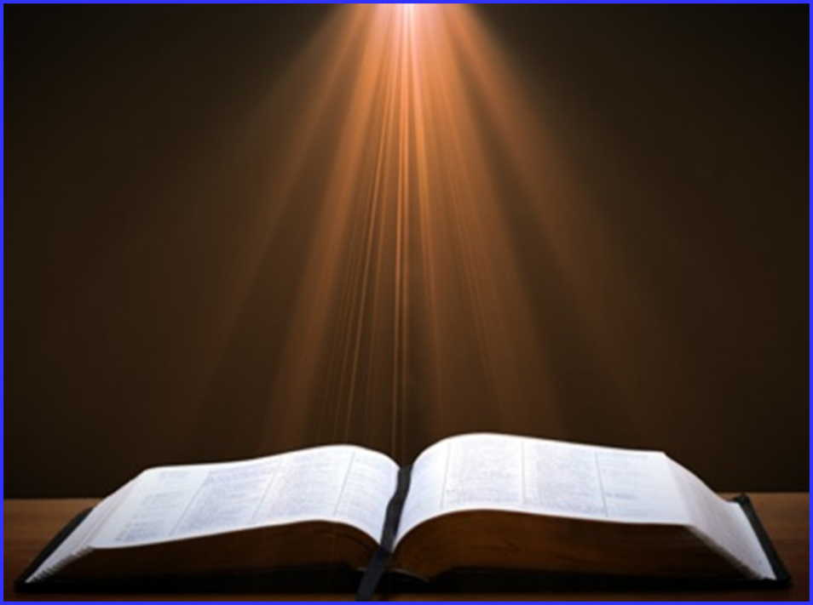

Exodus 19:5-6
“Now then, if you will indeed obey My voice and keep My covenant, then you shall be My own possession among all the peoples, for all the earth is Mine; and you shall be to Me a kingdom of priests and a holy nation.’ These are the words that you shall speak to the sons of Israel.”

Slide 8
Matthew 23:37-39
“Jerusalem, Jerusalem, who kills the prophets and stones those who are sent to her! How often I wanted to gather your children together, the way a hen gathers her chicks under her wings, and you were unwilling. ³⁸ Behold, your house is being left to you desolate! ³⁹ For I say to you, from now on you will not see Me until you say, ‘Blessed is He who comes in the name of the Lord!’”

Slide 9
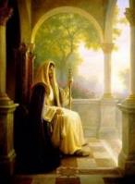
Israel’s Discipline & Restoration
Israel in the Diaspora
Israel’s regathering in unbelief
Israel’s conversion through distress
Israel’s final restoration

Slide 10
Israel’s Discipline & Restoration
Israel in the Diaspora
Israel’s regathering in unbelief
Israel’s conversion through distress
Israel’s final restoration

Slide 11
Six Parts of the Suzerain-Vassal Treaty in Deuteronomy
Preamble (1:1-5)
Prologue (1:6–4:40)
Covenant obligations (5–26)
Storage and reading instructions (27:2-3; 31:9, 24, 26)
Witnesses (32:1)
Blessings and curses (28)

Slide 12
Israel's Historical Judgments
Division of the kingdom in 931 B.C. (1 Kgs. 12)
Assyrian judgment in 722 B.C. (2 Kgs. 17)
Babylonian captivity in 586 B.C. (2 Kgs. 25)
Roman Judgment in A.D. 70 (Luke 19:41-44)

Slide 13
Deuteronomy 28:63-65
⁶³ It shall come about that as the Lord delighted over you to prosper you, and multiply you, so the Lord will delight over you to make you perish and destroy you; and you will be torn from the land where you are entering to possess it. ⁶⁴ Moreover, the Lord will scatter you among all peoples, from one end of the earth to the other end of the earth; and there you shall serve other gods, wood and stone, which you or your fathers have not known. ⁶⁵ Among those nations you shall find no rest, and there will be no resting place for the sole of your foot; but there the Lord will give you a trembling heart, failing of eyes, and despair of soul.

Slide 14
Israel’s Discipline & Restoration
Israel in the Diaspora
Israel’s regathering in unbelief
Israel’s conversion through distress
Israel’s final restoration

Slide 15
Israel’s Two Regatherings
THE PRESENT (FIRST) REGATHERING | THE PERMANENT (SECOND) REGATHERING
Return to part of the land | Return to all the land
Return in unbelief | Return in faith
Restored to the land only | Restored to the land and the Lord
Sets the stage for Tribulation (discipline) | Sets the stage for Millennium (blessing)
Adapted from: Price, Jerusalem In Prophecy, 219

Slide 16
Israel’s Discipline & Restoration
Israel in the Diaspora
Israel’s regathering in unbelief
Israel’s conversion through distress
Israel’s final restoration

Slide 17
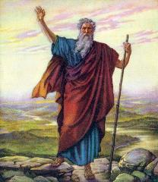
Deuteronomy 4:30
“ When you are in distress and all these things have come upon you, in the latter days you will return to the Lord your God and listen to His voice.”

Slide 18

Joel 3:1-2
“For behold, in those days and at that time,
When I restore the fortunes of Judah and Jerusalem, I will gather all the nations And bring them down to the valley of Jehoshaphat. Then I will enter into judgment with them there On behalf of My people and My inheritance, Israel, Whom they have scattered among the nations; And they have divided up My land.”

Slide 19

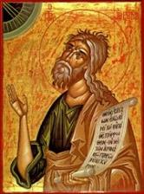
Jeremiah 30:7
“ Alas! for that day is great, There is none like it; And it is the time of Jacob’s distress, But he will be saved from it.”

Slide 20
Jeremiah 30:7
“ Alas! for that day is great, There is none like it; And it is the time of Jacob’s distress, But he will be saved from it.”

Slide 21
Jeremiah 30:7
“ Alas! for that day is great, There is none like it; And it is the time of Jacob’s distress, But he will be saved from it.”

Slide 22
Jeremiah 30:7
“ Alas! for that day is great, There is none like it; And it is the time of Jacob’s distress, But he will be saved from it.”

Slide 23
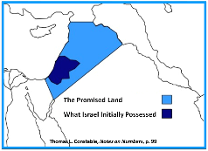
Jeremiah 30:3
“³ For behold, days are coming,’ declares the Lord, ‘when I will restore the fortunes of My people Israel and Judah.’ The Lord says, ‘I will also bring them back to the land that I gave to their forefathers and they shall possess it.’”

Slide 24


Slide 25

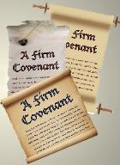
Daniel 9:27
And he will make a firm covenant with the many for one week, but in the middle of the week he will put a stop to sacrifice and grain offering; and on the wing of abominations will come one who makes desolate, even until a complete destruction, one that is decreed, is poured out on the one who makes desolate.

Slide 26
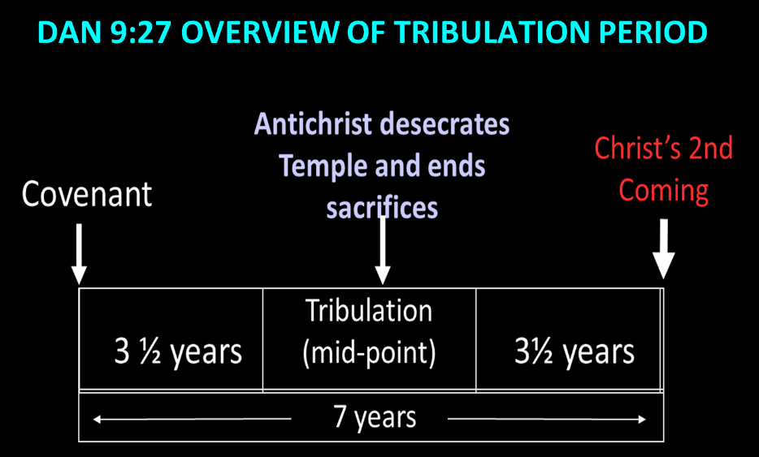

Slide 27
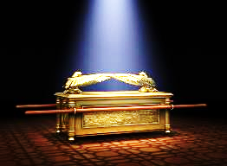
Daniel 9:24
Seventy weeks have been decreed for your people and your holy city, to finish the transgression, to make an end of sin, to make atonement for iniquity, to bring in everlasting righteousness, to seal up vision and prophecy and to anoint the most holy place.

Slide 28

6 Prophecies WILL BE fulfilled V.24c
  “to finish transgression”
  “to make an end of sin”
  “to make atonement for iniquity”
  “to bring in everlasting righteousness”
  “to seal up vision and prophecy”
  “to anoint the most holy place”
Arnold Fructenbaum, Footsteps of the Messiah, p.191-4

Slide 29
Israel’s Discipline & Restoration
Israel in the Diaspora
Israel’s regathering in unbelief
Israel’s conversion through distress
Israel’s final restoration

Slide 30
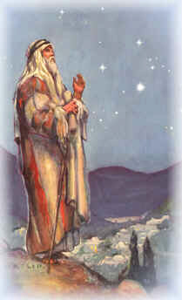
Israel’s Regathering in Belief
Deuteronomy 30:3
Jeremiah 16:14-15
Ezekiel 36:24-28
Zechariah 8:7-8
Amos 9:14-15

Slide 31
4. Israel’s Final Restoration
Law
Major Prophets
Minor Prophets
Conclusion

Slide 32
4. Israel’s Final Restoration
Law
Major Prophets
Minor Prophets
Conclusion

Slide 33


Deuteronomy 30:3
“Then the Lord your God will restore you from captivity, and have compassion on you, and will gather you again from all the peoples where the Lord your God has scattered you.”

Slide 34
4. Israel’s Final Restoration
Law
Major Prophets
Minor Prophets
Conclusion

Slide 35
Isaiah 27:13
“It will come about also in that day that a great trumpet will be blown, and those who were perishing in the land of Assyria and who were scattered in the land of Egypt will come and worship the Lord in the holy mountain at Jerusalem.”

Slide 36

Jeremiah 16:14-15
¹⁴ “Therefore behold, days are coming,” declares the Lord, “when it will no longer be said, ‘As the Lord lives, who brought up the sons of Israel out of the land of Egypt,’ ¹⁵ but, ‘As the Lord lives, who brought up the sons of Israel from the land of the north and from all the countries where He had banished them.’ For I will restore them to their own land which I gave to their fathers.”

Slide 37
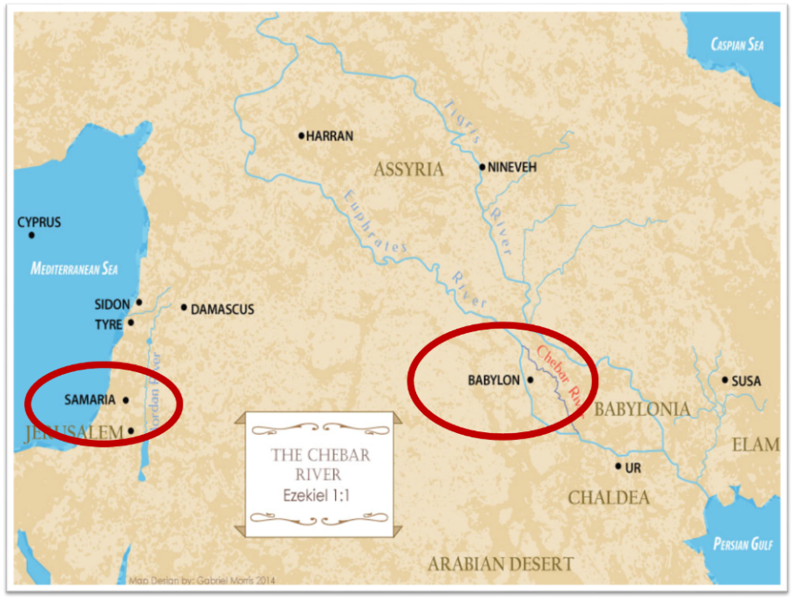

Slide 38

Ezekiel 36:24-28
“For I will take you from the nations, gather you from all the lands and bring you into your own land. ²⁵ Then I will sprinkle clean water on you, and you will be clean; I will cleanse you from all your filthiness and from all your idols. ²⁶ Moreover, I will give you a new heart and put a new spirit within you; and I will remove the heart of stone from your flesh and give you a heart of flesh. ²⁷ I will put My Spirit within you and cause you to walk in My statutes, and you will be careful to observe My ordinances. ²⁸ You will live in the land that I gave to your forefathers; so you will be My people, and I will be your God.”

Slide 39


Slide 40

The “Land” in Progressive Dispensationalism
For example, according to Progressive Dispensational progenitor Dr. Darrell L. Bock, his Progressive Dispensationalism is both “less land centered” and less “future centered” in comparison to traditional Dispensationalism.
Darrell Bock; quoted in Ken Sidey, “For the Love of Zion,”
Christianity Today, 9 March 1992, 50.
Notes:
WRONG!!!

Slide 41

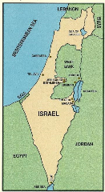
Leviticus 25:23
“The land, moreover, shall not be sold permanently, for the land is Mine; for you are but aliens and sojourners with Me.”

Slide 42
Deuteronomy 11:11-12
“¹¹ But the land into which you are about to cross to possess it, a land of hills and valleys, drinks water from the rain of heaven, ¹² a land for which the Lord your God cares; the eyes of the Lord your God are always on it, from the beginning even to the end of the year.”

Slide 43
4. Israel’s Final Restoration
Law
Major Prophets
Minor Prophets
Conclusion

Slide 44
Zechariah 8:7
“⁷ Thus says the Lord of hosts, ‘Behold, I am going to save My people from the land of the east and from the land of the west; ⁸ and I will bring them back and they will live in the midst of Jerusalem; and they shall be My people, and I will be their God in truth and righteousness.’”

Slide 45
Amos 9:14-15
“Also I will restore the captivity of My people Israel, And they will rebuild the ruined cities and live in them; They will also plant vineyards and drink their wine, And make gardens and eat their fruit.¹⁵ “I will also plant them on their land, And they will not again be rooted out from their land Which I have given them,” Says the Lord your God.

Slide 46
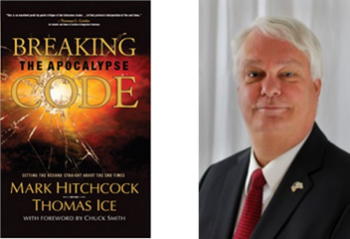
Mark Hitchcock and Thomas Ice
Breaking the Apocalypse Code (Costa Mesa, CA: Word for Today, 2007), 136-37.
"Every Old Testament prophet, except Jonah, speaks of a permanent return to the Land of Israel by the Jews."

Slide 47
4. Israel’s Final Restoration
Law
Major Prophets
Minor Prophets
Conclusion

Slide 48
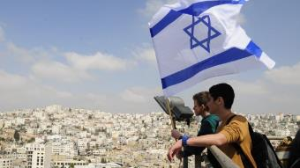
Reliability of the “Divine Regathering” Predictions
 | RETURN | PREDICTED | FULFILLED
1st | From Egypt to Canaan | Gen. 15:13-14 | Joshua 1‒12
2nd | From Babylon to Israel | Jer. 25:11; 29:10 | Ezra & Nehemiah
3rd | From the Diaspora to Israel’s restoration | Ezekiel 36:24-28 | Millennial Kingdom

Slide 49
Conclusion

Slide 50
Israel’s Discipline & Restoration
Israel in the Diaspora
Israel’s regathering in unbelief
Israel’s conversion through distress
Israel’s final restoration

