Slide 1
THE BOOK OF DANIEL
Dr. Andy Woods

Slide 2
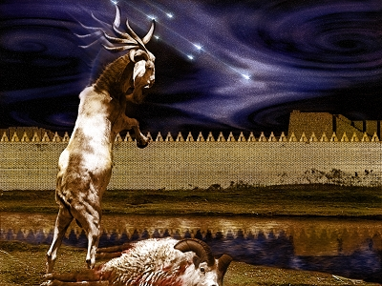
DANIEL 10-12 THE FINAL VISION

Slide 3
Chapter 10–12 Outline
The Setting (10:1-3)
Arrival of the Heavenly Messenger (10:4-9)
Explanation of the Heavenly Messenger (10:10–11:1)
The Prophecy of the Heavenly Messenger (11:2–12:13)

Slide 4
Chapter 10–12 Outline
The Setting (10:1-3)
Arrival of the Heavenly Messenger (10:4-9)
Explanation of the Heavenly Messenger (10:10–11:1)
The Prophecy of the Heavenly Messenger (11:2–12:13)

Slide 5
CHAPTER AND VERSE IN DANIEL | CHRONOLOGICAL DATE | BIBLICAL DATE
1:1 | 605 | 3rd year of Jehoiakim
2:1 | 603 | 2nd year of Nebuchadnezzar
5 | Sat. night 10/12/539 (Hoehner)
7:1 | 553 | 1st year of Belshazzar
8:1 | 551 | 3rd year of Belshazzar
9:1 | 538 | 1st year of Darius
10:1 | 536 | 3rd year of Cyrus

Slide 6
Chapter 10–12 Outline
The Setting (10:1-3)
Arrival of the Heavenly Messenger (10:4-9)
Explanation of the Heavenly Messenger (10:10–11:1)
The Prophecy of the Heavenly Messenger (11:2–12:13)

Slide 7
Chapter 10–12 Outline
The Setting (10:1-3)
Arrival of the Heavenly Messenger (10:4-9)
Explanation of the Heavenly Messenger (10:10–11:1)
The Prophecy of the Heavenly Messenger (11:2–12:13)

Slide 8
Chapter 10–12 Outline
The Setting (10:1-3)
Arrival of the Heavenly Messenger (10:4-9)
Explanation of the Heavenly Messenger (10:10–11:1)
The Prophecy of the Heavenly Messenger (11:2–12:13)

Slide 9
IV. The Prophecy of the Heavenly Messenger (11:2–12:13)
Persia (11:2)
Greece (11:3-4)
Ptolemies & Seleucids (11:5-20)
Antiochus IV (11:21-35)
Antichrist (11:36-45)
Tribulation & Millennium (12:1-13)

Slide 10
IV. The Prophecy of the Heavenly Messenger (11:2–12:13)
Persia (11:2)
Greece (11:3-4)
Ptolemies & Seleucids (11:5-20)
Antiochus IV (11:21-35)
Antichrist (11:36-45)
Tribulation & Millennium (12:1-13)

Slide 11
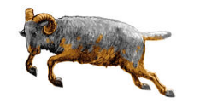
PERSIA 11:2
Cambyses 530-523 BC
Pseudo-Smerdis 522 BC
Darius I Hystaspes 521-486 BC
Xerxes 485-465 BC
Aka. “Ahasuerus” in Esther

Slide 12
IV. The Prophecy of the Heavenly Messenger (11:2–12:13)
Persia (11:2)
Greece (11:3-4)
Ptolemies & Seleucids (11:5-20)
Antiochus (11:21-35)
Antichrist (11:36-45)
Tribulation & Millennium (12:1-13)

Slide 13
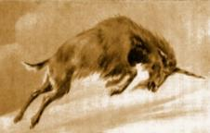
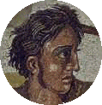
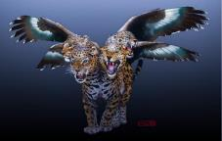
GREECE 11:3-4
Alexander the Great
Died at age 33 in 323 BC
No heirs
Kingdom divided among his 4 generals
Daniel 7:6, 8:5-8

Slide 14
Four Generals Daniel 7:6; 8:8, 22
Cassander Macedonia | Ptolemy Egypt
Lysimachus Thrace & Asia Minor | Seleucus Syria (including Israel)

Slide 15
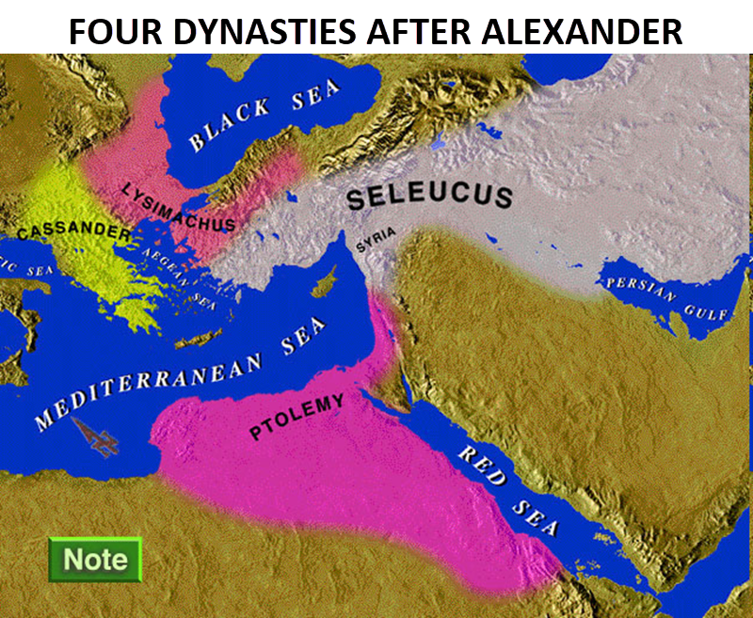

Slide 16
Four Generals Daniel 7:6; 8:8, 22
Cassander Macedonia | Ptolemy Egypt
Lysimachus Thrace & Asia Minor | Seleucus Syria (including Israel)

Slide 17
IV. The Prophecy of the Heavenly Messenger (11:2–12:13)
Persia (11:2)
Greece (11:3-4)
Ptolemies & Seleucids (11:5-20)
Antiochus (11:21-35)
Antichrist (11:36-45)
Tribulation & Millennium (12:1-13)

Slide 18
PTOLEMIES AND SELEUCIDS 11:5-20
History of warfare between the 2 dynasties
Ptolemies of Egypt vs. Seleucids of Syria
King of the South vs. King of the North
From 323 BC – 175 BC
The beautiful land = Israel
Cassander and Lysimachus not in view
Key transition in 198 B.C.
Selective and non-comprehensive history
What is at stake?

Slide 19
KINGS OF THE SOUTH (EGYPT) | KINGS OF THE NORTH (SYRIA)
Ptolemy I (Soter) 323–285 | Seleucus I (Nicator) 312–281
Ptolemy II (Philadelphus) 285–247 | Antiochus I (Soter) 281–261
Ptolemy III (Euregetus) 247–221 | Antiochus Theos 261–246
Ptolemy IV (Philopater) 221–220 | Seleucus Callinicus 246–226
Ptolemy V (Epiphanes) 203–182 | Seleucus III 226–223
 | Antiochus III (Great) 223–187
 | Seleucus IV (Philopater) 186–175
 | Antiochus IV (Epiphanes) 175–164
Paul N. Benware, Commentary on the Book of Daniel: The Coming Judgment of the Nations; Daniel's Prophecy of Things to Come (Clifton, TX: Scofield Ministries, 2007), 233.

Slide 20
Four Generals Daniel 7:6; 8:8, 22
Cassander Macedonia | Ptolemy Egypt
Lysimachus Thrace & Asia Minor | Seleucus Syria (including Israel)

Slide 21
Intertestamental Chronology (Dates BC)
SELEUCIDS
Seleucus I 312-281
Antiochus I 281-261
Antiochus II 261-246
Seleucus II 246-226
Seleucus III 226-223
Antiochus III 223-187
Seleucus IV Philapator 187-175
Antiochus IV Epiphanes 175-163

Slide 23
IV. The Prophecy of the Heavenly Messenger (11:2–12:13)
Persia (11:2)
Greece (11:3-4)
Ptolemies & Seleucids (11:5-20)
Antiochus IV (11:21-35)
Antichrist (11:36-45)
Tribulation & Millennium (12:1-13)

Slide 24
The Career of Antiochus IV Epiphanes Daniel 11:21-35
His rise to power (21)
His initial and general military successes (22-24)
His 1st military activities concerning Egypt & Israel (25-28)
His desecration of the Jewish Temple (29-31)
The reaction of Israel to the Temple’s desecration (32-25)

Slide 25
The Career of Antiochus IV Epiphanes Daniel 11:21-35
His rise to power (21)
His initial and general military successes (22-24)
His 1st military activities concerning Egypt & Israel (25-28)
His desecration of the Jewish Temple (29-31)
The reaction of Israel to the Temple’s desecration (32-25)

Slide 26
The Career of Antiochus IV Epiphanes Daniel 11:21-35
His rise to power (21)
His initial and general military successes (22-24)
His 1st military activities concerning Egypt & Israel (25-28)
His desecration of the Jewish Temple (29-31)
The reaction of Israel to the Temple’s desecration (32-25)

Slide 27
The Career of Antiochus IV Epiphanes Daniel 11:21-35
His rise to power (21)
His initial and general military successes (22-24)
His 1st military activities concerning Egypt & Israel (25-28)
His desecration of the Jewish Temple (29-31)
The reaction of Israel to the Temple’s desecration (32-25)

Slide 28
The Career of Antiochus IV Epiphanes Daniel 11:21-35
His rise to power (21)
His initial and general military successes (22-24)
His 1st military activities concerning Egypt & Israel (25-28)
His desecration of the Jewish Temple (29-31)
The reaction of Israel to the Temple’s desecration (32-25)

Slide 29
Daniel 11:31
Antiochus IV promoted Hellenism
Antiochus IV outlawed Judaism
Antiochus IV desecrated the Temple
Antiochus IV terminated Israel’s animal sacrifices
This period represented some of the darkest eras for Judaism
It is also predicted in Daniel 8:9-14
Paul N. Benware, Commentary on the Book of Daniel: The Coming Judgment of the Nations; Daniel's Prophecy of Things to Come (Clifton, TX: Scofield Ministries, 2007), 236-46.

Slide 30
Daniel 9:27
And he will make a firm covenant with the many for one week, but in the middle of the week he will put a stop to sacrifice and grain offering; and on the wing of abominations will come one who makes desolate, even until a complete destruction, one that is decreed, is poured out on the one who makes desolate.

Slide 32
The Career of Antiochus IV Epiphanes Daniel 11:21-35
His rise to power (21)
His initial and general military successes (22-24)
His 1st military activities concerning Egypt & Israel (25-28)
His desecration of the Jewish Temple (29-31)
The reaction of Israel to the Temple’s desecration (32-25)

Slide 33
Daniel 11:32-35 Overview
Israeli response to Antiochus IV
Two groups within Israel
Hellenism’s resisters
Hellenism’s embracers

Slide 34
Daniel 11:32-34
Antiochus IV operates by “smooth words” & flattery
The Maccabean revolt
Those with “insight” will help others
Rebels will bring down the wrath of Antiochus IV
The righteous ones were few in number (“little help”) at first but grew in number as they faithfully encouraged others
Some Israelis will defect to Antiochus IV
Paul N. Benware, Commentary on the Book of Daniel: The Coming Judgment of the Nations; Daniel's Prophecy of Things to Come (Clifton, TX: Scofield Ministries, 2007), 232-36.

Slide 35
HANUKKAH
The Maccabean revolt
December 25th 164 BC, the temple is liberated and rededicated
1 & 2 Maccabees
The miracle of the lamp oil
Hanukkah “Feast of Dedication” (festival of lights).
Christmas / Jewish Holiday
John 10:22-24

Slide 36
Levitical Feasts (Lev. 23)
Feast | Season | Purpose | Type
Passover | Spring | Redemption | 1 Cor. 5:7
Unleavened Bread | Spring | Separation | John 6:35
1st fruits | Spring | Praise | 1 Cor. 15:20
Pentecost | Spring | Praise | Acts 2:1-4
Trumpets | Fall | New Year | Matt. 24:31
Atonement | Fall | Lev 16 | Zech. 12:10
Booths | Fall | Wilderness provision | Zech. 14:16-18

Slide 37
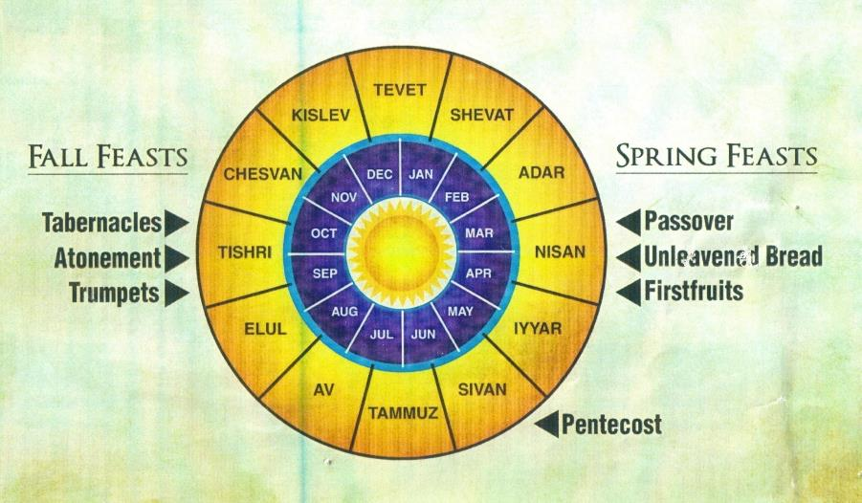

Slide 38
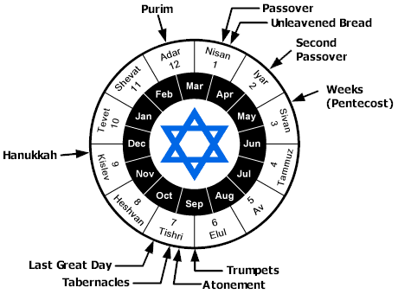

Slide 39
John 10:22-24
“At that time the Feast of the Dedication took place at Jerusalem; ²³ it was winter, and Jesus was walking in the temple in the portico of Solomon. ²⁴ The Jews then gathered around Him, and were saying to Him, “How long will You keep us in suspense? If You are the Christ, tell us plainly.”

Slide 40
Daniel 9:27
And he will make a firm covenant with the many for one week, but in the middle of the week he will put a stop to sacrifice and grain offering; and on the wing of abominations will come one who makes desolate, even until a complete destruction, one that is decreed, is poured out on the one who makes desolate.

Slide 41
Daniel 11:32-34
Antiochus IV operates by “smooth words” & flattery
The Maccabean revolt
Those with “insight” will help others
Rebels will bring down the wrath of Antiochus IV
The righteous ones were few in number (“little help”) at first but grew in number as they faithfully encouraged others
Some Israelis will defect to Antiochus IV
Paul N. Benware, Commentary on the Book of Daniel: The Coming Judgment of the Nations; Daniel's Prophecy of Things to Come (Clifton, TX: Scofield Ministries, 2007), 232-36.

Slide 42
Daniel 11:35
Defectors vs. loyalists created a purifying process
Process to continue “until the end time” and “the appointed time”
Foretaste of Zechariah 13:8-9
Paul N. Benware, Commentary on the Book of Daniel: The Coming Judgment of the Nations; Daniel's Prophecy of Things to Come (Clifton, TX: Scofield Ministries, 2007), 232-36.

Slide 43
Zechariah 13:8-9
⁸“It will come about in all the land,” Declares the Lord, “That two parts in it will be cut off and perish; But the third will be left in it. ⁹ And I will bring the third part through the fire, Refine them as silver is refined, And test them as gold is tested. They will call on My name, And I will answer them; I will say, ‘They are My people,’ And they will say, ‘The Lord is my God.’ ”

Slide 44
Discontinuity Between Israel & the Church
 | ISRAEL | CHURCH
Governing principle | Law | NT
Relation to HS | Selective, temporary, subsequent | Universal, permanent, at moment of salvation
Farewell address | Olivet Discourse | Upper Room Discourse
Designation | First Born Son | Bride of Christ
Revealed in OT | Yes | No
Evangelism | Come & See | Go & Proclaim
Blessings | Earthly | Heavenly
Composition | Believers & Unbelievers | Believers Only

Slide 45
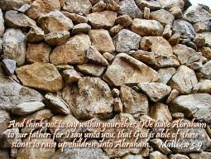
Matthew 3:9
“and do not suppose that you can say to yourselves, ‘We have Abraham for our father’; for I say to you that from these stones God is able to raise up children to Abraham.”

Slide 46
Romans 2:28-29
“²⁸ For he is not a Jew who is one outwardly, nor is circumcision that which is outward in the flesh. ²⁹ But he is a Jew who is one inwardly; and circumcision is that which is of the heart, by the Spirit, not by the letter; and his praise is not from men, but from God.”

Slide 47
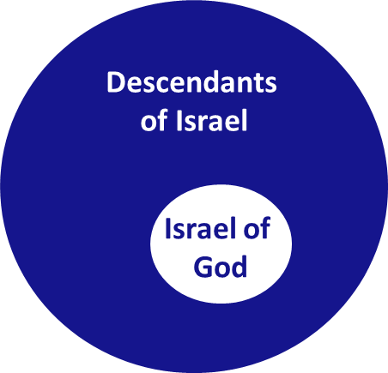
Romans 9:6
“But it is not as though the word of God has failed. For they are not all Israel who are descended from Israel.”

Slide 48
Revelation 2:9
“I know your tribulation and your poverty (but you are rich), and the blasphemy by those who say they are Jews and are not, but are a synagogue of Satan.”

Slide 49
Zechariah 13:8-9
⁸“It will come about in all the land,” Declares the Lord, “That two parts in it will be cut off and perish; But the third will be left in it. ⁹And I will bring the third part through the fire, Refine them as silver is refined, And test them as gold is tested. They will call on My name, And I will answer them; I will say, ‘They are My people,’ And they will say, ‘The Lord is my God.’ ”

Slide 50
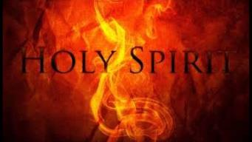
1 Corinthians 12:13
“For by one Spirit we were all baptized into one body, whether Jews or Greeks, whether slaves or free, and we were all made to drink of one Spirit.”

Slide 51
1 Corinthians 3:1-3 (NKJV)
¹And I, brethren, could not speak to you as to spiritual people but as to carnal, as to babes in Christ. ² I fed you with milk and not with solid food; for until now you were not able to receive it, and even now you are still not able; ³ for you are still carnal. For where there are envy, strife, and divisions among you, are you not carnal and behaving like mere men?

Slide 52
Notes:
Ray Steadman – “1st Californians”
Unbelievers vs Categories of Believers
Unbelievers – ψυχικός psuchikós; Natural, pertaining to the natural as distinguished from the spiritual
Spiritual Believers – πνευματικός pneumatikós; of persons who are spiritual, enlightened by the Holy Spirit
Infant Believers – σάρκινος sárkinos; with propensities of the flesh unto sin; νήπιος nḗpios; an infant, child, baby without any definite limitation of age. (This relates to immaturity and lack of instruction)
Carnal Believers – σαρκικός sarkikós; tendency to satisfy the flesh, implying sinfulness, sinful propensity, carnal (This relates to disobedience and open rebellion)

Slide 53
Conclusion

Slide 54
The Career of Antiochus IV Epiphanes Daniel 11:21-35
His rise to power (21)
His initial and general military successes (22-24)
His 1st military activities concerning Egypt & Israel (25-28)
His desecration of the Jewish Temple (29-31)
The reaction of Israel to the Temple’s desecration (32-25)

Slide 55
IV. The Prophecy of the Heavenly Messenger (11:2–12:13)
Persia (11:2)
Greece (11:3-4)
Ptolemies & Seleucids (11:5-20)
Antiochus IV (11:21-35)
Antichrist (11:36-45)
Tribulation & Millennium (12:1-13)

Slide 56
IV. The Prophecy of the Heavenly Messenger (11:2–12:13)
Persia (11:2)
Greece (11:3-4)
Ptolemies & Seleucids (11:5-20)
Antiochus IV (11:21-35)
Antichrist (11:36-45)
Tribulation & Millennium (12:1-13)

Slide 57
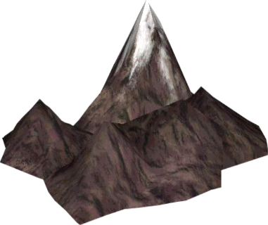
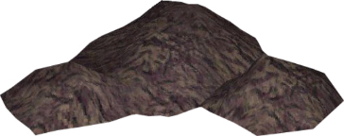
Understanding Daniel’s
Prophetic Perspective
Antichrist
Antiochus IV
(Daniel 11:36-45)
(Daniel 11:21-35)
Far
Fulfillment
Near
Fulfillment
Daniel

Slide 58
Why is Daniel 11:36-45 About Antichrist and not Antiochus IV?
It does not fit the known facts of history
The king is not from the North only but is in conflict with both the North and the South
It is consistent with the prophecies about the future Antichrist (Dan. 7; 2 Thess. 2; Rev. 13; 17)
The Antichrist is prominent in Daniel's earlier prophecies (“little horn” of Dan. 7)
Prophetic gaps are common in Scripture

Slide 59
6 Reasons for Gap in the 70 Weeks Prophecy
(Dan. 9:24-27)
Events prophesied v.26
Messiah crucified v.26a
70 AD holocaust v.26b
Prophecies in Dan. 9:24 would have been fulfilled 7 years after Palm Sunday
Jesus indicated a gap - (Matt. 24:15, 21-22, 29-30)
Daniel 9:27 was never fulfilled historically
Gap occurs elsewhere - (Is. 61:1-2; Luke 4:16-21; Isaiah 9:6)
Early church fathers indicated a gap

Slide 61
Zechariah 9:9-10
⁹ Rejoice greatly, O daughter of Zion! Shout in triumph, O daughter of Jerusalem! Behold, your king is coming to you; He is just and endowed with salvation, Humble, and mounted on a donkey, Even on a colt, the foal of a donkey.¹⁰ I will cut off the chariot from Ephraim And the horse from Jerusalem; And the bow of war will be cut off. And He will speak peace to the nations; And His dominion will be from sea to sea, And from the River to the ends of the earth.

Slide 62
Isaiah 9:6-7
⁶ For a child will be born to us, a son will be given to us; And the government will rest on His shoulders; And His name will be called Wonderful Counselor, Mighty God, Eternal Father, Prince of Peace.⁷ There will be no end to the increase of His government or of peace, On the throne of David and over his kingdom, To establish it and to uphold it with justice and righteousness From then on and forevermore. The zeal of the Lord of hosts will accomplish this.

Slide 63
Isaiah 61:1-2
¹ The Spirit of the Lord God is upon me, Because the Lord has anointed me To bring good news to the afflicted; He has sent me to bind up the brokenhearted, To proclaim liberty to captives And freedom to prisoners;² To proclaim the favorable year of the Lord And the day of vengeance of our God; To comfort all who mourn.

Slide 64
Luke 4:16-21
¹⁶ And He came to Nazareth, where He had been brought up; and as was His custom, He entered the synagogue on the Sabbath, and stood up to read. ¹⁷ And the book of the prophet Isaiah was handed to Him. And He opened the book and found the place where it was written,¹⁸ “The Spirit of the Lord is upon Me, Because He anointed Me to preach the gospel to the poor. He has sent Me to proclaim release to the captives, And recovery of sight to the blind, To set …

Slide 65
Luke 4:16-21
…free those who are oppressed,¹⁹ To proclaim the favorable year of the Lord.” ²⁰ And He closed the book, gave it back to the attendant and sat down; and the eyes of all in the synagogue were fixed on Him. ²¹ And He began to say to them, “Today this Scripture has been fulfilled in your hearing.”

Slide 66
Isaiah 61:1-2
¹ The Spirit of the Lord God is upon me, Because the Lord has anointed me To bring good news to the afflicted; He has sent me to bind up the brokenhearted, To proclaim liberty to captives And freedom to prisoners;² To proclaim the favorable year of the Lord And the day of vengeance of our God; To comfort all who mourn.

Slide 67
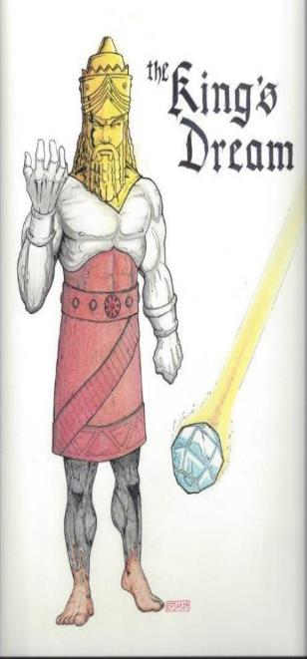
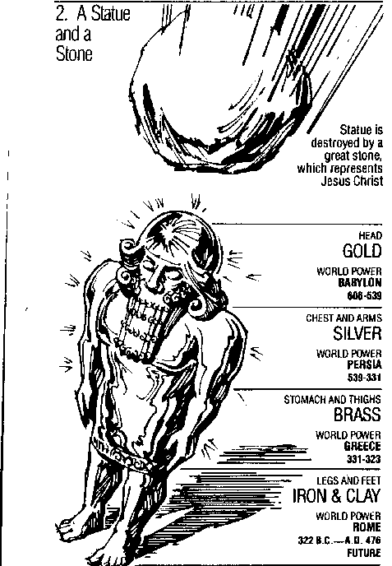
Statue
&
Stone

Slide 68
1 Peter 1:10-11
¹⁰ As to this salvation, the prophets who prophesied of the grace that would come to you made careful searches and inquiries, ¹¹ seeking to know what person or time the Spirit of Christ within them was indicating as He predicted the sufferings of Christ and the glories to follow.

Slide 69
Why is Daniel 11:36-45 about Antichrist and not Antiochus IV?
Many reputable commentators have interpreted these verses as referring to the future Antichrist (Jerome; Luther)
Contextual indicators
“At that time” (12:1)
“Latter days” (10:14)
“At the time of the end” (11:40)
“The indignation” (11:36)

Slide 70
Chapter 10–12 Outline
The Setting (10:1-3)
Arrival of the Heavenly Messenger (10:4-9)
Explanation of the Heavenly Messenger (10:10–11:1)
The Prophecy of the Heavenly Messenger (11:2–12:13)

Slide 71
Purpose
To encourage Judah by emphasizing the sovereignty of God during the Babylonian captivity and to teach Judah how to live while outside the land

Slide 72
“The Lord bless you and keep you; the Lord make his face shine on you and be gracious to you; the Lord turn his face toward you and give you peace.” (NIV)

