Slide 1
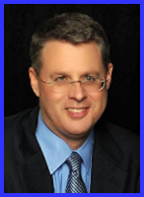
Ecclesiology Session 9
Dr. Andy Woods
Senior Pastor – Sugar Land Bible Church
President – Chafer Theological Seminary

Slide 2
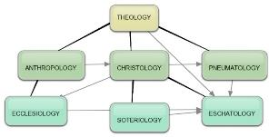
Areas of Systematic Theology
Prolegomena – Introduction
Theology – Study of God
Christology – Study of Christ
Pneumatology – Study of the Holy Spirit
Anthropology – Study of Man
Hamartiology – Study of sin
Soteriology – Study of salvation
Angelology – Study of angels
Ecclesiology – Study of the Church
Eschatology – Study of the end

Slide 3
Ecclesiology Overview
Definition
Universal vs. local
Word pictures
Origin
Israel – Church differences
Intercalation
Purposes
Activities
Government
Officers
Ordinances
Purity

Slide 4
Ecclesiology Overview
Definition
Universal vs. local
Word pictures
Origin
Israel – Church differences
Intercalation
Purposes
Activities
Government
Officers
Ordinances
Purity

Slide 5
Definition of Ecclesiology
Ekklēsía (ἐκκλησία)
ĕk (ἐκ) / kaleo (καλέω)
Acts 15:14
Logos
1 Cor 10:32

Slide 6
The Definition of the Church
All (both Jew & Gentile) who have trusted in the very Messiah rejected by first-century national Israel (Gal. 3:28; Rom. 10:19; Eph. 2:14)
Intercalation
Does not fulfill Israel’s purposes

Slide 7
Ecclesiology Overview
Definition
Universal vs. local
Word pictures
Origin
Israel – Church differences
Intercalation
Purposes
Activities
Government
Officers
Ordinances
Purity

Slide 8
The Universal vs. Local Church
 | Universal | Local
Number | One | Many
Members | All believers from Pentecost to the Rapture | Local gathering
Spiritual status | Believers only | Believers and unbelievers
Living or dead | Living and dead | Living only
Assembly | Cannot assemble at one place and time | Can assemble at one place and time
Visibility | Invisible | Visible
NT Material | Minority | Majority
Joining | Faith alone | Unique requirements
Denomination | All believers | Specific denomination

Slide 9
Ecclesiology Overview
Definition
Universal vs. local
Word pictures
Origin
Israel – Church differences
Intercalation
Purposes
Activities
Government
Officers
Ordinances
Purity

Slide 10
Universal Church Word Pictures
Shepherd/sheep – John 10:16; Acts 20:28; Heb 13:20; 1 Pet 5:2-4
Head/body – Rom 12:5; 1 Cor 12:12-13; Eph 1:22-23
Bride/groom – Eph 5:22-33; 2 Cor 11:2-3
Temple – 1 Cor 3:16-17; Eph 2:19-22; Gal 6:10
High priest/priesthood – Heb 4:14-15; 1 Pet 2:5-9; Rev 1:6
Pillar of truth – 1 Tim 3:15
Vine and branches – John 15:1-8

Slide 11
Ecclesiology Overview
Definition
Universal vs. local
Word pictures
Origin
Israel – Church differences
Intercalation
Purposes
Activities
Government
Officers
Ordinances
Purity

Slide 12
When Did the Church Begin?
Christ referred to the Church in the future tense (Matt. 16:18)
Paul referred to the Church as a “mystery” (Eph. 3:4-5, 9)
The Church did not exist prior to Acts 1 since Christ became the head of the Church (Eph. 5:23) after His Ascension (Eph. 1:20-22)
The Church did not exist prior to Acts 1 since spiritual gifts (1 Cor. 12:7; 14:26) only came into existence after His Ascension (Eph. 4:7-11)

Slide 13
When Did the Church Begin?
The Church existed before Paul’s conversion in Acts 9 (Acts 5:11; 8:1,3; Rom. 16:7)
The Baptizing (joining, uniting, identifying) ministry of the Holy Spirit began in Acts 2
1 Cor. 12:13
Acts 1:5
Acts 11:15-16
Acts 2:1-4, 37-41

Slide 14
Ecclesiology Overview
Definition
Universal vs. local
Word pictures
Origin
Israel – Church differences
Intercalation
Purposes
Activities
Government
Officers
Ordinances
Purity

Slide 15
Discontinuity Between Israel & the Church
 | ISRAEL | CHURCH
Marriage | Wife | Bride
Christ | Birthed Christ | Birthed by Christ
Return | 2nd advent | Rapture
Leader | King | Head, Groom
Beginning | Gen 12 | Acts 2
Scripture | 4/5 | 1/5
Covenants | Parties | Beneficiaries
Nation | Political | Spiritual

Slide 16
Discontinuity Between Israel & the Church
 | ISRAEL | CHURCH
Marriage | Wife | Bride
Christ | Birthed Christ | Birthed by Christ
Return | 2nd advent | Rapture
Leader | King | Head, Groom
Beginning | Gen 12 | Acts 2
Scripture | 4/5 | 1/5
Covenants | Parties | Beneficiaries
Nation | Political | Spiritual

Slide 17
2 Cor. 11:2-3
Betrothal Period
“ For I am jealous for you with a godly jealousy; for I betrothed you to one husband, so that to Christ I might present you as a pure virgin. But I fear, lest somehow, as the serpent deceived Eve by his craftiness, so your minds may be corrupted by from the simplicity that is in Christ.”

Slide 18
Discontinuity Between Israel & the Church
 | ISRAEL | CHURCH
Marriage | Wife | Bride
Christ | Birthed Christ | Birthed by Christ
Return | 2nd advent | Rapture
Leader | King | Head, Groom
Beginning | Gen 12 | Acts 2
Scripture | 4/5 | 1/5
Covenants | Parties | Beneficiaries
Nation | Political | Spiritual

Slide 19
Revelation 12:1-5
¹And a great sign appeared in heaven: a woman clothed in the sun, and the moon under her feet, and upon her head a crown of twelve stars; ²and she was with child; and she cried out, being in labor pain to give birth. ³And another sign was seen in heaven: and behold, a great red dragon, having seven heads and ten horns, and upon his heads seven diadems.

Slide 20
Revelation 12:1-5 (cont’d)
⁴And his tail swept a third part of the stars of heaven, and did cast them to the earth: and the dragon stood before the woman that is about to give birth, so that when she gave birth he may devour her child. ⁵And she gave birth to a son, a man child, who is to rule all the nations with a rod of iron: and her child was caught up unto God, and to his throne.

Slide 21
Revelation: 12 Symbols
Son = Messiah (Rev 12:5; Ps. 2:9; Acts 1:9)
Dragon = Satan (Rev 12:3, 9)
Woman = Israel (Rev 12:1; Gen 37:9-10)

Slide 22
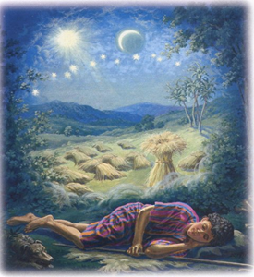
Genesis 37:9
Now he had still another dream, and related it to his brothers, and said, “Lo, I have had still another dream; and behold, the sun and the moon and eleven stars were bowing down to me.

Slide 23
Genesis 37:10
He related it to his father and to his brothers; and his father rebuked him and said to him, “What is this dream that you have had? Shall I and your mother and your brothers actually come to bow ourselves down before you to the ground?”

Slide 24
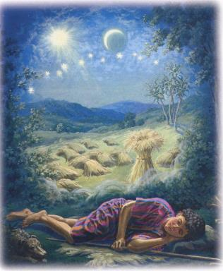
Genesis 37:9-10
Sun = Jacob
Moon = Leah
11 Stars=Joseph’s brothers
12th Star = Joseph
12 Stars=Israel’s twelve tribes

Slide 25
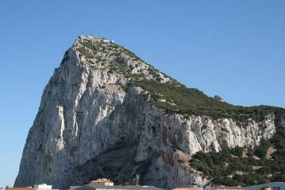
Matthew 16:18
I also say to you that you are Peter, and upon this rock I will build [oikodomeō] My church; and the gates of Hades will not overpower it.

Slide 26
Discontinuity Between Israel & the Church
 | ISRAEL | CHURCH
Marriage | Wife | Bride
Christ | Birthed Christ | Birthed by Christ
Return | 2nd advent | Rapture
Leader | King | Head, Groom
Beginning | Gen 12 | Acts 2
Scripture | 4/5 | 1/5
Covenants | Parties | Beneficiaries
Nation | Political | Spiritual

Slide 27
Matthew 23:37-39
“Jerusalem, Jerusalem, who kills the prophets and stones those who are sent to her! How often I wanted to gather your children together, the way a hen gathers her chicks under her wings, and you were unwilling. ³⁸ Behold, your house is being left to you desolate! ³⁹ For I say to you, from now on you will not see Me until you say, ‘Blessed is He who comes in the name of the Lord!”

Slide 28
Discontinuity Between Israel & the Church
 | ISRAEL | CHURCH
Marriage | Wife | Bride
Christ | Birthed Christ | Birthed by Christ
Return | 2nd advent | Rapture
Leader | King | Head, Groom
Beginning | Gen 12 | Acts 2
Scripture | 4/5 | 1/5
Covenants | Parties | Beneficiaries
Nation | Political | Spiritual

Slide 29
Discontinuity Between Israel & the Church
 | ISRAEL | CHURCH
Marriage | Wife | Bride
Christ | Birthed Christ | Birthed by Christ
Return | 2nd advent | Rapture
Leader | King | Head, Groom
Beginning | Gen 12 | Acts 2
Scripture | 4/5 | 1/5
Covenants | Parties | Beneficiaries
Nation | Political | Spiritual

Slide 30
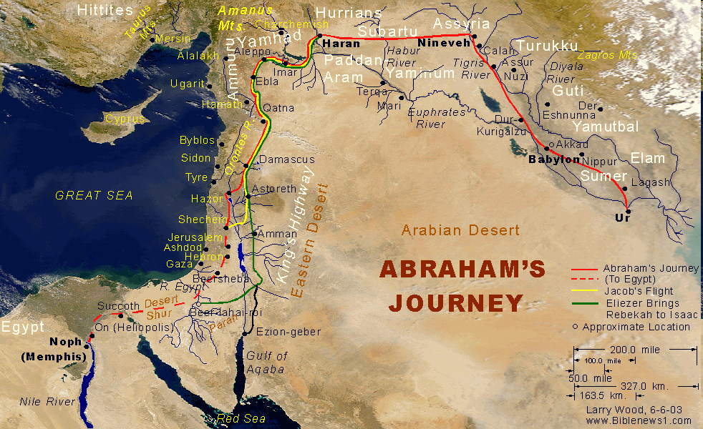

Slide 31
Discontinuity Between Israel & the Church
 | ISRAEL | CHURCH
Marriage | Wife | Bride
Christ | Birthed Christ | Birthed by Christ
Return | 2nd advent | Rapture
Leader | King | Head, Groom
Beginning | Gen 12 | Acts 2
Scripture | 4/5 | 1/5
Covenants | Parties | Beneficiaries
Nation | Political | Spiritual

Slide 32
Discontinuity Between Israel & the Church
 | ISRAEL | CHURCH
Marriage | Wife | Bride
Christ | Birthed Christ | Birthed by Christ
Return | 2nd advent | Rapture
Leader | King | Head, Groom
Beginning | Gen 12 | Acts 2
Scripture | 4/5 | 1/5
Covenants | Parties | Beneficiaries
Nation | Political | Spiritual

Slide 34
Discontinuity Between Israel & the Church
 | ISRAEL | CHURCH
Marriage | Wife | Bride
Christ | Birthed Christ | Birthed by Christ
Return | 2nd advent | Rapture
Leader | King | Head, Groom
Beginning | Gen 12 | Acts 2
Scripture | 4/5 | 1/5
Covenants | Parties | Beneficiaries
Nation | Political | Spiritual

Slide 35
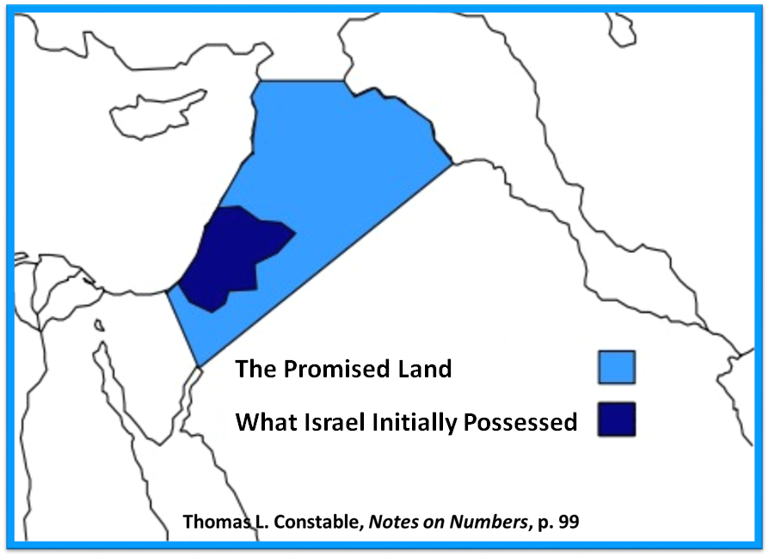

Slide 37
Romans 10:19
But I say, surely Israel did not know, did they? First Moses says, “I will make you jealous by that which is not a nation, By a nation without understanding will I anger you.”

Slide 38
Galatians 3:28
There is neither Jew nor Greek, there is neither slave nor free man, there is neither male nor female; for you are all one in Christ Jesus.

Slide 39
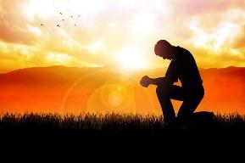
Ephesians 2:14
For He Himself is our peace, who made both groups into one and broke down the barrier of the dividing wall.

Slide 40
Discontinuity Between Israel & the Church
 | ISRAEL | CHURCH
Wars | Political | Spiritual
Timing | A quo / ad quem | No time indicators
Priesthood | Have a priesthood | Are a priesthood
Temple | Physical | Body
Resurrection | 1st resurrection | Rapture
Judgment | Earthly (Ezek. 20:33-44) | Heavenly (Bema)
New Jerusalem | Gates | Foundations
Entrance | Physical birth | Spiritual birth

Slide 41
Discontinuity Between Israel & the Church
 | ISRAEL | CHURCH
Wars | Political | Spiritual
Timing | A quo / ad quem | No time indicators
Priesthood | Have a priesthood | Are a priesthood
Temple | Physical | Body
Resurrection | 1st resurrection | Rapture
Judgment | Earthly (Ezek. 20:33-44) | Heavenly (Bema)
New Jerusalem | Gates | Foundations
Entrance | Physical birth | Spiritual birth

Slide 42
Discontinuity Between Israel & the Church
 | ISRAEL | CHURCH
Wars | Political | Spiritual
Timing | A quo / ad quem | No time indicators
Priesthood | Have a priesthood | Are a priesthood
Temple | Physical | Body
Resurrection | 1st resurrection | Rapture
Judgment | Earthly (Ezek. 20:33-44) | Heavenly (Bema)
New Jerusalem | Gates | Foundations
Entrance | Physical birth | Spiritual birth

Slide 43
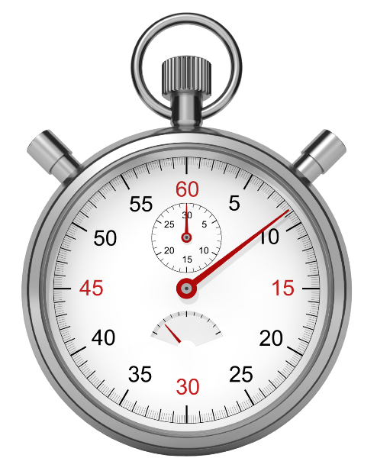

Slide 44
Levitical Feasts (23)
Feast | Season | Purpose | Type
Passover | Spring | Redemption | 1 Cor 5:7
Unleavened Bread | Spring | Separation | John 6:35
1st fruits | Spring | Praise | 1 Cor 15:20
Pentecost | Spring | Praise | Acts 2:1-4
Trumpets | Fall | New Year | Matt 24:31
Atonement | Fall | Lev 16 | Zech 12:10
Booths | Fall | Wilderness provision | Zech 14:16-18

Slide 45
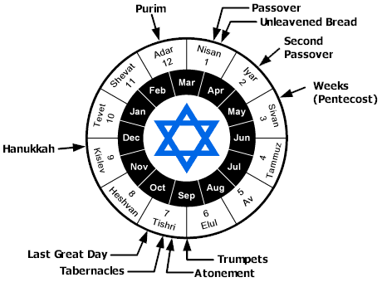

Slide 46
Discontinuity Between Israel & the Church
 | ISRAEL | CHURCH
Wars | Political | Spiritual
Timing | A quo / ad quem | No time indicators
Priesthood | Have a priesthood | Are a priesthood
Temple | Physical | Body
Resurrection | 1st resurrection | Rapture
Judgment | Earthly (Ezek. 20:33-44) | Heavenly (Bema)
New Jerusalem | Gates | Foundations
Entrance | Physical birth | Spiritual birth

Slide 47
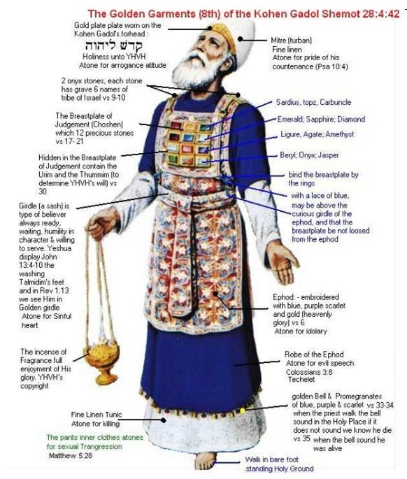

Slide 48
Revelation 1:6
“and He [God] has made us [Church] to be a kingdom, priests to His God and Father—to Him be the glory and the dominion forever and ever. Amen.”

Slide 49
Discontinuity Between Israel & the Church
 | ISRAEL | CHURCH
Wars | Political | Spiritual
Timing | A quo / ad quem | No time indicators
Priesthood | Have a priesthood | Are a priesthood
Temple | Physical | Body
Resurrection | 1st resurrection | Rapture
Judgment | Earthly (Ezek. 20:33-44) | Heavenly (Bema)
New Jerusalem | Gates | Foundations
Entrance | Physical birth | Spiritual birth

Slide 50
ISRAEL’S FOUR TEMPLES
Solomon’s pre exilic temple (966 bc, Kings and Chronicles)
Zerubbabel’s post exilic temple (Ezra 1-6; John 2:20)
Antichrist's temple (Dan 9:27; Matt 24:15; 2 Thess 2:4; Rev 11:1-2)
Millennial temple (Ezek 40-48)
Notes:
Herod proposed to renovate Zerubbabel’s Temple in 20-19 BC. Finishing touches continued until AD 63.

Slide 51
Discontinuity Between Israel & the Church
 | ISRAEL | CHURCH
Wars | Political | Spiritual
Timing | A quo / ad quem | No time indicators
Priesthood | Have a priesthood | Are a priesthood
Temple | Physical | Body
Resurrection | 1st resurrection | Rapture
Judgment | Earthly (Ezek. 20:33-44) | Heavenly (Bema)
New Jerusalem | Gates | Foundations
Entrance | Physical birth | Spiritual birth

Slide 52
Revelation 20:4-6
“⁴ Then I saw thrones, and they sat on them, and judgment was given to them. And I saw the souls of those who had been beheaded because of their testimony of Jesus and because of the word of God, and those who had not worshiped the beast or his image, and had not received the mark on their forehead and on their hand; and they came to life and reigned with Christ for a thousand years. ⁵ The…

Slide 53
Revelation 20:4-6
…⁵ The rest of the dead did not come to life until the thousand years were completed. This is the first resurrection. ⁶ Blessed and holy is the one who has a part in the first resurrection; over these the second death has no power, but they will be priests of God and of Christ and will reign with Him for a thousand years.”

Slide 54
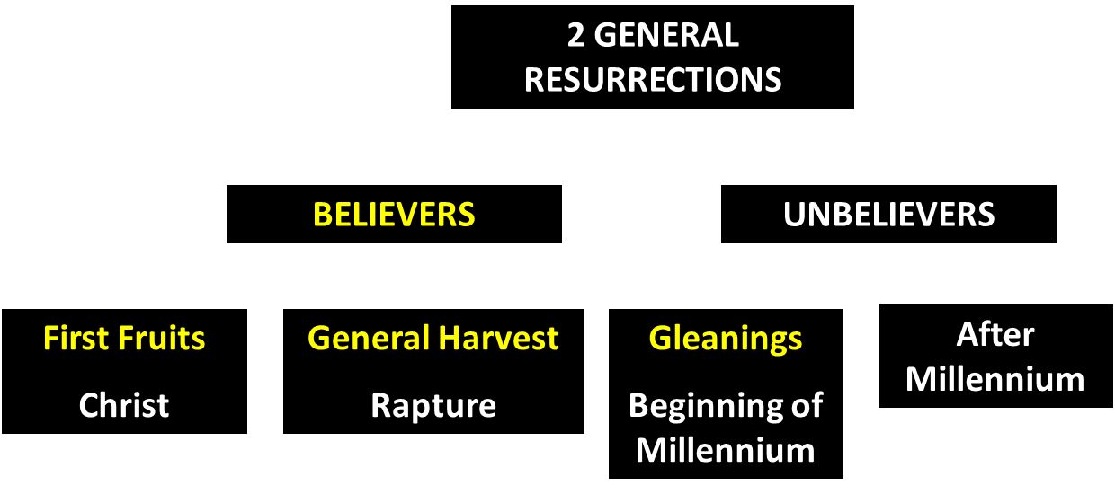
God’s Resurrection Program
Notes:
Gleanings – Believers before the Church started or after the Church Age is over during the Tribulation Period? They will be resurrected at the beginning of the Millennial Kingdom. Israel is resurrected at the end of the Tribulation, at the beginning of the Millennial Kingdom. This is the FIRST Resurrection.

Slide 55
Discontinuity Between Israel & the Church
 | ISRAEL | CHURCH
Wars | Political | Spiritual
Timing | A quo / ad quem | No time indicators
Priesthood | Have a priesthood | Are a priesthood
Temple | Physical | Body
Resurrection | 1st resurrection | Rapture
Judgment | Earthly (Ezek. 20:33-44) | Heavenly (Bema)
New Jerusalem | Gates | Foundations
Entrance | Physical birth | Spiritual birth
Notes:
Parallel judgments AFTER the Tribulation – Israel – surviving Jews (Eze. 20:33-44) and the judgment of the nations (Sheep & Goats Matthew 25:31-36).

Slide 56
Ezekiel 20:33-38
³³ “As I live,” declares the Lord God, “surely with a mighty hand and with an outstretched arm and with wrath poured out, I shall be king over you. ³⁴ I will bring you out from the peoples and gather you from the lands where you are scattered, with a mighty hand and with an outstretched arm and with wrath poured out; ³⁵ and I will bring you into the wilderness of the peoples, and there I will enter into judgment with you face to face. ³⁶ As I entered into judgment with your fathers in the wilderness of the land of Egypt, so I will enter into judgment with you,” declares the Lord God. …

Slide 57
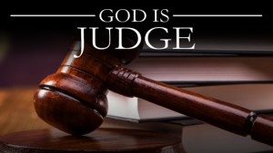
Ezekiel 20:33-38
…³⁷ “I will make you pass under the rod, and I will bring you into the bond of the covenant; ³⁸ and I will purge from you the rebels and those who transgress against Me; I will bring them out of the land where they sojourn, but they will not enter the land of Israel. Thus you will know that I am the Lord.

Slide 58
1 Corinthians 4:5
“ Therefore do not go on passing judgment before the time, but wait until the Lord comes who will both bring to light the things hidden in the darkness and disclose the motives of men’s hearts; and then each man’s praise will come to him from God.”
Notes:
Rapture and Bema

Slide 59
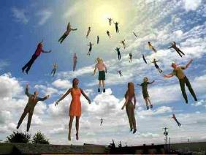
1 Thessalonians 4:17
“Then we who are alive and remain will be caught up together with them in the clouds to meet the Lord in the air, and so we shall always be with the Lord.”

Slide 61
Discontinuity Between Israel & the Church
 | ISRAEL | CHURCH
Wars | Political | Spiritual
Timing | A quo / ad quem | No time indicators
Priesthood | Have a priesthood | Are a priesthood
Temple | Physical | Body
Resurrection | 1st resurrection | Rapture
Judgment | Earthly (Ezek. 20:33-44) | Heavenly (Bema)
New Jerusalem | Gates | Foundations
Entrance | Physical birth | Spiritual birth
Notes:
Gen. 1-2 and Rev. 21-22 reveal what is NORMAL. Everything in between reveals what is ABNORMAL.

Slide 62
Jerusalem Descending
Notes:
The descending city is described as being like a stone called Jasper, only unlike the earthly stone, this one is clear as crystal. The ultimate state of heaven sounds more like a diamond, doesn’t it?

Slide 63
Revelation 21:16-17
¹⁶ The city was laid out like a square, as long as it was wide. He measured the city with the rod and found it to be [1500 miles] in length, and as wide and high as it is long. ¹⁷ He measured its wall and it was 144 cubits thick, by man's measurement, which the angel was using.
Notes:
READ…
The New Jerusalem exists now - Galatians 4:26 - But the Jerusalem above is free; she is our mother.

Slide 64
The New Jerusalem

Slide 65
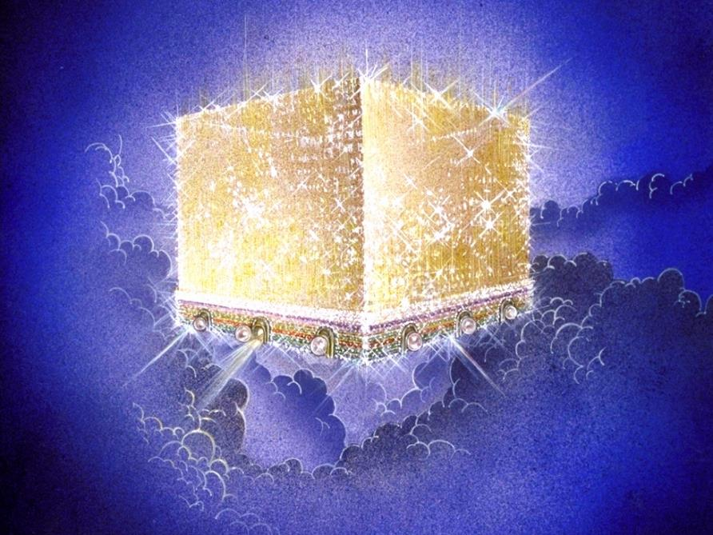
Notes:
Every city needs light. God, the ultimate source of power, illumines the city from his glory. Have you ever taken time to look at a sunset just after it has rained? As the sun sets, there is a kind of a glow cast on everything. It captures the spirit. This is just a little foretaste of the glory and splendor of heaven.

Slide 66
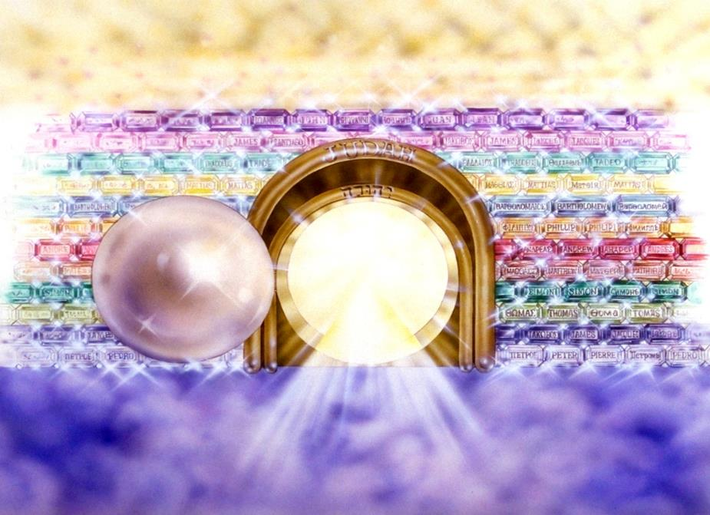
Notes:
Here you see an artist’s ideas of… 12 Gates = 12 Tribes of Israel 12 Foundation Stones = 12 Apostles of the Church
Israel and the Church are kept separate for all eternity.

Slide 67
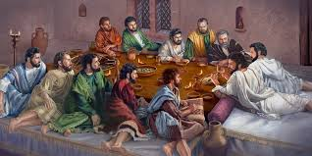
Ephesians 2:20
“having been built on the foundation of the apostles and prophets, Christ Jesus Himself being the corner stone.”

Slide 68
Discontinuity Between Israel & the Church
 | ISRAEL | CHURCH
Wars | Political | Spiritual
Timing | A quo / ad quem | No time indicators
Priesthood | Have a priesthood | Are a priesthood
Temple | Physical | Body
Resurrection | 1st resurrection | Rapture
Judgment | Earthly (Ezek. 20:33-44) | Heavenly (Bema)
New Jerusalem | Gates | Foundations
Entrance | Physical birth | Spiritual birth
Notes:
Israel – descendant of Abraham, Isaac, and Jacob
Romans 2:28–29 – ²⁸ For he is not a Jew who is one outwardly, nor is circumcision that which is outward in the flesh. ²⁹But he is a Jew who is one inwardly; and circumcision is that which is of the heart, by the Spirit, not by the letter; and his praise is not from men, but from God.
Romans 9:6 – But it is not as though the word of God has failed. For they are not all Israel who are descended from Israel;
Revelation 2:9 - ‘I know your tribulation and your poverty (but you are rich), and the blasphemy by those who say they are Jews and are not, but are a synagogue of Satan.
Revelation 3:9 - ‘Behold, I will cause those of the synagogue of Satan, who say that they are Jews and are not, but lie—I will make them come and bow down at your feet, and make them know that I have loved you.
The purpose of the Tribulation is to purge off the unbelievers within Israel. (Eze. 20:33-34; Zech. 13:8–9)
Zechariah 13:8–9 – ⁸ “It will come about in all the land,” Declares the Lord, “That two parts in it will be cut off and perish; But the third will be left in it. ⁹ “And I will bring the third part through the fire, Refine them as silver is refined, And test them as gold is tested. They will call on My name, And I will answer them; I will say, ‘They are My people,’ And they will say, ‘The Lord is my God.’ ”

Slide 69
Conclusion

Slide 70
Ecclesiology Overview
Definition
Universal vs. local
Word pictures
Origin
Israel – Church differences
Intercalation
Purposes
Activities
Government
Officers
Ordinances
Purity

