Slide 1
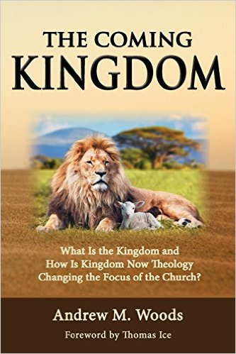

Slide 2

The Coming Kingdom
Chapter 6
Dr. Andy Woods
Senior Pastor – Sugar Land Bible Church
Adjunct Professor of Bible & Theology – College of Biblical Studies

Slide 3

Kingdom Study Outline
What does the Bible Say About the Kingdom?
The Main Problem with Kingdom Now NT interpretations
Why do some believe that we are in the kingdom now?
Why does it matter?

Slide 4
Kingdom Study Outline
What does the Bible Say About the Kingdom?
The Main Problem with Kingdom Now NT interpretations
Why do some believe that we are in the kingdom now?
Why does it matter?

Slide 5
1. Kingdom Throughout the Bible
Eden Abrahamic Covenant Mosaic Covenant Divided Kingdom Times of the Gentiles | Old Testament Prophets Post exile Offer of the King / Kingdom Rejection of the Offer Interim Age

Slide 6
1. Kingdom Throughout the Bible
Eden Abrahamic Covenant Mosaic Covenant Divided Kingdom Times of the Gentiles | Old Testament Prophets Post exile Offer of the King / Kingdom Rejection of the Offer Interim Age

Slide 7
1. Kingdom Throughout the Bible
Eden Abrahamic Covenant Mosaic Covenant Divided Kingdom Times of the Gentiles | Old Testament Prophets Post exile Offer of the King / Kingdom Rejection of the Offer Interim Age

Slide 8
1. Kingdom Throughout the Bible
Eden Abrahamic Covenant Mosaic Covenant Divided Kingdom Times of the Gentiles | Old Testament Prophets Post exile Offer of the King / Kingdom Rejection of the Offer Interim Age

Slide 9
1. Kingdom Throughout the Bible
Eden Abrahamic Covenant Mosaic Covenant Divided Kingdom Times of the Gentiles | Old Testament Prophets Post exile Offer of the King / Kingdom Rejection of the Offer Interim Age

Slide 10
1. Kingdom Throughout the Bible
Eden Abrahamic Covenant Mosaic Covenant Divided Kingdom Times of the Gentiles | Old Testament Prophets Post exile Offer of the King / Kingdom Rejection of the Offer Interim Age

Slide 11


2 Peter 1:19
“So we have the prophetic word made more sure, to which you do well to pay attention as to a lamp shining in a dark place, until the day dawns and the morning star arises in your hearts.”

Slide 12

OT PROPHETS DESCRIBE THE KINGDOM
Kingdom Characteristics
Is. 2:1-4; 11:6-9; 65:17-25
  Jerusalem = center of world spiritual and political authority
  Perfect justice
  World peace
  Peace in the animal kingdom
  Universal spiritual knowledge.

Slide 13

OT PROPHETS DESCRIBE THE KINGDOM
Established by God (Dan. 2:44)
Eternal (Dan. 7:27)
Christ’s direct rule (Zech. 9:9-10)
Earthly (Zech. 14:9)
Land promises realized (Gen. 15:18-21)
Israel’s preeminence (Isa. 49:22-23)
Millennial Temple (Ezek. 40‒46)

Slide 14
OT PROPHETS DESCRIBE THE KINGDOM
Millennial David (Jer. 30:9)
Righteousness (Isa. 9:6-7)
Curse curtailed (Isa. 65:20, 22)
Peace (Isa. 2:4)
Prosperity (Amos 9:13-14; Isa 65:22)
Topographical changes (Ezek. 47:1-12)
Immediate answers to prayer (Isa. 65:24)

Slide 15

Jeremiah 30:9 (NASB)
“But they shall serve the Lord their God and David their king, whom I will raise up for them.”

Slide 16
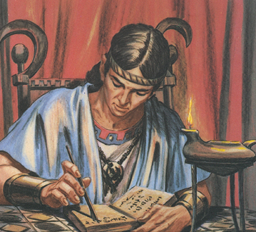
The Millennial David
Root of Jesse
Branch of David
Son of David
Seed of David

Slide 17
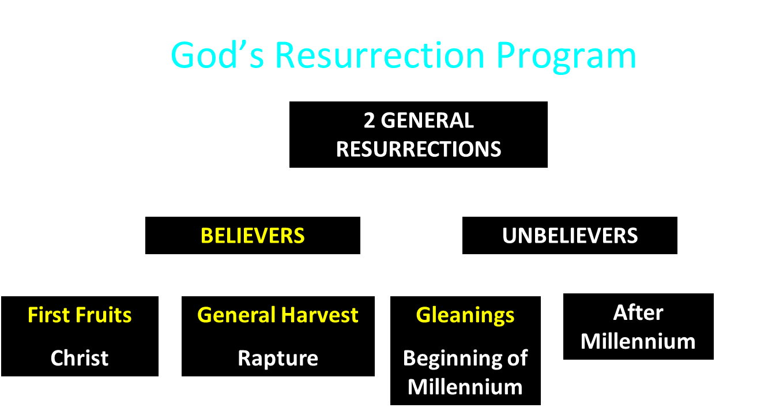

Slide 18
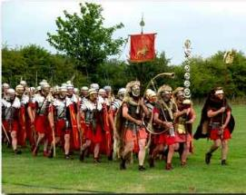
Order or Tagma (1 Cor. 15:23)
General: Christ’s resurrection (1 Cor 15:23)
Officer: Rapture (1 Thess 4:13-18)
Soldiers: OT saints & Tribulation martyrs (Rev 20:4)
Captives: Unsaved of all ages (Rev 20:5)

Slide 19
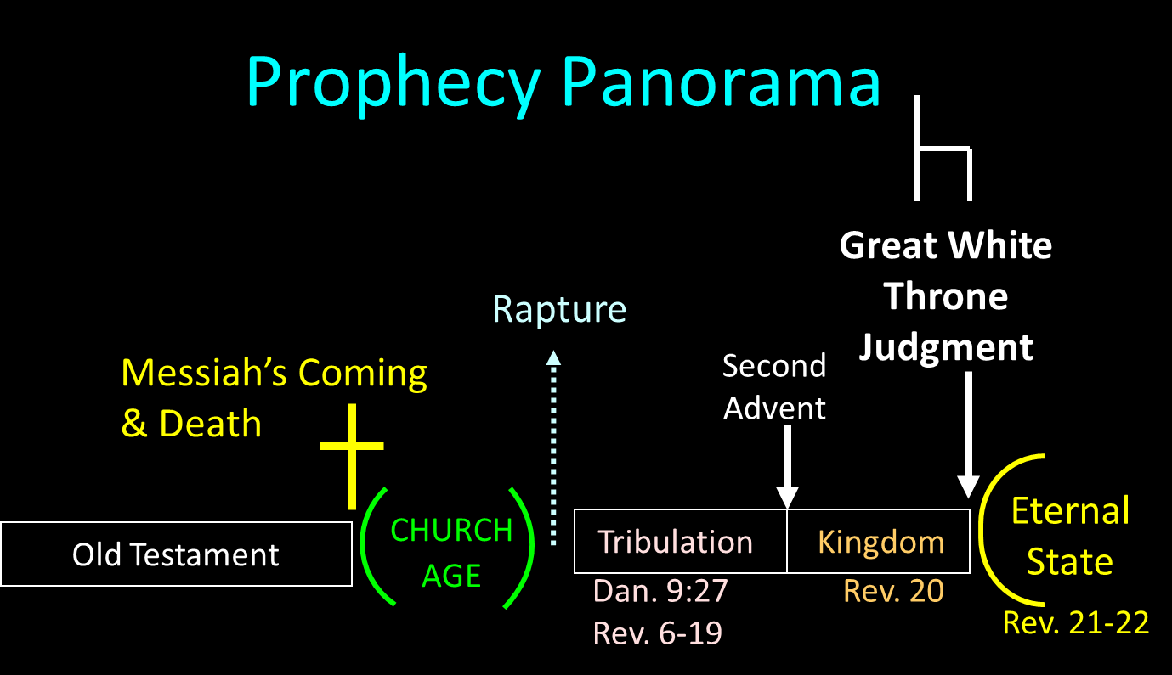

Slide 20
OT PROPHETS DESCRIBE THE KINGDOM
Millennial David (Jer. 30:9)
Righteousness (Isa. 9:6-7)
Curse curtailed (Isa. 65:20, 22)
Peace (Isa. 2:4)
Prosperity (Amos 9:13-14; Isa 65:22)
Topographical changes (Ezek. 47:1-12)
Immediate answers to prayer (Isa. 65:24)

Slide 21
Isaiah 9:6-7 (NASB)
⁶ For a child will be born to us, a son will be given to us; And the government will rest on His shoulders; And His name will be called Wonderful Counselor, Mighty God, Eternal Father, Prince of Peace.⁷ There will be no end to the increase of His government or of peace, On the throne of David and over his kingdom, To establish it and to uphold it with justice and righteousness From then on and forevermore. The zeal of the Lord of hosts will accomplish this.

Slide 22
9. Righteousness (Isa. 9:6-7)
New Covenant (Jer. 31:31-34)
Knowledge of the Lord (Isa. 11:9)
Resurrection of OT saints (Dan. 12:2)
Kingdom begins only with surviving believers (Ezek. 20:33-38)
Christ ruling with a rod of iron (Ps. 2:6-9)

Slide 23
9. Righteousness (Isa. 9:6-7)
New Covenant (Jer. 31:31-34)
Knowledge of the Lord (Isa. 11:9)
Resurrection of OT saints (Dan. 12:2)
Kingdom begins only with surviving believers (Ezek. 20:33-38)
Christ ruling with a rod of iron (Ps. 2:6-9)

Slide 24


Slide 25

Jeremiah 31:31-34
“Behold, days are coming,” declares the Lord, “when I will make a new covenant with the house of Israel and with the house of Judah, ³² not like the covenant which I made with their fathers in the day I took them by the hand to bring them out of the land of Egypt, My covenant which they broke, although I was a husband to them,” declares the Lord. ³³ “But this is the covenant which I will make with the house of Israel after those days,” declares the Lord, “I will put My law within them and on their heart I will write it; and I will be their God, and they shall be My people. ³⁴ They will not teach again, each man his neighbor and each man his brother, saying, ‘Know the Lord,’ for they will all know Me, from the least of them to the greatest of them,” declares the Lord, “for I will forgive their iniquity, and their sin I will remember no more.”

Slide 26
9. Righteousness (Isa. 9:6-7)
New Covenant (Jer. 31:31-34)
Knowledge of the Lord (Isa. 11:9)
Resurrection of OT saints (Dan. 12:2)
Kingdom begins only with surviving believers (Ezek. 20:33-38)
Christ ruling with a rod of iron (Ps. 2:6-9)

Slide 27
9. Righteousness (Isa. 9:6-7)
New Covenant (Jer. 31:31-34)
Knowledge of the Lord (Isa. 11:9)
Resurrection of OT saints (Dan. 12:2)
Kingdom begins only with surviving believers (Ezek. 20:33-38)
Christ ruling with a rod of iron (Ps. 2:6-9)

Slide 29
Order or Tagma (1 Cor. 15:23)
General: Christ’s resurrection (1 Cor 15:23)
Officer: Rapture (1 Thess 4:13-18)
Soldiers: OT saints & Tribulation martyrs (Rev 20:4)
Captives: Unsaved of all ages (Rev 20:5)

Slide 31
9. Righteousness (Isa. 9:6-7)
New Covenant (Jer. 31:31-34)
Knowledge of the Lord (Isa. 11:9)
Resurrection of OT saints (Dan. 12:2)
Kingdom begins only with surviving believers (Ezek. 20:33-38)
Christ ruling with a rod of iron (Ps. 2:6-9)

Slide 32
9. Righteousness (Isa. 9:6-7)
New Covenant (Jer. 31:31-34)
Knowledge of the Lord (Isa. 11:9)
Resurrection of OT saints (Dan. 12:2)
Kingdom begins only with surviving believers (Ezek. 20:33-38)
Christ ruling with a rod of iron (Ps. 2:6-9)

Slide 34
DIFFERENCES BETWEEN THE MILLENNIUM & ETERNAL STATE
Millennium (Rev. 20:1-10) | Eternal State (Rev. 21‒22)
Present earth (Gen. 13:17) | New Earth (Rev. 21:1)
Waters (Gen. 15:18-21) | No sea (Rev. 21:1)
Rebellion (Zech. 14:16-18) | No rebellion (Rev. 21:4)
Tribal land (Ezek. 47:13-23) | Tribal city gates (Rev. 21:12)
Sin exists (Ezek 45:22) | No sin (Rev. 21:4)
Temple (Ezek. 40‒46) | No temple (Rev. 21:22)
Rod of iron (Ps. 2:6-8) | No rod needed (Rev. 21:8)
Death (Isa. 65:20) | No death (Rev. 21:4)
Sun exists (Isa. 30:26) | No sun (Rev. 21:23; 22:5)

Slide 35
OT PROPHETS DESCRIBE THE KINGDOM
Millennial David (Jer. 30:9)
Righteousness (Isa. 9:6-7)
Curse curtailed (Isa. 65:20, 22)
Peace (Isa. 2:4)
Prosperity (Amos 9:13-14; Isa 65:22)
Topographical changes (Ezek. 47:1-12)
Immediate answers to prayer (Isa. 65:24)

Slide 36
Genesis 3 Structure
3:1-5 – Temptation by the serpent
3:6 – Sin of Adam and Eve
3:7-13 – Results of the sin
3:14-19 – Imposition of divine judgments
3:20-24 – God’s provision in spite of the sin

Slide 37
Genesis 3 Structure
3:1-5 – Temptation by the serpent
3:6 – Sin of Adam and Eve
3:7-13 – Results of the sin
3:14-19 – Imposition of divine judgments
3:20-24 – God’s provision in spite of the sin

Slide 38
Divine Judgments (3:14-19)
Serpent (3:14-15)
Woman (3:16)
Man (3:17-19)

Slide 39
Divine Judgments (3:14-19)
Serpent (3:14-15)
Woman (3:16)
Man (3:17-19)

Slide 40
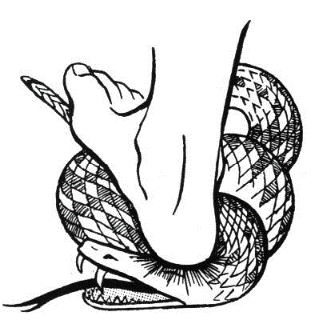
Serpent (3:14-15)
Serpent’s body (3:14)
Protevangelium (3:15)

Slide 41

Genesis 3:15
“And I will put enmity between you and the woman, and between your seed and her seed; He shall bruise you on the head, and you shall bruise him on the heel.” (NASB)

Slide 42
Divine Judgments (3:14-19)
Serpent (3:14-15)
Woman (3:16)
Man (3:17-19)

Slide 43
Woman (3:16)
Painful child birth (3:16a)
Relational conflict (3:16b)

Slide 44
Divine Judgments (3:14-19)
Serpent (3:14-15)
Woman (3:16)
Man (3:17-19)

Slide 45
Man (3:17-19)
Painful labor (3:17-19a)
Death (3:19b)

Slide 47
DIFFERENCES BETWEEN THE MILLENNIUM & ETERNAL STATE
Millennium (Rev. 20:1-10) | Eternal State (Rev. 21‒22)
Present earth (Gen. 13:17) | New Earth (Rev. 21:1)
Waters (Gen. 15:18-21) | No sea (Rev. 21:1)
Rebellion (Zech. 14:16-18) | No rebellion (Rev. 21:4)
Tribal land (Ezek. 47:13-23) | Tribal city gates (Rev. 21:12)
Sin exists (Ezek 45:22) | No sin (Rev. 21:4)
Temple (Ezek. 40‒46) | No temple (Rev. 21:22)
Rod of iron (Ps. 2:6-8) | No rod needed (Rev. 21:8)
Death (Isa. 65:20) | No death (Rev. 21:4)
Sun exists (Isa. 30:26) | No sun (Rev. 21:23; 22:5)

Slide 48
OT PROPHETS DESCRIBE THE KINGDOM
Millennial David (Jer. 30:9)
Righteousness (Isa. 9:6-7)
Curse curtailed (Isa. 65:20, 22)
Peace (Isa. 2:4)
Prosperity (Amos 9:13-14; Isa 65:22)
Topographical changes (Ezek. 47:1-12)
Immediate answers to prayer (Isa. 65:24)

Slide 49
Isaiah 9:6-7 (NASB)
⁶ For a child will be born to us, a son will be given to us; And the government will rest on His shoulders; And His name will be called Wonderful Counselor, Mighty God, Eternal Father, Prince of Peace.⁷ There will be no end to the increase of His government or of peace, The zeal of the Lord of hosts will accomplish this. On the throne of David and over his kingdom, To establish it and to uphold it with justice and righteousness From then on and forevermore.

Slide 50
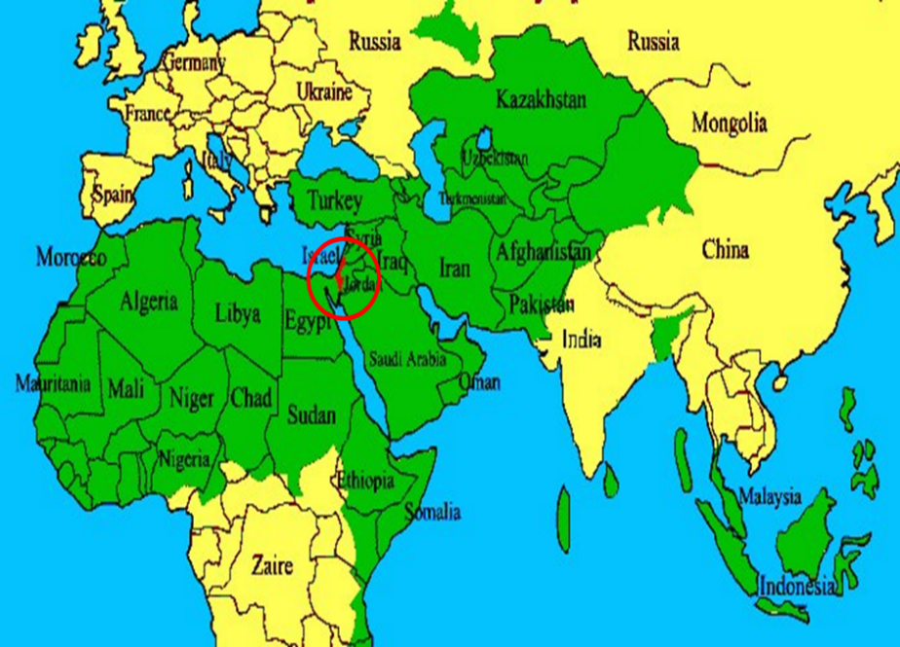

Slide 51
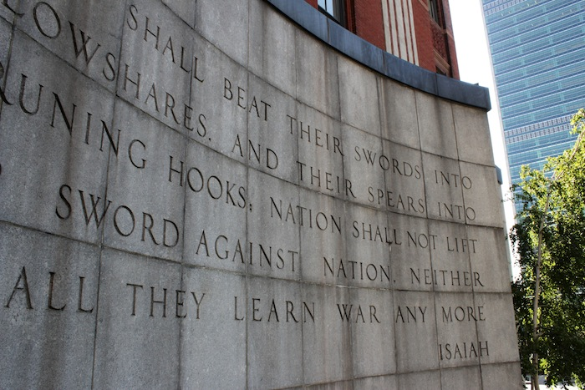

Slide 52
OT PROPHETS DESCRIBE THE KINGDOM
Millennial David (Jer. 30:9)
Righteousness (Isa. 9:6-7)
Curse curtailed (Isa. 65:20, 22)
Peace (Isa. 2:4)
Prosperity (Amos 9:13-14; Isa 65:22)
Topographical changes (Ezek. 47:1-12)
Immediate answers to prayer (Isa. 65:24)

Slide 53
OT PROPHETS DESCRIBE THE KINGDOM
Millennial David (Jer. 30:9)
Righteousness (Isa. 9:6-7)
Curse curtailed (Isa. 65:20, 22)
Peace (Isa. 2:4)
Prosperity (Amos 9:13-14; Isa 65:22)
Topographical changes (Ezek. 47:1-12)
Immediate answers to prayer (Isa. 65:24)

Slide 54
13. Topographical Changes (Ezek. 47:1-12)
Abundant rainfall (Ezek. 34:26-27)
Water in the desert (Isa. 35:6-7)
Life to the Dead Sea (Ezek. 47:1-12)
Sun seven times brighter (Isa. 30:26)
Physical healing (Isa. 35:5-6)

Slide 55
13. Topographical Changes (Ezek. 47:1-12)
Abundant rainfall (Ezek. 34:26-27)
Water in the desert (Isa. 35:6-7)
Life to the Dead Sea (Ezek. 47:1-12)
Sun seven times brighter (Isa. 30:26)
Physical healing (Isa. 35:5-6)

Slide 56
13. Topographical Changes (Ezek. 47:1-12)
Abundant rainfall (Ezek. 34:26-27)
Water in the desert (Isa. 35:6-7)
Life to the Dead Sea (Ezek. 47:1-12)
Sun seven times brighter (Isa. 30:26)
Physical healing (Isa. 35:5-6)

Slide 57
13. Topographical Changes (Ezek. 47:1-12)
Abundant rainfall (Ezek. 34:26-27)
Water in the desert (Isa. 35:6-7)
Life to the Dead Sea (Ezek. 47:1-12)
Sun seven times brighter (Isa. 30:26)
Physical healing (Isa. 35:5-6)

Slide 58
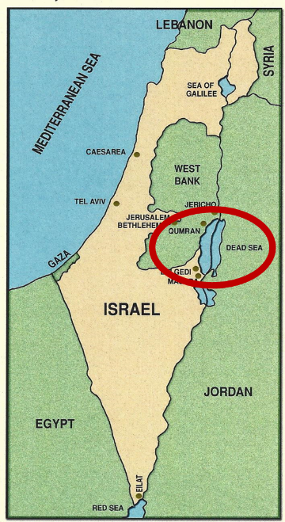

Slide 59
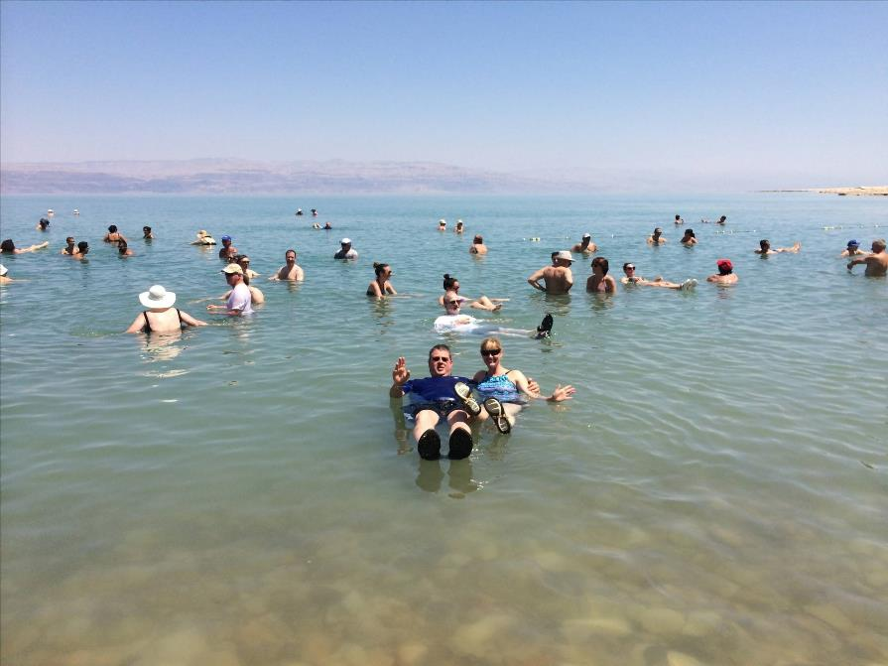

Slide 60
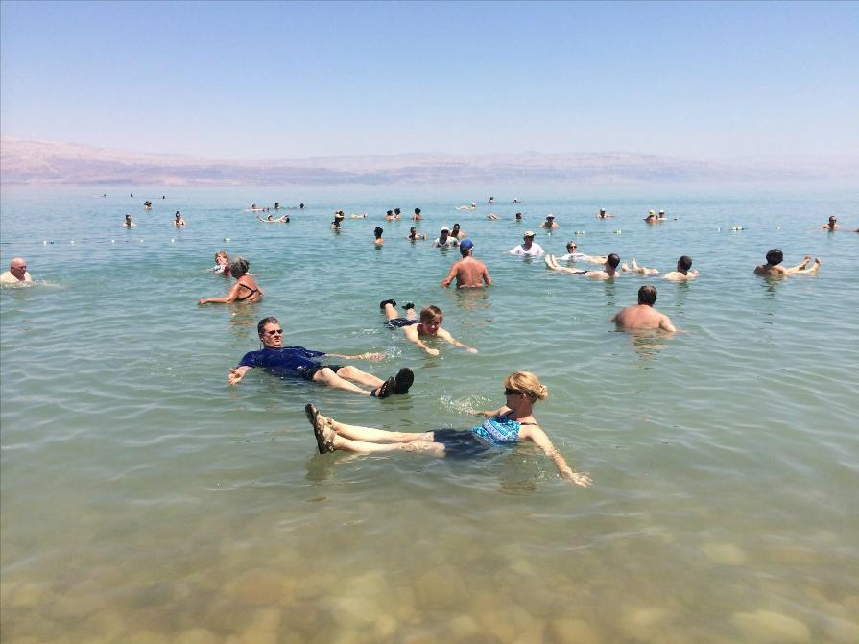

Slide 62
DIFFERENCES BETWEEN THE MILLENNIUM & ETERNAL STATE
Millennium (Rev. 20:1-10) | Eternal State (Rev. 21‒22)
Present earth (Gen. 13:17) | New Earth (Rev. 21:1)
Waters (Gen. 15:18-21) | No sea (Rev. 21:1)
Rebellion (Zech. 14:16-18) | No rebellion (Rev. 21:4)
Tribal land (Ezek. 47:13-23) | Tribal city gates (Rev. 21:12)
Sin exists (Ezek 45:22) | No sin (Rev. 21:4)
Temple (Ezek. 40‒46) | No temple (Rev. 21:22)
Rod of iron (Ps. 2:6-8) | No rod needed (Rev. 21:8)
Death (Isa. 65:20) | No death (Rev. 21:4)
Sun exists (Isa. 30:26) | No sun (Rev. 21:23; 22:5)

Slide 63
13. Topographical Changes (Ezek. 47:1-12)
Abundant rainfall (Ezek. 34:26-27)
Water in the desert (Isa. 35:6-7)
Life to the Dead Sea (Ezek. 47:1-12)
Sun seven times brighter (Isa. 30:26)
Physical healing (Isa. 35:5-6)

Slide 65
DIFFERENCES BETWEEN THE MILLENNIUM & ETERNAL STATE
Millennium (Rev. 20:1-10) | Eternal State (Rev. 21‒22)
Present earth (Gen. 13:17) | New Earth (Rev. 21:1)
Waters (Gen. 15:18-21) | No sea (Rev. 21:1)
Rebellion (Zech. 14:16-18) | No rebellion (Rev. 21:4)
Tribal land (Ezek. 47:13-23) | Tribal city gates (Rev. 21:12)
Sin exists (Ezek 45:22) | No sin (Rev. 21:4)
Temple (Ezek. 40‒46) | No temple (Rev. 21:22)
Rod of iron (Ps. 2:6-8) | No rod needed (Rev. 21:8)
Death (Isa. 65:20) | No death (Rev. 21:4)
Sun exists (Isa. 30:26) | No sun (Rev. 21:23; 22:5)

Slide 66
13. Topographical Changes (Ezek. 47:1-12)
Abundant rainfall (Ezek. 34:26-27)
Water in the desert (Isa. 35:6-7)
Life to the Dead Sea (Ezek. 47:1-12)
Sun seven times brighter (Isa. 30:26)
Physical healing (Isa. 35:5-6)

Slide 67
OT PROPHETS DESCRIBE THE KINGDOM
Millennial David (Jer. 30:9)
Righteousness (Isa. 9:6-7)
Curse curtailed (Isa. 65:20, 22)
Peace (Isa. 2:4)
Prosperity (Amos 9:13-14; Isa 65:22)
Topographical changes (Ezek. 47:1-12)
Immediate answers to prayer (Isa. 65:24)

Slide 68
Conclusion

Slide 69
OT PROPHETS DESCRIBE THE KINGDOM
Established by God (Dan. 2:44)
Eternal (Dan. 7:27)
Christ’s direct rule (Zech. 9:9-10)
Earthly (Zech. 14:9)
Land promises realized (Gen. 15:18-21)
Israel’s preeminence (Isa. 49:22-23)
Millennial Temple (Ezek. 40‒46)

Slide 70
OT PROPHETS DESCRIBE THE KINGDOM
Millennial David (Jer. 30:9)
Righteousness (Isa. 9:6-7)
Curse curtailed (Isa. 65:20, 22)
Peace (Isa. 2:4)
Prosperity (Amos 9:13-14; Isa 65:22)
Topographical changes (Ezek. 47:1-12)
Immediate answers to prayer (Isa. 65:24)

Slide 71

Genesis 8:22
“While the earth remains, Seedtime and harvest, And cold and heat, And summer and winter, And day and night Shall not cease.”

Slide 73
DIFFERENCES BETWEEN THE MILLENNIUM & ETERNAL STATE
Millennium (Rev. 20:1-10) | Eternal State (Rev. 21‒22)
Present earth (Gen. 13:17) | New Earth (Rev. 21:1)
Waters (Gen. 15:18-21) | No sea (Rev. 21:1)
Rebellion (Zech. 14:16-18) | No rebellion (Rev. 21:4)
Tribal land (Ezek. 47:13-23) | Tribal city gates (Rev. 21:12)
Sin exists (Ezek 45:22) | No sin (Rev. 21:4)
Temple (Ezek. 40‒46) | No temple (Rev. 21:22)
Rod of iron (Ps. 2:6-8) | No rod needed (Rev. 21:8)
Death (Isa. 65:20) | No death (Rev. 21:4)
Sun exists (Isa. 30:26) | No sun (Rev. 21:23; 22:5)

Slide 74
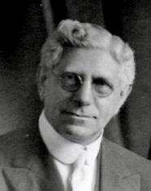
Premillennialism: A One-Text Theology?
"The only scriptural basis for this theory [i.e.' premillennialism] is Revelation 20:1-6, after an Old Testament content has been poured into it.”
Louis Berkhof, Systematic Theology: With a Complete Textual Index, 4th and rev. ed. (Grand Rapids: Eerdman's, 1932; reprint, Grand Rapids: Baker, 1996), 715.

Slide 75
Premillennialism: A One-Text Theology?
"The one millennial occurrence in the New Testament (and in the whole Bible) makes mention of none of the earthly characteristics so arbitrarily placed within that thousand years (Revelation 20).”
James Wilmot, Prophetic Interpretation, 5-6.

Slide 76
Premillennialism: A One-Text Theology?
The a-millennial theologian Archibald Hughes once directed a lady to study the New Testament for information on the millennial kingdom. According to the report of Hughes, this is what transpired: “Many months later this lady came to me and said she had followed my advice but could not find a single reference to any millennium. I said, 'well, have you learned something.’ She replied, ‘I have learned nothing!’ I said, ‘you have learned something, for you know now that the New Testament has nothing to say about a millennium.’”
Archibald Hughes, A New Heaven and a New Earth, 209.

Slide 77
2 Peter 1:19
“So we have the prophetic word made more sure, to which you do well to pay attention as to a lamp shining in a dark place, until the day dawns and the morning star arises in your hearts.”

Slide 78
1. Kingdom Throughout the Bible
Eden Abrahamic Covenant Mosaic Covenant Divided Kingdom Times of the Gentiles | Old Testament Prophets Post exile Offer of the King / Kingdom Rejection of the Offer Interim Age

Slide 79
1. Kingdom Throughout the Bible
Eden Abrahamic Covenant Mosaic Covenant Divided Kingdom Times of the Gentiles | Old Testament Prophets Post exile Offer of the King / Kingdom Rejection of the Offer Interim Age

